Slide 1
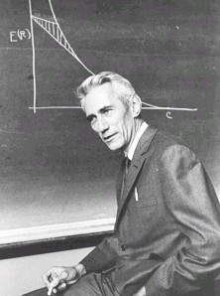
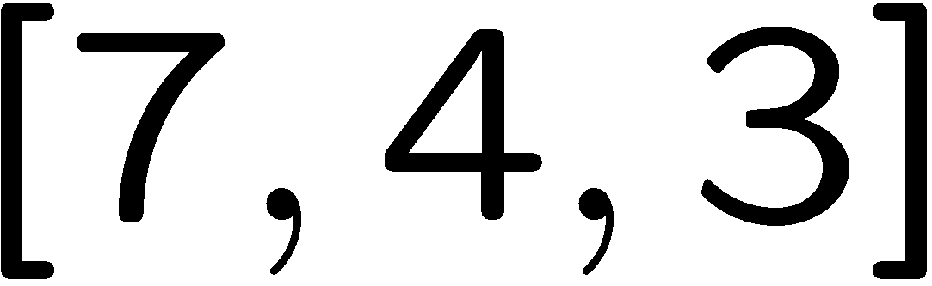
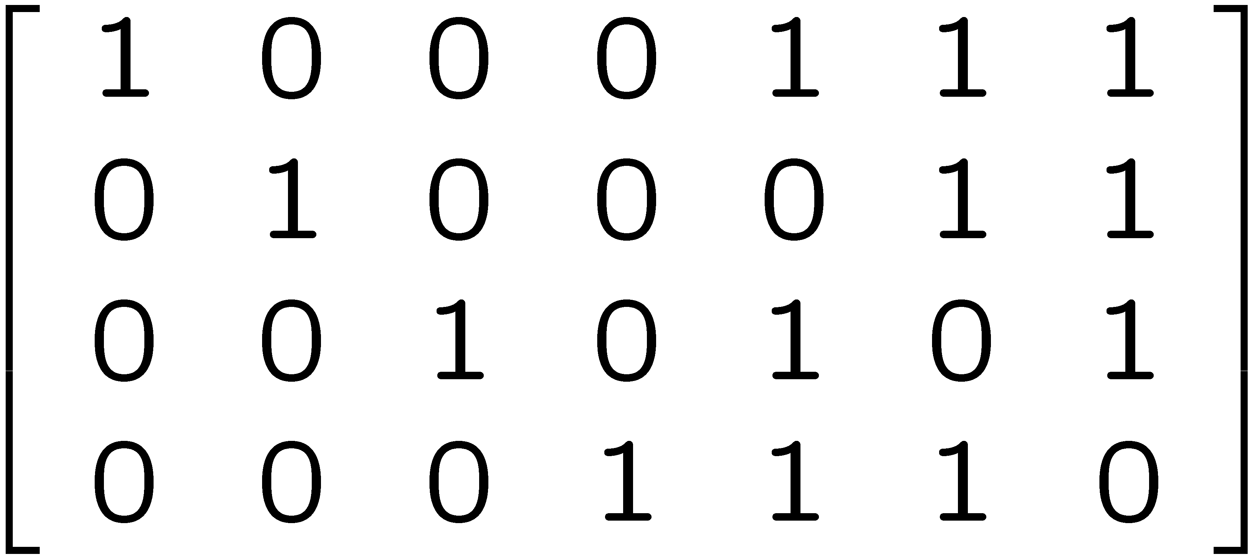

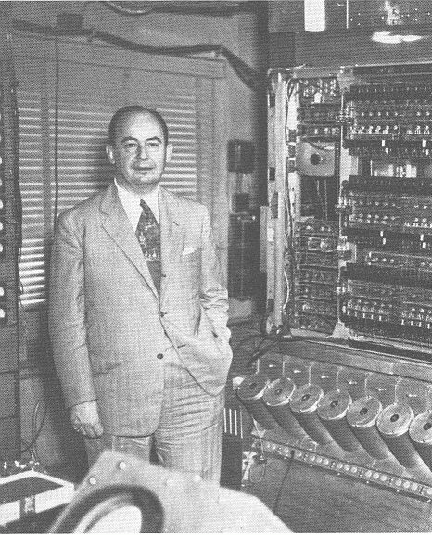


Reliable Computation From
Unreliable Components
Theory for Classical Computers
distance d
erred word
Error correcting codes
Hamming code
Claude Shannon
(1948)
code words
Fault-tolerance
Error correcting codes
M
M
John von Neumann
(1956)
M
error rate = p
error rate = O(p²)

Slide 2
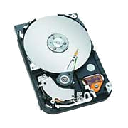
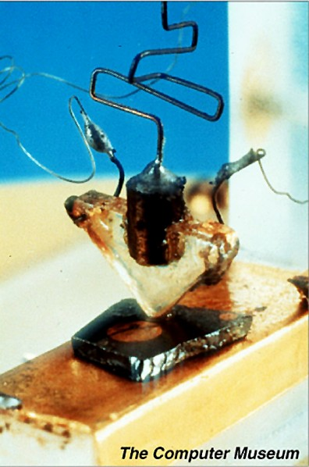
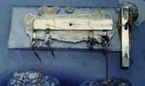
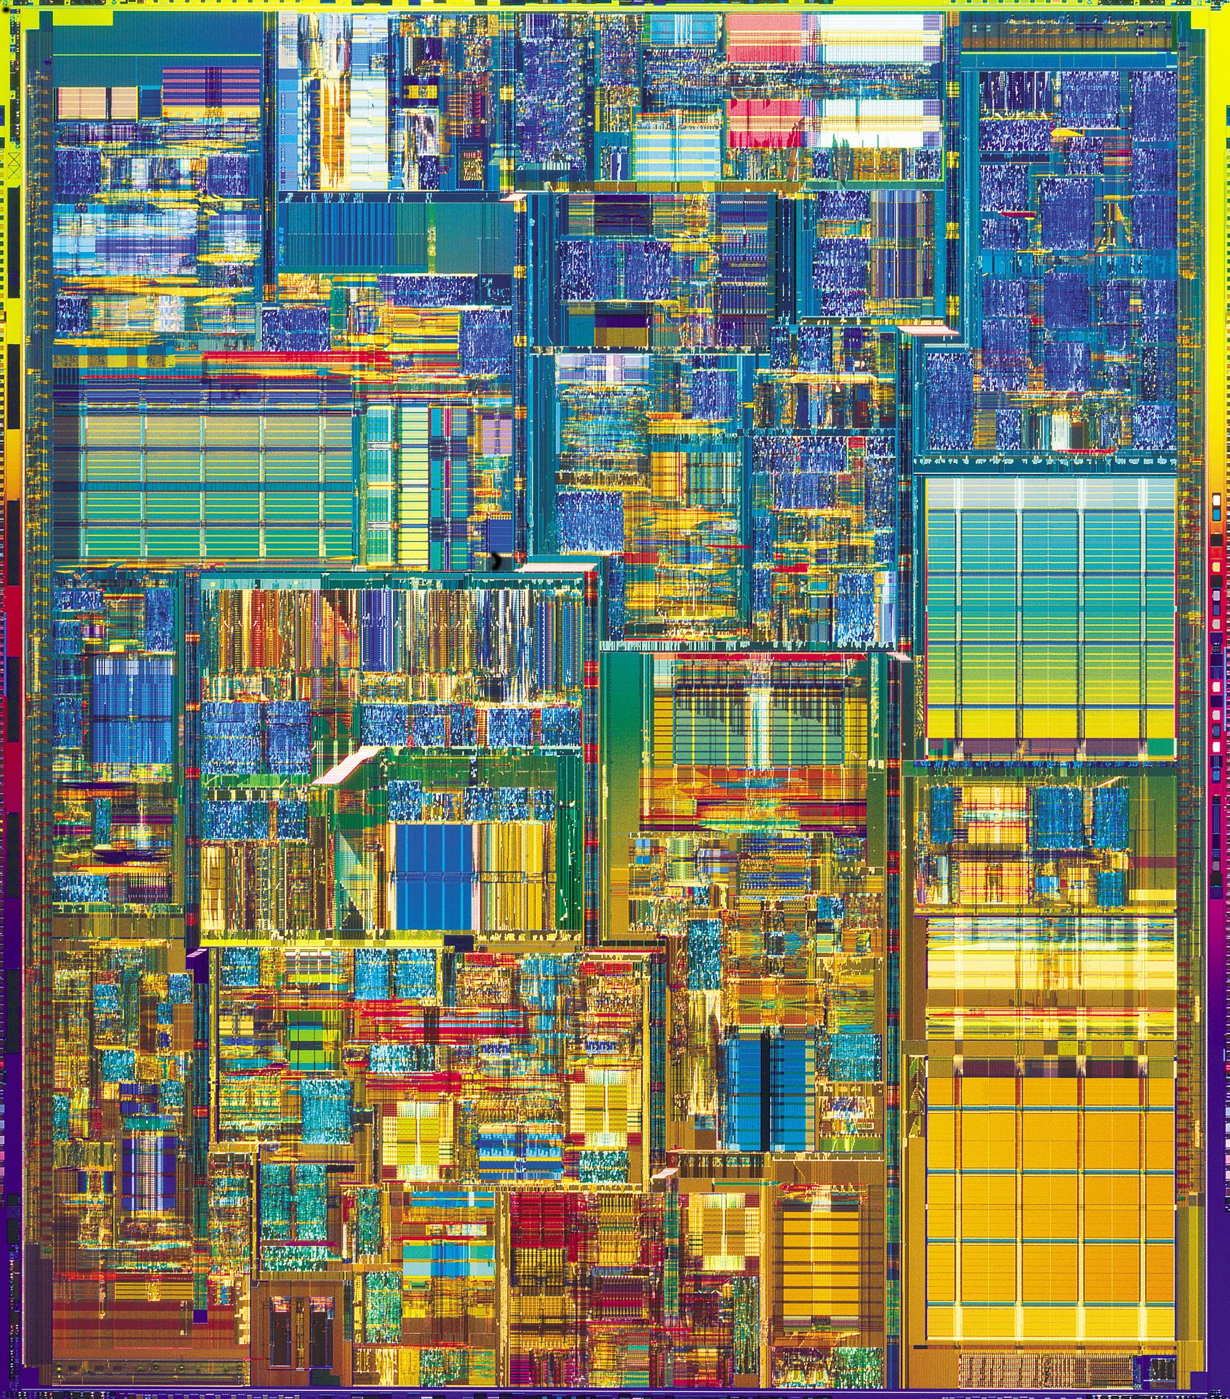
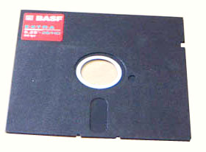


Reliable Computation From
Unreliable Components
Practice for Classical Computers
1st integrated
circuit
Pentium
chip
5.25” floppy
1st transistor
Hard drive
Theory concepts implemented by the physics of these devices
Example:
magnetic media
redundancy code
physical dynamics enacts
error correction
“self-correcting”

Slide 3
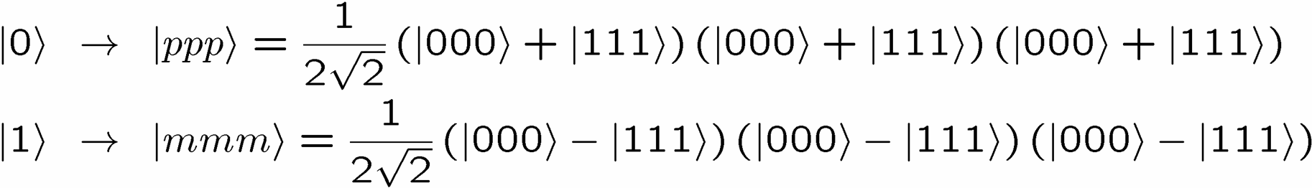
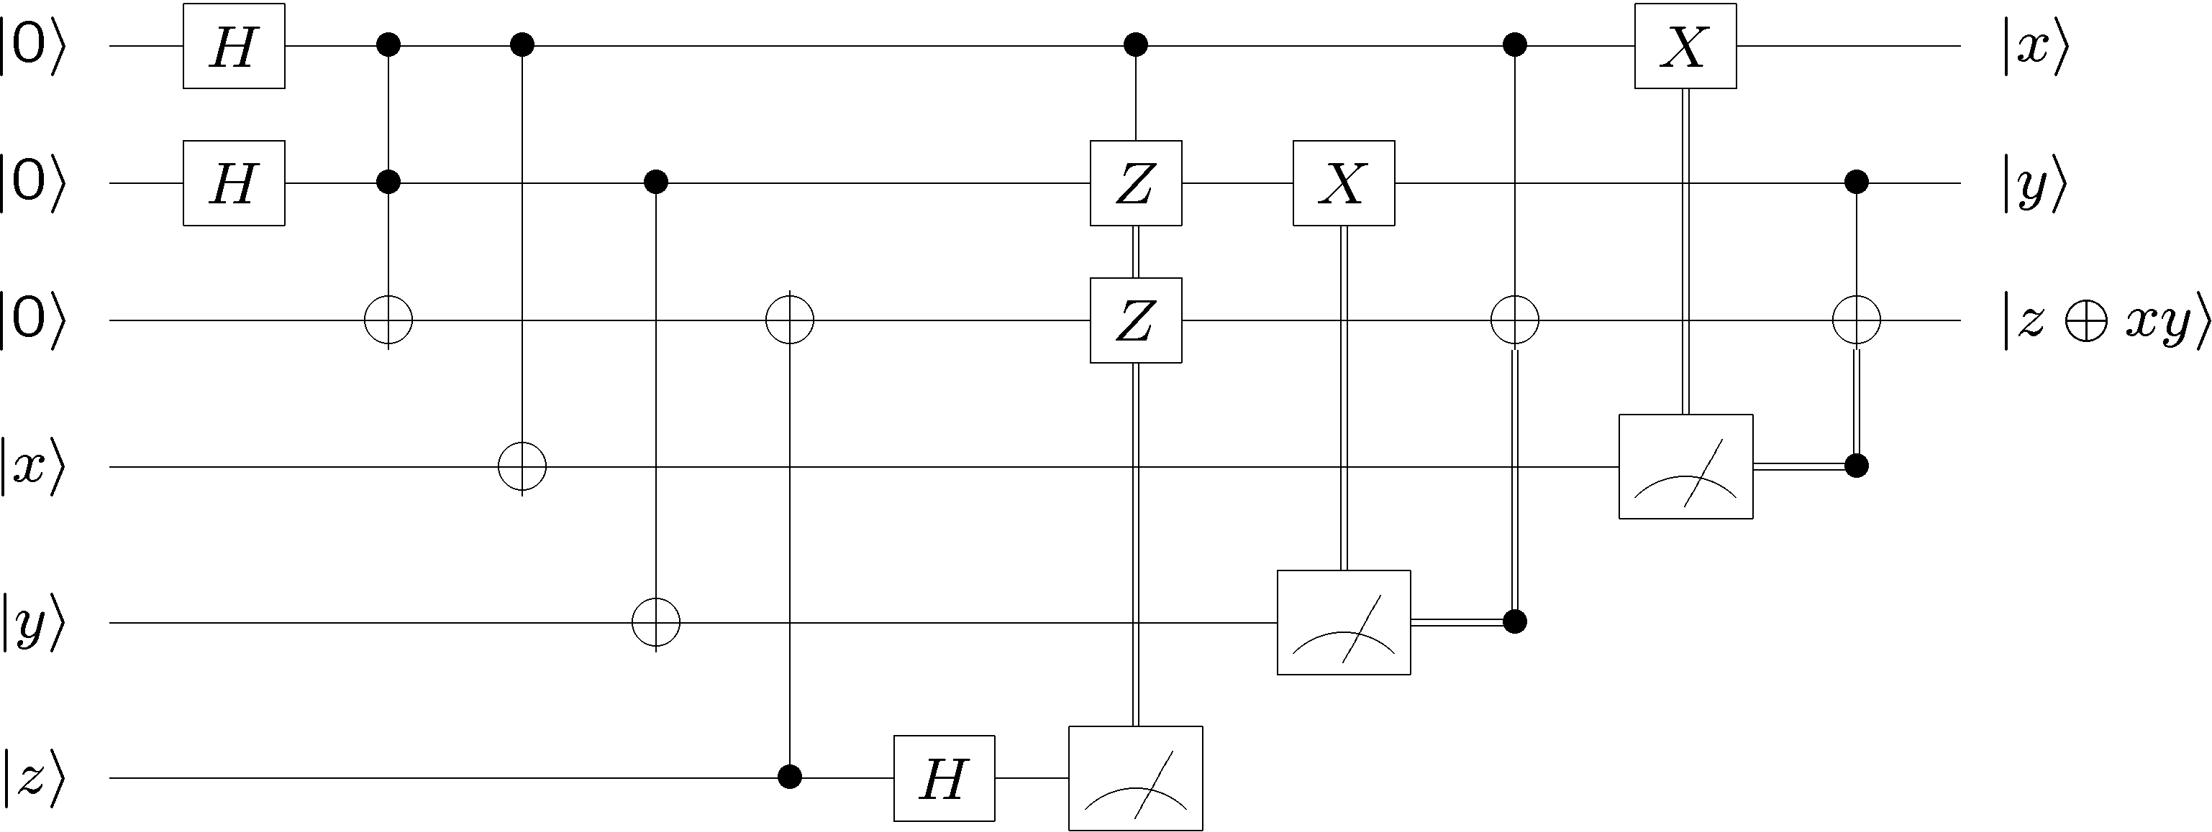
Reliable Computation From
Unreliable Components
Theory for Quantum Computers
Quantum error correcting codes
Quantum fault-tolerance

Slide 4
Reliable Computation From
Unreliable Components
Practice for Quantum Computers
Standard path
Quest for scalable architecture operating
below the threshold for fault-tolerant quantum
computation
Drawbacks: large device complexity,
reduced threshold for realistic architectures, …
A different path (Kitaev 97)
Do there exist (or can we engineer) materials
whose physics guarantees fault-tolerant
quantum computation?
Quantum hard drive?

Slide 5
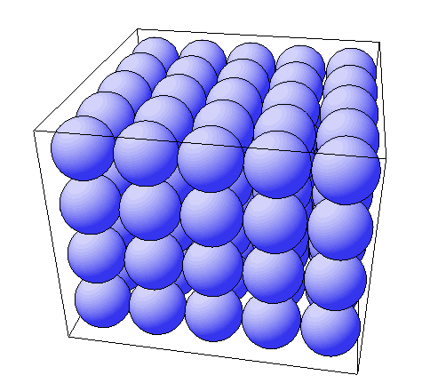
Self-Correcting Quantum Computers
Strongly interacting many-qubit system
Information encoded into a quantum
error correcting order parameter
2. Quantum error cause string-like
excitations with energy proportional
to perimeter
3. Below critical temperature system is
self-correcting
two qubit
interactions
Challenges
New codes: quantum error correcting subsystems
New physics: quantum error correcting order parameters
New architectures: cellular approaches to error correcting micro-architecture

Slide 6
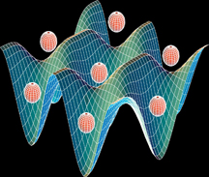
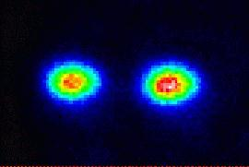
Self-Correcting Quantum Computers
Physical implementation in
Neutral atoms trapped in crystalline
potential created by standing waves
of light
optical lattices
(picture from NIST)
Two and three dimensional ion traps with hundreds of ions
novel ions traps
(picture of ions from NIST)

Slide 7
Self-Correcting Quantum Computers:
The Road Ahead
Expertise
Theory of quantum codes, strongly interacting quantum systems, quantum fault tolerance….
Experiment
Experimental challenges of engineering strongly interacting systems…
Engineering
Bridging divide of theory and experiment for realistic optimal device design…

