Slide 1
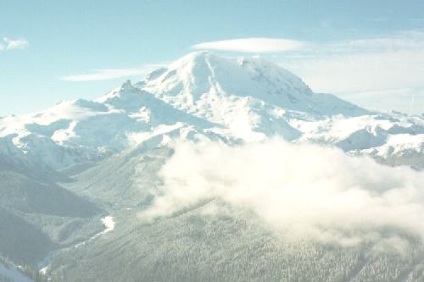

Wasting Away In Hidden Subgroup Ville
Dave Bacon
Department of Computer Science & Engineering
University of Washington

Slide 2
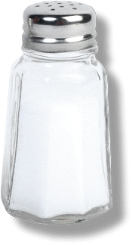
To: Dave Bacon
From: Patrick Hayden
> Tuesday, December 13: IQI Seminar
> "Wasting away in hidden subgroup ville"
Oh yes. I'm afraid we've seen this before. Obsessive-compulsive manic
consumptive research disorder. There is no cure, but it is treatable with
alternating doses of unwarranted optimism and gaping-abyss pessimism.

Slide 3
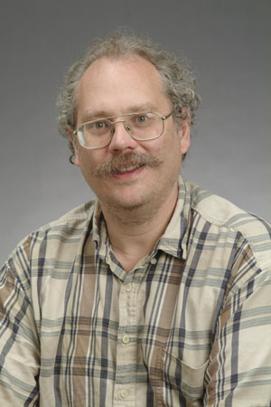
In the Beginning There Was…Factoring
18819881292060796383869723946165043
98071635633794173827007633564229888
59715234665485319060606504743045317
38801130339671619969232120573403187
9550656996221305168759307650257059
3980750864240649373971
2550055038649119906436
2342526708406385189575
946388957261768583317
4727721461074353025362
2307197304822463291469
5302097116459852171130
520711256363590397527
Peter Shor’s 1994 discovery
quantum computers can efficiently factor
and compute the discrete logarithm

Slide 4

Reaction #1
Run For the Hills
“Only time will tell if and when the problems of building a quantum computer can be overcome….As information becomes the world’s most valuable commodity, the economic, political and military fate of nations will depend on the strength of ciphers. Consequently, the development of a fully operational quantum computer would imperil our personal privacy, destroy electronic commerce and demolish the concept of national security. A quantum computer would jeopardize the stability of the world. Whichever country gets there first will have the ability to monitor the communications of its citizens, read the minds of its commercial rivals and eavesdrop on the plans of its enemies. Although it is still in its infancy, quantum computing presents a potential threat to the individual, to international business and to global security.” -Simon Singh

Slide 5

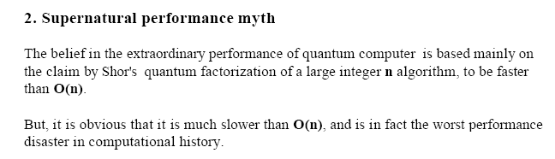
Reaction #2
Not Even Wrong
http://mywebpages.comcast.net/mycommon/Quantum_Computing_Myths.PDF

Slide 6
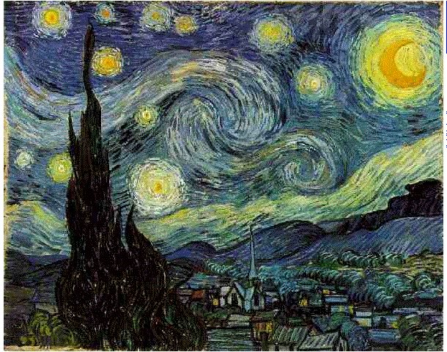
Reaction #3
Dreams of Future Algorithms
“For my part I know nothing with any certainty, but the sight of the stars makes me dream.” – Vincent van Gogh

Slide 7
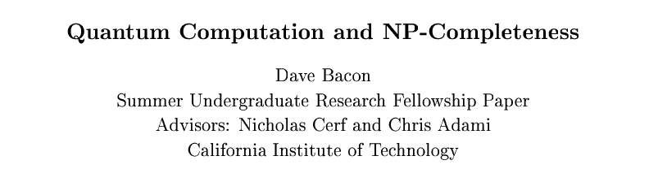
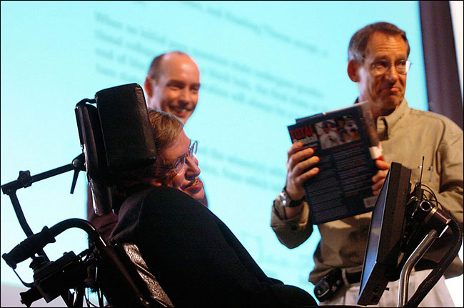
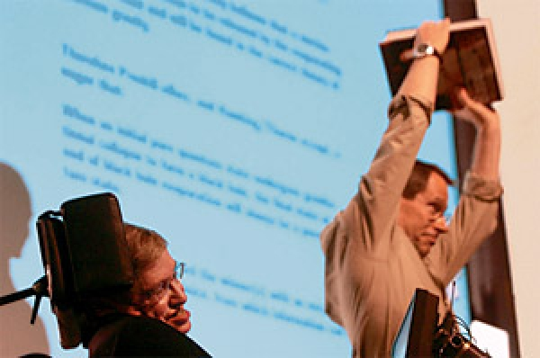
“I wasted time,
and now doth time waste me”
Caltech SURF, 1996
“That was a hard problem.” – John Preskill

Slide 8
Revolutions
Relativity Revolutions
1905: Special Relativity
1915: General Relativity
String Theory Revolutions
1984: Green and Schwarz anomaly cancellations
1994: Dualities between string theories
The Time Unit of Revolutions is the Decade
This means we are OVERDUE for a revolution in quantum computing!

Slide 9
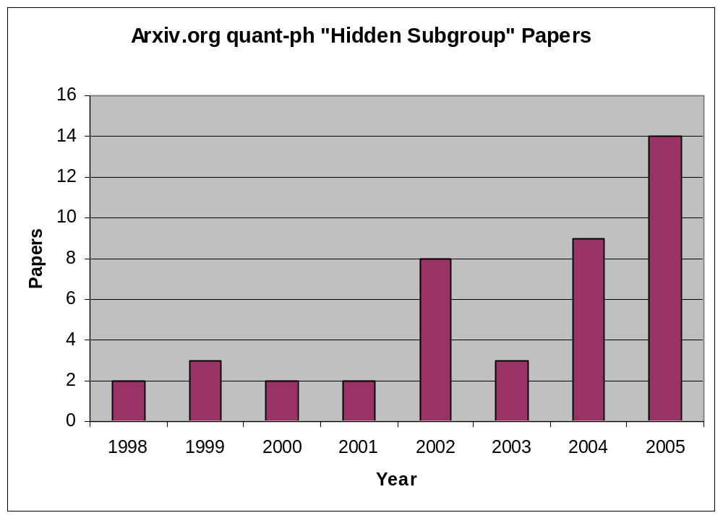
Hidden Subgroup Problem

Slide 10

Today
Where are we going? Why are we going there?
Structure of the Problem?

Slide 11




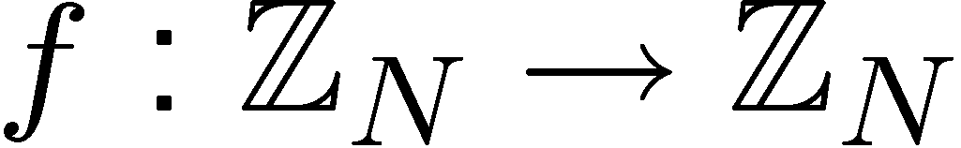
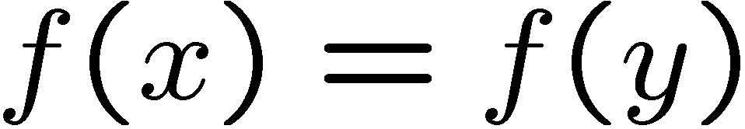
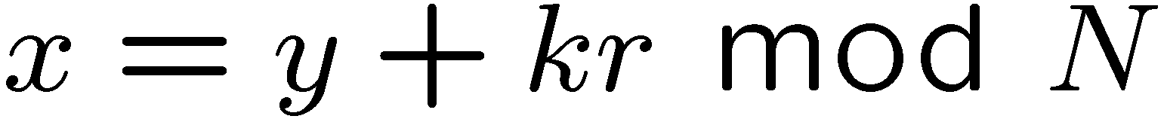
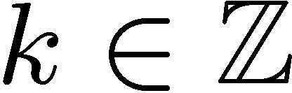

Shor’s Factoring Algorithm
Factoring can be reduced to order finding
Order finding can be reduced to period finding.
period=r
Given query access to a function with the promise
iff
Find the period

Slide 12


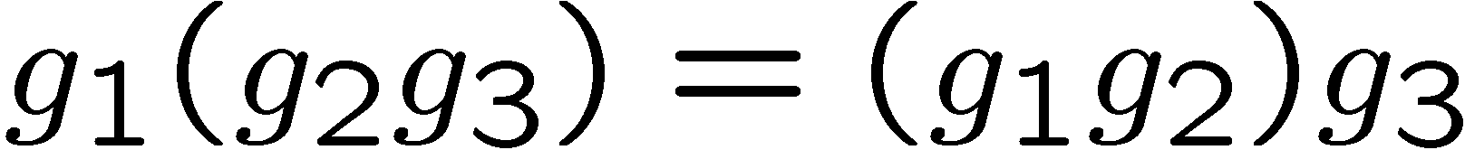
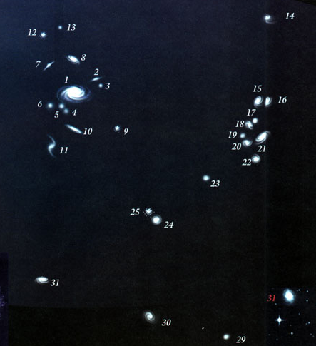
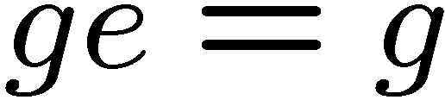
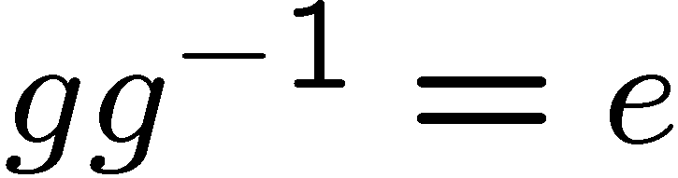
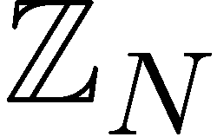
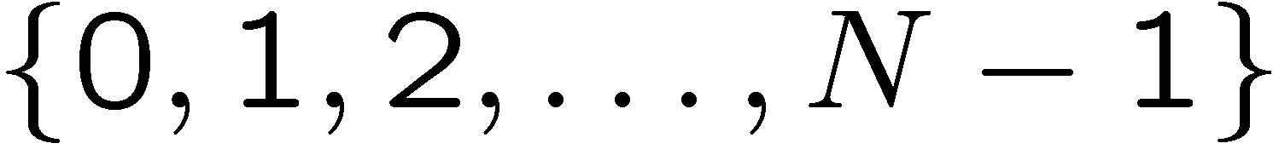
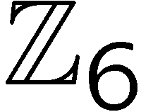


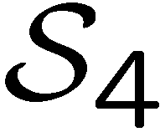
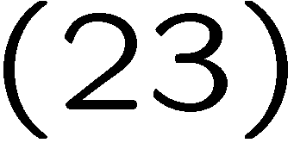
Groups
Definition
Group: Set of elements with binary multiplication rule
Associative:
Identity:
Inverse:
Group
2
1
elements:
3
0
group multiplication:
4
5
Symmetric Group
elements: permutations of n objects
1
2
3
4
group multiplication: composition of permutations

Slide 13
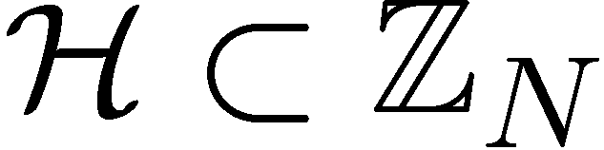
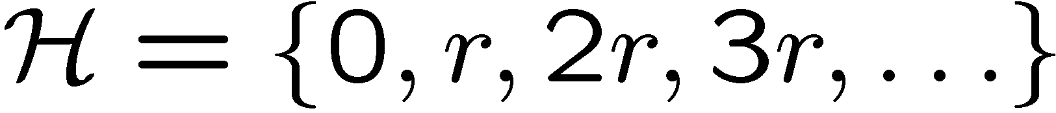
Shor’s Hidden Subgroup
Given query access to a function with the promise
iff
Subgroup

Slide 14
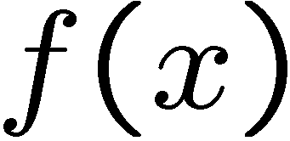

Shor’s Hidden Subgroup
Given query access to a function with the promise
is constant and distinct on cosets of

Slide 15
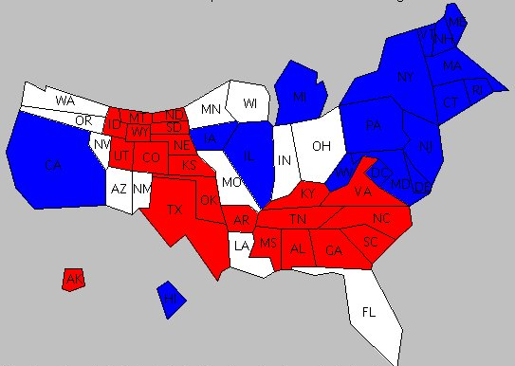
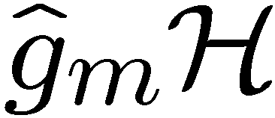
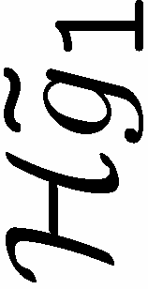



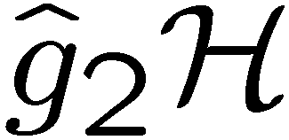
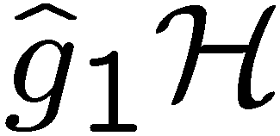

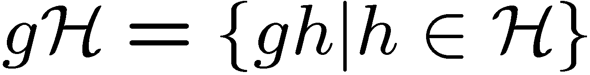
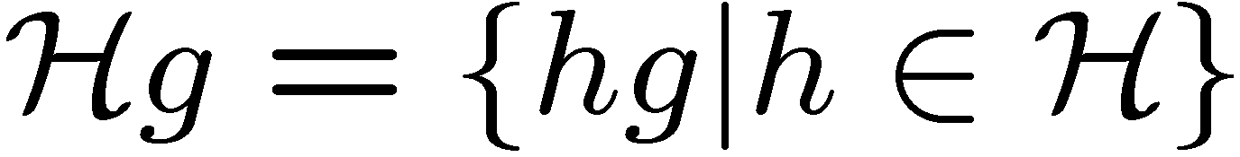
Cosets
Left cosets
Right cosets
Unless is normal, then the left and right cosets do not coincide
Definition
Normal subgroup:

Slide 16

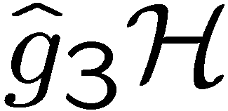
Hidden Subgroup Problem
Setup: Fix a group (known) and a subgroup (unknown). Given query access to a function f : → S that is constant and distinct on left (right) cosets of in . We say that f hides .
Problem: Find a generating set for (identify ).
Efficient: If runs in time polylog(| |)
f
S

Slide 17
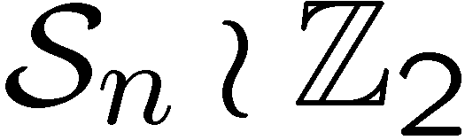
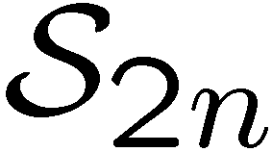


Why the HSP?
efficient algorithm for HSP
over (or )
efficient algorithm for the
graph isomorphism problem
efficient “standard” quantum
algorithm for HSP over
dihedral group
efficient algorithm for the poly(n) unique shortest vector in a lattice problem

Slide 18
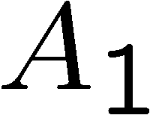
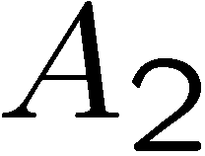
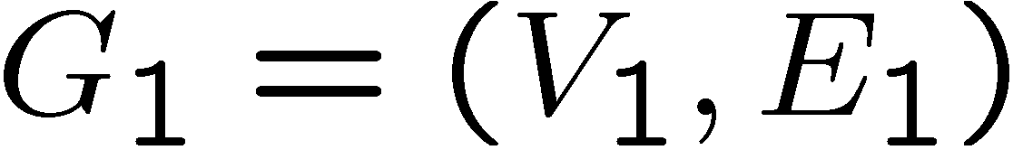
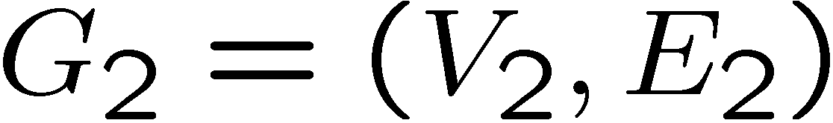

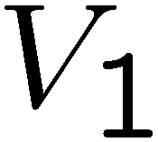
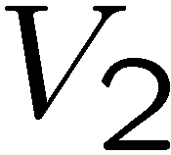
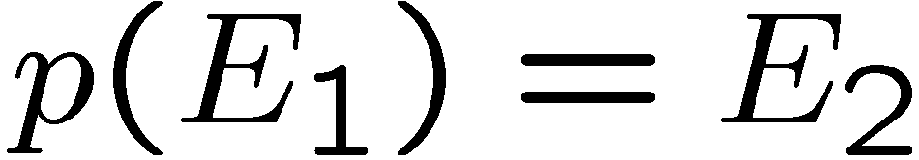
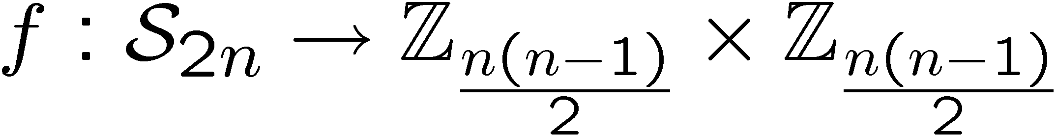
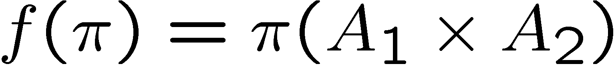
Graph Isomorphism
adjacency
matrix
adjacency
matrix
Problem: Is there a 1-to-1 mapping from the vertices to the
vertices such that the edges are respected, ?
Mapping to the HSP:
If graphs are not isomorphic, hidden subgroup will not mix
the graphs. If they are isomorphic, they will mix the graphs.

Slide 19
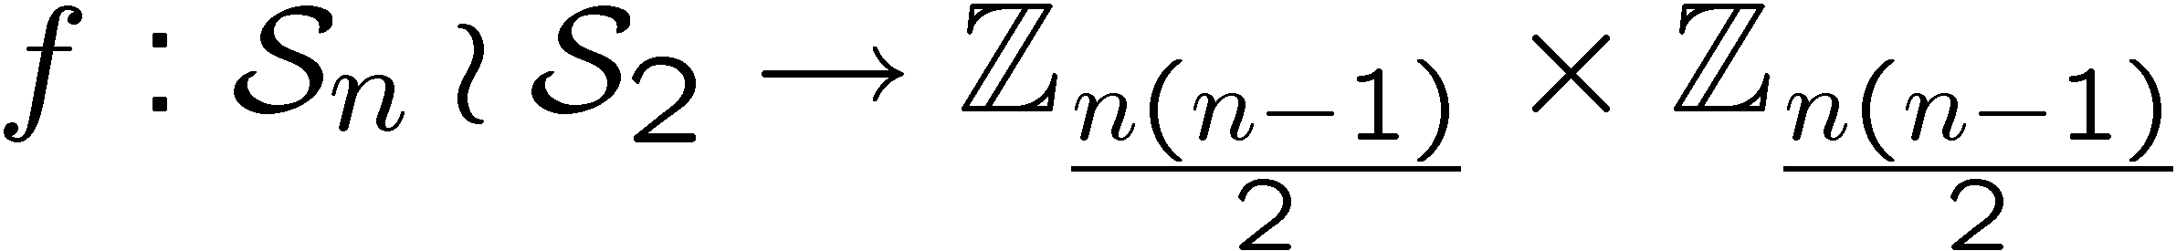

Graph Isomorphism
adjacency
matrix
adjacency
matrix
Problem: Is there a 1-to-1 mapping from the vertices to the
vertices such that the edges are respected, ?
Mapping to the HSP:
Notice now we are only worried if hidden subgroup has
a nontrivial

Slide 20
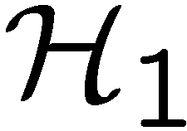
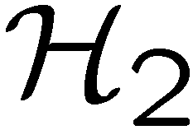
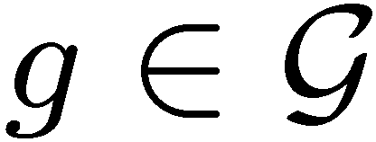
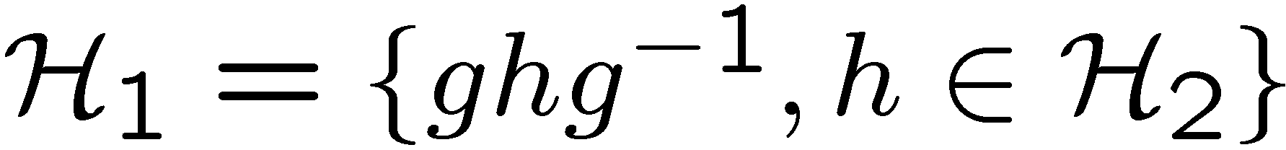
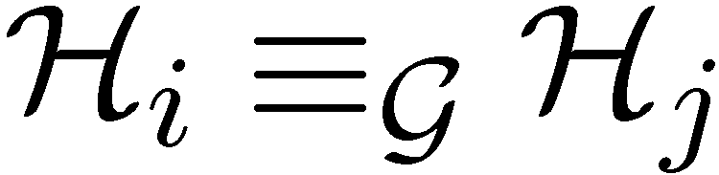
Conjugate Subgroups
Two subgroups, and , are conjugate if there exists an
element of the group such that
This is an equivalence relation among the subgroups of
voy, vas, va, vamos, van

Slide 21
Hidden Subgroup Conjugacy Problem
Setup: Fix a group (known) and a subgroup (unknown). Given query access to a function f : → S that is constant and distinct on left (right) cosets of in . We say that f hides .
Problem: identify the conjugate subgroup class of .
Efficient: If runs in time polylog(| |)
f
S

Slide 22
Graph Isomorphism
adjacency
matrix
adjacency
matrix
Problem: Is there a 1-to-1 mapping from the vertices to the
vertices such that the edges are respected, ?
Mapping to the HSCP:
Notice now we are only worried if hidden subgroup conjugacy
has a nontrivial

Slide 23

Relationships
How do the hidden subgroup problem (HSP) and the
hidden subgroup conjugacy problem (HSCP) differ?
1. If group is abelian, HSCP=HSP
All subgroups are only conjugate to themselves
2. If subgroups are normal, HSCP=HSP
All subgroups are only conjugate to themselves
These are two cases where we know quantum computers
can efficiently solve the HSP.

Slide 24





Dihedral Group
Dihedral group
group of symmetries of a N sided
regular polygon
= rotation
= reflection
Subgroups of
cyclic subgroups:
dihedral subgroups:

Slide 25




Dihedral HSP
Theorem [Ettinger, Hoyer 98]
Sufficient to solve Dihedral HSP when subgroups are
limited to
or
if is odd, then the subgroups are all conjugate to each other:
solving the Dihedral HSCP does not immediately solve
the Dihedral HSP…

Slide 26









Modification
Modify the function hiding the subgroup:
left cosets:
If is even, then is constant and distinct on left cosets
of
If is odd, then is constant and distinct on left cosets
of
Solving HSCP for new problem thus allows us to distinguish
between odd and even subgroups
[Moore 05, personal communication]

Slide 27



Modification
Modify the function hiding the subgroup:
left cosets:
Using more functions, we can determine 2nd least significant
bit of
Generalizing this allows us to use the Dihedral HSCP to solve
the Dihedral HSP (they are polynomial time equivalent.)
[Moore 05, personal communication]
see also [Kuperberg 03]

Slide 28
HSP and HSCP
More generally, we can ask if this method can be extended to work for any group/set of subgroups?

Slide 29

Why the HSCP?
The HSCP has more “symmetry” than the HSP

Slide 30










Standard Query Model
query in superposition:
constant and distinct on different left cosets of
random left coset state
hidden subgroup state
set of coset representatives

Slide 31




Multiple Queries
If we make a single measurement on the
HS state, can we distinguish different
NO
We need multiple queries to
distinguish different subgroups
sufficient
[Ettinger, Høyer, Knill 99]

Slide 32
Multiple Queries Approaches
Existential
explicit measurement,
exponentially sized circuit
[Ettinger, Høyer, Knill 99]
Pretty Good Measurement
often optimal
efficient circuits for some groups, but others appear hard
[Bacon, Childs, van Dam 05]
Imagine you have figured out how to solve the HSP
Describe to yourself the idea that makes your method work.

Slide 33










Symmetries
left regular representation
right regular representation
they commute
representation theory
sum over all irreps
The transform from the basis of group elements to this
block diagonal basis is the Fourier transform over

Slide 34


Symmetries of HS States
left regular representation
right regular representation

Slide 35






Symmetries of HS States
left regular representation
right regular representation
via Schur’s lemma this implies
after applying the Fourier transform

Slide 36



State Distinguishablity
Given with probability
Find measurement which maximizes probability of successfully
identifying
[Ip 03, Bacon, Childs, van Dam 05, Moore, Russell 05,
Bacon, Childs, van Dam 05, Childs, van Dam 05,
Childs, Wocjan 05, …]
Often the measurement which maximizing this probability is
the “pretty-good-measurement” (PGM)

Slide 37



State Distinguishablity
HSCP: we don’t care about which subgroup, just it’s conjugacy. New problem
Probability:
HSC state
multiple queries:
Probability:
These states have been symmetricized!

Slide 38




Single HSC State
Single HSC state is completely diagonalized (like Abelian!)

Slide 39













Dihedral HSCP
Dihedral group
2 one dimensional irreps
two dimensional irreps

Slide 40





Optimal Measurement?
Pretty good measurement:
For Dihedral group HSCP, PGP is
But this is not the optimal measurement!

Slide 41


Multiple Query HSC States
Diagonal representation of the group

Slide 42
Multiple Query HSC States
Diagonal representation of the group

Slide 43


Clebsch-Gordan Decomposition
Averaging over this representation,
implies

Slide 44












General Circuit

Slide 45
Quantum Algorithms for HSCP
1. Prepare m copies of the HS state.
2. Perform the QFT over on each copy.
  efficient circuits for most groups of interest
  [Moore, Russell, Rockmore 03]
3. Perform CG transform on resulting states
  efficient circuits?
4. Measurement on multiplicity index
  efficient circuits?

Slide 46





























Schur Transform
(work with Aram Harrow and Isaac Chaung)
set of all partitions of n
(all Young Diagrams with n rows)
Circuits of size polynomial in d,n,log(1/accuracy)
garbage bits

Slide 47




A Partial Solution
Generalized Kitaev circuit can be
used to project onto CG subspaces

Slide 48
A Partial Solution
Representation theory problem:
Given, irreps, and sum in CG series,
perform permutation between
different consistent irreps.

Slide 49

What’s My Point?
HSCP is (in the important instances at least)
polynomial time equivalent to the HSP
2. In the same way that symmetry implies we should
perform the QFT for the abelian case, the symmetry
of the HSCP implies we should apply the
Clebsch-Gordan transform over the finite group.

Slide 50

The Future
Efficient circuits for Clebsch-Gordan transforms over
finite groups?
Identification of symmetries of the multiplicity space of
the Clebsch-Gordan transform over finite groups.

Slide 51
Dorit Aharonov’s Question
(Redux, Paraphrase)
How much of your life have you spent working on finding new
algorithms for a quantum computer?
Never:
Hours:
Days:
Weeks:
Months:
Seasons:
Years:

Slide 52
Wasting Away In Hidden Subgroup Ville
Dave Bacon
Department of Computer Science & Engineering
University of Washington

