Slide 1



Quantum Computing
Lecture 1: Introduction and Quantum Theory
Dave Bacon
Department of Computer Science & Engineering
University of Washington

Slide 2
Quantum Computing
Professor Mark Oskin (University of Washington, CS&E)
1. Sunk his boat.
2. Salvaged (recovered) his boat.
3. Dropped his boat on his foot.
4. Bad for Mark, but good for me!
Slides also available at
http://www.cs.washington.edu/homes/dabacon/teaching/siena

Slide 3
Warning!
Two foreign languages for the price of one speaker:
English and Quantum Theory
Do not be shy!
Please, ask me to repeat, to rephrase, or to just plain slow down.

Slide 4
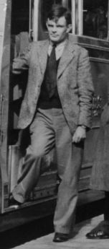
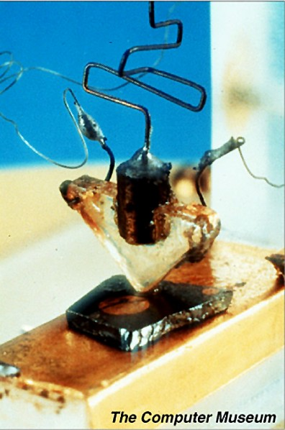
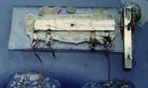
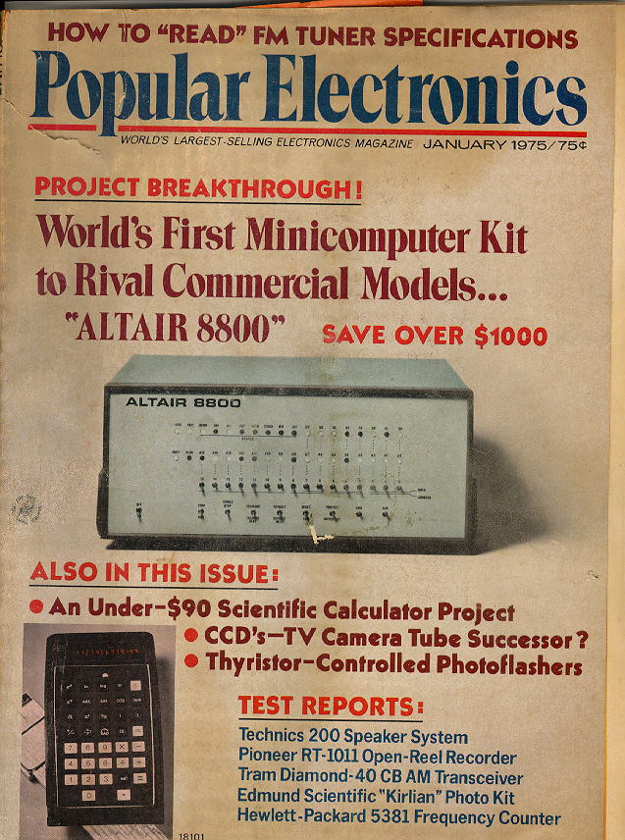
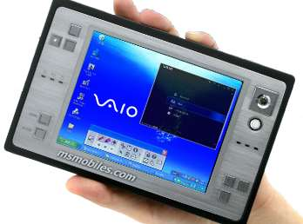
In the Beginning…
1936- Alan Turing: “On computable numbers, with an application to the Entscheidungsproblem”
1947- First transistor
1958- First integrated
circuit
Alan Turing
1975- Altair 8800
2005
GHz machines
that weight ~ 1 pound

Slide 5
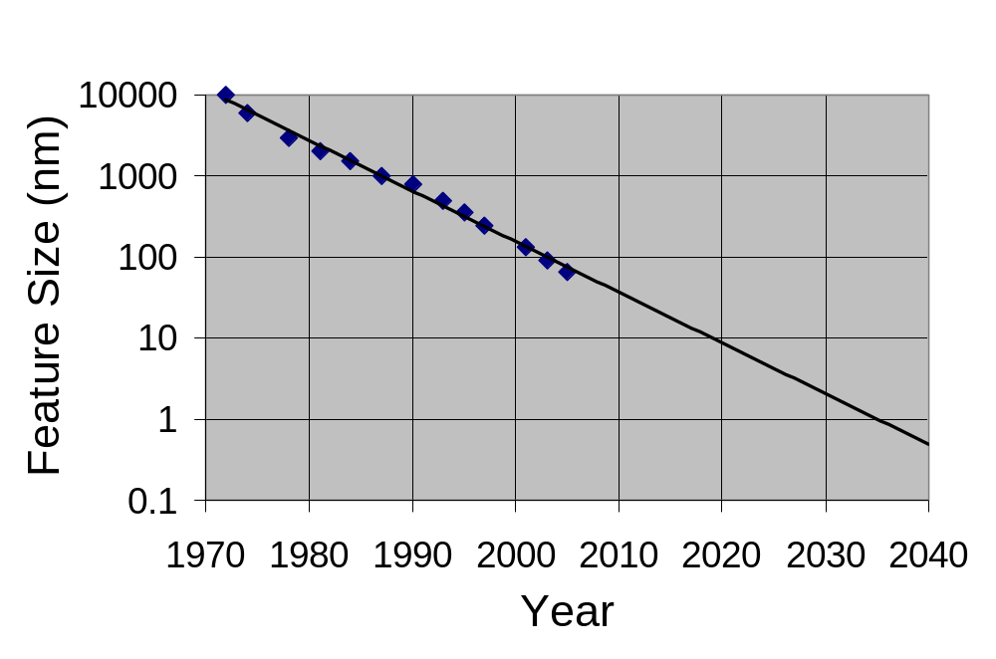
Moore’s Law
Computer Chip Feature Size versus Time
Eukaryotic cells
Mitochondria
AIDS virus
Amino acids

Slide 6
This Is the End?
1. Ride the wave to atomic size computers?
2. How do machines of atomic size operate?

Slide 7
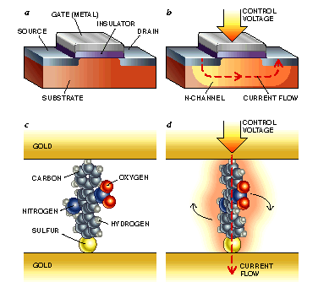
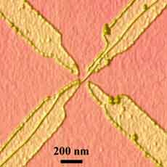
Argument by Unproven
Technology
1. Ride the wave to atomic size computers?
carbon
nanotube transistors
molecular transistors
Pictures: http://www.mtmi.vu.lt/pfk/funkc_dariniai/nanostructures/molec_computer.htm
http://www.cemes.fr/r2_rech/r2_sr2_gns/th1_3_3_2_combing.htm

Slide 8
This Is the End?
2. How do machines of atomic size operate?
“Quantum Laws”
“Classical Laws”
“Size”
“Quantum Computers?”

Slide 9
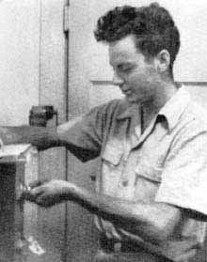


This Is the End?
2. How do machines of atomic size operate?
Richard Feynman
David Deutsch
Paul Benioff

Slide 10













Query Complexity
n bit strings
set
set of properties
How many times do we need to query
in order to determine ?
Example:
if
Promise problem:
restricted set of functions
domain of not all
if otherwise

Slide 11



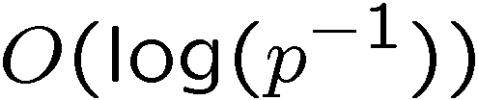

The Work of Crazies
“Can Quantum Systems be Probabilistically Simulated
by a Classical Computer?”
Richard
Feynman
1985: two classical queries
one quantum query
David
Deutsch
1992:
classical queries
quantum queries
classical queries to solve
with probability of failure
David
Deutsch
Richard
Jozsa

Slide 12


Crazies…Still Working
1993:
superpolynomially more classical than quantum queries
Umesh
Vazirani
Ethan
Bernstein
1994:
exponentially more classical than
quantum queries
Dan
Simon

Slide 13
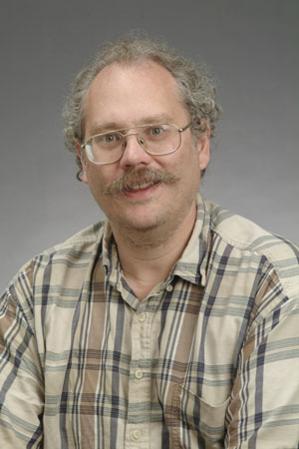


The Factoring Firestorm
18819881292060796383869723946165043
98071635633794173827007633564229888
59715234665485319060606504743045317
38801130339671619969232120573403187
9550656996221305168759307650257059
Peter
Shor
1994
3980750864240649373971
2550055038649119906436
2342526708406385189575
946388957261768583317
4727721461074353025362
2307197304822463291469
5302097116459852171130
520711256363590397527
Best classical algorithm
takes time
Shor’s quantum algorithm
takes time
An efficient algorithm for factoring breaks the
RSA public key cryptosystem

Slide 14
These Lectures
Quantum theory the easy way ☺ [lecture 1,2]
Quantum computers (circuits, teleportation) [lecture 2,3]
Quantum algorithms (Shor, Grover) [lecture 3,4,5]
Physical implementations of quantum computers [lecture 6]
Quantum error correction [lecture 6]
Quantum cryptography [lecture 6]
Quantum entanglement [possibly lecture 6]

Slide 15
Quantum Theory
“The Easy Way”

Slide 16

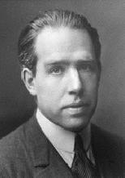
Slander
I think I can safely say that nobody
understands quantum mechanics.
Richard Feynman
Nobel Prize 1965
Anyone who is not shocked by quantum
theory has not understood it.
Niels Bohr
Nobel Prize 1922

Slide 17
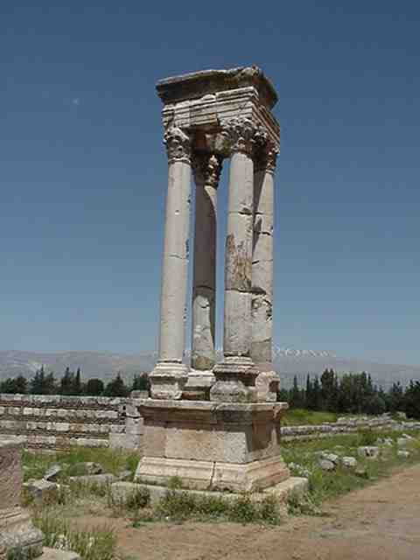
Quantum Theory
Electromagnetism
Strong force
Gravity (?)
Weak force
Quantum
Theory
“Quantum theory is the machine language of the universe”

Slide 18
Our Path
Probabilistic classical information processing device
Quantum information processing device

Slide 19
Probabilistic Information
Processing Device
Machine has N states
0,1,2,…,N-1
Rule 1 (State Description)
A probabilistic information processing machine is a machine
with a state labeled from a finite alphabet of size N. Our
description of the state of this system is a N dimensional
real vector with positive components which sum to unity.

Slide 20
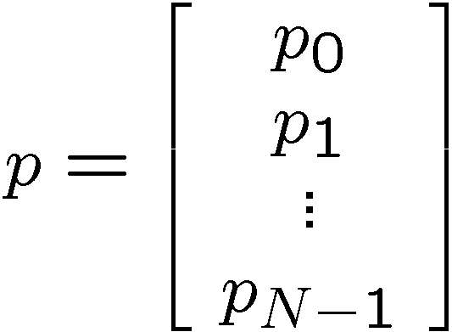
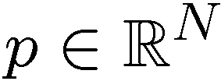

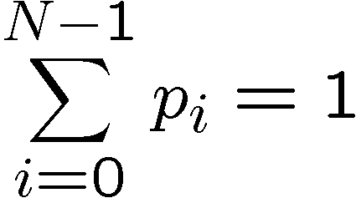
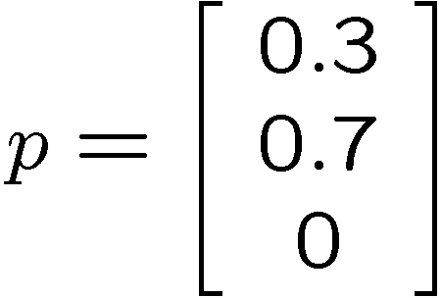
Rule 1
Machine has N states
0,1,2,…,N-1
N dimensional real vector
positive elements
which sum to unity
Example: 3 state device
30 % state 0
70 % state 1
probability vector
0 % state 2

Slide 21
Probabilistic Information
Processing Device
Rule 1 (State Description) N states, probability vector
Rule 2 (Evolution)
The evolution in time of our description of the device is specified by an N x N stochastic matrix A, such that if the description of the state before the evolution is given by the probability vector p then the description of the system after this evolution is given by q=Ap.

Slide 22
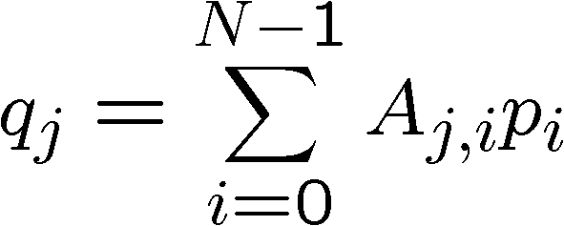
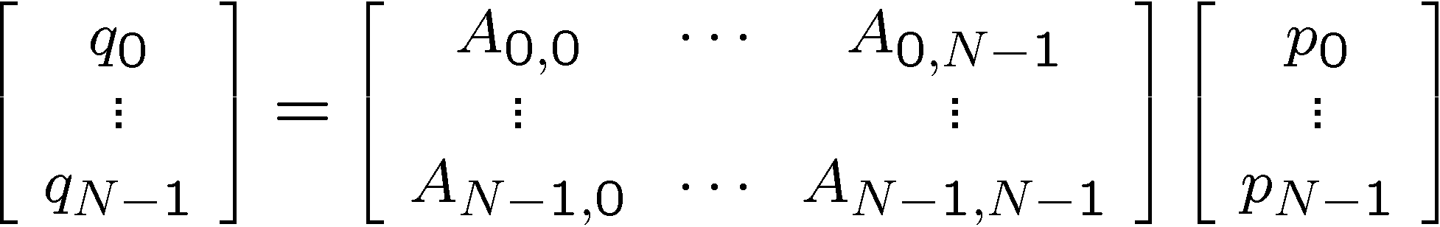

Rule 2
Evolution:
If we are in state 0, then with probability A_{j,0} switch to state j
If we are in state 1, then with probability A_{j,1} switch to state j
If we are in state N, then with probability A_{j,N} switch to state j
N² numbers A_{j,i}
probability to be in
state j after evolution

Slide 23

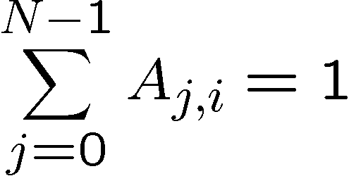
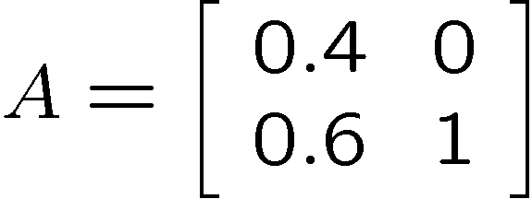
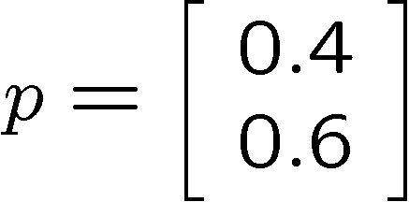
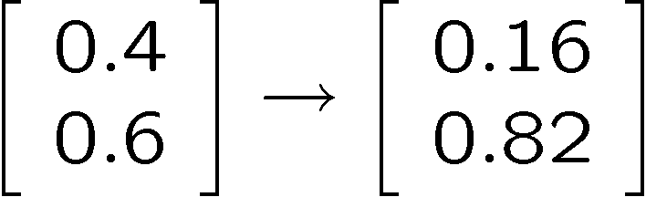
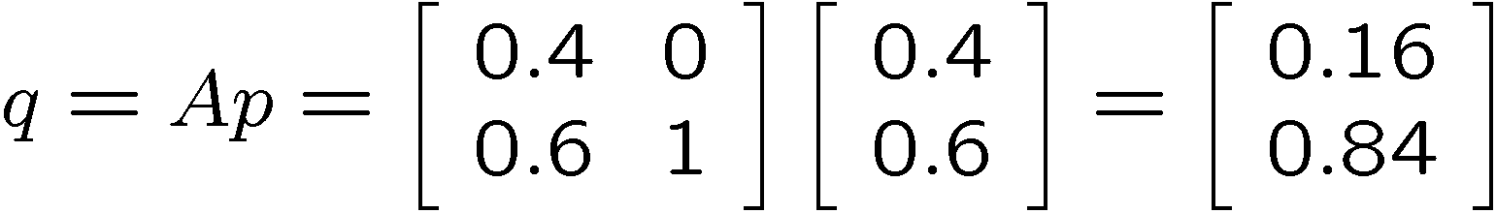
Rule 2
these are probabilities
stochastic matrix
If in state 0 switch to state 0 with probability 0.4
If in state 0 switch to state 1 with probability 0.6
If in state 1 always stay in state 1

Slide 24
Probabilistic Information
Processing Device
Rule 1 (State Description) N states, probability vector
Rule 2 (Evolution) N x N stochastic matrix
Rule 3 (Measurement)
A measurement in the computational basis of our N dimensional system which is described by a probability
vector p yields outcome j given by the jth component
of p. After the measurement, the system is described
by a probability vector with certainty that the state is j.

Slide 25
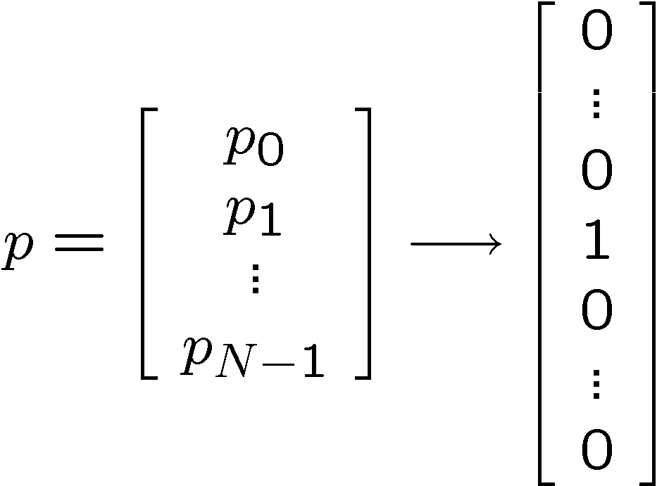
Rule 3
If we simply look at our device, then we see the states with the
probabilities given by the probability vector.
If we observe the state j, then the new probability of our
system is given by a probability vector with a single nonzero
in the jth component:
j
j

Slide 26

Probabilistic Information
Processing Device
Rule 1 (State Description) N states, probability vector
Rule 2 (Evolution) N x N stochastic matrix
Rule 3 (Measurement) k conditional probability vectors
Rule 4 (Composite Systems)
Two devices can be combined to form a bigger device.
If these devices have N and M states, respectively, then
the composite system has NM states. The probability
vector for this new machine is a real NM dimensional
probability vector from .

Slide 27

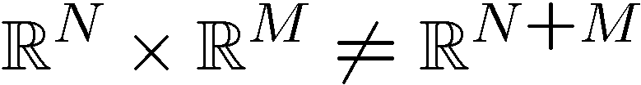
Rule 4
A
B
AB
N States
M States
NM States
0
1
N
0
1
M
0,0
0,1
0,M
1,0
1,1
1,M
N,0
N,1
N,M
Probability vector in

Slide 28
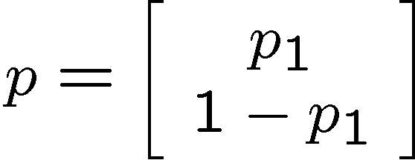
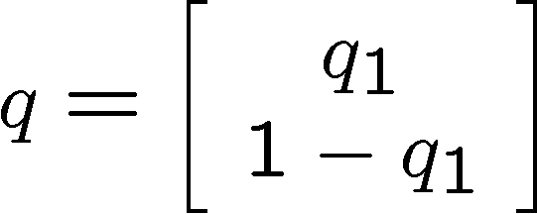

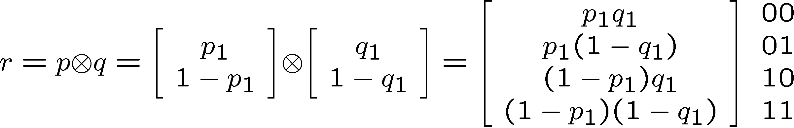
Rule 4 In Action
A
B
AB
Note that this is a description of a system which is not correlated.
Each subsystem has its own probability vector.

Slide 29
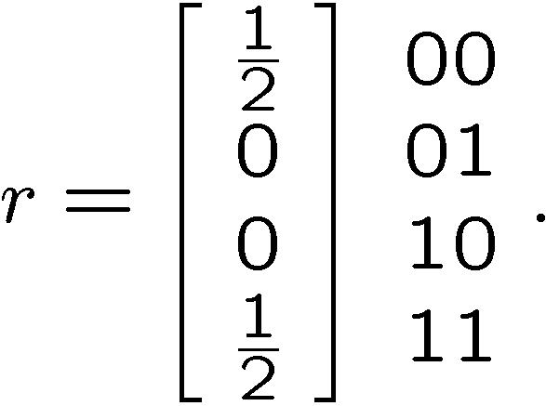

Rule 4 In Action
A
B
AB
contrast with
It is impossible to express this probability vector as a tensor
product:
This is a description of a correlated system. Subsystem A
is correlated with subsystem B.

Slide 30
Probabilistic Information
Processing Device
Rule 1 (State Description) N states, probability vector
Rule 2 (Evolution) N x N stochastic matrix
Rule 3 (Measurement) k conditional probability vectors
Rule 4 (Composite Systems) tensor product

Slide 31
Quantum Information
Processing Device
Rule 1 (State Description) N states, vector of amplitudes
Rule 2 (Evolution) N x N unitary matrix
Rule 3 (Measurement) k measurement operators
Rule 4 (Composite Systems) tensor product

Slide 32
Quantum Rule 1
Rule 1 (State Description)
Machine has N states
0,1,2,…,N-1
Rule 1 (State Description)
A quantum information processing machine is a machine
with a state labeled from a finite alphabet of size N. Our
description of the state of this system is a N dimensional
complex unit vector

Slide 33
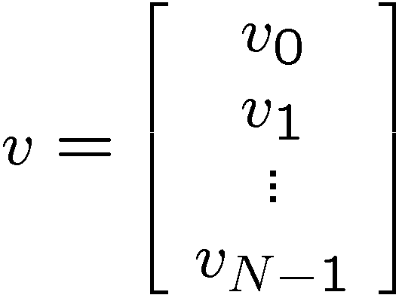


Quantum Rule 1
Machine has N states
0,1,2,…,N-1
N dimensional complex vector (vector of amplitudes)
Called: wave function, vector of amplitudes, quantum state

Slide 34







Complex Numbers
Complex numbers are numbers of the form
“square root of minus one”
real
real
Complex plane:
real axis
imaginary axis

Slide 35



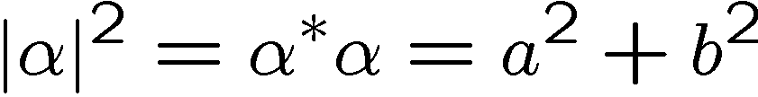
Complex Numbers, Operations
Complex numbers can be added:
Complex numbers can be multiplied:
Complex numbers can be conjugated:
Modulus of a complex number

Slide 36
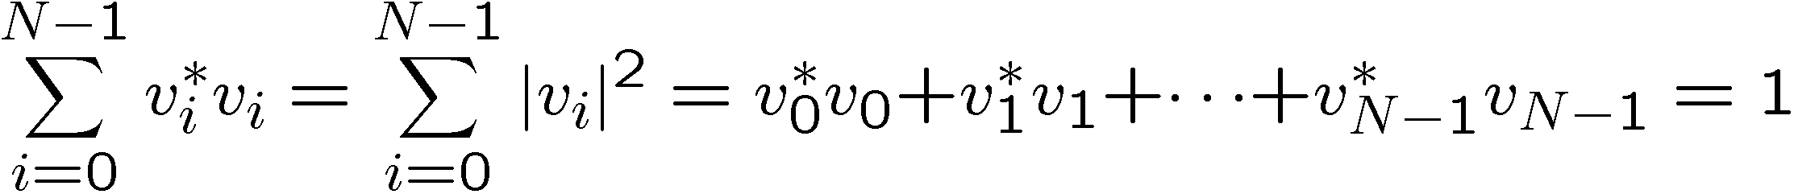
Quantum Rule 1
Machine has N states
0,1,2,…,N-1
N dimensional complex vector (vector of amplitudes)
Complex unit vector:

Slide 37
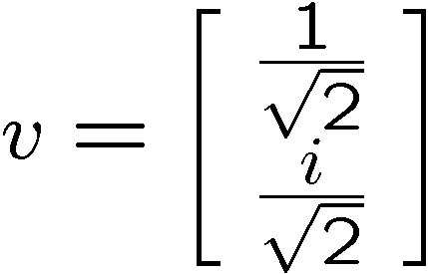
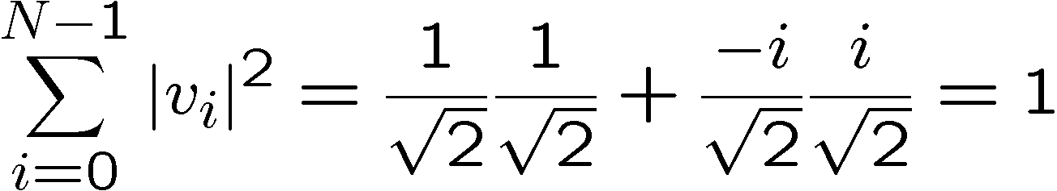
Quantum Rule 1
Machine has N states
0,1,2,…,N-1
N dimensional complex vector (vector of amplitudes)
Example: 2 state device

Slide 38



Quantum Information
Processing Device
Rule 1 (State Description) N states, vector of amplitudes
Rule 2 (Evolution) N x N unitary matrix
The evolution in time of our description of the device is specified by an N x N unitary matrix , such that if the description of the state before the evolution is given by the wave function then the description of the system after this evolution is given by the wave function

Slide 39

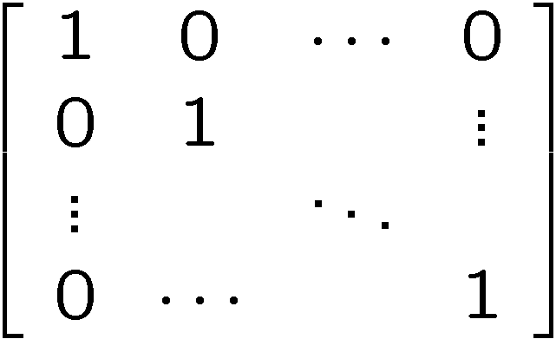
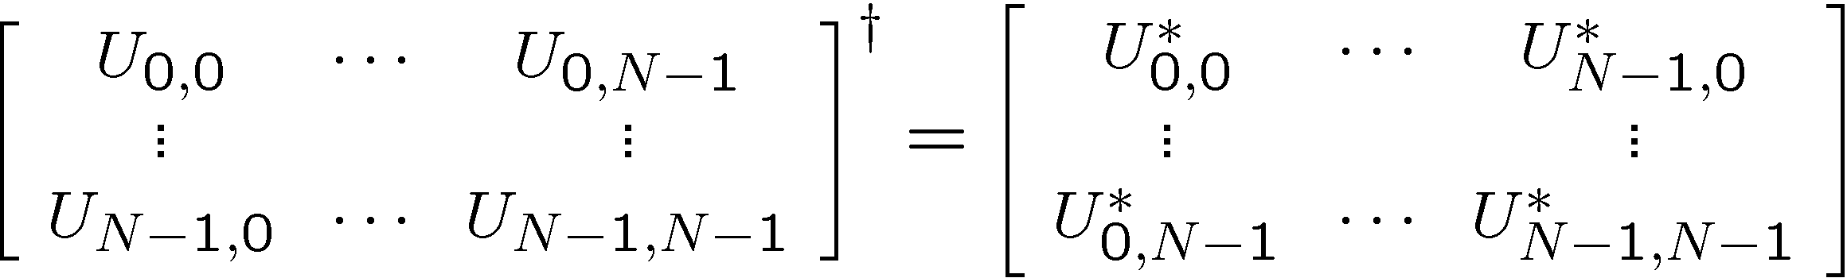



Unitary Matrix?
Unitary N x N matrix: an invertible N x N complex matrix
whose inverse is equal to it’s conjugate transpose.
Invertible: there exists an inverse of U, such that
N x N identity
matrix
Unitary:
or
or

Slide 40
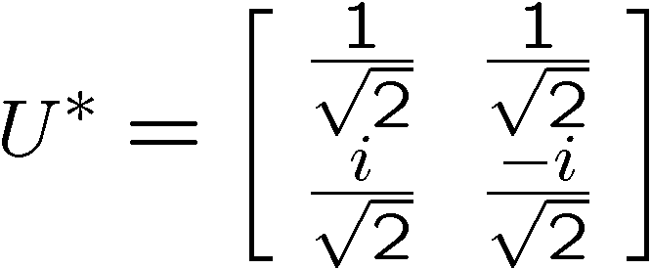
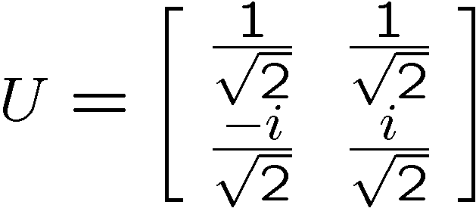
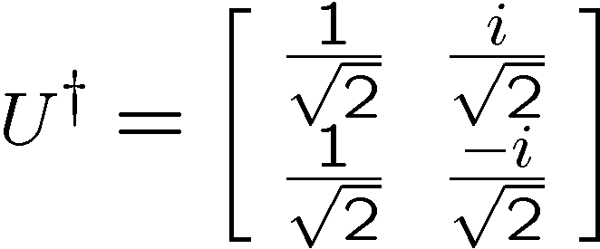
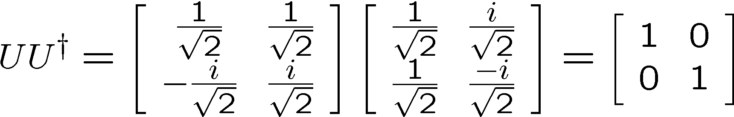
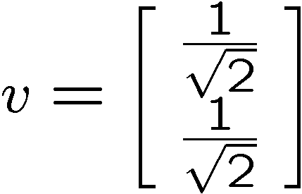
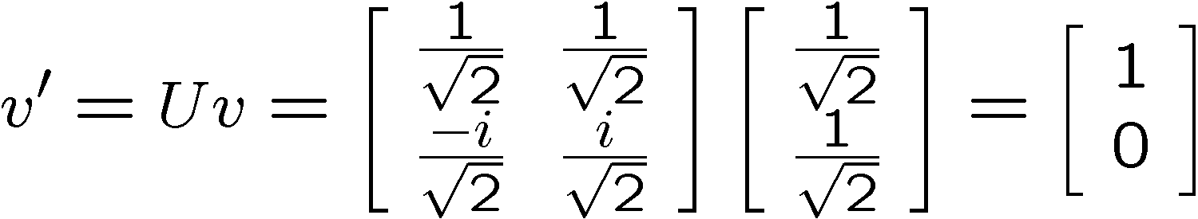
Quantum Rule 2, Example
Conjugate:
Conjugate
transpose:
Unitary?
evolves to

Slide 41
Quantum Information
Processing Device
Rule 1 (State Description) N states, vector of amplitudes
Rule 2 (Evolution) N x N unitary matrix
Rule 3 (Measurement) k measurement operators
Measurements in the computational basis of our device
whose description is the wave function results
in one of N outcomes. The probability of the outcome
is given by the modulus of the th component of
squared. After this measurement, the new state is
given by a wave function with a single nonzero
component: only the th component is one.

Slide 42
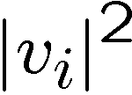
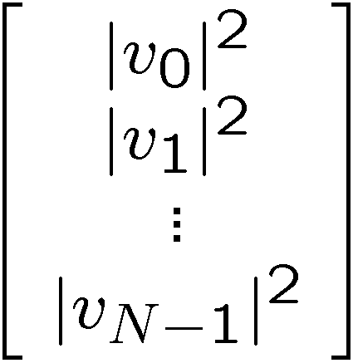



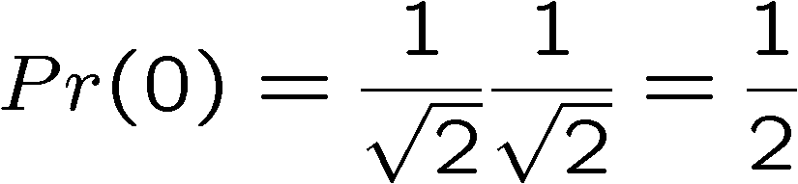
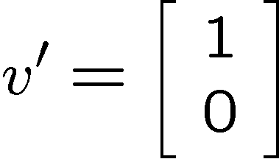
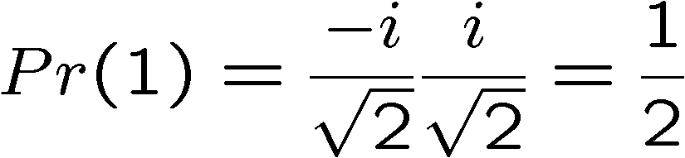
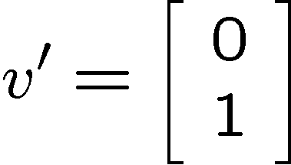
Quantum Rule 1, Probabilities?
If we measure our quantum information processing machine,
(in the computational basis) when our description is , then the
probability of observing state is .
quantum state
probabilities
requirement of unit vector insures these are probabilities
Example:

Slide 43



Quantum Information
Processing Device
Rule 1 (State Description) N states, vector of amplitudes
Rule 2 (Evolution) N x N unitary matrix
Rule 3 (Measurement) k measurement operators
Rule 4 (Composite Systems) tensor product
When combining two quantum systems with description
spaces and , the joint system is described
by a Hilbert space which is a tensor product of these
two systems, .

Slide 44









Quantum Rule 4
A
B
AB

Slide 45
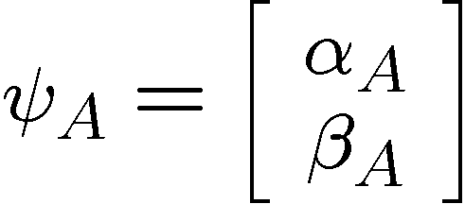


Quantum Rule 4
Example:
A
B
AB
separable state

Slide 46


Entangled States
Some joint states of two systems cannot be expressed as
Such states are called entangled states
Example:
We encountered something similar for our probabilistic device:
Entangled states are, similarly correlated.
But, we will find out later that they are
correlated in a very peculiar manner!

Slide 47
Quantum Information
Processing Device
Rule 1 (State Description) N states, vector of amplitudes
Rule 2 (Evolution) N x N unitary matrix
Rule 3 (Measurement) k measurement operators
Rule 4 (Composite Systems) tensor product
The Basic Postulates of Quantum Theory

Slide 48
These are the Laws
We need to learn notation,
and all about quantum circuits.

Slide 49







Dirac Notation
“Mathematicians tend to despise Dirac notation,
because it can prevent them from making
important distinctions, but physicists love it,
because they are always forgetting such
distinctions exist and the notation liberates
them from having to remember.”
David Mermin
Examples of Dirac Notation:

Slide 50


Bras and Kets
“ket” := column vector
“bra” := row vector
Every ket has a unique bra obtained by complex conjugating
and transposing:

Slide 51



Complex Vectors, Addition
Complex vectors can be added
Addition and multiplication by a scalar:

Slide 52





Computational Basis
Some special vectors:
Example:
2 dimensional complex vectors (also known as: a qubit!)

Slide 53



Computational Basis
Vectors can be “expanded” in the computational basis:
Example:

Slide 54



Computational Bras
Computational Basis, but now for bras:
Example:

Slide 55


The Inner Product
Given a “bra” and a “ket” we can calculate an “inner product”
This is a generalization of the dot product for real vectors
The result of taking an inner product is a complex number

Slide 56





The Inner Product
Example:
Complex conjugate of inner product:

Slide 57



The Inner Product in Comp. Basis
Inner product of computational basis elements:
Kronecker delta

Slide 58


The Inner Product in Comp. Basis
Example:

Slide 59



Norm of a Vector
Norm of a vector:
which is always a positive real number
it is the length of the complex vector
Example:

Slide 60

Quantum Rule 1
Rule 1 (State Description)
Machine has N states
0,1,2,…,N-1
Rule 1 (State Description)
A quantum information processing machine is a machine
with a state labeled from a finite alphabet of size N. Our
description of the state of this system is a N dimensional
complex unit vector
normalized

Slide 61






Basis?
“Other coordinate system”

Slide 62








Resolving a Vector
use the dot product to get the component of a vector
along a direction:
unit vector
use two orthogonal unit vectors in 2D to write in new basis:
orthogonal
unit vectors:

Slide 63



Expressing In a New Basis
“Other coordinate system”

Slide 64



Computational Basis
Computational basis:
is an orthonormal basis:
Kronecker delta
Computational basis is important because when we measure
our quantum computer (a qubit, two qubits, etc.) we get
an outcome corresponding to these basis vectors.
But there are all sorts of other basis which we could use to, say,
expand our vector about.

Slide 65





A Different Basis
A different orthonormal basis:
An orthonormal basis is complete if the number of basis elements
is equal to the dimension of the complex vector space.

Slide 66



Changing Your Basis
Express the qubit wave function
in the orthonormal complete basis
in other words find components of
Some inner products:
So:
Calculating these inner products allows us to express the
ket in a new basis.

Slide 67




Example Basis Change
Express in this basis:
So:

Slide 68





Explicit Basis Change
Express in this basis:
So:

Slide 69
Linear Algebra
Linear algebra is the language of quantum theory.
We will need to develop some basic proficiency in order to
work with quantum computers.

Slide 70





Matrices
A N dimensional complex matrix M is an N by N array
of complex numbers:
are complex numbers
Example:
Three dimensional complex matrix:

Slide 71




Matrices, Multiplied by Scalar
Matrices can be multiplied by a complex number
Example:

Slide 72




Matrices, Added
Matrices can be added
Example:

Slide 73


Matrices, Multiplied
Matrices can be multiplied

Slide 74


Matrices and Kets, Multiplied
Given a matrix, and a column vector:
These can be multiplied to obtain a new column vector:

Slide 75


Matrices and Bras, Multiplied
Given a matrix, and a row vector:
These can be multiplied to obtain a new row vector:

Slide 76


Matrices, Complex Conjugate
Given a matrix, we can form its complex conjugate by
conjugating every element:
Example:

Slide 77


Matrices, Transpose
Given a matrix, we can form it’s transpose by reflecting across
the diagonal
Example:

Slide 78


Matrices, Conjugate Transpose
Given a matrix, we can form its conjugate transpose by
reflecting across the diagonal and conjugating
Example:

Slide 79

Unitary Matrices
A matrix is unitary if
N x N identity
matrix
Equivalently a matrix is unitary if

Slide 80


Quantum Rule 2
Rule 2: The wave function of a N dimensional quantum system
evolves in time according to a unitary matrix . If the wave
function initially is then after the evolution correspond to
the new wave function is
“Unitary Evolution”

Slide 81




Unitary Evolution and the Norm
Unitary evolution
What happens to the norm of the ket?
Unitary evolution does not change the length of the ket.
Normalized wave function
Normalized wave function
unitary evolution
This implies that unitary evolution will maintain being a unit vector

