Slide 1



Quantum Computing
Lecture 2: More Quantum Theory
Deutsch’s Algorithm
Dave Bacon
Department of Computer Science & Engineering
University of Washington

Slide 2
Summary of Last Lecture

Slide 3
Summary of Last Lecture

Slide 4
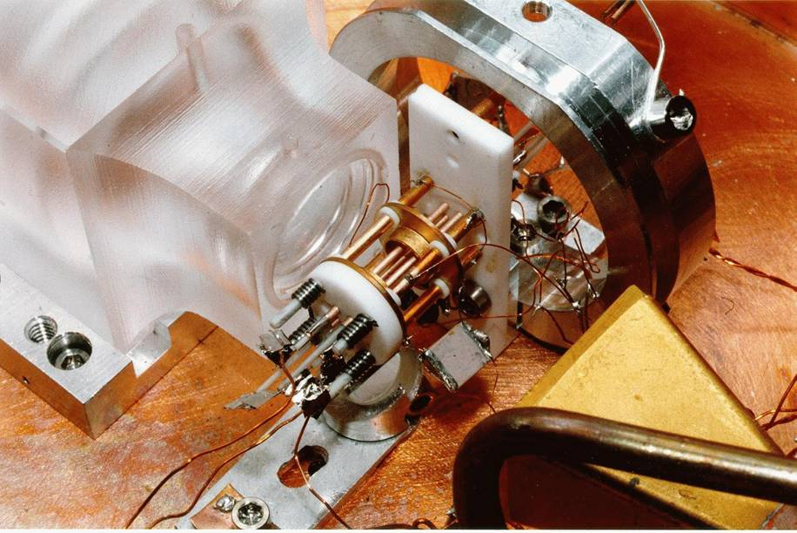
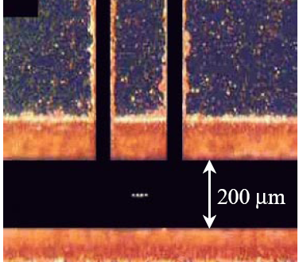
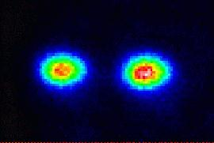
Ion Trap
Oscillating electric
fields trap ions
like charges repel
2 ⁹Be⁺ Ions in an Ion Trap

Slide 5
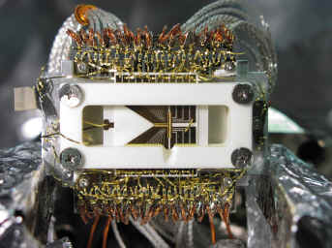
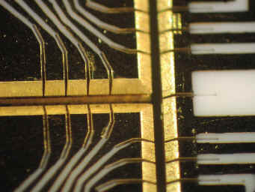
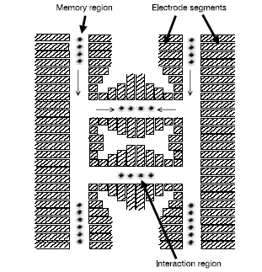
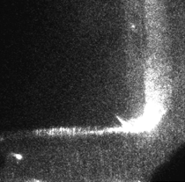
Shuttling Around a Corner
Pictures snatched from Chris Monroe’s
University of Michigan website

Slide 6

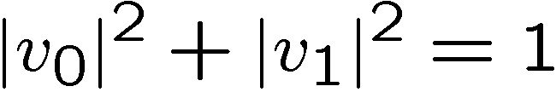
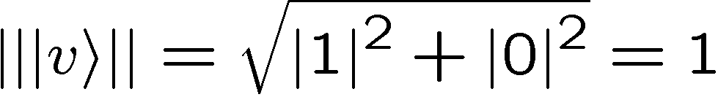

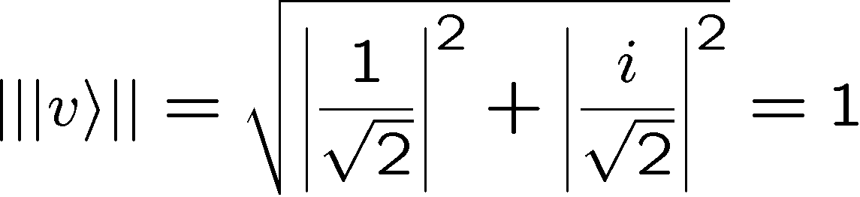
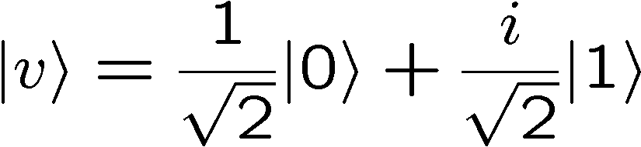

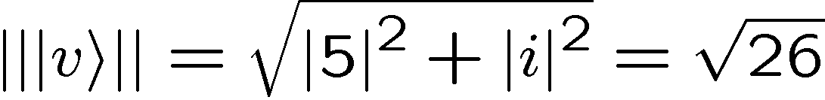
Qubits
Two dimensional quantum systems are called qubits
A qubit has a wave function which we write as
Examples:
Valid qubit wave functions:
Invalid qubit wave function (not normalized):

Slide 7

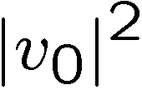
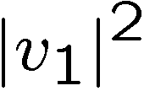
Measuring Qubits
A bit is a classical system with two possible states, 0 and 1
A qubit is a quantum system with two possible states, 0 and 1
When we observe a qubit, we get the result 0 or the result 1
0
or
1
If before we observe the qubit the wave function of the qubit is
then the probability that we observe 0 is
and the probability that we observe 1 is
“measuring in the computational basis”

Slide 8
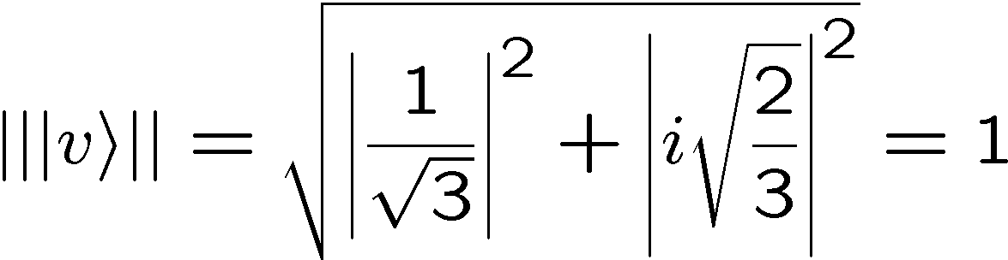
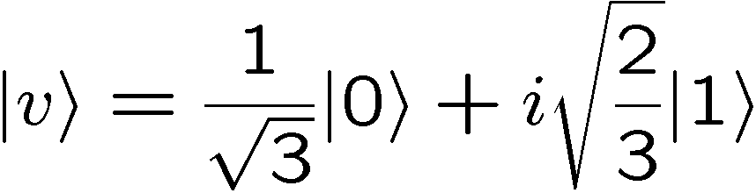
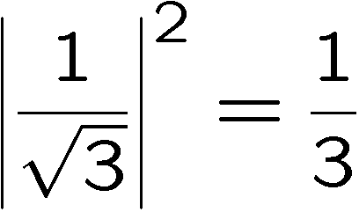
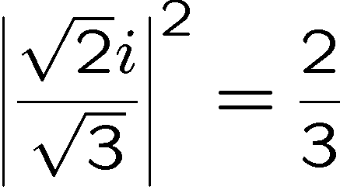
Measuring Qubits
Example:
We are given a qubit with wave function
If we observe the system in the computational basis, then we
get outcome 0 with probability
and we get outcome 1 with probability:

Slide 9


Measuring Qubits Continued
When we observe a qubit, we get the result 0 or the result 1
0
or
1
If before we observe the qubit the wave function of the qubit is
then the probability that we observe 0 is
and the probability that we observe 1 is
and the new wave function for the qubit is
and the new wave function for the qubit is
“measuring in the computational basis”

Slide 10

Measuring Qubits Continued
new wave function
probability
0
probability
new wave function
1
The wave function is a description of our system.
When we measure the system we find the system in one state
This happens with probabilities we get from our description

Slide 11
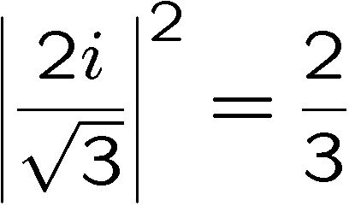
Measuring Qubits
Example:
We are given a qubit with wave function
If we observe the system in the computational basis, then we
get outcome 0 with probability
new wave function
and we get outcome 1 with probability:
new wave function

Slide 12
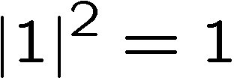
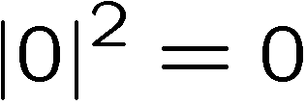
Measuring Qubits
Example:
We are given a qubit with wave function
If we observe the system in the computational basis, then we
get outcome 0 with probability
new wave function
and we get outcome 1 with probability:
a.k.a never

Slide 13
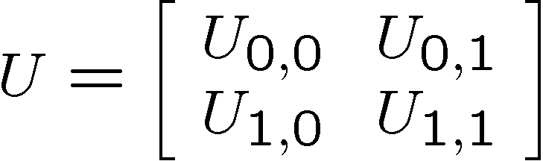
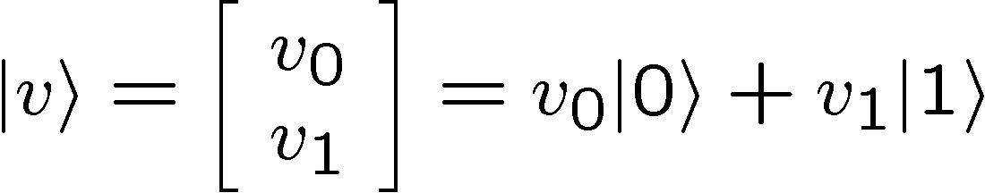
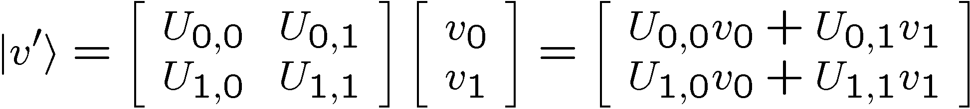
Unitary Evolution for Qubits
Unitary evolution will be described by a two dimensional
unitary matrix
If initial qubit wave function is
Then this evolves to

Slide 14
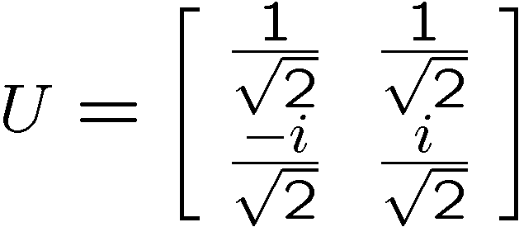
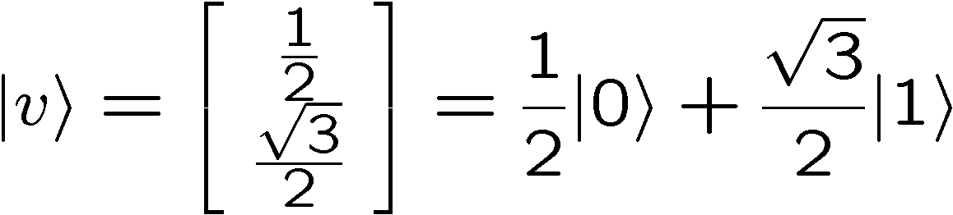
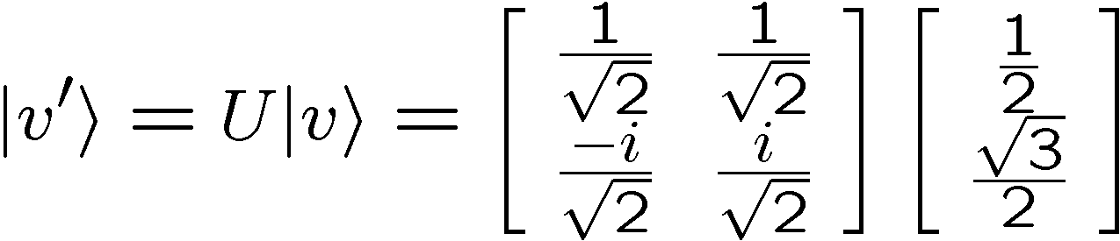
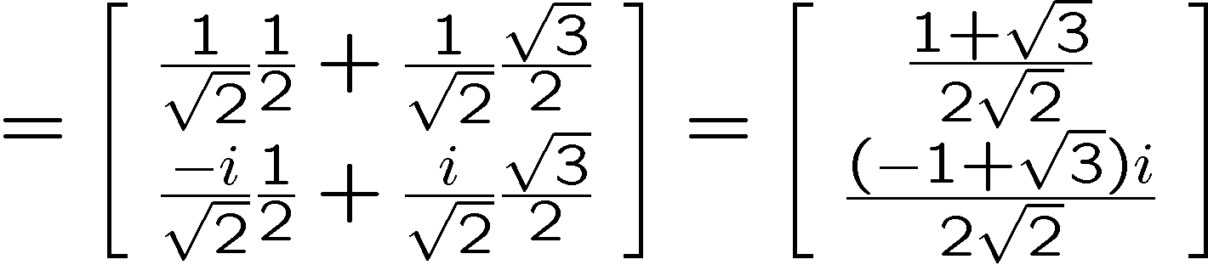
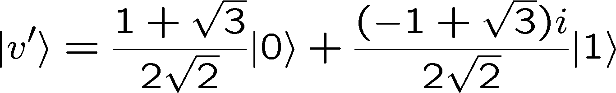
Unitary Evolution for Qubits

Slide 15

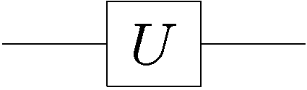

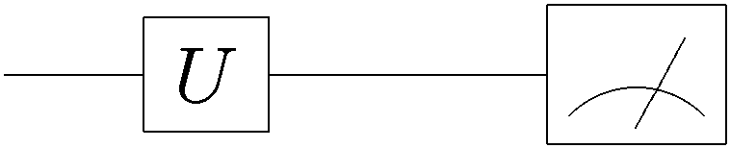
Single Qubit Quantum Circuits
Circuit diagrams for evolving qubits
quantum gate
input
qubit
wave
function
output
qubit
wave
function
quantum wire
single line = qubit
time
measurement in
computational
basis

Slide 16
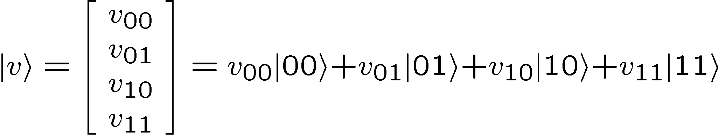
Two Qubits
Two bits can be in one of four different states
00
01
10
11
Similarly two qubits have four different states
00
01
10
11
The wave function for two qubits thus has four components:
first qubit
second qubit
first qubit
second qubit

Slide 17
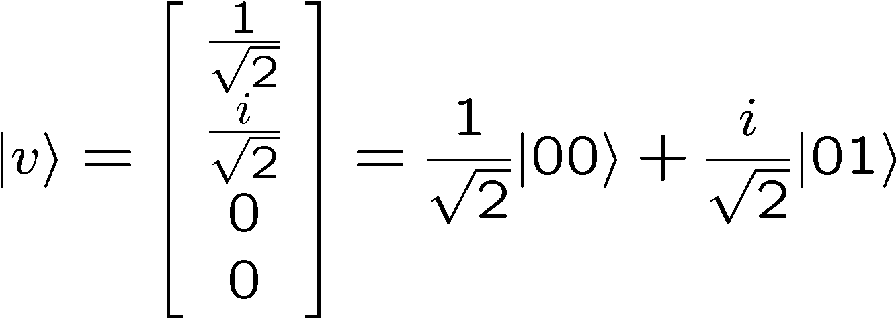
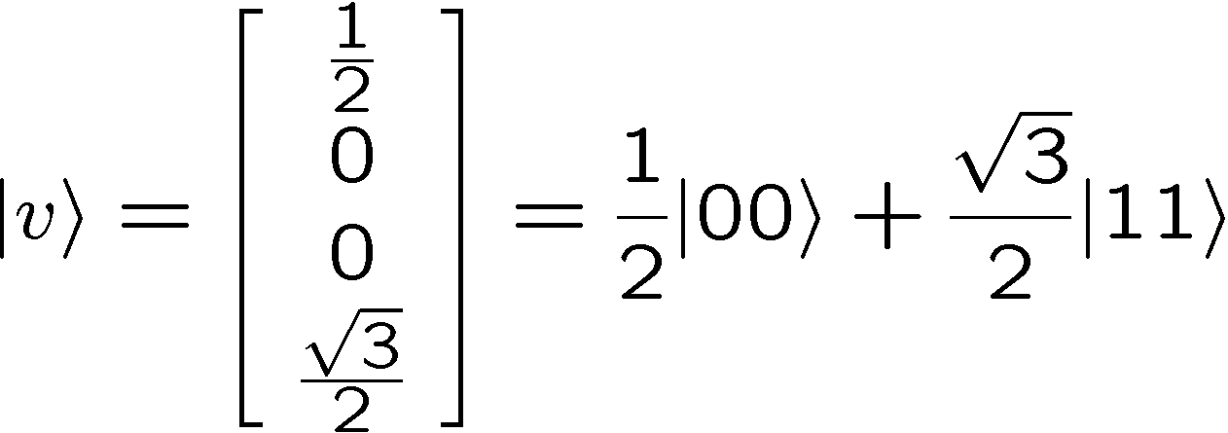
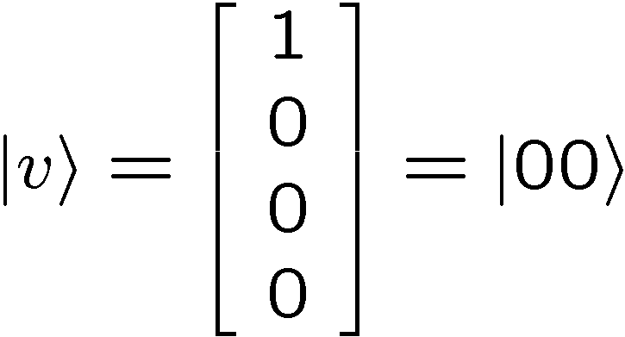
Two Qubits
Examples:

Slide 18



When Two Qubits Are Two
The wave function for two qubits has four components:
Sometimes we can write the wave function of two qubits
as the “tensor product” of two one qubit wave functions.
“separable”

Slide 19
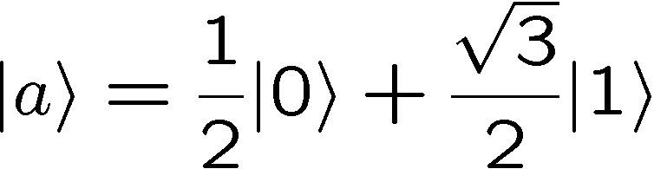
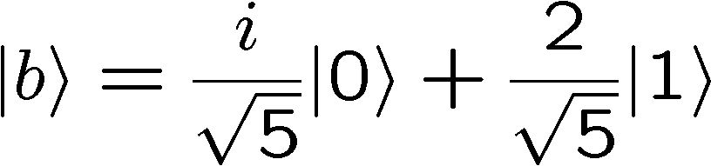
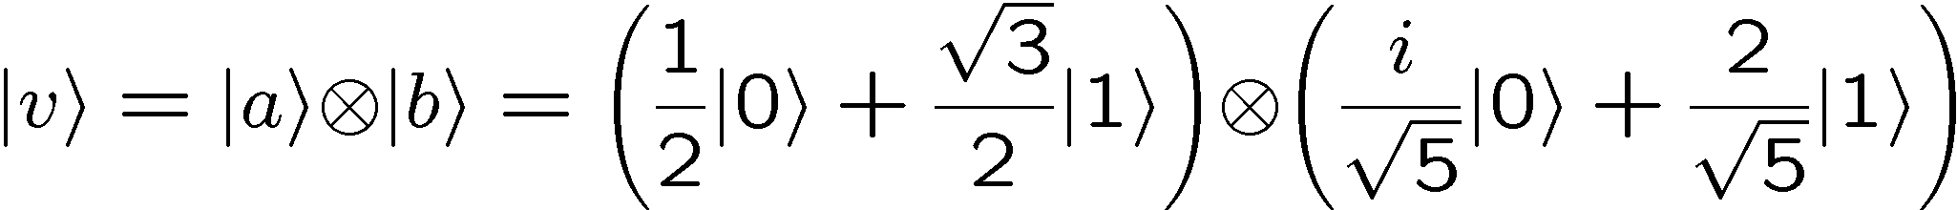
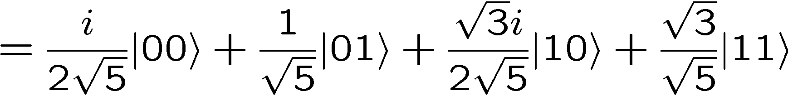
Two Qubits, Separable
Example:

Slide 20





Two Qubits, Entangled
Example:
Assume:
Either
but this implies
contradictions
or
but this implies
So is not a separable state. It is entangled.

Slide 21
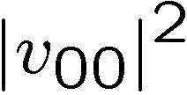

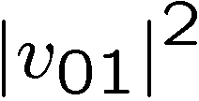

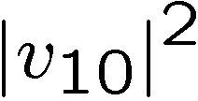

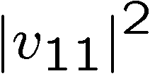

Measuring Two Qubits
If we measure both qubits in the computational basis, then we
get one of four outcomes: 00, 01, 10, and 11
If the wave function for the two qubits is
Probability of 00 is
New wave function is
Probability of 01 is
New wave function is
Probability of 10 is
New wave function is
Probability of 11 is
New wave function is

Slide 22
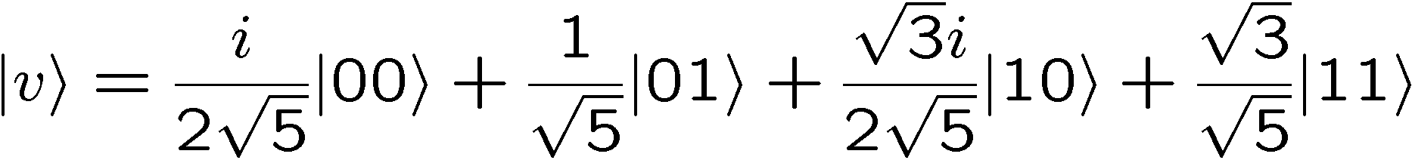
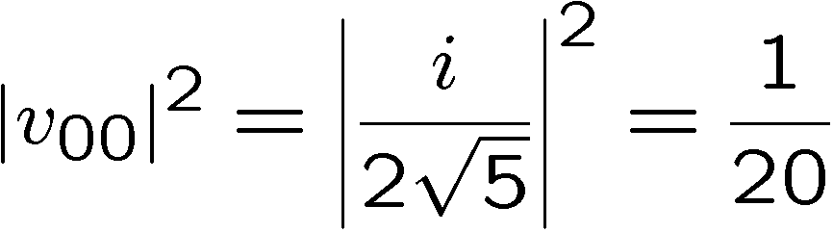
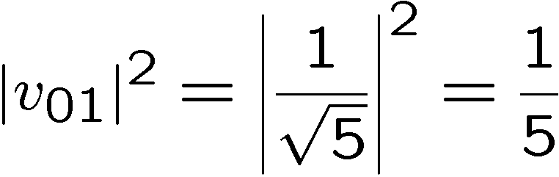
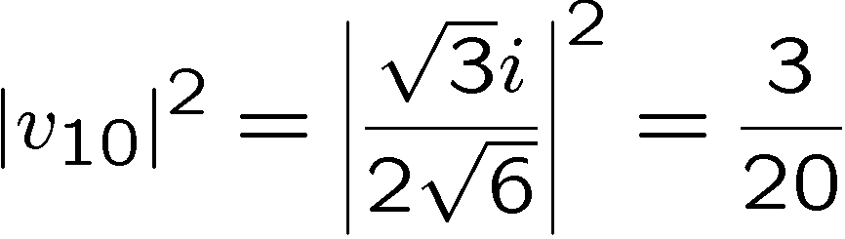
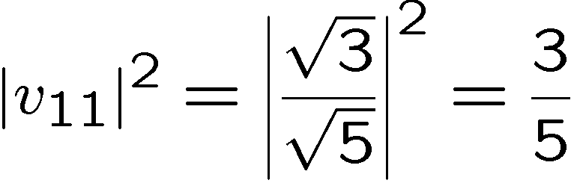
Two Qubits, Measuring
Example:
Probability of 00 is
Probability of 01 is
Probability of 10 is
Probability of 11 is

Slide 23

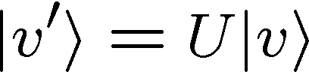
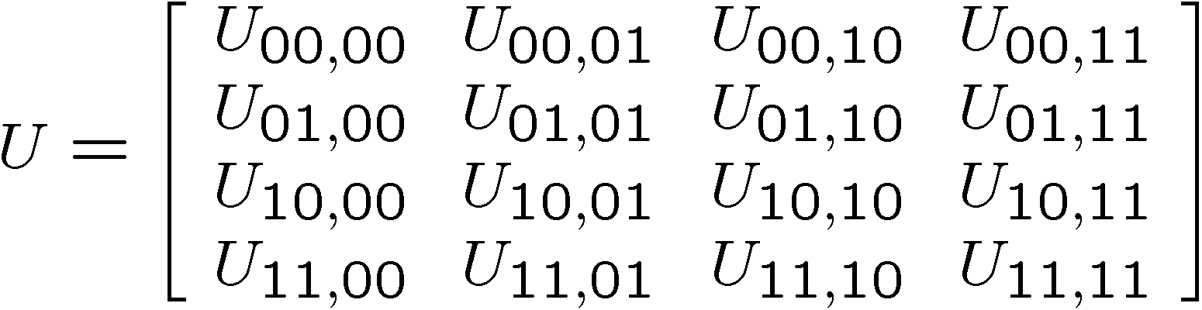


Two Qubit Evolutions
Rule 2: The wave function of a N dimensional quantum system
evolves in time according to a unitary matrix . If the wave
function initially is then after the evolution correspond to
the new wave function is

Slide 24


Two Qubit Evolutions

Slide 25
Manipulations of Two Bits
Two bits can be in one of four different states
00
01
10
11
We can manipulate these bits
00
01
01
00
10
10
11
11
Sometimes this can be thought of as just operating on one of
the bits (for example, flip the second bit):
00
01
01
00
10
11
11
10
But sometimes we cannot (as in the first example above)

Slide 26



Manipulations of Two Qubits
Similarly, we can apply unitary operations on only one of the
qubits at a time:
first qubit
second qubit
Unitary operator that acts only on the first qubit:
two dimensional
Identity matrix
two dimensional
unitary matrix
Unitary operator that acts only on the second qubit:

Slide 27





Tensor Product of Matrices

Slide 28




Tensor Product of Matrices
Example:

Slide 29


Tensor Product of Matrices
Example:

Slide 30




Tensor Product of Matrices
Example:

Slide 31
Tensor Product of Matrices
Example:

Slide 32







Two Qubit Quantum Circuits
A two qubit unitary gate
Sometimes the input our output is known to be seperable:
Sometimes we act only one qubit

Slide 33






Some Two Qubit Gates
control
controlled-NOT
target
Conditional on the first bit, the gate flips the second bit.

Slide 34

Computational Basis and Unitaries
Notice that by examining the unitary evolution of all computational
basis states, we can explicitly determine what the unitary matrix.

Slide 35
Linearity
We can act on each computational basis state and then resum
This simplifies calculations considerably

Slide 36




Linearity
Example:

Slide 37




Linearity
Example:

Slide 38






Some Two Qubit Gates
control
controlled-NOT
target
control
controlled-U
target
controlled-phase
swap

Slide 39









Quantum Circuits
controlled-H
Probability of 10:
Probability of 11:
Probability of 00 and 01:

Slide 40





Matrices, Bras, and Kets
So far we have used bras and kets to describe row and column
vectors. We can also use them to describe matrices:
Outer product of two vectors:
Example:

Slide 41






Matrices, Bras, and Kets
We can expand a matrix about all of the computational basis
outer products
Example:

Slide 42


Matrices, Bras, and Kets
We can expand a matrix about all of the computational basis
outer products
This makes it easy to operate on kets and bras:
complex numbers

Slide 43



Matrices, Bras, and Kets
Example:

Slide 44







Projectors
The projector onto a state (which is of unit norm) is given by
Projects onto the state:
Note that
and that
Example:

Slide 45



Measurement Rule
If we measure a quantum system whose wave function is
in the basis , then the probability of getting the outcome
corresponding to is given by
where
The new wave function of the system after getting the
measurement outcome corresponding to is given by
For measuring in a complete basis, this reduces to our normal
prescription for quantum measurement, but…

Slide 46







Measuring One of Two Qubits
Suppose we measure the first of two qubits in the computational basis. Then we can form the two projectors:
If the two qubit wave function is then the probabilities of
these two outcomes are
And the new state of the system is given by either
Outcome was 0
Outcome was 1

Slide 47





Measuring One of Two Qubits
Example:
Measure the first qubit:

Slide 48





Instantaneous Communication?
Suppose two distant parties each have a qubit and their
joint quantum wave function is
If one party now measures its qubit, then…
The other parties qubit is now either the or
Instantaneous communication? NO.
Why NO? These two results happen with probabilities.
Correlation does not imply communication.

Slide 49










Important Single Qubit Unitaries
Pauli Matrices:
“bit flip”
“phase flip”
“bit flip” is just the classical not gate

Slide 50






Important Single Qubit Unitaries
“bit flip” is just the classical not gate
Hadamard gate:
Jacques Hadamard

Slide 51


Single Qubit Manipulations
Use this to compute
But
So that

Slide 52







A Cool Circuit Identity
Using

Slide 53














Reversible Classical Gates
A reversible classical gate on bits is one to one function on
the values of these bits.
Example:
reversible
not reversible

Slide 54





Reversible Classical Gates
A reversible classical gate on bits is one to one function on
the values of these bits.
We can represent reversible classical gates by a permutation
matrix.
Permutation matrix is matrix in which every row and column contains at most one 1 and the rest of the elements are 0
Example:
input
reversible
output

Slide 55
Quantum Versions of
Reversible Classical Gates
A reversible classical gate on bits is one to one function on
the values of these bits.
We can turn reversible classical gates into unitary quantum gates
Permutation matrix is matrix in which every row and column contains at most one 1 and the rest of the elements are 0
Use permutation matrix as unitary evolution matrix
controlled-NOT

Slide 56

David Speaks
“Complexity theory has been mainly concerned with constraints upon the computation of functions: which functions can be computed, how fast, and with use of how much memory. With quantum computers, as with classical stochastic computers, one must also ask ‘and with what probability?’ We have seen that the minimum computation time for certain tasks can be lower for Q than for T . Complexity theory for Q deserves further investigation.”
David
Deutsch
1985
Q = quantum computers
T = classical computers

Slide 57

Deutsch’s Problem
Suppose you are given a black box which computes one of
the following four reversible gates:
controlled-NOT
+ NOT 2nd bit
“identity”
NOT 2nd bit
controlled-NOT
constant
balanced
Deutsch’s (Classical) Problem:
How many times do we have to use this black box to determine whether we are given the first two or the second two?

Slide 58
Classical Deutsch’s Problem
controlled-NOT
+ NOT 2nd bit
“identity”
NOT 2nd bit
controlled-NOT
constant
balanced
Notice that for every possible input, this does not separate the “constant” and “balanced” sets. This implies at least one use of the black box is needed.
Querying the black box with and distinguishes between
these two sets. Two uses of the black box are necessary and
sufficient.

Slide 59



Classical to Quantum Deutsch
controlled-NOT
+ NOT 2nd bit
“identity”
NOT 2nd bit
controlled-NOT
Convert to quantum gates
Deutsch’s (Quantum) Problem:
How many times do we have to use these quantum gates to determine whether we are given the first two or the second two?

Slide 60







Quantum Deutsch
What if we perform Hadamards before and after the quantum gate:

Slide 61

That Last One

Slide 62


Again

Slide 63





Some Inputs

Slide 64



Quantum Deutsch

Slide 65
Quantum Deutsch
By querying with quantum states we are able to distinguish
the first two (constant) from the second two (balanced) with
only one use of the quantum gate!
Two uses of the classical gates
Versus
One use of the quantum gate
first quantum speedup (Deutsch, 1985)

