Slide 1
You Did Not Just Read This
or did you?

Slide 2



Quantum Computing
Lecture 3: Teleportation, Superdense Coding,
Quantum Algortihms
Dave Bacon
Department of Computer Science & Engineering
University of Washington

Slide 3
Summary of Last Lecture

Slide 4
Final Examination

Slide 5
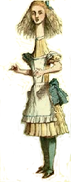



Quantum Teleportation
Alice wants to send her qubit to Bob.
She does not know the wave function of her qubit.
Alice
Bob
Can Alice send her qubit to Bob using classical bits?
Since she doesn’t know and measurements on her state
do not reveal , this task appears impossible.

Slide 6
Quantum Teleportation
Alice wants to send her qubit to Bob.
She does not know the wave function of her qubit.
classical communication
Alice
Bob
Suppose these bits contain information about
Then Bob would have information about as well as
the qubit
This would be a procedure for extracting information from
without effecting the state

Slide 7
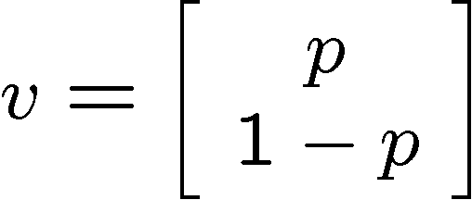
Quantum Teleportation
Classical
Alice wants to send her probabilistic bit to Bob using classical communication.
Alice
Bob
She does not wish to reveal any information about this bit.

Slide 8
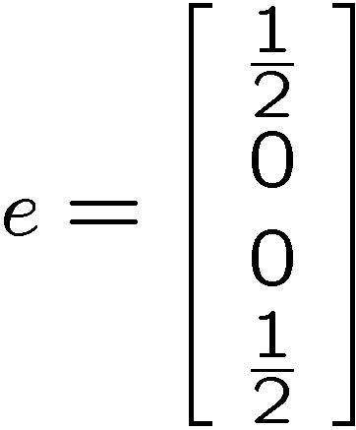
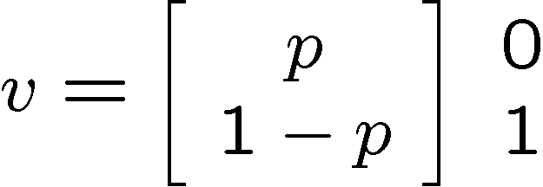

Classical Teleportation
(a.k.a. one time pad)
Alice
Bob
50 % 00
50 % 11
Alice and Bob have two perfectly correlated bits
Alice XORs her bit with the correlated bit and sends the
result to Bob.
Bob XORs his correlated bit with the bit Alice sent and
thereby obtains a bit with probability vector .

Slide 9
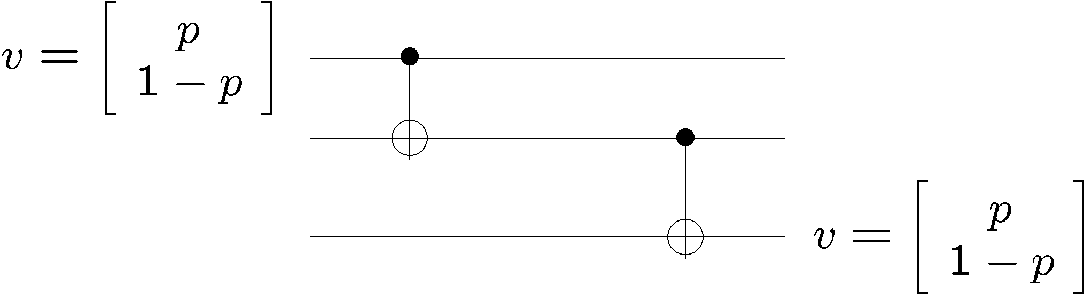
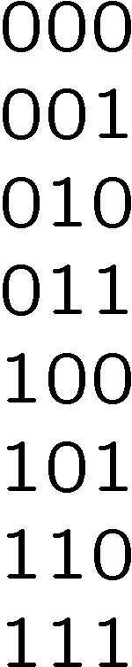
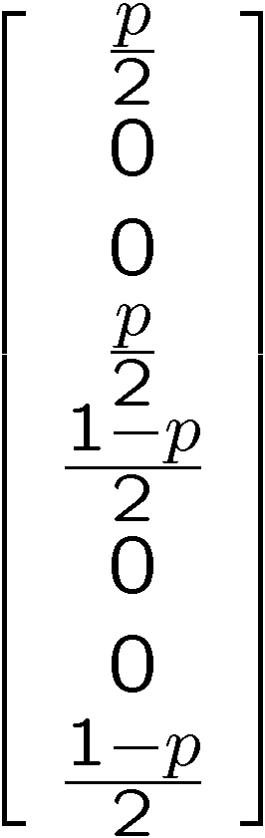
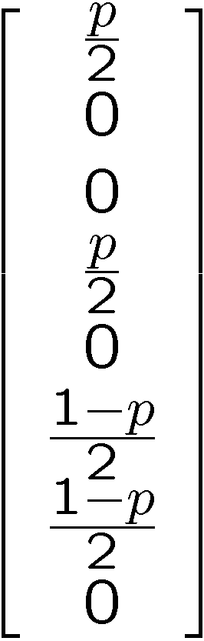
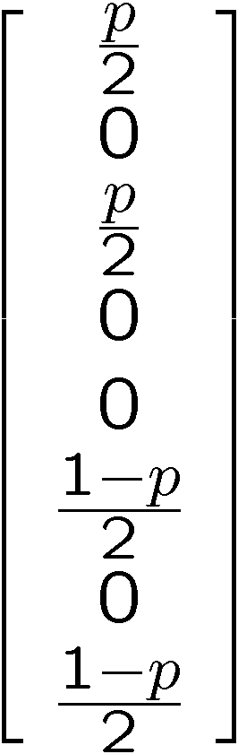
Classical Teleportation Circuit
Alice
Bob

Slide 10
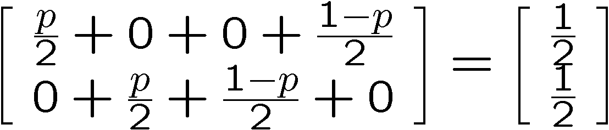
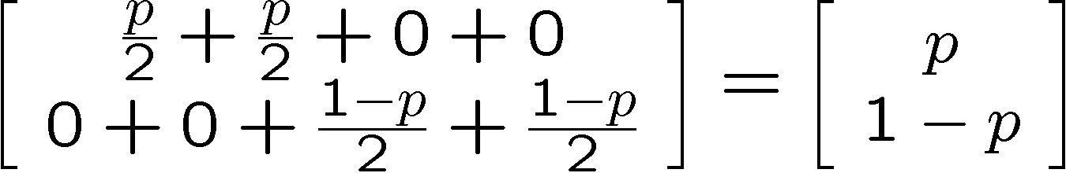
No information in transmitted bit:
transmitted bit
And it works:
Bob’s bit

Slide 11
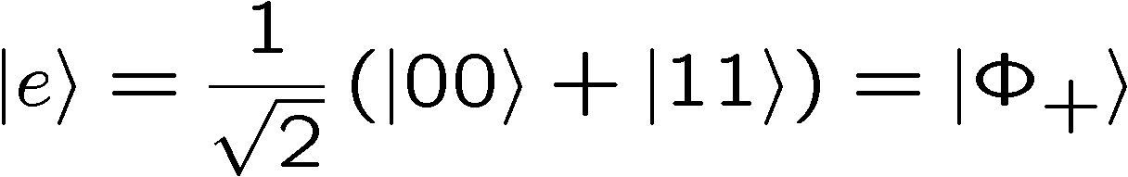
Quantum Teleportation
Alice wants to send her qubit to Bob.
She does not know the wave function of her qubit.
classical communication
Alice
Bob
allow them to share the entangled state:

Slide 12
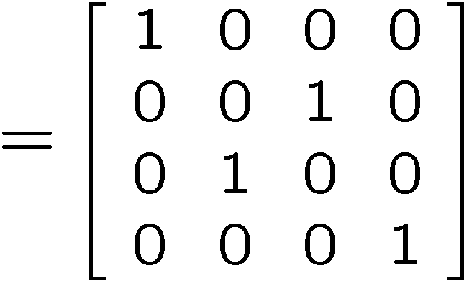
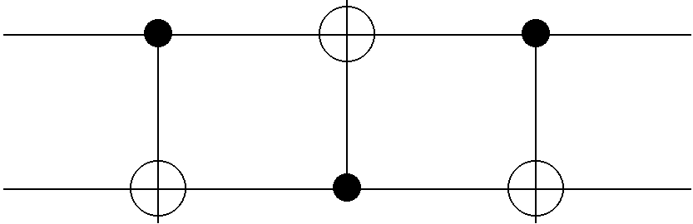
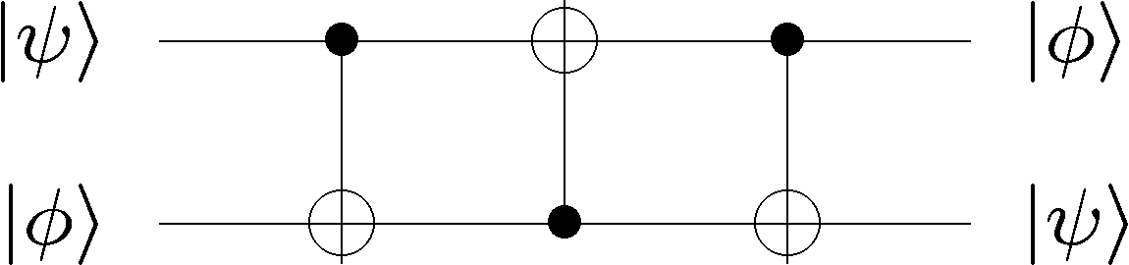
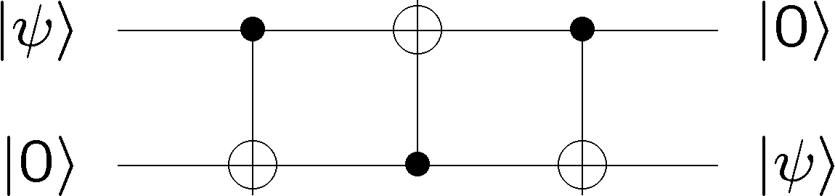
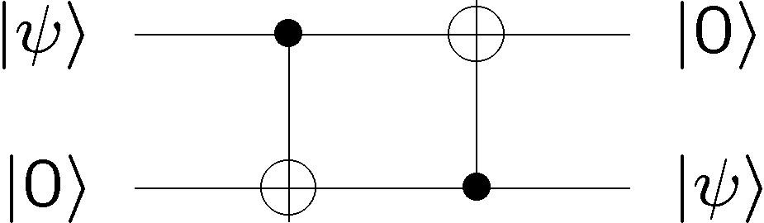
Deriving Quantum Teleportation
Our path: We are going to “derive” teleportation
“SWAP”
“Alice”
“Bob”
Only concerned with from Alice to Bob transfer

Slide 13
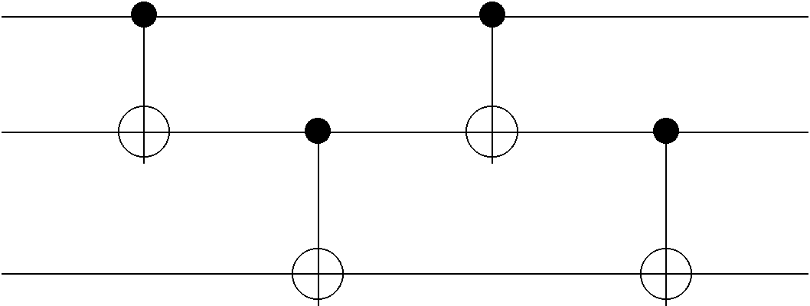
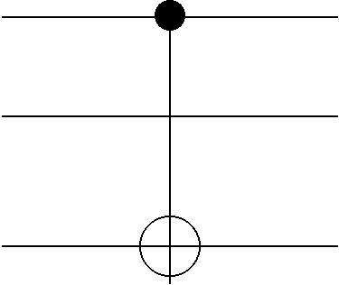
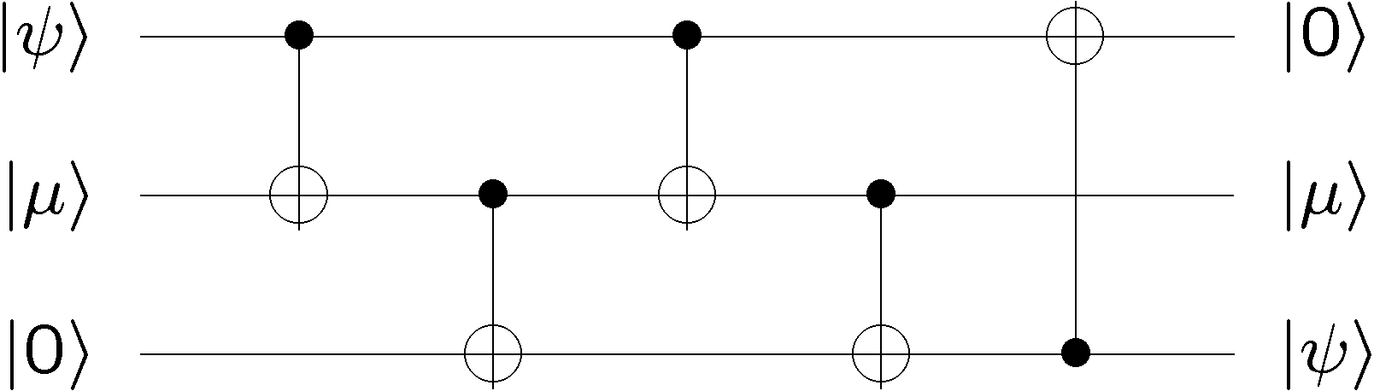
Deriving Quantum Teleportation
Need some way to get entangled states
new equivalent circuit:

Slide 14
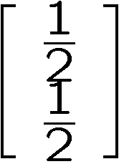
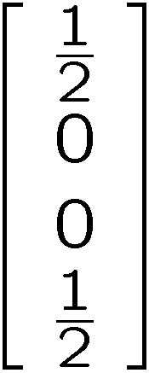
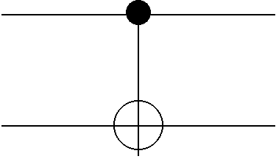
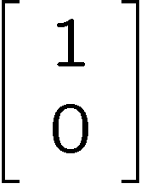
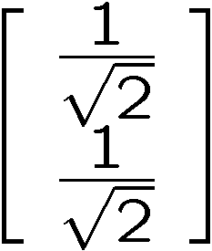
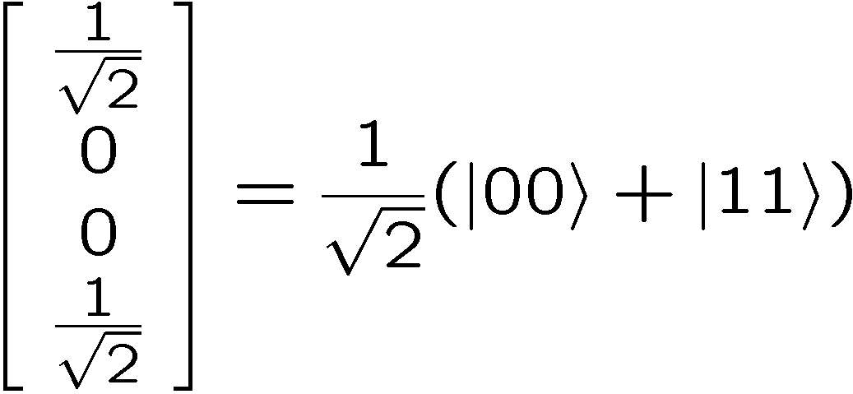
Deriving Quantum Teleportation
How to generate classical correlated bits:
Inspires: how to generate an entangled state:

Slide 15
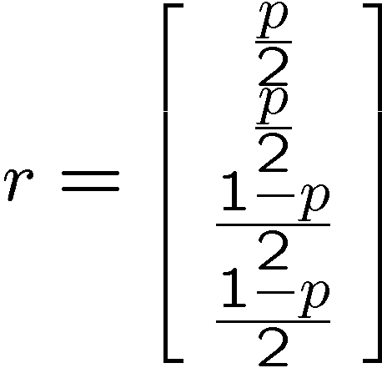
Deriving Quantum Teleportation
Classical Teleportation
Alice
Bob
like to use generate entanglement

Slide 16
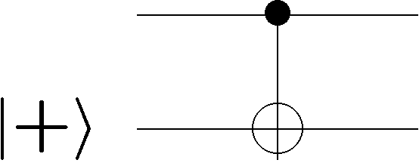
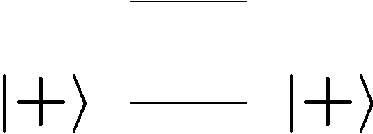
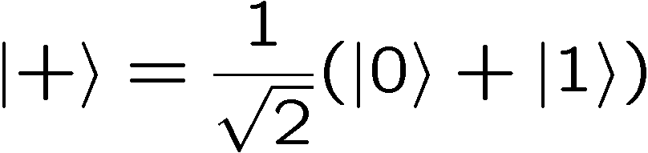

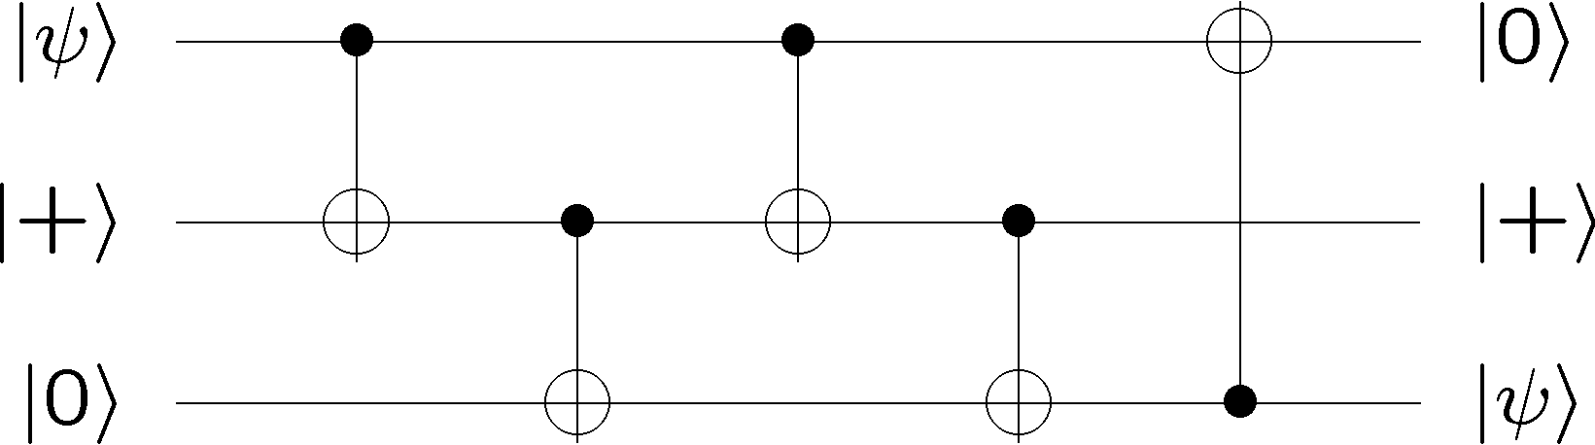
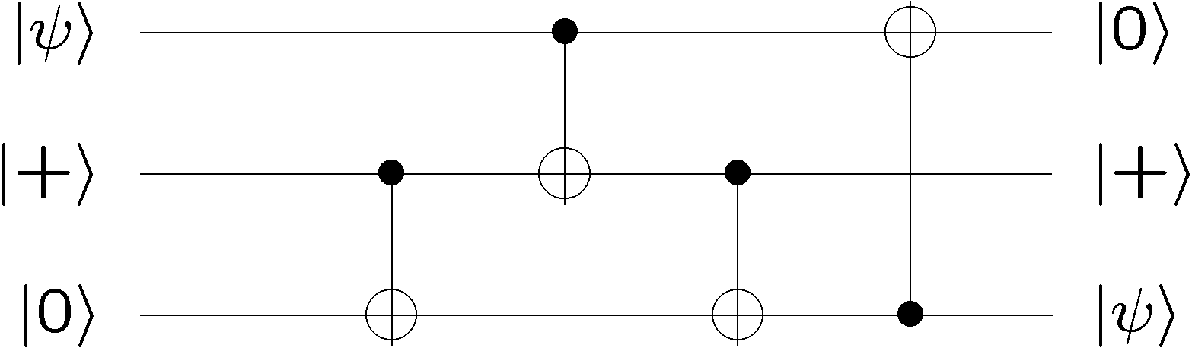
Deriving Quantum Teleportation

Slide 17
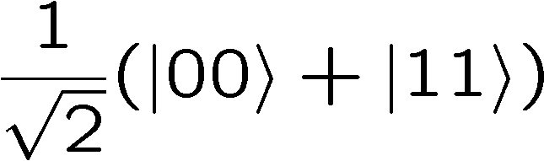
Deriving Quantum Teleportation
?? Acting backwards ??
entanglement
Alice
Bob

Slide 18
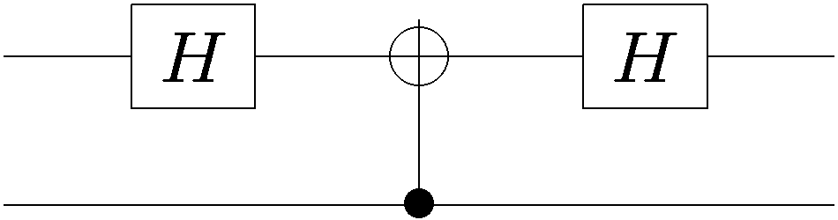
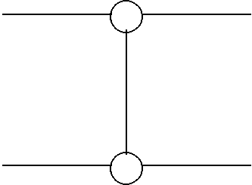
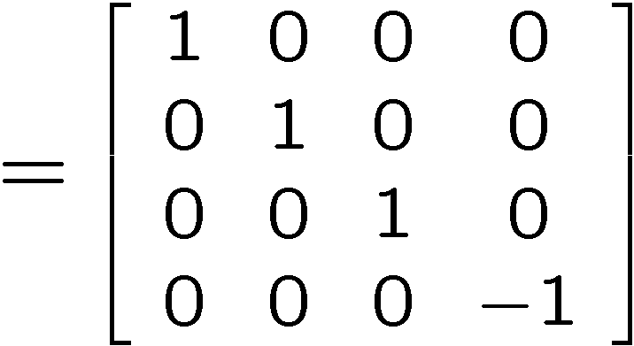
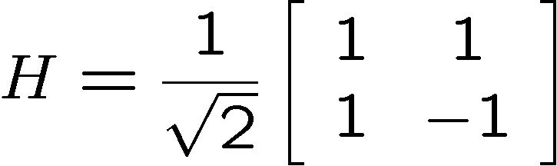

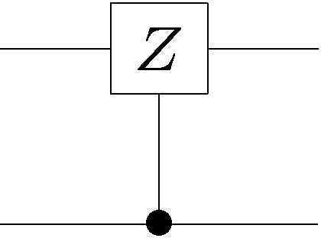
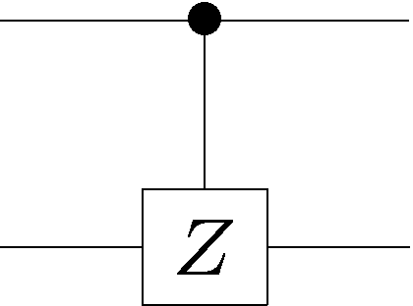

Deriving Quantum Teleportation
Use to turn around:

Slide 19
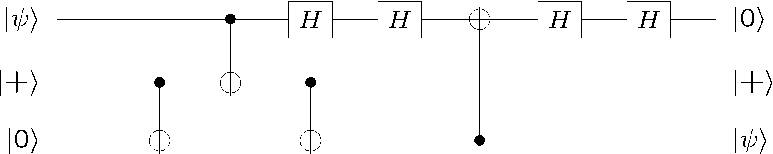
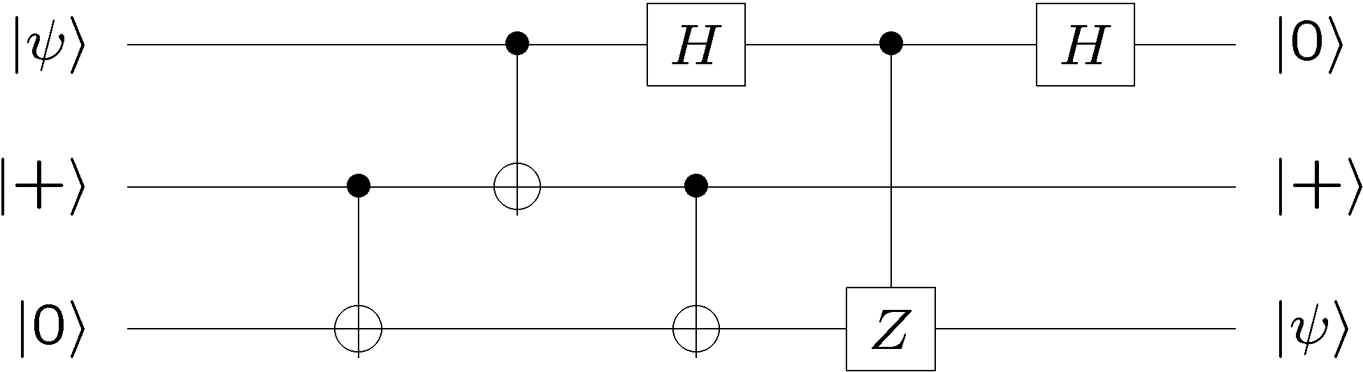
Deriving Quantum Teleportation

Slide 20
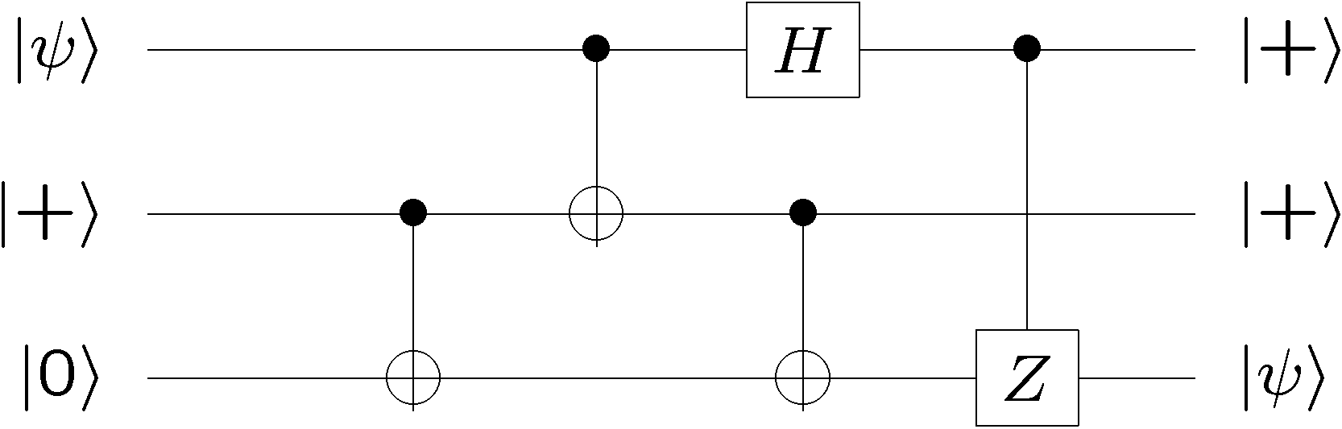
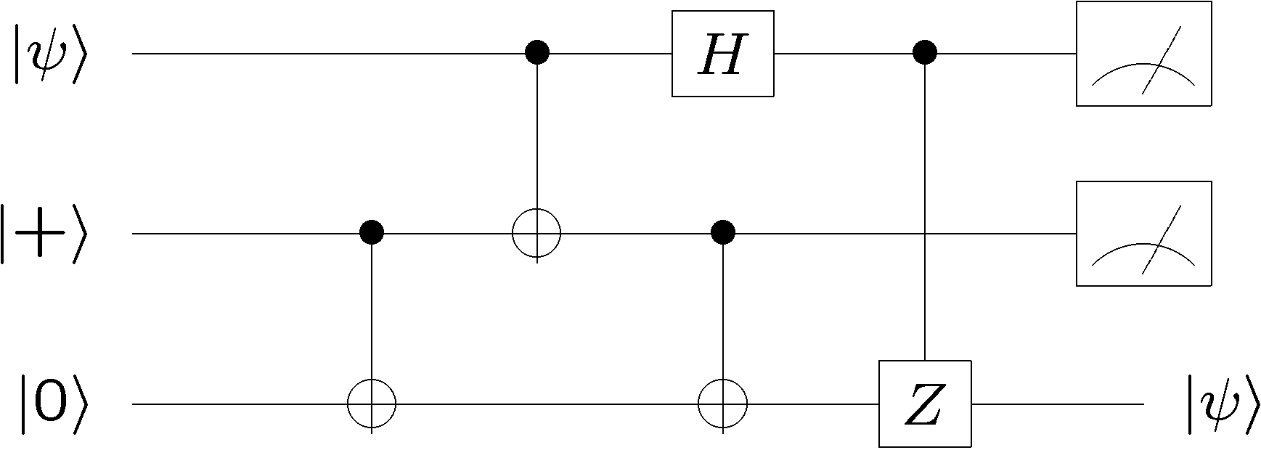
Deriving Quantum Teleportation
50 % 0, 50 % 1
50 % 0, 50 % 1

Slide 21
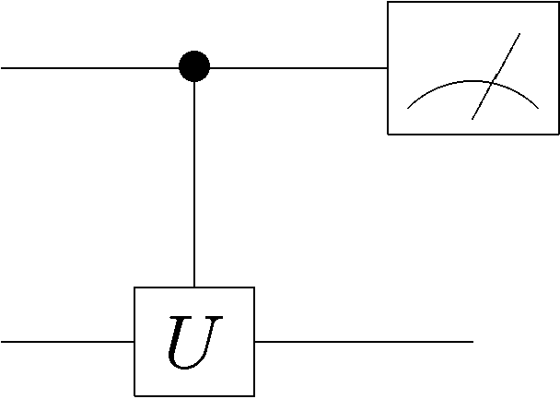
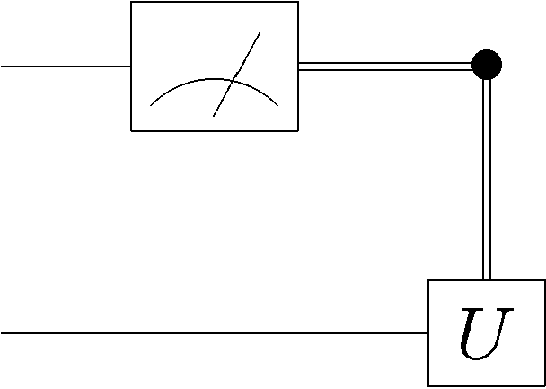
Measurements Through Control
Measurement in the computational basis commutes
with a control on a controlled unitary.
classical
wire

Slide 22
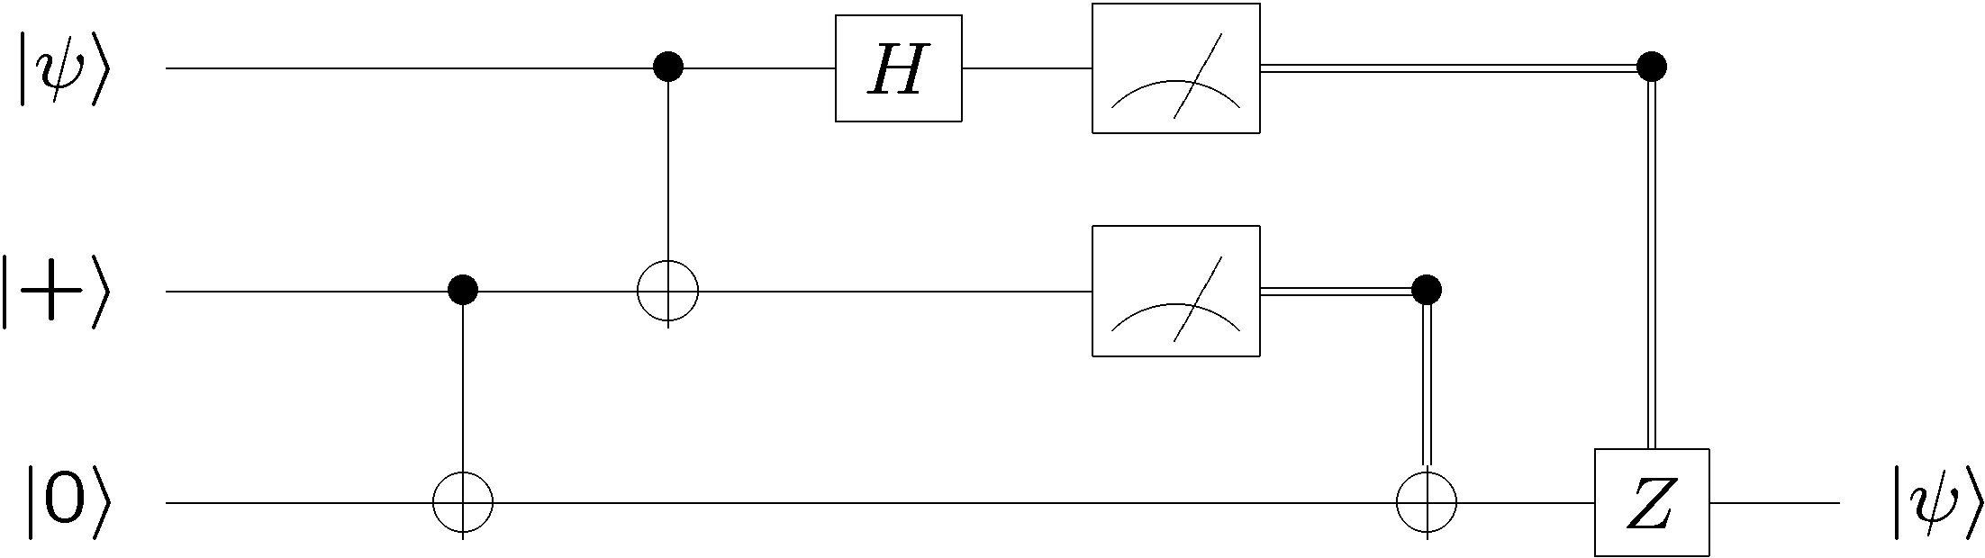
Deriving Quantum Teleportation
50 % 0, 50 % 1
50 % 0, 50 % 1
50 % 0, 50 % 1
50 % 0, 50 % 1

Slide 23
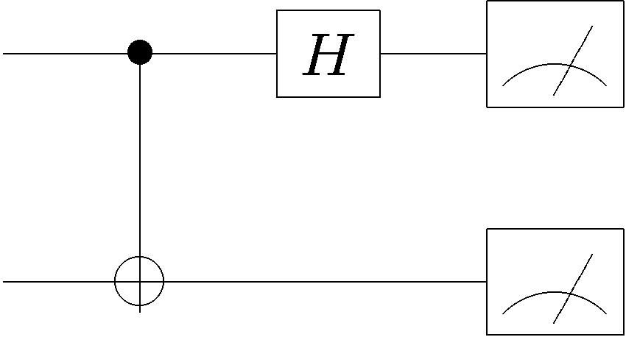
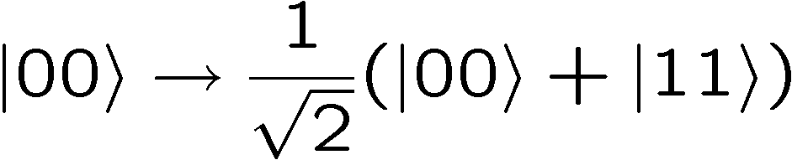
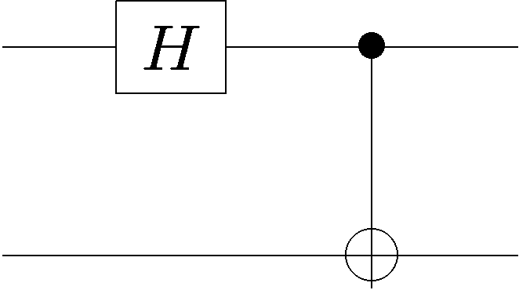
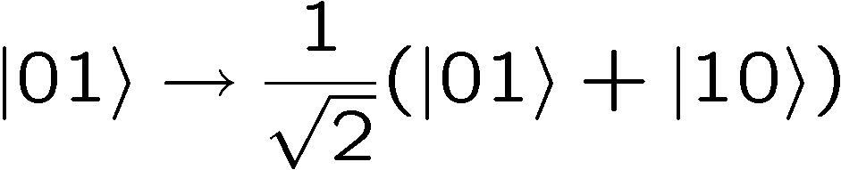


Bell Basis Measurement
Unitary followed by measurement in the computational basis
is a measurement in a different basis.
Run circuit backward to find basis:
Thus we are measuring in the Bell basis.

Slide 24
Teleportation
Bell basis measurement
Alice
50 % 0, 50 % 1
50 % 0, 50 % 1
Bob
Initially Alice has and they each have one of the two
qubits of the entangled wave function
2. Alice measures and her half of the entangled state in
the Bell Basis.
3. Alice send the two bits of her outcome to Bob who then
performs the appropriate X and Z operations to his qubit.

Slide 25


Teleportation
two qubits
2. Separate
1. Interact and
entangle
BOB
ALICE
Alice and Bob each have a qubit, and the wave function of their two qubit is entangled. This means that we can’t think of Alice’s
qubit as having a particular wave function. We have to talk about the “global” two qubit wave function.

Slide 26

Teleportation
ALICE
BOB
Alice does not know the wave function
We have three qubits whose wave function is
qubit 1
qubit 2 and qubit 3

Slide 27
Separable, Entangled, 3 Qubits
If we consider qubit 1 as one subsystem and qubits 2 and 3 as
another subsystem, then the state is separable across this divide
However, if we consider qubits 1 and 2 as one system and qubits 3 as one subsystem, then the state is entangled across this divide.
1
2
3
1
2
3
seperable
entangled

Slide 28

Separable, Entangled, 3 Qubits
Sometimes we will deal with entangled states across
non adjacent qubits:
How do we even “write” this?
Subscript denotes which qubit(s) you are talking about.

Slide 29

Separable, Entangled, 3 Qubits
1
2
3
1
2
3

Slide 30




Separable, Entangled, 3 Qubits
When we don’t write subscripts we mean “standard ordering”

Slide 31
Teleportation
ALICE
BOB
Alice does not know the wave function
We have three qubits whose wave function is
qubit 1
qubit 2 and qubit 3

Slide 32
Teleportation
Bell basis measurement
Alice
50 % 0, 50 % 1
50 % 0, 50 % 1
Bob

Slide 33








Teleportation
Express this state in terms of Bell basis for first two qubits.
Bell basis
Computational basis

Slide 34





Teleportation
Bell basis
Computational basis

Slide 35

Teleportation
Bell basis measurement
Alice
50 % 0, 50 % 1
50 % 0, 50 % 1
Bob

Slide 36


Dropping The Tensor Symbol
Sometimes we will just “drop” the tensor symbol.
“Context” lets us know that there is an implicit tensor product.

Slide 37

Teleportation
Bell basis measurement
Alice
50 % 0, 50 % 1
50 % 0, 50 % 1
Bob

Slide 38







Bell Basis Measurement

Slide 39
Teleportation
Bell basis measurement
Alice
50 % 0, 50 % 1
50 % 0, 50 % 1
Bob

Slide 40




Teleportation
Given the wave function
Measure the first two qubits in the computational basis
Equal ¼ probability for all four outcomes and new states are:

Slide 41
Teleportation
Bell basis measurement
Alice
50 % 0, 50 % 1
50 % 0, 50 % 1
Bob

Slide 42



Teleportation
If the bits sent from Alice to Bob are 00, do nothing
If the bits sent from Alice to Bob are 01, apply a bit flip
If the bits sent from Alice to Bob are 10, apply a phase flip
If the bits sent from Alice to Bob are 11, apply a bit & phase flip

Slide 43
Teleportation
Bell basis measurement
Alice
50 % 0, 50 % 1
50 % 0, 50 % 1
Bob

Slide 44







Teleportation
Alice
Bob
Alice
Bob

Slide 45
Teleportation
1 qubit = 1 ebit + 2 bits
Teleportation says we can replace transmitting a qubit
with a shared entangled pair of qubits plus two bits of
classical communication.
Superdense Coding
Next we will see that
2 bits = 1 qubit + 1 ebit

Slide 46




Superdense Coding
Suppose Alice and Bob each have one qubit and the joint
two qubit wave function is the entangled state
Alice wants to send two bits to Bob. Call these bits and .
Alice applies the following operator to her qubit:
Alice then sends her qubit to Bob.
note:
Bob then measures in the Bell basis to determine the two bits
2 bits = 1 qubit + 1 ebit

Slide 47
Bell Basis
The four Bell states can be turned into each other using
operations on only one of the qubits:

Slide 48









Superdense Coding
Initially:
Alice applies the following operator to her qubit:
Bob can uniquely determine which of the four states he has
and thus figure out Alice’s two bits!

Slide 49
Superdense Coding
Bell basis
measurement

Slide 50
Teleportation
1 qubit = 1 ebit + 2 bits
Teleportation says we can replace transmitting a qubit
with a shared entangled pair of qubits plus two bits of
classical communication.
Superdense Coding
2 bits = 1 qubit + 1 ebit
We can send two bits of classical information if we share an entangled state and can communicate one qubit of quantum information:

Slide 51
Quantum Algorithms

Slide 52






Classical Promise Problem
Query Complexity
Given: A black box which computes some function
k bit input
k bit output
black box
Promise: the function belongs to a set which is a subset
of all possible functions.
Properties: the set can be divided into disjoint subsets
Problem: What is the minimal number of times we have to
use (query) the black box in order to determine which subset
the function belongs to?

Slide 53











Example
Suppose you are given a black box which computes one of
the following four reversible classical gates:
2 bits input
2 bits output
controlled-NOT
+ NOT 2nd bit
“identity”
NOT 2nd bit
controlled-NOT
Deutsch’s (Classical) Problem: What is the minimal number of times we have to use this black box to determine whether we are given one of the first two or the second two functions?

Slide 54



Quantum Promise Query Complexity
Given: A quantum gate which, when used as a classical device
computes a reversible function
k qubit input
k qubit output
black box
Promise: the function belongs to a set which is a subset
of all possible functions.
Properties: the set can be divided into disjoint subsets
Problem: What is the minimal number of times we have to
use (query) the quantum gate in order to determine which
subset the function belongs to?

Slide 55



n Qubit Registers
Up until now, we have dealt with only 1,2,3, or 4 qubits.
Now we will deal with n qubits at a time!
n qubits
Computational basis:
n bit string

Slide 56




n Qubit States
n qubits have a wave function with complex numbers.
Writing complex numbers down, and keeping track of them
(in a naïve manner) is very computationally inefficient.
This is one of the first indications that simulating a quantum
computer on a classical computer might be very difficult.
are complex numbers
properly normalized:

Slide 57





n Qubit States
Example:
properly normalized:
Notice how compact this 1st notation is.

Slide 58

n Qubit Hadamard
Hadamard all n qubits
n qubits
input
n qubits
output

Slide 59



n Qubit Hadamard
Hadamard one qubit in computational basis:
Hadamard n qubits in computational basis:

Slide 60



n Qubit Hadamard
Addition can be done modulo 2 (turns plus to exclusive-or)
Again notice compactness of
notation.

Slide 61



Superposition Over All
If we start in the zero bitstring, then Hadmarding all n qubits
creates a superposition over all possible bitstrings:

Slide 62




Superposition Over All
Hadamarding the superposition over all states:

Slide 63




Superposition Over All

Slide 64



Superposition Over All
Could have found in easier fashion using

Slide 65

From Comp. Basis to Matrix
From the effect of the Hadamard on the computational basis
We can deduce the form of the matrix in outer product form:

Slide 66

Hadamard Basis Elements
Recall that the columns of a matrix form a basis.
What is this basis for the Hadamard?
The basis elements for the Hadmard are:

Slide 67




Hadamard Basis Elements
Check orthonormality:

Slide 68


Hadamard Basis Elements

