Slide 1
Sudoku
7
1
5
3
2
8
9
2
8
2
3
9
8
3
7
4
5
7
6
4
6
5
4
6
2
9
5
3
For those of you who are totally bored….

Slide 2

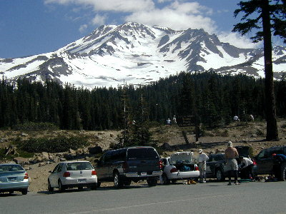


Quantum Computing
Lecture 5: Shor’s Algorithm, Grover’s Algorithm
Dave Bacon
Department of Computer Science & Engineering
University of Washington

Slide 3









Review
1992: Deutsch-Jozsa Algorithm
Exact classical q. complexity:
David
Deutsch
Richard
Jozsa
Bounded error classical q. complexity:
Exact quantum q. complexity:
1993: Bernstein-Vazirani Algorithm
(non-recursive)
Exact classical q. complexity:
Umesh
Vazirani
Ethan
Bernstein
Bounded error classical q. complexity:
Exact quantum q. complexity:

Slide 4
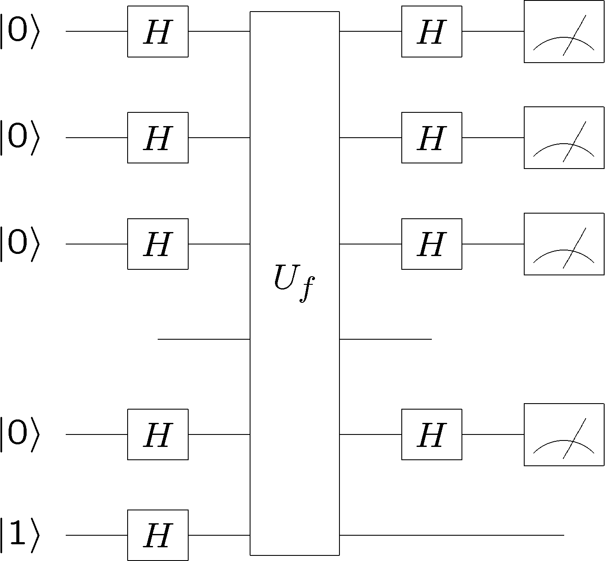

Review
n
qubits
Deutsch-Jozsa Algorithm
Bernsetein-Vazirani Algorithm

Slide 5

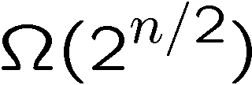


Review
1994: Simon’s Algorithm
Bounded error classical q. complexity:
Dan
Simon
Bounded error quantum q. complexity:
(first exponential separation)
Given: A function with n bit strings as input and one bit as
output
Promise: The function is guaranteed to satisfy
Problem: Find the n bit string

Slide 6
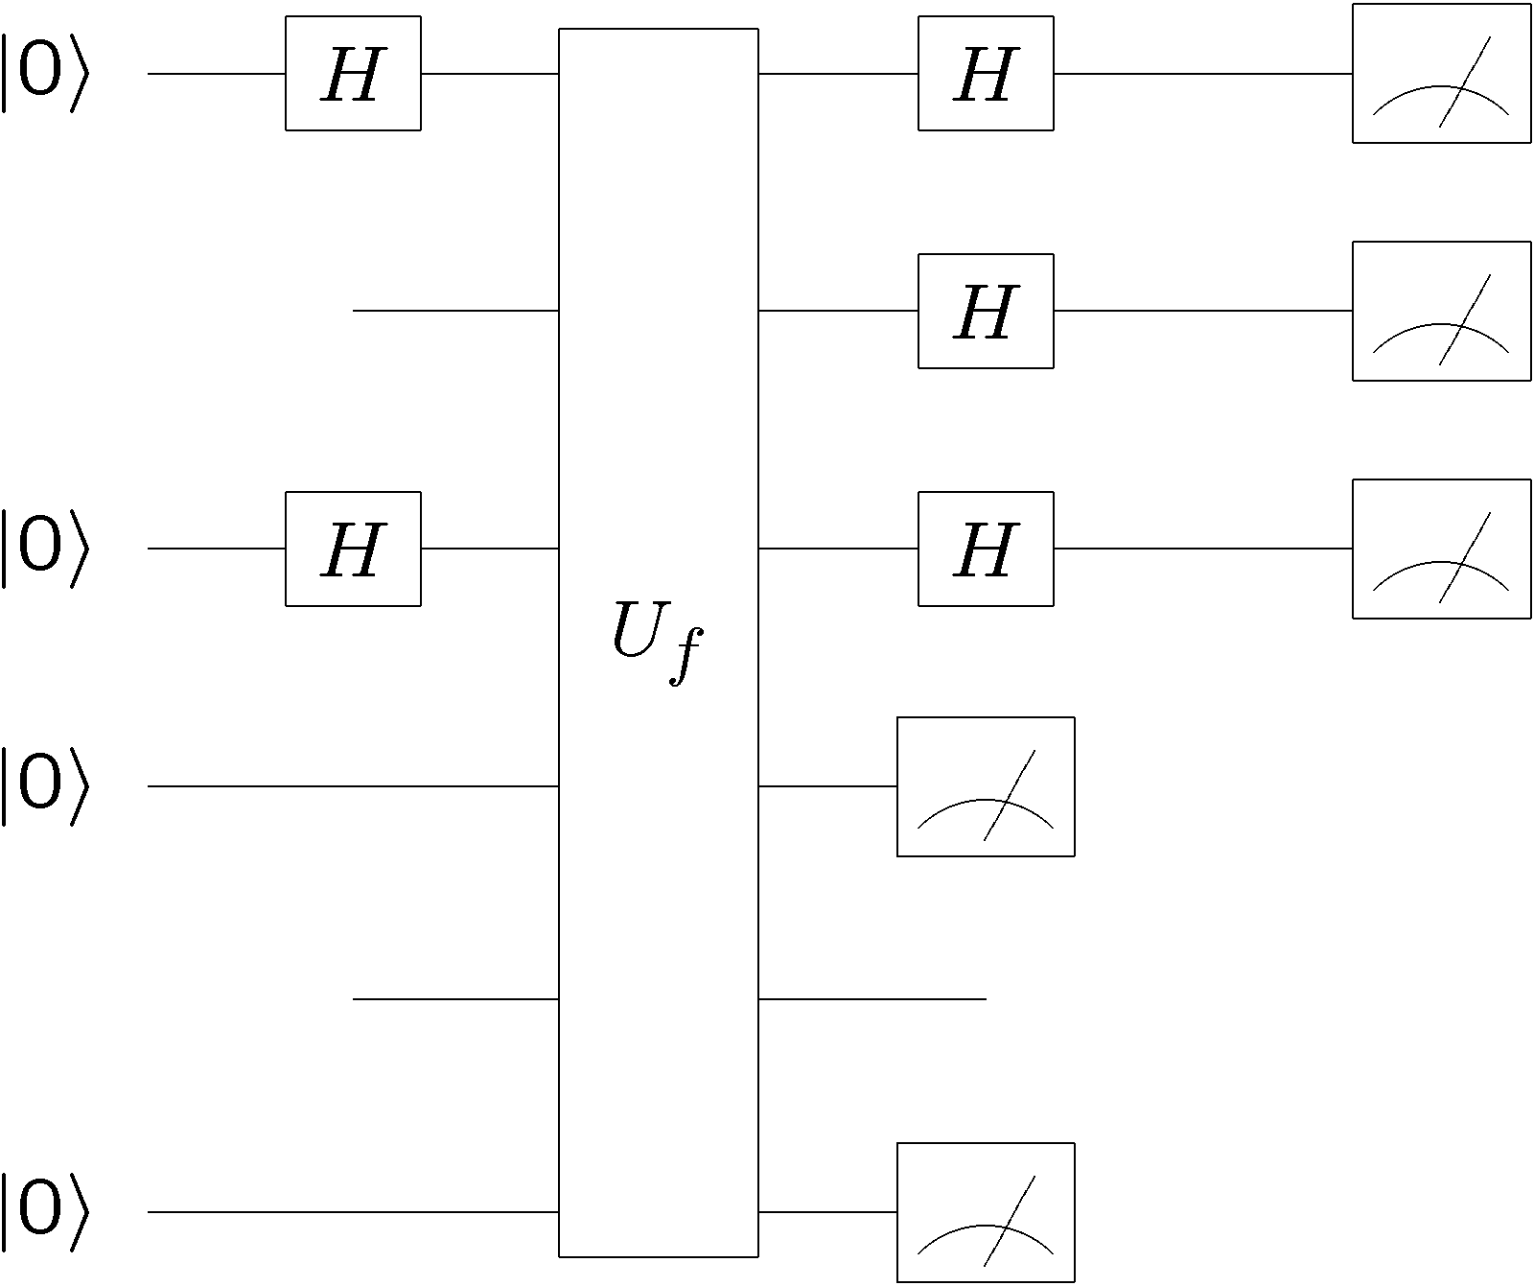

Review
n qubits
n qubits
Multiple runs to find s
Simon’s algorithm
Dan Simon - "You know, I really apologize: I was young, needed the money, I just had to do that..."

Slide 7
Today:
Factoring

Slide 8



One Time Pads
Random n bit string
0010101111010001
0010101111010001
Alice
Bob
Alice’s message
0110110011100101
secret
key
secret
key
0100011100110100
Eve
0110110011100101
cannot learn message

Slide 9
Public Key Cryptography
Interesting history:
1st schemes “known in public” where put forth by
Diffie and Hellman in 1976 (key exchange) and
Rivest, Shamir and Adleman in 1978 (encryption algorithm)
(based on work by Merkle in 1974, published 1978)
However, it now appears that the British researchers working for
British intelligence (GCHQ) were actually the first to discover
these protocols, but their work was classified at the time!
Clifford Cooks in 1973 (encryption algorithm)
Malcolm Williamson in ~1973 (key exchange)
(based on work by James Ellis in the late 1960s.)

Slide 10
Computational Complexity
P : decision problems which can be solved without error in
polynomial time on a deterministic classical Turing machine.
Decision problems: problem with a yes/no answer.
Polynomial time: worst case bounded by a polynomial in the
size of the problem.
Examples of problems in P:
Perfect matching: does a given graph have a perfect matching?
Primes: is a given number a prime number?
Linear Equalities: Given an integer n x d matrix A and an
integer n x 1 vector b, does there exists a rational d x 1
vector x>0 such that Ax=b?

Slide 11
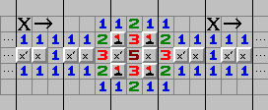
Computational Complexity
NP : decision problems which can be solved without error in
a polynomial time on a classical nondeterministic Turing machine. Shorthand, decision problems which, given a solution, and you can verify this solution in polynomial time on a deterministic classical Turing machine.
Examples of problems in NP:
Perfect matching: does a given graph have a perfect matching?
Satisfaction: does a given boolean function have a satisfying
assignment? Given f(x₁,x₂,…,x_{n}), does there exist
x={0,1}^{n} such that f(x)=1?
Minesweeper: Given a partially solved Minesweeper board, does
there exist an assignment of mines which can give rise
to this board?

Slide 12
One Million Dollars
P
NP
OR
NP=P
NP – Hard: Problems which have the property that for every
problem in NP there is a polynomial time reduction
to this problem.
NP – Complete (NPC): NP – Hard and in NP.
P
NPC
OR
NP=NPC=P
NP

Slide 13
Public Key Cryptography
1. There probably exist computational problems that are HARD.
2. Can we use these to perform secure cryptography by basing
the security of the problem on the difficulty of the hard problem?
If we make the hard problem big enough, baring a breakthrough
in the computational complexity of the problem, or in computer
hardware technology, the cryptography will be secure

Slide 14


Public Key Cryptography Roughly
Instructions for how
to make her lock.
Bob’s secret
documents
Alice
Bob
Assume: very hard to design key from instructions to make lock
This is (very roughly) what happens in public key cryptography

Slide 15








Public Key Encryption RSA
Alice
Bob
Alice generates two random large primes, and
2. Alice chooses a number which is coprime with .
3. Alice computes such that
Public Key:
Private Key:

Slide 16


Public Key Encryption: RSA
Public Key:
Alice
Bob
Public Key:
Bob’s message:
Private Key:
(FLT)
(CRT)

Slide 17
Public Key Encryption: RSA
Alice
Bob
Public Key:
Bob’s message:
Private Key:
Bob, using public key can encrypt
message.
Alice, using private key, can
decrypt the message
But decrypting without the private
key is (thought) to be
computationally hard

Slide 18



Public Key Encryption: RSA
Public Key:
Private Key:
Alice
Bob
Bob’s message:
Factoring can be used to break RSA
If we could factor, then we could compute
from which you could use to find
Then we just use the standard decryption:

Slide 19
Factoring
Difficulty?
Probably:
NP
P
NPC
Factoring: Is one of the factors less than k?
coNPC
coNP
NP
NPC
P
coNP: efficiently verifiable that NO solution to problem exists.

Slide 20
Mysterious
Extra
Slide

Slide 21
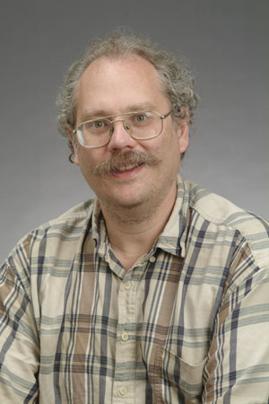


Shor’s Algorithm
18819881292060796383869723946165043
98071635633794173827007633564229888
59715234665485319060606504743045317
38801130339671619969232120573403187
9550656996221305168759307650257059
Peter
Shor
1994
3980750864240649373971
2550055038649119906436
2342526708406385189575
946388957261768583317
4727721461074353025362
2307197304822463291469
5302097116459852171130
520711256363590397527
Best classical algorithm
takes time
Shor’s quantum algorithm
takes time

Slide 22

Shor’s Algorithm
What were the key insights which Shor used?
Simon’s problem work’s because the function has a symmetry:
In this case the symmetry is a symmetry
Shor became interested in different symmetries and in
particular symmetries of
“the place where we do addition modulo N”

Slide 23


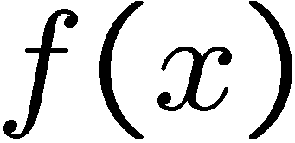

Period Finding
Given: A function from 0,1,…,N-1 to some n bit numbers
Promise: The function is guaranteed to satisfy
Problem: Find the hidden period
period

Slide 24
Shor’s Algorithm
What were the key insights which Shor used?
1. Period finding
2. Period finding can be perform efficiently on a quantum
computer.
3. Period finding can be used to factor integers

Slide 25




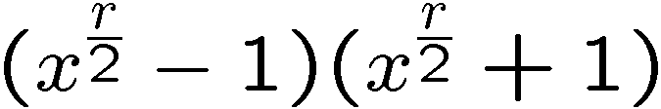
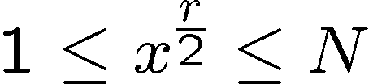


Order-Finding and Factoring
Factor N
choose x coprime to N (Euclid’s algorithm for gcd)
Order finding: find smallest r such that
Use order finding to factor: suppose is even,
divides
divides
But
must share a common factor
not equal to with
If r is even then compute as factor!
More tricky: is even happens with high probability

Slide 26

Order-Finding and Period-Finding
Order finding: find r such that
Find the period of
What were the key insights which Shor used?
1. Period finding
2. Period finding can be perform efficiently on a quantum
computer.
3. Period finding can be used to factor integers
To understand period finding, we need to understand
Fourier transforms

Slide 27



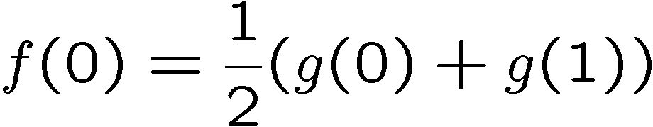
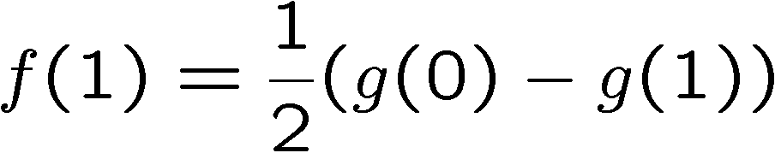
Fourier Transforms
Function of a single bit:
We could equally well deal with
Because we can “invert”:
“Look” familiar?

Slide 28
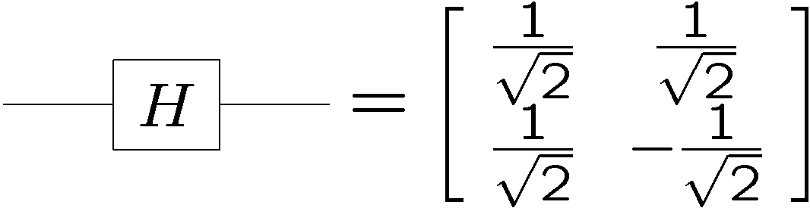

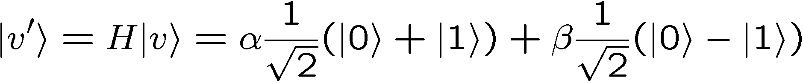
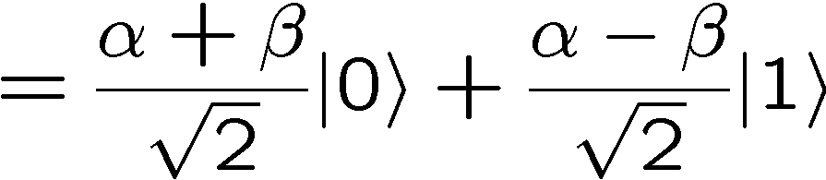
Fourier Transforms
Output:
The Hadmard is performing this transform (up to a constant)
on the AMPLITUDES of our wave function!

Slide 29
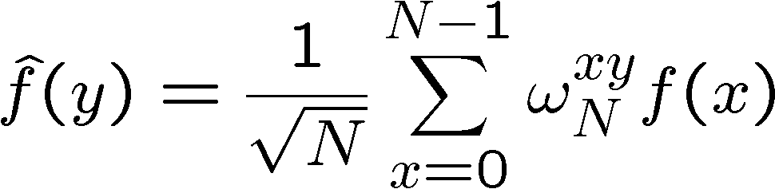
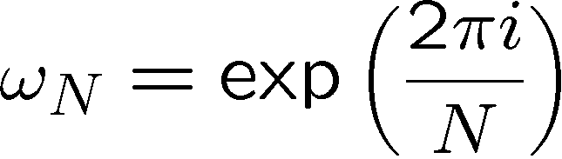
Fourier Transforms
Function on N different inputs:
We can the define the following N new numbers to represent
the function:
Slow down there egghead….
Nth root of unity:

Slide 30
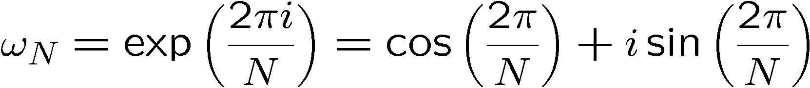

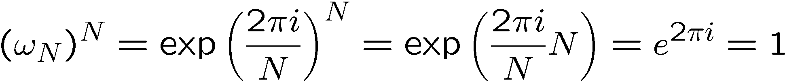
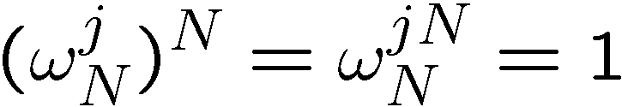
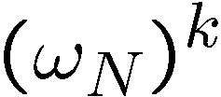
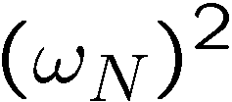

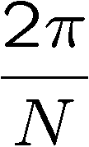
Nth Root Of Unity
Unit modulus:
Nth root of unity:
Im
Re

Slide 31
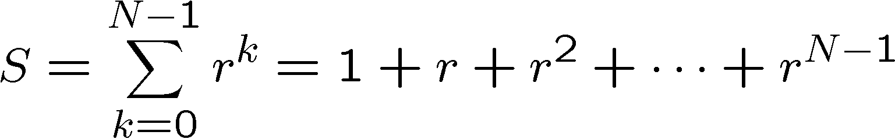

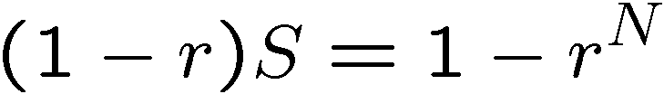
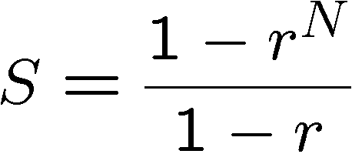



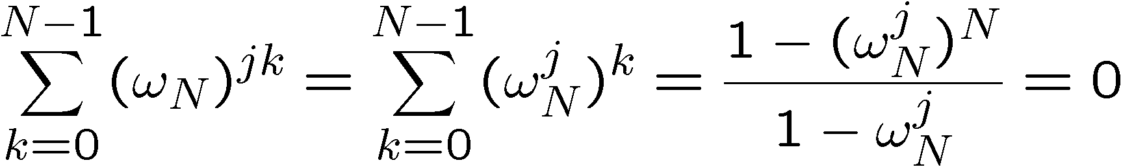
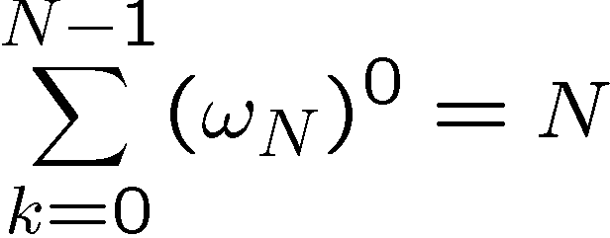

Nth Root Of Unity
The big sum:
for
for
Unless and then

Slide 32
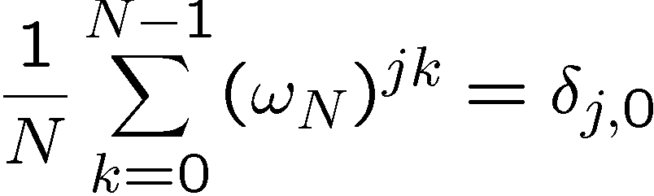
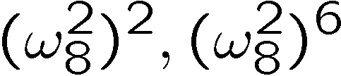
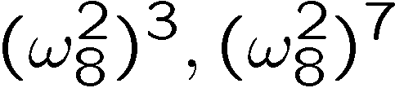
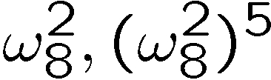
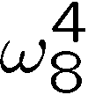


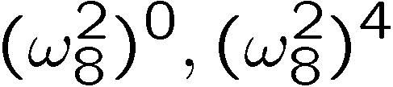


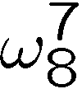


Nth Root Of Unity
The sum of all sums:
Im
Re

Slide 33
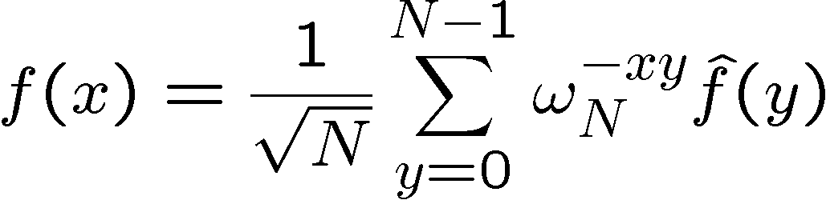
Fourier Transforms
Function on N different inputs:
We can the define the following N new numbers to represent
the function:
Now we can see how to go from the hats back to the non hats!

Slide 34
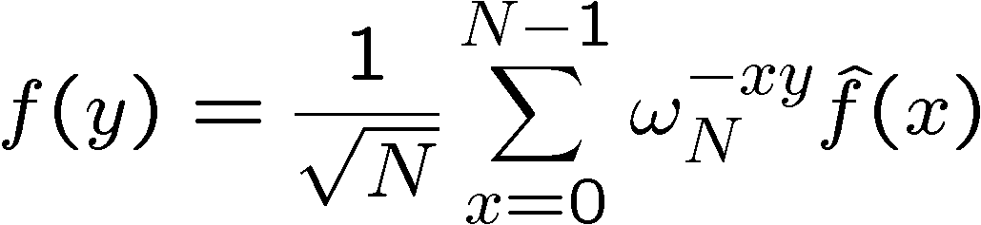
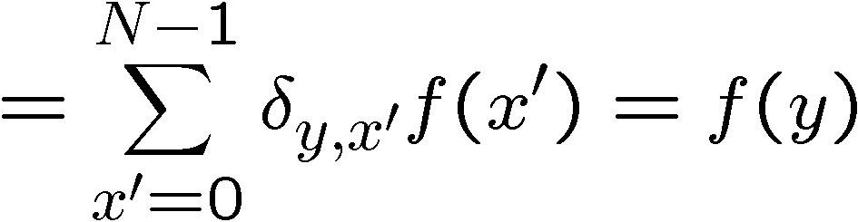
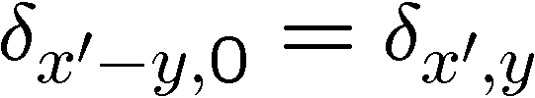
Fourier Transforms
It works!....

Slide 35

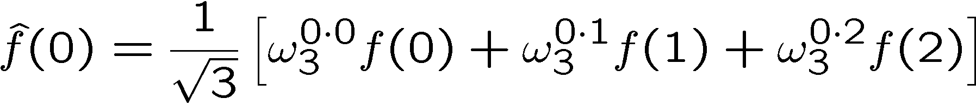
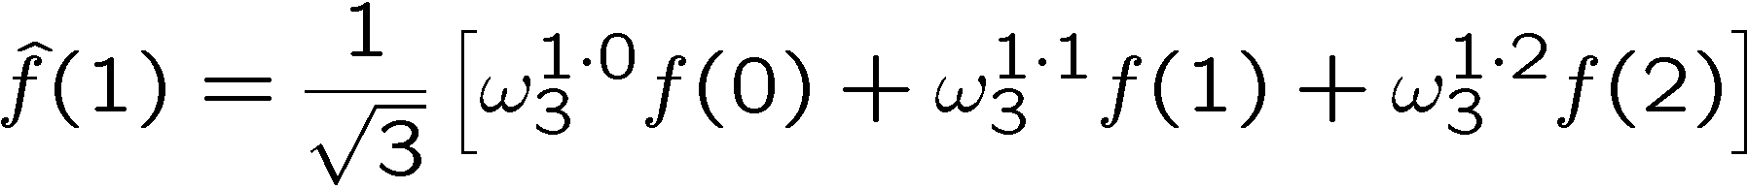

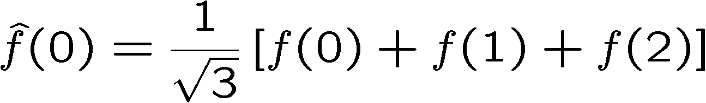
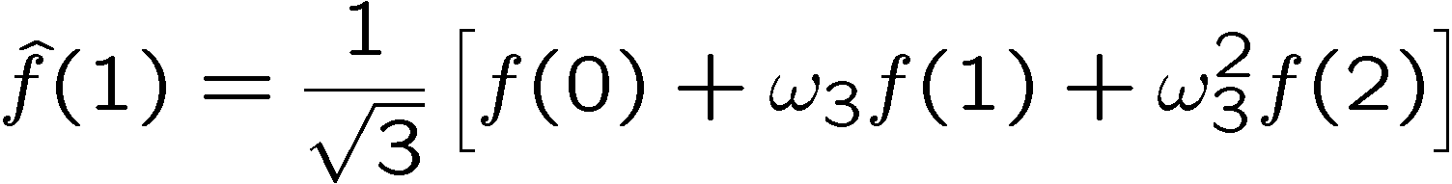
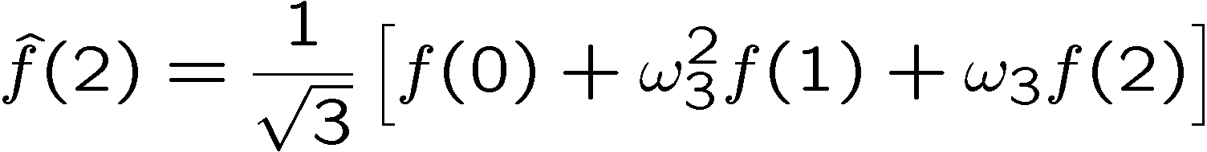
Fourier Transforms
Example:

Slide 36
Fourier Transforms
Example:
Fourier transformed coefficients:

Slide 37
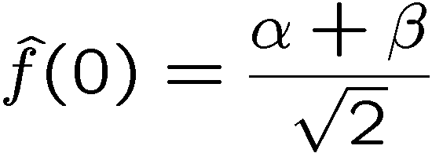


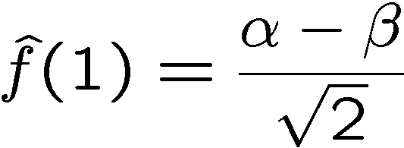


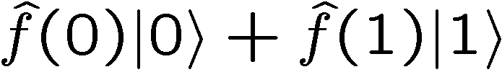
Unitarity & Fourier Transforms
Output:
New amplitudes are Fourier transform of old amplitudes!

Slide 38
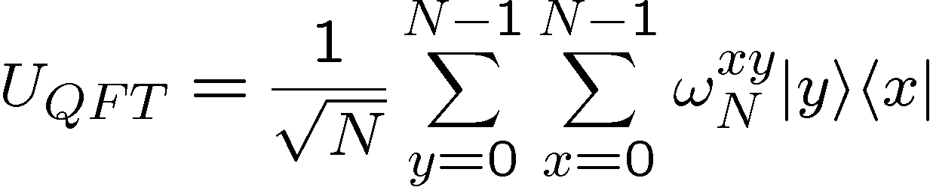
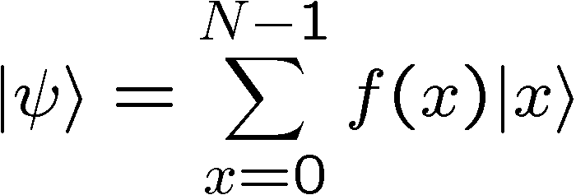

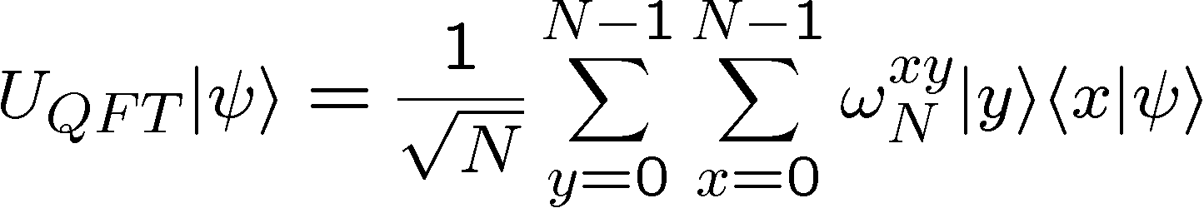
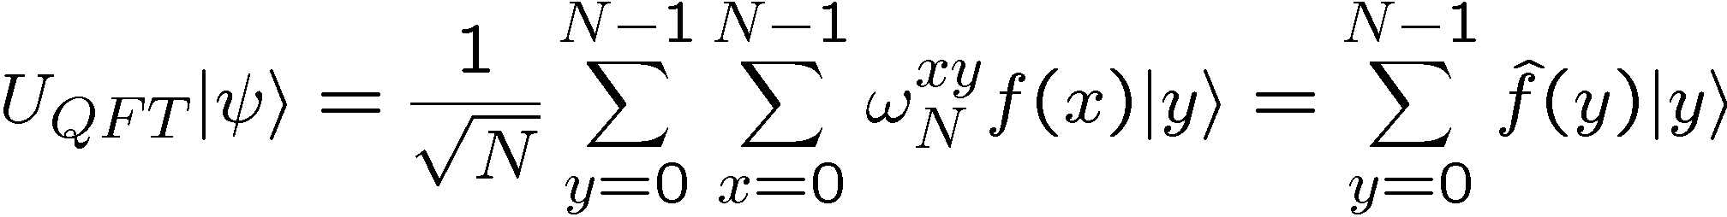
Quantum Fourier Transform
The quantum Fourier transform:
See it in action:

Slide 39







Quantum Fourier Transform
The quantum Fourier transform:
But is it unitary?

Slide 40



Quantum Fourier Transform
And about that inverse QFT:
It performs the inverse Fourier transform on the amplitudes!

Slide 41









Period Finding
quantum
oracle
Problem: find in as few
queries as possible
….in as few uses of the
quantum oracle as possible
Period Finding Problem
a symmetric problem!

Slide 42

















Fourier
to the Rescue
probability

Slide 43
Shor’s Algorithm
To Factor N on a quantum computer:
Select x coprime to N
Use the quantum computer to find the period of
Use order of x to compute possible factors of N.
Check if they work. If not rerun.
Running time? How many quantum gates?

Slide 44


QFT over 2^{n}
This circuit requires O(n²) “elementary” gates
QFTs for all other Ns can similarly be implemented.

Slide 45
Fourier
to the Rescue
O(n³) “elementary” gates
modular exponentiation

Slide 46
Shor’s Algorithm
To Factor N on a quantum computer:
Select x coprime to N
Use the quantum computer to find the period of
Use order of x to compute possible factors of N.
Check if they work. If not rerun.
Running time: O(n³)

Slide 47
Shor’s Algorithm
18819881292060796383869723946165043
98071635633794173827007633564229888
59715234665485319060606504743045317
38801130339671619969232120573403187
9550656996221305168759307650257059
Peter
Shor
1994
3980750864240649373971
2550055038649119906436
2342526708406385189575
946388957261768583317
4727721461074353025362
2307197304822463291469
5302097116459852171130
520711256363590397527
Best classical algorithm
takes time
Shor’s quantum algorithm
takes time

Slide 48
Shor’s Algorithm
In 2001, researchers at IBM constructed a quantum computer
which could factor the number 15.
Answer: 15 = 5 × 3
To break RSA we will need somewhere around 1000 qubits.

Slide 49







Grover’s Problem
Suppose we have a black box
n qubit
1qubit
with the property
Problem: find with as few queries as possible.

Slide 50



Grover’s Algorithm
Use the black box in a particular way
n qubit
Grover oracle:
How to use Grover oracle to find ?

Slide 51


The Grover Iterate
n qubits

Slide 52



The Grover Iterate
n qubits
Grover’s iterate

Slide 53







The Grover Iterate in 2D
Two orthonormal vectors:
Express the equal superposition in terms of these:
The Grover iterate will preserve this two dimensional subspace

Slide 54




The Grover Iterate in 2D
Expressed over the two dimensional subspace:
Grover’s iterate is just a rotation in this 2D space

Slide 55


Repeatedly Bang Your Head
Repeated application of the Grover iterate
Grover’s algorithm:
1. start with
2. repeatedly apply Grover’s iterate to rotate to near

Slide 56




Repeatedly Bang Your Head
Large amplitude in “bad” part of Hilbert space
physicist:
implies
Application of the repeated iterate to initial state rotates it to
nearly all amplitude in

Slide 57



Grover’s Algorithm
We have identified marked item using only queries!

Slide 58
Quantum Complexity Theory
BPP (Bounded-error Probabilistic Polynomial time):
Error probability less than some fixed constant < ½
BQP (Bounded-error Quantum Polynomial time):
Error probability less than some fixed constant < ½
NP
P
PSPACE
BPP
BQP

Slide 59

Quantum Algorithms
What else can quantum computers do?
Factoring, discrete log [Shor 94]
Unstructured search [Grover 96]
Various hidden subgroup problems [Long List]
Pell’s equation [Hallgren 02]
Hidden shift problems [van Dam, Hallgren, Ip 03]
Graph traversal [CCDFGS 03]
Spatial search [AA 03, CG 03/04, AKR 04]
Element distinctness [Ambainis 03]
Various graph problems [DHHM 04, MSS 03,…]
Testing matrix multiplication [Buhrman,Špalek 04]
hidden subgroup problem [Bacon, Childs, van Dam 05]
Certain hidden shift problems [Childs, van Dam 05]

Slide 60
Quantum Algorithms
What else might quantum computer be able to do?
Not likely:
BQP
P
NPC
NP
Interesting problems not NPC but possibly in BQP?
Graph isomorphism
Restricted shortest vector in a lattice problems
Finding Nash equilibrium
…

Slide 61
Quantum Simulation
Perhaps the least well studied and understood.
Simulating quantum many body systems is
often computationally very difficult
Quantum computers allow one to perform these simulation without having to engineer entirely new physical systems.
Quantum materials? Understanding High-T Superconductors?

Slide 62
Talk To Me
1 if a=b
0 if a≠b
F_{eq}(a,b)=
ALICE
BOB
a
b
0
1
0
1
0
0
1
1
1
0
n bits
n bits
How much (many bits) do Alice and Bob need
to exchange to compute F(a,b)?
With no error: n bits
With one-sided error ε: O(log(n/ε)) bits

Slide 63
Talk To Me
Some More
ALICE
BOB
a
b
0
1
0
1
0
0
1
1
1
0
n bits
n bits
F_{xor}(a,b)=a₁⊕a₂ ⊕ …⊕a_{n}⊕b₁⊕b₂ ⊕ …⊕b_{n}
How much (many bits) do Alice and Bob need
to exchange to compute F(a,b)?
With no error: 1 bit

Slide 64



Communication Complexity
Classical communication
costs of distributed
classical computations
[Yao, STOC 79]
[Kushilevitz and Nisan 96]
Quantum communication
costs of distributed
classical computations
[Yao, FOCS 93]
exchange qubits

Slide 65


Make It Quantum
ALICE
communicate qubits
BOB
a
b
How does classical communication complexity (bits)
compare to quantum communication complexity (qubits)?
Holevo’s Theoerem: sending n classical bits
requires n quantum bits.

Slide 66
Holevo’s Theorem
ALICE
communicate qubits
BOB
a
b
Holevo’s Theoerem: sending n classical bits
requires n quantum bits.
One is often tempted to think about a qubit as storing
an analog number, the amplitudes. But this is totally
wrong. This would be like saying that you are storing a
an infinite amount of information in a classical bit to
which you have probabilities for the state of the bit

Slide 67


Not So Fast
There exists functions F(a,b) which require
Ω(m^{1/4}/log(m)) bits of communication to solve
but can be solved using only O(log(m)) qubits.
[m is the length of a and b]
Ran Raz
(1999)
Exponential benefit in
quantum over classical.
Exact model 0-error:
Buhrman, Cleve, Wigderson (1998)
1-way communication exponential separation:
Bar-Yossef, Jayram, Kerenidis (2004)

Slide 68


Quantum Teleportation
1 qubits
ALICE
BOB
a
b
2 bits
+
entangled
quantum
state
ALICE
BOB
b
a
Quantum Teleportation Protocol

Slide 69

Quantum Communication
Complexity
Holevo’s Theoerem: sending n classical bits
over a quantum channel requires n qubits
There exist functions F(a,b) which require
Ω(m^{1/4}/log(m)) bits of communication to solve
(with error) but can be solved using only
O(log(m)) qubits of communication.
(m is the length of a and b)
[Raz, STOC 99]
Exponential benefit of
quantum over classical.

Slide 70

Rehash
There exist functions F(a,b) which require
Ω(m^{1/4}/log(m)) bits of communication to solve
(with error) but can be solved using only
O(log(m)) bits and O(log(m)) ebits of
communication. (m is the length of a and b)
[Raz, STOC 99]
1 ebit :=
Entanglement can be used to gain exponential reduction in
  communication resources
2. Entanglement is “like” classically correlated bits…but it’s
  different…
Preliminary thesis: entanglement is involved in quantum benefits

Slide 71


Entanglement and Quantum Computation
We remarked before, that a general quantum state on n qubits
Required complex numbers to specify. Exponential in n!
But, suppose that this n qubit state is separable across all
n qubits:
Each single qubit wave function requires us to specify only two
complex numbers, so we only need 2n complex numbers to
specify this separable state!

Slide 72
Entanglement and Quantum Computation
Suppose during an algorithm, the state always remains separable
We can efficiently simulate this quantum computation on a
classical computer:
One and two qubit gates are just 2x2 and 4x4 matrix
multiplications.
So, we need some entanglement in a quantum algorithm in order to have a speedup of quantum over classical.

Slide 73
Entanglement and Quantum Computation
A little more sophisticated [Jozsa and Linden]
p-blocked: If no p+1 subset of n qubits is entangled.
Such circuits can be efficiently simulated if p is poly(log n)
Basic idea: Entangled blocks of size p can be expressed
as 2^{p} complex numbers.
This is polynomial in n if p is poly(log n)
A “large amount” of entanglement is necessary for a quantum
speedup. Interestingly it is not sufficient.

Slide 74
Entanglement and Quantum Computation
A side benefit: physicists spend a lot of time trying to simulate
quantum systems. This is often computationally hard.
Because we know that entanglement is important for this to be
difficult, we can design our algorithms to keep track of as much
entanglement as possible.
This has lead to nice deep insights into some algorithms
physicists had previously invented, and is currently being
exploited to design new faster algorithms!
Understanding entanglement is essential to understand the
limits of computational quantum physics!

