Slide 1

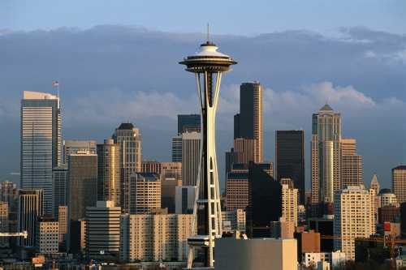

Quantum Computing
Lecture 6: Quantum Error Correction,
Quantum Cryptography, and Entanglement
Dave Bacon
Department of Computer Science & Engineering
University of Washington

Slide 2
Final Exam Plan
After this lecture.
2. If you wrote up a solution and it is right: great!
If you are still struggling, we will talk about the problem,
together as a group.
3. These problems were designed to be HARD, (not just the
last one!), so if you did make progress on trying to tackle
them, then great, and if not, all I’m looking for is that you
tried to conquer some of this quantum stuff (which is
very different from probably everything else you’ve seen.)

Slide 3
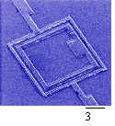
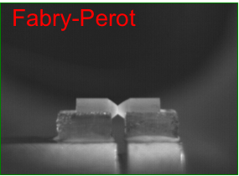
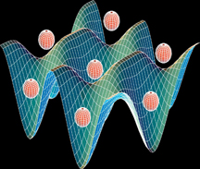
But What Will It Look Like?
Atomic
cavity QED
neutral atoms in optical lattices
ion traps
Solid State
superconducting circuits
electron spin in Phosphorus doped Silicon
quantum dots
defects in diamonds
Molecular
Photon Based
Liquid NMR (no longer?)
linear optics plus single photon devices
Pics: Mabuchi (Caltech), Orlando (MIT)

Slide 4

DiVincenzo’s Criteria
1. Well defined qubits in a scalable architecture
David
DiVincenzo
2. The ability to initialize the system to a fixed wave function.
3. Have faster control over the system than error processes in the system.
4. Have the ability to perform a universal set of quantum gates.
5. Have the ability to perform high quality measurements

Slide 5
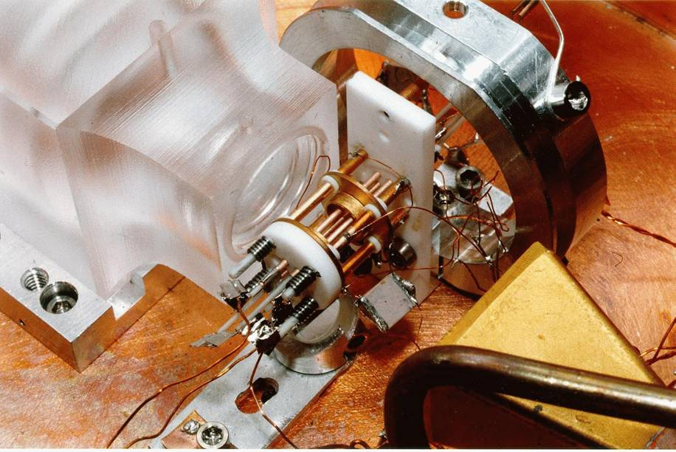
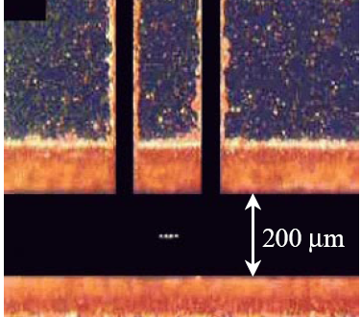
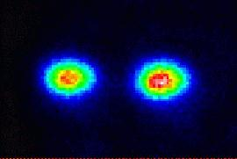
Ion Trap
Oscillating electric
fields trap ions
like charges repel
2 ⁹Be⁺ Ions in an Ion Trap

Slide 6
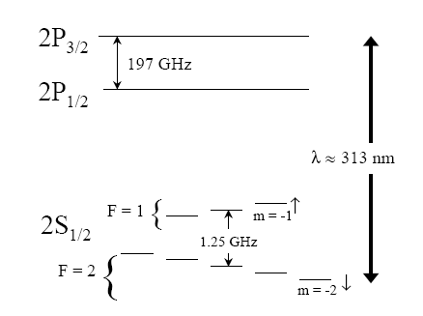
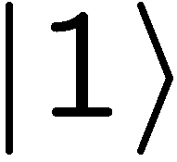

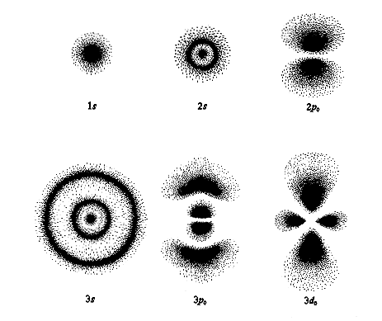
Where’s the Qubit?
Energy
Each ion = 1 qubit
1. Well defined qubits 
orbitals

Slide 7
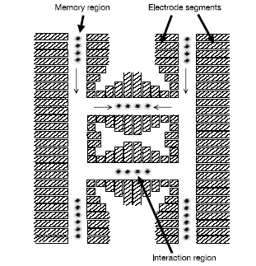
Scalable?
. Well defined qubits in a scalable architecture
Solid state qubits seem to have a huge advantage for scalability.

Slide 8

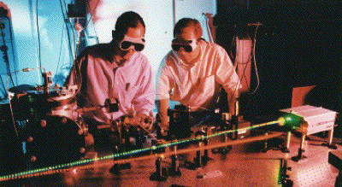
Measurement
Energy
laser
decay
Detecting florescence implies
in state 0
99.99% efficiency
5. Have the ability to perform high quality measurements 

Slide 9
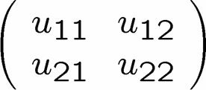
Single Qubit Operations
Laser 1
Energy
Laser 2
Allows any one qubit unitary operations

Slide 10
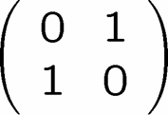
Initialization
Laser 1
laser
Laser 2
decay
If not in zero state, flip
measure
2. The ability to initial the system to a deterministic state. 

Slide 11
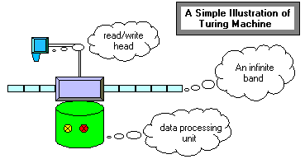
Universal Computers
Turing machine reads state of tape at current position.
Based on this reading and state of machine, Turing machine writes new symbol at current position and possibly moves left or right.
Certain Turing machines can perform certain tasks.
A Universal Turing Machine can act like any other possible
Turing machine (i.e. it is programmable)

Slide 12

Universal Quantum Computer
Universal Quantum Computer
a quantum computer which can be programmed to perform any algorithmic manipulation on quantum information.
U(2)
Set of Universal Quantum Gates
a set of operations/gates which, acting on the quantum information, can be used to implement (to any desired accuracy) any unitary evolution of the quantum info.
The Royal King and Queen of Universal Quantum Gates
CNOT and 1-qubit rotations

Slide 13
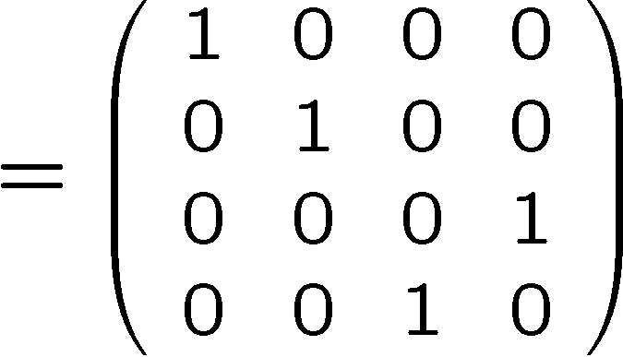
Coupling Two Qubits
stationary
sloshing mode
These modes can be used as a bus between the qubits.
4. Have the ability to perform a universal set of quantum gates 

Slide 14



What is the Problem?
3. Have faster control over the system than error processes in the system.
Real quantum systems are open quantum systems!
system
environment
Quantum systems readily couple to an environment…
qubits
0
System decoheres:
bits
1
50% 0 50% 1
Quantum
Classical
The Decoherence Problem (1996)
Notes:
Quantum systems readily couple to an environment.

Slide 15
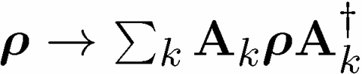
Quantum Computing is Bunk
Ways Quantum Computers Fail to Quantum Compute
Decoherence
Lack of Unitary Control
attempting to apply unitary evolution U instead results in V
or (worse) results in non-unitary evolution
Measurements are faulty
measurement result is noisy, incorrect result obtained
preparation is faulty

Slide 16
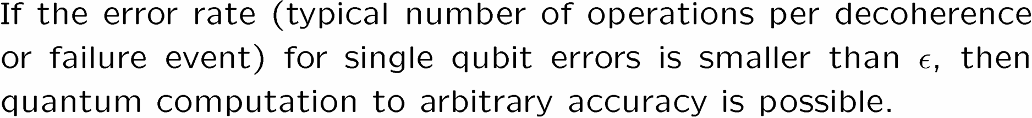
The Quantum Solution (1995-96)
Threshold Theorem:
QC
Error Rate

Slide 17
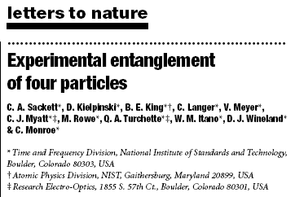
Ion Trap Parameters
Decoherence rate for qubits: 1 minutes
Gate speed: 10 microseconds
Decoherence rate for bus: 100 microseconds to 100 milliseconds
Measurement errors: 0.01%
3. Have faster control over the system than error processes in the system. 
State of the Art
NIST Boulder

Slide 18
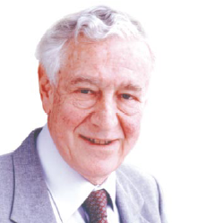
A Critical Ghost
All papers on quantum computing should carry a footnote: “This proposal, like all proposals for quantum computation, relies on speculative technology, does not in its current form take into account all possible sources of noise, unreliability and manufacturing error, and probably will not work.”
Rolf Landauer
IBM

Slide 19
Analog Computers
Compute by adding, multiplying real infinite precision numbers.
0.0211414511244121222311122222118656…..
This can be used to solve NP complete problems in polynomial
time!
This, however is NOT a realistic model of computation.
Why? Infinite precision is requires, as far as we know, infinite
resources! Noise destroys the speedup.
Is quantum computing an analog computer?
The resolution of this is the subject of quantum error correction.

Slide 20



Don’t Eat That Apple
plus: simple
minus: unrealistic
plus: essential ideas
Lucifer’s channel:

Slide 21
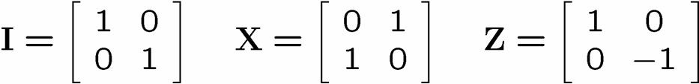





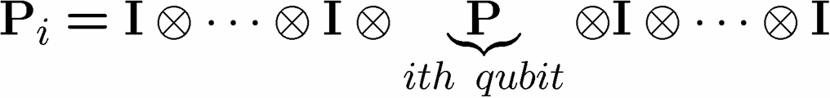
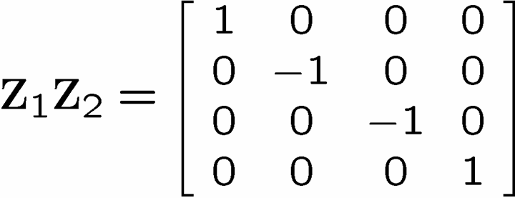
Identity

Slide 22
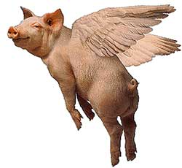
The Story of the Ghost
You are protecting your quantum information against a crazy noise model! Z₁Z₂? If this is all nature can throw at you, then pigs can fly.
Rolf Landauer
IBM

Slide 23
Noisy Cell Phone
Hello? Hello? Hello? Hello?
I have a flat tire. I said, I have a flat tire! A flat tire.
No, I’m not trying to flatter you..No, you’re not getting fatter. I have a flat tire!
Communication over a noisy CHANNEL can be overcome via
ENCODING
“Hello?” = “Hello? Hello? Hello? Hello?” [using redundancy to encode “Hello”]

Slide 24
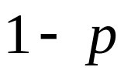
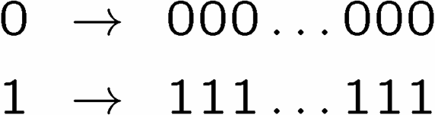

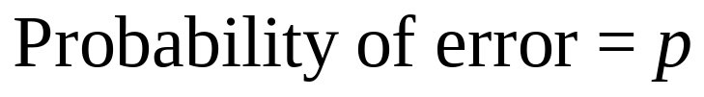
Simple Repetition Code
Encode:
0
0
n copies
1
1
No encoding:
Binary Symmetric Channel
b
measure
Encoding (n=3):
b
encode
b
b
b
decode
and correct
measure
Probability of error

Slide 25
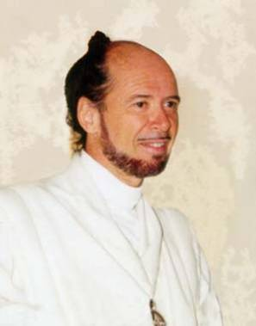





1994 Reasons to be a Pessimist
No cloning:
Quantum Cloning Machine
“A single quantum cannot be cloned,” Wootters and Zurek, Nature, 1982
No quantum repetition code:
Measurement destroys coherence:
How can one decode without destroying the information?

Slide 26

Unrealistic Realistic Channel

Slide 27

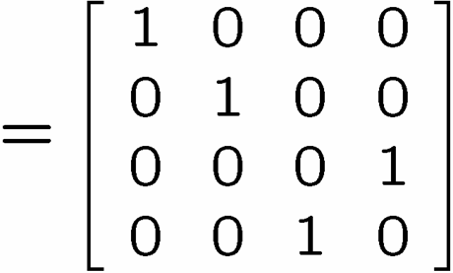
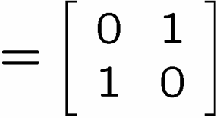
Baby Steps
WWCCD? (What Would Classical Coders Do?)
measure
b
b
0 →000, 1 → 111
0
b
0
b
encode
error
decode
fix
100 → 111→101 → 110 → 110
identities
b
b
=
b
1
0
1
1
1
=
0
error #@%

Slide 28



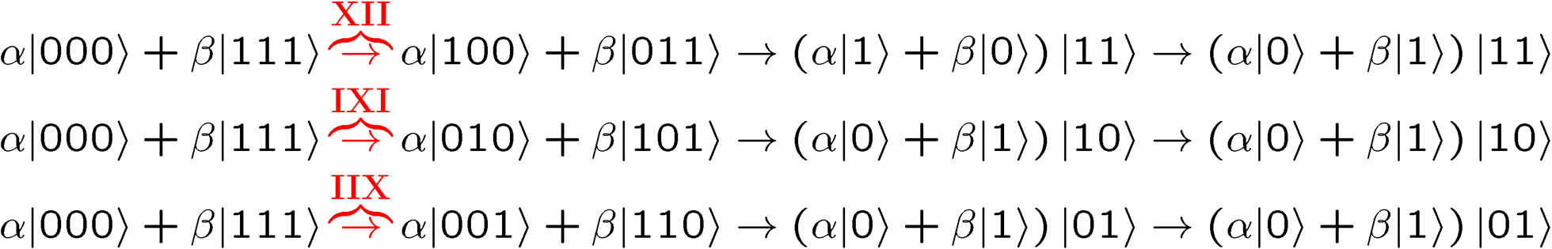
Naïve
4. operator identities still hold
Lets be naïve, take classical and move over to quantum
encode
error
decode fix
?
error
decode
fix
encoded into subspace:
2. errors take to orthogonal
subspaces + maintain orthogonality
3. syndrome
(no-cloning evaded!)

Slide 29






Identity
encode
error
decode fix

Slide 30

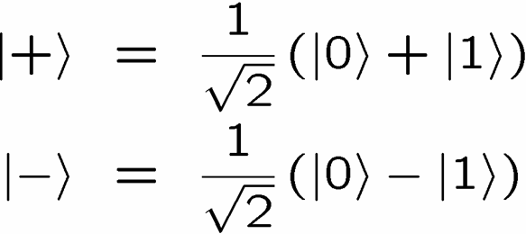
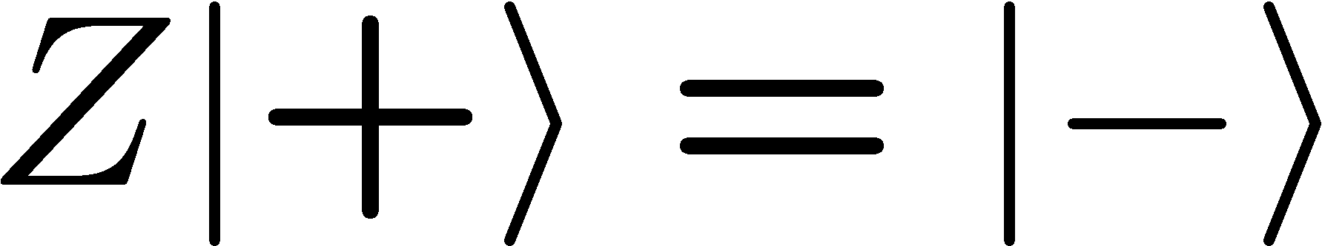




OK Wise Guy
What about “phase” errors?
…sort of not classical error
phase error:
Wise guy says “basis change please”:
looks like bit flip error in this new basis!
H
H
H
H
H
H
phase errors
bit flip errors

Slide 31
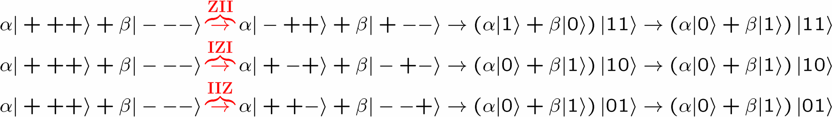
Molly: “I love you, I really love you”
Sam: “Ditto.”
encode
error
decode
fix
H
H
?
H
H
H
H
error
decode
fix
encoded into subspace:
2. errors take to orthogonal
subspaces + maintain orthogonality
3. syndrome
(no-cloning evaded!)

Slide 32
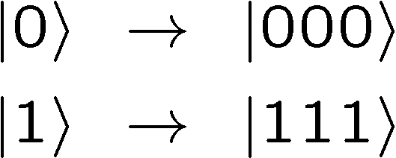
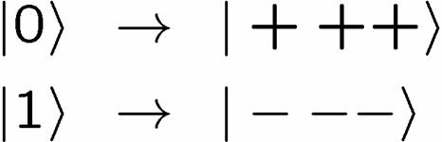


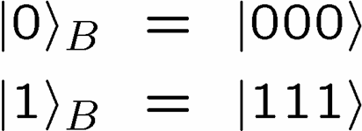
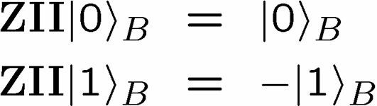
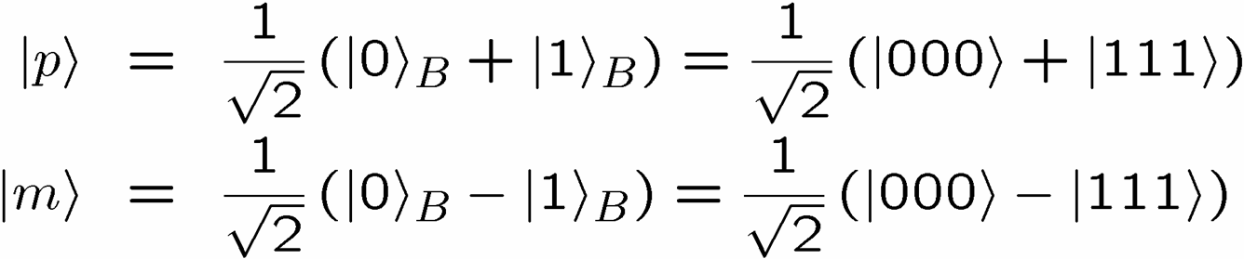
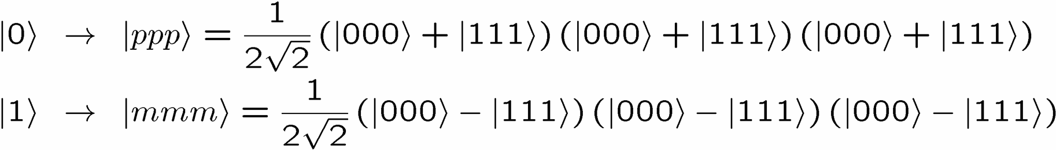
Encoding Away Your Ills
3 qubit bit flip code
3 qubit phase flip code
phase errors act as on bit flip code qubits:
define:
Shor Code: (Peter Shor, 1995)

Slide 33
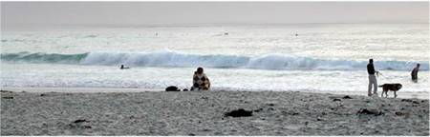


Inside Shor
H
H
H
H
H
H
bit flip code
phase flip code

Slide 34

Linearity of Errors
We have only discussed two types of errors, bit flips and phase flips. What about “general” errors?
Theorem of digitizing quantum errors:
If we can correct errors in some set, then we can correct
any linear complex combination of such errors.
While errors may form a continuous set, we only need to correct
a discrete set of these errors

Slide 35


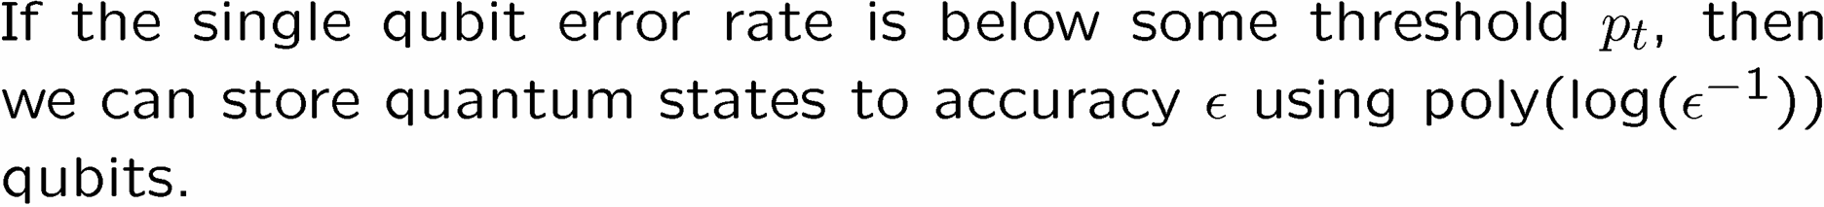
Perfection Through Concatenation
U
V
U
Threshold Theorem for Quantum Memory

Slide 36
Quantum Error Correction
The insight that quantum computers could be defined in the
presence of noise (the full theory is called fault-tolerant
quantum computation) is why we have been justified in using
the quantum circuit model.
Quantum error correction justifies calling a quantum computer
a digital computer.

Slide 37
The Quantum Solution (1995-96)
Threshold Theorem:
QC
Error Rate

Slide 38
Quantum Cryptography
We saw that quantum computers defeat many public key
cryptosystems. Luckily quantum theory also provides an
alternative, known as quantum cryptography.
Goal: a manner in which Alice and Bob can share secret key
such that they can detect if an eavesdropper can
be detected.

Slide 39
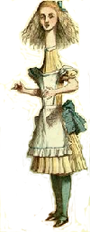







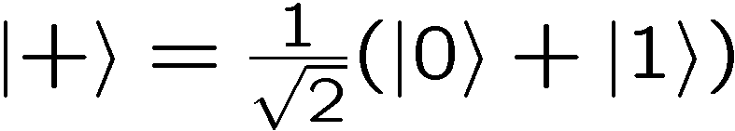
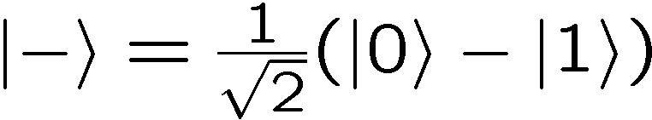
Quantum Cryptography
Alice generates 2n bits with equal probability
The first of these bits labels a basis choice and the second
labels a wave function choice. Alice prepares n qubits:
Alice’s qubit
0 0
0 1
1 0
1 1

Slide 40
Quantum Cryptography
Alice sends her n qubits to Bob.
Alice then announces via a public channel what basis she
measured in: the b bitstring.
If Bob measures his qubits in the same basis, he will
end up with results which exactly match Alice’s bit string
They can then reveal a few of their bits at random to
check whether someone has been eavesdropping.
If not eavesdropping, the rest of their bits are a shared
key string

Slide 41
Quantum Cryptography
Eve sees a procession of qubits in the computational
or plus/minus basis. Eve does not know the basis.
Intuition: If Eve tries to measure this qubit, since she doesn’t
know what basis to measure in, sometimes she will
make measurement in the wrong basis and this
can be detected by Alice and Bob.

Slide 42





Quantum Cryptography
0 | 1 | 1 | 0 | 0
1 | 0 | 0 | 0 | 1
Alice’s qubit
0 0
0 1
1 0
1 1
0 | 0 | 1 | 1 | 1
Eve’s basis
50%
50%
50%
State after Eve’s measurement
50%
50%
50%

Slide 43
Quantum Cryptography
Eve sees a procession of qubits in the computational
or plus/minus basis. Eve does not know the basis.
Proof of security, with certain key generation rate, against
all types of Eve’s attacks.

Slide 44
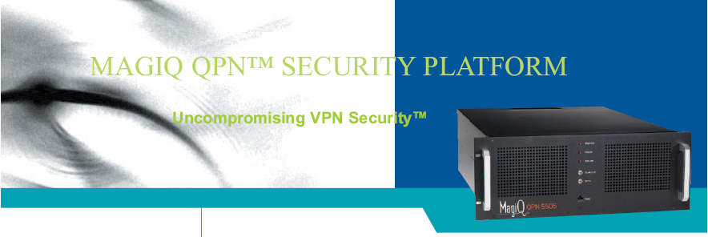
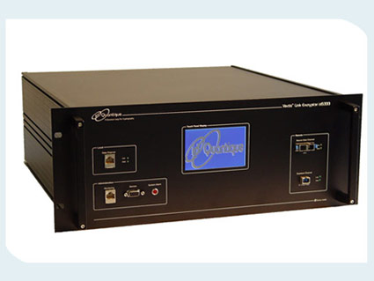
Quantum Cryptography
MagiQ (New York)
id Quantique (Geneva)

Slide 45
Big Picture
Entanglement has long been known to be one of the
fundamentally strange things about quantum theory.
For years, people worried about entanglement.
(Einstein, Schrodinger, Bell,….)
What happening in quantum computing is that people
stopped learning to worry about entanglement, and began
to realize that if they just accepted it, it was a very valuable
resource!
Accept Entanglement!
But what is entanglement? Why is it “mysterious”?
Why is it important for quantum computation?

Slide 46




Bipartite Entanglement
Alice’s qubit
Bob’s qubit
Two qubits have a wave function which is either
Separable: we can express it as
valid wave functions
Entangled: we cannot express it as

Slide 47
Special Relativity
To understand what makes entanglement so interesting in
physics we need to know a little special relativity.
We don’t need to know how to calculate in special relativity,
but we do need to understand the concept of “locality” which
arises in special relativity.

Slide 48
Spacetime
time
“event”:
(time,position)
position
“spacetime path”:
curve in spacetime
“inertial frame”:
constant velocity

Slide 49
Special Relativity
Special relativity:
(1) physics is the same in all inertial reference frames
(2) speed of light is same in all reference frames.
time
time
“light”
position
position
“spacetime paths”
Reference frame 1
Reference frame 2

Slide 50
Simultaneity
In special relativity, the idea of simultaneity is relative:
time
time
time
event B
event A
event B
position
position
event A
position
event A
event B
Reference frame 1
Reference frame 2
Reference frame 3
Different events are seen as occurring in a different order,
depending on the reference frame.

Slide 51
Special Relativity
Signal: I do something at my location and time such that you can,
conditional on what I do, act conditionally at your location
and time.
time
time
time
event B
event A
event B
position
position
event A
position
event A
event B
Reference frame 1
Reference frame 2
Reference frame 3
If I try to send a signal from A to B, then in some reference frame,
B acts before A sends the signal. Better not allow this!

Slide 52
Special Relativity
For all inertial observers moving through the origin, there are three
regions of spacetime which are preserved between inertial frames:
“future”
time
“light”
“light”
position
“elsewhere”
“elsewhere”
“past”

Slide 53
Special Relativity
When Alice and Bob both live in each other’s “elsewhere” they
cannot communicate with each other:
time
Bob
position
Alice
We call such setups “space-like separated”

Slide 54
Cellular Automata
CA Rules
Cellular automata (CA):
0
1
State:
0
1
0
0
0
1
0
1
0
0
0
0
0
1
0
0
0
1
0
0
1
1
Evolution of a CA:
1
1
T=2
0
1
0
1
1
0
0
1
0
1
T=1
0
1
0
1
0
1
1
0
T=0
0
1
0
0
0
1
0
1
1
1
0
1
1
1
These rules are local

Slide 55
Cellular Automata
CA rules are local
e
a
b
c
Time
Position
CA “Spacetime”

Slide 56
Cellular Automata
CA rules are local
e
a
b
c
Time
Changing this value
can only every change
the blue states (the
future)
Finite speed of signaling
Position
CA “Spacetime”

Slide 57
Cellular Automata
CA rules are local
e
a
b
c
Time
This state is a function of
the states in red (the past)
Finite speed of signaling
Position
CA “Spacetime”

Slide 58
Bipartite Entanglement
Alice’s qubit
Bob’s qubit
We will be interested in situations where Alice and Bob are
spacelike separated. It is in these setups, where they cannot
communicate, that quantum theory becomes interesting.

Slide 59
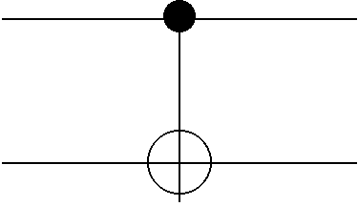
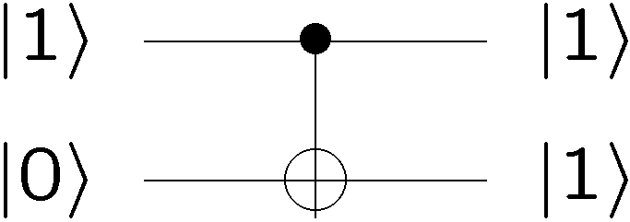
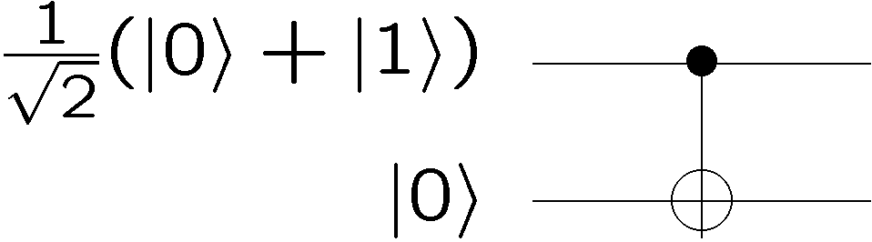






Entanglement Generation
Example:
separable
separable
separable
entangled
entangled
separable
entangled
entangled

Slide 60
Entanglement Generation
time
Bob
position
Alice
Entanglement can only to be generated “locally”
i.e. the two parties got together in the past and interacted
their qubits

Slide 61



Correlation
Alice’s qubit
Bob’s qubit
1. Alice measures in the computational basis.
Facts:
With probability 50% she gets outcome 0.
With probability 50% she gets outcome 1.
If her outcome was 0, the new wave function is
If her outcome was 1, the new wave function is
2. Bob now measures in the computational basis
If Alice’s outcome was 0, and Bob’s outcome will be 0
If Alice’s outcome was 1, and Bob’s outcome will be 1

Slide 62
Correlation
Alice’s qubit
Bob’s qubit
If Alice’s outcome was 0, and Bob’s outcome will be 0
If Alice’s outcome was 1, and Bob’s outcome will be 1
Notice that this is NOT signaling. Why?
What does Bob see?
Having NOT seen Alice’s measurement outcome,
he finds that he gets
0 with 50% probability and
1 with 50% probability.

Slide 63
Special Relativity
time
time
time
event B
event A
event B
position
position
event A
position
event A
event B
Reference frame 1
Reference frame 2
Reference frame 3
Should we worry that “who does the measurement first”
depends on the frame of reference?
From the perspective of each party, NO, because they always
get the same probabilities of outcomes.

Slide 64
Correlation
Alice’s qubit
Bob’s qubit
A completely classical way to simulate this experiment:
Flip a fair coin.
  If the result is heads, put 0 into two boxes.
  If the result is tails, put 1 into two boxes.
2. Give Alice and Bob the boxes.
3. Parties perform measurements by opening their boxes
and reporting the classical bit inside as their measurement
outcome

Slide 65
Correlation
Alice’s qubit
Bob’s qubit
A completely classical way to simulate this experiment:
Flip a fair coin.
  If the result is heads, put 0 into two boxes.
  If the result is tails, put 1 into two boxes.
2. Give Alice and Bob the boxes.
3. Parties perform measurements by opening their boxes
and reporting the classical bit inside as their measurement
outcome

Slide 66
Local Hidden Variable Model
time
position
Suppose we try to respective special relativity, but at the same
time, reproduce the probabilities we get from quantum systems
Local Hidden Variable Models

Slide 67

Einstein, Bohr (1927-36)
After the creation of quantum theory, Einstein became very concerned about quantum theory.
Einstein: “God does not play dice.”
Bohr: “Stop telling God what to do.”
Actually Einstein was not troubled by the indeterminism of
quantum theory, but by the fact that he thought quantum theory
was probably not the “ultimate” theory. He thought quantum
theory was incomplete.

Slide 68

John Bell
In 1964, John Bell showed that the question
of whether or not quantum theory could
be explained by a local hidden variable
theory was an EXPERIMENTAL question
(and thus a real scientific hypothesis!)
“the most profound discovery of science”

Slide 69

A Game
Alice and Bob are locked away in prison cells and they cannot
communicate.
A warden plays the following game.
He gives Alice and Bob a slip of paper. Written on each of
these papers is the letter S or the letter T.
2. Alice are instructed that at a certain time, they will both be
required to shout out either +1 or -1.

Slide 70
A Game
Call Alice’s output (+1,-1) if she received S, A_{S}
Call Alice’s output (+1,-1) if she received T, A_{T}
Call Bob’s output (+1,-1) if she received S, B_{S}
Call Bob’s output (+1,-1) if she received T, B_{T}
Alice’s slip Bob’slip Product of their answers
S S A_{S}B_{S}
S T A_{S}B_{T}
T S A_{T}B_{S}
T T A_{T}B_{T}
Note that the product of their answers depends only on what
each party does locally.

Slide 71
A Game
The Warden will let Alice and Bob free if they produce
Alice’s slip Bob’slip Winning Product
S S +1
S T +1
T S +1
T T -1
Is it possible for Alice and Bob to always win this game?
No.
A_{S}B_{S}= A_{S}B_{T}=+1 implies that B_{S}=B_{T}.
A_{T}B_{S}= -A_{T}B_{T}=+1 implies that B_{S}=-B_{T}.
But this implies B_{S}=B_{T}=0, contradiction!

Slide 72
A Game
Suppose they play this game lots of times, each time they are
given one of the sheets of paper with equal probability (i.e. the
Warden gives each party an S or a T with 50% probability)
An indication of how well they are doing is to calculate the
probability of winning:
Probability of winning= ¼(Pr(A_{S}B_{S}=+1|S,S)+ Pr(A_{S}B_{T}=+1|S,T)
+ Pr(A_{T}B_{S}=+1|T,S)+Pr(A_{T}B_{T}=-1|T,T))
How are they doing?

Slide 73
A Game
Suppose Alice and Bob always play the same strategy.
This means assigning values to A_{S},A_{T},B_{S},and B_{T}.
Probability of winning= ¼(Pr(A_{S}B_{S}=+1|S,S)+ Pr(A_{S}B_{T}=+1|S,T)
+ Pr(A_{T}B_{S}=+1|S,T)+Pr(A_{T}B_{T}=-1|S,T))
At most they can win ¾ of the time.
Why? There must always be a contradiction with the winning
formula and so one of these probabilities is zero.
And they can achieve the case where one is zero and all three
others are one by always having A and B output +1

Slide 74
A Game
Suppose Alice and Bob are even allowed to share some random
numbers they copied from each other before they were thrown in
jail.
What is their maximum probability of winning? Same as before.
Why? Fix the random numbers. Run the protocol.
Probability of winning will be less than ¾.
Average over the random numbers.
No help. Probability of winning is at most ¾.
Probability of winning is at most ¾

Slide 75
The Connection
time
position
Local classical data
Local hidden variables

Slide 76
A Game
Suppose Alice and Bob are even allowed to share an entangled
quantum state which they made when they were plotting together
before the were thrown in jail.
Suppose they each have one qubit of two qubits with
wave function

Slide 77


A Basis
These states are orthogonal
And normal
Measurement operators in this basis, labeling these outcomes
+ and -

Slide 78


A Measurement
Suppose that Alice measures in the basis
and that Bob measures in the basis
Probabilities of outcomes:

Slide 79




A Measurement
Suppose that Alice measures in the basis
and that Bob measures in the basis
Probabilities of outcomes:

Slide 80




A Game
They share
If Alice got a slip with S, she measures in the basis with
If Alice got a slip with T, she measures in the basis with
If Bob got a slip with S, she measures in the basis with
If Bob got a slip with T, she measures in the basis with
Both parties output their measurement (+ = +1, - =-1)
Choose angles which maximize the probability of winning

Slide 81


A Measurement
Suppose that Alice measures in the basis
and that Bob measures in the basis
Probabilities of outcomes:

Slide 82




A Game

Slide 83
A Game
By sharing this entangled state, which they cannot use to
communicate with each other, but they can increase their
chances of defeating this evil evil warden.

Slide 84
Bell’s Theorem
Bell’s theorem tells us that we cannot simulate the statistics
of quantum theory using a local hidden variable theory!
time
position
Local classical data
Local hidden variables

Slide 85
Bell’s Theorem
Why is this profound?
Local theories, with classical information, like cellular automata
cannot reproduce the predictions of quantum theory
(Apologies to Stephen Wolfram)

Slide 86



Bell’s Theorem
Why is this profound?
Bell’s theorem is an experiment:
All local hidden variable theories satisfy:
But quantum theory predicts
So go out and test it!!!! Famous tests of Aspect 1982.

Slide 87
Bell’s Theorem
Why is this profound?
Recall our model where we put bits into boxes to get correlation
Correlation is not profound.
But quantum correlation is different from experiments where
we generate correlations locally!
This was truly the first result in quantum information:
quantum correlations play games better
than classical correlations

Slide 88

“Dave, may I be excused? My brain is full.”

