Slide 1
Test Slide
SAT
MCAT
GRE

Slide 2
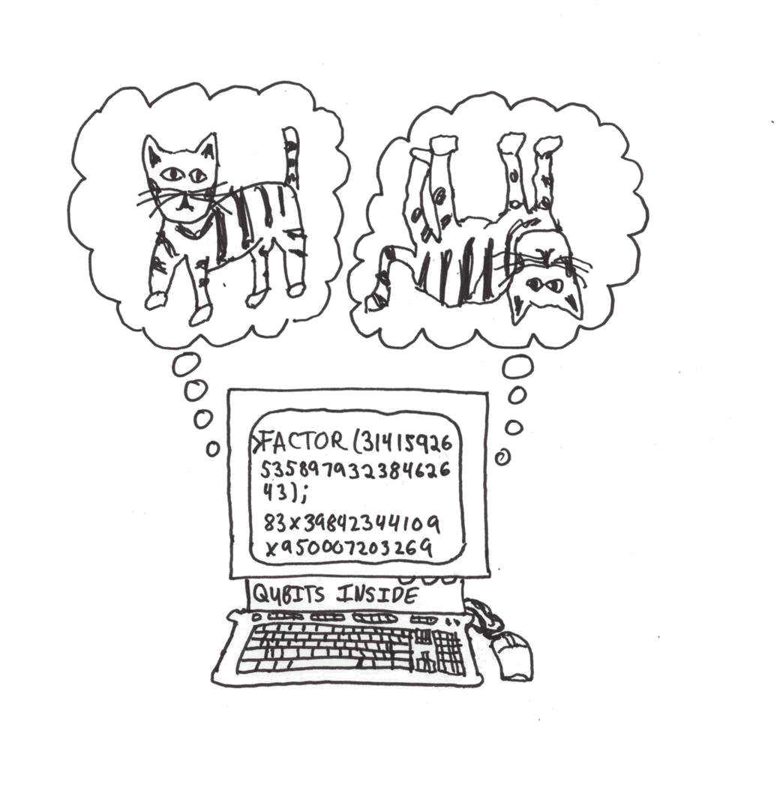

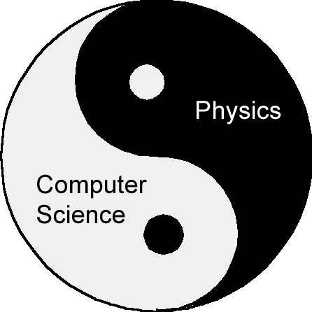

The Power of Quantum Algorithms
Dave Bacon
Department of Computer Science & Engineering
University of Washington

Slide 3

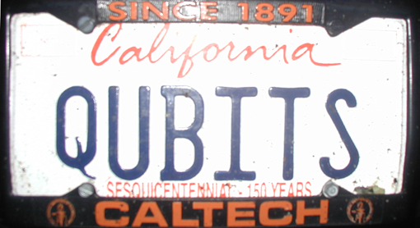

Apologies

Slide 4
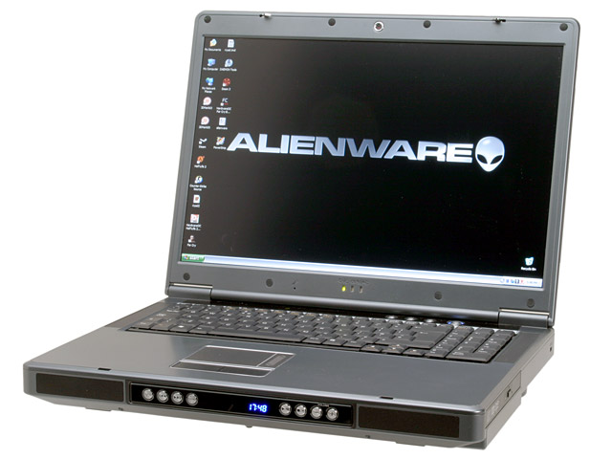
What Do You See?
SOFTWARE
Email
The Web
Databases
Etc.etc.etc.
HARDWARE
Moore’s law
Architecture
Communication
Etc.etc.etc.

Slide 5
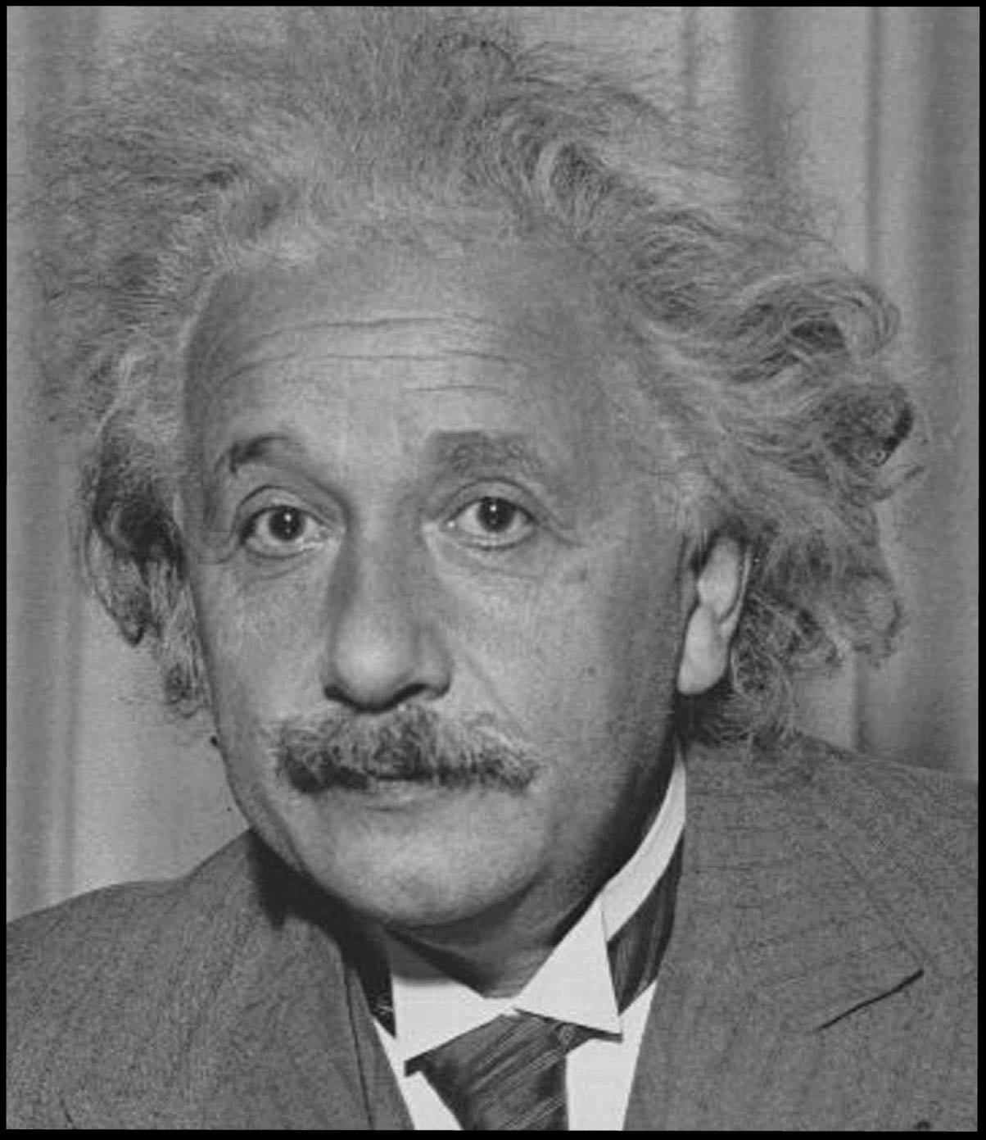
What Do Physicists See?
A New Phase of Matter

Slide 6
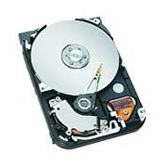
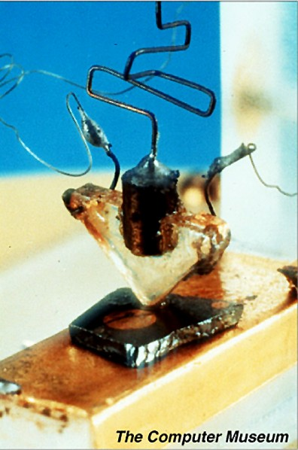
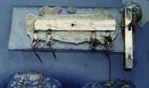
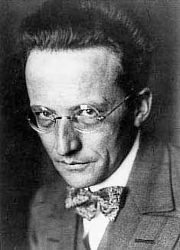

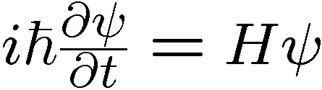
Computing State of Matter
Integrated Circuit
Magnetic Storage
Media
Transistor
Robust (Fault-Tolerant) Storage and Manipulation of Discrete Data
LOOKS VERY LITTLE LIKE
Our fundamental laws of Physics
Continuous (noisy) data, chaotic, etc.

Slide 7
Masked
Digital Computers
Noisy, Continuous Physical Systems
What constitutes a computer must ultimately be answered
the laws of physics combined with an understanding of how
robust behavior can arise in light of this physics.

Slide 8
Two At Once
Digital Computers
Classical
Continuous Physical Systems
Quantum
The big discovery (1983-1997):
Digital Computers
Quantum
Continuous Physical Systems
Quantum

Slide 9
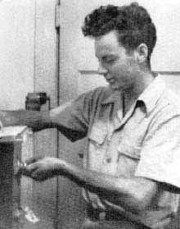

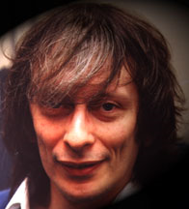
Quantum Computers
Machines whose operation is inherently quantum
Richard Feynman
David Deutsch
Paul Benioff
“How can we simulate quantum mechanics?...Can we do it with a new kind of computer…a quantum computer? It’s not a Turing machine but a machine of a different kind” Feynman, 1981

Slide 10
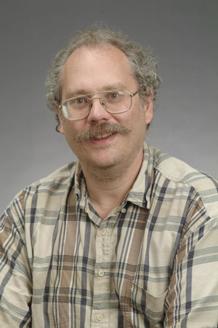


The Factoring Firestorm
18819881292060796383869723946165043
98071635633794173827007633564229888
59715234665485319060606504743045317
38801130339671619969232120573403187
9550656996221305168759307650257059
Peter
Shor
1994
3980750864240649373971
2550055038649119906436
2342526708406385189575
946388957261768583317
4727721461074353025362
2307197304822463291469
5302097116459852171130
520711256363590397527
Best classical algorithm
takes time
Shor’s quantum algorithm
takes time
An efficient algorithm for factoring breaks the
RSA public key cryptosystem

Slide 11
Reasons to Study
In the future we may build large quantum computers.
2. The ultimate limits of computation are quantum limits
If someone showed P does not equal NP, would we be
satisfied today?
3. The beginning of an interplay between physics and
computer science?

Slide 12
The Power of Quantum Algorithms
What gives quantum computers their power?
Can we use this to aid in finding new quantum algorithms?

Slide 13
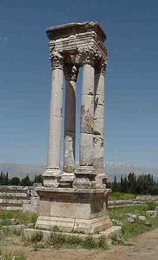
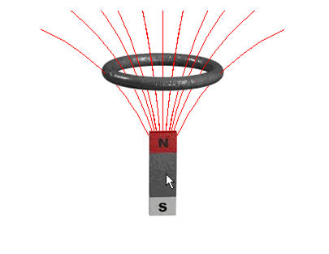
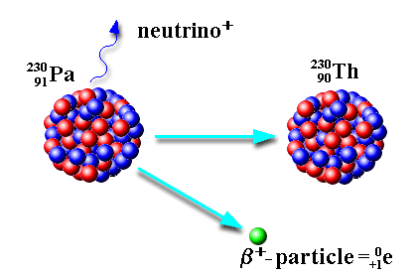
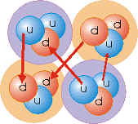
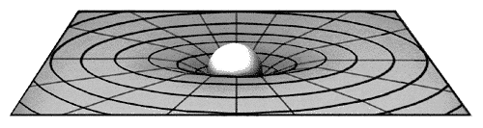
What is Quantum Theory?
Electromagnetic
Force
Weak
Force
Strong
Force
Gravitational
Force (?!?!)
Quantum Theory
Quantum theory is the machine language of the universe

Slide 14

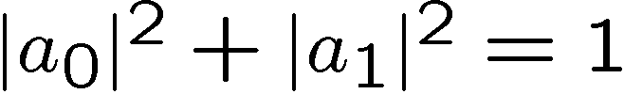
Bit? Pbit? No: Qubit!
Classical Bit
Probabilistic
Classical Bit
0
0
p
two states
two states
1
1
1-p
description of the system
Quantum Bit
upon measurement,
acts like a pbit:
0
a₀
complex numbers
0
p=|a₀|²
1
a₁
1
1-p =|a₁|²
description of the system

Slide 15
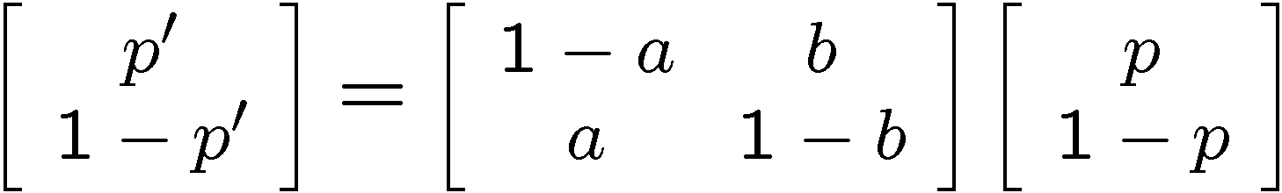
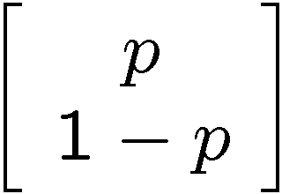
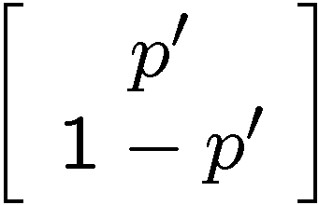



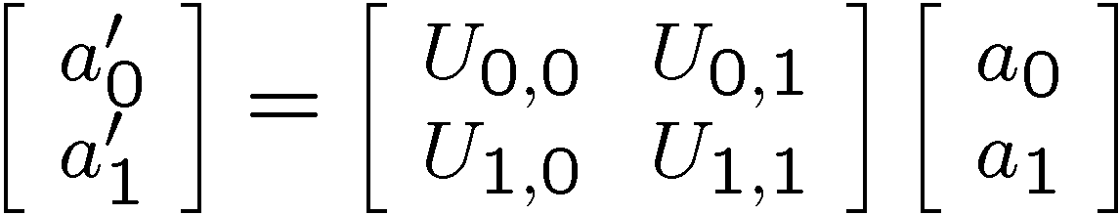




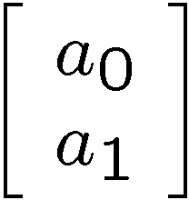
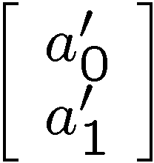

Evolution
Probabilistic Classical Bit Evolution
1-a
0
0
a
1
b
1
1-b
stochastic
Quantum Bit Evolution
0
0
1
1
unitary

Slide 16

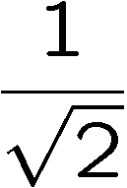
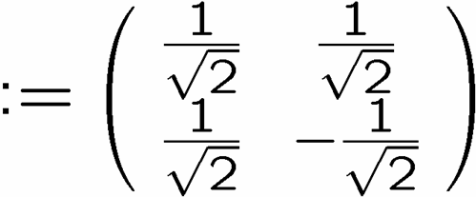

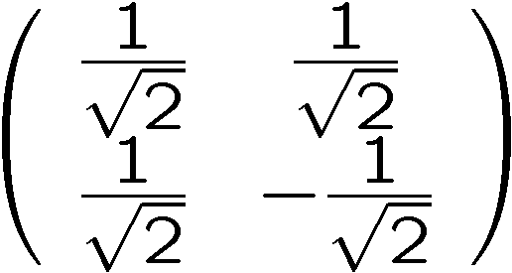
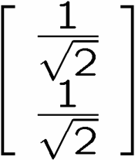
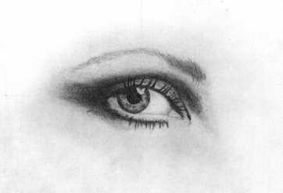
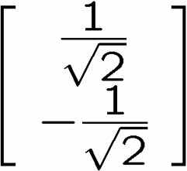
Interference
0
0
1
1
qubit
input
0
50%
100%
1
50%
0%
measure
0
50%
0%
1
50%
100%
measure

Slide 17
Interfering Pathways
100% H
1.0 H
50%
50%
0.707
0.707
50% H
50% C
0.707 H
0.707
0.707 C
90%
10%
0.707
0.707
80%
20%
-0.707
85% C
0.0 H
1.0 C
15% H
Always addition!
Subtraction!
Classical
Quantum

Slide 18



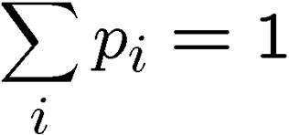
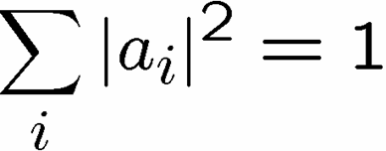
Quantum Theory Made Easy
Classical
Quantum
0
0
0
p₀
a₀
0
0
1
p₁
a₁
0
1
0
p₂
probabilities
amplitudes
a₂
0
1
1
p₃
a₃
1
0
0
p₄
a₄
1
0
1
p₅
a₅
probability of
observing state
s is p_{s}
probability of
observing state
s is |a_{s}|²
1
1
0
p₆
a₆
1
1
1
p₇
a₇

Slide 19







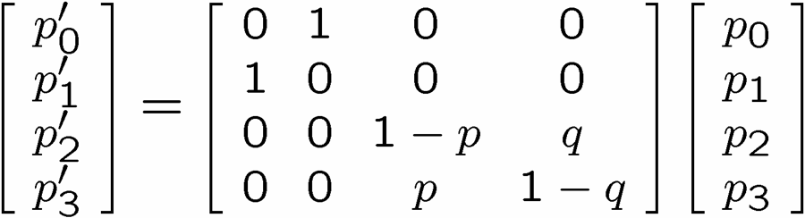
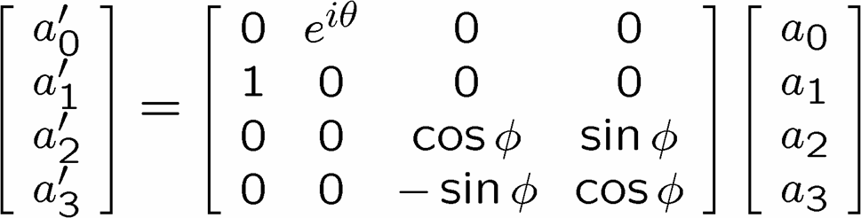
Quantum Theory Made Easy
Classical Evolution
Quantum Evolution
0
0
0
0
0
0
0
0
0
1
0
1
0
1
0
1
1
0
1
0
1
0
1
0
1
1
1
1
1
1
1
1
transition probabilities
transition amplitudes
stochastic matrix
unitary matrix

Slide 20

Quantum Circuits
uniform quantum circuit families
sequence of
    one and two qubit unitary evolutions
    measurements
H
R₂
R_{n-1}
R_{n}
H
R_{n-2}
R_{n-1}
H
R₂
H
Quantum circuit for the Fourier Transform over

Slide 21


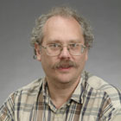
Quantum Algorithms
Quantum computers offer superpolynomial speedups (for certain oracle promise problems) over classical computers
[Bernstein and Vazirani STOC 93]
Umesh Vazirani
(U.C. Berkeley)
Quantum computers offer exponential speedups (for certain oracle promise
problems) over classical computers
[Simon FOCS 94]
Dan Simon
(Microsoft)
Quantum computers can efficiently factor integers and can efficiently compute the discrete logarithm
[Shor FOCS 94]
Peter Shor
(AT&T→MIT)

Slide 22
Quantum Algorithms
*Factoring, Discrete log [Shor 94]
Unstructured search [Grover 96]
*Abelian hidden subgroup problems [Shor 94, Kitaev 95]
*Solving Pell’s equation [Hallgren 02]
*Some hidden shift problems [van Dam, Hallgren, Ip 03]
*Graph traversal [CCDFGS 03]
Spatial search [AA 03, CG 03/04, AKR 04]
Element distinctness [Ambainis 03]
Various graph problems [DHHM 04, MSS 03,…]
Testing matrix multiplication [Buhrman,Špalek 04]
…[Your Algorithm Here]
Where is the power of quantum algorithms coming from?
* = suspected exponential gain over classical

Slide 23
Some Counting
To describe the generic state of n qubits, we need 2^{n} amplitudes
2^{n} complex numbers
n qubits
But, to describe the generic state of n pbits, we need
2^{n} probabilities
2^{n} real numbers
n pbits
Moral: that our description is exponentially large is cannot be
at the heart of the speedup provided by quantum
computers. No “massive parallelism for free.”

Slide 24
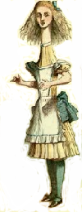

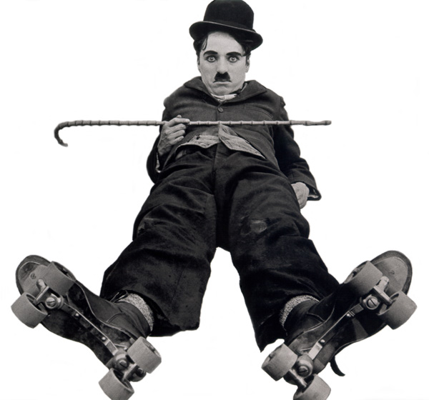
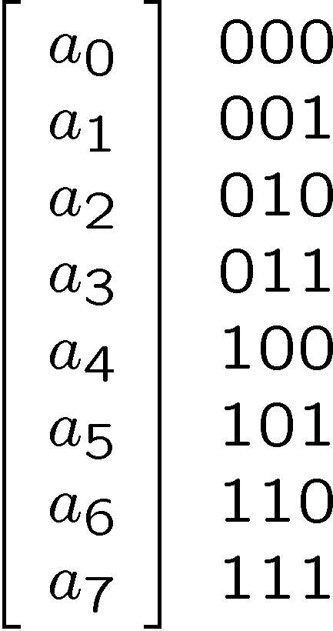
Separablity
Alice
Bob
Charlie
Generic state requires 8 complex numbers:

Slide 25
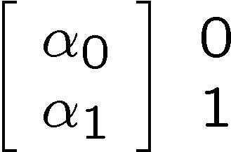
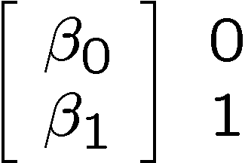
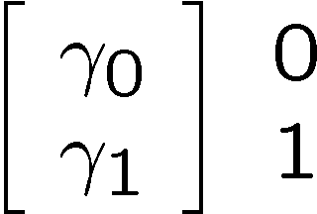
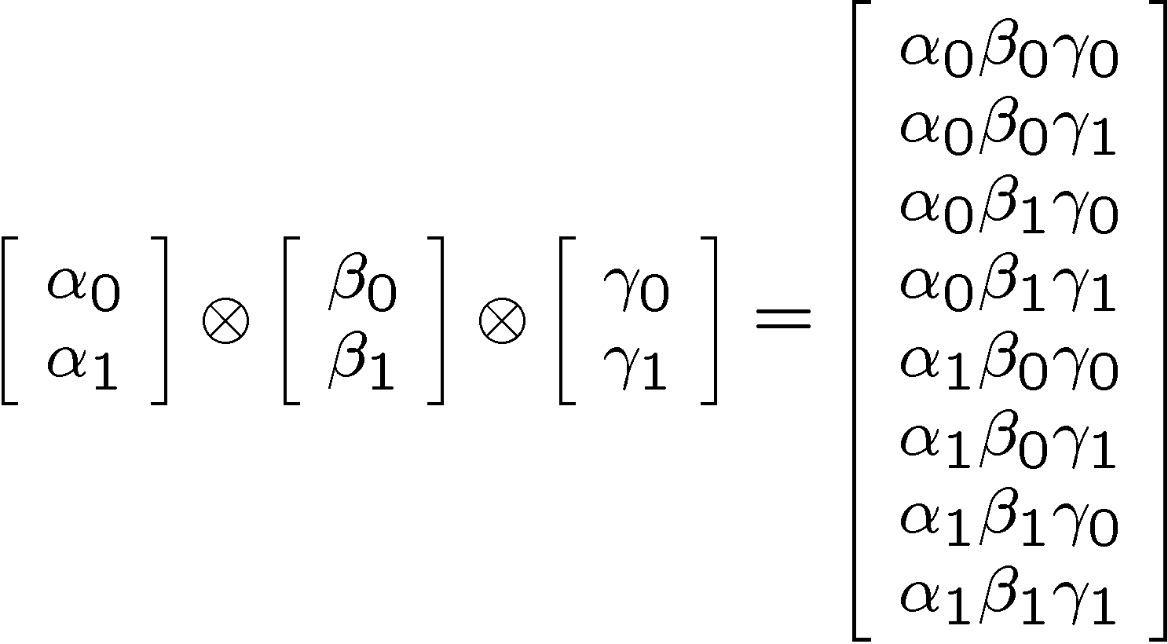
Separablity
But some states require us to store less numbers:
Alice
Bob
Charlie

Slide 26
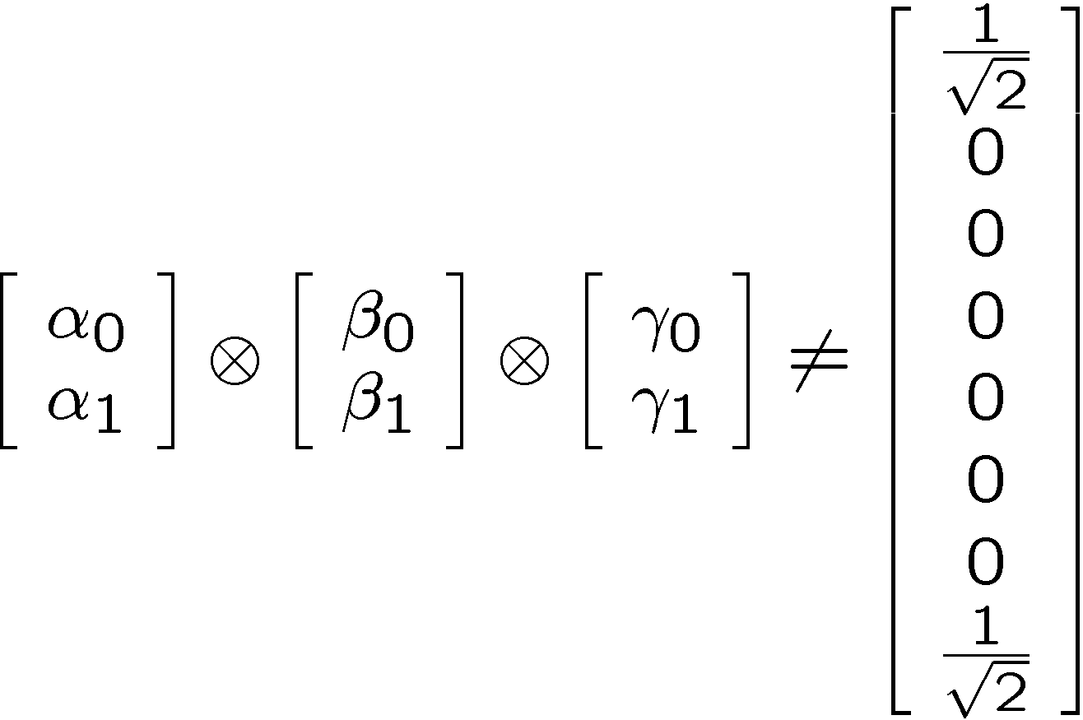
Entangled States
Some states cannot be expressed as separable states:
Alice
Bob
Charlie

Slide 27
More Counting
n qubits in separable state:
2n complex numbers
n qubits
Entanglement and Quantum Speedups:
small quantity of
entanglement
efficient classical algorithm
for simulating the system
[Jozsa and Linden, Proc. Math. Phys. & Eng. Sci. 459 2011 (2003)]
[Vidal, Phys. Rev. Lett. 93, 040502 (2004)]
Entanglement is necessary for quantum speedups.
What makes entanglement special?

Slide 28
A Game
Alice
Bob
Charlie

Slide 29

An Evil Game
Alice
Bob
Charlie
X
Y
1. Each given slip or
2. At midnight each party shouts
“+1” or “-1”

Slide 30
Winning the Game
Winning
Product
Alice
Bob
Charlie
X
X
X
+1
X
Y
Y
-1
Y
Y
X
-1
Y
X
Y
-1

Slide 31
A Game
Alice
Bob
Charlie
A_{X}
B_{X}
C_{X}
A_{Y}
B_{Y}
C_{Y}
All either +1 or -1

Slide 32
A Game
Alice
Charlie
Product
Bob
X
X
X
A_{X}B_{X}C_{X}
X
Y
Y
A_{X}B_{Y}C_{Y}
Y
Y
X
A_{Y}B_{Y}C_{X}
Y
A_{Y}B_{X}C_{Y}
Y
X

Slide 33
Winners?
Assuming winning strategy:
A_{X}B_{X}C_{X} = +1
A_{X}B_{Y}C_{Y} = -1
A_{Y}B_{Y}C_{X} = -1
A_{Y}B_{X}C_{Y} = -1
Multiply equations….contradiction!
LHS: A_{X}²A_{Y}²B_{x}²B_{Y}²C_{x}²C_{Y}²=+1
RHS: -1

Slide 34
Losers
Alice
Bob
Charlie
There is no strategy to win the game

Slide 35
In the Real World
Alice
Bob
Charlie
This is wrong, there is a way to win

Slide 36
GHZ State
Alice
Bob
Charlie

Slide 37
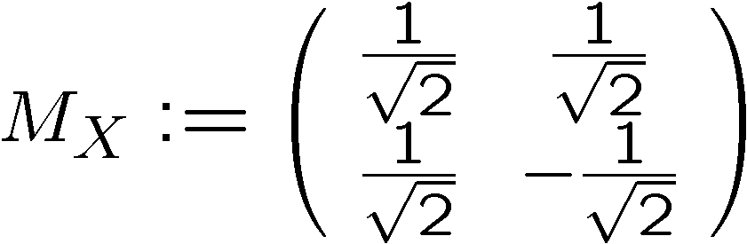
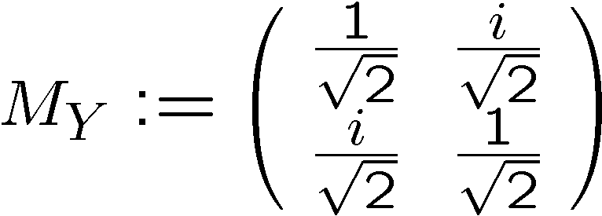
GHZ Protocol
Alice
Bob
Charlie
Each party applies:

Slide 38


GHZ Magic
Alice
Bob
Charlie
XXX
YXX
XYX
XXY

Slide 39
In the Real World
Alice
Bob
Charlie
By sharing “entangled” quantum
particles, Alice, Bob, and Charlie win!

Slide 40
More Counting
Entanglement and Quantum Speedups:
small quantity of
entanglement
efficient classical algorithm
for simulating the system
[Jozsa and Linden, Proc. Math. Phys. & Eng. Sci. 459 2011 (2003)]
[Vidal, Phys. Rev. Lett. 93, 040502 (2004)]
Entanglement is necessary for quantum speedups.
Entanglement is a powerful form of correlation.
Can we use this to build new quantum algorithms?

Slide 41




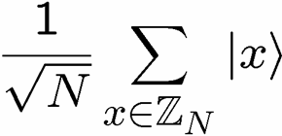



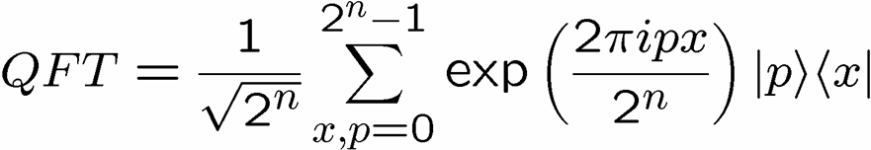
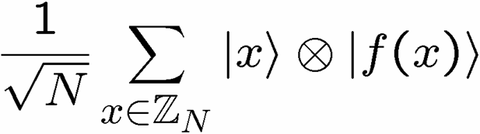
Factoring and Entanglement
Factoring can be reduced to period finding.
period=r
Anatomy of Shor’s algorithm:
lots of
entanglement
Measure
and use to
determine r

Slide 42
Hidden Subgroup Problem
Setup: Fix a group G (known) and a subgroup H⊆G (unknown). Given query access to a function f : G → S that
is constant and distinct on left cosets of H in G. We say that f hides H.
Problem: Find a generating set for H. Efficient: polylog(|G|)
g_{m}H
f
g₃H
g₂H
g₁H
H
G
S

Slide 43
Groups
Group Definition
Set of elements with a binary operation “⋅”
Binary operation satisfies:
1. Closure: g₁⋅g₂ is in the set
2. Associativity: (g₁⋅g₂)⋅g₃= g₁⋅(g₂⋅g₃)
3. Identity element: Exists e such that g₁⋅e=g₁
4. Inverse: For all g₁ there exists an element g₂
such that g₁g₂=e.
We will study only finite groups (set is finite.)

Slide 44
Left Cosets
Subgroups
Subset of group which is itself a group.
Left Cosets
Let H be a subgroup of G.
Def: g₁H is the set {g₁h, h∈H}
g₁H is a left coset of G with respect to H.
Given group G, subgroup H, we can uniquely partition G into left cosets of H.

Slide 45
Hidden Subgroup Problems
Shor’s factoring algorithm is an example of a HSP.
Efficient algorithms for the HSP over
an efficient algorithm
for graph isomorphism
the Symmetric group
1
2
3
4
S₄
an efficient algorithm for
poly(d)–unique shortest
vector in a lattice
the Dihedral group
D₈

Slide 46
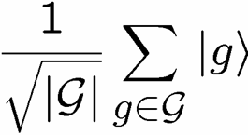






Dihedral HSP
Low dimensional
systems
Not much entanglement
k copies of the hidden subgroup states:
entangled
measurement
to determine the
hidden subgroup

Slide 47
Query Complexity of HSP
Theorem: [Ettinger, Hoyer, Knill 99] k=O(log(N))
hidden subgroup states are sufficient
to solve the hidden subgroup problem.
(but no efficient quantum circuit is known.)
Theorem: [Bacon, Childs, van Dam 05] k=log(N)
hidden subgroup states are necessary
to solve the dihedral hidden subgroup
problem (no known efficient quantum
circuit)
Measurement across k copies is in entangled basis
Success probability of measurement is related to…

Slide 48








The Subset Sum Problem
Given:
k integers from
i.e. , and a target
Problem: Does there exist a subset which sums to t
Define:
density :=
“low density”
“high density”
most subsets have
a distinct sum
most sums achieved by some subset
efficient algorithm
efficient algorithm
hard?
[Lagarias, Odlyzko 85]
[Flaxman, Pryzdatek 04]

Slide 49
Query Complexity of HSP
Theorem: [Bacon, Childs, van Dam 05] k=log(N)
hidden subgroup states are necessary
to solve the dihedral hidden subgroup
problem.
Phase transition in a classical compute science problem appearing in a quantum setting….
classical
computational
complexity
phase
transitions
quantum
computational
complexity
entanglement
Unfortunately, no known efficient circuit….

Slide 50
Towards New HSP Algorithms
We need multiple copies of the hidden subgroup
states.
But we have no examples of efficient circuits which require entangled measurements…

Slide 51






Heisenberg Group
Semidirect product group
Elements of the group:
Multiplication rule:
Copenhagen: “Your talent is for ski-ing too fast for anyone to see where you are.
For always being in more than one position at a time, like one of your particles.”

Slide 52


Heisenberg HSP
Bacon, Childs, and van Dam FOCS 2005
For one copy, the probability of successfully
identifying the hidden subgroup is
But for two copies, the probability of successfully
identifying the hidden subgroup is
This would require an entangled measurement.

Slide 53


Heisenberg HSP Algorithm
Bacon, Childs, and van Dam FOCS 2005
Efficient quantum circuit families
measure

Slide 54



The Hidden Subgroup Success
Abelian groups [Shor 94; Kitaev 95]
[Püschel, Rötteler, Beth 98]
Normal subgroups [Hallgren, Russell, Ta-Shma 00]
“Amost Abelian” groups [GSVV 01]
[FIMMS 02]
“Near Hamiltonian” groups [Gavinsky 04]
Some q-hedral groups [MRRS 04]
[Inui, Le Gall 04]
Heisenberg type groups [this talk]
Some
Bacon, Childs, and van Dam FOCS 2005
Things are heating up…

Slide 55
Quantum Algorithms
The power: entanglement is a big part of the story
Leads to new quantum algorithms.
Open Problems
Efficient quantum algorithms for the nonabelian hidden
subgroup problem?
We need a deeper understanding of entanglement and
and a merging of this understanding with dynamics
(interference)

Slide 56
Reasons to Study
In the future we may build large quantum computers.
2. The ultimate limits of computation are quantum limits
If someone showed P does not equal NP, would we be
satisfied today?
3. The beginning of an interplay between physics and
computer science?

Slide 57

Math and Physics
“The must incomprehensible thing about the universe is that it is comprehensible”
Mathematics
Physics
Why no similar interplay for the theory of computation?

Slide 58
The Power of Quantum Algorithms
Dave Bacon
Department of Computer Science & Engineering
University of Washington

