Slide 1
sihT esraP oT yrT

Slide 2
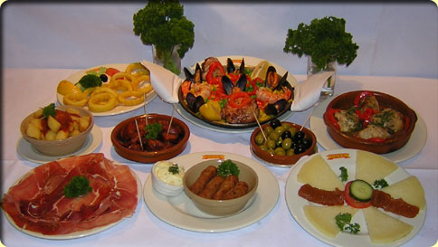
Two Quantum Tapas
Dave Bacon
Santa Fe Institute

Slide 3
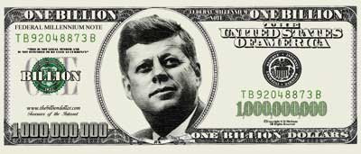

Henry Everitt (ARO, paraphrase)
“Cumulative worldwide quantum information
science spending is now over 1 Billion dollars.”
Greg Egan (Schild’s Ladder)
“Cass dated the advent of civilization to the
invention of the quantum singleton processor.
The Qusp.”

Slide 4
Tapas Menu
Valued-Added Multipartite Quantum
Correlations………………………..……........>12.5 ¢
(Trace Tessier, Carl Caves, Ivan Deutsch, Bryan Eastin, db)
A Quantum Error Correcting Subsystem….2 ¢
(db)
Dihedral Hidden Subgroup Problem……….query for $
(Andrew Childs, Wim van Dam, db)
Efficient Quantum Clebsch-Gordan
Transforms………………………..……….….$1 per n
per d
per log(ε⁻¹)
(Isaac Chuang, Aram Harrow, db)

Slide 5


GHZ/Mermin Game
Alice
Input A
Output a
Bob
Input B
Output b
Input: X or Y, Output: +1 or -1
Win condition:
A B C abc
X X X +1
Y Y X -1
Y X Y -1
X Y Y -1
Charlie
Input C
Output c
Classical
Quantum:
a_{Y} b_{Y} c_{X} = -1
a_{Y} b_{X} c_{Y} = -1
XXX|GHZ⟩=|GHZ⟩
YYX|GHZ⟩=|GHZ⟩
YXY|GHZ⟩=|GHZ⟩
XYY|GHZ⟩=|GHZ⟩
not
possible
to always
win
possible
to always
win
×
a_{X} b_{Y} c_{Y} = -1
a_{X} b_{X} c_{X} = -1

Slide 6

Cheaters Always Win
Alice
Input A
Output a
Bob
Input B
Output b
Win condition:
A B C abc
X X X +1
Y Y X -1
Y X Y -1
X Y Y -1
Charlie
Input C
Output c
Charlie: always outputs c=+1
Bob: always outputs b=+1, tells Alice his measurement
Alice: knows A and B
A B a abc
X X +1 +1
Y Y -1 -1
Y X -1 -1
X Y -1 -1
Using a single bit of communication they can win.

Slide 7
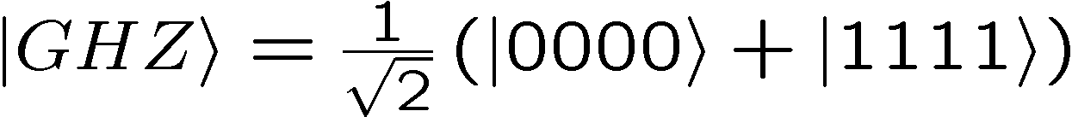
GHZ Extended
win condition
A B C D abcd
X X X X +1
X X Y Y -1
X Y Y X -1
X Y X Y -1
Alice
Input A
Output a
Bob
Input B
Output b
Charlie
Input C
Output c
Dodo
Input D
Output d
Quantum
possible to always win
Classical (no talking)
Classical (A and B talk)
a_{X} b_{X} c_{Y} d_{Y}= -1
v_{XX}c_{Y} d_{Y}= -1
a_{X} b_{Y} c_{X} d_{Y}= -1
v_{XY}c_{Y} d_{X}= -1
a_{X} b_{Y} c_{Y} d_{X}= -1
×
v_{XY}c_{X} d_{Y}= -1
×
a_{X} b_{X} c_{X} d_{X}= -1
v_{XX}c_{X} d_{X}= -1
impossible to always win
impossible to always win

Slide 8
GHZ Super Extended
win condition
Quantum
A B C D abcd
X X X X +1
X X Y Y -1
X Y Y X -1
X Y X Y -1
Y X X Y -1
Y X Y X -1
Y Y X X -1
possible to always win
Alice
Input A
Output a
Bob
Input B
Output b
Charlie
Input C
Output c
Dodo
Input D
Output d
If any two parties talk, they cannot always win!

Slide 9


Bell Inequality With Communication
two parties, three two-outcome measurements
local hidden variable theory + 1 bit of communication
D. Bacon and B.F. Toner, Bell Inequalities with Auxiliary Communication
PRL 90, 157904 (2003)
|-ab+ac-ba+bb+bc+ca+cb+cc|≤6
|aa+2ab-2ac+2ba+bb+2bc-2ca+2cb+cc|≤11
but, quantum theory has
⟨-AB+AC-BA+BB+BC+CA+CB+CC⟩_{QM}≤6
⟨AA+2AB-2AC+2BA+BB+2BC-2CA+2CB+CC⟩_{QM}≤11
four parties, two two-outcome measurements
local hidden variable theory + 1 bit of communication
|aaaa-aabb-abab-abba-baab-baba-bbaa|≤5
quantum theory violates this bound
⟨AAAA-AABB-ABAB-ABBA-BAAB-BABA-BBAA⟩_{GHZ}=7

Slide 10
Measure It!
Just as Bell Inequalities tell us that we can experimentally distinguish between quantum theory and local hidden variable models,
this Bell Inequality with Communication tells us that we can experimentally distinguish between quantum theory and local hidden variable models, plus one bit of cheating communication.
|aaaa-aabb-abab-abba-baab-baba-bbaa|≤5
⟨AAAA-AABB-ABAB-ABBA-BAAB-BABA-BBAA⟩_{GHZ}=7

Slide 11
3,4,…,n
win condition
A ……… n-3 n-2 n-1 n abcd
X ……… X X X X +1
X ……… X X Y Y -1
X ……… X Y Y X -1
X ……… X Y X Y -1
local hidden variable theory
plus n-3 bits of communication
|A…A-∑(observables with 2 B’s and rest A’s)|≤n(n-1)/2-1
⟨A...A-∑(observables with 2 B’s and rest A’s)⟩_{GHZ}=n(n-1)/2+1
Bell Inequality with n-3 bits of communication

Slide 12
Simulating Pauli Measurements on GHZ
n parties, each measure {X,Y,Z} on n party GHZ state
BIwC implies least n-2 bits of communication necessary
n-2 bits of communication is also sufficient
1 2 3 … n
X R₂ R₃…R_{n} R₂ R₃ … R_{n}
Y R₁ R₂…R_{n} R₁R₂ R₁R₃ … R₁R_{n}
Z R₁ R₁ R₁ … R₁
R_{i}∈{+1,-1}
uniform
random
variables
parties 2…n-1 communicate to party 1 whether they measured Y or not
party 1 flips her outcome bit if [hers Y plus 2…n-1 Y’s]
is odd else she does nothing

Slide 13
GHZ and Determinism
Peres: ““The list of authors [claiming that a single experiment
is sufficient to invalidate local realism] is too long to be given
explicitly, and it would be unfair to give only a partial list.”
|aa+ab+ba-bb|≤2
CHSH inequality
each party outputs uniform random outcome irrespective
of what they are measuring
measure each observable once (four experiments)
with probability = 1/8, |aa+ab+ba-bb|=4
similar argument for GHZ paradox, with probability 1/8,
|-aaa+abb+bab+bba|=4

Slide 14
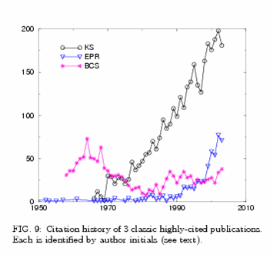
GHZ and Kochen-Specker
Einstein, Podolsky, Rosen element of reality:
  “If, without in any way disturbing a system, we can predict
  with certainty (i.e., with probability equal to unity) the value
  of a physical quantity, then there exists an element of
  physical reality corresponding to this physical quantity.
quantum computing
saved EPR!
from S. Redner
physics/0407137

Slide 15

Cits
Kochen-Specker-GHZ-Mermin contradiction:
v(X₁)v(X₂)v(X₃)v(X₁X₂X₃)=1
v(Y₁)v(Y₂)v(X₃)v(Y₁Y₂X₃)=1
v(Y₁)v(X₂)v(Y₃)v(Y₁X₂Y₃)=1
v(X₁)v(Y₂)v(Y₃)v(X₁Y₂Y₃)=1
v(X₁X₂X₃)v(Y₁Y₂X₃)v(Y₁X₂Y₃)v(X₁Y₂Y₃)=-1
cits not mits
GHZ elements of (Pauli) reality:
1 2 3 … n
X R₂ R₃…R_{n} R₂ R₃ … R_{n}
Y R₁ R₂…R_{n} R₁R₂ R₁R₃ … R₁R_{n}
Z R₁ R₁ R₁ … R₁
+ n-2 bits of
communication
cits (contextual bits): number of bits communicated from system
to measurement device to restore non-contextuality.

Slide 16
The Finiteness Conjecture
Conjecture: all multipartite entangled systems can be exactly
simulated by augmenting a local hidden variable theory
with an amount of communication polynomial in the
product of the dimensions of the entangled subsystems.
projective measurements on two entangled qubits
  (Brassard, Cleve, Tapp 99, Toner, Bacon 03)
all bipartite two outcome correlation observables
  (Bacon, Toner 05)
Knill-Gottesman States and Pauli Measurements
  (Gottesman, Knill 97)
  optimal solution for Pauli measurements on GHZ (Tessier, Caves, Deutsch, Eastin, Bacon 04)

Slide 17
Multipartite Sausage Correlations

Slide 18






Subspaces Versus Subsystems
The most general way to encode quantum information is into
subsystem (not subspaces)
two qubits
encode a qubit in a subspace
encode a qubit in a subsystem
generic subsystem:

Slide 19
Quantum Error Correcting Subsystems
Knill and Laflamme, “A theory of quantum error correcting codes”
PRA, 55, pp. 900-911 (1997)
Knill, Laflamme, and Viola, “Theory of quantum error correction
for general noise,” PRL, 84, pp. 2525-2528 (200)
Subsystem encoding:
implicit from the beginnings of quantum error
explicit for degenerate (noiseless) codes and dynamic recoupling
Quantum error correcting subsystem codes?

Slide 20





Subsystem Error Correction
Only need to protect subsystem,
not full subspaces.
encoding
subsystem
error
recovery
encoded quantum
information
recovery need not perfectly restore system, but only
preserve information encoded into subsystem.

Slide 21
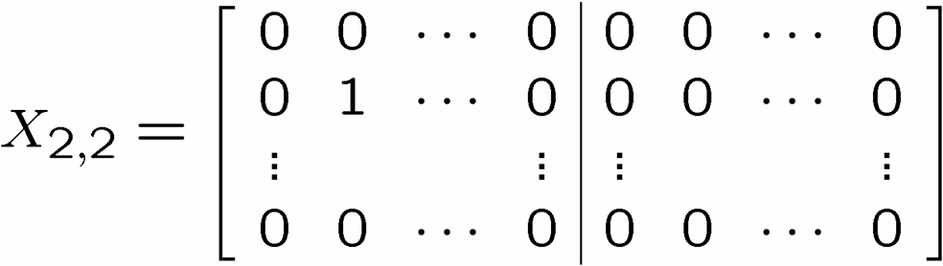
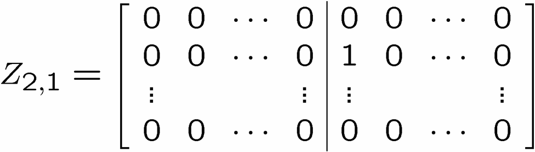
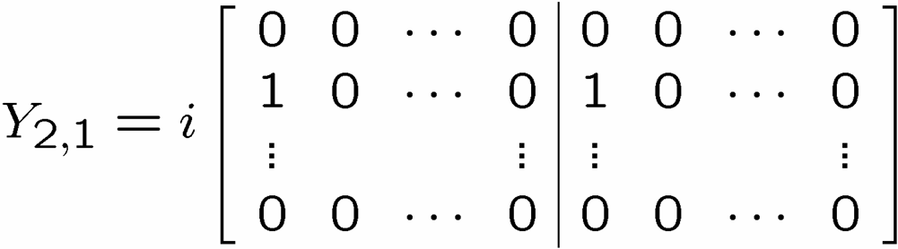

Flatland
X
Z
n by n cubic
lattice of qubits:
Generic Pauli group operator on cubic lattice:
A, B n by n 0,1 matrices

Slide 22

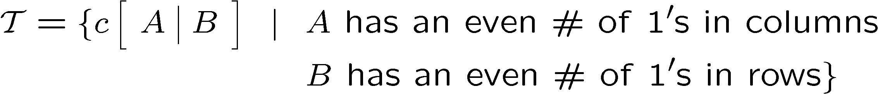
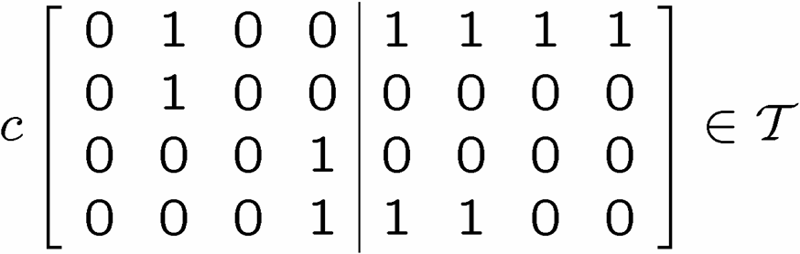

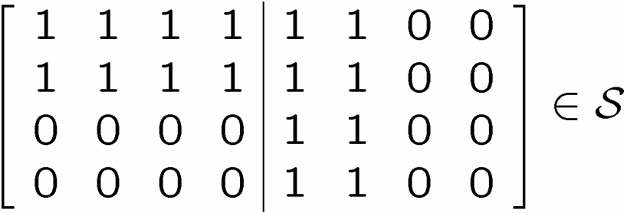
X Columns, Z Rows
X
Z
ZZ
ZZ
XX
XX
XX
ZZ
ZZ
XX
XX
XX
ZZ
ZZ
X
X
X
X
X
X

Slide 23
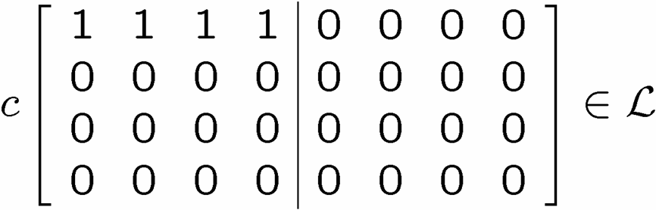

X Columns, Z Rows
Z
X
X
X
Z
Z

Slide 24
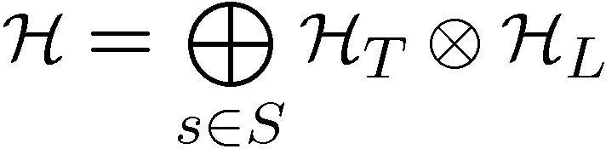


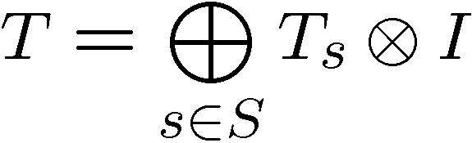
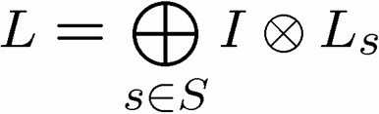
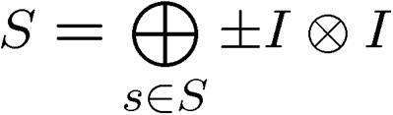
A Little Representation Theory

Slide 25
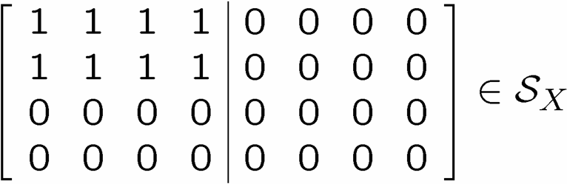
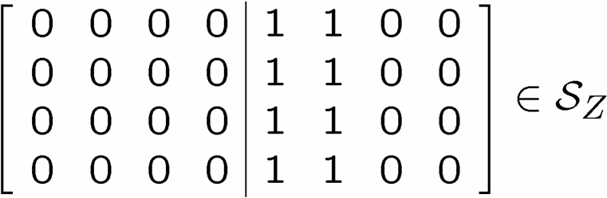
Quantum Error Correcting Subsystems

Slide 26

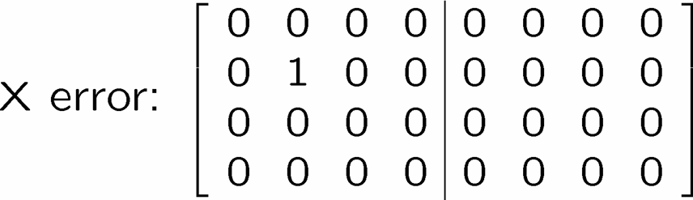
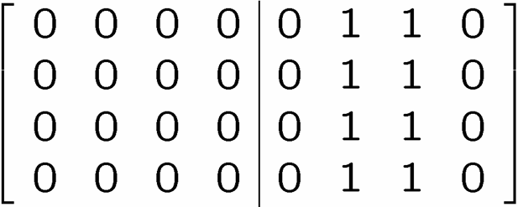
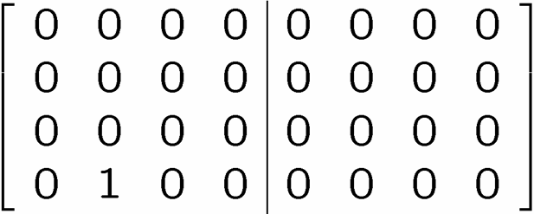
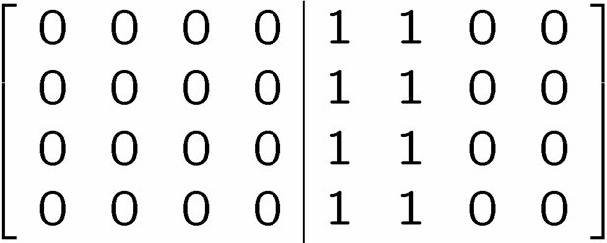
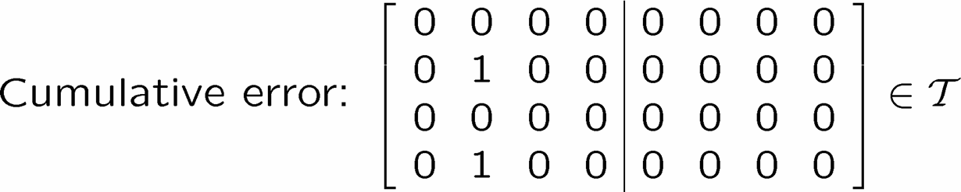

Diagnose and Pseudo-Fix
1
2
3
4

Slide 27
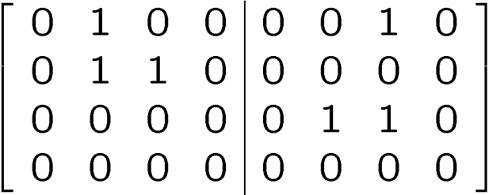



Detailing The Fix

Slide 28

Relation To Physics
ZZ
ZZ
XX
XX
XX
ZZ
ZZ
XX
XX
XX
ZZ
ZZ
Eigenstates of
are a quantum error correcting subsystem

Slide 29

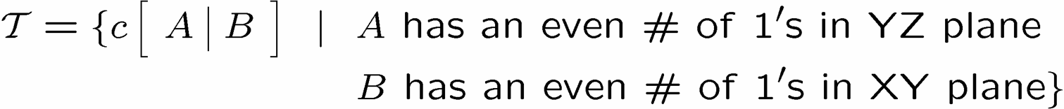
Frinkahedron
n by n by cube of qubits
ZZ
ZZ
XX
XX
ZZ
ZZ
ZZ
XX
XX
XX
ZZ
ZZ
XX
XX
XX
XX
XX
ZZ
ZZ
ZZ
XX
XX
ZZ
ZZ

Slide 30




Expectations
eigenstates are quantum error correcting subsystem
assume phase with two point n.n. correlations
XX
XX
errors are stringlike excitations
in this “mean field” approximation
XX
XX
XX
XX
Z
XX
Energy proportional to perimeter
self correcting?
XX
XX
XX
XX
XX

Slide 31
Quantum Error Correcting Subsystems
we need not perfectly preserve subspaces
new codes
quantum error correcting subsystems in
spin lattice systems
YY
ZZ
XX
ZZ
XX
YY
YY
ZZ
ZZ
XX
XX
YY
self-correcting quantum memories?

Slide 32
QIP Tapas Menu
Valued-Added Multipartite Quantum
Correlations………………………..……........>12.5 ¢
(Trace Tessier, Carl Caves, Ivan Deutsch, Bryan Eastin, db)
A Quantum Error Correcting Subsystem….2 ¢
(db)
Dihedral Hidden Subgroup Problem……….query for $
(Andrew Childs, Wim van Dam, db)
Efficient Quantum Clebsch-Gordan
Transforms………………………..……….….$1 per n
per d
per log(ε⁻¹)
(Isaac Chuang, Aram Harrow, db)

