Slide 1
The Reconciliation of
Quantum Theory and
General Relativity
No Strings Attached
Dave Bacon
Santa Fe Institute

Slide 2

Possible Paths
They flutter behind you your possible pasts,
Some brighteyed and crazy, some frightened and lost.
A warning to anyone still in command
Of their possible future, to take care. – Pink Floyd, Your Possible Pasts
Time
We Will Be Here
The World Will Look Different
100(0) years
Global science
tenure window
Local science
Space
You Are Here

Slide 3
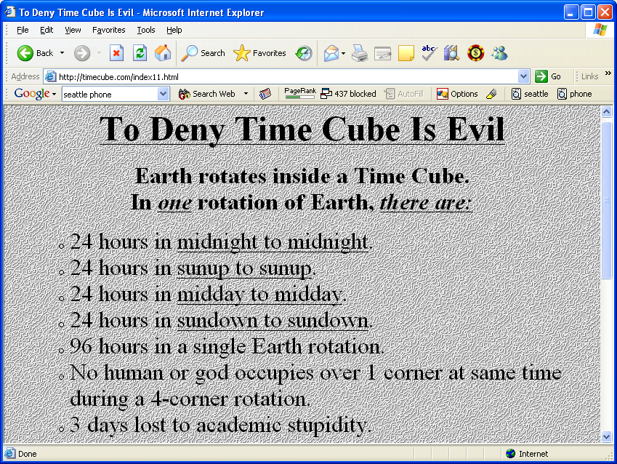
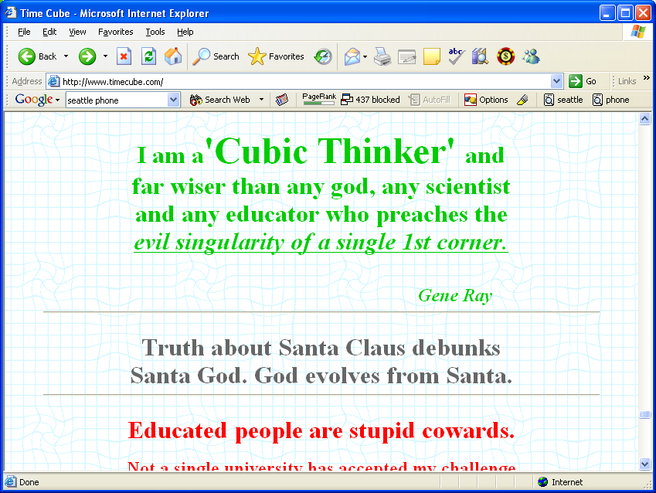
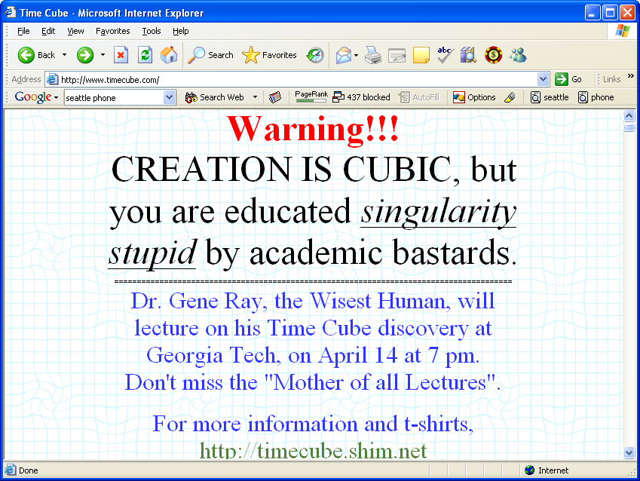
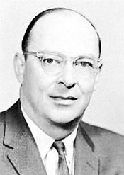
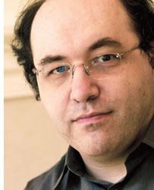
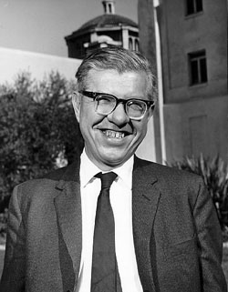
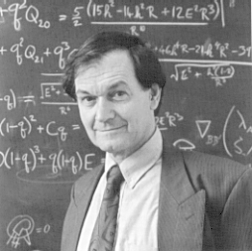
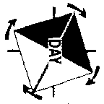
Crackpot Meter
0
1
0
1
0
1
0
1
0
1
John
Bardeen
Roger
Penrose
Stephen
Wolfram
Fred
Hoyle
Gene
Ray
+ Transistor
+ BCS theory
of super-
conductivity
+ Singularity
theorems
+ Twistor theory
+ Penrose tilings
- Quantum
microtubule
brains
+ Cellular
automata
+ Mathematica
- “A New Kind
of Science”
- “A New Kind
of Science”
+ Nucleosynthesis
- The steady state
universe
- Dark matter is
bacteria
- Bumblebees are
integalactic
travelers

Slide 4
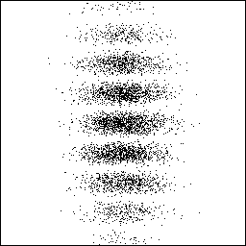
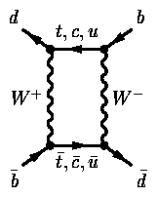
Three Revolutions of
Fundamental Physics
0
1
Relativity
Special and General
Quantum
Theory
The Standard
Model

Slide 5
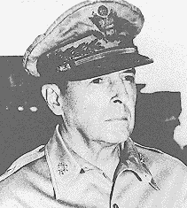
Three Revolutions of
Fundamental Physics
0
1
Special
Relativity
General
Relativity
Quantum Field
Theory
Renormalization
Quantum
Theory
The Standard
Model

Slide 6
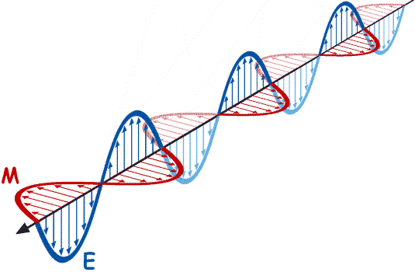
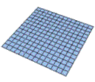



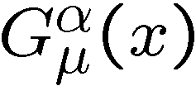

The Failure
0
1
Quantum Field Theory
General Relativity
dynamic variables
particle fields
metric
defined over some space-time
space-time itself!
the game called renormalization
works
fails

Slide 7
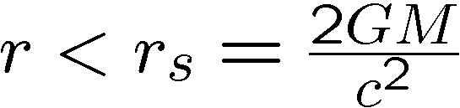
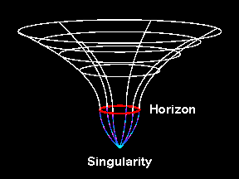
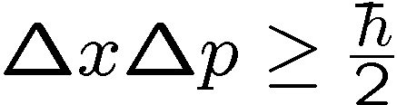
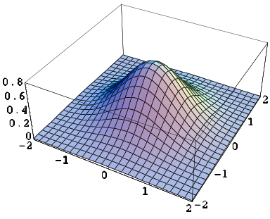

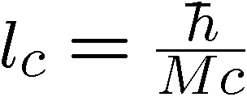
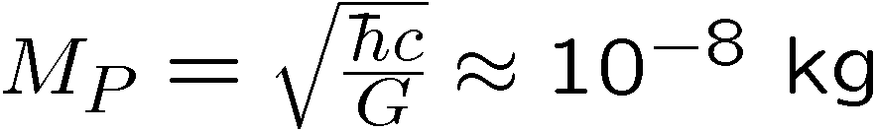
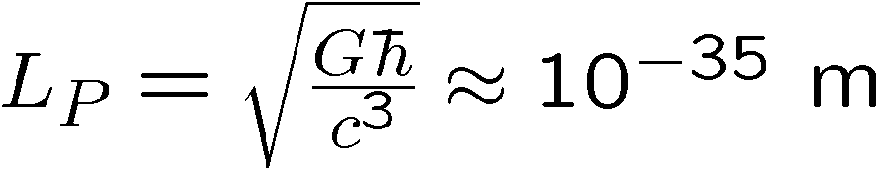
Planck Length
0
1
General Relativity
Blackholes:
If we cram mass inside
we create a blackhole
Any mass blackhole possible
Quantum Field Theory
localize to diameter d → large momentum possible
large momentum → particle creation
Compton length:
Black holes of small mass such that Compton length is outside horizon?
Planck Mass
Planck Length

Slide 8
The Beaten Path
0
1
  String Theory:
    quantum theory of strings in higher dimensional spaces
    graviton (spin 2) naturally arises
    hope to incorporate all of Standard Model
    Big Problem: no string universe looks like our own
  Loop Quantum Gravity:
    Non-canonical quantization of Ashtekar’s variables
    Gravity only
    Non-perturbative
    Big Problem: emergence of classical general relativity uncertain
  Others:
  Euclidean quantum gravity, Twistors, Causal sets, Dynamical
  triangulation, Causal dynamical triangulation, supergravity,…

