Slide 1
You Did Not Just Read This
or did you?

Slide 2
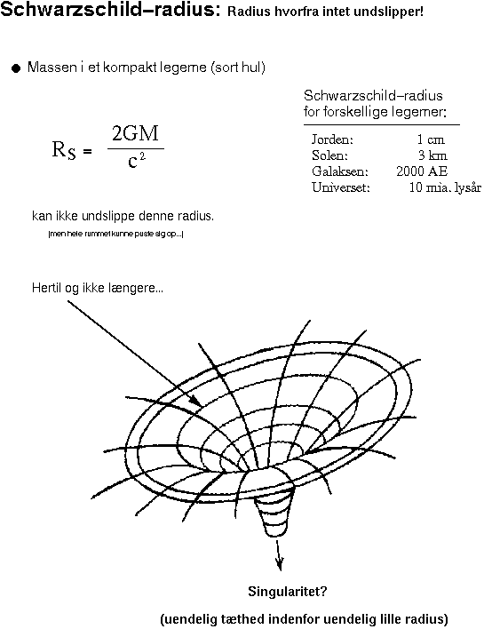
The Reconciliation of
Quantum Theory and
General Relativity
No Strings Attached
Dave Bacon
Santa Fe Institute

Slide 3

Possible Paths
They flutter behind you your possible pasts,
Some brighteyed and crazy, some frightened and lost.
A warning to anyone still in command
Of their possible future, to take care. – Pink Floyd, Your Possible Pasts
Time
We Will Be Here
The World Will Look Different
100(0) years
Global science
tenure window
Local science
Space
You Are Here

Slide 4
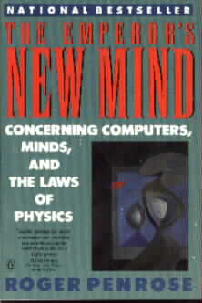
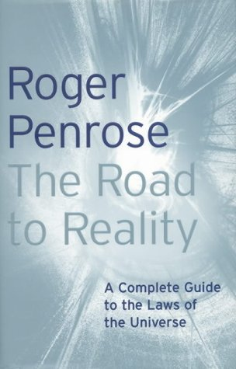
Book Deal
This talk morphed into:
“If I were going to write a book speculating about the
future of quantum theory and general relativity”
Lots of history
Lots of history of speculative ideas
Speculative ideas
Who is my audience?
Healthy(?) skepticism

Slide 5
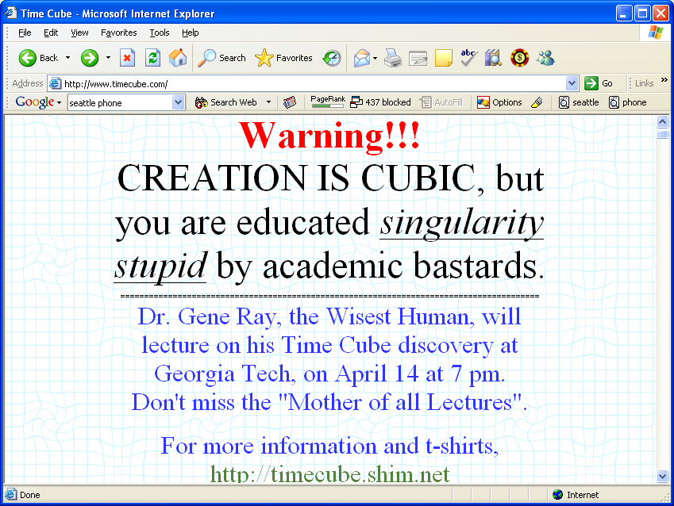
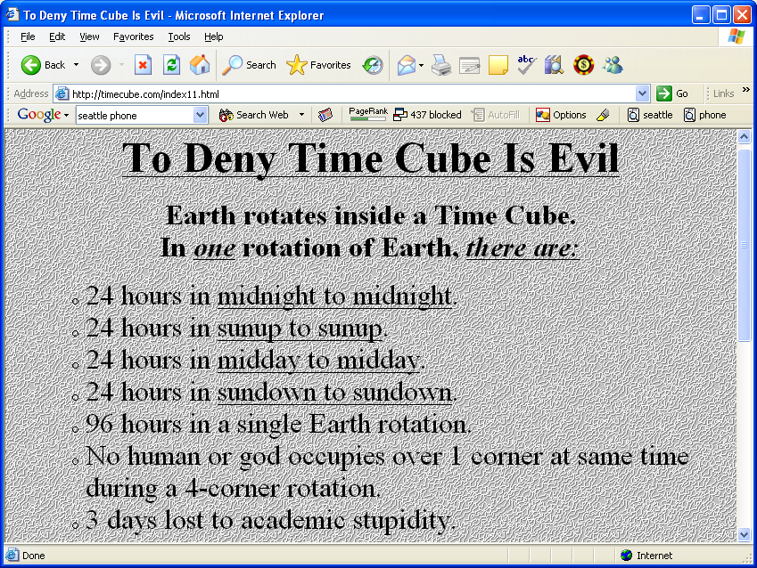
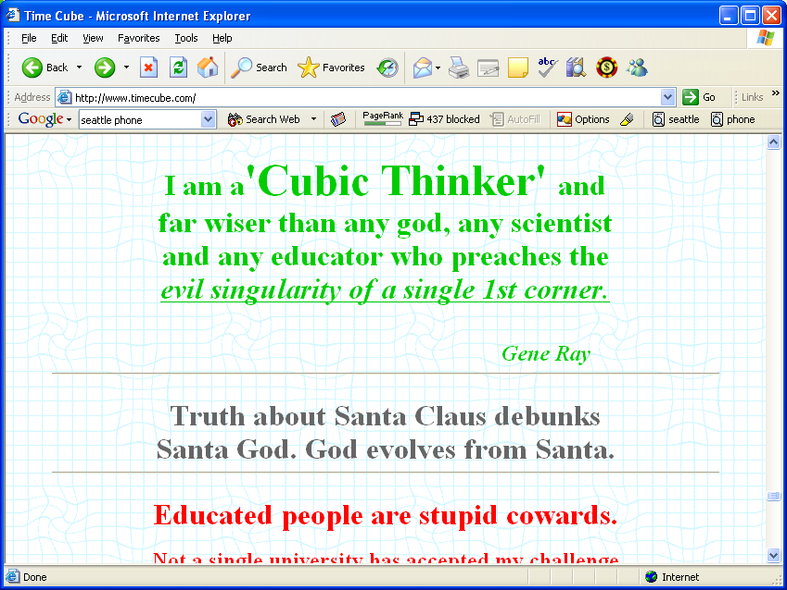
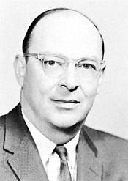
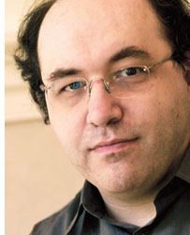
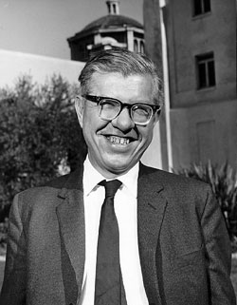
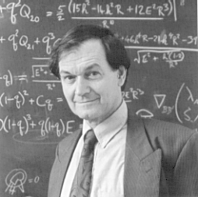
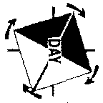
Crackpot Meter
0
1
0
1
0
1
0
1
0
1
John
Bardeen
Roger
Penrose
Stephen
Wolfram
Sir Fred
Hoyle
Gene
Ray
+ Transistor
+ BCS theory
of super-
conductivity
+ Singularity
theorems
+ Twistor theory
+ Penrose tilings
- Quantum
microtubule
brains
+ Cellular
automata
+ Mathematica
- “A New Kind
of Science”
- “A New Kind
of Science”
+ Nucleosynthesis
- The steady state
universe
- Dark matter is
bacteria
- Bumblebees are
integalactic
travelers

Slide 6
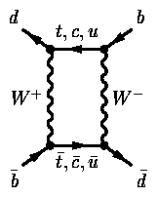
Three Revolutions of
Fundamental Modern Physics
0
1
Relativity
Special and General
Quantum
Theory
The Standard
Model

Slide 7
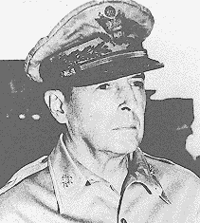
Three Revolutions of
Fundamental Modern Physics
0
1
Special
Relativity
General
Relativity
Quantum Field
Theory
Renormalization
Quantum
Theory
The Standard
Model

Slide 8
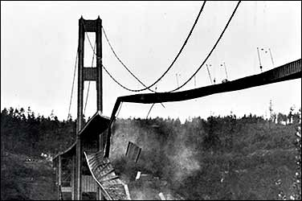
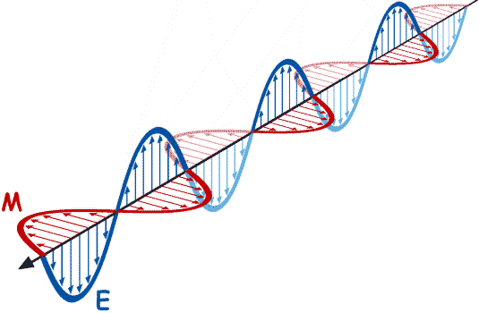
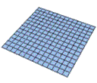



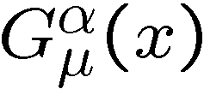

The Failure
0
1
Quantum Field Theory
General Relativity
dynamic variables
particle fields
metric
defined over some space-time
space-time itself!
the game called renormalization
works
fails

Slide 9
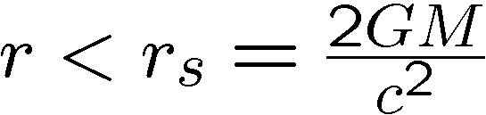
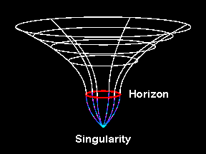
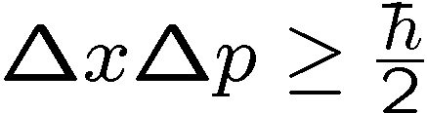
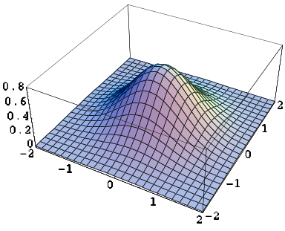

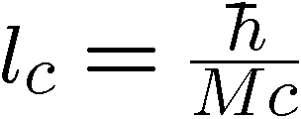
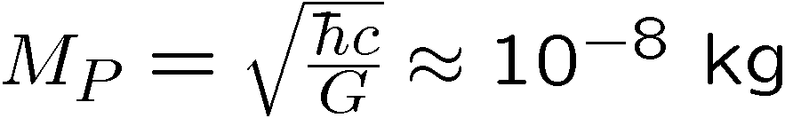
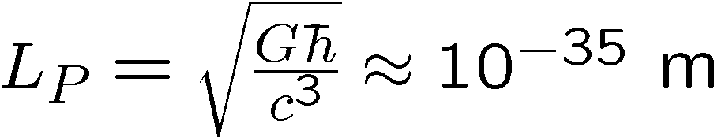
Planck Length
0
1
General Relativity
Blackholes:
If we cram mass inside
we create a blackhole
Any mass blackhole possible
Quantum Field Theory
localize to diameter d → large momentum possible
large momentum → particle creation
Compton length:
Black holes of small mass such that Compton length is outside horizon?
Planck Mass
Planck Length

Slide 10
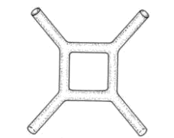
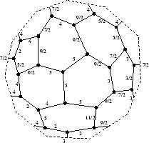
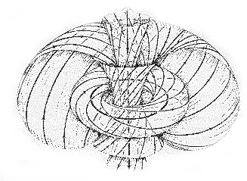
The Beaten Path
0
1
String Theory:
  quantum theory of strings in high dimensional spaces
  graviton (spin 2) naturally arises
  hope to incorporate all of Standard Model
Big Problem: no string universe looks like our own (the landscape problem), what is M-theory?
Loop Quantum Gravity:
  non-canonical quantization of Ashtekar’s variables
  gravity only
  non-perturbative
Big Problem: emergence of classical general relativity uncertain, proper dynamics not established, can we calculate anything?
Others:
  Euclidean quantum gravity, Twistors, Causal sets,
  Dynamical triangulation, Supergravity,
  Causal dynamical triangulation, ….

Slide 11
Square Peg
0
1
second quantization
renormalization
U(1)
SU(2)
SU(3)
Electromagnetic
Force
Weak
Force
Strong
Force
Gravitational
Force

Slide 12
The Unbeaten Path
0
1
Instead of trying to quantize gravity, a “possible path” is to
Derive quantum (field) theory from a deeper theory of
spacetime which includes general relativity as a limit.
QFT,
Standard
Model
General
Relativity
1. Motivation. Defining properties of quantum theory.
2. Argument by anecdote.
3. The possible path.
4. Technological implications.

Slide 13
Quantum Theory
0
1
“We all know how to use [quantum mechanics] and how to apply it to problems;
and so we have learned to live with the fact that nobody can understand it.”
- Murray Gell-Mann
Postulates of Quantum Theory
The state of a system is described by a wave function.
The wave function is an element of a Hilbert space
(think: a vector).
2. Evolution of the state of the quantum system is described
by a unitary operator acting on the wave function
(think: rotating vector)
3. From the wave function we can calculate the probability of
measurement outcomes by examining the overlap
squared of the wave function with a set of vectors
describing the measurement. (think: projecting vector)
3
2
1
4. State space for different degrees of freedom combine as
a tensor product. (think: d₁+d₂ dim vector as concatenation
of d₁ dim vector and d₂ dim vector )

Slide 14
Quantum Non-Mysteries
0
1
The wave function and reality
we have no right to demand a connection between the wave
function and elements of reality
Kochen-Specker Theorem: those measurement directions do not correspond to elements of reality.
Silliness: “intrinsic quantum uncertainty”
quantum theory contains determinism
3
3
3
2
2
2
1
1
1
“100% 2”
“100% 3”
KS: no way to assign “100% 2” with an element of reality “2”.
information
describing
system
010010
100101
110111
measurement
device
property:
10
01
00
A
B
C

Slide 15




Quantum Non-Mysteries
0
1
“Collapse” of the wave function
any theory which only predicts probabilities will have “collapse”
outcome
outcome
Conflict between classical physics and quantum physics
the emergence of classical physics from quantum theory is not
“totally” solved, but we sure know a lot about how this occurs
Well understood
Quantum
Theory
Classical
Theory
Why this arrow?
We should not demand “classicality” in a theory which explains the
origin of quantum theory

Slide 16


Quantum Mysteries
0
1
Why Hilbert space? Why the quantum probability law?
Quantum theory has been very universal:
all of the standard model obeys quantum theory
How do we separate out the information content of quantum
theory from deeper physics? (The Fuchs Program)
Wootters’ thesis (1980):
“yes”
“no”
Transmitter
Receiver
600 yes, 400 no → root mean square deviation ≈15.5.
maximize number of distinguishable
distinguishable angles
quantum probability law:
fraction of “yes”

Slide 17
Quantum Mysteries
0
1
Information and Locality
Alice
cannot communicate
Bob
time
time-like
future
space-like
elsewhere
space-like
elsewhere
space
time-like
past
Special relativity gives rise to a causal structure for the transmission
of classical information.

Slide 18

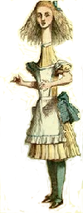
Compare
0
1
two quantum
subsystems
2. Separate
3. Choose measurement
4. Measure
5. Get outcome
3. Choose
measurement
4. Measure
5. Get outcome
1. Interact and
entangle
BOB
ALICE
Share classical
correlations
2. Choose
measurement
2. Choose
measurement
data
data
3. Produce
measurement
outcome
03XSFW3331
03XSFGF111
3. Produce
measurement
outcome
BOB
ALICE

Slide 19



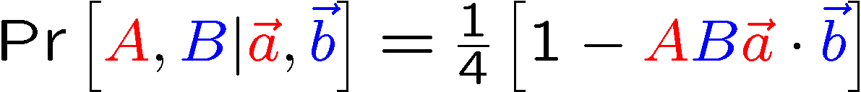
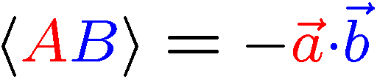
An Experiment
0
1
ALICE
φ
BOB
Measurement:
Measurement:
θ
Outcome:
A∈{+1,-1}
Outcome:
B∈{+1,-1}
Quantum Experiment Results:

Slide 20
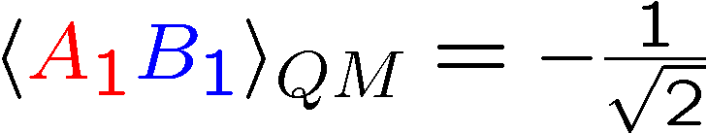
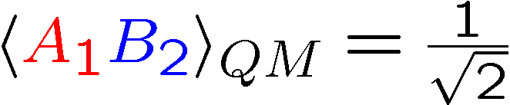

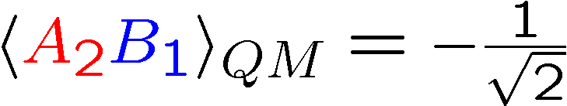


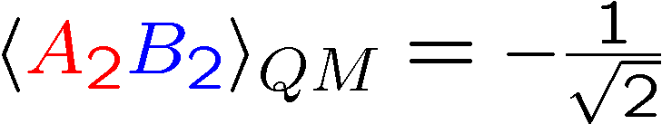



Bell’s Theorem
0
1
Four Quantum Experiments
Four Classical Experiments
cannot depend on (either outcome or which measurement)
Bell’s Theorem: quantum theory produces correlations which
cannot be explained as locally created classical correlations:

Slide 21
Quantum Mysteries
0
1
Bell’s Theorem:
Assumptions:
classical information describing quantum system (weak realism)
(note: no assumption that we can measure this information, KS)
2. no cosmic conspiracy
3. causal structure of space-time
Comments:
Bell’s theorem is stronger than just ruling out “classical physics”
explanations of quantum theory.
No faster than light communication. No spooky action at a distance.
No faster than light communication. No spooky action at a distance.
No faster than light communication. No spooky action at a distance.
No faster than light communication. No spooky action at a distance.
No faster than light communication. No spooky action at a distance.

Slide 22
0
1
Mysterious Extra Slide

Slide 23




General Relativity
0
1
“Matter tells space-time how to bend and space-time tells matter how to move”
-John Wheeler
Equivalence principle: all physical laws are the same in all inertial and
freely falling frames of reference (gravitational mass = inertial mass)
Postulates of General Relativity
Space-time is a four-dimensional pseudo-Riemannian
manifold whose metric signature is (-1,+1,+1,+1).
2. Matter/energy is described by the stress energy tensor, a two index
tensor describing both the static and dynamic properties.
3. Einstein field equations.
Nonlinear partial differential
equations for metric.
Einstein tensor
Cosmological constant
(4). Sometimes we also add that test particles travel along geodesics
(but we could instead talk about singularities, limit of small mass)

Slide 24

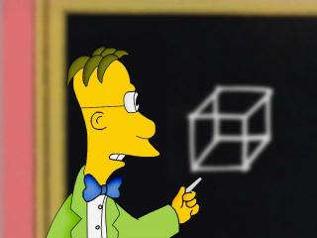
General Relativity’s
Muteness
0
1
General Relativity’s incompleteness about spacetime:
Topology
and
Dimension
D=1
D=2
D=3
D=4

Slide 25



Twins in Torusland
0
1
Topology:
Metric: flat
Twin paradox:
identified
t
t
identify
opposite
sides of cube
x
x
A
B
A
B
Time dilation implies
A is older than B
who is older?
preferred reference frame

Slide 26
Topology and Murder
0
1
t
identify
identify
closed time-like
curve
x
Chronology protection conjecture (Hawking):
The lord doth prohibit spacetimes with closed timelike curves.
Moral: Some topologies are harmless, some lead to severe headaches.
T. Brun, “Computers with closed timelike curves can solve hard problems efficiently,” Foundations of Physics Letters 16, 245 (2003).
D. Bacon, “Quantum computation in the presence of closed timelike curves,” Phys.
Rev. A 70, 032309 (2004)
S. Aaronson, “NP-complete Problems and Physical Reality,” SIGACT News
Complexity Theory Column, March 2005.

Slide 27
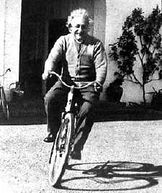
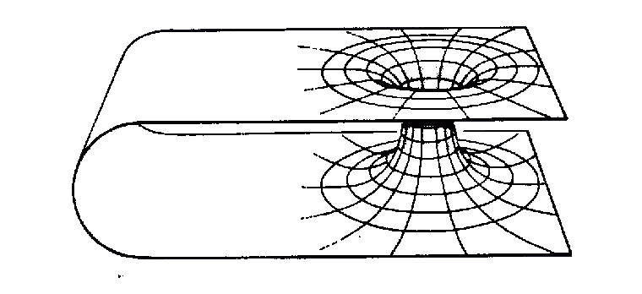
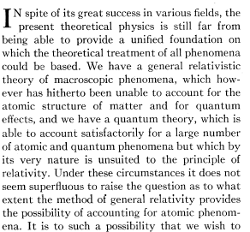
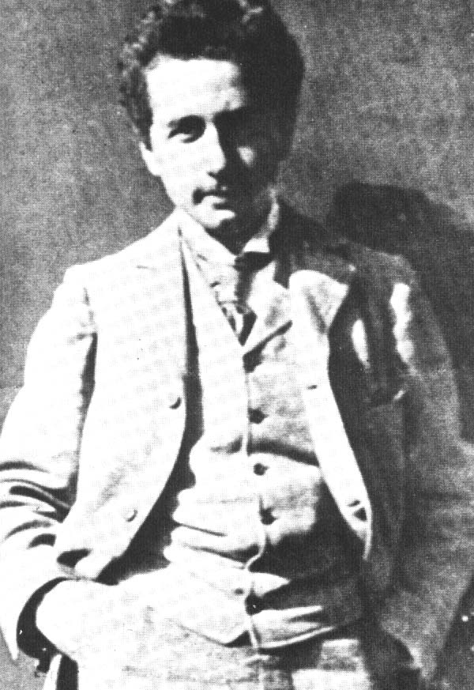
Old Einstein
0
1
A. Einstein and N. Rosen 1935
Einstein-Rosen Bridge
(a.k.a. “a wormhole”)
Paste together two
Schwarzschild throats
Basically unstable.
Not possible to traverse wormhole
before the throat pinches itself off.
Note: Einstein, Rosen paper publish two months after famous Einstein, Podolsky, Rosen paper. Can we deduce Einstein’s response to Bell’s theorem?
Crank checklist: references to Einstein

Slide 28

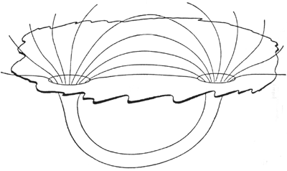

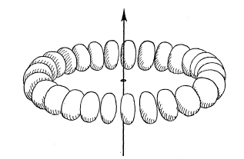
JAWs Says
0
1
Gauss’s Law
point particles as singularities in the electric field
John Archibald Wheeler (1957)
Charge without charge: source free Gauss’s law on wormhole topology makes throats look like charged particles
Wheeler and Misner’s attempts a using source free Maxwell equations,
general relativity, plus topology to derive all of classical physics.
Random extra JAW cool thing: geon

Slide 29
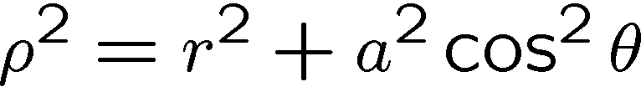
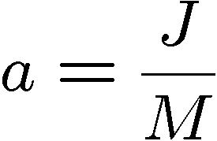
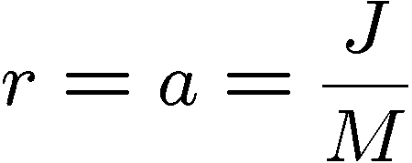
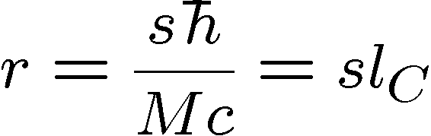
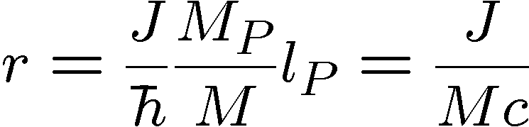
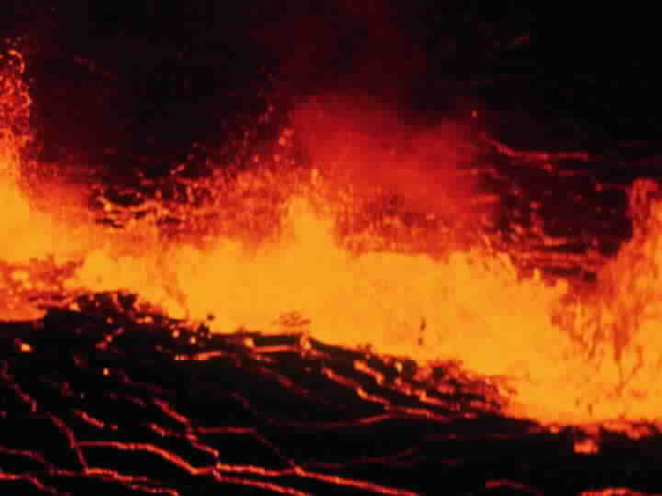
Serious Point Particles
0
1
Spinning (J), charged (Q), massive (M) object: Kerr-Newman solution
Take seriously for elementary particles?
Solution has a naked (no event horizon) ring
Singularity with closed timelike curves!
spin s particle:
Naked singularity of size the Compton length?!?!?
What the does this mean?

Slide 30


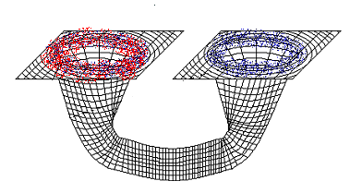
Wormhole, Time Machine
0
1
1988: Misner and Thorne show traversable wormhole solutions
All previous solutions had event horizons and from point of view
of outside observers took an infinite amount of time to traverse.
Misner and Thorne’s trick: make interesting geometry and then
derive the stress energy tensor consistent with it.
Problem: requires violation of the null energy condition
“negative energy density”
for all null vectors
(NEC)
Problem:
Time machines, Misner, Thorne, Yurtsever
t
Time delay between throats.
Closed timelike curves
Twin paradox:
x
A
B

Slide 31


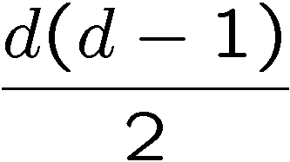

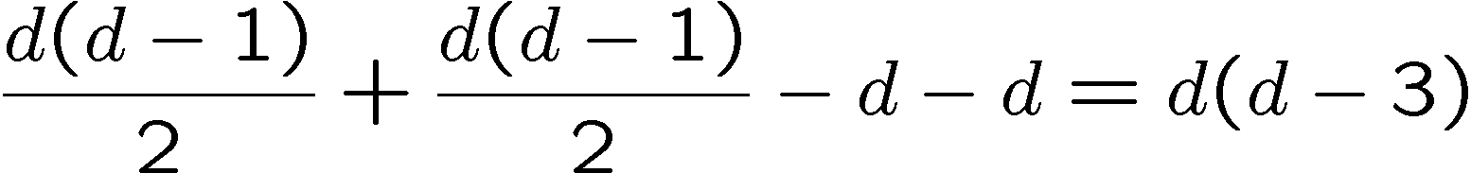
Dimensionality
0
1
What does gravity look like in different dimensions?
Counting argument (ADM formalism):
real, symmetric, dim=d-1
spatial metric
external curvature
degrees of
freedom:
Einstein’s equation
constraints
coordinate choices
Degree’s of freedom:
d=4 → 4 degrees of freedom
d=3 → 0 degrees of freedom
2 gravitational wave polarizations
No degrees of freedom!

Slide 32





2+1 ≠ 3
0
1
Einstein vacuum equations:
becomes
Space is everywhere flat, de Sitter or ant-de Sitter
concentrate on flat case
t
Boring!
x
But on topologically nontrivial
space, we can patch together
flat space with coordinate
patches. The transition
functions are elements of the
Poincaré group ISO(2,1)

Slide 33


2+1 Chronology Safety?
0
1
Particles in 2+1 dimenisional gravity are conical singularities
deficit angle
identify
Gott constructed a spacetime in 2+1 with closed timelike curves
This set off a series of work (t’Hooft, Carroll, Farhi, Guth, Olum)
showing that very generally closed timelike curves are not physical
in 2+1 dimensional gravity.

Slide 34



Smitten with Witten
0
1
Ed Witten showed 2+1 dimensional gravity can be cast as a
Chern-Simons theory with gauge group ISO(2,1)
is an ISO(2,1) valued connection
Independent of the metric of the manifold M:
Topological Quantum Field Theory (TQFT)
Side note: Chern-Simons theory with gauge group SU(2) leads to
Wilson loops whose values are the knot invariants known as
the Jones polynomial
(SU(N) leads to the HOMFLY polynomial)

Slide 35
TQFT I
0
1
“Quantum Quandries: A Category-Theoretic Perspective,” J. Baez 04
Manifold M
Hilbert space H
Cobordism C
Unitary Operator U
functor
Manifold M
Hilbert space H
Manifold M
Hilbert space H
Cobordism C
Linear Operator L
functor
Manifold M
Hilbert space H
Moral: Topology change corresponds to measurement

Slide 36

TQFT II
0
1
Manifold M
Hilbert Space
Cobordism C
Linear Operator
functor
Trivial Manifold M
Hilbert space
We can associate preparation of a state with cobordism C from trivial
manifold to a manifold of topology associated with a given Hilbert space
Realistic description of the wavefunction as cobordism from trivial.
Unitary manipulation by cobordism.
Measurement corresponds to “trimming the tree” topology chage.
Can the topological properties allow us to get around Bell’s theorem?
But: why the quantum probability rule?

Slide 37

Spin Networks
0
1
Penrose’s original spin networks
2
1
trivalent graph with edges labeled by half integers
3
1/2
1/2
1
5
4
7/2
1
9/2
4
4
+ cyclic permutations
5
1/2
1
1/2
3
1
Penrose: Combinatorial rule for calculating effect of “measuring”
the spin network reproduces the statistics of a single qubit.
obtain rational values whose density
is proportional to size of network
realistic description from which probabilities
can be calculated is the double of the spin
network.

Slide 38



A Protocol
How to simulate without sending full description of vectors
between Alice and Bob?
Alice and Bob share two perfectly correlated uniformly
distributed unit three dimensional vectors
Alice output
Alice sends to Bob
Bob outputs
Correlations on a single ebit
=
shared randomness + 1 bit of communication
[Bacon and Toner, Phys. Rev. Lett. 90, 157904 (2003)]
[Toner and Bacon, Phys. Rev. Lett. 91, 187904 (2003)]

Slide 39


Dirac Belt Tricks
0
1
Me a few years ago: Why 1 bit?
What game are quantum correlations good at?
Me today: Why the geometric structure of
the protocol?
The existence of SU(2) as evidence for of particles as embedding
of a geometric object in spacetime?
DEMONSTRATION

Slide 40
Let’s Build Spacetime
0
1
Build curved spaces by gluing
together flat pieces of space.
Take limit as flat pieces shrink
D dimensional simplexes
D=0
D=1
D=2
D=3
D=4

Slide 41



Regge Calculus
0
1
Build up spacetime by gluing together 4 dimensional flat simplexes of spacetimes with variable length edges
D=4
For given configuration can calculate the action S
Quantum Regge Calculus
Amplitude for evolution of spacetime:
How to define this sum over geometries?
Do we include topology?
CTC spacetimes?
Singular metrics?
A common trick in the 1990s was to consider Euclidean theories
and then perform a Wick rotation

Slide 42


Not My Spacetime
0
1
bare
cosmological
constant
branched polymer
d_{eff}=2
d_{eff}=∞
Infinite volume
limit exists
1st order
phase transition
bare inverse
coupling constant

Slide 43

Causal Dynamical
Triangulations
0
1
Ambjorn, Jurkiewicz, Loll, …
variation on quantum Regge Calculus
Lorentzian theories which can be rotated to Euclidean theories
spacetime topology preserving, no causality violations….
yields 4 dimensional spacetimes!

Slide 44
Reconciliation
0
1
Extension of general relativity to derive quantum theory
3+1 nontrivial topologies problematic
2+1 topologies do not lead to causality problems
2+1 topologies lead to realistic description of wavefunction
spin networks similarly lead to realistic description
spin networks lead to combinatorial quantum probabilities
half-integer spin implies relational embedding important
dynamical triangulations give quantum theory of spacetime
we can reinterpret dynamical triangulations as classical theory
3+1 dimensional dynamical triangulation
plus
2+1 dimensional objects which obey quantum theory

Slide 45
A Possible Path
0
1
Understand how to incorporate all of the
objects of the standard model into theory
Understand breaking of general covariance
in merging 3+1 dimensional and 2+1
dimensional gravity
Realistic description of quantum theory
from 2+1 dimensional gravity or
2+1 dimensional TQFT

Slide 46

Technological
Implications
0
1
Generalized
General
Relativistic
Computers
Classical
Computers
Quantum
Computers
Hard to envision modifications of quantum theory which do not
end up efficiently solving NP-hard problems.
Does the physical theory described here allow for the solution
of NP-hard problems?
Efficiently solving NP-hard problems implies all sorts of craziness!

Slide 47
Technological
Implications
0
1
“If such a procedure existed, then we could quickly find the smallest Boolean circuits that output (say) a table of historical stock market data, or the human
genome, or the complete works of Shakespeare. It seems entirely conceivable that, by analyzing these circuits, we could make an easy fortune on Wall Street, or retrace evolution, or even generate Shakespeare’s 38th play. For broadly speaking, that which we can compress we can understand, and that which we can understand we can predict. Indeed, in a recent book [12], Eric Baum argues
that much of what we call ‘insight’ or ‘intelligence’ simply means finding succinct representations for our sense data. On his view, the human mind is largely a bundle of hacks and heuristics for this succinct-representation problem, cobbled together over a billion years of evolution. So if we could solve the general case—if knowing something was tantamount to knowing the shortest efficient description of it—then we would be almost like gods. The NP Hardness Assumption is the belief that such power will be forever beyond our reach.”
-Scott Aaronson
SIGACT News Complexity Theory Column, March 2005

Slide 48




Technological
Implications of Being God
0
1
Polynomial Hierachy
Even with the power of the NP-god, there are still a series
of difficult problems for us to conquer.
How far up the ladder of deity does physical reality allow?

Slide 49
Summary
1. Dave is Crazy
Quantum theory is strange
3. General relativity is rich
4. 3+1 dim gravity on nontrivial topologies lead to difficulties
5. 2+1 dim gravity has less difficulties and looks like quantum theory
6. Put these together to yield a geometric derivation of quantum
theory?
7. You should take Dave to the Looney Pen

