Slide 1
sihT esraP oT yrT

Slide 2


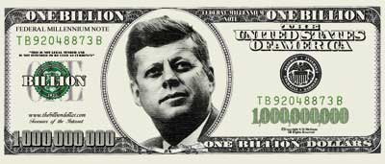

The Cost of Spookiness
Dave Bacon
Santa Fe Institute
SFI Research Talk, New Years Day, 4703

Slide 3


In Collaboration With…
G.S. Ben Toner– Caltech
G.S. Tracey Tessier – Univ. of New Mexico
Prof. Carl Caves – Univ. of New Mexico
Prof. Ivan Deutsch – Univ. of New Mexico
G.S. Brian Eastin – Univ. of New Mexico

Slide 4
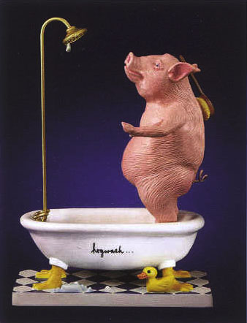
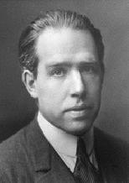
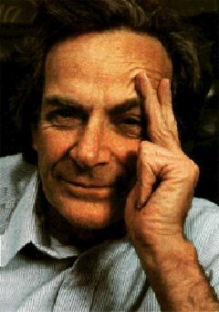
Propaganda
Anyone who is not shocked by quantum
theory has not understood it.
Niels Bohr
They understood it.
They used it.
They just needed to ditch
their preconceptions.
I think I can safely say that nobody
understands quantum mechanics.
Richard Feynman

Slide 5
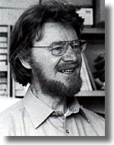
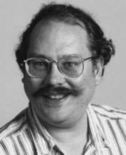
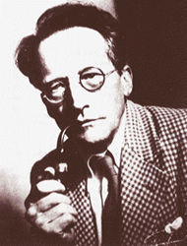
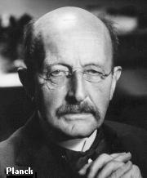
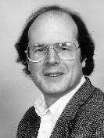
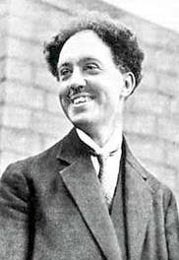
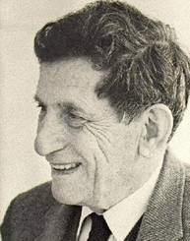
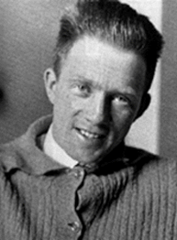
War Is Over
Inventing
Worrying
Accepting
1900
1910
1920
1930
1940
1950
1960
1970
1980
1990
2000
Peter Shor
Niels Bohr
John Bell
Erwin Schrodinger
Max Planck
Louis de Broglie
David Bohm
Charlie Bennett
Werner Heisenberg

Slide 6
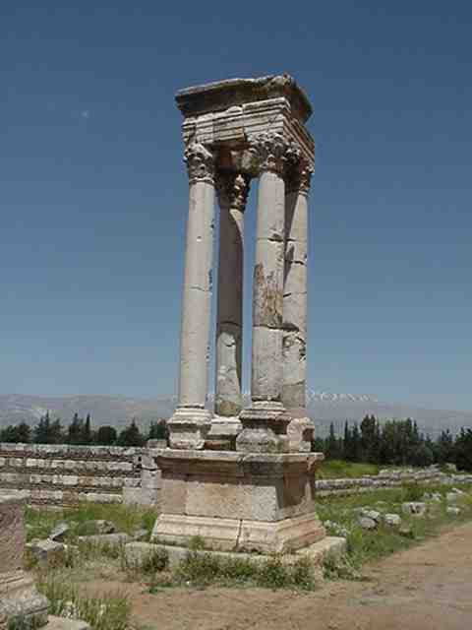
Worrying?
Electromagnetism
Strong force
Gravity??
Weak force
Quantum
Theory
"I have this student, he's thinking about the foundations of quantum mechanics.
He is doomed." — John McCarthy (of Artificial Intelligence fame)

Slide 7

Quantum Information Science
…is what happens when we stop worrying
about quantum theory and love the strangeness.
Were the worries were in vain?
This talk: NO

Slide 8
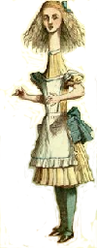

Talk To Me
1 if a=b
0 if a≠b
F_{eq}(a,b)=
ALICE
BOB
a
b
0
1
0
1
0
0
1
1
1
0
n bits
n bits
How much (many bits) do Alice and Bob need
to exchange to compute F(a,b)?
With no error: n bits
With one-sided error ε: O(log(n/ε)) bits

Slide 9
Talk To Me
Some More
ALICE
BOB
a
b
0
1
0
1
0
0
1
1
1
0
n bits
n bits
F_{xor}(a,b)=a₁⊕a₂ ⊕ …⊕a_{n}⊕b₁⊕b₂ ⊕ …⊕b_{n}
How much (many bits) do Alice and Bob need
to exchange to compute F(a,b)?
With no error: 1 bit

Slide 10
Communication Complexity
How much communication between Alice
and Bob is necessary for them to compute
F(a,b) when Alice knows a and Bob knows b?
[Yao 79]
many rigorous lower and matching upper bounds
…in contrast to computational complexity
P
NP
N=1?
P=0?

Slide 11


Make It Quantum
ALICE
communicate qubits
BOB
a
b
How does classical communication complexity (bits)
compare to quantum communication complexity (qubits)?
Holevo’s Theoerem: sending n classical bits
requires n quantum bits.

Slide 12

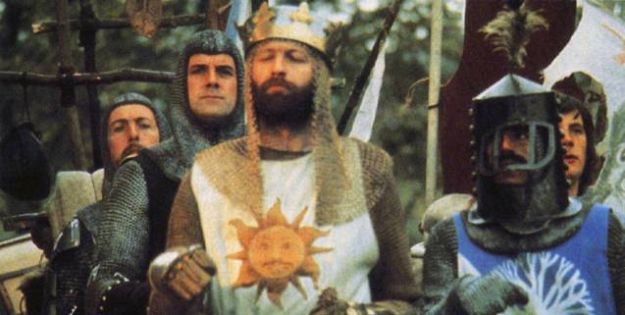
Not So Fast
There exists functions F(a,b) which require
Ω(m^{1/4}/log(m)) bits of communication to solve
but can be solved using only O(log(m)) qubits.
[m is the length of a and b]
Ran Raz
(1999)
Exponential benefit in
quantum over classical.
Exact model 0-error:
Buhrman, Cleve, Wigderson (1998)
1-way communication exponential separation:
Bar-Yossef, Jayram, Kerenidis (2004)

Slide 13

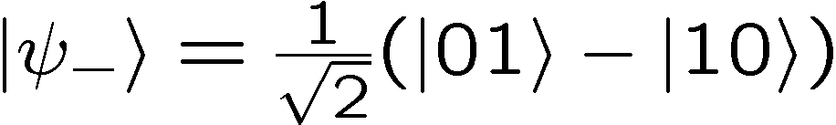
Quantum Teleportation
1 qubits
ALICE
BOB
a
b
2 bits
+
entangled
quantum
state
ALICE
BOB
b
a
Quantum Teleportation Protocol

Slide 14
Entanglement as a Resource
If parties share entangled states, they can outperform classical
communication complexity protocols. What is entanglement?
Alice performs
measurement of
her choice.
Bob performs
measurement of
his choice.
ALICE
BOB
Alice gets
measurement
outcome
Bob gets
measurement
outcome
CORRELATED

Slide 15

What Entanglement Is Not
shared randomness
once shoes put on, cannot change
(shoes not allowed to talk to each other)
note: shared randomness cannot be used to communicate

Slide 16
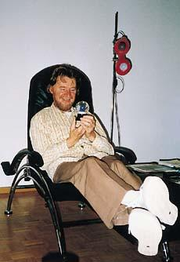

For Whom the Bell Tolls
Entanglement is not like shared randomness
Historical context:
Einstein: quantum theory is incomplete
there is a deeper theory which gives rise
to quantum theory
realistic variables of
a more fundamental
theory.
A happy
John Bell
John Bell to Einstein: “If those variables are local, then such a
fundamental theory cannot exist.”

Slide 17







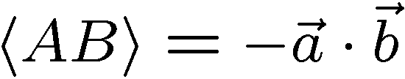
Bell Experiment
-1
-1
+1
+1
A
B
ALICE
BOB
A B Probability
- 1 - 1 - 1 +1 +1 - 1 +1 +1

Slide 18
Bell Inequality (CHSH)
A∈{+1,-1}
B∈{+1,-1}
ALICE
X
Y
BOB
|A₁B₁+A₁B₂+A₂B₁-A₂B₂|≤2
Consider all deterministic values for A₁,A₂,B₁,B₂ where parties output is independent of others measurement
A₁(B₁+B₂)+A₂(B₁-B₂)
Probabilistic= Convex sum
of deterministic

Slide 19


Celebrate Good Times
1
1
2
2
45º
1
1
2
2
Quantum:
|A₁B₁+A₁B₂+A₂B₁-A₂B₂|=2√2
Local Hidden Variables:
|A₁B₁+A₁B₂+A₂B₁-A₂B₂|≤2
Bell’s Theorem: Quantum theory cannot be explained
by a local hidden variable theory.

Slide 20
Recap
1. Entanglement can be used for exponential gain in quantum
communication complexity.
2. Entanglement is not like shared randomness.
3. Physicists have worried about entanglement since it
invalidates local realism. (spooky correlation)
Quantum information science: I don’t care about locality,
I just care about these using these strange quantum
correlations as a resource!

Slide 21

The Question
What is the communication cost of simulating the correlations produced by measuring entangled quantum states?
Quantify Bell’s Theorem

Slide 22








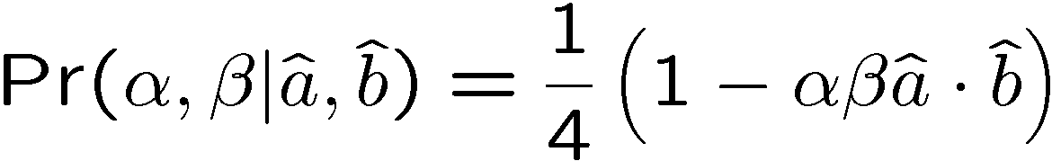
Simulating Bell Correlations

Slide 23

Why Is It Hard?

Slide 24


Towards Simulating Bell

Slide 25

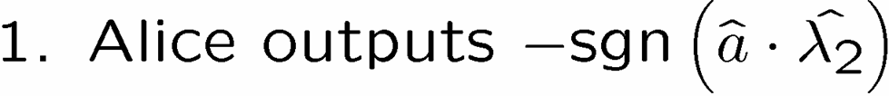

A 1 Bit Protocol

Slide 26
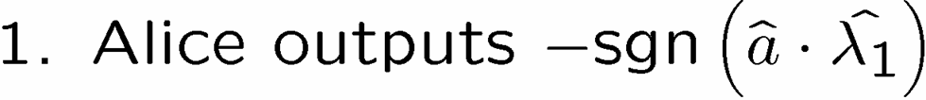








The Intuition

Slide 27


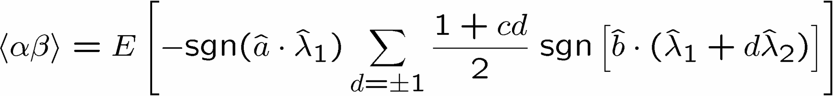
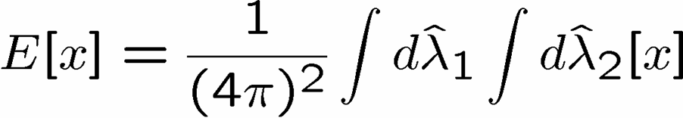
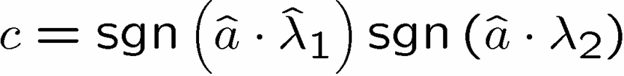
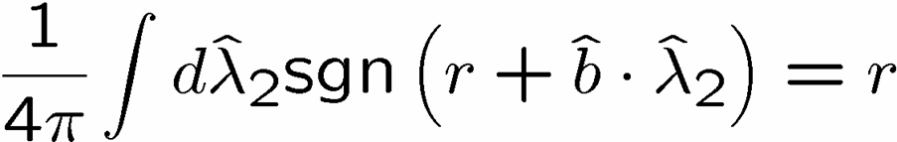
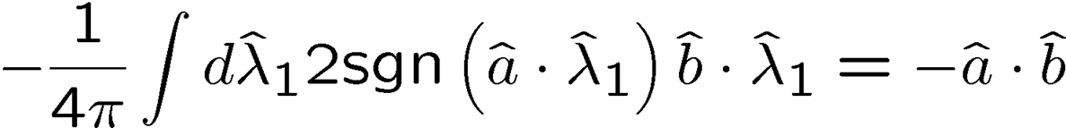

It Works!

Slide 28

1 Bell Pair’s Worth of Correlations
B. Toner and D. Bacon, Phys. Rev. Let., 91, 187904 (2003)

Slide 29
The Finiteness Conjecture
Conjecture: all multipartite entangled systems can be exactly
simulated by augmenting a local hidden variable theory
with an amount of communication polynomial in the
product of the dimensions of the entangled subsystems.
projective measurements on two entangled qubits
  (Brassard, Cleve, Tapp 99, Toner, Bacon 03)
all bipartite two outcome correlation observables
  (Bacon, Toner, t.b.p., 05)
Today: add more evidence for the conjecture.

Slide 30


GHZ/Mermin Game
Alice
Input A
Output a
Bob
Input B
Output b
Input: X or Y, Output: +1 or -1
Win condition:
A B C abc
X X X +1
Y Y X -1
Y X Y -1
X Y Y -1
Charlie
Input C
Output c
Classical
Quantum:
a_{Y} b_{Y} c_{X} = -1
a_{Y} b_{X} c_{Y} = -1
XXX|GHZ⟩=|GHZ⟩
YYX|GHZ⟩=-|GHZ⟩
YXY|GHZ⟩=-|GHZ⟩
XYY|GHZ⟩=-|GHZ⟩
not
possible
to always
win
possible
to always
win
×
a_{X} b_{Y} c_{Y} = -1
a_{X} b_{X} c_{X} = -1

Slide 31
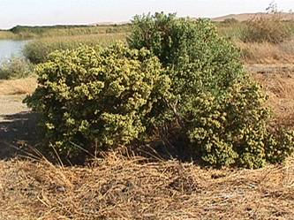
Cheaters Always Win
Alice
Input A
Output a
Bob
Input B
Output b
Win condition:
A B C abc
X X X +1
Y Y X -1
Y X Y -1
X Y Y -1
Charlie
Input C
Output c
Charlie: always outputs c=+1
Bob: always outputs b=+1, tells Alice his measurement
Alice: knows A and B
A B a abc
X X +1 +1
Y Y -1 -1
Y X -1 -1
X Y -1 -1
Using a single bit of communication they can win.

Slide 32
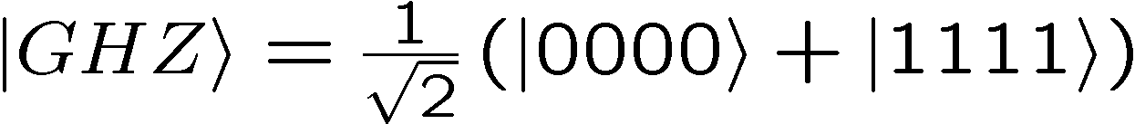
GHZ Extended
win condition
A B C D abcd
X X X X +1
X X Y Y -1
X Y Y X -1
X Y X Y -1
Alice
Input A
Output a
Bob
Input B
Output b
Charlie
Input C
Output c
Dodo
Input D
Output d
Quantum
possible to always win
Classical (no talking)
Classical (A and B talk)
a_{X} b_{X} c_{Y} d_{Y}= -1
v_{XX}c_{Y} d_{Y}= -1
a_{X} b_{Y} c_{X} d_{Y}= -1
v_{XY}c_{Y} d_{X}= -1
a_{X} b_{Y} c_{Y} d_{X}= -1
×
v_{XY}c_{X} d_{Y}= -1
×
a_{X} b_{X} c_{X} d_{X}= -1
v_{XX}c_{X} d_{X}= -1
impossible to always win
impossible to always win

Slide 33
GHZ Super Extended
win condition
Quantum
A B C D abcd
X X X X +1
X X Y Y -1
X Y Y X -1
X Y X Y -1
Y X X Y -1
Y X Y X -1
Y Y X X -1
possible to always win
Alice
Input A
Output a
Bob
Input B
Output b
Charlie
Input C
Output c
Dodo
Input D
Output d
If any two parties talk, they cannot always win!

Slide 34

Bell Inequality With Communication
two parties, three two-outcome measurements
local hidden variable theory + 1 bit of communication
D. Bacon and B.F. Toner, Phys. Rev. Let. 90, 157904 (2003)
|-ab+ac-ba+bb+bc+ca+cb+cc|≤6
|aa+2ab-2ac+2ba+bb+2bc-2ca+2cb+cc|≤11
but, quantum theory has
⟨-AB+AC-BA+BB+BC+CA+CB+CC⟩_{QM}≤6
⟨AA+2AB-2AC+2BA+BB+2BC-2CA+2CB+CC⟩_{QM}≤11
four parties, two two-outcome measurements
local hidden variable theory + 1 bit of communication
|aaaa-aabb-abab-abba-baab-baba-bbaa|≤5
quantum theory violates this bound
⟨AAAA-AABB-ABAB-ABBA-BAAB-BABA-BBAA⟩_{GHZ}=7

Slide 35
Measure It!
Just as Bell Inequalities tell us that we can experimentally distinguish between quantum theory and local hidden variable models,
this Bell Inequality with Communication tells us that we can experimentally distinguish between quantum theory and local hidden variable models, plus one bit of cheating communication.
|aaaa-aabb-abab-abba-baab-baba-bbaa|≤5
⟨AAAA-AABB-ABAB-ABBA-BAAB-BABA-BBAA⟩_{GHZ}=7

Slide 36
3,4,…,n
win condition
A ……… n-3 n-2 n-1 n abcd
X ……… X X X X +1
X ……… X X Y Y -1
X ……… X Y Y X -1
X ……… X Y X Y -1
local hidden variable theory
plus n-3 bits of communication
|A…A-∑(observables with 2 B’s and rest A’s)|≤n(n-1)/2-1
⟨A...A-∑(observables with 2 B’s and rest A’s)⟩_{GHZ}=n(n-1)/2+1
Bell Inequality with n-3 bits of communication

Slide 37
Simulating Pauli Measurements on GHZ
n parties, each measure {X,Y,Z} on n party GHZ state
BIwC implies least n-2 bits of communication necessary
n-2 bits of communication is also sufficient
1 2 3 … n
X R₂ R₃…R_{n} R₂ R₃ … R_{n}
Y R₁ R₂…R_{n} R₁R₂ R₁R₃ … R₁R_{n}
Z R₁ R₁ R₁ … R₁
R_{i}∈{+1,-1}
uniform
random
variables
parties 2…n-1 communicate to party 1 whether they measured Y or not
party 1 flips her outcome bit if [hers Y plus 2…n-1 Y’s]
is odd else she does nothing

Slide 38
The Finiteness Conjecture
Conjecture: all multipartite entangled systems can be exactly
simulated by augmenting a local hidden variable theory
with an amount of communication polynomial in the
product of the dimensions of the entangled subsystems.
projective measurements on two entangled qubits
  (Brassard, Cleve, Tapp 99, Toner, Bacon 03)
all bipartite two outcome correlation observables
(Bacon, Toner 05)
Pauli measurements on a n-party GHZ states
  (Tessier, Caves, Deutsch, Eastin, Bacon 05)

Slide 39
Conclusion
Entanglement gives exponential benefits
Entanglement is not like shared classical randomness
What is the communication cost of simulating quantum
correlations?
Simulating projective measurement on a singlet requires
shared randomness plus a single bit of communication
Simulating Pauli measurement on a n-party GHZ state
requires n-2 bits of communication and this is also sufficient.
Is there a deeper structure to quantum correlations?
Can all correlations be simulated by shared randomness
and an amount of communication related to the amount of
entanglement?

