Slide 1
This
Space
For
Sale

Slide 2
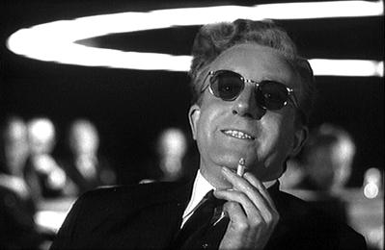
Quantum Computing
(or how we learned to stop worrying
and to love quantum theory.)
Dave Bacon
(once upon a time, a SFI postdoc)
Department of Computer Science & Engineering
University of Washington

Slide 3
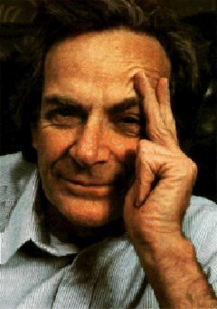
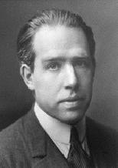
Quantum Propaganda
I think I can safely say that nobody
understands quantum mechanics.
Richard Feynman
Nobel Prize 1965
Anyone who is not shocked by quantum
theory has not understood it.
Niels Bohr
Nobel Prize 1922

Slide 4
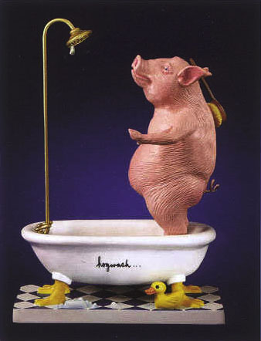
They understand it.
They use it.
But they don’t really believe it?

Slide 5
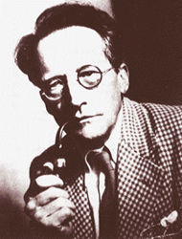
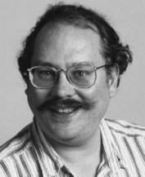
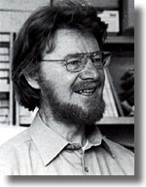
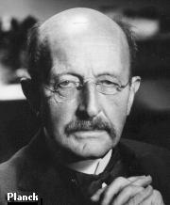
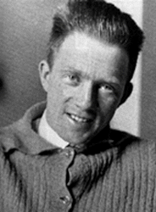
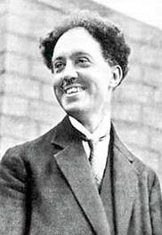
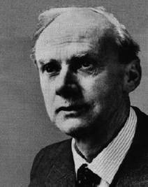
Quantum History
Inventing
Shut Up and Calculate
Accepting
1900
1910
1920
1930
1940
1950
1960
1970
1980
1990
2000
I Object!
Erwin Schrodinger
Niels Bohr
Peter Shor
John Bell
Max Planck
Werner Heisenberg
Louis de Broglie
P.A.M. Dirac

Slide 6
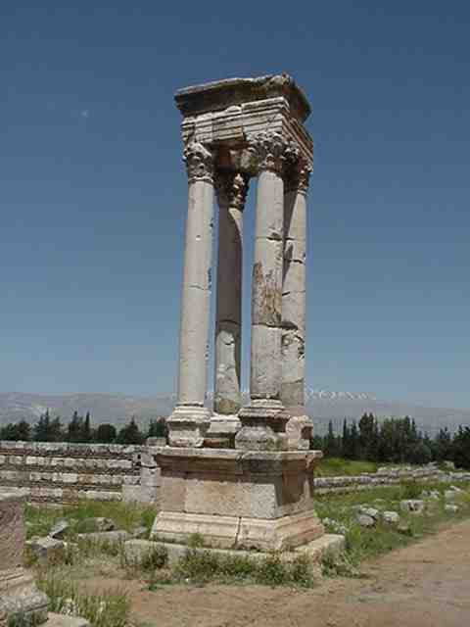
What Is Quantum Theory?
Electromagnetism
Strong force
Gravity
Weak force
Quantum
Theory
"I have this student, he's thinking about the foundations of quantum mechanics.
He is doomed." — John McCarthy (of Artificial Intelligence fame)

Slide 7
Acceptance
“Do not ask yourself, if you can possibly avoid that, 'how can
it be like that?' because you will lead yourself down a blind
alley in which no one has ever escaped.”
“For a successful technology, nature must take
precedence over public relations, for nature
cannot be fooled.”
Richard Feynman
“How can we simulate quantum mechanics?...Can we do
it with a new kind of computer…a quantum computer? It’s
not a Turing machine but a machine of a different kind” (1981)
“Perhaps…we need a mathematical theory of quantum
automata…” – Yu Manin (Radio Moscow, 1980)

Slide 8
What IF we think about COMPUTERS which operate according to QUANTUM THEORY?
Quantum
Classical
small
roughly size
large
QUANTUM THEORY rules but its intricacies become
unimportant for effects at “larger sizes.”

Slide 9
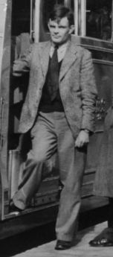
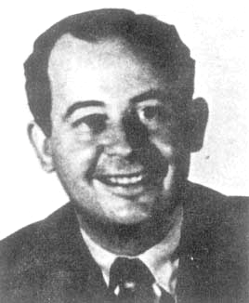
Near Misses
Rediscovered the Zeno effect in quantum theory
(if you measure a system constantly it will not
evolve!)
Alan Turing
Wrote classic text on the axioms of quantum theory.
John Von Neumann

Slide 10
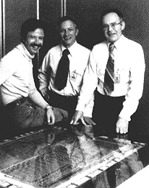
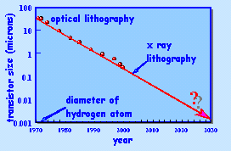
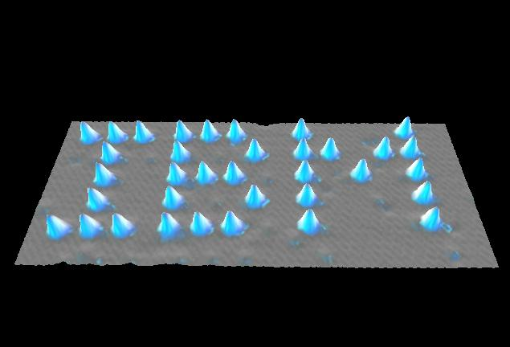
We Needed Moore
Noyce, Grove, Moore
Moore’s Law
(Moore’s prophesy?)

Slide 11
Quantum Computation
Why learn hear quantum computing at a summer school for complex systems?
1. The fundamental theory of information processing is the quantum theory of information processing.
2. Understanding complex quantum systems is a past time which physicists have made little progress in understanding. What sort of strange and wonderful materials, behaviors, and computations will quantum systems lead to?
3. Making a quantum computer robust must draw upon the
insights gained in understanding how robust behavior can
emerge from noisy processes in classical theory.
0. It’s fun.

Slide 12
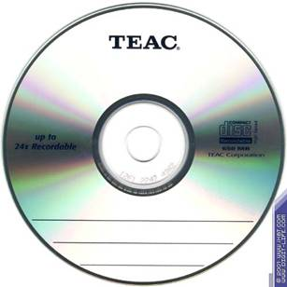
Quantum Uncertainty Is Not
Special
Quantum theory gives us probabilities of outcomes.
50% of the time the red light comes on
50% of the time the green light comes on
Try to describe classical computers.
Hardware errors do occur, but the timescales
involved are ridiculously long.
99.999999999999999999% the computer works perfectly
0.000000000000000001 the computer makes a mistake

Slide 13
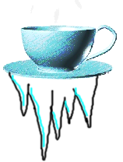
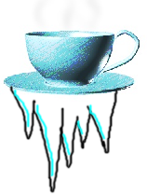
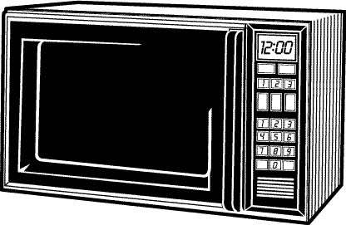


Randomizing Microwave
Digital Coffee
(Not Java!)
Mystery Markov Microwave
Scalding Hot
Freezing Cold
H
C

Slide 14

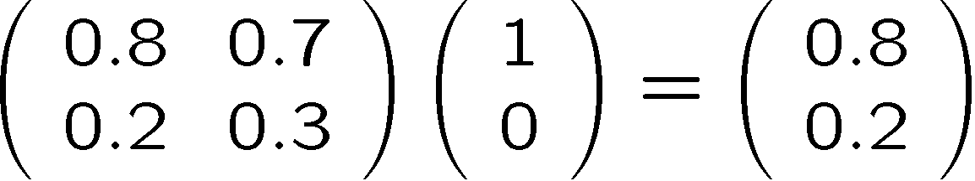
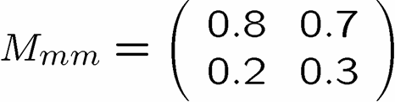
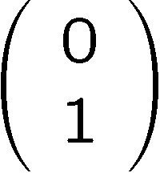
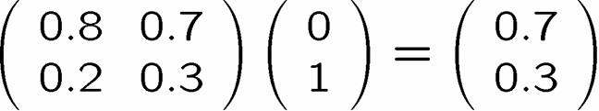
Markov
The true method of knowledge is experiment. - William Blake 1788
Run Experiments To Understand MMM Machine
If you put in C, 70% of the time you get H out
and 30% of the time you get C out
If you put in H, 80% of the time you get H out
and 20% of the time you get C out
A nice little formalism
H
C
columns sum to 1

Slide 15
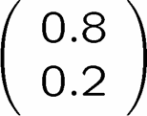
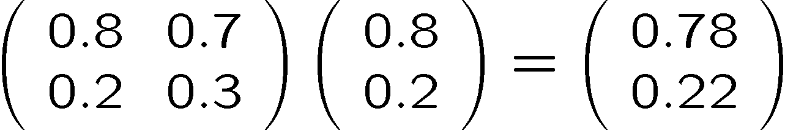
Uncertainty
20% C
22% C
80% H
78% H

Slide 16

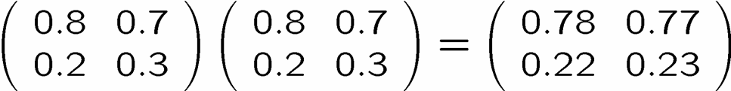
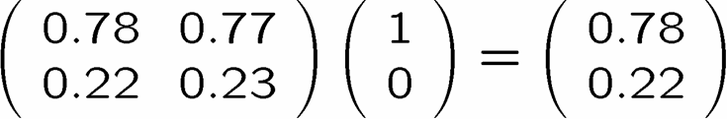
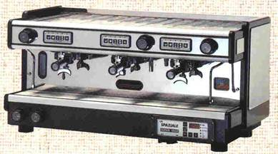
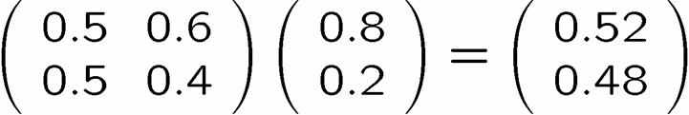
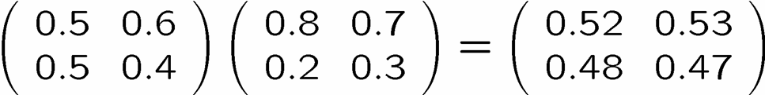
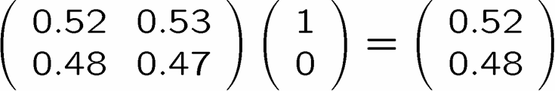
arkov Chains
78 % H
22 % C
or
52 % H
48 % C
or

Slide 17
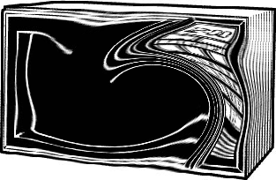


Quantum Microwave
Quantum Digital Coffee
Quantum Microwave (QM)
Scalding Hot
Freezing Cold
H
C
What are the rules for the Quantum Microwave?

Slide 18


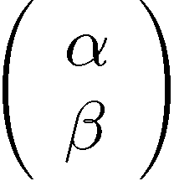









The Amplitude Attitude
H
C
For Our Purposes

Slide 19

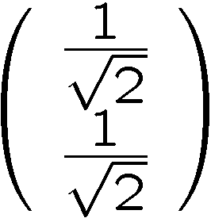
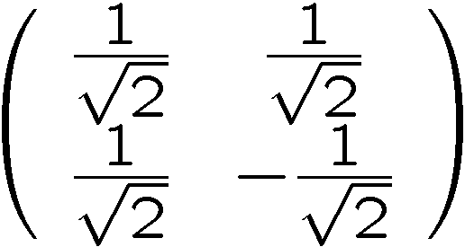

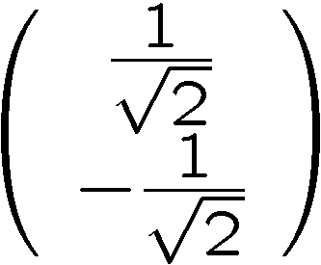
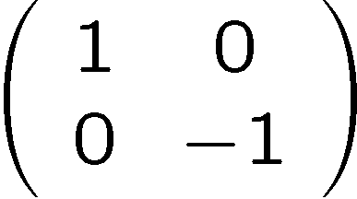
Interference
50 % H
50 % C
100 % H
0 % C
50 % H
50 % C
0 % H
100 % C

Slide 20
Interfering Pathways
100% H
1.0 H
50%
50%
0.707
0.707
50% H
50% C
0.707 H
0.707
0.707 C
90%
10%
0.707
0.707
80%
20%
-0.707
85% C
0.0 H
1.0 C
15% H
Always addition!
Subtraction!
Classical
Quantum

Slide 21
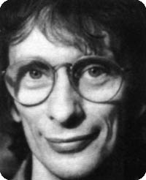
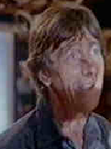

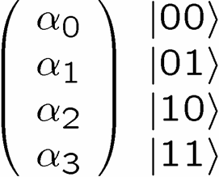
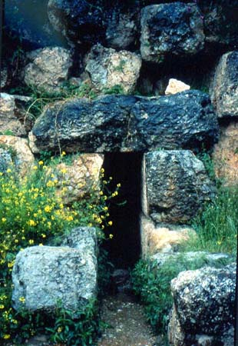

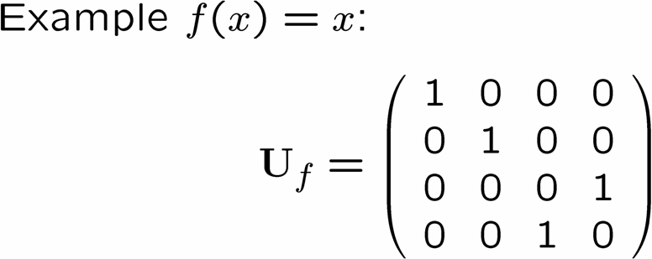





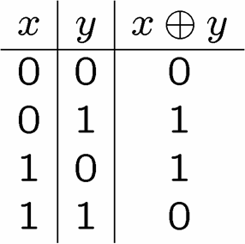
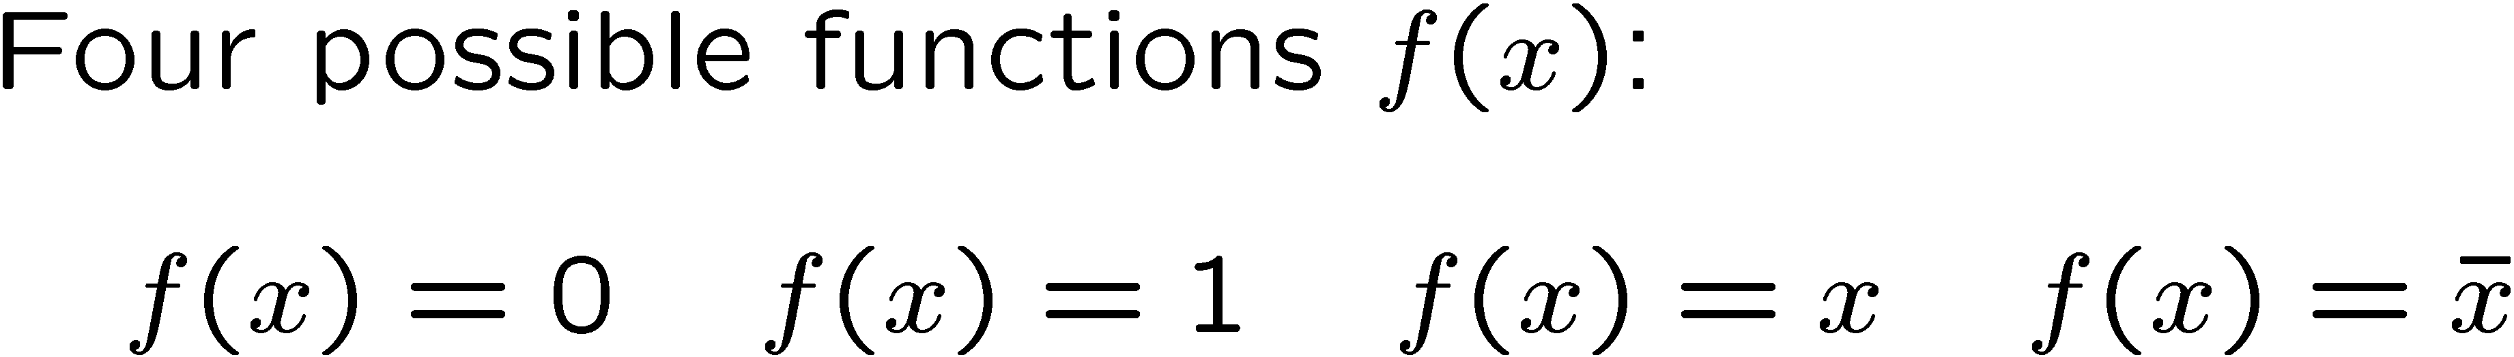
Deutsch’s Problem
(1985)
David Deutsch
Dr. Falcon
Delphi
Deutsch’s Problem
Determine whether f(x) is constant or balanced using as few queries to the oracle as possible.

Slide 22

Classical Deutsch
Classically we need to query the oracle two
times to solve Deutsch’s Problem
Delphi
Delphi

Slide 23





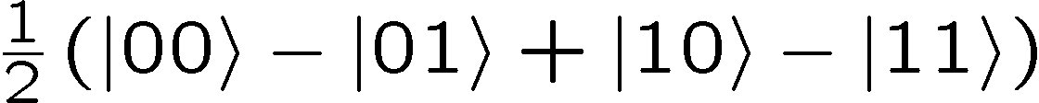
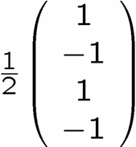
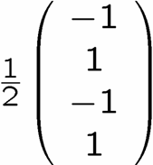
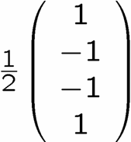







Quantum Deutsch
1.
2.
3.
100 % |01⟩
100 % |01 ⟩
100 % |11 ⟩
100 % |11 ⟩

Slide 24










Deutsch Circuit
measure

Slide 25
Deutsch In Perspective
Quantum theory allows us to do in a single query what classically requires two queries!
Interesting but just a factor of 2!

Slide 26
1. Pause.
2. Look at your watch.
3. How yah doing?

Slide 27
Multiplication and Factoring
Multiplication
Factoring
152
2537
×
421
divisible by 2?
152
divisible by 3?
304
divisible by 4?
+
1008
103992
2537=43 × 59
multiplying n digit numbers this way
requires about n² basic operations
factoring an n digit number this
way requires about 10^{n/2} basic
operations

Slide 28
Computational Complexity
time to solve
Factoring
(exponential)
Multiplication
(polynomial)
problem size
Hard versus Easy: time to solve as function of size
Does Quantum Computing change Complexity of a Problem?

Slide 29







Deutsch-Jozsa Problem
(1992)
Deutsch-Jozsa Problem
Determine whether f(x) is constant or balanced using as few queries
to the oracle as possible.

Slide 30

Classical DJ
1
0
x
1
0
x

Slide 31









Quantum DJ

Slide 32





Quantum DJ

Slide 33
Full Quantum DJ
Solves DJ with a SINGLE query vs 2^{n-1}+1 classical deterministic!!!!!!!!!

Slide 34



Simon’s Problem
(is that no one does what “Simon says”?)
(1994)
Simon’s Problem
Determine whether f(x) has is distinct on an XOR mask or distinct
on all inputs using the fewest queries of the oracle. (Find s)

Slide 35


Classical Simon
Quantum Simon

Slide 36
A Brief History of Algorithms
Deutsch’s algorithm demonstrates task quantum computer can perform in one shot that classically takes two shots.
1992 Deutsch-Jozsa algorithm demonstrates an exponential separation between classical deterministic and quantum algorithms.
1993 Bernstein-Vazirani demonstrates a superpolynomial algorithm separation between probabilistic and quantum algorithms.
1994 Simon’s algorithm demonstrates an exponential separation between probabilistic and quantum algorithms.

Slide 37
Quantum Parallelism?
Many universes collapse when you measure.
You don’t get to choose which universe!
Period Finding
period
f(x)
x

Slide 38

Shor’s Algorithm
188198812920607963838697239461650439807
163563379417382700763356422988859715234
665485319060606504743045317388011303396
716199692321205734031879550656996221305
168759307650257059
=
398075086424064937397125500550386491199
064362342526708406385189575946388957261
768583317
×
472772146107435302536223071973048224632
914695302097116459852171130520711256363
590397527
Peter Shor
Building on the work of Simon, Shor showed how to find
the period of a function. This can then be used to factor!
1994

Slide 39
Shor’s Algorithm
Breaks RSA Cryptography!
“Only time will tell if and when the problems of building a
quantum computer can be overcome….As information
becomes the world’s most valuable commodity, the
economic, political and military fate of nations will depend
on the strength of ciphers. Consequently, the development
of a fully operational quantum computer would imperil
our personal privacy, destroy electronic commerce and demolish the concept of
national security. A quantum computer would jeopardize the stability of the world.
Whichever country gets there first will have the ability to monitor the communications
of its citizens, read the minds of its commercial rivals and eavesdrop on the plans
of its enemies. Although it is still in its infancy, quantum computing presents a
potential threat to the individual, to international business and to global security. “
-Simon Singh

Slide 40


Grover’s Algorithm
Lov Grover
Cacti
Ferocactus wislizeni
Peniocereus greggii
Opuntia acanthocarpa
Opuntia fulgida
Opuntia leptocaulis
Opuntia arbuscula
Opuntia versicolor
Opuntia bigelovii
Echinocereus triglochidiatus
Echinocereus fasciculatus
Mammillaria grahamii
Carnegiea gigantea
1996
Searching a list of n items
for one particular entry
Classical: Worst case n queries
Quantum: Worst case √n queries
Ex: 100 queries versus 10 queries

Slide 41


Quantum Communication
Complexity
F(x,y)
How much (how many bits) do they
need to communicate to compute F?
Example
ALICE
BOB
F(x,y)=1 if x=y
F(x,y)=0 otherwise
x
y
Alice needs to communicate n bits to Bob
Example
x=010111
y=100101
F(x,y)=x⊕y
Odd # 1’s F=1
Even # 1’s F=0
110010
Alice needs to communicate 1 bit to Bob

Slide 42

Quantum Communication
Complexity
How much (how many qubits) do they need to communicate to compute F?
BOB
ALICE
y
x
Exponentially less quantum
communication than classical
communication!
Ran Raz
(1999)
But currently like Simon 1994, something really useful?

Slide 43
But What Will It Look Like?
Solid State
Atomic
electron spin in Phosphorus doped Silicon
quantum dots
defects in diamonds
superconducting circuits
cavity QED
neutral atoms in optical lattices
ion traps
Molecular
Photon Based
Liquid NMR
linear optics plus single photon devices
And Why Is It Hard?

Slide 44

DiVincenzo’s Criteria
David
DiVincenzo
1. Well defined qubits in a scalable architecture
2. The ability to initial the system to a deterministic state.
3. Have faster control over the system than error processes in the system.
4. Have the ability to perform a universal set of quantum gates.
5. Have the ability to perform high quality measurements

Slide 45



Ion Trap
Oscillating electric
fields trap ions
like charges repel
2 ⁹Be⁺ Ions in an Ion Trap

Slide 46




Where’s the Qubit?
Energy
Each ion = 1 qubit
1. Well defined qubits 
orbitals

Slide 47

Scalable?
. Well defined qubits in a scalable architecture
Solid state qubits have a huge advantage for scalability.

Slide 48


Measurement
Energy
laser
decay
Detecting florescence implies
in state 0
99.99% efficiency
5. Have the ability to perform high quality measurements 

Slide 49

Single Qubit Operations
Laser 1
Energy
Laser 2
Allows any one qubit unitary operations

Slide 50

Initialization
Laser 1
laser
Laser 2
decay
If not in zero state, flip
measure
2. The ability to initial the system to a deterministic state. 

Slide 51

Universal Computers
Turing machine reads state of tape at current position.
Based on this reading and state of machine, Turing machine writes new symbol at current position and possibly moves left or right.
Certain Turing machines can perform certain tasks.
A Universal Turing Machine can act like any other possible
Turing machine (i.e. it is programmable)

Slide 52

Universal Quantum Computer
Universal Quantum Computer
a quantum computer which can be programmed to perform any algorithmic manipulation on quantum information.
U(2)
Set of Universal Quantum Gates
a set of operations/gates which, acting on the quantum information, can be used to implement (to any desired accuracy) any unitary evolution of the quantum info.
The Royal King and Queen of Universal Quantum Gates
CNOT and 1-qubit rotations

Slide 53
Coupling Two Qubits
stationary
sloshing mode
These modes can be used as a bus between the qubits.
4. Have the ability to perform a universal set of quantum gates 

Slide 54



What is the Problem?
3. Have faster control over the system than error processes in the system.
Real quantum systems are open quantum systems!
system
environment
Quantum systems readily couple to an environment…
qubits
0
System decoheres:
bits
1
50% 0 50% 1
Quantum
Classical
The Decoherence Problem (1996)
Notes:
Quantum systems readily couple to an environment.

Slide 55

The Problem
Decoherence is a lot like classical noise, BUT:
Strong coupling to
environment
causes
decoherence
Strong coupling to
control devices
needed to enact
computations
Yingyang of quantum computing

Slide 56

Quantum Computing is Bunk
Ways Quantum Computers Fail to Quantum Compute
Decoherence
Lack of Unitary Control
attempting to apply unitary evolution U instead results in V
or (worse) results in non-unitary evolution
Measurements are faulty
measurement result is noisy, incorrect result obtained
Quantum Computing Disappearing Act
qubits disappear (leakage of computing states)

Slide 57


The Quantum Solution (1995-96)
Fault Tolerant Quantum
Computing is Possible!
Peter Shor
Andrew Steane
Threshold Theorem:
QC
Error Rate

Slide 58

Ion Trap Parameters
Decoherence rate for qubits: 10 minutes
Gate speed: 10 microseconds
Decoherence rate for bus: 100 microseconds to 100 miliseconds
Measurement errors: 0.01%
3. Have faster control over the system than error processes in the system. 
State of the Art
NIST Boulder

Slide 59


5 Years, 10 Years
Australia (UNSW)
Electron spin from place P doners
flux qubits in superconducting
circuits

Slide 60


Fin (Really the Beginning)
When we get to ~30 qubits, a quantum computer can
do things today’s classical computer cannot do in less
than decades of time.

Slide 61







Quantum Computers
That Fix Themselves

Slide 62
1941 – First programmable electronic calculator.
mechanical relays.
1943 – ENIAC.
18000 vacuum tubes: “nature abhors the vacuum tube.”
1947 – Bell labs develops the transistor.
1952 – G. W. Dummer proposes manufacturing electronic equipment in one
block with no connecting wires.
1959 – Texas Instruments and Fairchild Semiconductor invent the integrated
circuit.
1964 – first IBM 360 series (the concept of an “architecture”)
1964 – Integrated circuit which cost $1000 in 1959 now costs $10. Moore
describes his law.
1972 – Intel 8008 and 8 bit microprocessor.
1975 – First personal computer the Altair.
1982 – IBM PC introduced. Personal computer revolution begins.
Have We Learned Anything?

Slide 63
The Physics Guarantee
Rant mode ON
What is the phase of matter corresponding to the computer?
PRACTICAL QUESTION (as opposed to philosophical)
There are distinct PHYSICAL and DYNAMICAL reasons why
robust classical computation is possible.
not all physical systems are equally good for computation:
there exists systems whose PHYSICS guarantees
their ability to enact robust classical computation.
Are there (or can we engineer) physical systems whose
PHYSICS guarantees robust quantum computation?

Slide 64


Two Paths
(“it’s made all the difference”)
Hard Drive
Transistor
Coding: majority vote of
magnetism
Coding: majority vote of
current
Error correction: local energy
minimization
Error correction: amplification
Fault-tolerant: conducting / insulating phase transition
Fault-tolerant: macro applied
field.
More than storage?

Slide 65









No Quantum Transistor
Quantum Cloning Machine
“A single quantum cannot be cloned,” Wootters and Zurek, Nature, 1982

Slide 66







The Quantum
Hard Drive?
(Kitaev)
Do there exist (or can we engineer) quantum systems whose
physics guarantees fault-tolerant quantum computation?
1. Coherence preserving.
2. Accessible Fault-Tolerant
Operations
“self-correcting”
3. Universality

Slide 67
Fin x2
Error correcting codes
Geometry, Topology?
classical
quantum
Statistical Physics
theory of strongly interacting
quantum systems
renormalization group
methods
Fault-tolerance
local structures giving rise
to global robustness (CA)
Real Physics
physical implementation
optical lattices, donor
electrons, superconducting
circuits, etc.
Representation theory
identification of qubits
and logical operations
Naturally Fault-Tolerant Quantum Computation

Slide 69
BOOM!

