Slide 1
Tht Yuo Cna Reda Ths Snetnce
Impls Tat Yor Mnid Cna Efncenlty Solev
NP-Cmoplet Prbolems???

Slide 2

New Quantum Algorithms for the
Hidden Subgroup Problem
Dave Bacon
Department of Computer Science & Engineering
University of Washington
in collaboration with
Andrew Childs [Caltech]
Wim van Dam [U.C. Santa Barbara]

Slide 3
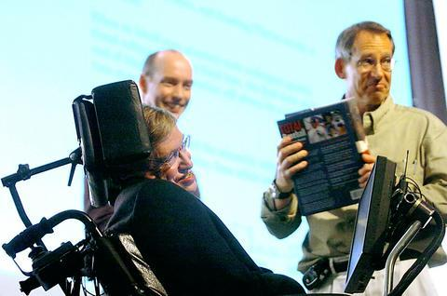

Quantum Algorithms
“If I had a good idea in quantum algorithms, that is what I’d be
working on.” – John Preskill 2004
Preskill
McHawking
What is the future of quantum computing
if there aren’t more important quantum
algorithms?

Slide 4
When I was a Grad Student…
Quantum Algorithms
  Factoring, discrete log [Shor 94]
  Unstructured search [Grover 96]

Slide 5

State of the Art
Quantum Algorithms
  Factoring, discrete log [Shor 94]
  Unstructured search [Grover 96]
  Various hidden subgroup problems [Long List]
  Pell’s equation [Hallgren 02]
  Hidden shift problems [van Dam, Hallgren, Ip 03
  Childs, van Dam 05]
  Graph traversal [CCDFGS 03]
  Spatial search [AA 03, CG 03/04, AKR 04]
  Element distinctness [Ambainis 03]
  Various graph problems [DHHM 04, MSS 03,…]
  Testing matrix multiplication [Buhrman,Špalek 04]
  …

Slide 6
The Problem
The Hidden Subgroup Problem (HSP)
Problem: Fix a group G (known) and a subgroup
H⊆G (unknown). Given query access to a function
f : G → S that is constant and distinct on left cosets
of H in G. We say that f hides H.
Goal: Find (a generating set for) H.
Efficient algorithm: run time poly(log |G|).

Slide 7
Groups
Group Definition
Set of elements with a binary operation “⋅”
Binary operation satisfies:
1. Closure: g₁⋅g₂ is in the set
2. Associativity: (g₁⋅g₂)⋅g₃= g₁⋅(g₂⋅g₃)
3. Identity element: Exists e such that g₁⋅e=g₁
4. Inverse: For all g₁ there exists an element g₂
such that g₁g₂=e.
We will study only finite groups (set is finite.)

Slide 8
Left Cosets
Subgroups
Subset of group which is itself a group.
Left Cosets
Let H be a subgroup of G.
Def: g₁H is the set {g₁h, h∈H}
g₁H is a left coset of G with respect to H.
Given group G, subgroup H, we can uniquely partition G into left cosets of H.

Slide 9
Anatomy of Our Problem
Problem: Fix a group G (known) and a subgroup
H⊆G (unknown). Given query access to a function
f : G → S that is constant and distinct on left cosets
of H in G. We say that f hides H.
g_{m}H
f
g₃H
g₂H
g₁H
H
G
S

Slide 10
The Hidden Subgroup Saga
Why is everyone so interested in the HSP?
Efficient algorithm for the HSP for Abelian groups
⇒ an efficient algorithm for Factoring (Shor).
2. An efficient algorithm for the HSP for the
symmetric group would given an efficient
algorithm for graph isomorphism.
3. An efficient algorithm for the HSP for the dihedral
group would give algorithms for k-unique shortest
vector in a lattice problems (break a cryptosystem)
4. Solving the HSP would make everyone work on
really new quantum algorithms.

Slide 11

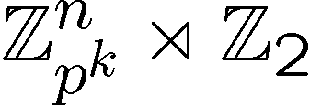
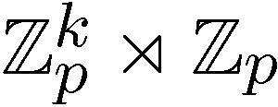
The Hidden Subgroup Success
Abelian groups [Shor 94; Kitaev 95]
[Püschel, Rötteler, Beth 98]
Normal subgroups [Hallgren, Russell, Ta-Shma 00]
“Amost Abelian” groups [GSVV 01]
[FIMMS 02]
“Near Hamiltonian” groups [Gavinsky 04]
Some q-hedral groups [MRRS 04]
[Inui, Le Gall 04]
Heisenberg type groups [this talk]
Some
Bacon, Childs, and van Dam FOCS 2005
Things are heating up…

Slide 12





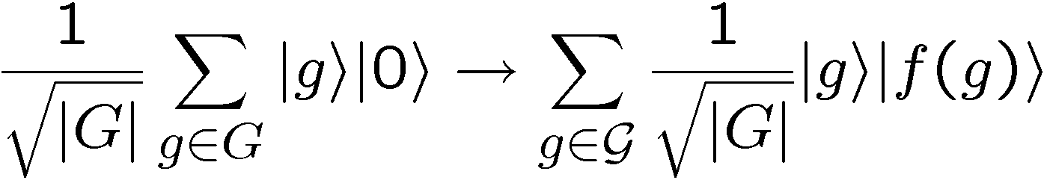
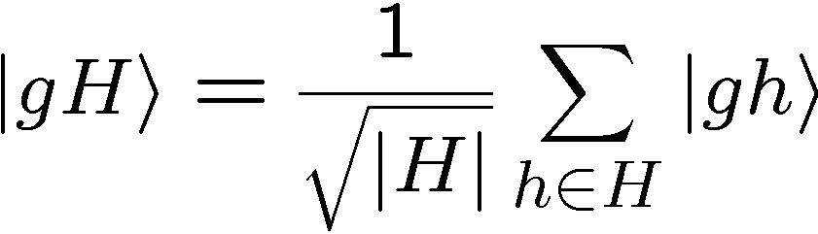
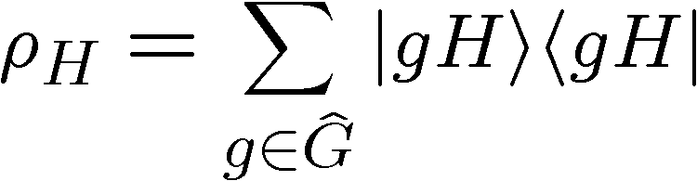
Standard Query Model
U_{f}
constant and distinct on different left cosets of H:
hidden subgroup state

Slide 13
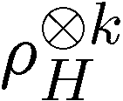
HSP as State Distinction
Single Copy
Given:
with probability p_{H}
Determine:
H by a generalized measurement
Maximize: probability of successfully identifying H
Multiple Copy
Given:
with probability p_{H}
Determine:
H by a generalized measurement
Maximize: probability of successfully identifying H

Slide 14
Query Complexity of HSP
Given: k=O(log(N)) standard queries to HSP
Exists: an inefficient quantum algorithm which
solves any HSP.
[Ettinger, Hoyer, Knill 99]
“Query complexity of HSP is polynomial.”
Results: Shor’s algorithm is optimal with O(1)
queries to the HSP [Ip 03]
Results: There are groups for which O(log(N))
standard queries are necessary [BCV 05]

Slide 15

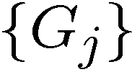

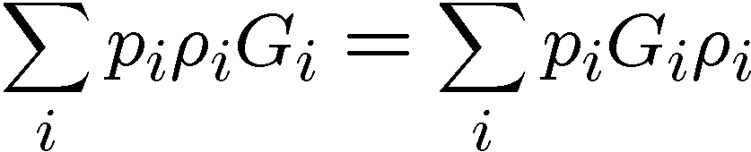
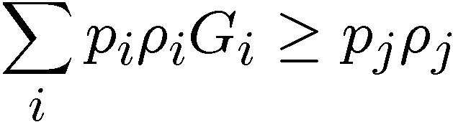
Holevo’s Condition
Given:
with probability p_{i}
Measure:
POVM with elements
Outcome:
j corresponds to guessing state
Maximize:
probability of successfully identifying
Necessary and Sufficient Condition:
[Holevo 73]
Hard to find explicit forms for G_{j}

Slide 16
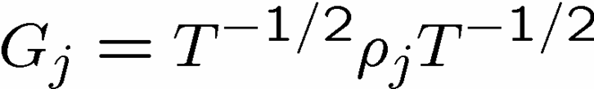
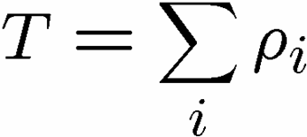
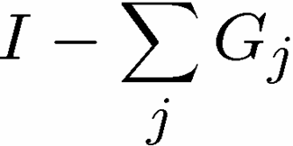
Pretty Good
Given:
with equal probabilities
Observation:
the “Pretty Good Measurement” is
often pretty good.
Pretty Good Measurement (PGM):
(plus if needed.)

Slide 17

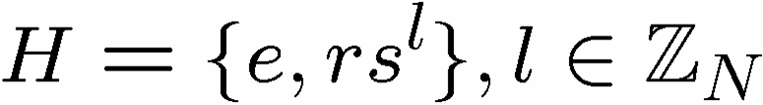
Hidden Reflection
Given:
with equal a priori probability
Dihedral HSP
Theorem: [Bacon, Childs, van Dam 05]
The PGM is the optimal measurement for
identifying H (hidden reflection problem)
Theorem: [Moore, Russell 05]
The PGM is the optimal measurement for
identifying H when H and G are a Gelfand pair.
arXiv generalization speed
= Jan 10 – Jan 31 = 21 days

Slide 18
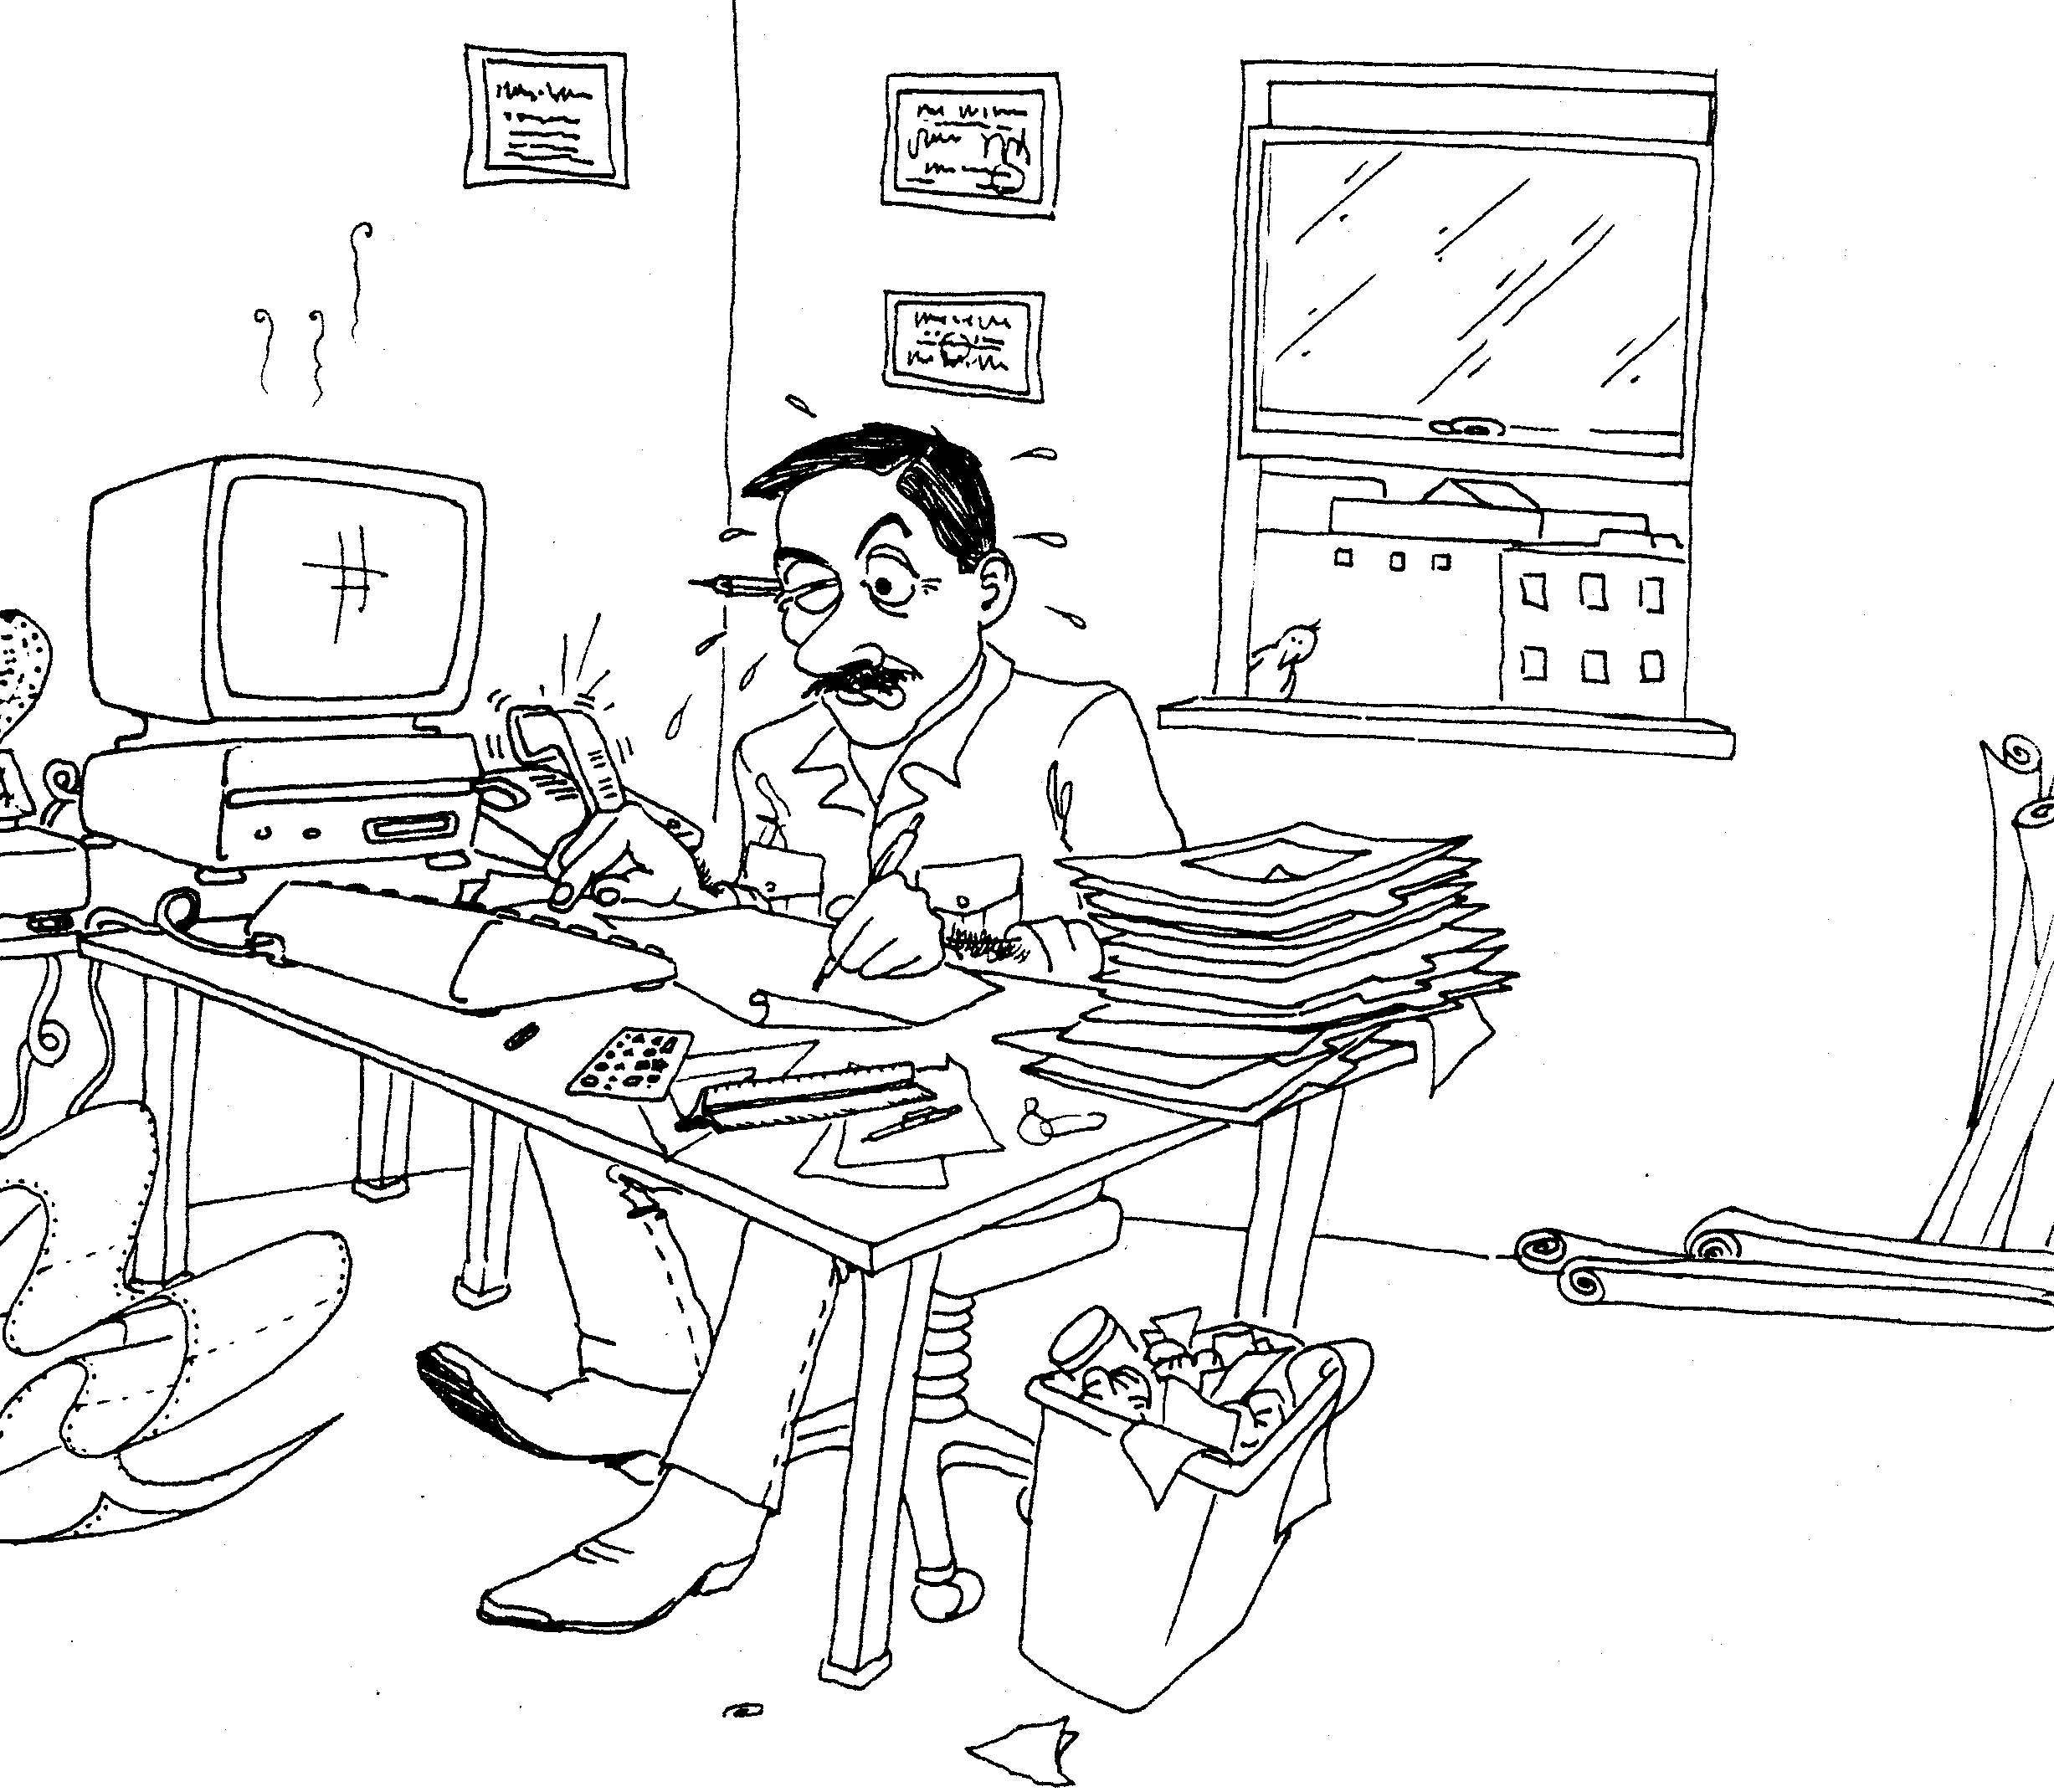
Must Work Hard
Theorem: [Bacon, Childs, van Dam 05]
Determining the hidden reflection requires
O(log(N)) copies of the hidden subgroup states.
Theorem: [Bacon, Childs, van Dam 05]
Determining the most significant bit of the
hidden reflection requires O(log(N)) copies
of the hidden subgroup states.

Slide 19

A Strange Lock
Setup: Display will give same
result if we enact rotation by
k and if we enact rotation by
-k+x and a reflection.
x is the hidden combo.
Rotation:
0
1
0
0
Reflection:
0
1
POE
Goal: Make display repeat to
open the lock.
Display:
BFD
Dihedral Hidden Reflection Problem

Slide 20
Dihedral HSP
Dihedral group
G = D_{N}: symmetry group of a
N-sided regular polygon.
Rotation ≡ s, s^{N}=e
Reflection ≡ r, r²=e and rsr=s⁻¹
D₈
Element of D_{N}: r^{t}s^{k}, where t∈Z₂,s∈Z_{N}
Theorem: Solving the hidden subgroup problem
when H={e,rs^{l}}, l∈Z_{N} or H={e} solves the full
Dihedral HSP [Etinger, Hoyer 98]

Slide 21
Dihedral HSP Facts
Efficient algorithm for
the poly(d) unique
shortest vector in a
lattice problem
Efficient algorithm
for DHSP
[Regev 02]
Quantum algorithm:2^{O(√N)} time [Kuperberg 03]
poly(log(N)) space [Regev 04]
Efficient algorithm
average case subset sum
Efficient quantum
Algorithm for DHSP
[Regev 02]

Slide 22
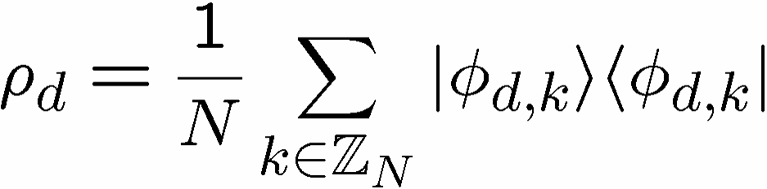
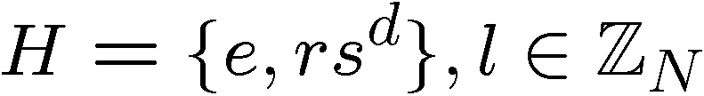
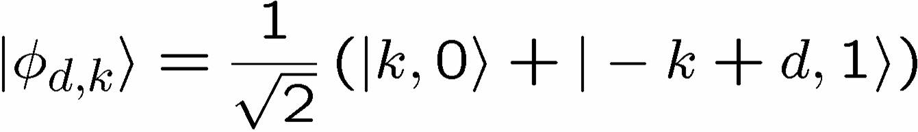
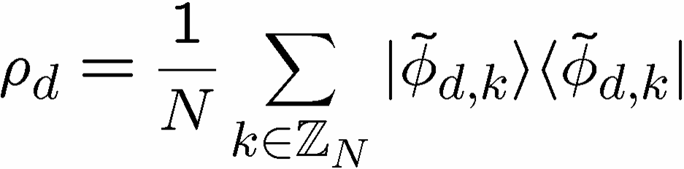
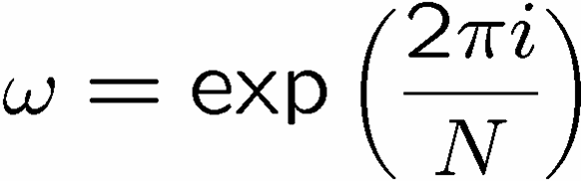
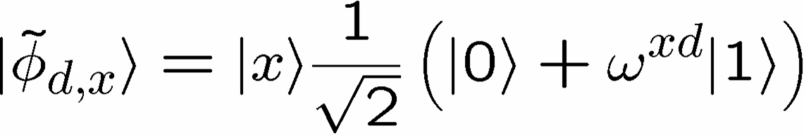
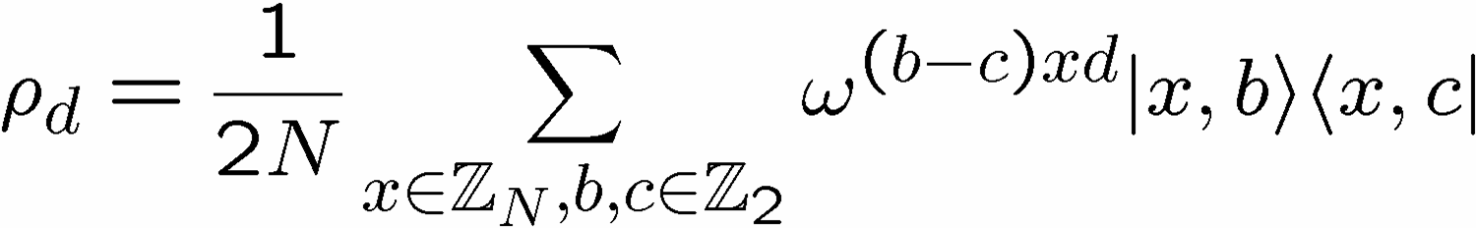
One Copy
Punishment
One copy of the Hidden Subgroup state:
Basis change:

Slide 23
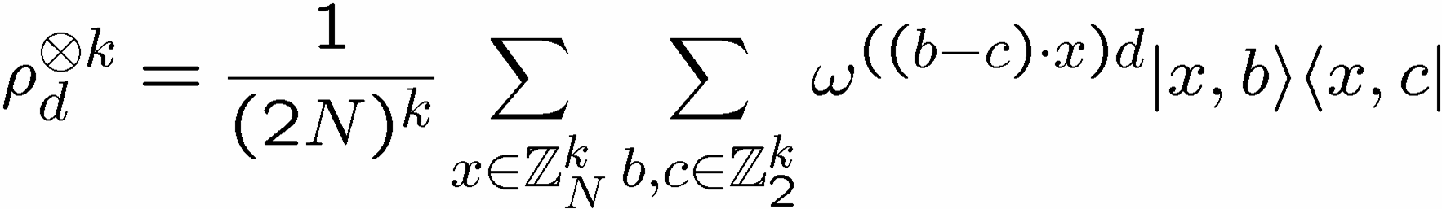
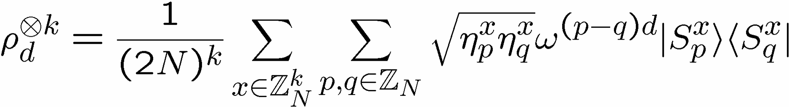
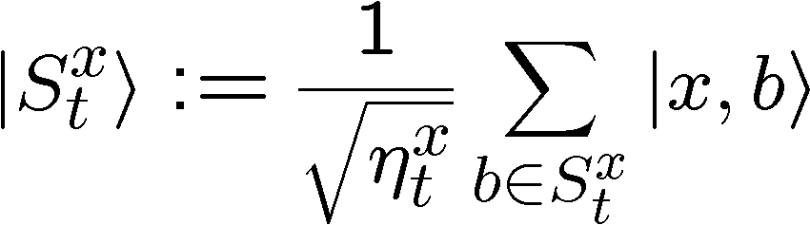

Multi Copy
More Punishment
number of subsets of x which sum to t

Slide 24
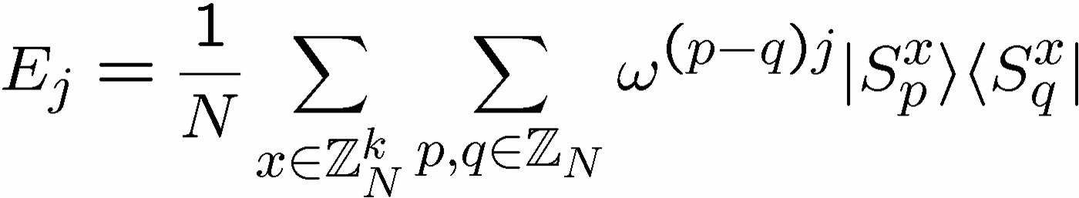
Optimal PGM
Stop The
Punishment
Note: Entangled measurement over k copies

Slide 25
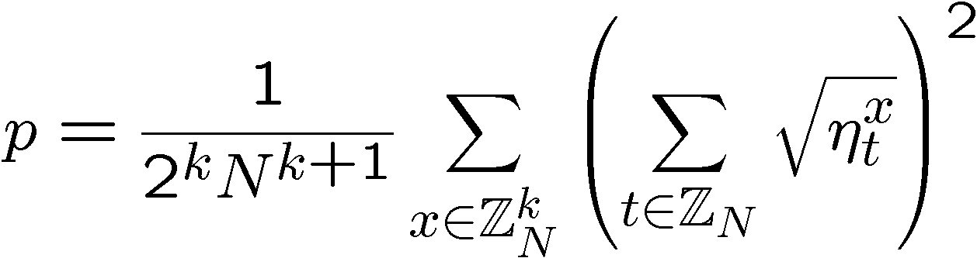
Success Probability
Probability of correctly guessing reflection:
number of subsets of x which sum to t
p is related to a phase transition

Slide 26
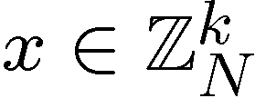


Subset Sum Problem
Given:
k integers from
i.e. , and a target
Goal:
Find a subset of x which sums to t
Problem:
does there exists such a subset?
NP-complete
Problem:
If such a subset exists, return this subset
NP-hard
basis for old (broken) public key cryptosystem

Slide 27
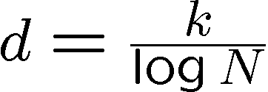



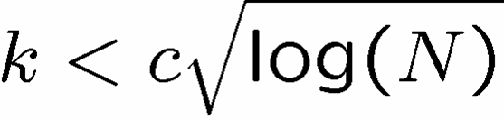
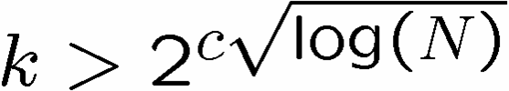
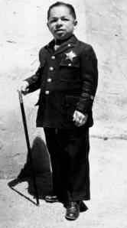
The Subset Sum Landscape
Given:
k integers from
i.e. , and a target
Define:
density :=
“low density”
“high density”
most subsets have
a distinct sum
most sums achieved by some subset
efficient algorithm
efficient algorithm
hard?
[Lagarias, Odlyzko 85]
[Flaxman, Pryzdatek 04]

Slide 28
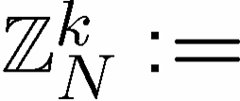

Success Probability
Probability of correctly guessing reflection:
k dimensional vector of elements of
number of subsets of x which sum to t
Two orders:
For k<log N, p is exponentially small (in log(N))
For k>log N, p is O(1)
transition at density = d=1

Slide 29
Must Work Hard
Theorem: [Bacon, Childs, van Dam 05]
Determining the hidden reflection requires
O(log(N)) copies of the hidden subgroup states.
Theorem: [Bacon, Childs, van Dam 05]
Determining the most significant bit of the
hidden reflection requires O(log(N)) copies
of the hidden subgroup states.
The Dihedral Hidden Subgroup problem looks hard,
Are there similar groups where the combinatorial
problem is not subset sum?

Slide 30
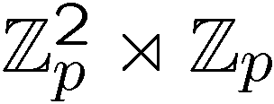
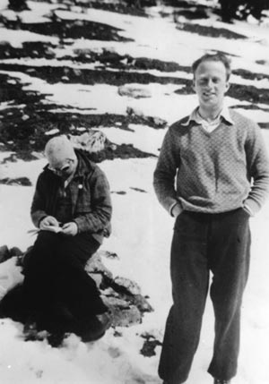
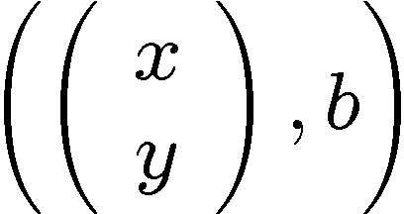

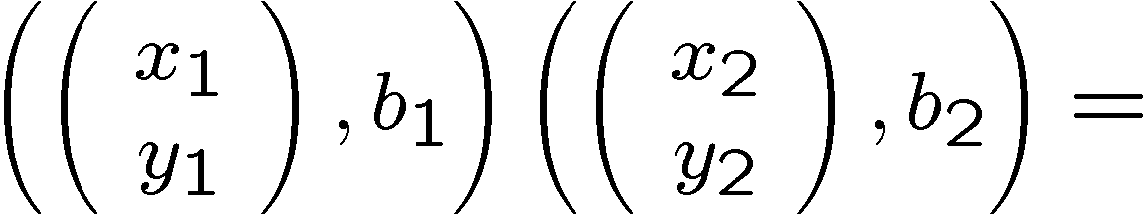
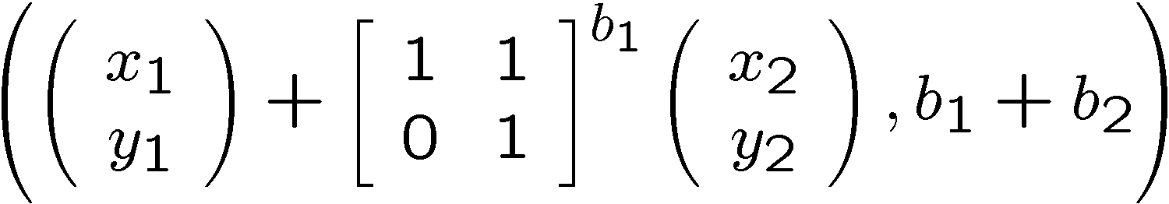
Heisenberg Group
Semidirect product group
Elements of the group:
Multiplication rule:
From the play “Copenhagen” Margrethe Bohr to Heisenberg:
  “Your talent is for ski-ing too fast for anyone to see where you are. For always being
  in more than one position at a time, like one of your particles.”

Slide 31
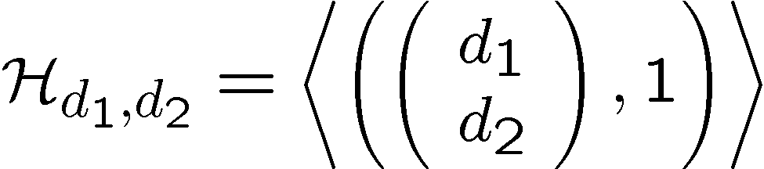
Heisenberg HSP
We can restrict to subgroups of the form
General version of theorem from [Etinger, Hoyer 98]

Slide 32
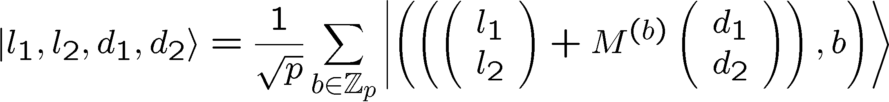
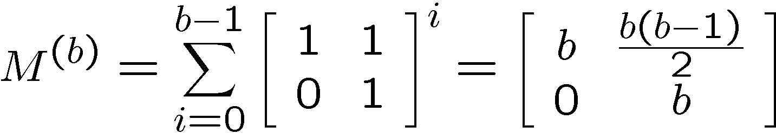

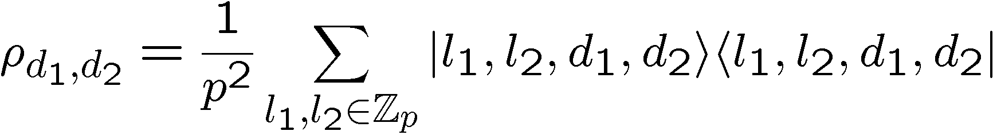
Heisenberg HS State
Restricted subgroups:
Random coset states:
Coset labels:
Hidden Subgroup states:

Slide 33
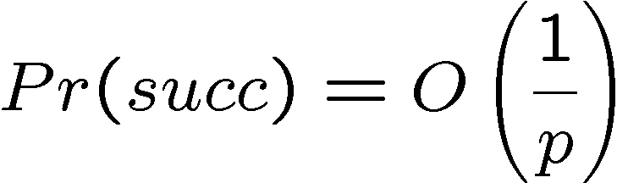

Optimal Measumrent
The optimal measurement for k copies is again the
pretty good measurement.
For one copy, the probability of successfully
identifying the hidden subgroup is
But for two copies, the probability of succesfully
identifying the hidden subgroup is
Can we efficiently implement this measurement?

Slide 34
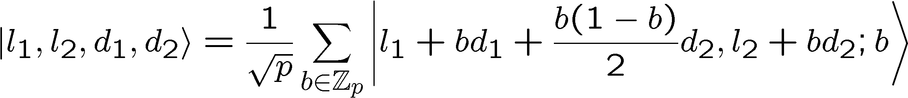
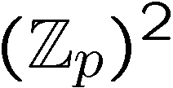

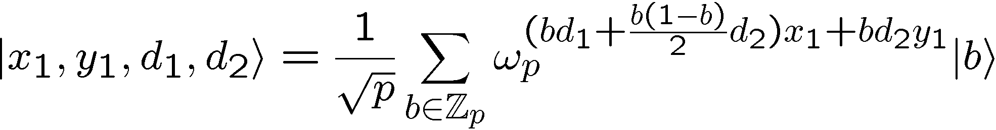
HS States
Perform the QFT over to the first two registers:
Measure these two registers:

Slide 35

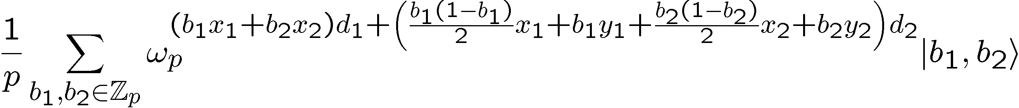

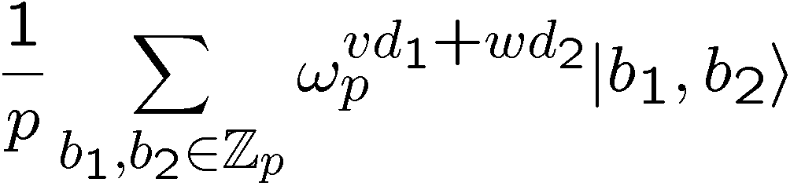
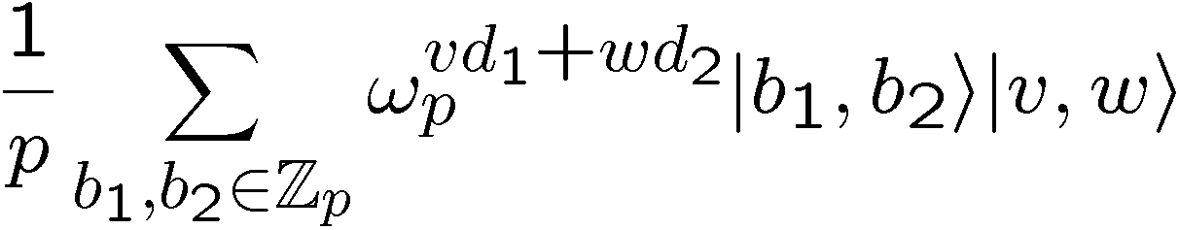
HS States
Two copies:
Compute v and w:

Slide 36
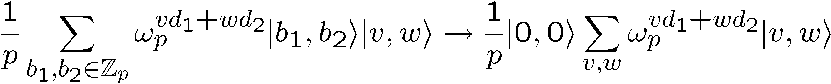
Uncompute
If we could erase the b₁,b₂ values:
Then a QFT over would find d₁ and d₂.
Remember v and w are a function of b₁ and b₂.

Slide 37



Solving Equations
Compute v and w:
For fixed x₁,x₂,y₁,y₂ let be the set of b₁,b₂
solutions to these equations.
We want to implement

Slide 38

Solving Equations
Easier to think about the inverse (do it unitarily):
i.e. given v and w, transform to superposition over
solutions to the equations

Slide 39





Solving Equations
Assuming y₁,y₂,y₁+y₂ do not equal 0 (prob O(1/p)),
then
solutions have
solutions have
solutions have

Slide 40


Solving Equations
Focus on when there are two solutions.
We can use standard finite arithmetic to find these
solutions. Use to create labeled superposition of
solutions:
Hadamard first qubit, measure. If 0, you have

Slide 41
Heisenberg HSP Solved
This allows us to perform:
Which has a O(1/2) fidelity squared with the
state we desire.
QFTing the second register will let us find d₁ and d₂
Efficient algorithm for the Heisenberg HSP!

Slide 42

Extensions
This algorithm can be extended to an efficient
quantum algorithm for all
Also, certain metacyclic groups
Interesting
Entangled measurement over two registers used
in a constructive form.
Superposition over solutions to equations we can efficiently invert.

Slide 43
Open
The PGM is not optimal for all groups, what is the
optimal multicopy measurement?
Other groups for which this technique works?
Connections to the Clebsch-Gordan transform
over finite groups. When can these transforms
be efficiently implemented?

Slide 44

Conclusion
Subgroups for which multicopy queries are
necessary.
PGM is often optimal for distinguishing HS states.
Efficient algorithm for Heisenberg, generalizations,
and metacyclic groups.

