Slide 1
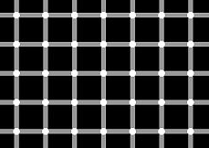

Slide 2

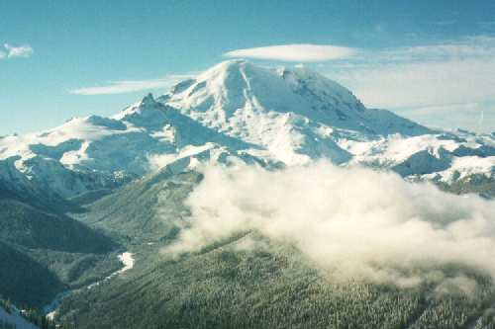

Self-Correcting Quantum Computers
Dave Bacon
Department of Computer Science & Engineering
University of Washington
funded by

Slide 3
Warning:
Lah-less Talk
In This Talk We Will Obey The
Lahs of Quantum Theory

Slide 4
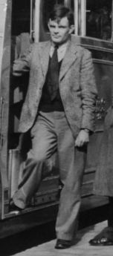
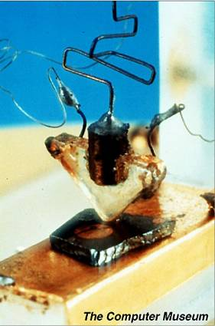
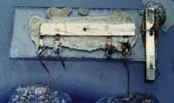
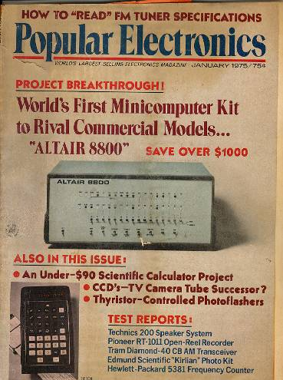
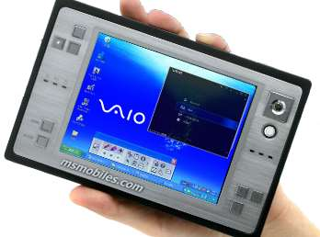
It Was a Long Slog…
1936- Alan Turing: “On computable numbers, with an application to the Entscheidungsproblem”
1947- First transistor
1958- First integrated
circuit
Alan Turing
1975- Altair 8800
2005
GHz machines
that weight ~ 1 pound

Slide 5
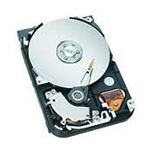
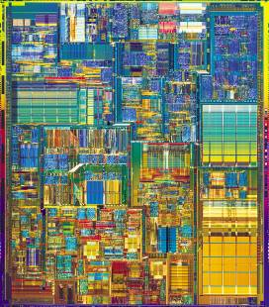
What is a Computer?
Practical question (as opposed to philosophical)
What is the phase of matter corresponding to the computer?
There are distinct physical reasons why robust classical
computation is possible.
Hard Drive
Integrated Circuit
Are there (or can we engineer) physical systems whose
PHYSICS guarantees robust quantum computation?
The physics of classical robust computation
(2) An attempt to port these ideas to quantum computers

Slide 6


Three Storage Testbeds
Ferromagnetic Ising models:
one dimensional
two (and >) dimensional
Toom’s rule:
0
0
1
0
0
0
0
0
0
1
1
0
1
0
0
0
two dimensional noisy
cellular automata
0
1
0
0
0
0
0
0
0
0
1
1
1
1
1
0
0
0
0
0
1
0
1
0
1
1
1
0
0
0
0
0

Slide 7
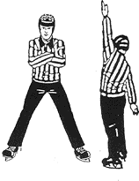

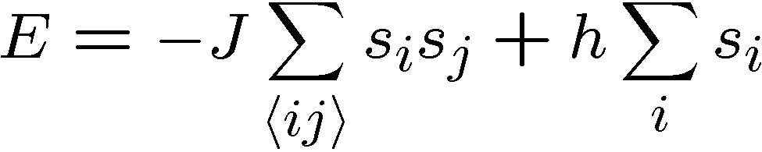


Ferromagnetic Ising Models
Ising model
spins on edges of a lattice:
energy of a configuration:
sum over neighbors
external magnetic field
for now

Slide 8

Dynamic Ising Models
Dynamic Ising model (Metropolis update)
Interaction with environment causes spin flips
Update rule:
If flipping spin would decrease energy, flip spin
If flipping spin would increase energy, flip spin with probability

Slide 9
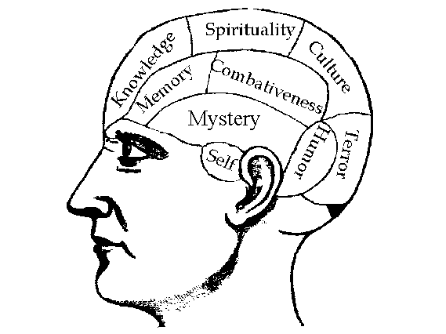


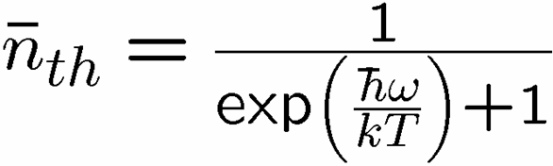

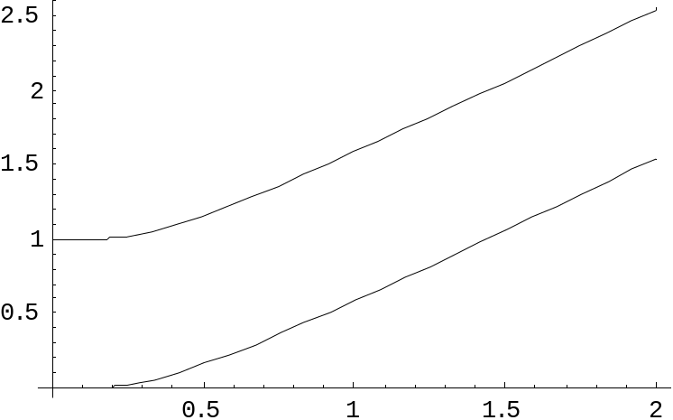
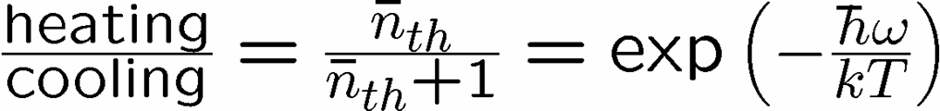


Reminder
two-level system perturbatively coupled to a thermal boson bath
“heating”
“cooling”
“non-dissipative”

Slide 10
Dynamic Ising Models
Dynamic Ising model (Metropolis update)
Interaction with environment causes spin flips
Update rule (alternate with noise):
If flipping spin would decrease energy, flip spin
If flipping spin would increase energy, flip spin with probability

Slide 11
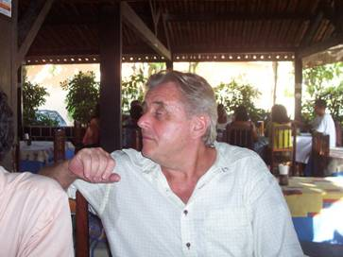
Toom’s Rule
0
0
1
0
0
0
0
0
0
1
1
0
1
0
0
0
two dimensional noisy cellular automata
0
1
0
0
0
0
0
0
0
0
1
1
1
1
1
0
0
0
0
0
1
0
1
0
1
1
1
0
0
0
0
0
Update rule:
n
n
b=majority(n,e,b)
a
e
b
e
0
0
0
0
0
0
0
0
0
0
0
0
0
0
0
0
0
1
1
0
0
1
0
0
0
0
0
0
0
0
0
0
0
1
0
0
0
1
0
0
0
1
0
0
0
0
0
0
0
0
0
0
0
0
0
0
0
0
0
0
0
0
0
0
Update rule with noise: with some probability the update fails
and a random state is assigned

Slide 12


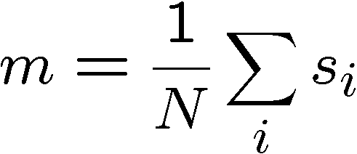
Compare and Contrast
Encode information into the system and watch what happens
0
0
0
0
0
0
0
0
0
0
0
0
0
0
0
0
0
0
0
0
0
0
0
0
0
0
0
0
0
0
0
0
0
0
0
0
0
0
0
0
0
0
0
0
0
0
0
0
Redundancy code.
Order parameter is magnetization:

Slide 13



Storage
Long time behavior (not infinite time, but effectively)
1D Ising
2D Ising
Toom’s Rule
Criticism: (1) thermodynamic limit taken
(2) what if relaxation to equilibrium takes a long time?

Slide 14
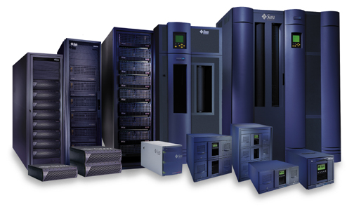


Storage
2nd attempt:
Relaxation to thermal
1D Ising
2D Ising, Toom’s Rule
Imperfect preparation

Slide 15
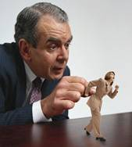




Manipulation
Flipping spins is imperfect
2D Ising
Toom’s Rule
1D Ising
1D Ising
temperature less than gap (2J)
manipulation error must be small
(i.e. NOT fault-tolerant)
2D Ising
temperature less than critical temp

Slide 16















“Self Fixing”
Excitations point-like
Energy to err is constant
Disordering entropy >> Energy
Excitations string-like
Energy to error is prop to size
Energy >> Disordering entropy

Slide 17

Toom’s Rule Versus 2D Ising
Applied magnetic field (corresponds to a bias in noise)
2D Ising
Toom’s Rule
Regions with two coexisting phases
External magnetic fields disorder magnetic media

Slide 18




The Quantum Hard Drive?
(Kitaev)
Do there exist (or can we engineer) quantum systems whose
physics guarantees fault-tolerant quantum computation?
1. Coherence preserving.
2. Accessible Fault-Tolerant
Operations
3. Universality

Slide 19





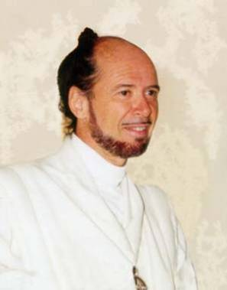



No Quantum Transistor?
Quantum Cloning Machine
“A single quantum cannot be cloned,” Wootters and Zurek, Nature, 1982

Slide 20


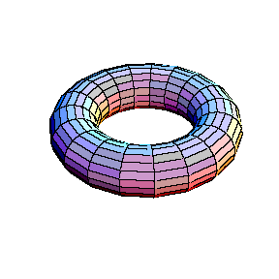


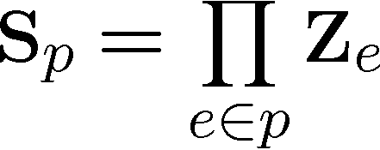
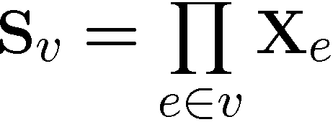
Kitaev’s Toric Codes
Qubits on the edges of a lattice on a torus
(torus condition can be removed)
Plaque operators:
Vertex operators:
Stabilizer code: plaque and vertex opertors commute
degenerate +1 eigenspace is quantum error correcting code

Slide 21
Kitaev’s Toric Codes
+1
+1
+1
+1
+1
+1
+1
+1
+1
+1
+1
+1
+1
+1
+1
+1
+1
+1
+1
+1
+1
-1
-1
+1
+1
+1
+1
+1
+1
+1
+1
+1
+1
+1
+1
+1
+1
-1
+1
+1
+1
+1
-1
+1
+1
+1
+1
+1

Slide 22
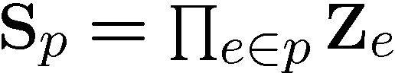








Toric Code Correcting Properties
Nonlocal matching
algorithm allows the
toric code to correct
qubit errors.
Toric codes provide fault-tolerant threshold for quantum computation with this nonlocal correcting algorithm.

Slide 23
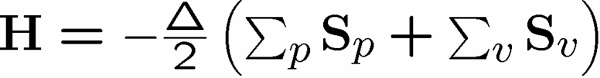

Toric Code Hamiltonians
Excitations are point
particles (anyons)

Slide 24

Kitaev’s Toric Codes
This Hamiltonian provides a mechanism
for robust storage of quantum information.
But it does not provide a mechanism for
robust manipulation of quantum information.
Is it possible to construct a Hamiltonian, which allows for fault-tolreant manipulation as well?

Slide 25
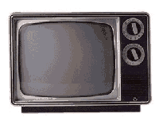
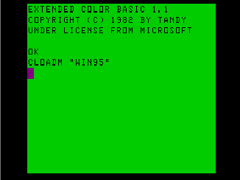
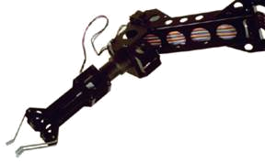
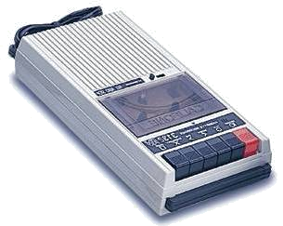

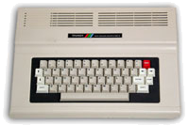
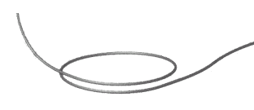
Self Correcting Quantum Computers
The toric code in four dimensions is probably self-correcting
(two dimensions each for phase and bit flips)
Can we self-correct in realistic systems?
D. Bacon “Operator Quantum Error Correcting Subsystems for
Self-Correcting Quantum Memories” quant-ph/0506023

Slide 26






Subspaces Versus Subsystems
The most general way to encode quantum information is into
subsystem (not subspaces)
two qubits
encode a qubit in a subspace
encode a qubit in a subsystem
generic subsystem:

Slide 27
Quantum Error Correcting Subsystems
Knill and Laflamme, “A theory of quantum error correcting codes”
PRA, 55, pp. 900-911 (1997)
Knill, Laflamme, and Viola, “Theory of quantum error correction
for general noise,” PRL, 84, pp. 2525-2528 (2000)
Subsystem encoding:
implicit from the beginnings of quantum error correction
explicit for degenerate (noiseless) codes and dynamic recoupling
Quantum error correcting subsystem codes:
Kribbs, Laflamme, and Poulin, “A Unified and Generalized
Approach to Quantum Error Correction,” PRL, 94,
p. 180501 (2005)

Slide 28





Subsystem Error Correction
Only need to protect subsystem,
not full subspaces.
encoding
subsystem
error
recovery
encoded quantum
information
recovery need not perfectly restore system, but only
preserve information encoded into subsystem.

Slide 29
Mysterious Extra Slide

Slide 30
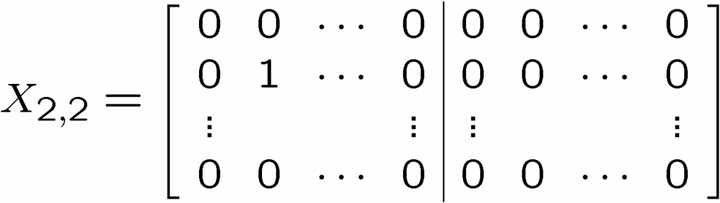
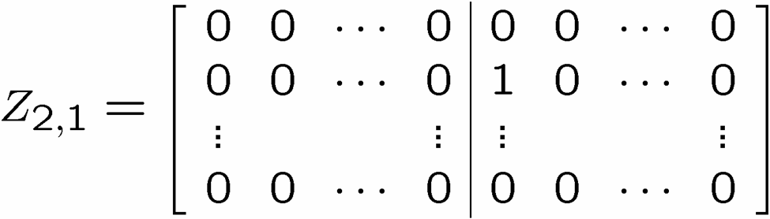
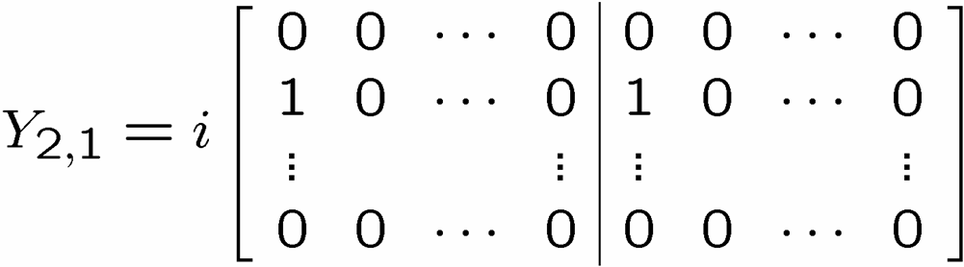

Flatland
X
Z
n by n cubic
lattice of qubits:
Generic Pauli group operator on cubic lattice:
A, B n by n 0,1 matrices

Slide 31

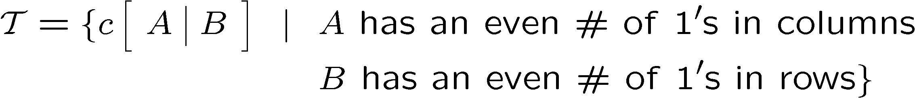
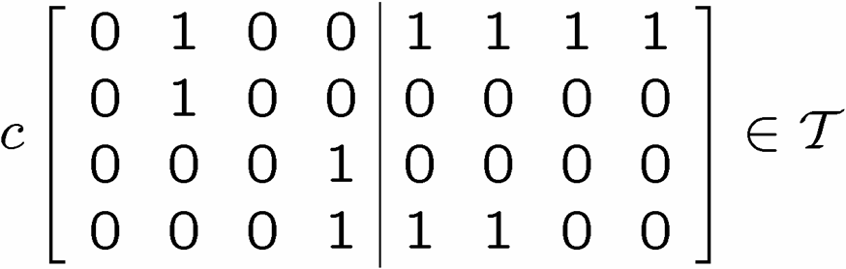

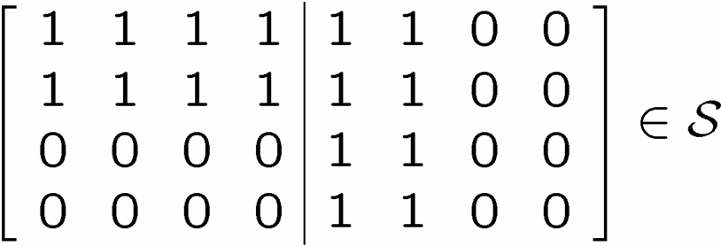
X Columns, Z Rows
X
Z
ZZ
ZZ
XX
XX
XX
ZZ
ZZ
XX
XX
XX
ZZ
ZZ
X
X
X
X
X
X

Slide 32
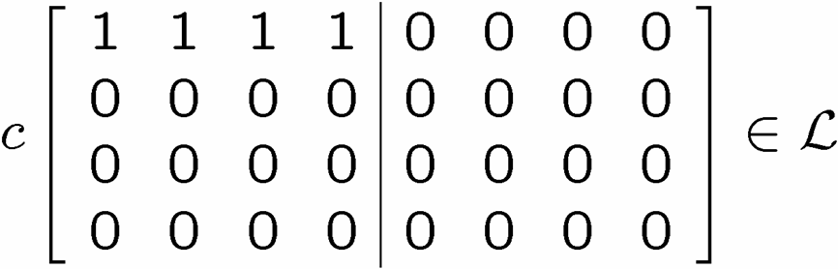

X Columns, Z Rows
Z
X
X
X
Z
Z

Slide 33
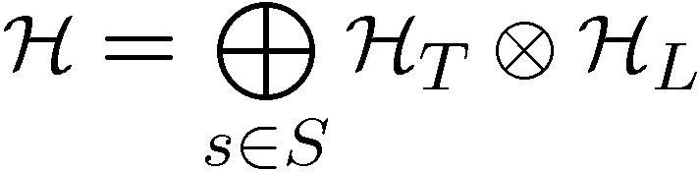


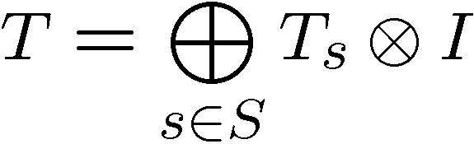
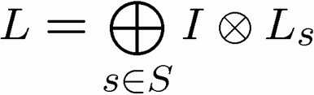
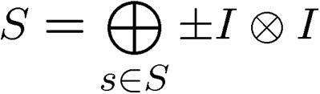
A Little Representation Theory

Slide 34
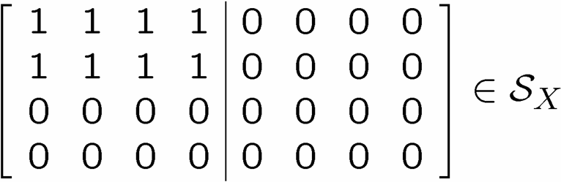
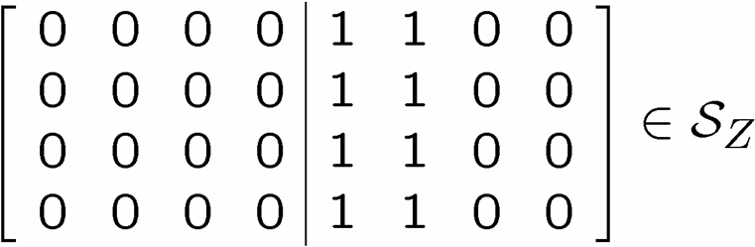
Quantum Error Correcting Subsystems

Slide 35

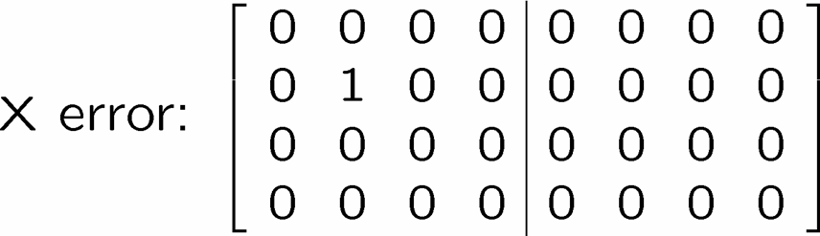
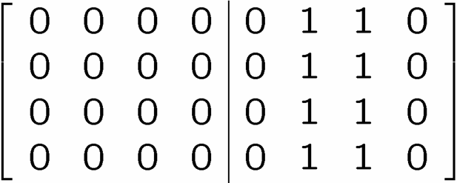
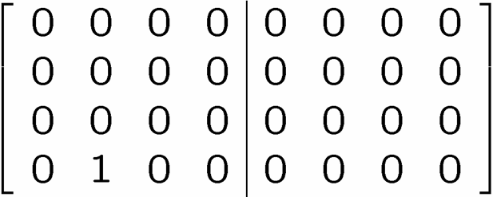
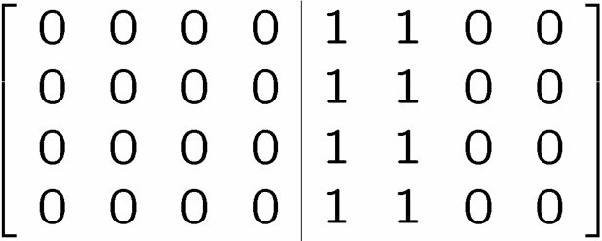
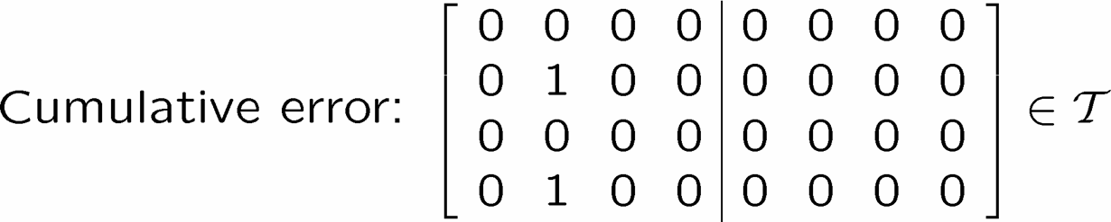

Diagnose and Pseudo-Fix
1
2
3
4

Slide 36
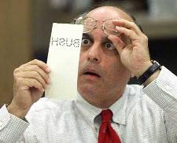




Detailing The Fix

Slide 37

Relation To Physics
ZZ
ZZ
XX
XX
XX
ZZ
ZZ
XX
XX
XX
ZZ
ZZ
Eigenstates of
are a quantum error correcting subsystem
Expect excitations to be pointlike…not self-correcting

Slide 38


Frinkahedron
n by n by cube of qubits
ZZ
ZZ
XX
XX
ZZ
ZZ
ZZ
XX
XX
XX
ZZ
ZZ
XX
XX
XX
XX
XX
ZZ
ZZ
ZZ
XX
XX
ZZ
ZZ

Slide 39




Expectations
eigenstates are quantum error correcting subsystem
assume phase with two point n.n. correlations
XX
XX
errors are stringlike excitations
in this “mean field” approximation
XX
XX
XX
XX
Z
XX
Energy proportional to perimeter
self correcting?
XX
XX
XX
XX
XX

Slide 40






Mean Field Correct?
“To be an Error and to be Cast out is Part of [Nature’s] Design.” -William Blake
[4,2,2] quantum error detecting code:

Slide 41

Supercoherence
4 qubit system
1
XX
2
ZZ
ZZ
4
XX
3
System Hamiltonian:

Slide 42






















Bond expectation values are
finite and negative.

Slide 43

Supercoherence
ALL single qubit errors take degenerate ground state to higher energy levels.
Single qubit errors change value of (S₁,S₂) and hence take ground state to higher energy level.
FORBIDDEN
D. Bacon, Ph.D. thesis, U.C. Berkeley, 2001

Slide 44




Quantum Error Correcting
Order Parameter
The quantum information is
still here. How do we see it?
diagnose
fix
measure encoded info
j
Encoded quantum information

Slide 45
Subsystem Order Parameter
Suppose probability of error per qubit is p.
If p<1/(2L), then error correction will succeed.
Contrast with toric codes percolation threshold.

Slide 46


Finite Size Saves
Error rate scales like:
This must be
The system must be gapped in order for the subsystem code
to allow readout of encoded quantum information.

Slide 47





Back to the Third Dimension

Slide 48



Long Range Interactions?
Same 2D subsystem code, but now mean field argument
for the Hamiltonian yields self-correction (Weiss-Ising)

Slide 49


Physical Implementations?
optical lattice
ion traps?

Slide 50






Quantum Computing Roadmap
NIST Boulder Ions

Slide 51
Self Correcting Quantum Computers
quantum error correcting subsystems in
spin lattice systems
YY
ZZ
XX
ZZ
XX
YY
YY
ZZ
ZZ
XX
XX
YY
self-correcting quantum memories?

