Slide 1
Tht Yuo Cna Reda Ths Snetnce
Impls Tat Yor Mnid Cna Efncenlty Solev
NP-Cmoplet Prbolems

Slide 2
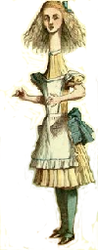

Optimal Measurements for the Dihedral Hidden Subgroup Problem
Dave Bacon, Santa Fe Institute
in collaboration with
Andrew Childs, Caltech
Wim van Dam, U.C. Santa Barbara
SQuint 2005

Slide 3
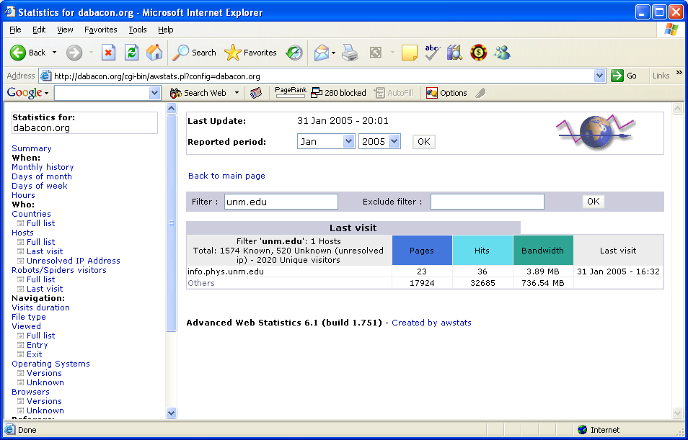

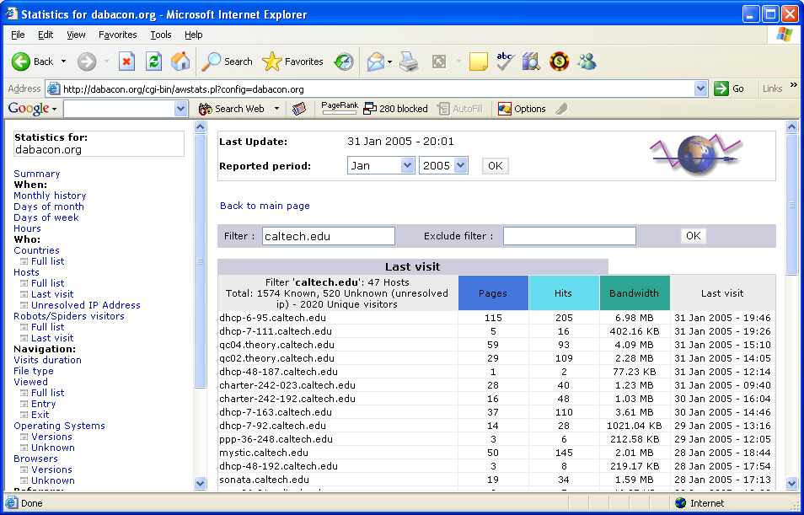
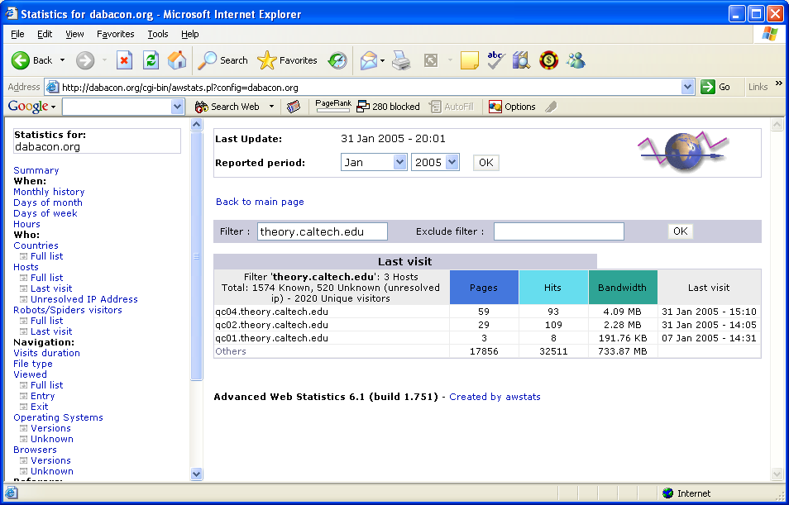

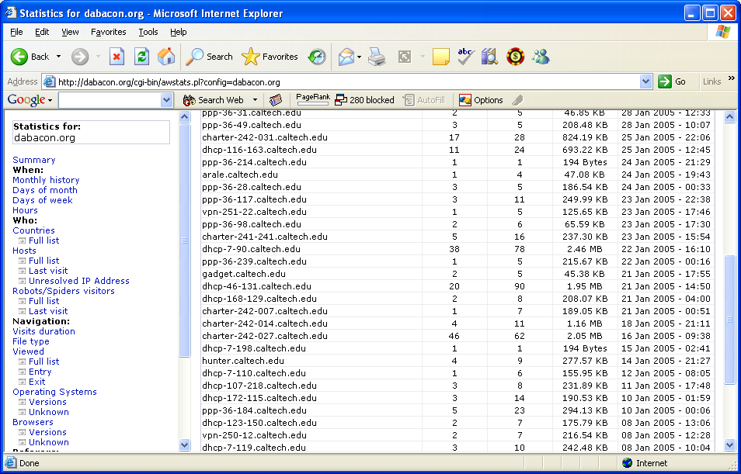
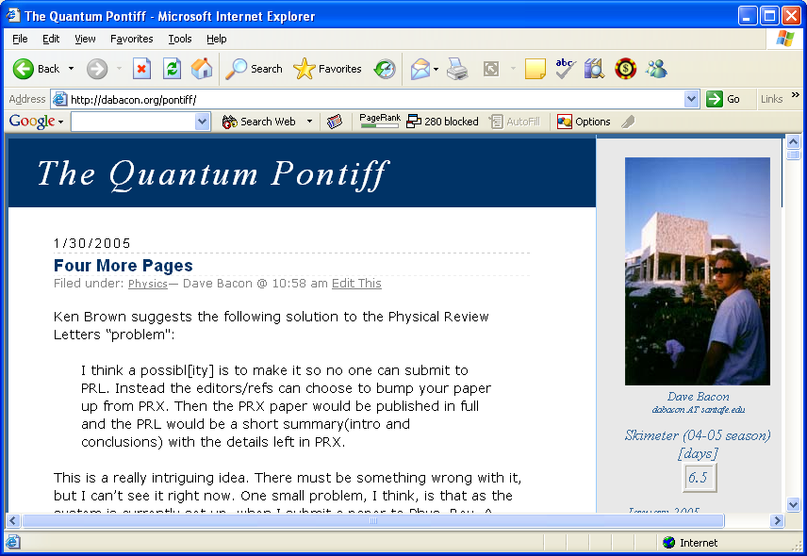
Southwest Distractions

Slide 4
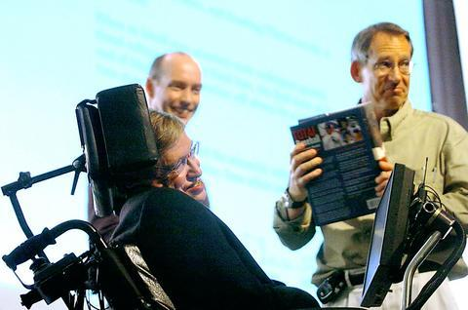

Quantum Algorithms
“If I had a good idea in quantum algorithms that’s
what I’d be working on” – John Preskill, 2004
What happens to quantum
computing if no significant
new algorithms are discovered?

Slide 5
When I was a Grad Student…
Quantum Algorithms
  Factoring, discrete log [Shor 94]
  Unstructured search [Grover 96]

Slide 6

State of the Art
Quantum Algorithms
  Factoring, discrete log [Shor 94]
  Unstructured search [Grover 96]
  Various hidden subgroup problems [Long List]
  Pell’s equation [Hallgren 02]
  Hidden shift problems [van Dam, Hallgren, Ip 03]
  Graph traversal [CCDFGS 03]
  Spatial search [AA 03, CG 03/04, AKR 04]
  Element distinctness [Ambainis 03]
  Various graph problems [DHHM 04, MSS 03,…]
  Testing matrix multiplication [Buhrman,Špalek 04]
  …

Slide 7
The Problem
The Hidden Subgroup Problem (HSP)
Problem: Fix a group G (known) and a subgroup
H⊆G (unknown). Given query access to a function
f : G → S that is constant and distinct on left cosets
of H in G. We say that f hides H.
Goal: Find (a generating set for) H.
Efficient algorithm: run time poly(log |G|).

Slide 8
Anatomy of Our Problem
Problem: Fix a group G (known) and a subgroup
H⊆G (unknown). Given query access to a function
f : G → S that is constant and distinct on left cosets
of H in G. We say that f hides H.
g_{m}H
f
g₃H
g₂H
g₁H
H
G
S

Slide 9
The Hidden Subgroup Saga
Why is everyone so interested in the HSP?
Factoring can be solved by solving an HSP
for an Abelian group.
2. Solving the HSP for the symmetric group would
given an algorithm for graph isomorphism.
3. Solving the HSP for the dihedral group would
give algorithms for k-unique shortest vector in a
lattice problems (and thus break a cryptosystem.)
4. Solving the HSP would make everyone work on
really new quantum algorithms.

Slide 10

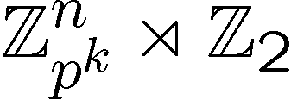
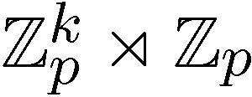
The Hidden Subgroup Success
Abelian groups [Shor 94; Kitaev 95]
[Püschel, Rötteler, Beth 98]
Normal subgroups [Hallgren, Russell, Ta-Shma 00]
“Amost Abelian” groups [GSVV 01]
[FIMMS 02]
“Near Hamiltonian” groups [Gavinsky 04]
Some q-hedral groups [MRRS 04]
[Inui, Le Gall 04]
Some
Things are heating up

Slide 11

A Strange Lock
Setup: Display will give same
result if we enact rotation by
k and if we enact rotation by
-k+x and a reflection.
x is the hidden combo.
Rotation:
0
1
0
0
Reflection:
0
1
POE
Goal: Make display repeat to
open the lock.
Display:
BFD
Dihedral Hidden Reflection Problem

Slide 12
Dihedral HSP
Dihedral group
G = D_{N}: symmetry group of a
N-sided regular polygon.
Rotation ≡ s, s^{N}=e
Reflection ≡ r, r²=e and rsr=s⁻¹
D₈
Element of D_{N}: r^{t}s^{k}, where t∈₂,s∈_{N}
Theorem: Solving the hidden subgroup problem
when H={e,rs^{l}}, l∈_{N} or H={e} solves the full
Dihedral HSP [Etinger, Hoyer 98]

Slide 13
Dihedral HSP Facts
Efficient algorithm for
the poly(d) unique
shortest vector in a
lattice problem
Efficient algorithm
for DHSP
[Regev 02]
Quantum algorithm:2^{O(√N)} time [Kuperberg 03]
poly(log(N)) space [Regev 04]
Efficient algorithm
average case subset sum
Efficient quantum
Algorithm for DHSP
[Regev 02]

Slide 14





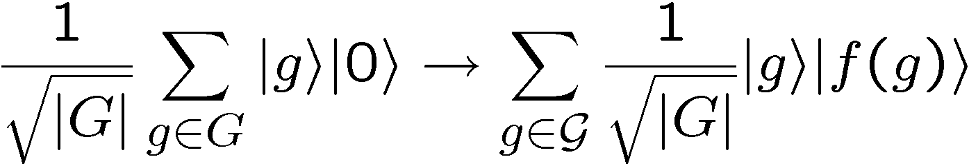
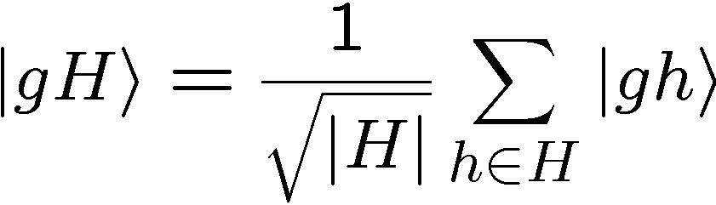
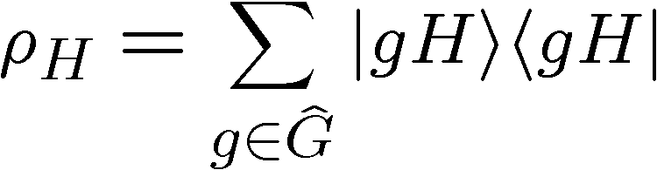
Standard Query Model
U_{f}
constant and distinct on different left cosets of H:
hidden subgroup state

Slide 15

HSP as State Distinction
Single Copy
Given:
with probability p_{H}
Determine:
H by a generalized measurement
Maximize: probability of successfully identifying H
Multiple Copy
Given:
with probability p_{H}
Determine:
H by a generalized measurement
Maximize: probability of successfully identifying H

Slide 16
Query Complexity of HSP
Given: k=O(log(N)) standard queries to HSP
Exists: an inefficient quantum algorithm which
solves any HSP.
[Ettinger, Hoyer, Knill 99]
“Query complexity of HSP is polynomial.”
Results: Shor’s algorithm is optimal with O(1)
queries to the HSP [Ip 03]
Question: Are there groups for which O(log(N))
standard queries are necessary?

Slide 17

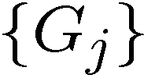

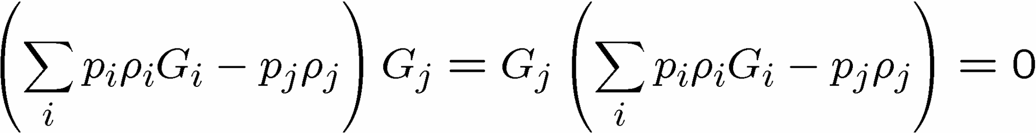
Holevo’s Condition
Given:
with probability p_{i}
Measure:
POVM with elements
Outcome:
j corresponds to guessing state
Maximize:
probability of successfully identifying
Necessary and Sufficient Condition:
[Holevo:73]
Hard to find explicit forms for G_{j}

Slide 18
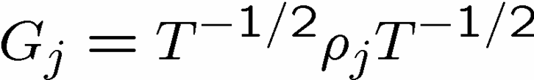
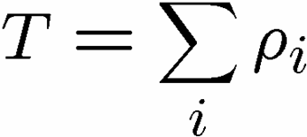
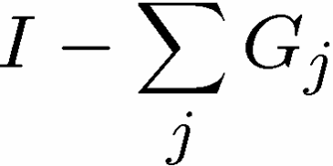
Pretty Good
Given:
with equal probabilities
Observation:
the “Pretty Good Measurement” is
often pretty good.
Pretty Good Measurement (PGM):
(plus if needed.)

Slide 19
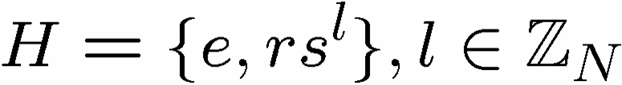
Hidden Reflection
Given:
with equal a priori probability
Theorem: [Bacon, Childs, van Dam 05]
The PGM is the optimal measurement for
identifying H.
Theorem: [Moore, Russell 05]
The PGM is the optimal measurement for
identifying H when H and G are a Gelfand pair.
arXiv generalization speed
= Jan 10 – Jan 31 = 21 days

Slide 20
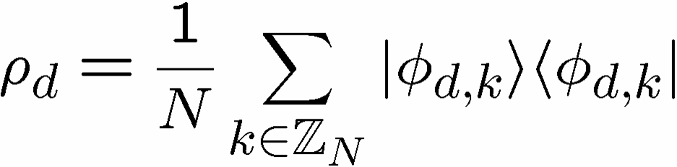
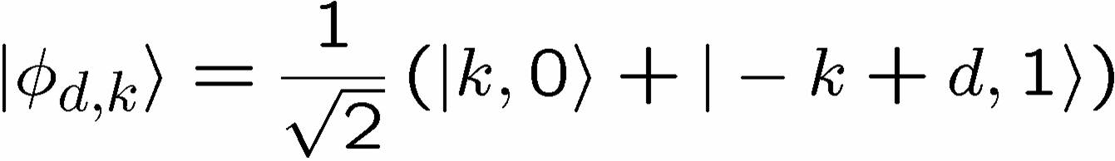
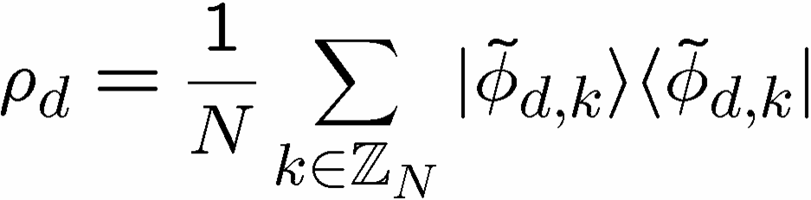
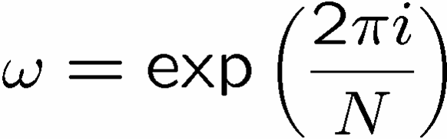
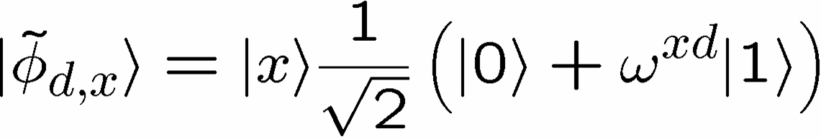
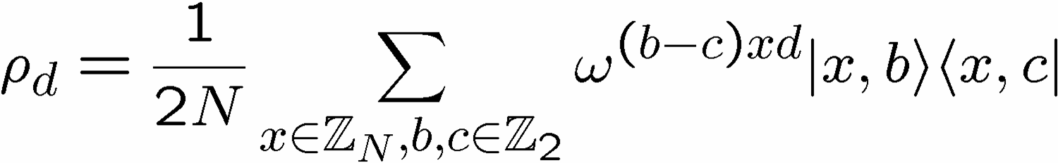
One Copy
Punishment
One copy of the Hidden Subgroup state:
Basis change:

Slide 21
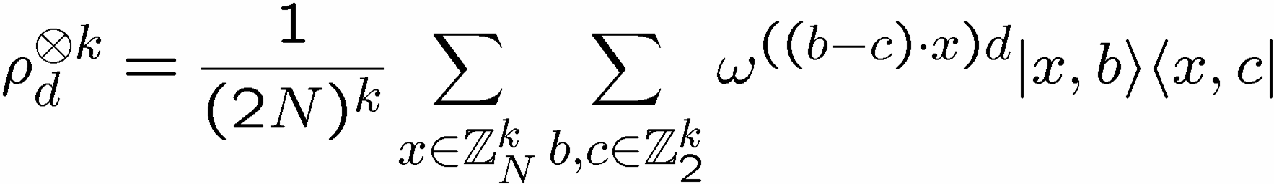
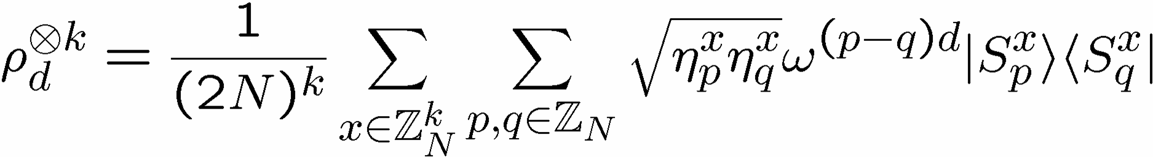
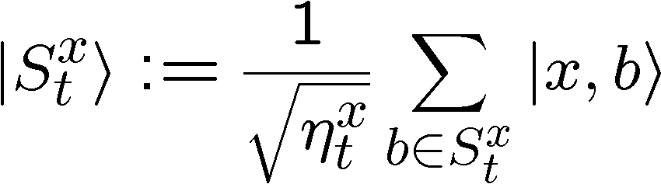

Multi Copy
More Punishment
number of subsets of x which sum to t

Slide 22
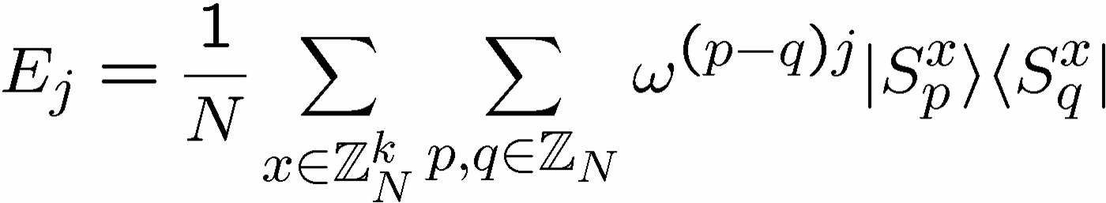
Optimal PGM
Stop The
Punishment
Note: Entangled measurement over k copies

Slide 23
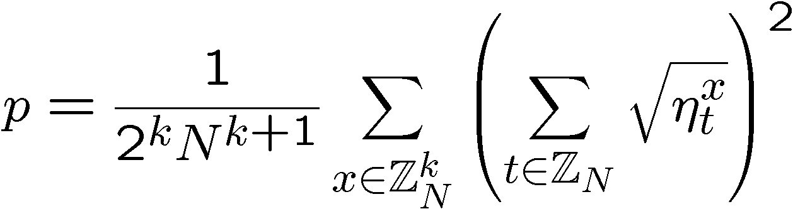
Success Probability
Probability of correctly guessing reflection:
number of subsets of x which sum to t
p is related to a phase transition

Slide 24
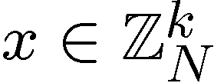


Subset Sum Problem
Given:
k integers from
i.e. , and a target
Goal:
Find a subset of x which sums to t
Problem:
does there exists such a subset?
NP-complete
Problem:
If such a subset exists, return this subset
NP-hard
basis for old (broken) public key cryptosystem

Slide 25
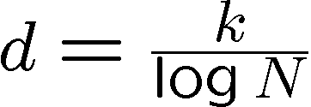



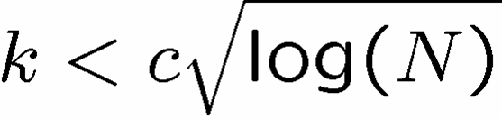
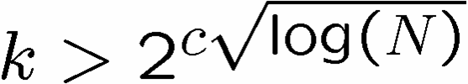
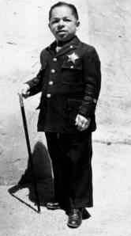
The Subset Sum Landscape
Given:
k integers from
i.e. , and a target
Define:
density :=
“low density”
“high density”
most subsets have
a distinct sum
most sums achieved by some subset
efficient algorithm
efficient algorithm
hard?
[Lagarias, Odlyzko 85]
[Flaxman, Pryzdatek 04]

Slide 26
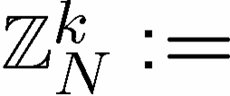

Success Probability
Probability of correctly guessing reflection:
k dimensional vector of elements of
number of subsets of x which sum to t
Two orders:
For k<N, p is exponentially small (in log(N))
For k>N, p is O(1)
transition at density = d=1

Slide 27
Must Work Hard
Theorem: [Bacon, Childs, van Dam 05]
Determining the hidden reflection requires
O(log(N)) copies of the hidden subgroup states.
Theorem: [Bacon, Childs, van Dam 05]
Determining the most significant bit of the
hidden reflection requires O(log(N)) copies
of the hidden subgroup states.
An efficient quantum circuit for the dihedral PGM?

Slide 28

MMMMore
Implementation of dihedral PGM in a particular
manner would allow for solution of subset sum
problems.
Information theoretic description of bounds
on number of copies to solve dihedral HSP.

Slide 29
Conclusions
Optimal measurements for the dihedral HSP
Probability of success and subset sum
At k=log(N) copies transition to solvable
Open
Efficient quantum circuit for optimal measurement
Efficient quantum circuits for a PGM

Slide 30
Optimal Measurements for the Dihedral Hidden Subgroup Problem
Dave Bacon, Santa Fe Institute
in collaboration with
Andrew Childs, Caltech
Wim van Dam, U.C. Santa Barbara
SQuint 2005

