Slide 1
You Did Not Just Read This
or did you?

Slide 2
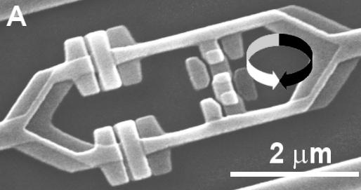
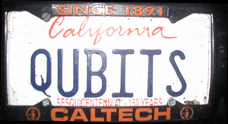
SquInT: Quantum Algorithms
18819881292060796383869
72394616504398071635633
79417382700763356422988
85971523466548531906060
65047430453173880113033
96716199692321205734031
87955065699622130516875
9307650257059
3980750864240649
3739712550055038
6491199064362342
5267084063851895
7594638895726176
8583317
4727721461074353
0253622307197304
8224632914695302
0971164598521711
3052071125636359
0397527

Dave Bacon
University of Washington
Department of Computer Science & Engineering

Slide 3
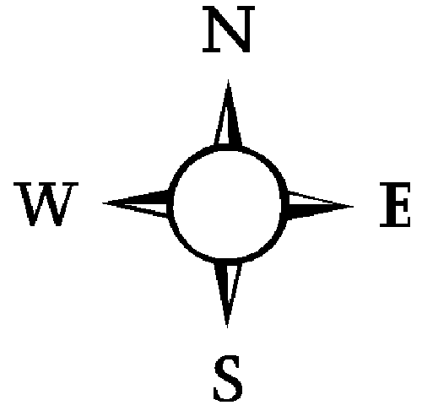
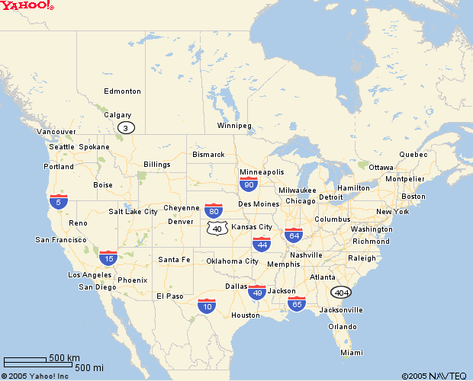
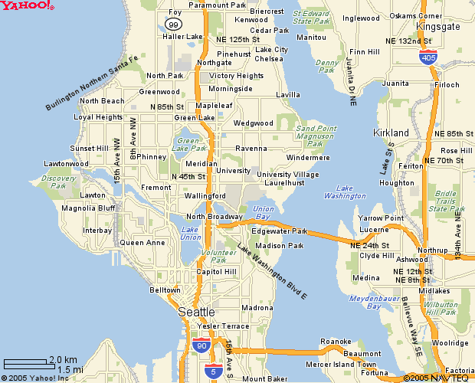

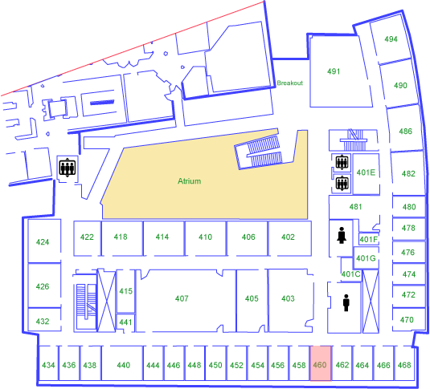
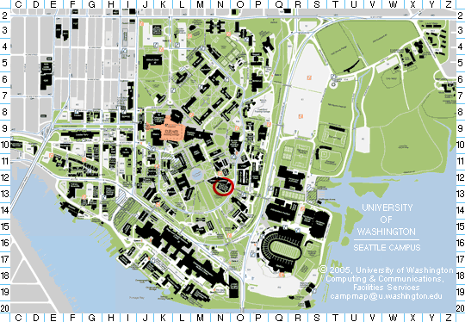
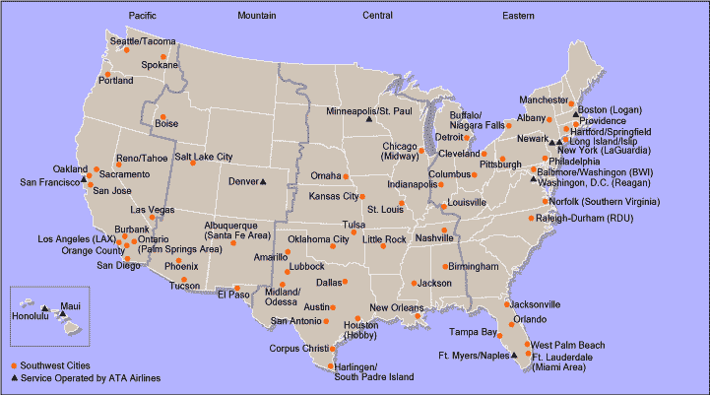
Southwest?
Southwest Airlines Route Map

Slide 4
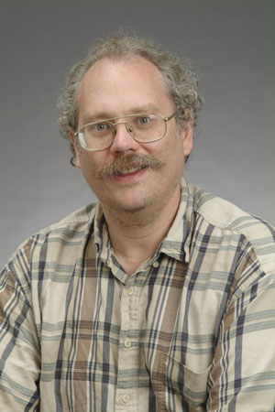
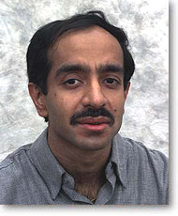

Today
Two 1 Hour Lectures
(you poor souls)
Quantum Algorithms
of the Shor Kind
Quantum Algorithms
of the Grover Kind
Quantum Algorithms
of the Future Kind
your face here?

Slide 5
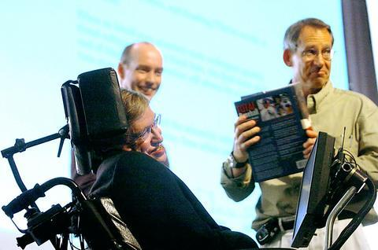

Quantum Algorithms
“If I had a good idea in quantum algorithms that’s
what I’d be working on” – John Preskill, 2004
What happens to quantum
computing if no significant
new quantum algorithms
are discovered?
Most important, most exciting, most frustrating.

Slide 6


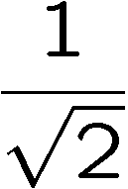
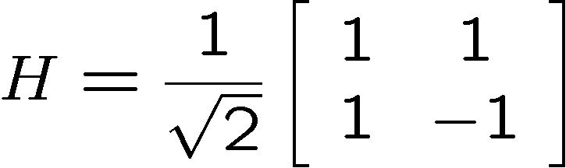
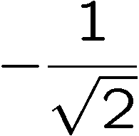
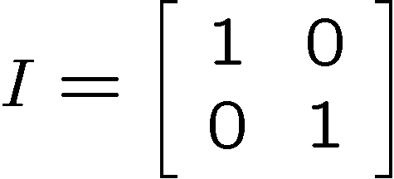
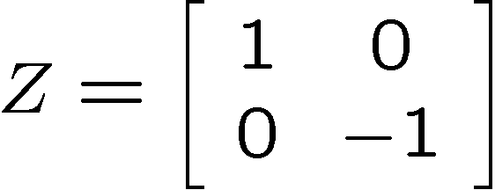
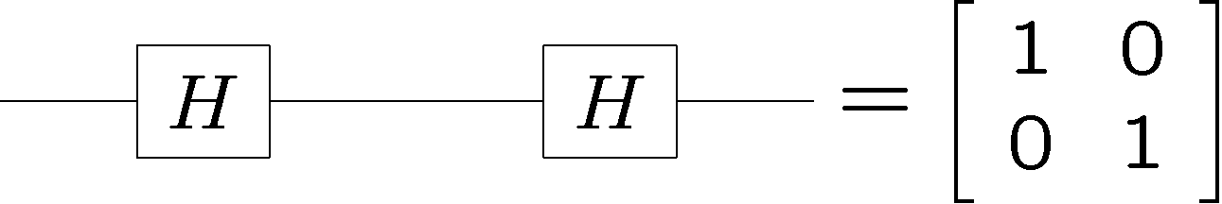
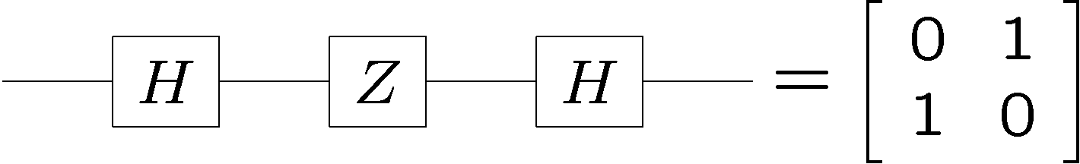
Interference

Slide 7



Compare To…
probabilistic classical evolution of a finite state machine
All of the transitions are labeled by postive numbers:
hence no interference
Note we can simulate interference on a classical system, but
we know of no efficient way to simulate quantum interference
of a quantum system with the same resource size as that
quantum system.
Can we use interference for algorithms?

Slide 8

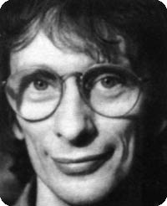
In the Beginning There Was…
David
Deutsch
Dr. Falken
(from the movie War Games)

Slide 9
David Speaks
“Complexity theory has been mainly concerned with constraints upon the computation of functions: which functions can be computed, how fast, and with use of how much memory. With quantum computers, as with classical stochastic computers, one must also ask ‘and with what probability?’ We have seen that the minimum computation time for certain tasks can be lower for Q than for T . Complexity theory for Q deserves further investigation.”
David
Deutsch
1985
Q = quantum computers
T = classical computers

Slide 10
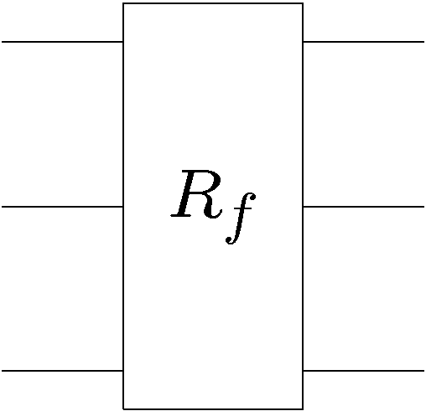





Classical Promise Problem
Query Complexity
Given: A black box which computes some function
k bit input
k bit output
black box
Promise: the function belongs to a set which is a subset
of all possible functions.
Properties: the set can be divided into disjoint subsets
Problem: What is the minimal number of times we have to
use (query) the black box in order to determine which subset
the function belongs to?

Slide 11
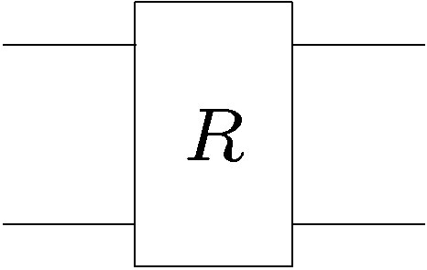










Deutsch’s Problem (Revisionist)
Suppose you are given a black box which computes one of
the following four reversible classical gates:
2 bits input
2 bits output
controlled-NOT
+ NOT 2nd bit
“identity”
NOT 2nd bit
controlled-NOT
Deutsch’s (Classical) Problem: What is the minimal number of times we have to use this black box to determine whether we are given one of the first two or the second two functions?

Slide 12
Deutsch’s Problem (Revisionist)
controlled-NOT
+ NOT 2nd bit
“identity”
NOT 2nd bit
controlled-NOT
Deutsch’s (Classical) Problem: What is the minimal number of times we have to use this black box to determine whether we are given one of the first two or the second two functions?
1. It is necessary to query more than once.
2. Two queries are sufficient.
“classical query complexity of Deutsch’s problem is two”

Slide 13
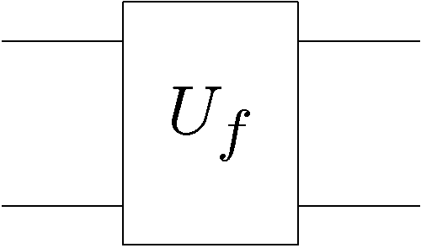
Quantum Deutsch’s Problem
controlled-NOT
+ NOT 2nd bit
“identity”
NOT 2nd bit
controlled-NOT
These functions are all reversible (one-to-one). Thus we
can implement them on a quantum computer as reversible
quantum gates.
2 qubits input
2 qubits output

Slide 14

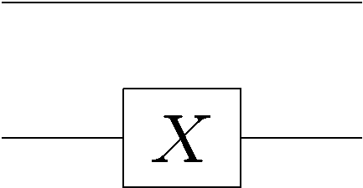
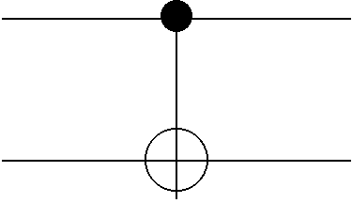
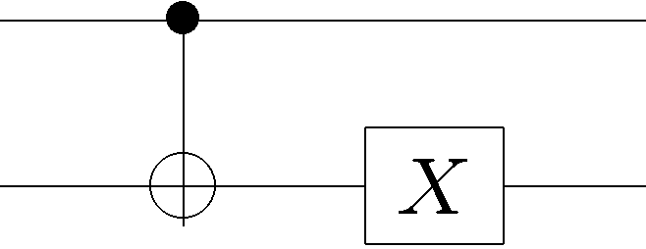
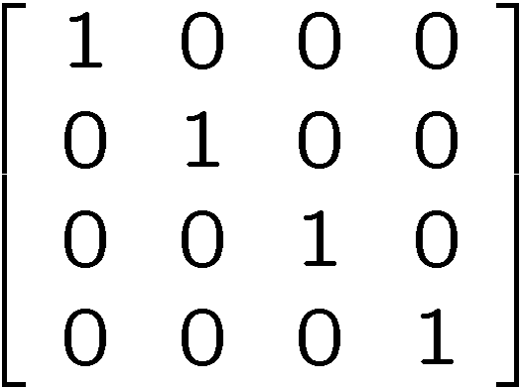
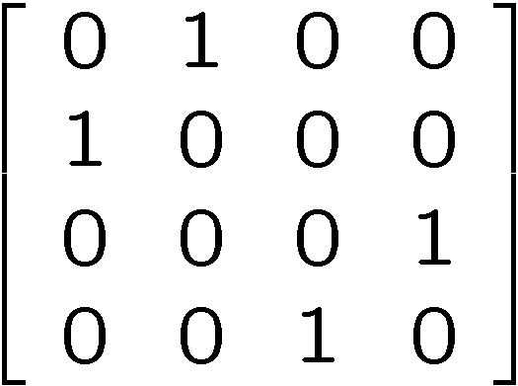
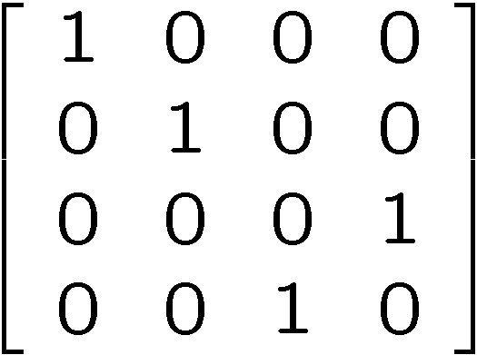
Classical to Quantum Deutsch
controlled-NOT
+ NOT 2nd bit
“identity”
NOT 2nd bit
controlled-NOT
convert to quantum gates

Slide 15
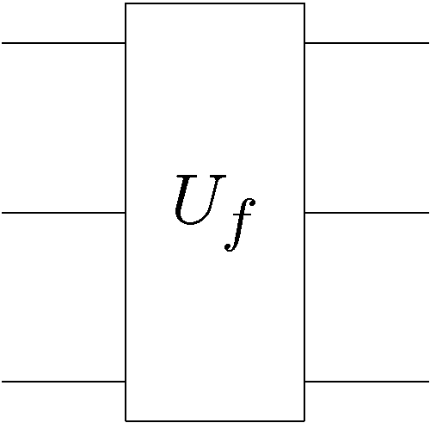


Quantum Promise Query Complexity
Given: A quantum gate which, when used as a classical device
computes a reversible function
k qubit input
k qubit output
black box
Promise: the function belongs to a set which is a subset
of all possible functions.
Properties: the set can be divided into disjoint subsets
Problem: What is the minimal number of times we have to
use (query) the quantum gate in order to determine which
subset the function belongs to?

Slide 16
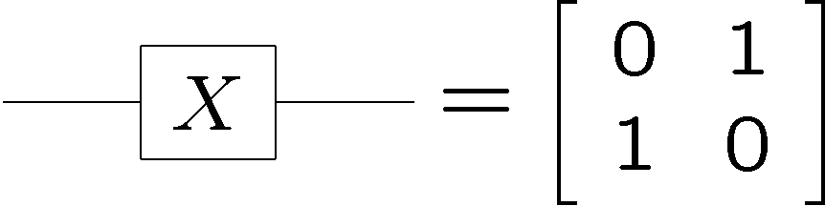
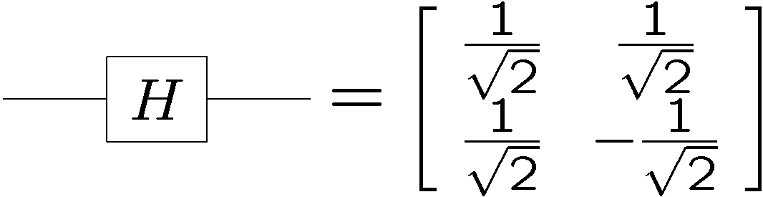
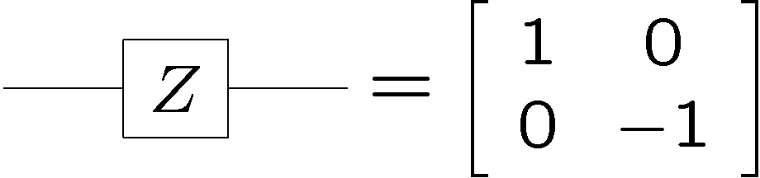
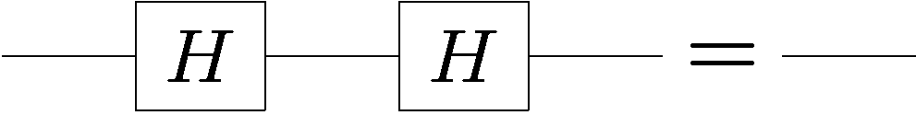
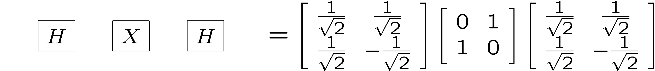
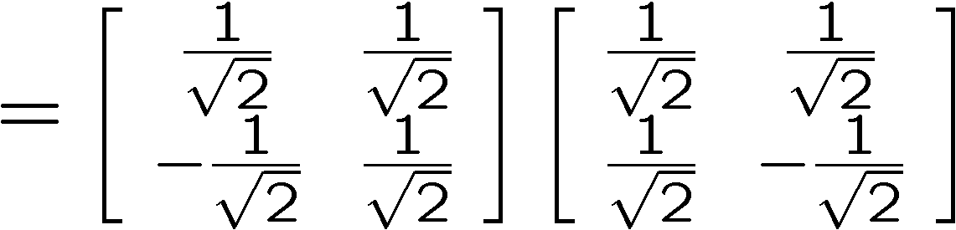
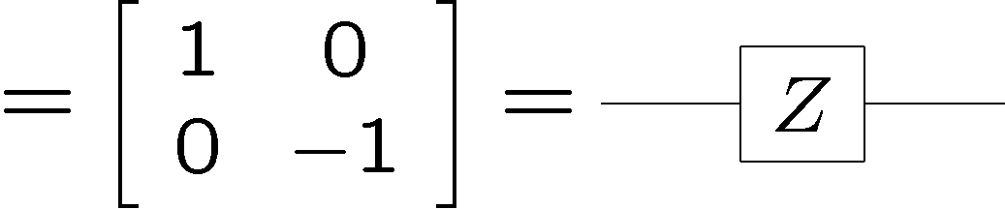
Fun With Quantum Circuits
“bit flip”
“phase flip”
“Hadamard”
The Hadamard exchanges the role of bit flips and phase flips

Slide 17
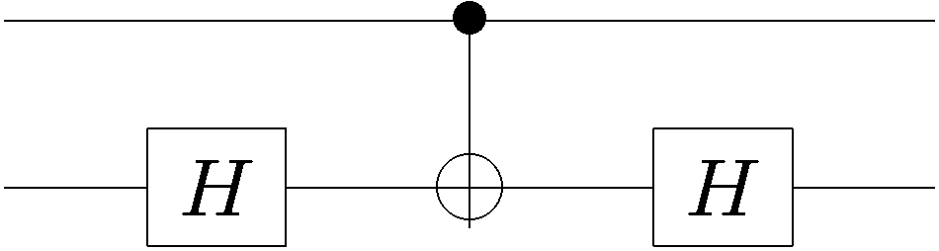
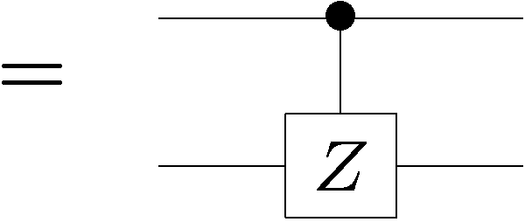
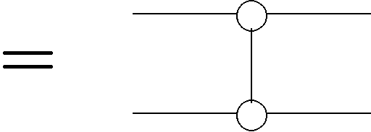
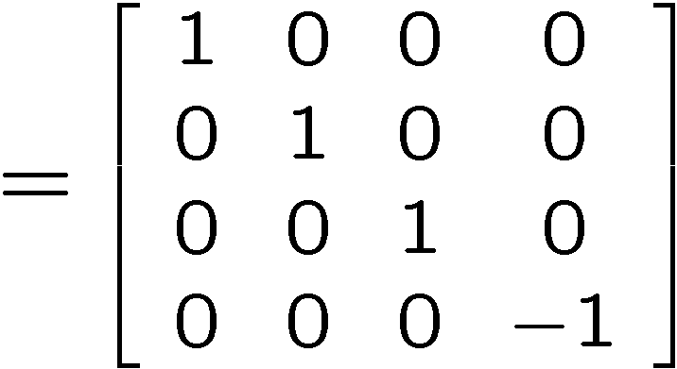
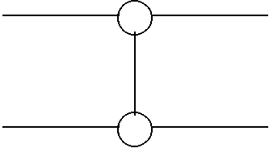
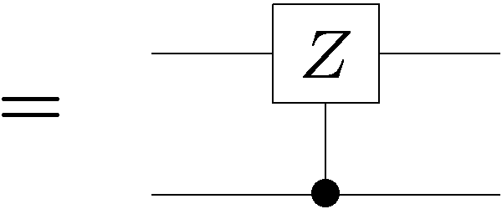
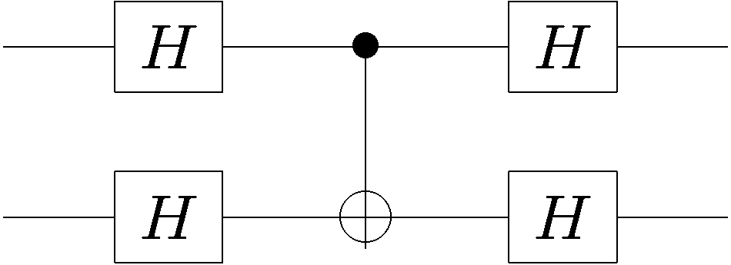
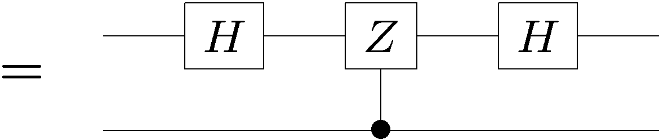
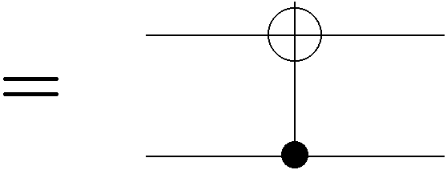
More Fun With Quantum Circuits
Using

Slide 18
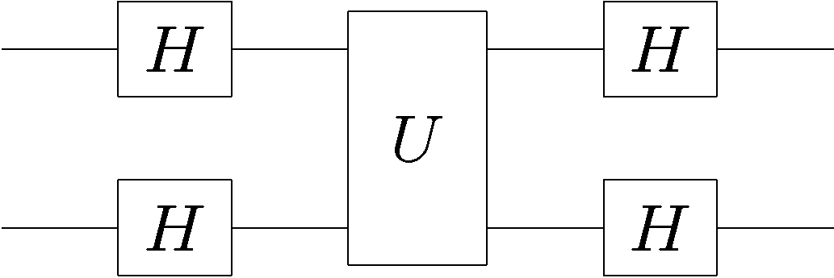
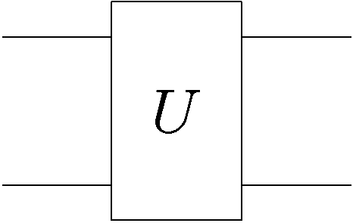
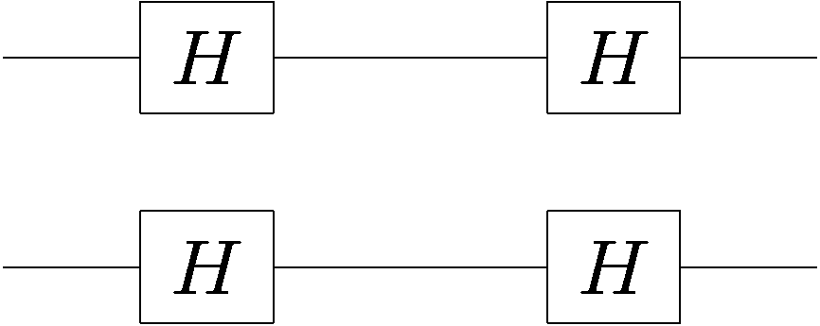
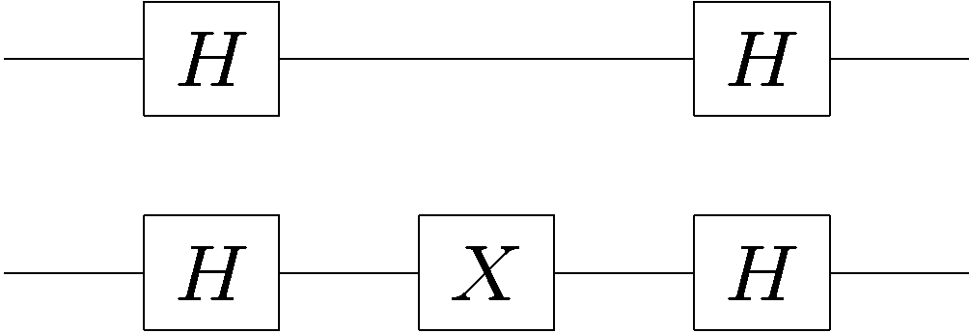
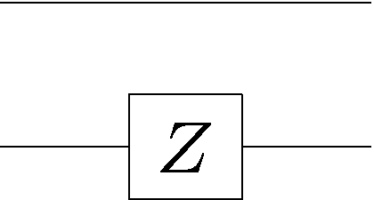


Quantum Deutsch
What if we perform Hadamards before and after the quantum gate:

Slide 19

That Last One

Slide 20


Again

Slide 21





Some Inputs

Slide 22



Quantum Deutsch

Slide 23
Quantum Deutsch
By querying with quantum states we are able to distinguish
the first two (constant) from the second two (balanced) with
only one use of the quantum gate!
Two uses of the classical gates
Versus
One use of the quantum gate
quantum speedup

Slide 24





An Aside on Functions
k qubit input
k qubit output
Normally this is presented in a slightly different manner. The
reason for this has to do with how we calculate non-reversible
functions on a quantum computer
Suppose for example you want to implement the function
This is not a reversible function, but we can implement it as
exclusive or:

Slide 25









An Aside on Functions
Generically we can compute a non-reversible function using
function from n bits
to k bits:
n qubits
k qubits
is a bitwise exclusive or
Such that, with proper input we can calculate f:

Slide 26




From This Perspective
controlled-NOT
+ NOT 2nd bit
“identity”
NOT 2nd bit
controlled-NOT
constant functions
balanced functions
Deutsch’s problem is to distinguish constant from balanced

Slide 27

Query Complexities
black box
probability
of failure
Exact classical
query complexity
Bounded error algorithms are allowed to fail with a bounded probability of failure.
Bounded error classical
query complexity
Exact quantum
query complexity
Bounded error quantum
query complexity

Slide 28
Random Extra Slide

Slide 29







Quantum Algorithms
1992: Deutsch-Jozsa Algorithm
Exact classical q. complexity:
David
Deutsch
Richard
Jozsa
Bounded error classical q. complexity:
Exact quantum q. complexity:
1993: Bernstein-Vazirani Algorithm
(non-recursive)
Exact classical q. complexity:
Umesh
Vazirani
Ethan
Bernstein
Bounded error classical q. complexity:
Exact quantum q. complexity:

Slide 30





Quantum Algorithms
1993: Bernstein-Vazirani Algorithm
(recursive)
Bounded error classical q. complexity:
Umesh
Vazirani
Ethan
Bernstein
Exact quantum q. complexity:
(first super-polynomial separation)
1994: Simon’s Algorithm
Bounded error classical q. complexity:
Dan
Simon
Bounded error quantum q. complexity:
(first exponential separation)
Generalizing Simon’s algorithm, in 1994, Peter Shor was able
to show that…

Slide 31



The Factoring Firestorm
18819881292060796383869723946165043
98071635633794173827007633564229888
59715234665485319060606504743045317
38801130339671619969232120573403187
9550656996221305168759307650257059
Peter
Shor
1994
3980750864240649373971
2550055038649119906436
2342526708406385189575
946388957261768583317
4727721461074353025362
2307197304822463291469
5302097116459852171130
520711256363590397527
Best classical algorithm
takes time
Shor’s quantum algorithm
takes time
An efficient algorithm for factoring breaks the
RSA public key cryptosystem

Slide 32
The Golden Years
1992: Deutsch-Jozsa Algorithm
David
Deutsch
Richard
Jozsa
1993: Bernstein-Vazirani Algorithm
(non-recursive)
Umesh
Vazirani
Ethan
Bernstein
1994: Simon’s Algorithm
Dan
Simon
1994: Shor’s Algorithm
Peter
Shor

Slide 33



Deutsch-Jozsa Problem
Given: A function with n bit strings as input and one bit as
output
(this will be a non-reversible function)
Promise: The function is either constant or balance.
constant function:
balanced function:
constant
balanced
Problem: determine whether the function is constant or
balanced.

Slide 34
Classical Deutsch-Jozsa
constant
balanced
Problem: determine whether the function is constant or
balanced.
No failure allowed: we need to query in the worst case
values of to distinguish between constant and
balanced
Exact classical q. complexity:

Slide 35

Classical Deutsch-Jozsa
constant
balanced
Problem: determine whether the function is constant or
balanced.
Bounded error:
Query two different random values of
the function.
If they are equal, guess constant.
Otherwise, guess balanced.
Bounded error classical q. complexity:

Slide 36

Quantum Deutsch-Jozsa
Given: A quantum gate on n+1 qubits strings which calculates
the promised f
n qubit
1qubit

Slide 37





Trick 1: Phase Kickback
Input a superposition over second register:
Function is computed into phase:

Slide 38







Trick 2: Hadamarding Qubits
Note:
and

Slide 39




Tricks 1 and 2 Together
n
qubits

Slide 40


Tricks 1 and 2 Together
n qubits

Slide 41

Function in the Phase
constant
balanced

Slide 42



Function in the Phase
When the function is constant:
When the function is balanced:
amplitude in zero state

Slide 43


Quantum Deutsch-Jozsa
n
qubits
If function is constant, r is always 0.
If function is balanced, r is never 0.
Distinguish constant from balanced using one quantum query

Slide 44
Deutsch-Jozsa
1992: Deutsch-Jozsa Algorithm
Exact classical q. complexity:
David
Deutsch
Richard
Jozsa
Bounded error classical q. complexity:
Exact quantum q. complexity:

Slide 45




Bernstein-Vazirani Problem
Given: A function with n bit strings as input and one bit as
output
Promise: The function is of the form
Problem: Find the n bit string

Slide 46
Classical Bernstein-Vazirani
Given: A function with n bit strings as input and one bit as
output
Promise: The function is of the form
Problem: Find the n bit string
Notice that the querying yields a single bit of information.
But we need n bits of information to describe .
Bounded error classical q. complexity:

Slide 47

Quantum Bernstein-Vazirani
n qubits

Slide 48




Hadamard It!

Slide 49
Quantum Bernstein-Vazirani
n
qubits
We can determine using only a single quantum query!

Slide 50
Bernstein-Vazirani
1993: Bernstein-Vazirani Algorithm
(non-recursive)
Exact classical q. complexity:
Umesh
Vazirani
Ethan
Bernstein
Bounded error classical q. complexity:
Exact quantum q. complexity:

Slide 51

Pooh-Pooh?
People like to pooh-pooh these early problems because they
do not solve problems which are “natural”
This is silly. These results show that treating a device as
classical or as quantum show amazing differences and
should only be “pooh-pooh”ed by people who have invented
their own new quantum algorithms.

Slide 52




Simon’s Problem
(is that nobody does what Simon says)
Given: A function with n bit strings as input and one bit as
output
Promise: The function is guaranteed to satisfy
Problem: Find the n bit string

Slide 53






Classical Simon’s Problem
Promise: The function is guaranteed to satisfy
Suppose we start querying the function and build up a list
of the pairs
If we find such that then we solve the
problem:
But suppose we start querying the function m times….
Probability of getting a matching pair
Bounded error query complexity:

Slide 54

Quantum Simon’s Problem
black box
Unlike previous problems, we can’t use the phase kickback
trick because there is no structure in the function.
Charge ahead:

Slide 55



Quantum Simon’s Problem
n qubits
n qubits

Slide 56

Quantum Simon’s Problem
Measure the second register
Using the promise on the function
This implies that we have the state
For random uniformly distributed
Measuring this state at this time does us no good….

Slide 57


Quantum Simon’s Problem
n qubits
n qubits

Slide 58




Quantum Simon’s Problem
Measuring this state, we obtain uniformly distributed random
values of such that
If we have eliminated the possible values of by half

Slide 59








Quantum Simon’s Problem
Think about the bit strings as vectors in
Multiple runs of the quantum algorithm yield equations
random
uniform
If we obtain linearly independent equations of this form,
we win (Guassian elimination)
Suppose we have linearly independent ‘s. What is the
probability that is linearly independent of previous ‘s?

Slide 60


Quantum Simon’s Problem
What is the probability that our equations are linearly
independent?
With constant probability we obtain linearly independence and
hence solve Simon’s problem.

Slide 61

Quantum Simon’s Problem
1994: Simon’s Algorithm
Bounded error classical q. complexity:
Dan
Simon
Bounded error quantum q. complexity:
It is also possible to make Simon’s algorithm an exactly
quantum algorithm with the same query complexity.
Further note that the actually running time for Simon’s
quantum algorithm has a running time using
the best known algorithms for solving the system of
linear equations

Slide 62



winner!
A Game
winner!
winner is last to place disk
The Physicist’s Game

Slide 63




Mmmm…Symmetry
What are physicists good at?
symmetry
symmetry
Why are physicists good at this?
Nature is often symmetric!
Symmetric problems are solvable problems, especially in quantum theory!
Example: Hydrogen atom
spherical symmetry

Slide 64



Mmmm…Symmetry
Simon’s algorithm is an example of a problem
for which the promise on the function is a symmetry
Random quantum states
which is the density matrix
Define the symmetry operators
Then the density matrix is invariant under this symmetry:

Slide 65
Shor
18819881292060796383869723946165043
98071635633794173827007633564229888
59715234665485319060606504743045317
38801130339671619969232120573403187
9550656996221305168759307650257059
Peter
Shor
1994
3980750864240649373971
2550055038649119906436
2342526708406385189575
946388957261768583317
4727721461074353025362
2307197304822463291469
5302097116459852171130
520711256363590397527
Shor’s algorithm for factoring is a combination of the insight
that quantum computers are good at solving symmetric
problems combined with the number theoretic observation
that factoring can be solved by period finding.

Slide 66




A Guessing Game
12?
29?
F(29)=16
F(12)=1
period
the secret of Delphi?

Slide 67







Period Finding
quantum
oracle
Problem: find in as few
queries as possible
….in as few uses of the
quantum oracle as possible
Period Finding Problem
a symmetric problem!

Slide 68









Explicit Symmetry
measure second register, randomly obtain
first register:
translational invariance
work in momentum basis

Slide 69













Fourier
to the Rescue
probability

Slide 70
The Factoring Firestorm
18819881292060796383869723946165043
98071635633794173827007633564229888
59715234665485319060606504743045317
38801130339671619969232120573403187
9550656996221305168759307650257059
Peter
Shor
1994
3980750864240649373971
2550055038649119906436
2342526708406385189575
946388957261768583317
4727721461074353025362
2307197304822463291469
5302097116459852171130
520711256363590397527
Best classical algorithm
takes time
Shor’s quantum algorithm
takes time
An efficient algorithm for factoring breaks the
RSA public key cryptosystem

Slide 71

Shor’s Algorithm
Breaks RSA Cryptography!
“Only time will tell if and when the problems of building a
quantum computer can be overcome….As information
becomes the world’s most valuable commodity, the
economic, political and military fate of nations will depend
on the strength of ciphers. Consequently, the development
of a fully operational quantum computer would imperil
our personal privacy, destroy electronic commerce and demolish the concept of
national security. A quantum computer would jeopardize the stability of the world.
Whichever country gets there first will have the ability to monitor the communications
of its citizens, read the minds of its commercial rivals and eavesdrop on the plans
of its enemies. Although it is still in its infancy, quantum computing presents a
potential threat to the individual, to international business and to global security. “
-Simon Singh

Slide 72

This Space for Sale

Slide 73










The Hidden Subgroup Problem
Finite group:
Given:
which is constant and distinct on left cosets of some subgroup
Find:
generators for

Slide 74







Symmetry and the HSP
function register outcome
regular representation:
SYMMETRY!

Slide 75




We Care About HSP Because…
Group .
classical problem
Abelian
period finding
order finding
factoring
discrete logarithm
Abelian groups
efficiently solvable
efficiently solvable?
dihedral group
certain shortest vector
in a lattice problems
symmetric group
graph isomoprhism
non-Abelian

Slide 76
Algorithms of the Grover Type

Slide 77




Grover’s Problem
Suppose we have a black box
n qubit
1qubit
with the property
Problem: find with as few queries as possible.

Slide 78



Grover’s Algorithm
Use the black box in a particular way
n qubit
Grover oracle:
How to use Grover oracle to find ?

Slide 79


The Grover Iterate
n qubits

Slide 80



The Grover Iterate
n qubits
Grover’s iterate

Slide 81






The Grover Iterate in 2D
Two orthonormal vectors:
Express the equal superposition in terms of these:
The Grover iterate will preserve this two dimensional subspace

Slide 82




The Grover Iterate in 2D
Expressed over the two dimensional subspace:
Grover’s iterate is just a rotation in this 2D space

Slide 83


Repeatedly Bang Your Head
Repeated application of the Grover iterate
Grover’s algorithm:
1. start with
2. repeatedly apply Grover’s iterate to rotate to near

Slide 84




Repeatedly Bang Your Head
Large amplitude in “bad” part of Hilbert space
physicist:
implies
Application of the repeated iterate to initial state rotates it to
nearly all amplitude in

Slide 85


Gover’s Algorithm
We have identified marked item using only queries!

Slide 86
Where Are We Going
What problems are there that quantum computers might
speed up?
Graph Isomorphism

Slide 87
Where Are We Going
Certain Shortest Vector in a Lattice Problems
Can breaks Aitai and Dwork cryptosystems

Slide 88


Where Are We Going
Code Isomorphism
Breaks the McEliece cryptosystem

Slide 89

Where Are We Going
Problems from PPP?
PPP: Polynomial Pigeonhole Principle
Problems which are guaranteed to have a solution
due to the pigeon hole principle.
Example:
Given a list of residues mod
and suppose , find two distinct
subsets so that .

Slide 90

Where Are We Going
Finding Nash Equilbrium

Slide 91
Where Are We Going
Recently there have been a surge in proof of classical complexity results using quantum methods.
“Assume that computer you had on your lap was actually
a quantum computer…then with a lot less work, we can show
such and such a complexity result.”
Real
Analysis
Complex Analysis
Classical
Complexity
Theory
Quantum
Complexity
Theory

Slide 92
SquInT: Quantum Algorithms
18819881292060796383869
72394616504398071635633
79417382700763356422988
85971523466548531906060
65047430453173880113033
96716199692321205734031
87955065699622130516875
9307650257059
3980750864240649
3739712550055038
6491199064362342
5267084063851895
7594638895726176
8583317
4727721461074353
0253622307197304
8224632914695302
0971164598521711
3052071125636359
0397527

Dave Bacon
University of Washington
Department of Computer Science & Engineering

