Slide 1
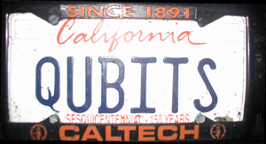
SQUINT: Quantum Algorithms
Lecture 1
Dave Bacon
University of Washington
Department of Computer Science & Engineering

