Slide 1
Test Slide
SAT
MCAT
GRE

Slide 2
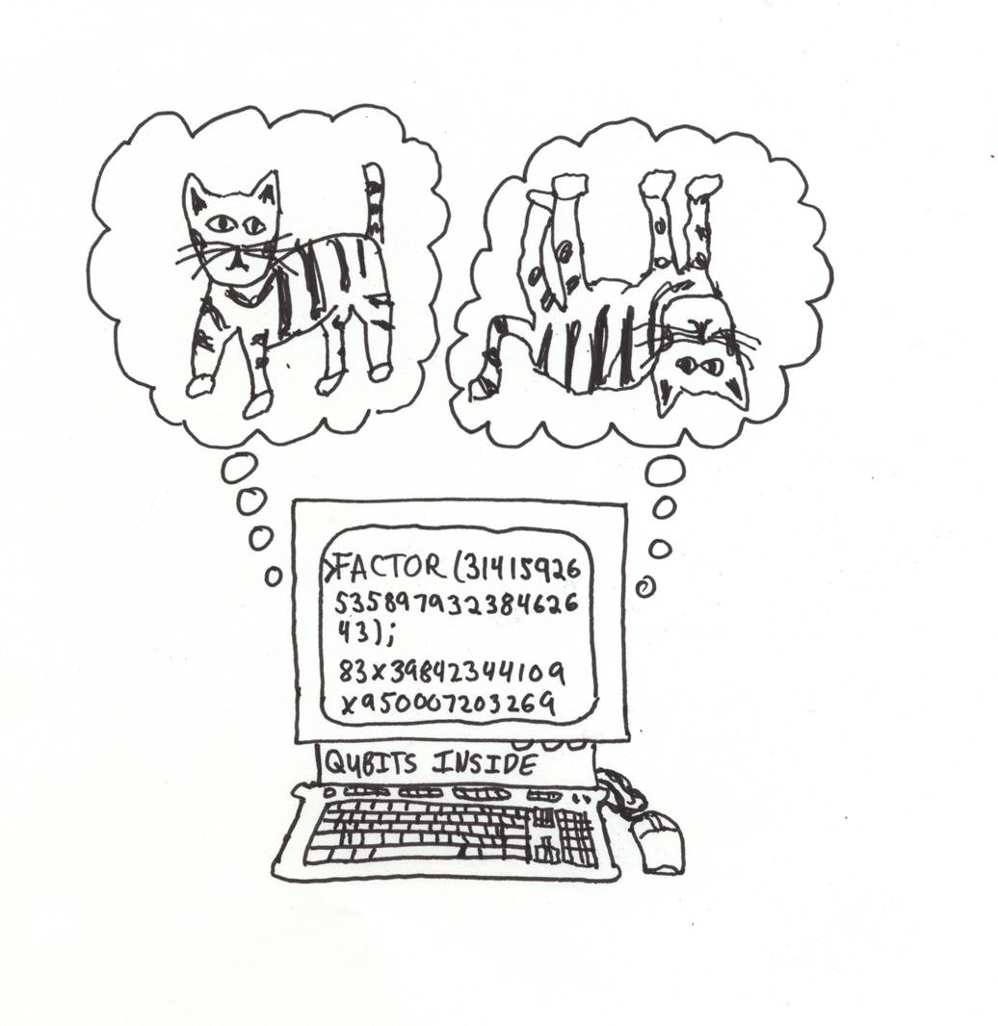
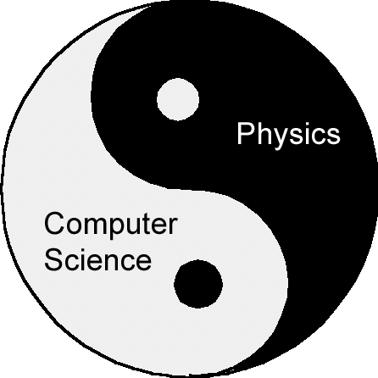
How and What to
Quantum Compute
Dave Bacon
Santa Fe Institute
[University of Washington CSE Colloquium, 2/24/05]

Slide 3

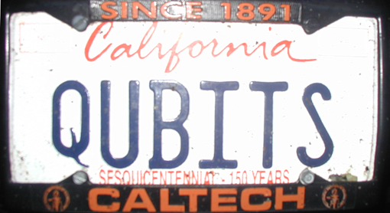
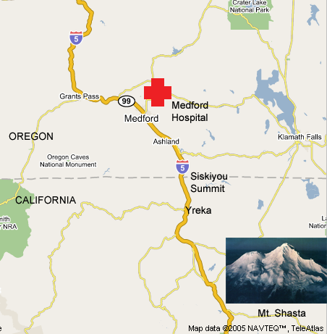
All Apologies

Slide 4
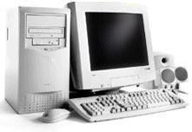
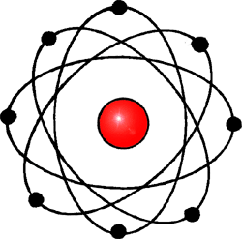
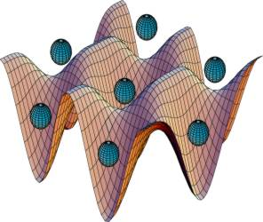
20th Century Reduced Redux
Quantum
Computation
Computation
Physics
exponential growth of digital computing power combined with the rise of software
elucidation and verification of
laws describing how nature
operates

Slide 5
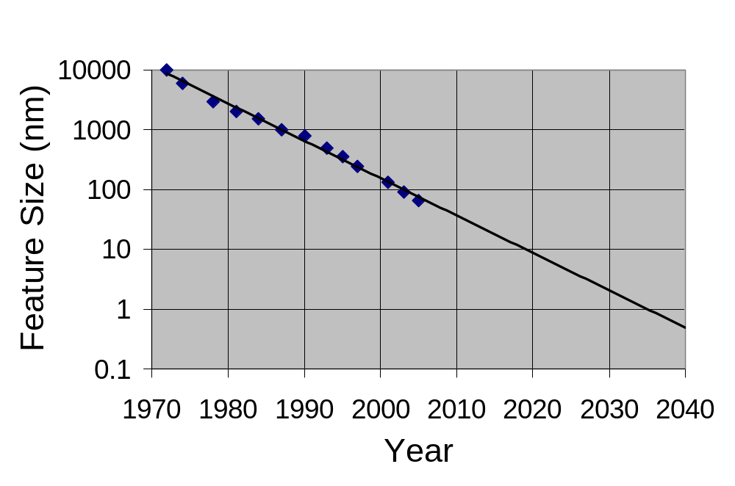
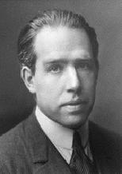
Into the Future
Computer Chip Feature Size versus Time
Eukaryotic cells
Mitochondria
AIDS virus
Amino acid
Quantum
Theory
“Prediction is very difficult,
especially if it's about the future.”
Niels Bohr

Slide 6
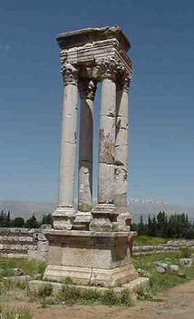
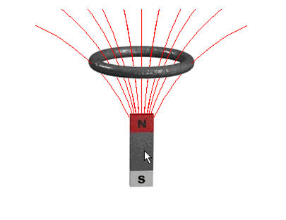
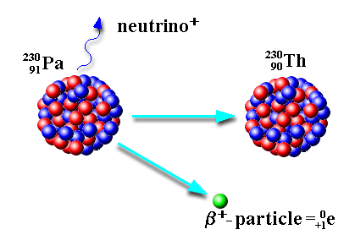
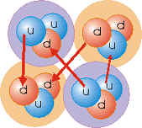
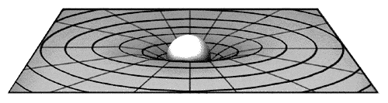
What is Quantum Theory?
Electromagnetic
Force
Weak
Force
Strong
Force
Gravitational
Force (?!?!)
Quantum Theory
Quantum theory is the machine language of the universe

Slide 7
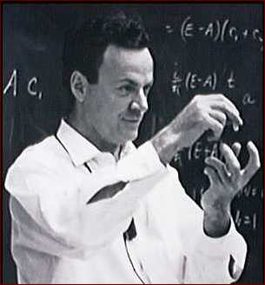
A Worrying Physicist
2040 is a long time in the future….so why worry?
Richard Feynman
Observations
No efficient computer simulations of
quantum theory
2. Systems evolving according to quantum
theory efficiently compute properties of the
quantum system (that’s what experiments are!)
“How can we simulate quantum mechanics?...
Can we do it with a new kind of computer…a
quantum computer? It’s not a Turing machine
but a machine of a different kind” (1981)

Slide 8


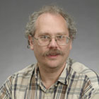
Shocking Discoveries
Quantum computers offer superpolynomial speedups (for certain oracle promise problems) over classical computers
[Bernstein, Vazirani STOC 93]
Umesh Vazirani
(U.C. Berkeley)
Quantum computers offer exponential speedups (for certain oracle promise
problems) over classical computers
[Simon FOCS 94]
Dan Simon
(Microsoft)
Quantum computers can efficiently factor integers and can efficiently compute the discrete logarithm
[Shor FOCS 94]
Peter Shor
(AT&T→MIT)

Slide 9


The Factoring Firestorm
18819881292060796383869723946165043
98071635633794173827007633564229888
59715234665485319060606504743045317
38801130339671619969232120573403187
9550656996221305168759307650257059
3980750864240649373971
2550055038649119906436
2342526708406385189575
946388957261768583317
4727721461074353025362
2307197304822463291469
5302097116459852171130
520711256363590397527
Best classical algorithm
takes time
Shor’s quantum algorithm
takes time
An efficient algorithm for factoring breaks the
RSA public key cryptosystem

Slide 10
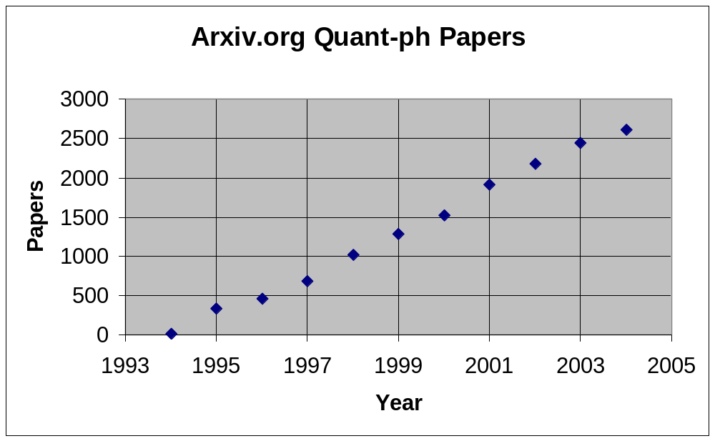
Boom!
Comparison
2004 quant-ph: 2606
2004 hep-th: 3357
(string theory)
2004 cond-mat: 8961
Quantum Information Science
Every single information processing task should be
reexamined in light of quantum theory

Slide 11
Quantum Information Science
C
O
M
P
U
T
E
R
S
C
I
E
N
C
E
Q
U
A
N
T
U
M
P
H
Y
S
I
C
S
Computational Complexity
Cryptography
Information Theory
Communication Complexity
Algorithms
Error Correction
Games
Feedback and Control
Quantum
Quantum
Quantum
Quantum
Quantum
Quantum
Quantum
Quantum

Slide 12
Quantum Information Science
Quantum Computation in
Quantum Computation in
Quantum Computation in
Quantum Computation in
Quantum Computation in
Quantum Computation in
Quantum Computation in
Quantum Computation in
Quantum Computation in
Ion Traps
Optical Lattices
Quantum Dots
Nuclear Magnetic Resonance
Superconductivity
Spins in Semiconductors
Electrons on Liquid Helium
Optical Systems
Cavity QED
INFORMATION
PROCESSING
P
H
Y
S
I
C
S

Slide 13
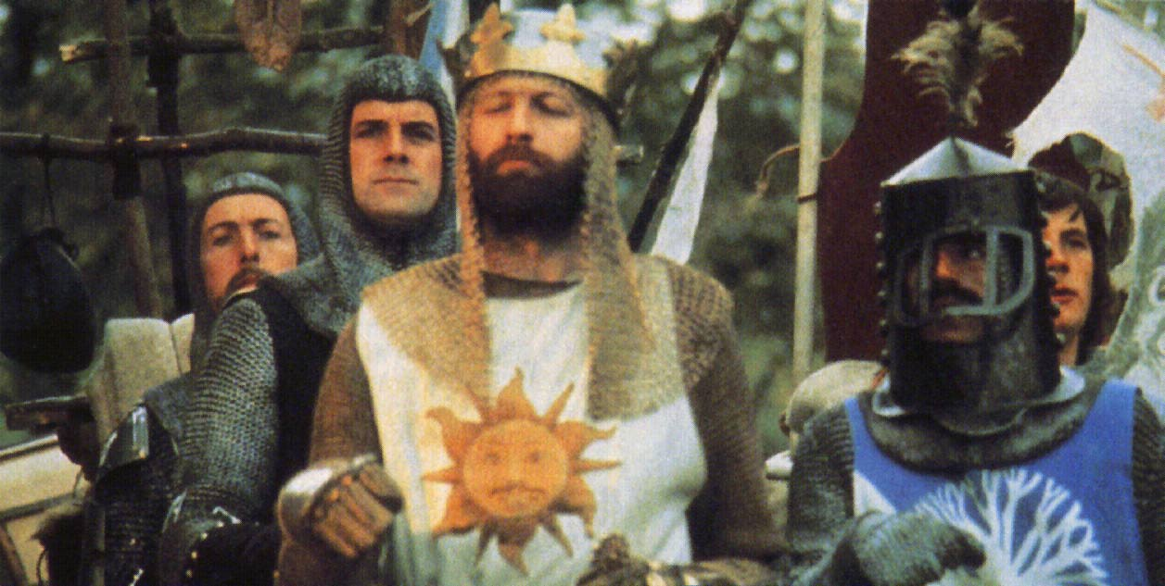
Crossbreeding Results!
Holy Grails of Quantum
Information Science
Exponential reduction in quantum resources over classical
(time, space, communication cost, etc.)
Impossibility of classical task possible with quantum theory
    (cryptographic protocols, games, etc.)
Methods of building quantum computers which are robust
  to noise and component faults
  (error correction, fault-tolerance, decoherence-reduction)
Experimental realizations of quantum evolution
  (physical manipulation of quantum information)

Slide 14
Yesterday, Today, Tomorrow
What gives quantum computers their power
over classical computers
How to jumpstart the building of a
quantum computer?

Slide 15




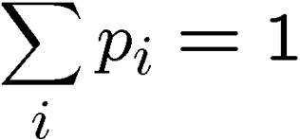
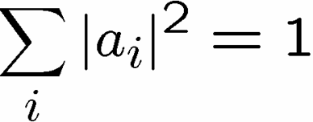
Quantum Theory Made Easy
Classical
Quantum
0
0
0
p₀
a₀
0
0
1
p₁
a₁
0
1
0
p₂
probabilities
amplitudes
a₂
0
1
1
p₃
a₃
1
0
0
p₄
a₄
1
0
1
p₅
a₅
probability of
observing state
s is p_{s}
probability of
observing state
s is |a_{s}|²
1
1
0
p₆
a₆
1
1
1
p₇
a₇

Slide 16







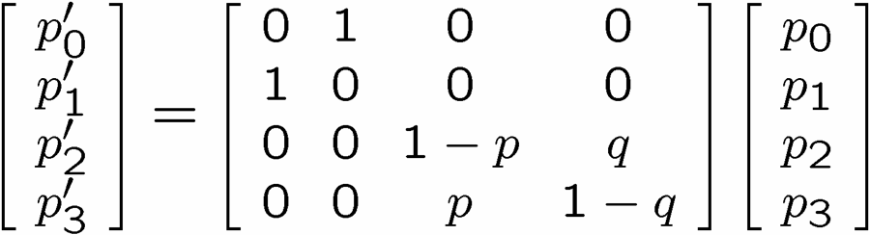
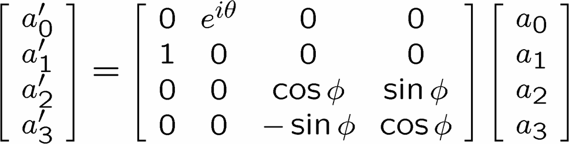
Quantum Theory Made Easy
Classical Evolution
Quantum Evolution
0
0
0
0
0
0
0
0
0
1
0
1
0
1
0
1
1
0
1
0
1
0
1
0
1
1
1
1
1
1
1
1
transition probabilities
transition amplitudes
stochastic matrix
unitary matrix

Slide 17

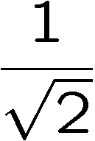
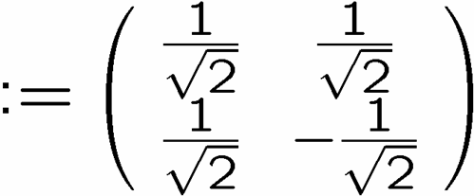

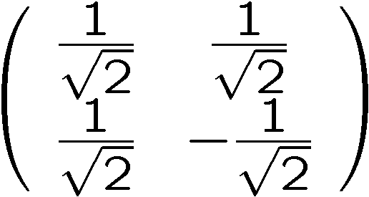
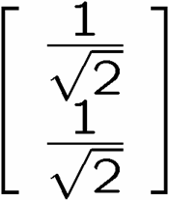
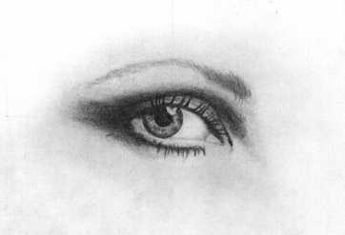
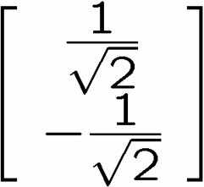
Interference
0
0
1
1
qubit
input
0
50%
100%
1
50%
0%
measure
0
50%
0%
1
50%
100%
measure

Slide 18

Quantum Algorithms
uniform quantum circuit families
sequence of
    one and two qubit unitary evolutions
    measurements
H
R₂
R_{n-1}
R_{n}
H
R_{n-2}
R_{n-1}
H
R₂
H
Quantum circuit for the Fourier Transform over

Slide 19
Quantum Algorithms
*Factoring, Discrete log [Shor 94]
Unstructured search [Grover 96]
*Abelian hidden subgroup problems [Shor 94, Kitaev 95]
*Pell’s equation [Hallgren 02]
*Hidden shift problems [van Dam, Hallgren, Ip 03]
*Graph traversal [CCDFGS 03]
Spatial search [AA 03, CG 03/04, AKR 04]
Element distinctness [Ambainis 03]
Various graph problems [DHHM 04, MSS 03,…]
Testing matrix multiplication [Buhrman,Špalek 04]
…[Your Algorithm Here]
Where is the power of quantum algorithms coming from?
* = suspected exponential gain over classical

Slide 20
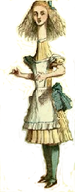

Minimizing the
Yakking
1 if a=b
0 if a≠b
F_{eq}(a,b)=
ALICE
BOB
a
b
0
1
0
1
0
0
1
1
1
0
n bits
n bits
How many bits do Alice and Bob need to exchange
(in the worst case) to compute F(a,b)?
With no error: n+1 bits
With one-sided error ε: O(log(n/ε)) bits

Slide 21
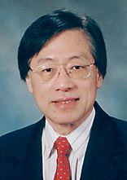
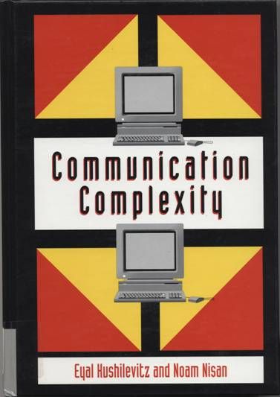
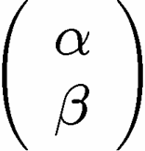
Communication Complexity
Classical communication
costs of distributed
classical computations
[Yao, STOC 79]
[Kushilevitz and Nisan 96]
Quantum communication
costs of distributed
classical computations
[Yao, FOCS 93]
exchange qubits

Slide 22

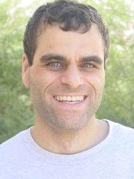
Quantum Communication
Complexity
Holevo’s Theoerem: sending n classical bits
over a quantum channel requires n qubits
There exist functions F(a,b) which require
Ω(m^{1/4}/log(m)) bits of communication to solve
(with error) but can be solved using only
O(log(m)) qubits of communication.
(m is the length of a and b)
[Raz, STOC 99]
Exponential benefit of
quantum over classical.

Slide 23
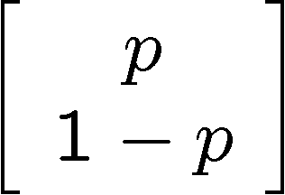
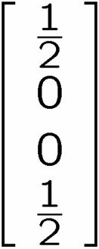

Teleportation (Demystified)
Alice wants to send to Bob
1 bit
A
1 bit
B
AB
If Alice’s bit is 1,
then flip A
If received bit is 1,
then flip B

Slide 24
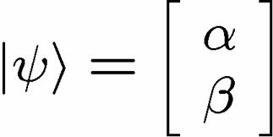
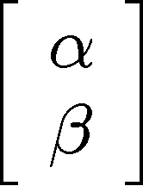
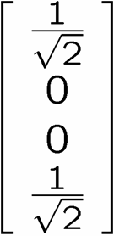
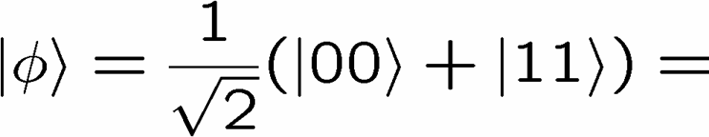
Quantum Teleportation
Alice wants to send to Bob
1 qubit
X
2 bits
Y
Alice performs operation on
her state and half of entangled
system and sends outcome
Conditional on received bits,
Bob performs manipulation of
his half of entangled system

Slide 25
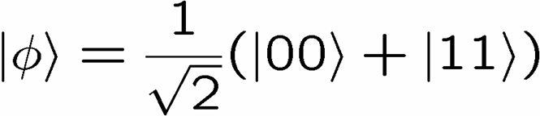
Rehash
There exist functions F(a,b) which require
Ω(m^{1/4}/log(m)) bits of communication to solve
(with error) but can be solved using only
O(log(m)) bits and O(log(m)) ebits of
communication. (m is the length of a and b)
[Raz, STOC 99]
1 ebit :=
Entanglement can be used to gain exponential reduction in
  communication resources
2. Entanglement is “like” classically correlated bits…but it’s
  different…
Preliminary thesis: entanglement is involved in quantum benefits

Slide 26
Entanglement
Alice
time
Bob
space
Entanglement can be only be created locally
…but classical correlations can only be created locally as well
What is the difference between classical correlations
and quantum correlations?

Slide 27
Compare
two quantum
subsystems
2. Separate
3. Choose measurement
4. Measure
5. Get outcome
3. Choose
measurement
4. Measure
5. Get outcome
1. Interact and
entangle
BOB
ALICE
Share classical
correlations
2. Choose
measurement
2. Choose
measurement
data
data
3. Produce
measurement
outcome
03XSFW3331
03XSFGF111
3. Produce
measurement
outcome
BOB
ALICE

Slide 28



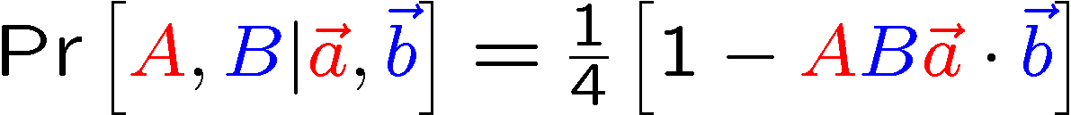

An Experiment
ALICE
φ
BOB
Measurement:
Measurement:
θ
Outcome:
A∈{+1,-1}
Outcome:
B∈{+1,-1}
Quantum Experiment Results:

Slide 29
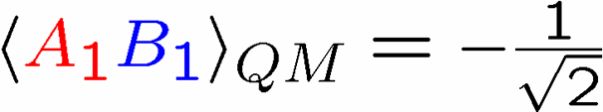

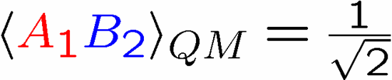

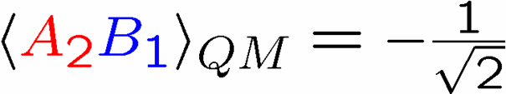


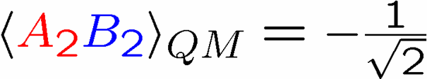


Bell’s Theorem
Four Quantum Experiments
Four Classical Experiments
cannot depend on (either outcome or which measurement)
Bell’s Theorem: quantum theory produces correlations which
cannot be explained as locally created classical correlations:

Slide 30
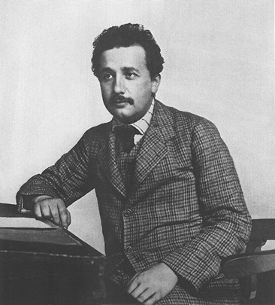
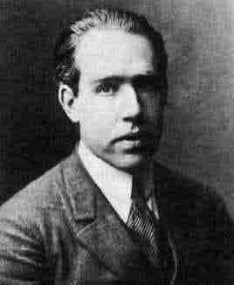
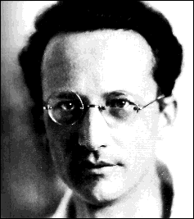
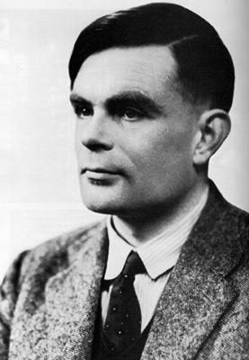
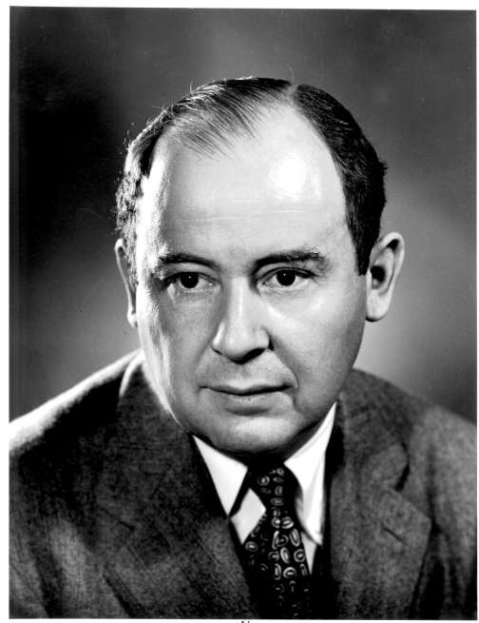
A History of Worry
Albert
Einstein
Niels
Bohr
Erwin
Schrödinger
Alan Turing
John
von Neumann
time
If Alice and Bob cannot
communicate, how can
quantum correlations be
explained?
Alice
Bob
space

Slide 31

Quantum Information Science
…is what happens when we learn to stop
worrying about quantum theory and love
the strangeness
Worrying:
classical
correlations
quantum
correlations
Bell’s Theorem
Accepting: quantum correlations are a resource
How do we quantify this resource?

Slide 32
A New Question
What is the communication cost of simulating the correlations produced by measuring entangled quantum states?
[Bacon and Toner, Phys. Rev. Lett. 90, 157904 (2003)]
[Toner and Bacon, Phys. Rev. Lett. 91, 187904 (2003)]
Share classical
correlations
2. Choose
measurement
2. Choose
measurement
data
data
0
0
1
1
0
1
4. Produce
measurement
outcome
03XSFW3331
03XSFGF111
4. Produce
measurement
outcome
3. Communicate b bits
BOB
ALICE
Communication complexity of Nature!

Slide 33



A Protocol
How to simulate without sending full description of vectors
between Alice and Bob?
Alice and Bob share two perfectly correlated uniformly
distributed unit three dimensional vectors
Alice output
Alice sends to Bob
Bob outputs
Correlations on a single ebit
=
shared randomness + 1 bit of communication
[Bacon and Toner, Phys. Rev. Lett. 90, 157904 (2003)]
[Toner and Bacon, Phys. Rev. Lett. 91, 187904 (2003)]

Slide 34
Finiteness Conjecture
Conjecture: all multipartite entangled systems can be exactly
simulated by augmenting a classical correlations with
an amount of communication polynomial in the product
of the dimensions of the entangled subsystems.
projective measurements on two entangled qubits
[Toner and Bacon, Phys. Rev. Lett. 91, 187904 (2003)]
[Bacon and Toner, Phys. Rev. Lett. 90, 157904 (2003)]
all bipartite two outcome correlation observables
[Bacon and Toner, in preparation (2005)]
Pauli measurements on a n-party GHZ states
  [Tessier, Caves, Deutsch, Eastin, Bacon, quant-ph/ 0407133 (2005)]
average case with projective measurements on n ebits
    [Massar, Bacon, Cerf, Cleve, Phys. Rev. A 63, 052305 (2001)]
….

Slide 35
Back To Algorithms
Entanglement and Quantum Speedups:
small quantity of
entanglement
efficient classical algorithm
for simulating the system
[Jozsa and Linden, Proc. Math. Phys. & Eng. Sci. 459 2011 (2003)]
[Vidal, Phys. Rev. Lett. 93, 040502 (2004)]
How can this help us guide finding
new quantum algorithms?
Next: a simple example

Slide 36










Factoring and Entanglement
Factoring can be reduced to period finding.
period=r
Anatomy of Shor’s algorithm:
lots of
entanglement
Measure
and use to
determine r

Slide 37
Hidden Subgroup Problem
Setup: Fix a group G (known) and a subgroup H⊆G (unknown). Given query access to a function f : G → S that
is constant and distinct on left cosets of H in G. We say that f hides H.
Problem: Find a generating set for H. Efficient: polylog(|G|)
g_{m}H
f
g₃H
g₂H
g₁H
H
G
S

Slide 38
Hidden Subgroup Problems
Shor’s factoring algorithm is an example of a HSP.
Efficient algorithms for the HSP over
an efficient algorithm
for graph isomorphism
the Symmetric group
1
2
3
4
S₄
an efficient algorithm for
poly(d)–unique shortest
vector in a lattice
the Dihedral group
D₈

Slide 39





Dihedral HSP
Low dimensional
systems
Not much entanglement
AND
No way to make
an entangling measurement
k copies of the hidden subgroup states:
entangled
measurement
to determine the
hidden subgroup

Slide 40
Query Complexity of HSP
Theorem: [Ettinger, Hoyer, Knill 99] k=O(log(N))
hidden subgroup states are sufficient
to solve the hidden subgroup problem.
(but no efficient quantum circuit is known.)
Theorem: [Bacon, Childs, van Dam 05] k=log(N)
hidden subgroup states are necessary
to solve the dihedral hidden subgroup
problem.
Measurement across k copies is in entangled basis
Success probability of measurement is related to…

Slide 41








The Subset Sum Problem
Given:
k integers from
i.e. , and a target
Problem: Does there exist a subset which sums to t
Define:
density :=
“low density”
“high density”
most subsets have
a distinct sum
most sums achieved by some subset
efficient algorithm
efficient algorithm
hard?
[Lagarias, Odlyzko 85]
[Flaxman, Pryzdatek 04]

Slide 42
Query Complexity of HSP
Theorem: [Bacon, Childs, van Dam 05] k=log(N)
hidden subgroup states are necessary
to solve the dihedral hidden subgroup
problem.
Phase transition in a classical compute science problem appearing in a quantum setting….
classical
computational
complexity
phase
transitions
quantum
computational
complexity
entanglement

Slide 43
What gives quantum computers their power
over classical computers
How to jumpstart the building of a
quantum computer?

Slide 44

To Build a Quantum Computer
Classical
Problem (1938): How to build a reliable system from
unreliable components?
“A mathematical theory of communication” (1948)
How to communicate in the presence of noise
“Probabilistic logics and the synthesis
of reliable organisms from unreliable
components” (1956)
Claude
Shannon
How to compute when the subsystems
of your computer can fail?
John
von Neumann

Slide 45


No Need for Theory?
Integrated Circuit
Hard Drive
The physics of these devices enacts the methods of the
theory (von Neumann and Shannon)!

Slide 46
Two Paths
Hard Drive
Integrated Circuit
Coding: majority vote of
magnetism
Coding: majority vote of
current
Error correction: local energy
minimization
Error correction: amplification
Fault-tolerance: macroscopic
applied field fixed by
local energy minimziation
Fault-tolerance: conducting / insulating phase
transition

Slide 47










The Physics Guarantee
Classical Ising model: energy:=
one dimension
two dimensions
Redundancy code:
Order parameter: total magnetization
Information “still there”
1D memory bad
2D memory good

Slide 48

















Self Fixing
Excitations point-like
disordering entropy >> energy
Excitations string-like
Energy grows like perimeter
disordering entropy << energy

Slide 49




To Build a Quantum Computer
Quantum Computer: Information is now quantum.
probabilistic bit:
p% 0, 1-p% 1
qubit:
Evolution is now quantum
Schrödinger equation, i.e. unitary evolution
Measurement is now quantum
Probability of observing bitstring is
This description is very “analog” (compare “digital”) looking?
Are quantum computers a reasonable computational model?

Slide 50

Even Worse!
Problems:
Real quantum systems are open quantum systems
system
system
evolution
environment
evolution
system-
environment
evolution
environment
“system decoheres”
pure state
mixed state
system evolution
is no longer unitary!
Real quantum experiments have finite precision
Perfect unitary evolution is a fiction.
Measurements are faulty. Preparation is imperfect.

Slide 51




Solutions
Observations:
Quantum information can be encoded
span a subspace of some Hilbert space
Quantum error correcting codes
encode
diagnose
error
fix
error
encoded
quantum
information
entropy dump
Quantum equivalent to Shannon’s noisy coding

Slide 52
Quantum Threshold Theorem
Threshold Theorem:
[Aharanov, Ben-Or, Shor, Zurek, Knill, Laflamme, Kitaev, and Gottesman (95-96)]
If the error rate (decoherence or failure rate per operation) is
smaller than some p_{thresh}, then quantum computations of length
m can be enacted to accuracy ε at a cost of using a factor
O(log^{c}(mε⁻¹)m) more operations.
QC
Error Rate
Quantum computation is digital and is resilient to noise!

Slide 53
Whence Physics?
RANT
MODE
ON
Today: similar situation to early days of classical computation
(threshold theorems but no physics!)
What is the phase of matter corresponding to the computer?
There are distinct PHYSICAL and DYNAMICAL reasons why
robust classical computation is possible.
not all physical systems are equally good for computation
there exists systems whose PHYSICS guarantees
their ability to enact robust classical computation.
THE BILLION DOLLAR QUANTUM QUESTION:
Are there (or can we engineer) physical systems whose
PHYSICS guarantees robust quantum computation?

Slide 54

Self-Correcting Quantum
Computers
YY
XX
Quantum many-body systems which have
excitations which are string-like and are
self-correct, but into which we can encode
quantum information?
ZZ
XX
ZZ
YY
YY
ZZ
ZZ
XX
XX
YY
Q
coherence order parameter(s)
optical lattice
[Bacon, Ph.D. thesis, U.C. Berkeley 2001]
[Bacon, “Quantum Error Correcting Subsystems” in preparation]

Slide 55

Two Paths Diverged…
Traditional
Build a quantum computer
1 qubit at a time, with a severe
device complexity overhead
in the micro-architecture
necessary for quantum error
correction and fault-tolerance
Self-Correcting
Engineer a many-body system whose physics enacts the quantum error correction and fault-tolerance

Slide 56
How and What to
Quantum Compute
What gives quantum computers their power
over classical computers
How to jumpstart the building of a
quantum computer?
Dave Bacon
Santa Fe Institute

Slide 57



Collaborators
Univ. of Waterloo
Richard Cleve
MIT
Isaac Chaung
Kenneth Brown
Aram Harrow
U.C. Berkeley
K. Birgitta Whaley
Univ. of Toronto
Daniel Lidar
Stanford
Xinlan Zhou
IBM T.J. Watson
David Divencenzo
Guido Burkard
U.C. Santa Barbara
Wim van Dam
Univ. of New Mexico
Carl Caves
Ivan Deutsch
Brian Eastin
Tracey Tessier
Caltech
Andrew Childs
Debbie Leung
Benjamin Toner
Universit Libre de Bruxelles
Nicholas Cerf
Serge Masar
Univ. of Queensland
Michael Nielsen
Michael Bremner
Jennifer Dodd
Universite de Paris-Sud
Julia Kempe

Slide 58



Exchange Everywhere
Can we engineer systems which turn
dephasing/cooling → heating?
1
2
4
3
S_{tot}=2
Energy
S_{tot}=1
S_{tot}=0
Encode quantum information into ground state
ground state is a quantum error detecting code

Slide 59



Supercoherence
[Bacon, Brown, and Whaley, Phys. Rev. Lett. 87, 247902 (2001)]
Independent coupling of system to environment
1
2
4
3
S_{tot}=2
all single qubit interactions on
this system are of heating
S_{tot}=1
S_{tot}=0
never cause transitions on encoded space
All first order decoherence processes suppressed

