Slide 1
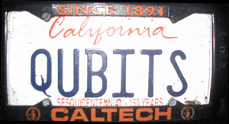
CSEP 590tv: Quantum Computing
Dave Bacon
June 22, 2005
Today’s Menu
Administrivia
What is Quantum Computing?
Quantum Theory 101
Quantum Circuits
Linear Algebra

Slide 2
Administrivia
Le Syllabus
Course website: http://www.cs.washington.edu/csep590
[power point, homework assignments, solutions]
Mailing list: https://mailman.cs.washington.edu/csenetid/
auth/mailman/listinfo/csep590
Lecture: 6:30-9:20 in EE 01 045
Office Hours:
Dave Bacon, Tuesday 5-6pm in 460 CSE
Ioannis Giotis, Wednesday 5:30-6:30pm in TBA

Slide 3
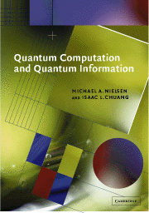

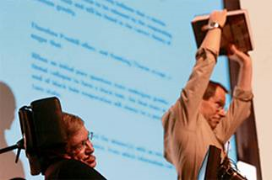
Administrivia
Textbook:
“Quantum Computation and Quantum Information”
by Michael Nielsen and Isaac Chuang
Supplementary Material:
John Preskill’s lecture notes
http://www.theory.caltech.edu/people/preskill/ph229/
David Mermin’s lecture notes
http://people.ccmr.cornell.edu/~mermin/qcomp/CS483.html

Slide 4
Administrivia
Homework: due in class the week after handed out
1. Extra day if you email me
2. One homework, one full week extension, email me
3. Major obstacles, email me
4. Collaboration fine, but must put significant effort on
your own first and write-up must be “in your words.”
Final Take Home Exam
Making the Grade: GRADES!!!!
70% Homework, 30% Final

Slide 5
Administrivia
Quick survey
Linear Algebra: all Do You Remember It: 50%
Quantum Theory: ¼ remember: 0
Computational Complexity: ¼
Background:
Computer Science:2/3
Computer Engineering: 4 peebs
Electrical Engineering: 1
Physics: 3
Other: 0

Slide 6
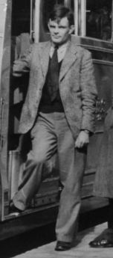
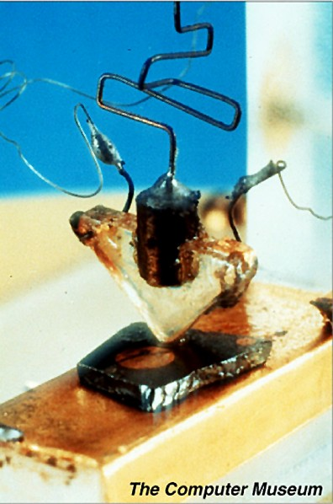
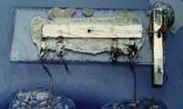
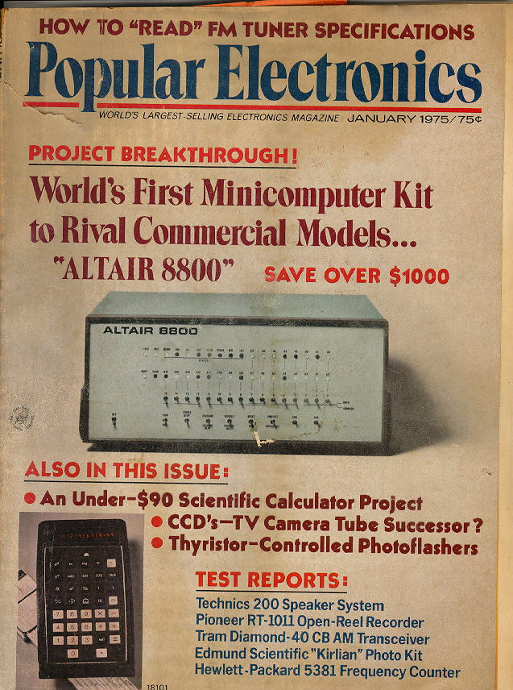
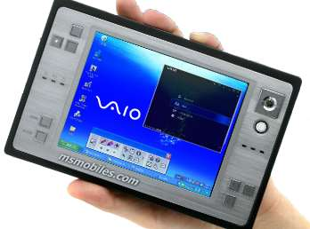
In the Beginning…
1936- “On computable numbers, with an application to the Entscheidungsproblem”
1947- First transistor
1958- First integrated
circuit
Alan Turing
1975- Altair 8800
2004
GHz machines
that weight ~ 1 pound

Slide 7
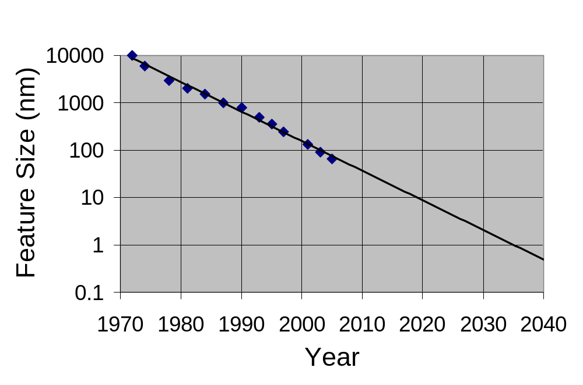
Moore’s Law
Computer Chip Feature Size versus Time
Eukaryotic cells
Mitochondria
AIDS virus
Amino acids

Slide 8
This Is the End?
1. Ride the wave to atomic size computers?
2. How do machines of atomic size operate?

Slide 9
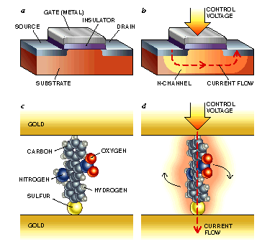
Argument by Unproven
Technology
1. Ride the wave to atomic size computers?
molecular transistors
Pic: http://www.mtmi.vu.lt/pfk/funkc_dariniai/nanostructures/molec_computer.htm

Slide 10
This Is the End?
2. How do machines of atomic size operate?
“Quantum Laws”
“Classical Laws”
“Size”
“Quantum Computers?”

Slide 11
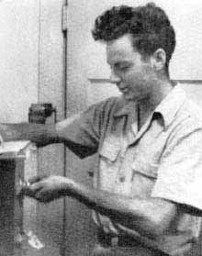


This Is the End?
2. How do machines of atomic size operate?
Richard Feynman
David Deutsch
Paul Benioff

Slide 12













Query Complexity
n bit strings
set
set of properties
How many times do we need to query
in order to determine ?
Example:
if
Promise problem:
restricted set of functions
domain of not all
if otherwise

Slide 13



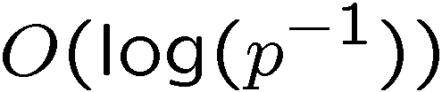

The Work of Crazies
“Can Quantum Systems be Probabilistically Simulated
by a Classical Computer?”
Richard
Feynman
1985: two classical queries
one quantum query
(but sometimes fails)
David
Deutsch
1992:
classical queries
quantum queries
classical queries to solve
with probability of failure
David
Deutsch
Richard
Jozsa

Slide 14


Crazies…Still Working
1993:
superpolynomially more classical than quantum queries
Umesh
Vazirani
Ethan
Bernstein
1994:
exponentially more classical than
quantum queries
Dan
Simon

Slide 15



The Factoring Firestorm
18819881292060796383869723946165043
98071635633794173827007633564229888
59715234665485319060606504743045317
38801130339671619969232120573403187
9550656996221305168759307650257059
Peter
Shor
1994
3980750864240649373971
2550055038649119906436
2342526708406385189575
946388957261768583317
4727721461074353025362
2307197304822463291469
5302097116459852171130
520711256363590397527
Best classical algorithm
takes time
Shor’s quantum algorithm
takes time
An efficient algorithm for factoring breaks the
RSA public key cryptosystem

Slide 16
This Course
Quantum theory the easy way
Quantum computers
Quantum algorithms (Shor, Grover, Adiabatic, Simulation)
Quantum entanglement
Physical implementations of a quantum computer
Quantum error correction
Quantum cryptography

Slide 17
Quantum Theory

Slide 18

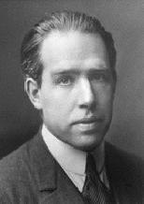
Slander
I think I can safely say that nobody
understands quantum mechanics.
Richard Feynman
Nobel Prize 1965
Anyone who is not shocked by quantum
theory has not understood it.
Niels Bohr
Nobel Prize 1922

Slide 19
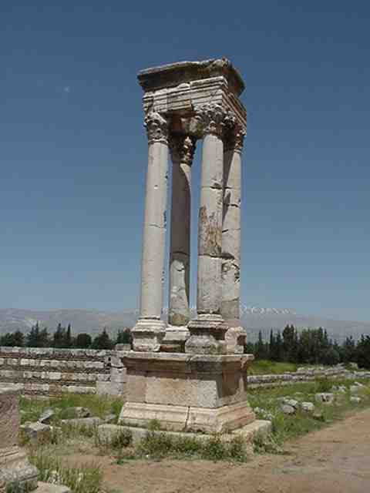
Quantum Theory
Electromagnetism
Strong force
Gravity (?)
Weak force
Quantum
Theory
“Quantum theory is the machine language of the universe”

Slide 20
Our Path
Probabilistic information processing device
Quantum information processing device

Slide 21
Probabilistic Information
Processing Device
Machine has N states
0,1,2,…,N-1
Rule 1 (State Description)
A probabilistic information processing machine is a machine
with a state labeled from a finite alphabet of size N. Our
description of the state of this system is a N dimensional
real vector with positive components which sum to unity.

Slide 22
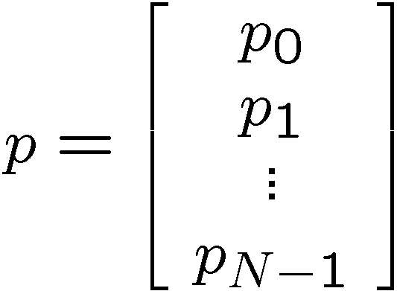
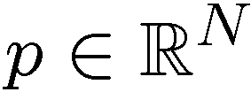

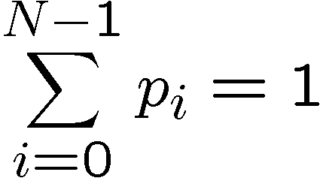
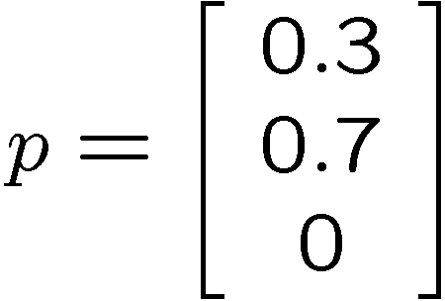
Rule 1
Machine has N states
0,1,2,…,N-1
N dimensional real vector
positive elements
which sum to unity
Example: 3 state device
30 % state 0
70 % state 1
probability vector
0 % state 2

Slide 23
Probabilistic Information
Processing Device
Rule 1 (State Description) N states, probability vector
Rule 2 (Evolution)
The evolution in time of our description of the device is specified by an N x N stochastic matrix A, such that if the description of the state before the evolution is given by the probability vector p then the description of the system after this evolution is given by q=Ap.

Slide 24
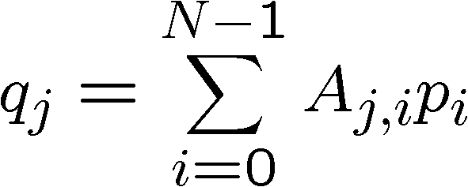
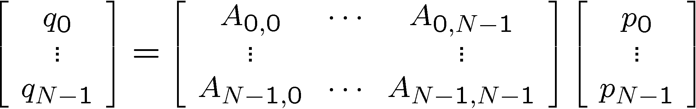

Rule 2
Evolution:
If we are in state 0, then with probability A_{j,0} switch to state j
If we are in state 1, then with probability A_{j,1} switch to state j
If we are in state N, then with probability A_{j,N} switch to state j
N² numbers A_{j,i}
probability to be in
state j after evolution

Slide 25

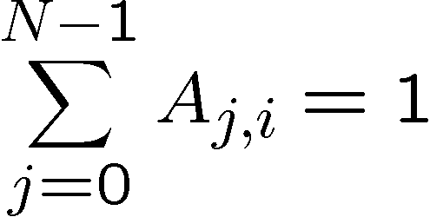
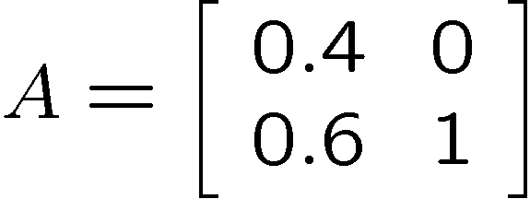
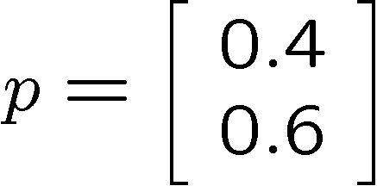
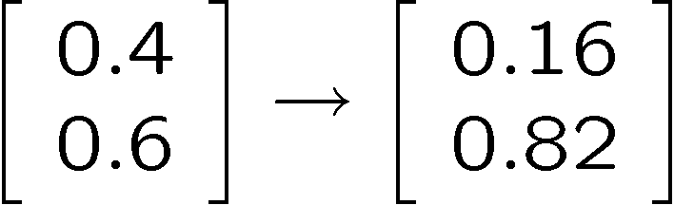
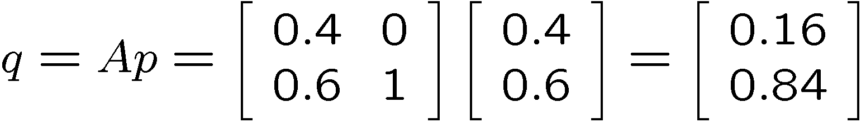
Rule 2
these are probabilities
stochastic matrix
If in state 0 switch to state 0 with probability 0.4
If in state 0 switch to state 1 with probability 0.6
If in state 1 always stay in state 1

Slide 26
Probabilistic Information
Processing Device
Rule 1 (State Description) N states, probability vector
Rule 2 (Evolution) N x N stochastic matrix
Rule 3 (Measurement)
A measurement with k outcomes is described by k N
dimensional real vectors with positive components. If we
sum over all of these k vectors then we obtain the all 1’s
vector. If our description of the system before the measurement is p, then the probability of getting the outcome corresponding to vector m is the dot product of these vectors.
Our description of the state after this measurement
is given by the point wise product of the outcome vector
with p, divided by the probability of obtaining the outcome.

Slide 27
Rule 3
Simple measurement: If we simply look at our device, then we
see the states with the probabilities given by the probability
vector.
More complicated measurements:
measurements which don’t fully distinguish states
Example: if state is 0 or 1, outcome is 0
if state is 3 or 4, outcome is 1
measurements which assign probabilities of outcomes
for a given state measurement
Example: if state is 0, 40% of the time outcome is 0
and 60% of the time outcome is 1
if state is 1, outcome is always 1

Slide 28



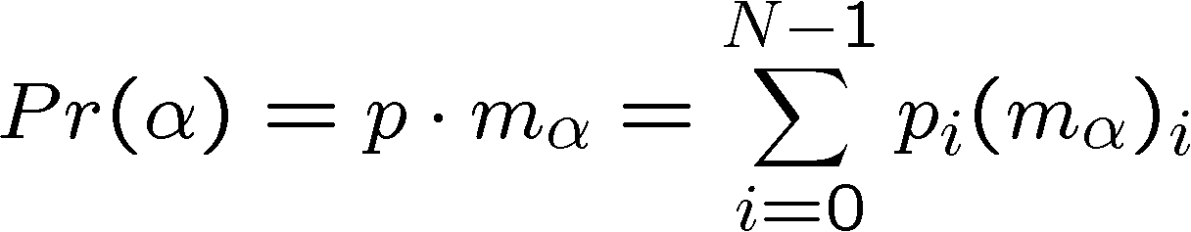
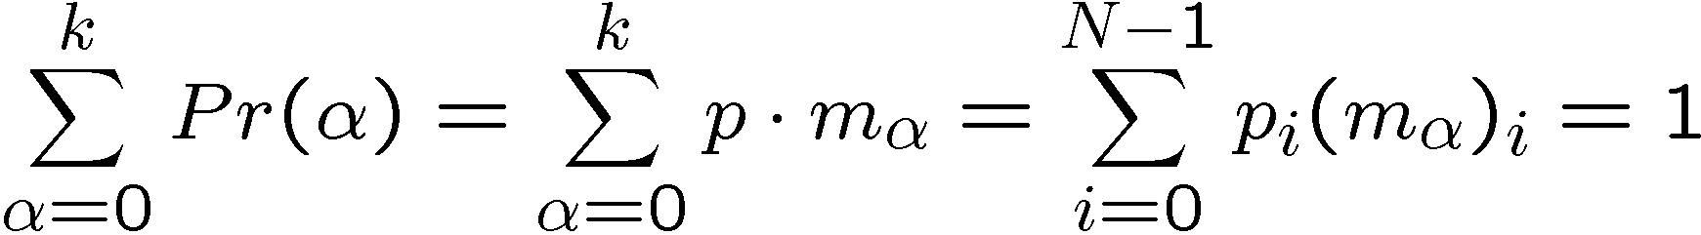
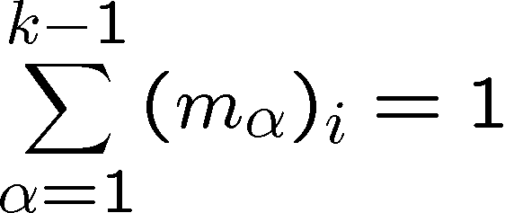

Rule 3
Measurement
k vectors
measurement outcomes
Probability of outcome
Require that these are probabilities

Slide 29

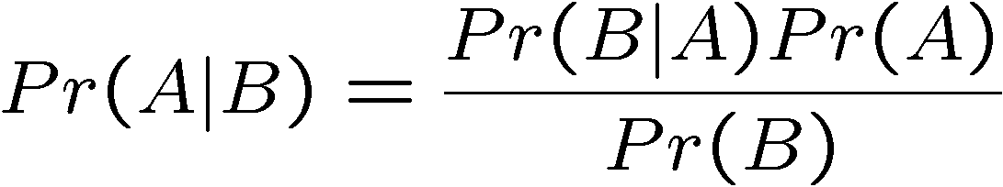

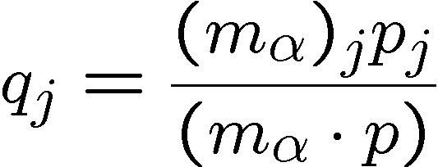
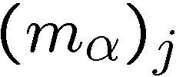
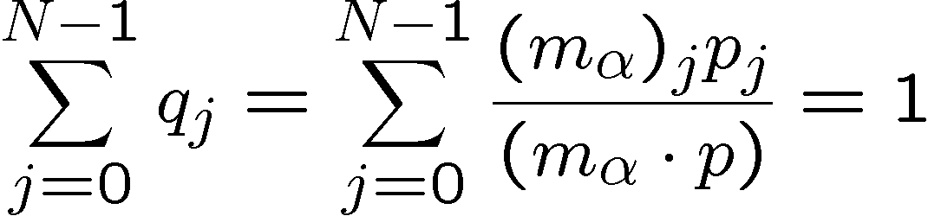
Rule 3 Update Rule
What is the probability vector after a measurement?
Bayes’ Rule:
B := outcome A := being in state
are conditional
probabilities of being in
state given outcome
Valid probabilities:

Slide 30
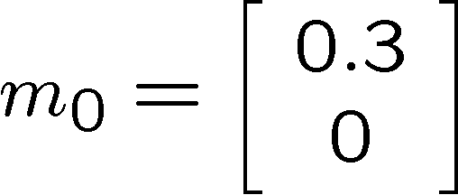
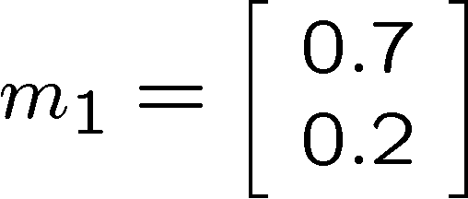
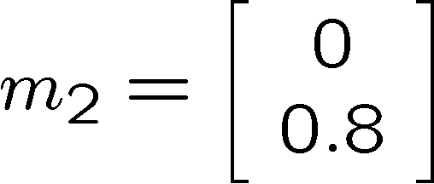


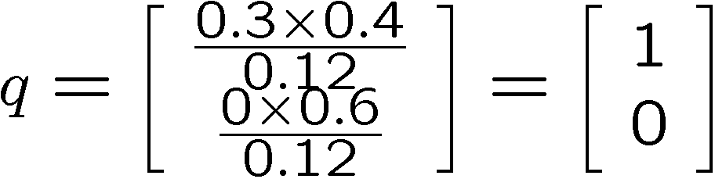
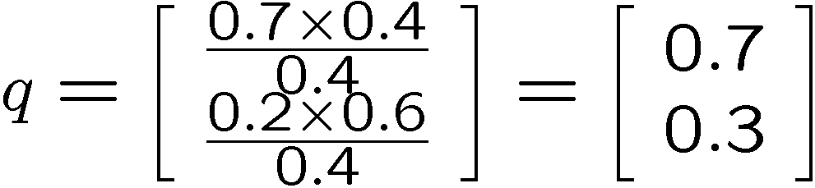
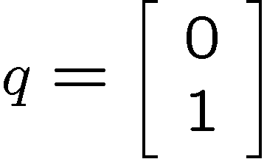
Rule 3 In Action
Two state machine with probability vector:
Three outcome measurement (k=3)
Probability of these three outcomes:
Outcome 0:
Outcome 1:
Outcome 2:

Slide 31

Probabilistic Information
Processing Device
Rule 1 (State Description) N states, probability vector
Rule 2 (Evolution) N x N stochastic matrix
Rule 3 (Measurement) k conditional probability vectors
Rule 4 (Composite Systems)
Two devices can be combined to form a bigger device.
If these devices have N and M states, respectively, then
the composite system has NM states. The probability
vector for this new machine is a real NM dimensional
probability vector from .

Slide 32

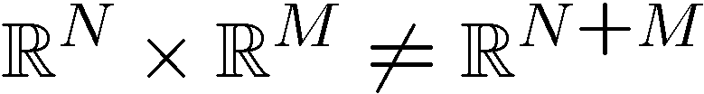
Rule 4
A
B
AB
N States
M States
NM States
0
1
N
0
1
M
0,0
0,1
0,M
1,0
1,1
1,M
N,0
N,1
N,M
Probability vector in

Slide 33
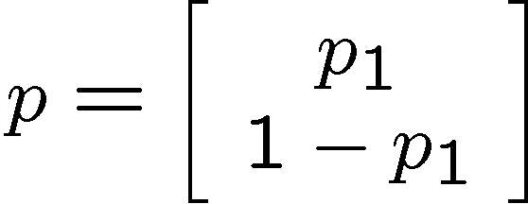
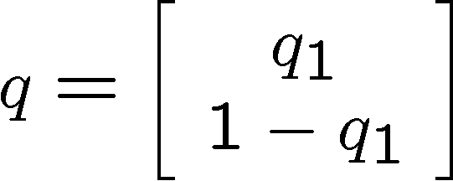

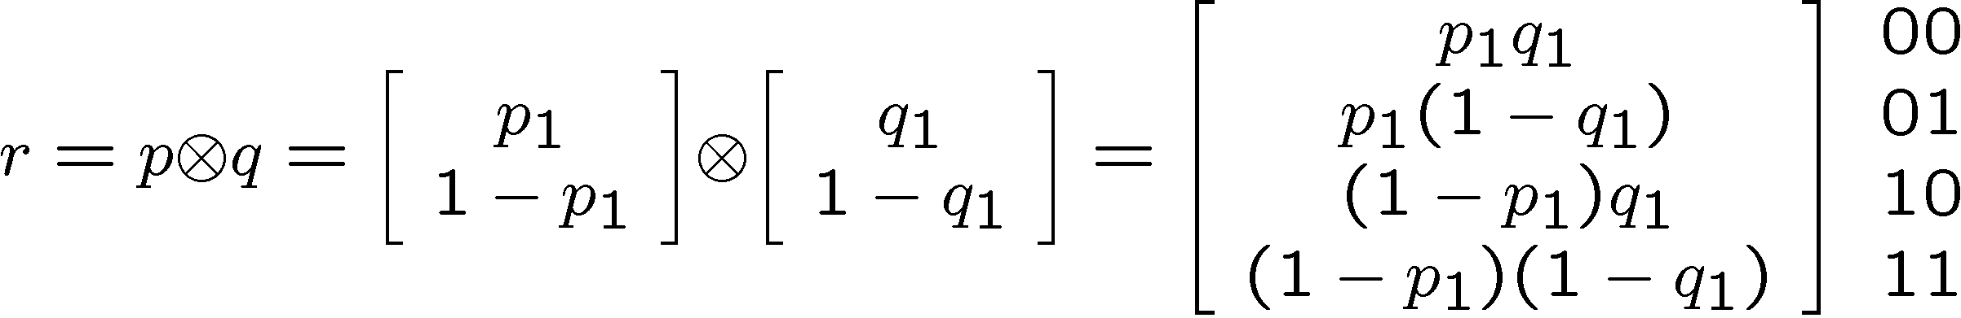
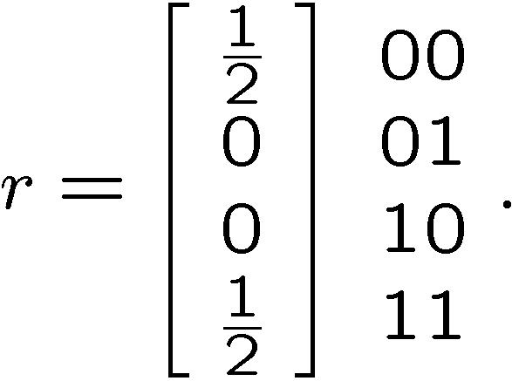
Rule 4 In Action
A
B
AB
contrast with

Slide 34
Probabilistic Information
Processing Device
Rule 1 (State Description) N states, probability vector
Rule 2 (Evolution) N x N stochastic matrix
Rule 3 (Measurement) k conditional probability vectors
Rule 4 (Composite Systems) tensor product

Slide 35
Quantum Information
Processing Device
Rule 1 (State Description) N states, vector of amplitudes
Rule 2 (Evolution) N x N unitary matrix
Rule 3 (Measurement) k measurement operators
Rule 4 (Composite Systems) tensor product

Slide 36
Quantum Rule 1
Rule 1 (State Description)
Machine has N states
0,1,2,…,N-1
Rule 1 (State Description)
A quantum information processing machine is a machine
with a state labeled from a finite alphabet of size N. Our
description of the state of this system is a N dimensional
complex unit vector

Slide 37
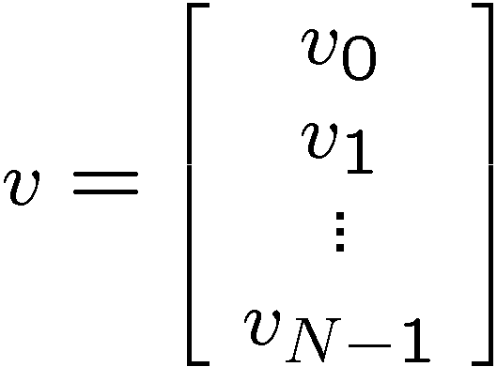



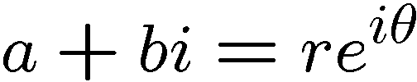




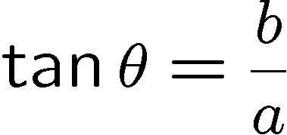



Quantum Rule 1
Machine has N states
0,1,2,…,N-1
N dimensional complex vector (vector of amplitudes)
Complex numbers:

Slide 38
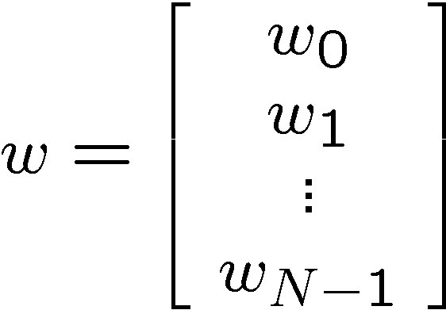
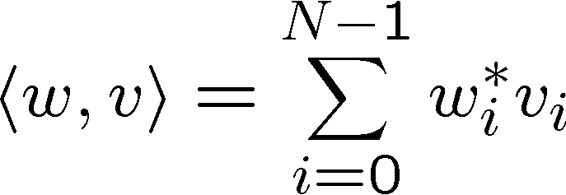
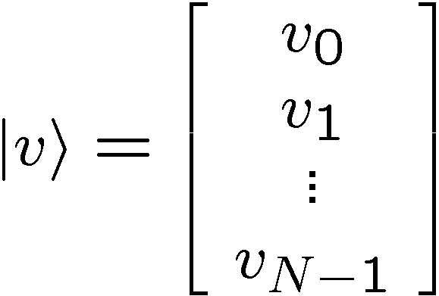
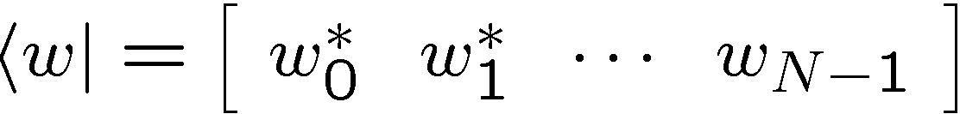





Quantum Rule 1
inner product
“bra”
“ket”
Example: 2 state device
unit vector:

Slide 39




Quantum Rule 1
Dirac notation
“Mathematicians tend to despise Dirac notation, because it can prevent them
from making important distinctions, but physicists love it, because they are
always forgetting such distinctions exist and the notation liberates them from
having to remember.” - David Mermin

Slide 40










Quantum Rule 1, Probabilities?
If we measure our quantum information processing machine,
(in the state basis) when our description is , then the
probability of observing state is .
requirement of unit vector insures these are probabilities
Example:

Slide 41
Quantum Rule 1, Philosophy
Unfortunately, we often call the unit complex vector, the state of
The system. This is like calling the probability distribution the
State of the system and confuses our description of the system
with the physical state of the system.
For our classical machine, the system is always in one of the
states. For the quantum system, this type of statement is
much trickier. The only time we will say the quantum system
is in a particular state is immediately after we make a
measurement of the system.
“I have this student. he's thinking about the foundations of quantum mechanics. He is doomed.“
— John McCarthy (of A.I. fame)

Slide 42



Quantum Rule 1, Nomenclature
Complex unit vector
Vector of amplitudes
Wave function
Quantum State
State
Actually all of the
are the same description
(global phase)
More general condition is wave function is an element of a
complex Hilbert space: a vector space with an inner product.
We will deal in this class almost exclusively with finite
dimensional Hilbert spaces:
Hilbert space
“State space”

Slide 43


Quantum Information
Processing Device
Rule 1 (State Description) N states, vector of amplitudes
Rule 2 (Evolution) N x N unitary matrix
The evolution in time of our description of the device is specified by an N x N unitary matrix , such that if the description of the state before the evolution is given by the wave function then the description of the system after this evolution is given by the wave function

Slide 44


Quantum Rule 2
before evolution
after evolution
Unitary evolution:
Unitary matrix

Slide 45





Unitary Matrix?
Unitary N x N matrix: an invertible N x N complex matrix
whose inverse is equal to it’s conjugate transpose.
Invertible: there exists an inverse of U, such that
N x N identity
matrix
or

Slide 46






Quantum Rule 2, Example
Conjugate:
Conjugate
transpose:
Unitary?
evolves to

Slide 47


Properties of Unitary Matrices
row vectors
are orthonormal:
column vectors are also orthonormal

Slide 48

Special Unitary Matrices
We will often restrict the class of unitary matrices
to special unitary matrices:
U(N) := N x N unitary matrices
SU(N) := N x N special unitary matrices

Slide 49




Quantum Information
Processing Device
Rule 1 (State Description) N states, vector of amplitudes
Rule 2 (Evolution) N x N unitary matrix
Rule 3 (Measurement) k measurement operators
Measurements with k outcomes are described by k N x N
matrices, which satisfy the completeness criteria:
The probability of observing outcome if the wave
function of the system is is given by
The new wave function of the system after the
measurement is

Slide 50




Quantum Rule 3
completeness
probability
collapse
probabilities sum to 1:
final state is properly normalized:

Slide 51





The Computational Basis
We have already described measurements with outcomes
Measurement operators:
Wavefunction , probability of outcome:
state of system after measurement is

Slide 52









Quantum Rule 3 Example
Measurement operators:
Projectors:
Completeness:
Initial state

Slide 53




Quantum Rule 3 Example
Measurement operators:
Initial state
outcome 0:
outcome 1:

Slide 54



Quantum Information
Processing Device
Rule 1 (State Description) N states, vector of amplitudes
Rule 2 (Evolution) N x N unitary matrix
Rule 3 (Measurement) k measurement operators
Rule 4 (Composite Systems) tensor product
When combining two quantum systems with Hilbert
spaces and , the joint system is described
by a Hilbert space which is a tensor product of these
two systems, .

Slide 55











Quantum Rule 4
A
B
AB

Slide 56


Quantum Rule 4
Example:
A
B
AB
separable state

Slide 57


Entangle States
Some joint states of two systems cannot be expressed as
Such states are called entangled states
Example:
We encountered something similar for our probabilistic device:
Entangled states are, similarly correlated.
But, we will find out later that they are
correlated in a very peculiar manner!

Slide 58
Quantum Information
Processing Device
Rule 1 (State Description) N states, vector of amplitudes
Rule 2 (Evolution) N x N unitary matrix
Rule 3 (Measurement) k measurement operators
Rule 4 (Composite Systems) tensor product
The Basic Postulates of Quantum Theory

Slide 59













Qubits
Two level quantum systems
Basis:
Generic state:
Bloch sphere

Slide 60






Pauli Matrices
Important qubit matrices, the Pauli matrices:
Unitary matrices
real unit vector

Slide 61






Operations on Qubits
Example:

Slide 62


U rotates the Bloch sphere about the z-axis
Single qubit rotations:
Rotates by angle about the axis

Slide 63




Some Important Single Qubit
Rotations
Hadamard rotation:
Rotation by angle about y-axis
P – gate (also called T – gate):
Rotation by angle about z-axis

Slide 64










Interference
50 % H
50 % C
100 % H
0 % C
50 % H
50 % C
0 % H
100 % C

Slide 65
Interfering Pathways
100% H
1.0 H
50%
50%
0.707
0.707
50% H
50% C
0.707 H
0.707
0.707 C
90%
10%
0.707
0.707
80%
20%
-0.707
85% C
0.0 H
1.0 C
15% H
Always addition!
Subtraction!
Classical
Quantum

Slide 66


Quantum Circuits
Circuit diagrams for quantum information
quantum gate
input
wave
function
output
wave
function
quantum wire
single line = qubit
time
Quantum circuits are instructions for a series of unitary
evolutions (quantum gates) to be executed on quantum
Information.

Slide 67











Quantum Circuit Elements
single qubit rotations
two qubit rotations
control
controlled-NOT
target
control
controlled-U
target
measurement in the basis

Slide 68







Quantum Circuit Example
50%
50%

Slide 69





Deutsch’s Problem
A one bit function:
Four such functions:
“constant”
“balanced”
Deutsch’s Problem
instance: unknown function f
problem: determine whether function is constant or balanced

Slide 70

Classical Deutsch’s Problem
“constant”
“balanced”
Question: What is ?
Must ask two question to separate balanced from constant.

Slide 71






Deutsch’s Problem
Oracle:
If the wires and gates are classical, then we need two queries.
What if the wires and gates are quantum?

Slide 72









Quantum Deutsch’s Problem
constant
balanced
Measure first qubit determines constant vs. balance in 1 query!
THE BEGINNING OF QUANTUM COMPUTING

Slide 73










Linear Algebra
Matrices:
Eigenvectors, eigenvalues
Characteristic equation
solve for eigenvalues
use eigenvalues to determine eigenvectors
Example:

Slide 74





Linear Algebra
Matrices continued
Hermitian:
eigenvalues are real
diagonalizing Hermitian matrix:
is unitary
rows of are eigenvectors of H

Slide 75



Linear Algebra
Normal Matrices:
Spectral Theorem: A matrix is diagonalizable iff it is normal
Implies both unitary and Hermitian matrices are diagonalizable.
Eigenvalues of unitary matrices:
in basis where is diagonal,
this implies

Slide 76






Linear Algebra
Example:
eigenvector:
eigenvector:

Slide 77






Linear Algebra
Trace
Sum of the diagonal elements of a matrix:
Suppose is Hermitian
is diagonal
Trace is the sum of the eigenvalues

Slide 78






Linear Algebra
Determinant
Example:
permutation of 0,1,…,N-1
0 1 2 3 4 5 6 7
number of transpositions
0 1 2 3 4 5 6 7
Suppose is Hermitian:
product of eigenvalues

Slide 79





Linear Algebra
Singular value decomposition:
not all matrices has full set of eigenvectors
Example:
but every matrix has a singular value decomposition
diagonal
Example:

Slide 80




Linear Algebra
Matrix exponentiation:
if

Slide 81





Linear Algebra
Example:

Slide 82




Linear Algebra
Special case of
when

Slide 83

Hamiltonians
Rule 2 (Evolution) N x N unitary matrix
The evolution in time of our description of the device is specified by an N x N unitary matrix , such that if the description of the state before the evolution is given by the wave function then the description of the system after this evolution is given by the wave function
Rule 2 prime: (Hamiltonian Evolution)
The evolution of our description of the device in time is specified by a possibly time dependent N x N matrix known as a Hamiltonian. If the wave function is initially
then after a time t, the new state is where

Slide 84



Hamiltonians
Where we hide the physics:
time ordering
Time independent Hamiltonian:
Eigenstates of Hamiltonian are the energy eigenstates.
energies

Slide 85



The Next Episode
Teleportation
Superdense Coding
Universal Quantum Computers
Density Matrices

