Slide 1
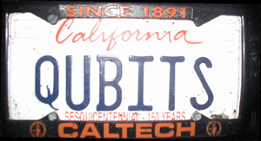
CSEP 590tv: Quantum Computing
Dave Bacon
July 13, 2005
Today’s Menu
Administrivia
Partial Measurements
Circuit Elements
Deutsch’s Algorithm
Quantum Teleportation
Superdense Coding

Slide 2
Administrivia
Hand in HW #2
Pick up HW #3 (due July 20)
HW #1 solution available on website

Slide 3
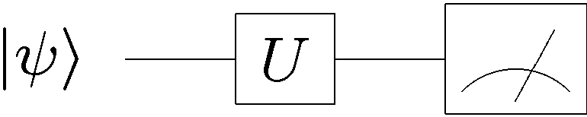
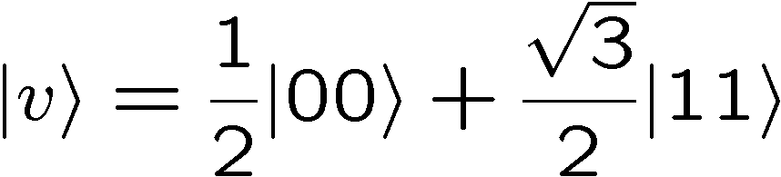

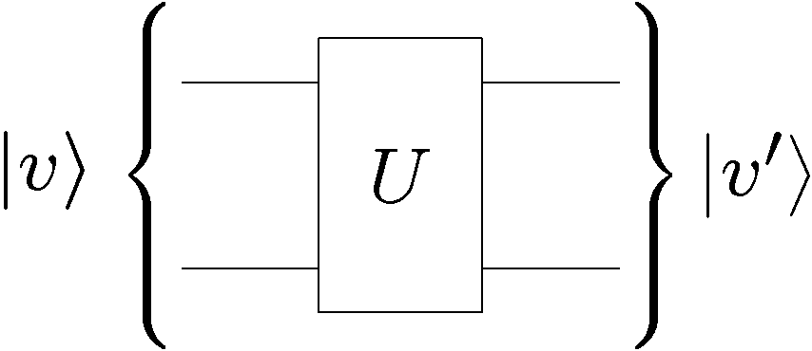
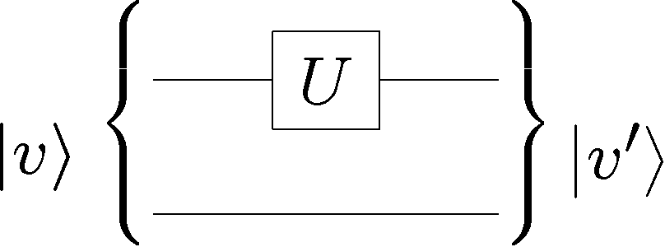
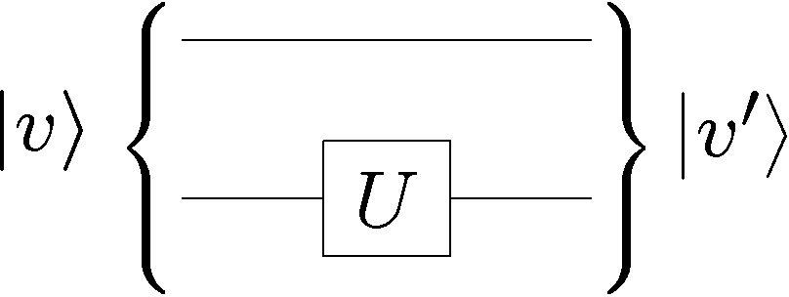
Recap
Unitary rotations and measurements in different basis
Two qubits.
Separable versus Entangled.
Single qubit versus two qubit unitaries

Slide 4
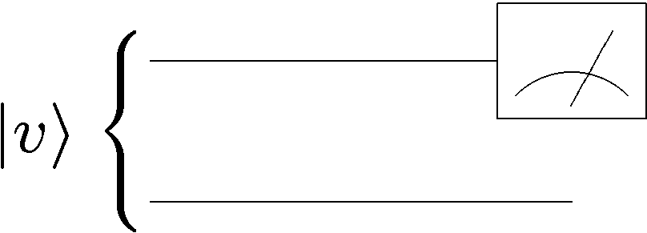
Partial Measurements
Say we measure one of the two qubits of a two qubit system:
What are the probabilities of the different measurement
outcomes?
2. What is the new wave function of the system after we
perform such a measurement?

Slide 5
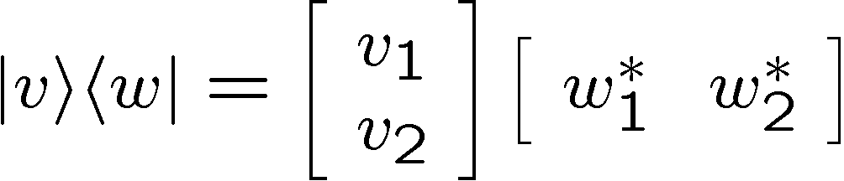
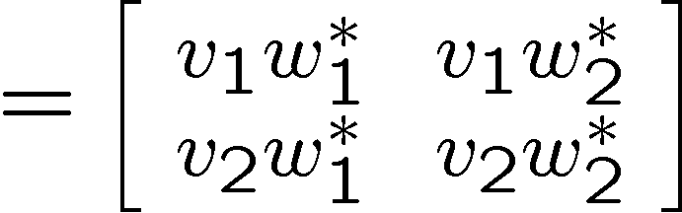
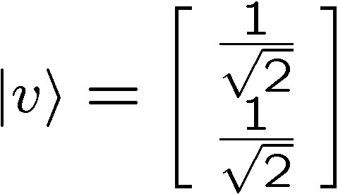
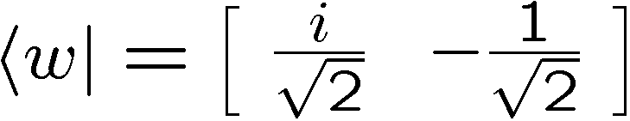
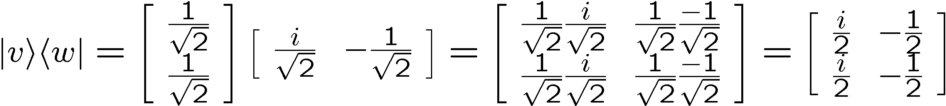
Matrices, Bras, and Kets
So far we have used bras and kets to describe row and column
vectors. We can also use them to describe matrices:
Outer product of two vectors:
Example:

Slide 6
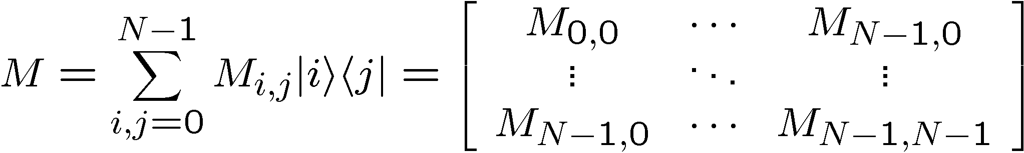
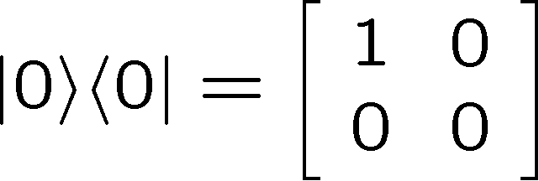
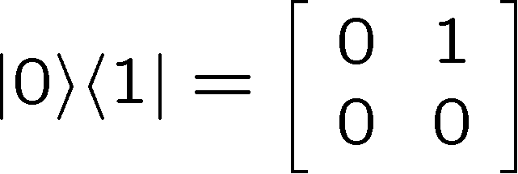
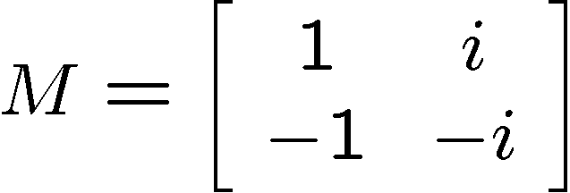
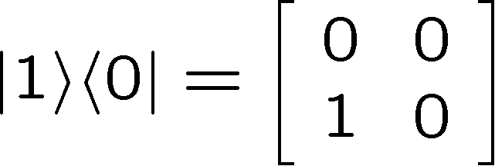
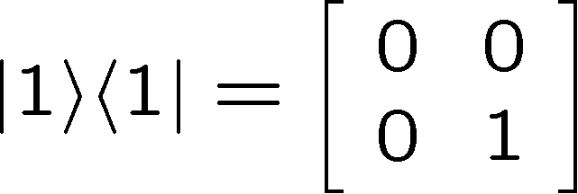
Matrices, Bras, and Kets
We can expand a matrix about all of the computational basis
outer products
Example:

Slide 7
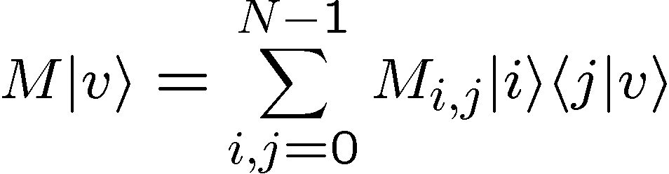
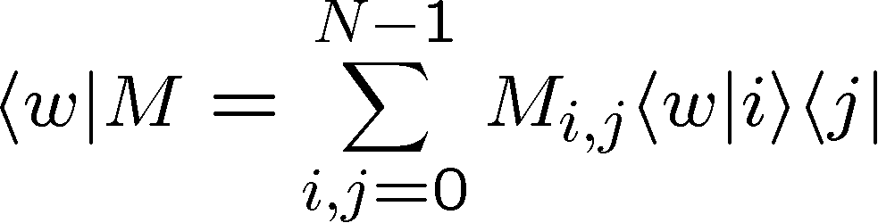
Matrices, Bras, and Kets
We can expand a matrix about all of the computational basis
outer products
This makes it easy to operate on kets and bras:
complex numbers

Slide 8
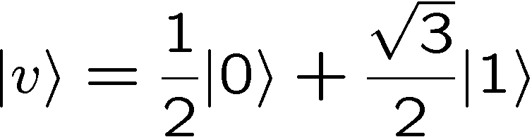
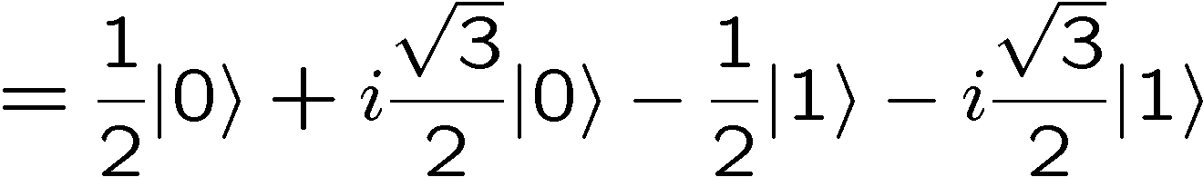
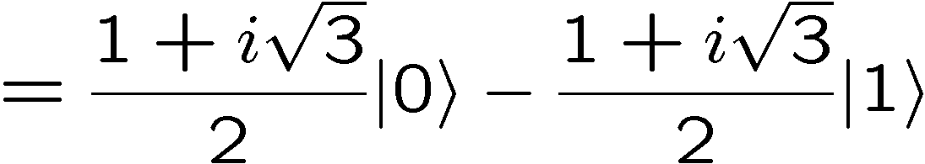
Matrices, Bras, and Kets
Example:

Slide 9







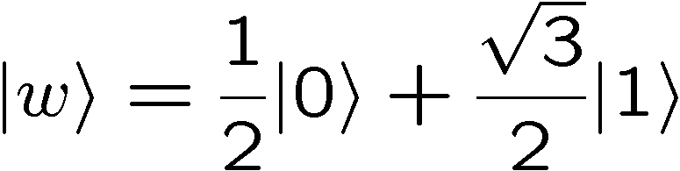
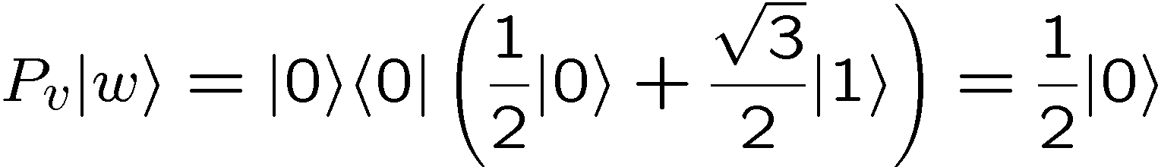
Projectors
The projector onto a state (which is of unit norm) is given by
Projects onto the state:
Note that
and that
Example:

Slide 10


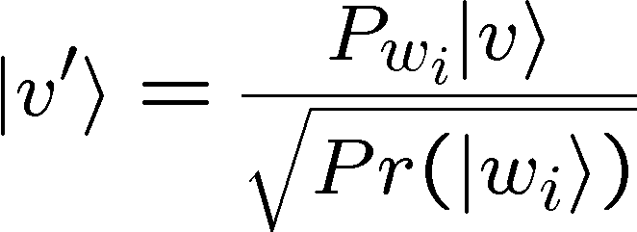
Measurement Rule
If we measure a quantum system whose wave function is
in the basis , then the probability of getting the outcome
corresponding to is given by
where
The new wave function of the system after getting the
measurement outcome corresponding to is given by
For measuring in a complete basis, this reduces to our normal
prescription for quantum measurement, but…

Slide 11





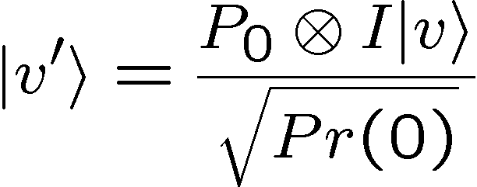
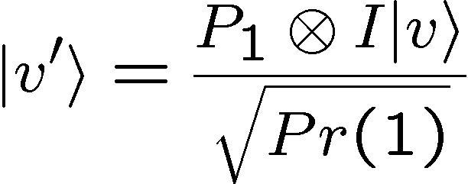
Measuring One of Two Qubits
Suppose we measure the first of two qubits in the computational basis. Then we can form the two projectors:
If the two qubit wave function is then the probabilities of
these two outcomes are
And the new state of the system is given by either
Outcome was 0
Outcome was 1

Slide 12
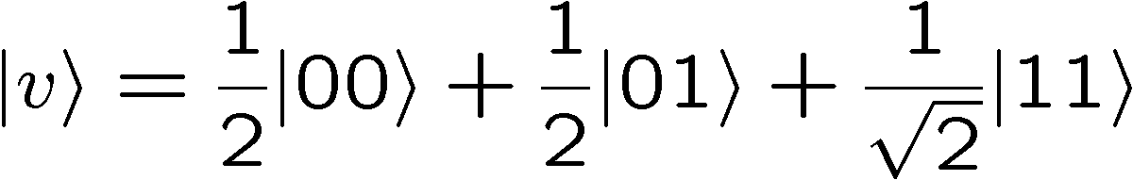
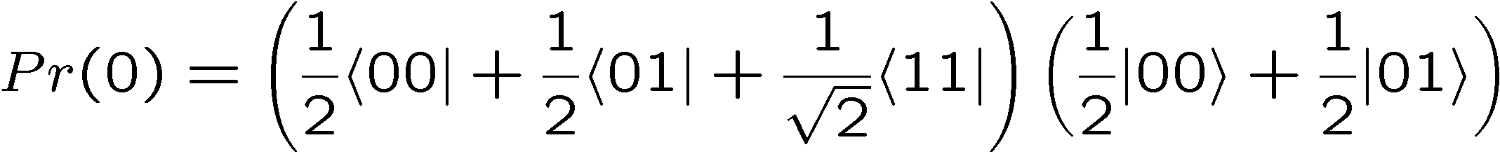
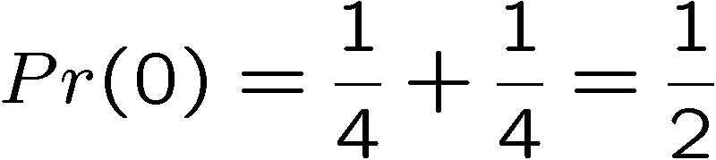
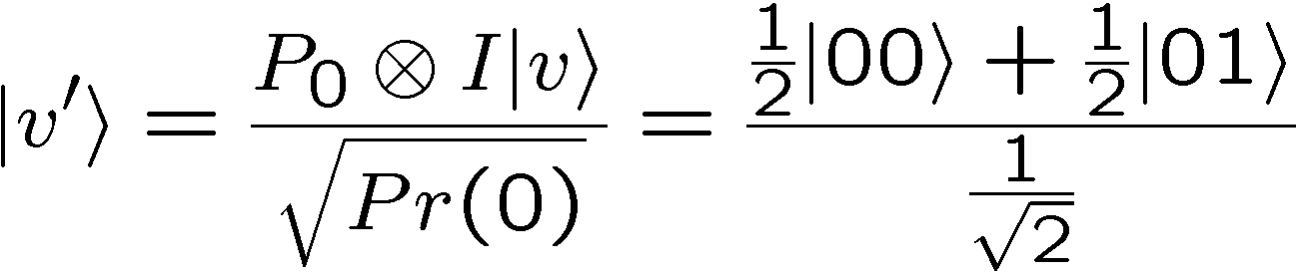
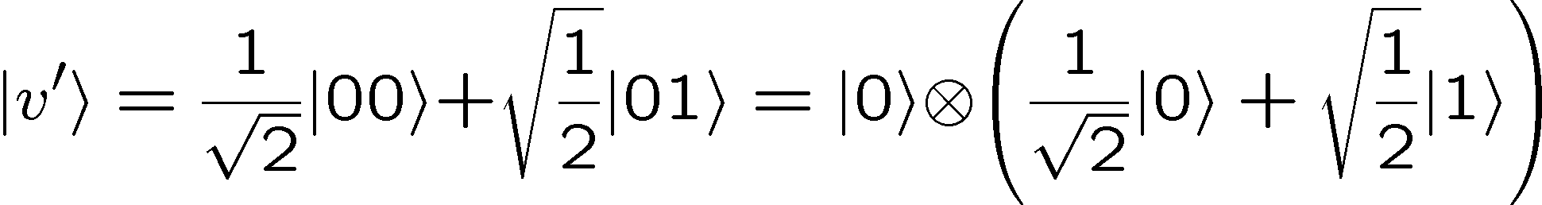
Measuring One of Two Qubits
Example:
Measure the first qubit:

Slide 13
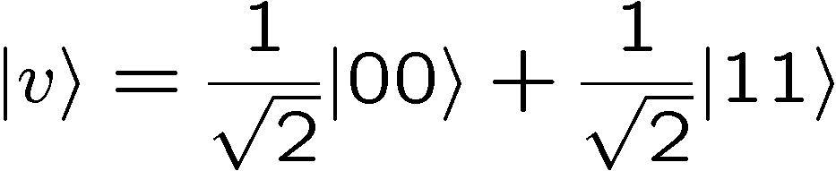
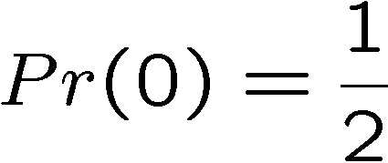
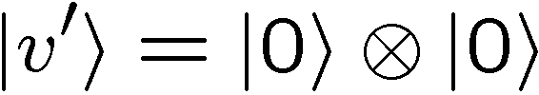
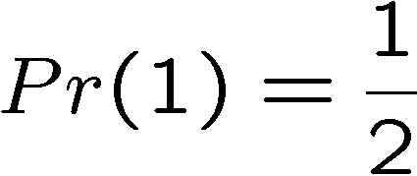
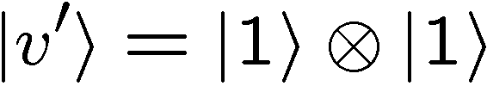


Instantaneous Communication?
Suppose two distant parties each have a qubit and their
joint quantum wave function is
If one party now measures its qubit, then…
The other parties qubit is now either the or
Instantaneous communication? NO.
Why NO? These two results happen with probabilities.
Correlation does not imply communication.

Slide 14
In Class Problem 1

Slide 15
You Are Now a Quantum Master

Slide 16
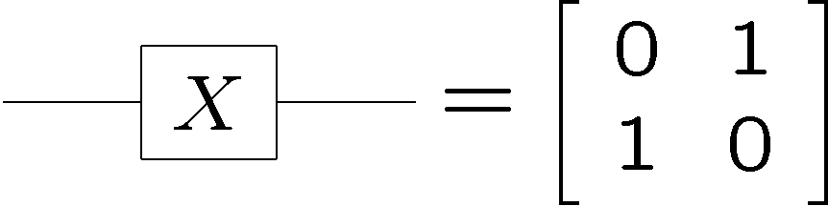


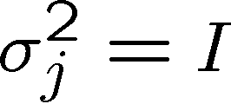
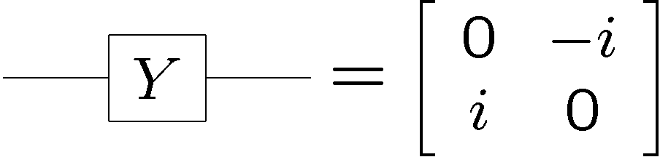

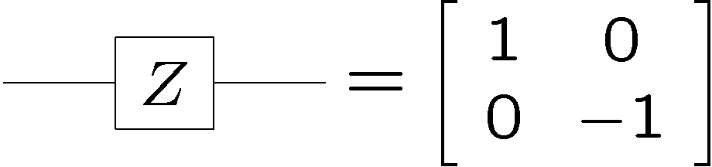

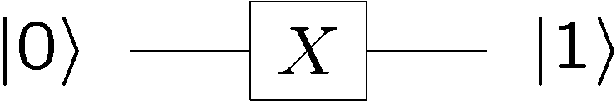
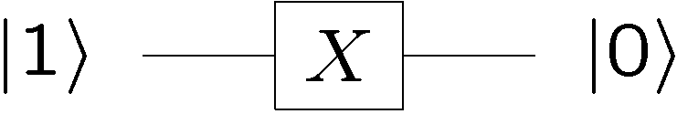
Important Single Qubit Unitaries
Pauli Matrices:
“bit flip”
“phase flip”
“bit flip” is just the classical not gate

Slide 17
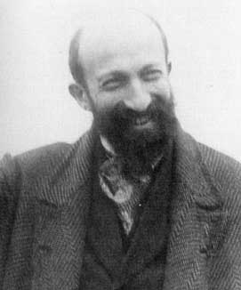
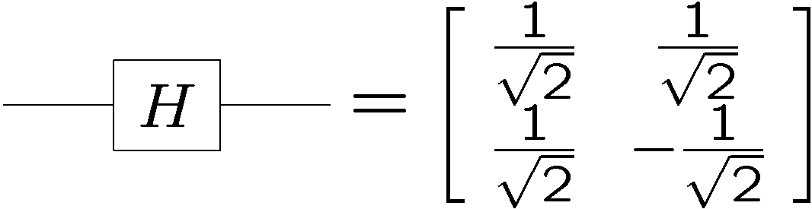

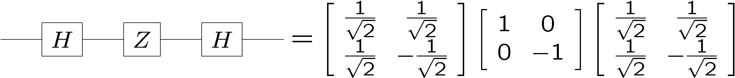
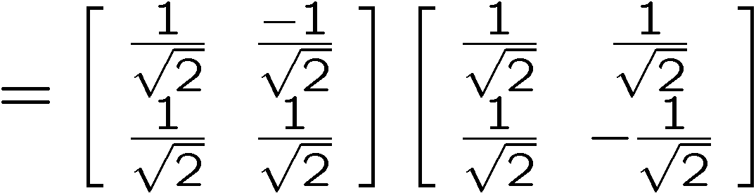
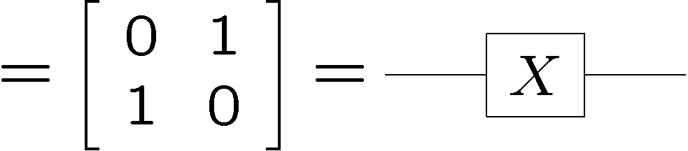
Important Single Qubit Unitaries
“bit flip” is just the classical not gate
Hadamard gate:
Jacques Hadamard

Slide 18

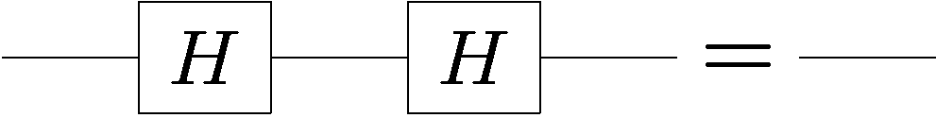
Single Qubit Manipulations
Use this to compute
But
So that

Slide 19









A Cool Circuit Identity
Using

Slide 20














Reversible Classical Gates
A reversible classical gate on bits is one to one function on
the values of these bits.
Example:
reversible
not reversible

Slide 21





Reversible Classical Gates
A reversible classical gate on bits is one to one function on
the values of these bits.
We can represent reversible classical gates by a permutation
matrix.
Permutation matrix is matrix in which every row and column contains at most one 1 and the rest of the elements are 0
Example:
input
reversible
output

Slide 22


Quantum Versions of
Reversible Classical Gates
A reversible classical gate on bits is one to one function on
the values of these bits.
We can turn reversible classical gates into unitary quantum gates
Permutation matrix is matrix in which every row and column contains at most one 1 and the rest of the elements are 0
Use permutation matrix as unitary evolution matrix
controlled-NOT

Slide 23

David Speaks
“Complexity theory has been mainly concerned with constraints upon the computation of functions: which functions can be computed, how fast, and with use of how much memory. With quantum computers, as with classical stochastic computers, one must also ask ‘and with what probability?’ We have seen that the minimum computation time for certain tasks can be lower for Q than for T . Complexity theory for Q deserves further investigation.”
David
Deutsch
1985
Q = quantum computers
T = classical computers

Slide 24

Deutsch’s Problem
Suppose you are given a black box which computes one of
the following four reversible gates:
controlled-NOT
+ NOT 2nd bit
“identity”
NOT 2nd bit
controlled-NOT
constant
balanced
Deutsch’s (Classical) Problem:
How many times do we have to use this black box to determine whether we are given the first two or the second two?

Slide 25
Classical Deutsch’s Problem
controlled-NOT
+ NOT 2nd bit
“identity”
NOT 2nd bit
controlled-NOT
constant
balanced
Notice that for every possible input, this does not separate the “constant” and “balanced” sets. This implies at least one use of the black box is needed.
Querying the black box with and distinguishes between
these two sets. Two uses of the black box are necessary and
sufficient.

Slide 26



Classical to Quantum Deutsch
controlled-NOT
+ NOT 2nd bit
“identity”
NOT 2nd bit
controlled-NOT
Convert to quantum gates
Deutsch’s (Quantum) Problem:
How many times do we have to use these quantum gates to determine whether we are given the first two or the second two?

Slide 27







Quantum Deutsch
What if we perform Hadamards before and after the quantum gate:

Slide 28

That Last One

Slide 29


Again

Slide 30





Some Inputs

Slide 31



Quantum Deutsch

Slide 32
Quantum Deutsch
By querying with quantum states we are able to distinguish
the first two (constant) from the second two (balanced) with
only one use of the quantum gate!
Two uses of the classical gates
Versus
One use of the quantum gate
first quantum speedup (Deutsch, 1985)

Slide 33
In Class Problem 2

Slide 34




Quantum Teleportation
Alice wants to send her qubit to Bob.
She does not know the wave function of her qubit.
Alice
Bob
Can Alice send her qubit to Bob using classical bits?
Since she doesn’t know and measurements on her state
do not reveal , this task appears impossible.

Slide 35
Quantum Teleportation
Alice wants to send her qubit to Bob.
She does not know the wave function of her qubit.
classical communication
Alice
Bob
Suppose these bits contain information about
Then Bob would have information about as well as
the qubit
This would be a procedure for extracting information from
without effecting the state

Slide 36

Quantum Teleportation
Classical
Alice wants to send her probabilistic bit to Bob using classical communication.
Alice
Bob
She does not wish to reveal any information about this bit.

Slide 37



Classical Teleportation
(a.k.a. one time pad)
Alice
Bob
50 % 00
50 % 11
Alice and Bob have two perfectly correlated bits
Alice XORs her bit with the correlated bit and sends the
result to Bob.
Bob XORs his correlated bit with the bit Alice sent and
thereby obtains a bit with probability vector .

Slide 38





Classical Teleportation Circuit
Alice
Bob

Slide 39


No information in transmitted bit:
transmitted bit
And it works:
Bob’s bit

Slide 40

Quantum Teleportation
Alice wants to send her qubit to Bob.
She does not know the wave function of her qubit.
classical communication
Alice
Bob
allow them to share the entangled state:

Slide 41





Deriving Quantum Teleportation
Our path: We are going to “derive” teleportation
“SWAP”
“Alice”
“Bob”
Only concerned with from Alice to Bob transfer

Slide 42



Deriving Quantum Teleportation
Need some way to get entangled states
new equivalent circuit:

Slide 43





Deriving Quantum Teleportation
How to generate classical correlated bits:
Inspires: how to generate an entangled state:

Slide 44

Deriving Quantum Teleportation
Classical Teleportation
Alice
Bob
like to use generate entanglement

Slide 45






Deriving Quantum Teleportation

Slide 46

Deriving Quantum Teleportation
?? Acting backwards ??
entanglement
Alice
Bob

Slide 47






Deriving Quantum Teleportation
Use to turn around:

Slide 48


Deriving Quantum Teleportation

Slide 49


Deriving Quantum Teleportation
50 % 0, 50 % 1
50 % 0, 50 % 1

Slide 50


Measurements Through Control
Measurement in the computational basis commutes
with a control on a controlled unitary.
classical
wire

Slide 51

Deriving Quantum Teleportation
50 % 0, 50 % 1
50 % 0, 50 % 1
50 % 0, 50 % 1
50 % 0, 50 % 1

Slide 52






Bell Basis Measurement
Unitary followed by measurement in the computational basis
is a measurement in a different basis.
Run circuit backward to find basis:
Thus we are measuring in the Bell basis.

Slide 53
Teleportation
Bell basis measurement
Alice
50 % 0, 50 % 1
50 % 0, 50 % 1
Bob
Initially Alice has and they each have one of the two
qubits of the entangled wave function
2. Alice measures and her half of the entangled state in
the Bell Basis.
3. Alice send the two bits of her outcome to Bob who then
performs the appropriate X and Z operations to his qubit.

Slide 54
In Class Problem 3

Slide 55

Teleportation
Bell basis measurement
Alice
50 % 0, 50 % 1
50 % 0, 50 % 1
Bob

Slide 56










Teleportation
Bell basis
Computational basis

Slide 57




Teleportation
Bell basis measurement
Alice
50 % 0, 50 % 1
50 % 0, 50 % 1
Bob

Slide 58







Teleportation
Alice
Bob
Alice
Bob

Slide 59
Teleportation
1 qubit = 1 ebit + 2 bits
Teleportation says we can replace transmitting a qubit
with a shared entangled pair of qubits plus two bits of
classical communication.
Superdense Coding
Next we will see that
2 bits = 1 qubit + 1 ebit

Slide 60
Bell Basis
The four Bell states can be turned into each other using
operations on only one of the qubits:

Slide 61



Superdense Coding
Suppose Alice and Bob each have one qubit and the joint
two qubit wave function is the entangled state
Alice wants to send two bits to Bob. Call these bits and .
Alice applies the following operator to her qubit:
Alice then sends her qubit to Bob.
Bob then measures in the Bell basis to determine the two bits
2 bits = 1 qubit + 1 ebit

Slide 62









Superdense Coding
Initially:
Alice applies the following operator to her qubit:
Bob can uniquely determine which of the four states he has
and thus figure out Alice’s two bits!

Slide 63
Quantum Algorithms

Slide 64






Classical Promise Problem
Query Complexity
Given: A black box which computes some function
k bit input
k bit output
black box
Promise: the function belongs to a set which is a subset
of all possible functions.
Properties: the set can be divided into disjoint subsets
Problem: What is the minimal number of times we have to
use (query) the black box in order to determine which subset
the function belongs to?

Slide 65



Example
Suppose you are given a black box which computes one of
the following four reversible classical gates:
2 bits input
2 bits output
controlled-NOT
+ NOT 2nd bit
“identity”
NOT 2nd bit
controlled-NOT
Deutsch’s (Classical) Problem: What is the minimal number of times we have to use this black box to determine whether we are given one of the first two or the second two functions?

Slide 66



Quantum Promise Query Complexity
Given: A quantum gate which, when used as a classical device
computes a reversible function
k qubit input
k qubit output
black box
Promise: the function belongs to a set which is a subset
of all possible functions.
Properties: the set can be divided into disjoint subsets
Problem: What is the minimal number of times we have to
use (query) the quantum gate in order to determine which
subset the function belongs to?

