Slide 1
CSEP 590tv: Quantum Computing
Dave Bacon
Aug 10, 2005
Today’s Menu
Entanglement
Bell’s Theorem
Entanglement and Quantum Computation
Quantum Communication Complexity
Entanglement as a resource

Slide 2
Administrivia
Questions on final?
Last lecture will be a non-technical summary of the sections
of quantum information science we didn’t cover.
Quantum cryptography, quantum error correction,
quantum communication, physical implementations.
Plus probably a little something on some far off topics like
quantum information and the black hole information paradox.

Slide 3
Email From Home
From: Nancy Bacon
To: Dave Bacon
Subject: teaching
Parts/Attachments:
1 OK 1 lines Text
2 Shown 0 lines Text
----------------------------------------
from you earthly mortal mother, i learn best when someone gives me a broad and
general concept, then goes into details, and then returns to the basic concept, of
course the trick is to find just the very right details to explain the general
concept. ha! good luck davers

Slide 4
Big Picture
Entanglement has long been known to be one of the
fundamentally strange things about quantum theory.
For years, people worried about entanglement.
(Einstein, Schrodinger, Bell,….)
What happening in quantum computing is that people
stopped learning to worry about entanglement, and began
to realize that if they just accepted it, it was a very valuable
resource!
Accept Entanglement!
But what is entanglement? Why is it “mysterious”?
Why is it important for quantum computation?

Slide 5






Bipartite Entanglement
Alice’s qubit
Bob’s qubit
Two qubits have a wave function which is either
Separable: we can express it as
valid wave functions
Entangled: we cannot express it as

Slide 6
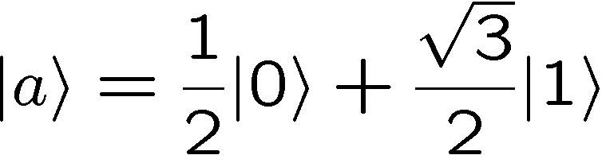
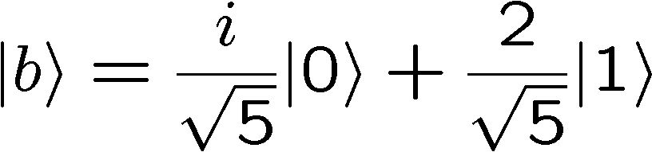
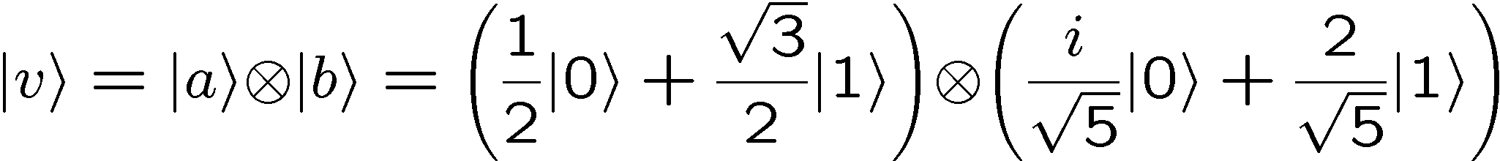
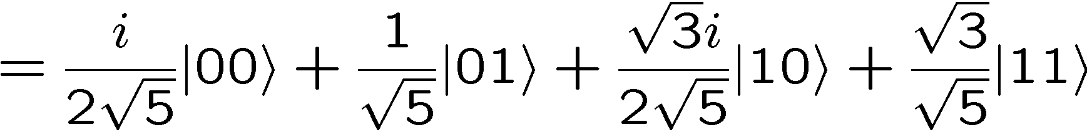
Two Qubits, Separable
Example:

Slide 7
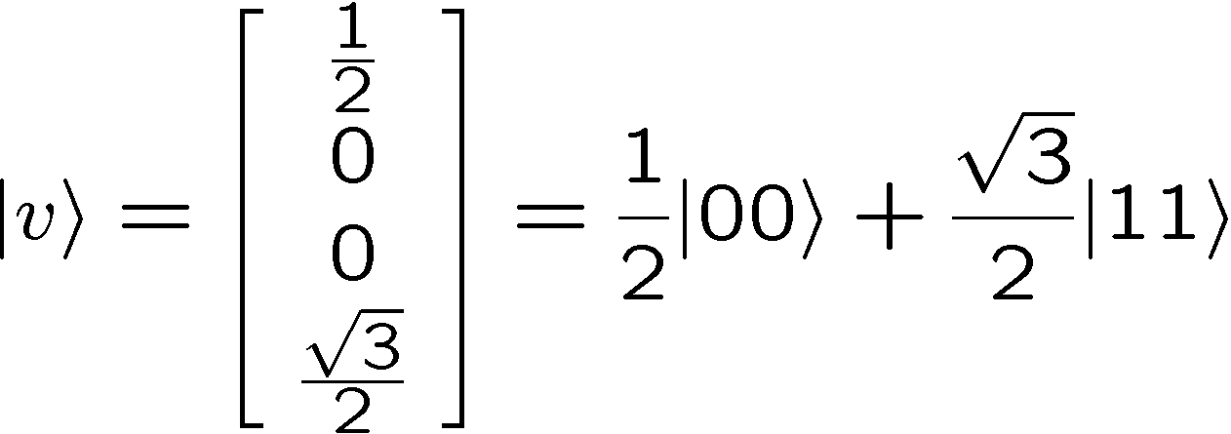







Two Qubits, Entangled
Example:
Assume:
Either
but this implies
contradictions
or
but this implies
So is not a separable state. It is entangled.

Slide 8
Special Relativity
To understand what makes entanglement so interesting in
physics we need to know a little special relativity.
We don’t need to know how to calculate in special relativity,
but we do need to understand the concept of “locality” which
arises in special relativity.

Slide 9
Spacetime
time
“event”:
(time,position)
position
“spacetime path”:
curve in spacetime
“inertial frame”:
constant velocity

Slide 10
Special Relativity
Special relativity:
(1) physics is the same in all inertial reference frames
(2) speed of light is same in all reference frames.
time
time
“light”
position
position
“spacetime paths”
Reference frame 1
Reference frame 2

Slide 11
Simultaneity
In special relativity, the idea of simultaneity is relative:
time
time
time
event B
event A
event B
position
position
event A
position
event A
event B
Reference frame 1
Reference frame 2
Reference frame 3
Different events are seen as occurring in a different order,
depending on the reference frame.

Slide 12
Special Relativity
Signal: I do something at my location and time such that you can,
conditional on what I do, act conditionally at your location
and time.
time
time
time
event B
event A
event B
position
position
event A
position
event A
event B
Reference frame 1
Reference frame 2
Reference frame 3
If I try to send a signal from A to B, then in some reference frame,
B acts before A sends the signal. Better not allow this!

Slide 13
Special Relativity
For all inertial observers moving through the origin, there are three
regions of spacetime which are preserved between inertial frames:
“future”
time
“light”
“light”
position
“elsewhere”
“elsewhere”
“past”

Slide 14
Special Relativity
When Alice and Bob both live in each other’s “elsewhere” they
cannot communicate with each other:
time
Bob
position
Alice
We call such setups “space-like separated”

Slide 15
Cellular Automata
CA Rules
Cellular automata (CA):
0
1
State:
0
1
0
0
0
1
0
1
0
0
0
0
0
1
0
0
0
1
0
0
1
1
Evolution of a CA:
1
1
T=2
0
1
0
1
1
0
0
1
0
1
T=1
0
1
0
1
0
1
1
0
T=0
0
1
0
0
0
1
0
1
1
1
0
1
1
1
These rules are local

Slide 16
Cellular Automata
CA rules are local
e
a
b
c
Time
Position
CA “Spacetime”

Slide 17
Cellular Automata
CA rules are local
e
a
b
c
Time
Changing this value
can only every change
the blue states (the
future)
Finite speed of signaling
Position
CA “Spacetime”

Slide 18
Cellular Automata
CA rules are local
e
a
b
c
Time
This state is a function of
the states in red (the past)
Finite speed of signaling
Position
CA “Spacetime”

Slide 19
Bipartite Entanglement
Alice’s qubit
Bob’s qubit
We will be interested in situations where Alice and Bob are
spacelike separated. It is in these setups, where they cannot
communicate, that quantum theory becomes interesting.

Slide 20


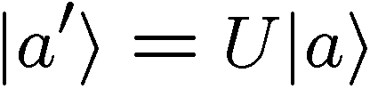
Separable States: Properties
Alice’s qubit
Bob’s qubit
If Alice acts on her qubit, while Bob does nothing, the resulting
unitary is of the form
If Bob acts on his qubit, while Alice does nothing, the resulting
unitary is of the form
Both of these preserve separability:
What about entangled states?

Slide 21


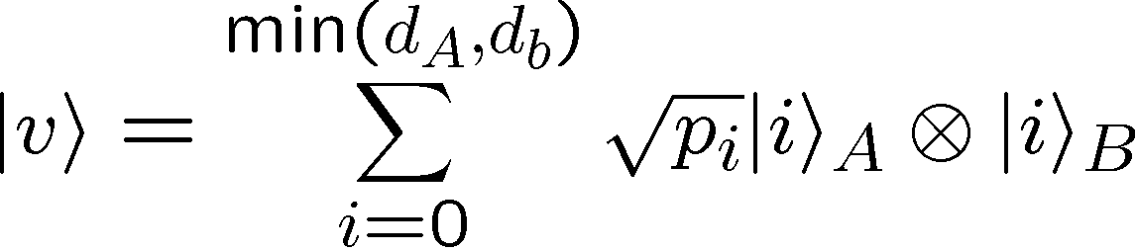
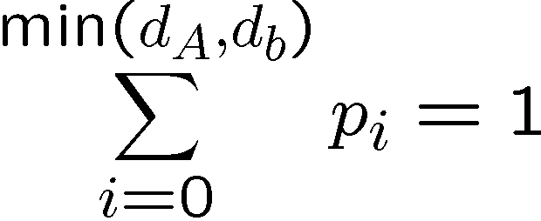


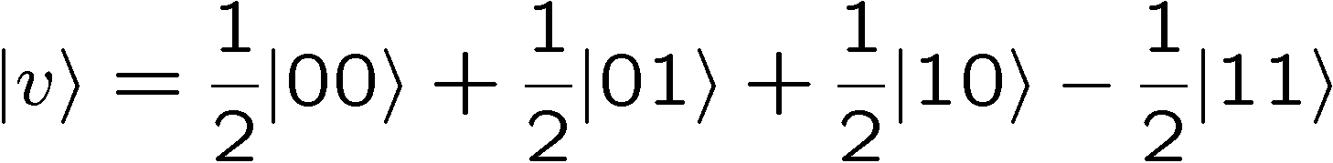
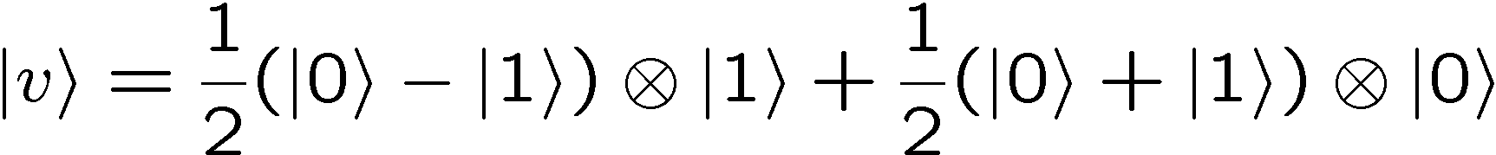
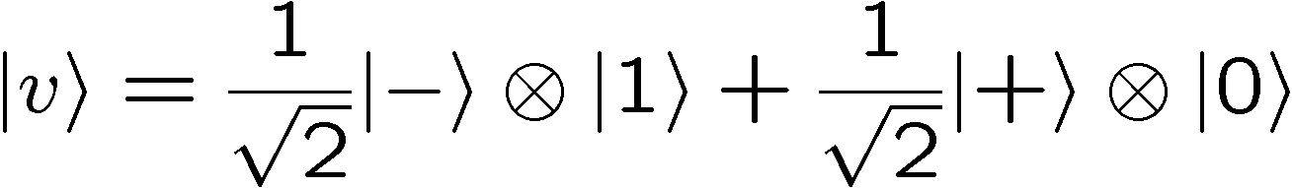
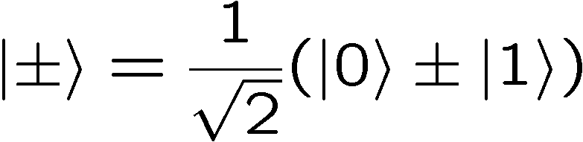
Schmidt Decomposition
Alice
Bob
All bipartite quantum systems can be expressed as
For some choice of basis of the two parties, and
Example:

Slide 22

Schmidt Decomposition
Alice
Bob
All bipartite quantum systems can be expressed as
For some choice of basis of the two parties, and
When only one is nonzero (and hence equal to one) then
the wave function is separable
Thus we can use Schmidt form to test for entanglement.

Slide 23
Entangled States: Properties
Alice’s qubit
Bob’s qubit
If Alice acts on her qubit, while Bob does nothing, the resulting
unitary is of the form
If Bob acts on his qubit, while Alice does nothing, the resulting
unitary is of the form
Both of these preserve entanglement.

Slide 24
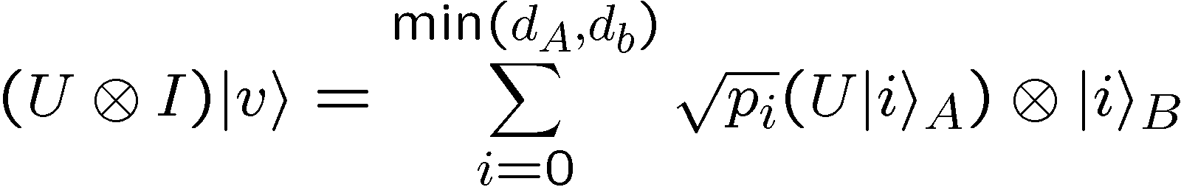
Entangled States: Properties
Alice’s qubit
Bob’s qubit
Just a change of basis.
Does not change
Hence and preserve entanglement

Slide 25
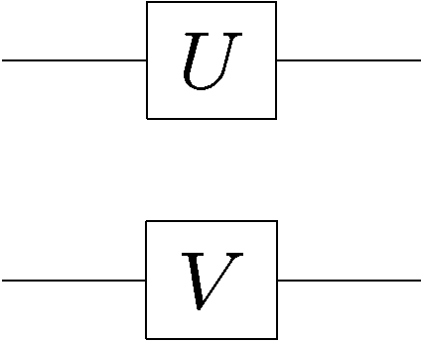
Local Unitaries
Alice’s qubit
Bob’s qubit
Local unitaries
A
B
separable
separable
entangled
entangled
separable
entangled

Slide 26
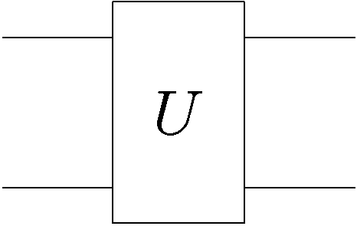
Entanglement Generation
Alice’s qubit
Bob’s qubit
Two party unitary:
A
B
separable
separable
entangled
separable
separable
entangled
entangled
entangled
Depends on the details of the unitary and on the inputs

Slide 27
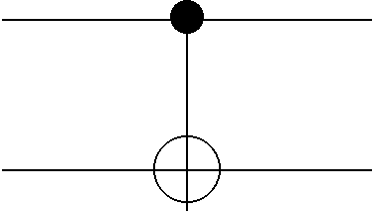
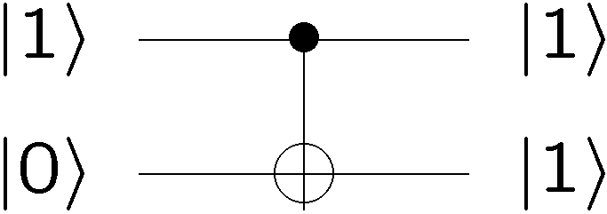
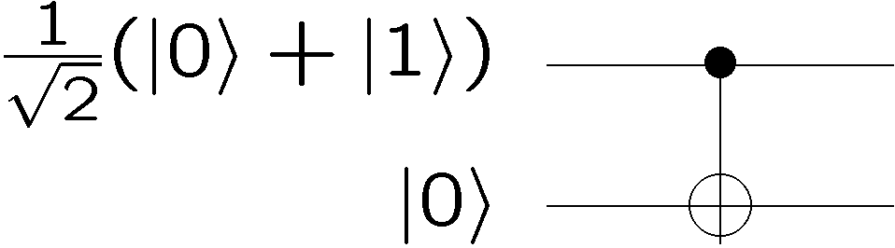
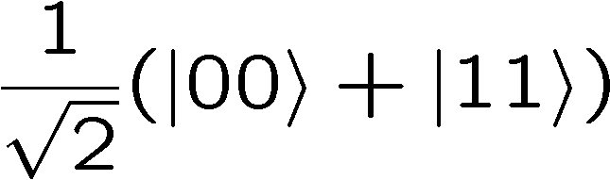
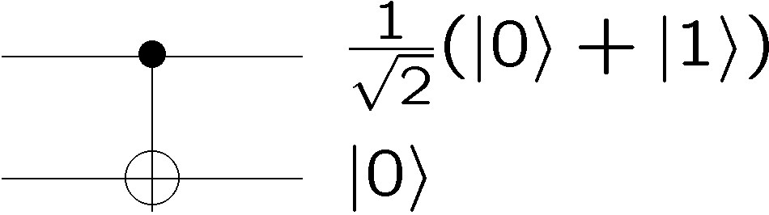
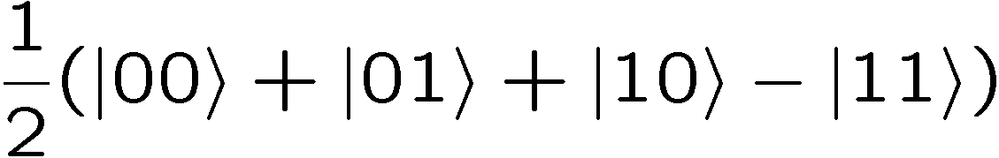
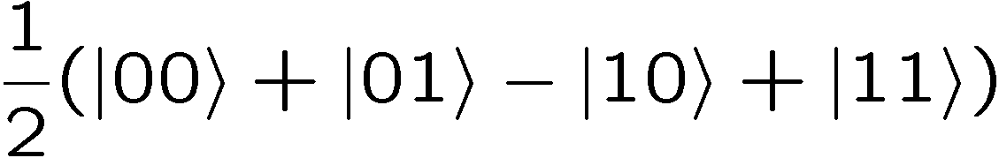
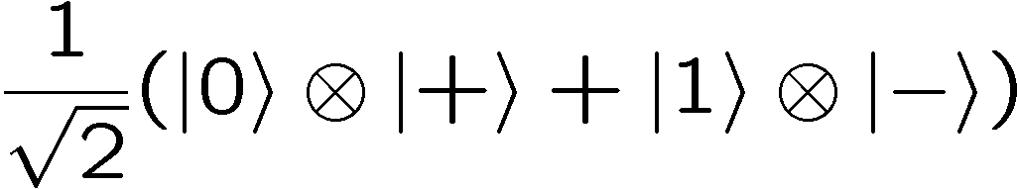
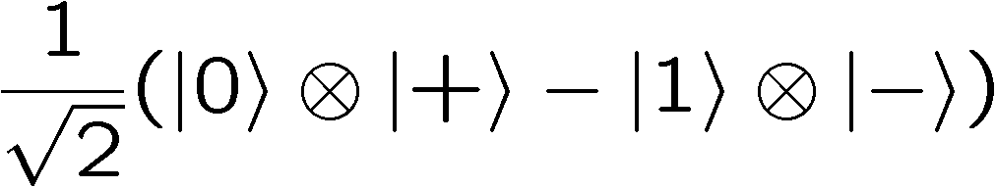
Entanglement Generation
Example:
separable
separable
separable
entangled
entangled
separable
entangled
entangled

Slide 28
Entanglement Generation
time
Bob
position
Alice
Entanglement needs to be generated “locally”
i.e. the two parties got together in the past and interacted
their qubits

Slide 29
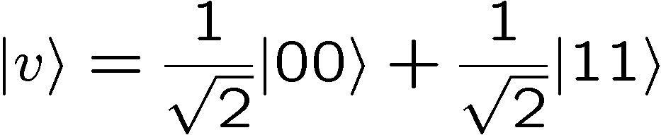


Correlation
Alice’s qubit
Bob’s qubit
1. Alice measures in the computational basis.
Facts:
With probability 50% she gets outcome 0.
With probability 50% she gets outcome 1.
If her outcome was 0, the new wave function is
If her outcome was 1, the new wave function is
2. Bob now measures in the computational basis
If Alice’s outcome was 0, and Bob’s outcome will be 0
If Alice’s outcome was 1, and Bob’s outcome will be 1

Slide 30
Correlation
Alice’s qubit
Bob’s qubit
If Alice’s outcome was 0, and Bob’s outcome will be 0
If Alice’s outcome was 1, and Bob’s outcome will be 1
Notice that this is NOT signaling. Why?
What does Bob see?
Having NOT seen Alice’s measurement outcome,
he finds that he gets
0 with 50% probability and
1 with 50% probability.

Slide 31
Special Relativity
time
time
time
event B
event A
event B
position
position
event A
position
event A
event B
Reference frame 1
Reference frame 2
Reference frame 3
Should we worry that “who does the measurement first”
depends on the frame of reference?
From the perspective of each party, NO, because they always
get the same probabilities of outcomes.

Slide 32
Correlation
Alice’s qubit
Bob’s qubit
A completely classical way to simulate this experiment:
Flip a fair coin.
  If the result is heads, put 0 into two boxes.
  If the result is tails, put 1 into two boxes.
2. Give Alice and Bob the boxes.
3. Parties perform measurements by opening their boxes
and reporting the classical bit inside as their measurement
outcome

Slide 33
Correlation
Alice’s qubit
Bob’s qubit
A completely classical way to simulate this experiment:
Flip a fair coin.
  If the result is heads, put 0 into two boxes.
  If the result is tails, put 1 into two boxes.
2. Give Alice and Bob the boxes.
3. Parties perform measurements by opening their boxes
and reporting the classical bit inside as their measurement
outcome

Slide 34
Local Hidden Variable Model
time
position
Suppose we try to respective special relativity, but at the same
time, reproduce the probabilities we get from quantum systems
Local Hidden Variable Models

Slide 35
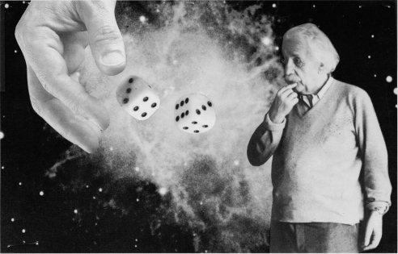
Einstein, Bohr (1927-36)
After the creation of quantum theory, Einstein became very concerned about quantum theory.
Einstein: “God does not play dice.”
Bohr: “Stop telling God what to do.”
Actually Einstein was not troubled by the indeterminism of
quantum theory, but by the fact that he thought quantum theory
was probably not the “ultimate” theory. He thought quantum
theory was incomplete.

Slide 36
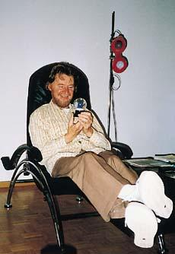
John Bell
In 1964, John Bell showed that the question
of whether or not quantum theory could
be explained by a local hidden variable
theory was an EXPERIMENTAL question
(and thus a real scientific hypothesis!)
“the most profound discovery of science”

Slide 37

A Game
Alice and Bob are locked away in prison cells and they cannot
communicate.
A warden plays the following game.
He gives Alice and Bob a slip of paper. Written on each of
these papers is the letter S or the letter T.
2. Alice are instructed that at a certain time, they will both be
required to shout out either +1 or -1.

Slide 38
A Game
Call Alice’s output (+1,-1) if she received S, A_{S}
Call Alice’s output (+1,-1) if she received T, A_{T}
Call Bob’s output (+1,-1) if she received S, B_{S}
Call Bob’s output (+1,-1) if she received T, B_{T}
Alice’s slip Bob’slip Product of their answers
S S A_{S}B_{S}
S T A_{S}B_{T}
T S A_{T}B_{S}
T T A_{T}B_{T}
Note that the product of their answers depends only on what
each party does locally.

Slide 39
A Game
The Warden will let Alice and Bob free if they produce
Alice’s slip Bob’slip Winning Product
S S +1
S T +1
T S +1
T T -1
Is it possible for Alice and Bob to always win this game?
No.
A_{S}B_{S}= A_{S}B_{T}=+1 implies that B_{S}=B_{T}.
A_{T}B_{S}= -A_{T}B_{T}=+1 implies that B_{S}=-B_{T}.
But this implies B_{S}=B_{T}=0, contradiction!

Slide 40
A Game
Suppose they play this game lots of times, each time they are
given one of the sheets of paper with equal probability (i.e. the
Warden gives each party an S or a T with 50% probability)
An indication of how well they are doing is to calculate the
probability of winning:
Probability of winning= ¼(Pr(A_{S}B_{S}=+1|S,S)+ Pr(A_{S}B_{T}=+1|S,T)
+ Pr(A_{T}B_{S}=+1|T,S)+Pr(A_{T}B_{T}=-1|T,T))
How are they doing?

Slide 41
A Game
Suppose Alice and Bob always play the same strategy.
This means assigning values to A_{S},A_{T},B_{S},and B_{T}.
Probability of winning= ¼(Pr(A_{S}B_{S}=+1|S,S)+ Pr(A_{S}B_{T}=+1|S,T)
+ Pr(A_{T}B_{S}=+1|S,T)+Pr(A_{T}B_{T}=-1|S,T))
At most they can win ¾ of the time.
Why? There must always be a contradiction with the winning
formula and so one of these probabilities is zero.
And they can achieve the case where one is zero and all three
others are one by always having A and B output +1

Slide 42
A Game
Suppose Alice and Bob are even allowed to share some random
numbers they copied from each other before they were thrown in
jail.
What is their maximum probability of winning? Same as before.
Why? Fix the random numbers. Run the protocol.
Probability of winning will be less than ¾.
Average over the random numbers.
No help. Probability of winning is at most ¾.
Probability of winning is at most ¾

Slide 43
The Connection
time
position
Local classical data
Local hidden variables

Slide 44
The Connection
After the break: how quantum entanglement allows Alice and
Bob a greater probability of freedom!
“The entanglement shall set you free!”

Slide 45
A Game
Suppose Alice and Bob are even allowed to share an entangled
quantum state which they made when they were plotting together
before the were thrown in jail.
Suppose they each have one qubit of two qubits with
wave function

Slide 46


A Basis
These states are orthogonal
And normal
Measurement operators in this basis, labeling these outcomes
+ and -

Slide 47


A Measurement
Suppose that Alice measures in the basis
and that Bob measures in the basis
Probabilities of outcomes:

Slide 48
In Class Problem

Slide 49
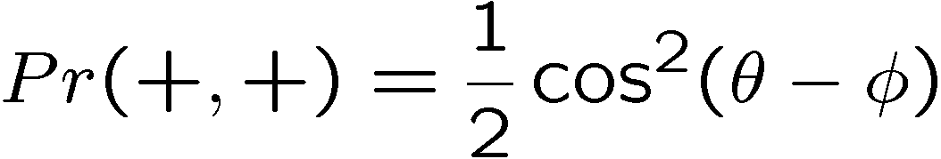
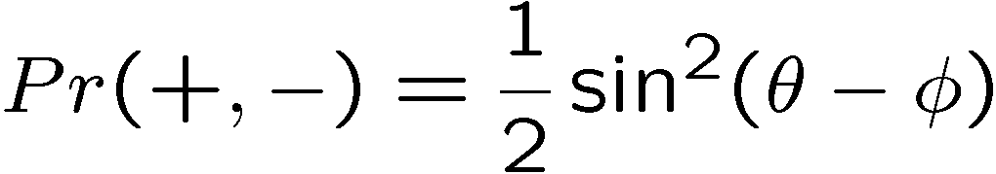
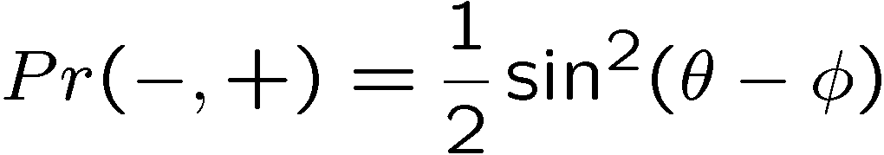
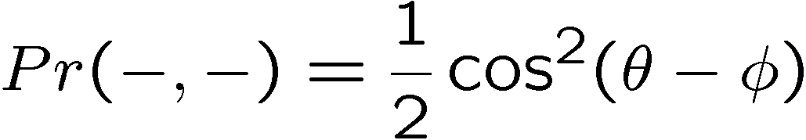
A Measurement
Suppose that Alice measures in the basis
and that Bob measures in the basis
Probabilities of outcomes:

Slide 50




A Game
They share
If Alice got a slip with S, she measures in the basis with
If Alice got a slip with T, she measures in the basis with
If Bob got a slip with S, she measures in the basis with
If Bob got a slip with T, she measures in the basis with
Both parties output their measurement (+ = +1, - =-1)
Choose angles which maximize the probability of winning

Slide 51
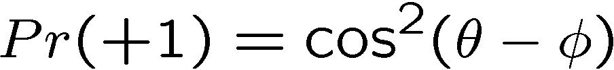
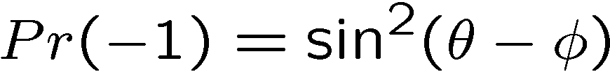
A Measurement
Suppose that Alice measures in the basis
and that Bob measures in the basis
Probabilities of outcomes:

Slide 52
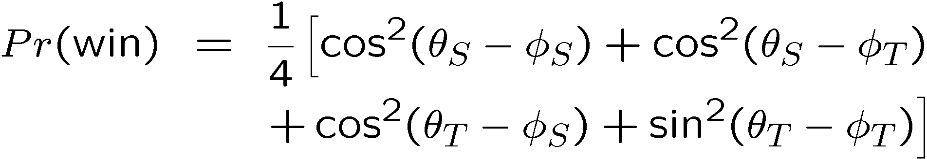
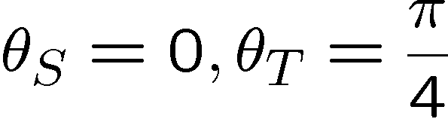
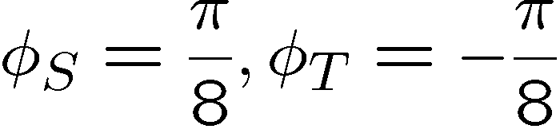
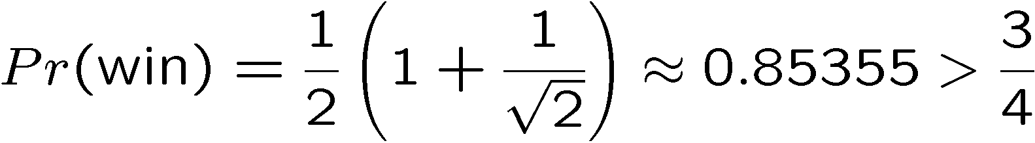
A Game

Slide 53
A Game
By sharing this entangled state, which they cannot use to
communicate with each other, but they can increase their
chances of defeating this evil evil warden.

Slide 54
Bell’s Theorem
Bell’s theorem tells us that we cannot simulate the statistics
of quantum theory using a local hidden variable theory!
time
position
Local classical data
Local hidden variables

Slide 55
Bell’s Theorem
Why is this profound?
Local theories, with classical information, like cellular automata
cannot reproduce the predictions of quantum theory
(Apologies to Stephen Wolfram)

Slide 56
Bell’s Theorem
Why is this profound?
Recall our model where we put bits into boxes to get correlation
Correlation is not profound.
But quantum correlation is different from experiments where
we generate correlations locally!
This was truly the first result in quantum information:
quantum correlations play games better
than classical correlations

Slide 57
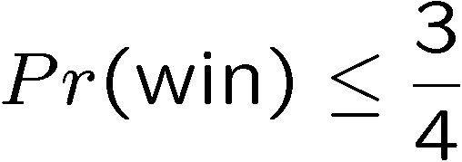
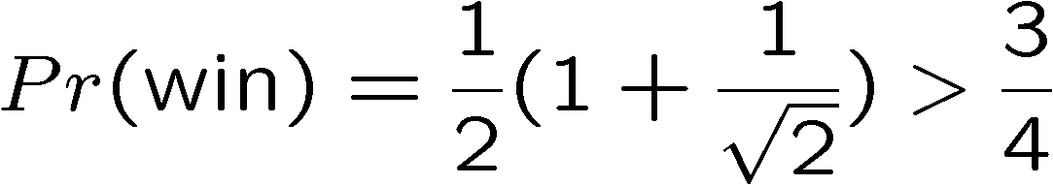
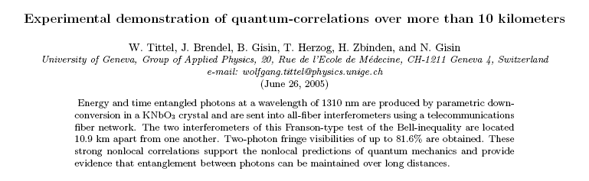
Bell’s Theorem
Why is this profound?
Bell’s theorem is an experiment:
All local hidden variable theories satisfy:
But quantum theory predicts
So go out and test it!!!! Famous tests of Aspect 1982.

Slide 58
Entanglement and Philosophy
Bell’s theorem (along with another important result known
as the Kochen-Specker theorem) is one of the strangest
parts (some would say the only) of quantum theory.
Viewpoint 1: “Shut up and calculate”, David Mermin
Quantum theory is consistent.
It provides no local realistic description, but that’s just
the way the world works.
Viewpoint 2: “Many worlds”
Those states in the superposition should be interpreted
as different parallel universes.
Bell universes only split when communication of results
between parties (split is always a local event)
There are hundreds more different viewpoints…..

Slide 59
Entanglement and Philosophy
Until these different viewpoints yield different experimental
results, we don’t worry too much about them.
But: by studying the controversies, many quantum information
scientists have developed a heightened awareness of what
quantum theory does and does not say.
“I have this student, he’s thinking about the foundations of
quantum theory. He’s doomed.” –John McCarthy
“...contemporary physicists come in two varieties. Type 1 physicists
are bothered by EPR and Bell's Theorem. Type 2 (the majority) are
not, but one has to distinguish two subvarieties. Type 2a physicists
explain why they are not bothered. Their explanations tend either
to miss the point entirely (like Born's to Einstein) or to contain
physical assertions that can be shown to be false. Type 2b are
not bothered and refuse to explain why.” – David Mermin

Slide 60
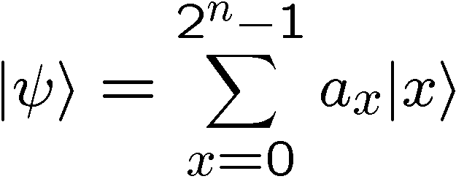

Entanglement and Quantum Computation
We remarked before, that a general quantum state on n qubits
Required complex numbers to specify. Exponential in n!
But, suppose that this n qubit state is separable across all
n qubits:
Each single qubit wave function requires us to specify only two
complex numbers, so we only need 2n complex numbers to
specify this separable state!

Slide 61
Entanglement and Quantum Computation
Suppose during an algorithm, the state always remains separable
We can efficiently simulate this quantum computation on a
classical computer:
One and two qubit gates are just 2x2 and 4x4 matrix
multiplications.
So, we need some entanglement in a quantum algorithm in order to have a speedup of quantum over classical.

Slide 62
Entanglement and Quantum Computation
A little more sophisticated [Jozsa and Linden]
p-blocked: If no p+1 subset of n qubits is entangled.
Such circuits can be efficiently simulated if p is poly(log n)
Basic idea: Entangled blocks of size p can be expressed
as 2^{p} complex numbers.
This is polynomial in n if p is poly(log n)
A “large amount” of entanglement is necessary for a quantum
speedup. Interestingly it is not sufficient.

Slide 63
Entanglement and Quantum Computation
A side benefit: physicists spend a lot of time trying to simulate
quantum systems. This is often computationally hard.
Because we know that entanglement is important for this to be
difficult, we can design our algorithms to keep track of as much
entanglement as possible.
This has lead to nice deep insights into some algorithms
physicists had previously invented, and is currently being
exploited to design new faster algorithms!
Understanding entanglement is essential to understand the
limits of computational quantum physics!

Slide 64
Talk To Me
1 if a=b
0 if a≠b
F_{eq}(a,b)=
ALICE
BOB
a
b
0
1
0
1
0
0
1
1
1
0
n bits
n bits
How much (many bits) do Alice and Bob need
to exchange to compute F(a,b)?
With no error: n bits
With one-sided error ε: O(log(n/ε)) bits

Slide 65
Talk To Me
Some More
ALICE
BOB
a
b
0
1
0
1
0
0
1
1
1
0
n bits
n bits
F_{xor}(a,b)=a₁⊕a₂ ⊕ …⊕a_{n}⊕b₁⊕b₂ ⊕ …⊕b_{n}
How much (many bits) do Alice and Bob need
to exchange to compute F(a,b)?
With no error: 1 bit

Slide 66
Communication Complexity
How much communication between Alice
and Bob is necessary for them to compute
F(a,b) when Alice knows a and Bob knows b?
[Yao 79]
many rigorous lower and matching upper bounds
…in contrast to computational complexity
P
NP
N=1?
P=0?

Slide 67


Make It Quantum
ALICE
communicate qubits
BOB
a
b
How does classical communication complexity (bits)
compare to quantum communication complexity (qubits)?
Holevo’s Theoerem: sending n classical bits
requires n quantum bits.

Slide 68
Holevo’s Theorem
ALICE
communicate qubits
BOB
a
b
Holevo’s Theoerem: sending n classical bits
requires n quantum bits.
One is often tempted to think about a qubit as storing
an analog number, the amplitudes. But this is totally
wrong. This would be like saying that you are storing a
an infinite amount of information in a classical bit to
which you have probabilities for the state of the bit

Slide 69

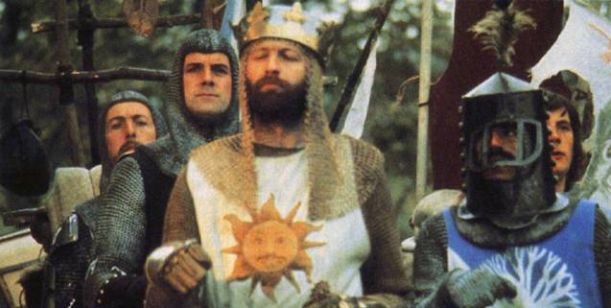
Not So Fast
There exists functions F(a,b) which require
Ω(m^{1/4}/log(m)) bits of communication to solve
but can be solved using only O(log(m)) qubits.
[m is the length of a and b]
Ran Raz
(1999)
Exponential benefit in
quantum over classical.
Exact model 0-error:
Buhrman, Cleve, Wigderson (1998)
1-way communication exponential separation:
Bar-Yossef, Jayram, Kerenidis (2004)

Slide 70

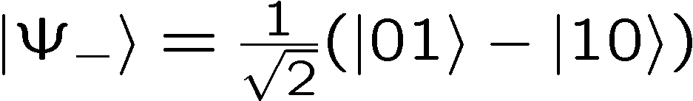
Quantum Teleportation
1 qubits
ALICE
BOB
a
b
2 bits
+
entangled
quantum
state
ALICE
BOB
b
a
Quantum Teleportation Protocol

Slide 71
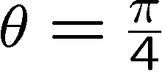
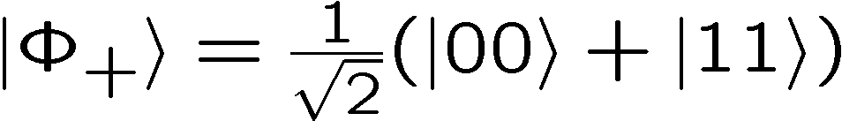
Entanglement as a Resource
If parties share entangled states, they can outperform classical
communication complexity protocols.
But there are all sorts of different “kinds” of entanglement.
For example, for two qubits:
When,
“maximally entangled”
“1 ebit”
If we use non-maximally entangled qubits for teleportation,
for example, it becomes less efficient.

Slide 72

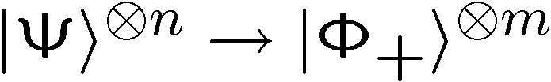
Entanglement Distillation
Suppose I give you many copies of a non-maximally entangled
qubits
Is it possible to convert into m<n maximally entangled
qubits?
Entanglement distillation! Rate is
von Neumann entropy

Slide 73
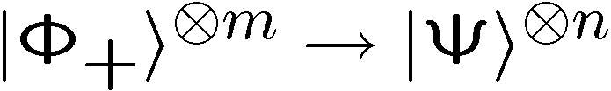
Entanglement Dilution
What about the reverse? n>m
Entanglement diluation
von Neumann entropy

Slide 74
Fungible
(pure state) bipartite entanglement is a fungible resource
which can be quantified in the quantity of ebits.
Fungible, adj. 1. being of such a nature that one part or
quantity may be replaced by another equal part or
quantity in the satisfaction of an obligation

Slide 75
Entanglement
Bell’s theorem says quantum theory is not a local realistic
hidden variable theory
Entanglement can be used to speed up communication
complexity problems over classical problems
Entanglement is necessary (but not sufficient) for speedups in quantum algorithms
Entanglement is a fungible resource measured in ebits

