Slide 1
CSEP 590tv: Quantum Computing
Dave Bacon
Aug 17, 2005
Today’s Menu
Quantum Computing implementations
Quantum Error Correction
Quantum Cryptography
Quantum Information and Black Holes…

Slide 2
Administrivia
Turn in the take home final. Let out a deep breath.
If you are taking the 1 week extension which is an
extension to Monday, please let me know via email.
Fill out course evaluations at end of class.

Slide 3
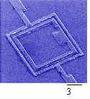
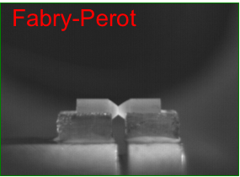
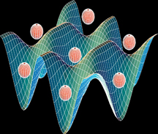
But What Will It Look Like?
Atomic
cavity QED
neutral atoms in optical lattices
ion traps
Solid State
superconducting circuits
electron spin in Phosphorus doped Silicon
quantum dots
defects in diamonds
Molecular
Photon Based
Liquid NMR (no longer?)
linear optics plus single photon devices
Pics: Mabuchi (Caltech), Orlando (MIT)

Slide 4

DiVincenzo’s Criteria
1. Well defined qubits in a scalable architecture
David
DiVincenzo
2. The ability to initialize the system to a fixed wave function.
3. Have faster control over the system than error processes in the system.
4. Have the ability to perform a universal set of quantum gates.
5. Have the ability to perform high quality measurements

Slide 5
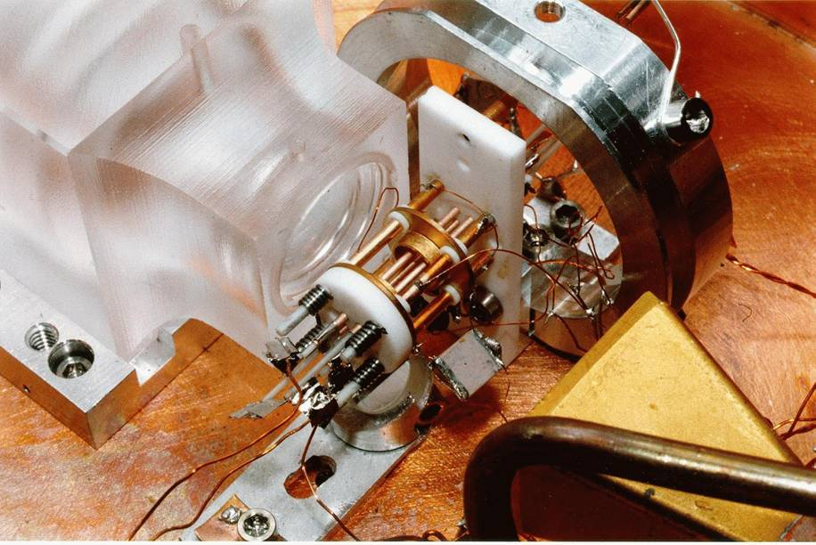
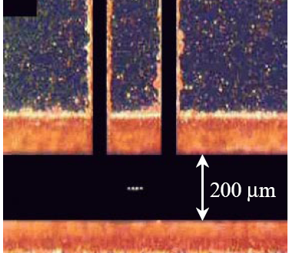
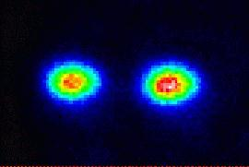
Ion Trap
Oscillating electric
fields trap ions
like charges repel
2 ⁹Be⁺ Ions in an Ion Trap

Slide 6
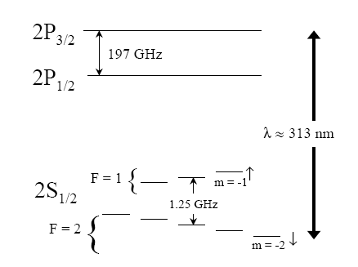
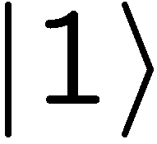

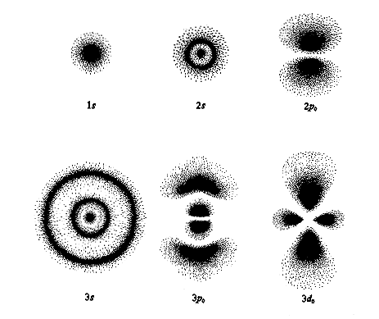
Where’s the Qubit?
Energy
Each ion = 1 qubit
1. Well defined qubits 
orbitals

Slide 7
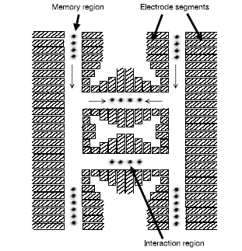
Scalable?
. Well defined qubits in a scalable architecture
Solid state qubits seem to have a huge advantage for scalability.

Slide 8
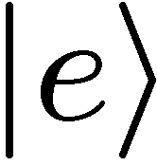
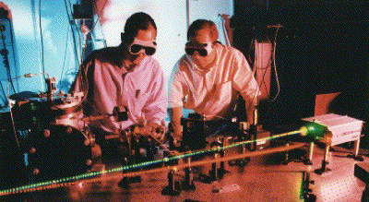
Measurement
Energy
laser
decay
Detecting florescence implies
in state 0
99.99% efficiency
5. Have the ability to perform high quality measurements 

Slide 9
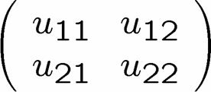
Single Qubit Operations
Laser 1
Energy
Laser 2
Allows any one qubit unitary operations

Slide 10
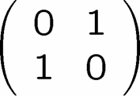
Initialization
Laser 1
laser
Laser 2
decay
If not in zero state, flip
measure
2. The ability to initial the system to a deterministic state. 

Slide 11
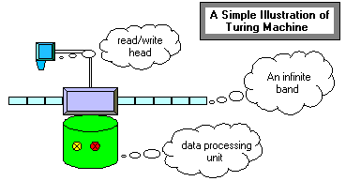
Universal Computers
Turing machine reads state of tape at current position.
Based on this reading and state of machine, Turing machine writes new symbol at current position and possibly moves left or right.
Certain Turing machines can perform certain tasks.
A Universal Turing Machine can act like any other possible
Turing machine (i.e. it is programmable)

Slide 12

Universal Quantum Computer
Universal Quantum Computer
a quantum computer which can be programmed to perform any algorithmic manipulation on quantum information.
U(2)
Set of Universal Quantum Gates
a set of operations/gates which, acting on the quantum information, can be used to implement (to any desired accuracy) any unitary evolution of the quantum info.
The Royal King and Queen of Universal Quantum Gates
CNOT and 1-qubit rotations

Slide 13
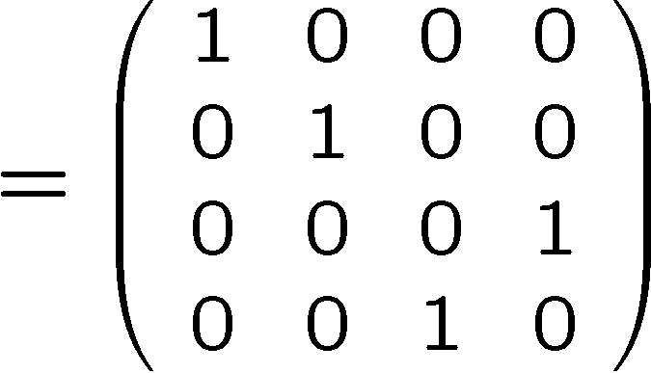
Coupling Two Qubits
stationary
sloshing mode
These modes can be used as a bus between the qubits.
4. Have the ability to perform a universal set of quantum gates 

Slide 14



What is the Problem?
3. Have faster control over the system than error processes in the system.
Real quantum systems are open quantum systems!
system
environment
Quantum systems readily couple to an environment…
qubits
0
System decoheres:
bits
1
50% 0 50% 1
Quantum
Classical
The Decoherence Problem (1996)
Notes:
Quantum systems readily couple to an environment.

Slide 15

The Problem
Decoherence is a lot like classical noise, BUT:
Strong coupling to
environment
causes
decoherence
Strong coupling to
control devices
needed to enact
computations
Yingyang of quantum computing

Slide 16
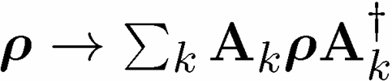
Quantum Computing is Bunk
Ways Quantum Computers Fail to Quantum Compute
Decoherence
Lack of Unitary Control
attempting to apply unitary evolution U instead results in V
or (worse) results in non-unitary evolution
Measurements are faulty
measurement result is noisy, incorrect result obtained
Quantum Computing Disappearing Act
qubits disappear (leakage of computing states)

Slide 17
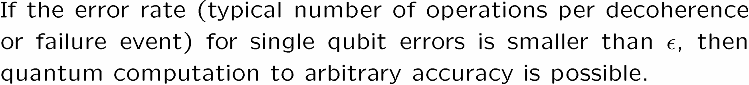
The Quantum Solution (1995-96)
Threshold Theorem:
QC
Error Rate

Slide 18
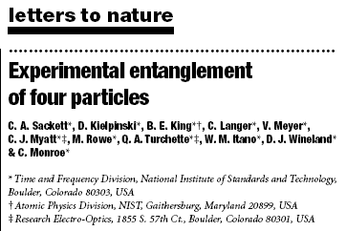
Ion Trap Parameters
Decoherence rate for qubits: 1 minutes
Gate speed: 10 microseconds
Decoherence rate for bus: 100 microseconds to 100 milliseconds
Measurement errors: 0.01%
3. Have faster control over the system than error processes in the system. 
State of the Art
NIST Boulder

Slide 19
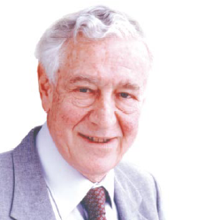
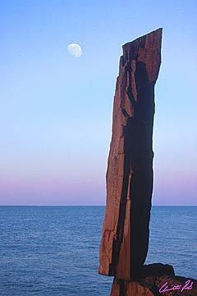
A Critical Ghost
All papers on quantum computing should carry a footnote: “This proposal, like all proposals for quantum computation, relies on speculative technology, does not in its current form take into account all possible sources of noise, unreliability and manufacturing error, and probably will not work.”
Rolf Landauer
IBM
Maintenance of giganto-coherence?
Faulty quantum gates?
Do we understand the physics of quantum errors in the system?
Nature abhors a quantum computer?

Slide 20
Analog Computers
Compute by adding, multiplying real infinite precision numbers.
This can be used to solve NP complete problems in polynomial
time!
This, however is NOT a realistic model of computation.
Why? Infinite precision is requires, as far as we know, infinite
resources! Noise destroys the speedup.
Is quantum computing an analog computer?
The resolution of this is the subject of quantum error correction.

Slide 21



Don’t Eat That Apple
plus: simple
minus: unrealistic
plus: essential ideas
Lucifer’s channel:

Slide 22
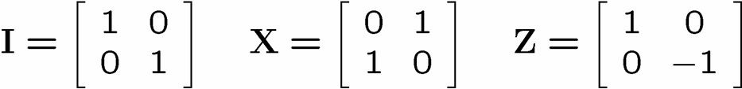





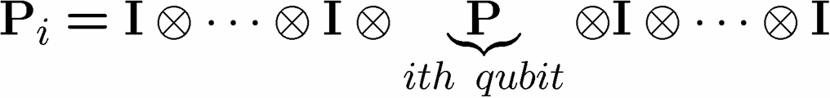
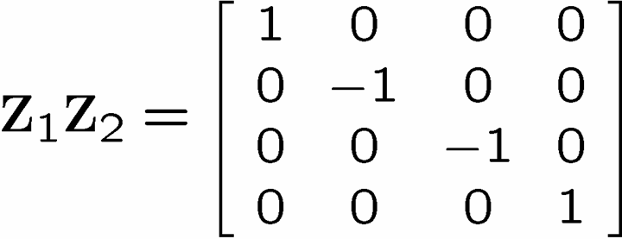
Identity

Slide 23
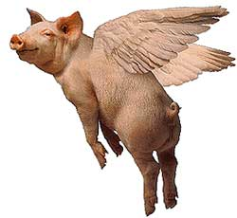
The Story of the Ghost
You are protecting your quantum information against a crazy noise model! Z₁Z₂? If this is all nature can throw at you, then pigs can fly.
Rolf Landauer
IBM

Slide 24
Noisy Cell Phone
Hello? Hello? Hello? Hello?
I have a flat tire. I said, I have a flat tire! A flat tire.
No, I’m not trying to flatter you..No, you’re not getting fatter. I have a flat tire!
Communication over a noisy CHANNEL can be overcome via
ENCODING
“Hello?” = “Hello? Hello? Hello? Hello?” [using redundancy to encode “Hello”]

Slide 25
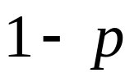
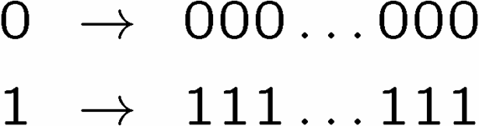

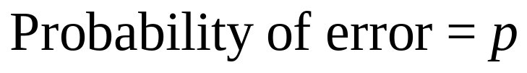
Simple Repetition Code
Encode:
0
0
n copies
1
1
No encoding:
Binary Symmetric Channel
b
measure
Encoding (n=3):
b
encode
b
b
b
decode
and correct
measure
Probability of error

Slide 26
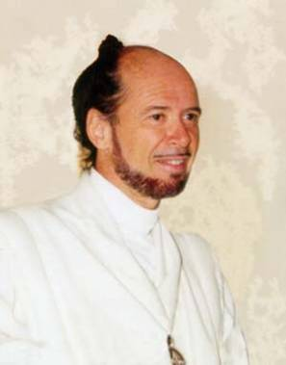





1994 Reasons to be a Pessimist
No cloning:
Quantum Cloning Machine
“A single quantum cannot be cloned,” Wootters and Zurek, Nature, 1982
No quantum repetition code:
Measurement destroys coherence:
How can one decode without destroying the information?

Slide 27

Unrealistic Realistic Channel

Slide 28
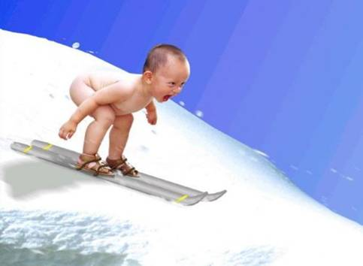
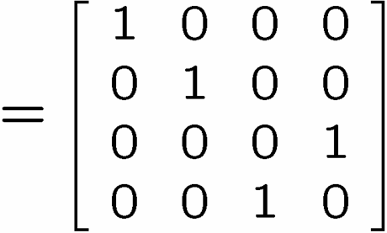
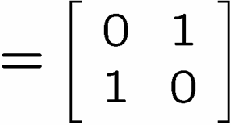
Baby Steps
WWCCD? (What Would Classical Coders Do?)
measure
b
b
0 →000, 1 → 111
0
b
0
b
encode
error
decode
fix
100 → 111→101 → 110 → 110
identities
b
b
=
b
1
0
1
1
1
=
0
error #@%

Slide 29



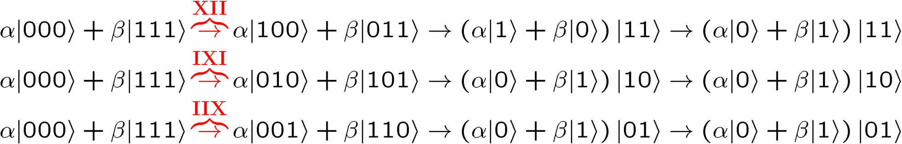
Naïve
4. operator identities still hold
Lets be naïve, take classical and move over to quantum
encode
error
decode fix
?
error
decode
fix
encoded into subspace:
2. errors take to orthogonal
subspaces + maintain orthogonality
3. syndrome
(no-cloning evaded!)

Slide 30






Identity
encode
error
decode fix

Slide 31
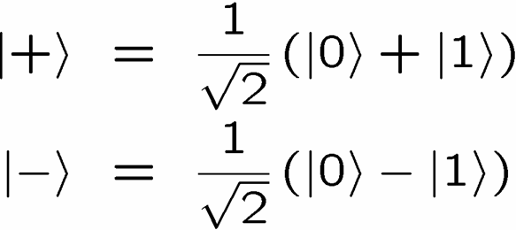
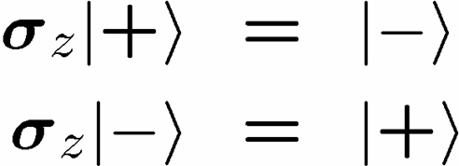


OK Wise Guy
What about “phase” errors?
…sort of not classical error
phase error:
Wise guy says “basis change please”:
looks like bit flit error in this new basis!
H
H
H
H
H
H
phase errors
bit flip errors

Slide 32
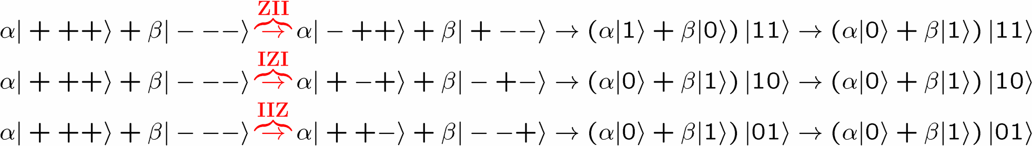
Molly: “I love you, I really love you”
Sam: “Ditto.”
encode
error
decode
fix
H
H
?
H
H
H
H
error
decode
fix
encoded into subspace:
2. errors take to orthogonal
subspaces + maintain orthogonality
3. syndrome
(no-cloning evaded!)

Slide 33


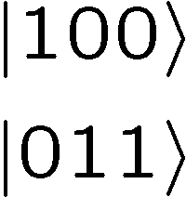




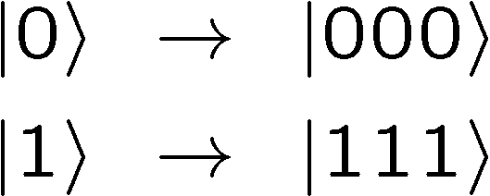

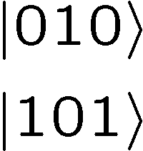



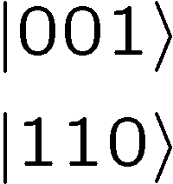

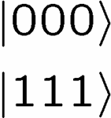
Perspective
Orthogonal subspaces can be distinguished by measurements
without measuring information encoded into the subspace!!!

Slide 34

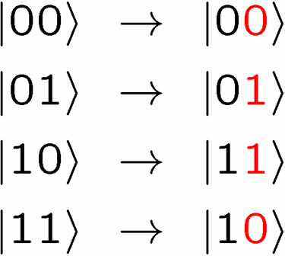
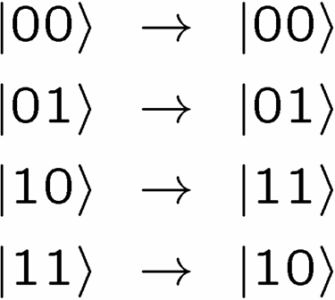



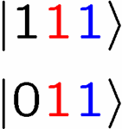
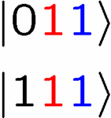
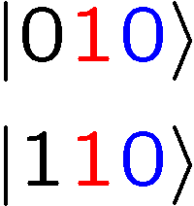
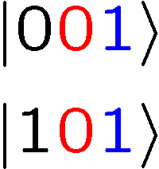
Not An Optical Illusion
fix
error

Slide 35
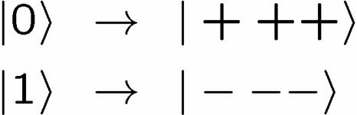


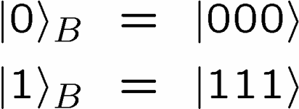
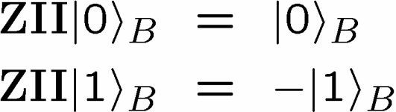


Encoding Away Your Ills
3 qubit bit flip code
3 qubit phase flip code
phase errors act as on bit flip code qubits:
define:
Shor Code: (Peter Shor, 1995)

Slide 36



Inside Shor
H
H
H
H
H
H
bit flip code
phase flip code

Slide 37

Linearity of Errors
We have only discussed two types of errors, bit flips and phase flips. What about “general” errors?
Theorem of digitizing quantum errors:
If we can correct errors in some set, then we can correct
any linear complex combination of such errors.
While errors may form a continuous set, we only need to correct
a discrete set of these errors

Slide 38



Perfection Through Concatenation
U
V
U
Threshold Theorem for Quantum Memory

Slide 39
Quantum Error Correction
The insight that quantum computers could be defined in the
presence of noise (the full theory is called fault-tolerant
quantum computation) is why we have been justified in using
the quantum circuit model.
Quantum error correction justifies calling a quantum computer
a digital computer.

Slide 40
Whence Physics?
RANT
MODE
ON
Today: similar situation to early days of classical computation
(threshold theorems but no physics!)
What is the phase of matter corresponding to the computer?
There are distinct PHYSICAL and DYNAMICAL reasons why
robust classical computation is possible.
not all physical systems are equally good for computation
there exists systems whose PHYSICS guarantees
their ability to enact robust classical computation.
THE BILLION DOLLAR QUANTUM QUESTION:
Are there (or can we engineer) physical systems whose
PHYSICS guarantees robust quantum computation?

Slide 41


Self-Correcting Quantum
Computers
YY
XX
Quantum many-body systems which have
excitations which are string-like and are
self-correct, but into which we can encode
quantum information?
ZZ
XX
ZZ
YY
YY
ZZ
ZZ
XX
XX
YY
Q
coherence order parameter(s)
optical lattice
[Bacon, Ph.D. thesis, U.C. Berkeley 2001]
[Bacon, “Quantum Error Correcting Subsystems” in preparation]

Slide 42
Quantum Cryptography
We saw that quantum computers defeat many public key
cryptosystems. Luckily quantum theory also provides an
alternative, known as quantum cryptography.
Goal: a manner in which Alice and Bob can share secret key
such that they can detect if an eavesdropper can
be detected.

Slide 43










Quantum Cryptography
Alice generates 2n bits with equal probability
The first of these bits labels a basis choice and the second
labels a wave function choice. Alice prepares n qubits:
Alice’s qubit
0 0
0 1
1 0
1 1

Slide 44
Quantum Cryptography
Alice sends her n qubits to Bob.
Alice then announces via a public channel what basis she
measured in: the b bitstring.
If Bob measures his qubits in the same basis, he will
end up with results which exactly match Alice’s bit string
They can then reveal a few of their bits at random to
check whether someone has been eavesdropping.
If not eavesdropping, the rest of their bits are a shared
key string

Slide 45
Quantum Cryptography
Eve sees a procession of qubits in the computational
or plus/minus basis. Eve does not know the basis.
Intuition: If Eve tries to measure this qubit, since she doesn’t
know what basis to measure in, sometimes she will
make measurement in the wrong basis and this
can be detected by Alice and Bob.

Slide 46





Quantum Cryptography
0 | 1 | 1 | 0 | 0
1 | 0 | 0 | 0 | 1
Alice’s qubit
0 0
0 1
1 0
1 1
0 | 0 | 1 | 1 | 1
Eve’s basis
50%
50%
50%
State after Eve’s measurement
50%
50%
50%

Slide 47
Quantum Cryptography
Eve sees a procession of qubits in the computational
or plus/minus basis. Eve does not know the basis.
Proof of security, with certain key generation rate, against
all types of Eve’s attacks.

Slide 48

Quantum Cryptography

Slide 49
Black Holes Information Paradox

Slide 50


Three Revolutions of
Fundamental Modern Physics
Relativity
Special and General
Quantum
Theory
The Standard
Model

Slide 51

Three Revolutions of
Fundamental Modern Physics
Special
Relativity
General
Relativity
Quantum Field
Theory
Renormalization
Quantum
Theory
The Standard
Model

Slide 52







The Physics
Quantum Field Theory
General Relativity
dynamic variables
particle fields
metric
defined over some space-time
space-time itself!

Slide 53


Black Holes
Blackholes:
If we cram mass inside
we create a blackhole.
Two regions:
A. outside of the black hole.
B. Inside the horizon of the black hole.
Things can go from A to B, but not from B to A
At the center of the black hole, the general relativity solution becomes
singular. This is scary and no one knows what to do about this.

Slide 54
Black Holes Have no Hair?
Blackholes:
If we cram mass inside
we create a blackhole
Classically, black holes have only three properties which are accessible to an observer outside of the black hole:
Mass M, Charge Q, Angular momentum L
We say that a “black hole has no hair.”
All other information about how we formed the black hole has disappeared except these three numbers.

Slide 55






Black Holes Thermodynamics
Throwing stuff into a black hole will increase it’s mass
This will increase the radius of the black hole
Second law of thermodynamics: the entropy of a closed system
can only increase.
Entropy measures roughly the “degrees of freedom” of a physical
system.
Entropy of a black hole of area A:
Boltzman’s constant
Newton’s constant
Planck’s constant
speed of light

Slide 56






Planck Length
0
1
General Relativity
Blackholes:
If we cram mass inside
we create a blackhole
Any mass blackhole possible
Quantum Field Theory
localize to diameter d → large momentum possible
large momentum → particle creation
Compton length:
Black holes of small mass such that Compton length is outside horizon?
Planck Mass
Planck Length

Slide 57

Black Holes Thermodynamics
Entropy of a black hole of area A:
Boltzman’s constant
Newton’s constant
Planck’s constant
speed of light
Entropy of a black hole is equal to ¼ the area measured in the units
of Planck area.
Bits in a black hole?

Slide 58

Hawking Radiation
large momentum → particle creation
Black holes are not black!
They radiate due to particle
creation/annihilation across
the black hole horizon
(this is a fudge, but…)
This radiation causes a black
hole to lose mass
Black holes can evaporate!
http://library.thinkquest.org/C0126626/fate
No hair implies radiation should depend only on M, Q, L

Slide 59

Black Hole Information Paradox
Throw qubit into a black hole (more properly state with initial
conditions which are a pure state)
Radiation doesn’t depend on only on mass,
charge, and angular momentum content
Black hole evaporates:
Where did the qubit go to?
Unitary evolution requires qubit should
reappear somewhere…
This is the black hole information paradox

Slide 60

Black Hole Information Paradox
Whereas Stephen Hawking and Kip Thorne firmly believe that information
swallowed by a black hole is forever hidden from the outside universe, and
can never be revealed even as the black hole evaporates and completely
disappears,
And whereas John Preskill firmly believes that a mechanism for the information
to be released by the evaporating black hole must and will be found in the
correct theory of quantum gravity,
Therefore Preskill offers, and Hawking/Thorne accept, a wager that:
When an initial pure quantum state undergoes gravitational collapse to form a black hole,
the final state at the end of black hole evaporation will always be a pure quantum state.
The loser(s) will reward the winner(s) with an encyclopedia of the winner's choice,
from which information can be recovered at will.
Stephen W. Hawking, Kip S. Thorne, John P. Preskill
Pasadena, California, 6 February 1997

Slide 61

Holographic Principle
t’Hooft, Susskind: all of the information contained in a
volume of space can be represented by a theory that lives in
the boundary of that region
Side result: The ultimate limit to the storage of information is that if you try to pack more and more information onto your hard drive, then eventually this hard drive will collapse into a black hole. What this information storage capacity of a hard drive?
that’s a lot of bits!

Slide 62

“Dave, may I be excused? My brain is full.”

