Slide 1
Test Slide
SAT
MCAT
GRE
TOEFL

Slide 2

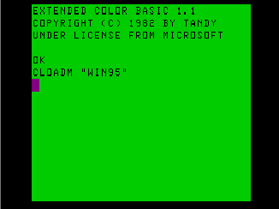
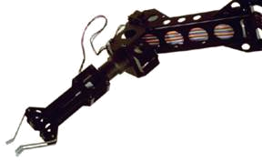
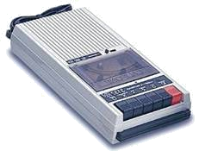
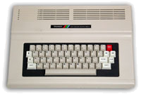

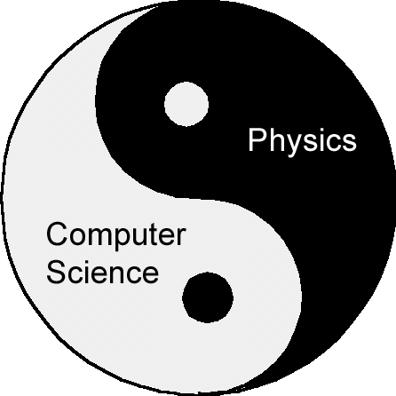

Quantum Computing in 2020
f
G
S
Dave Bacon
Santa Fe Institute

Slide 3
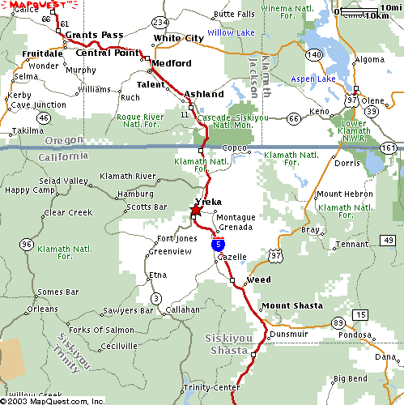
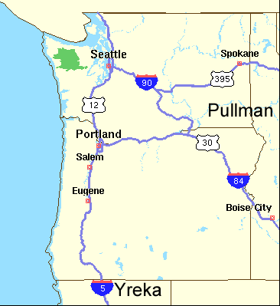
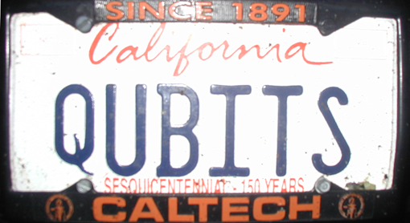
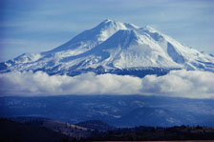
Apologies

Slide 4
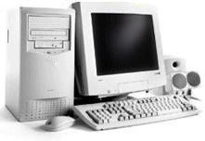
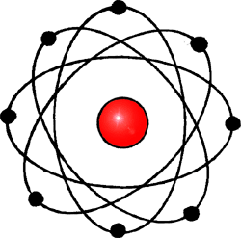
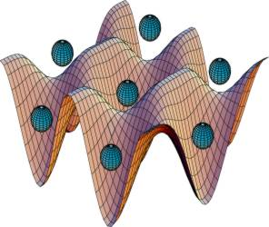
20th Century Reduced Redux
Quantum
Computation
Computation
Physics
exponential growth of digital computing power combined with the rise of software
elucidation and verification of
laws describing how nature
operates

Slide 5
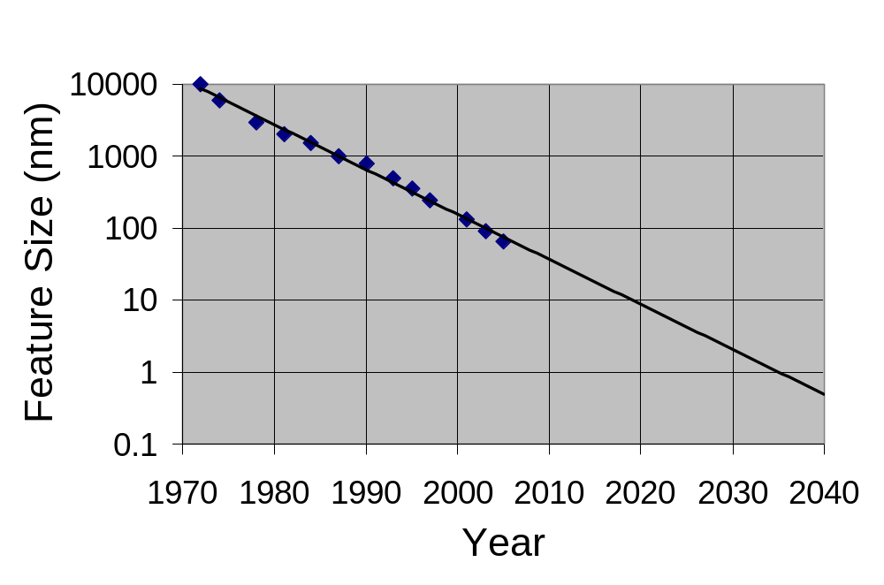
The Future
Computer Chip Feature Sizes
Eukaryotic cells
Mitochondria
AIDS virus
Amino acid
Quantum Theory
Meets
The Future of Computing
The Past of Physics

Slide 6
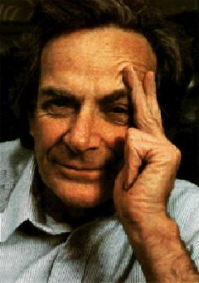
Plenty of Time, Right?
“How can we simulate quantum mechanics?...
Can we do it with a new kind of computer…a quantum computer?…It’s not a Turing machine but a machine of a different kind.” (1981)
“Perhaps…we need a mathematical
theory of quantum automata…”
Yu Manin (Radio Moscow, 1980)
Richard Feynman
1980-1994: Computers operating according to quantum theory?
“A place where really distinguished older physicists
went to retire.” - Robert Calderbank

Slide 7
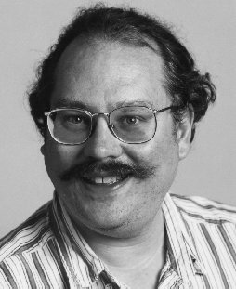



A Shocking Discovery
1994: A quantum computer can efficiently
factor integers (breaking an important
cryptosystem)
digit integer
188198812920607963838697239461650439807
163563379417382700763356422988859715234
665485319060606504743045317388011303396
716199692321205734031879550656996221305
168759307650257059
Peter Shor
3980750864240649373971
2550055038649119906436
2342526708406385189575
946388957261768583317
4727721461074353025362
2307197304822463291469
5302097116459852171130
520711256363590397527
Best classical algorithm
takes time
Shor’s algorithm takes
time

Slide 8
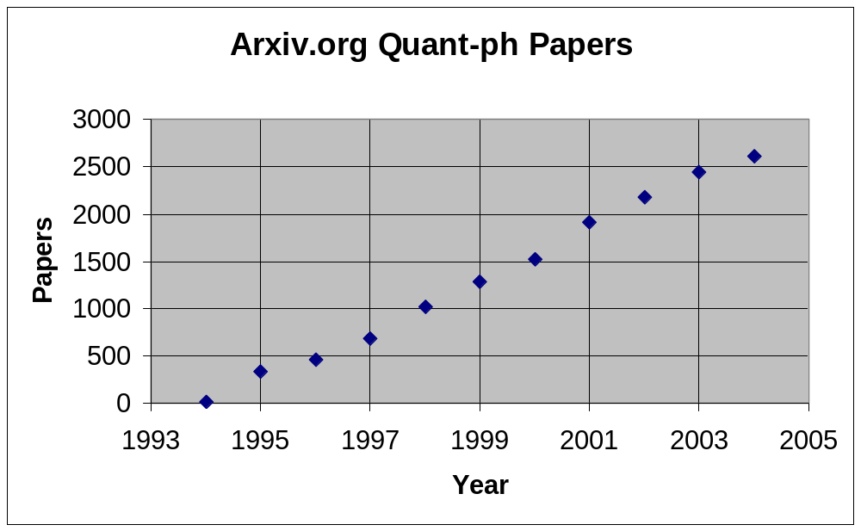
Boom!
Comparison
2004 quant-ph: 2606
2004 hep-th: 3357
(string theory)
2004 cond-mat: 8961
Quantum Information Science
Every single information processing task should be
reexamined in light of quantum theory

Slide 9
Quantum Information Science
Quantum
Theory
Computer Science
Physics
Building a
Quantum Computer
Quantum
Cryptography
Quantum
Algorithms
Physical Quantum Error Correction
Quantum
Error Correction
Quantum
Computational
Complexity
Quantum
Devices
Quantum
Information Theory
Quantum
Entanglement

Slide 10
Where Do You Want To Go
Tomorrow?
This Talk:
What will quantum information science look like in 2020?
Two and Half Hard Questions:
How will we build a quantum computer?
What gives a quantum computer its power and how
can we exploit this to find new quantum algorithms?

Slide 11
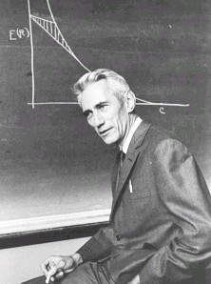
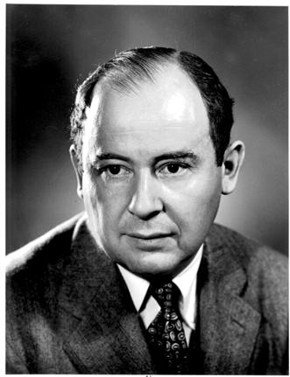
To Build a Quantum Computer
Classical
Problem (1938): How to build a reliable system from
unreliable components?
“A mathematical theory of communication” (1948)
How to communicate in the presence of noise
“Probabilistic logics and the synthesis
of reliable organisms from unreliable
components” (1956)
Claude
Shannon
How to compute when the subsystems
of your computer can fail?
John
von Neumann

Slide 12
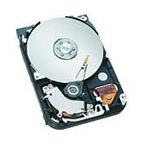
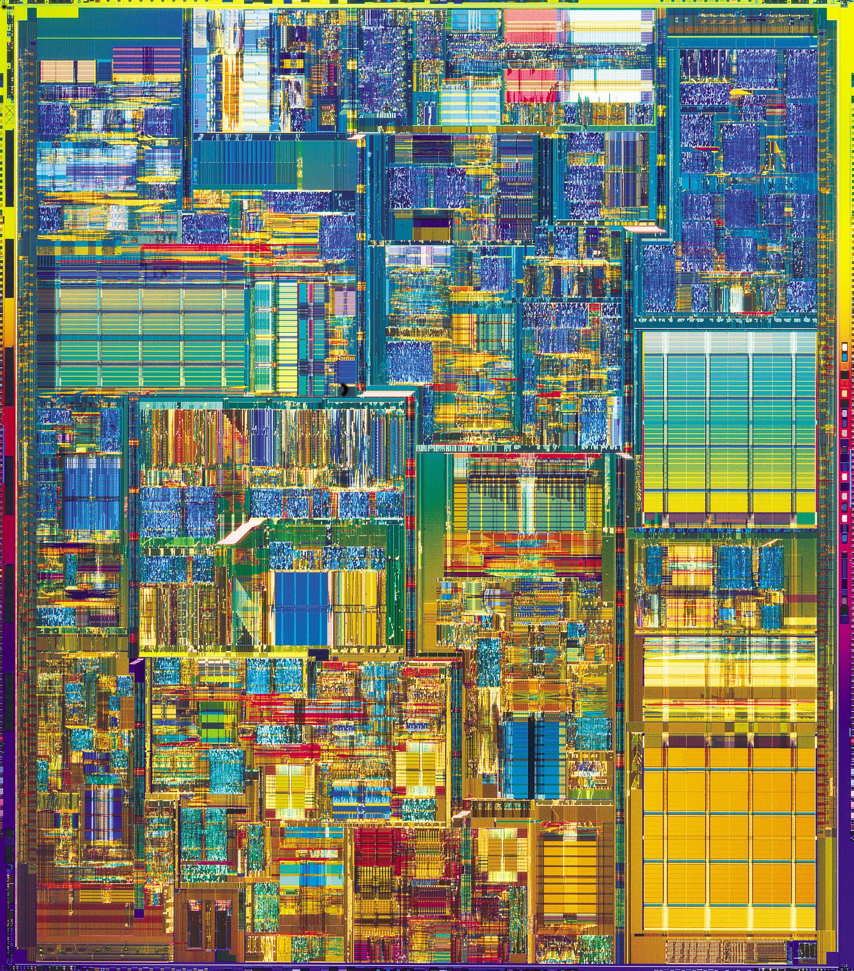
No Need for Theory?
Inventions which led to the computer revolution:
Integrated Circuit
Hard Drive
The physics of these devices enacts the methods of the
theory (von Neumann and Shannon)!

Slide 13
Two Paths
Hard Drive
Integrated Circuit
Coding: majority vote of
magnetism
Coding: majority vote of
current
Error correction: local energy
minimization
Error correction: amplification
Fault-tolerance: macroscopic
applied field fixed by
local energy minimziation
Fault-tolerance: conducting / insulating phase
transition

Slide 14





To Build a Quantum Computer
Quantum Computer: Information is now quantum.
probabilistic bit:
p% 0, 1-p% 1
qubit:
n qubits:
Evolution is now quantum
Schrödinger equation, i.e. unitary evolution
Measurement is now quantum
Probability of observing bitstring is
ANALOG? (Compare Digital)

Slide 15

Even Worse!
Problems:
Real quantum systems are open quantum systems
system
system
evolution
environment
evolution
system-
environment
evolution
environment
“system decoheres”
pure state
mixed state
system evolution
is no longer unitary!
Real quantum experiments have finite precision
Perfect unitary evolution is a fiction.
Measurements are faulty. Preparation is imperfect.

Slide 16




Solutions
Observations:
Quantum information can be encoded
span a subspace of some Hilbert space
Quantum error correcting codes
encode
diagnose
error
fix
error
encoded
quantum
information
entropy dump
Quantum equivalent to Shannon’s noisy coding

Slide 17
Quantum Threshold Theorem
Threshold Theorem:
[Aharanov, Ben-Or, Shor, Zurek, Knill, Laflamme, Kitaev, and Gottesman (95-96)]
If the error rate (decoherence or failure rate per operation) is
smaller than some p_{thresh}, then quantum computations of length
m can be enacted to accuracy ε at a cost of using a factor
O(log^{c}(mε⁻¹)m) more operations.
QC
Error Rate
Quantum computation is digital and is resilient to noise!

Slide 18
Whence Physics?
RANT
MODE
ON
Today: similar situation to early days of classical computation
(threshold theorems but no physics!)
What is the phase of matter corresponding to the computer?
There are distinct PHYSICAL and DYNAMICAL reasons why
robust classical computation is possible.
not all physical systems are equally good for computation
there exists systems whose PHYSICS guarantees
their ability to enact robust classical computation.
THE BILLION DOLLAR QUANTUM QUESTION:
Are there (or can we engineer) physical systems whose
PHYSICS guarantees robust quantum computation?

Slide 19

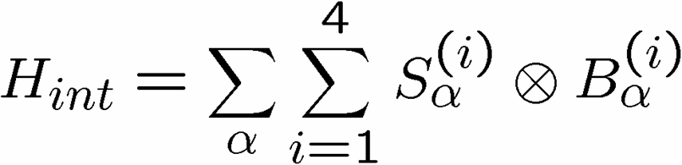
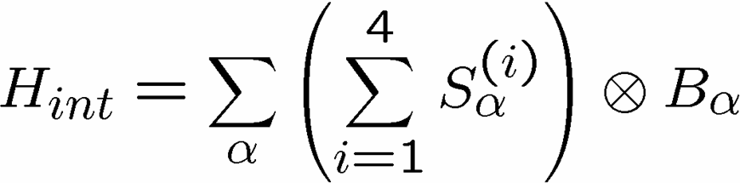
Decoherence-Free Subspaces
[Zanardi and Rasetti, Phys. Rev. Lett. 79, 1953 (1997)]
system
environment
Return to the physics of decoherence:
Suppose: posses a symmetry
Example:
environment cannot
distinguish between atoms
Then: it is often possible to find a subspace of the system
which decouples from the environment (decoherence-free)

Slide 20
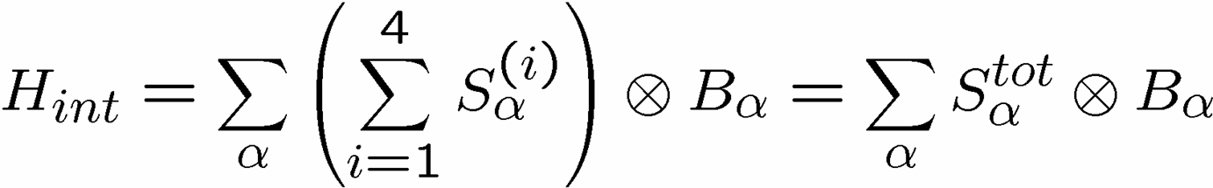
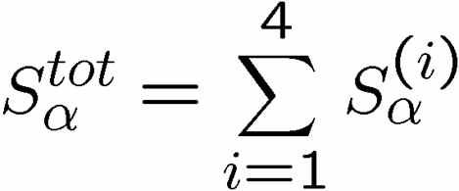







Collective Decoherence
Collective coupling to the environment:
addition of four spin
½ angular momenta
Spin 0 is two-fold degenerate
decoherence does not effect this 2 dimensional subspace
encode a single qubit into this system

Slide 21
Decoherence-Free
Quantum Computation
Symmetry breaking interactions enter at third order (robustness)
[Bacon, Lidar, and Whaley, Phys. Rev. A 60, 1944 (1999)]
experimentally verified with photonic qubits
[Altepeter et al, Phys. Rev. Lett. 92, 14 (2004)]
Alternative symmetric decoherence mechanisms
[Lidar, Bacon, Kempe, and Whaley, Phys. Rev. A 63, 022306 (2001)]
[Lidar, Bacon, Kempe, and Whaley, Phys. Rev. A 63, 022307 (2001)]
Combining with quantum error correcting codes
[Lidar, Bacon, and Whaley, Phys. Rev. Lett. 82, 4556 (1999)]
How to manipulate information encoded into a
decohrence-free subspace?

Slide 22




Encoded Quantum Computation
How to compute with encoded quantum information?
Want to manipulate encoded operations
  using realistic interactions
  not leave the protected subspace
Exchange: Hamiltonian between i and jth qubits
vector of Pauli
spin operators
exchange preserves the decoherence-free subspace

Slide 23
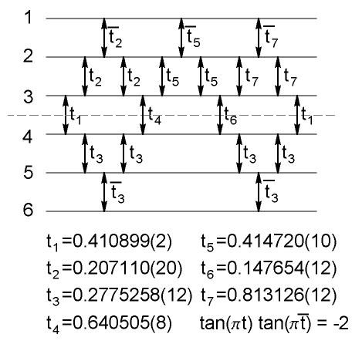
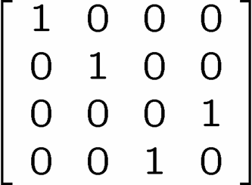

Universal Quantum Computation
Exchange alone can be used to perform any quantum computation
[Bacon, Lidar, and Whaley, Phys. Rev. Lett. 85, 1758 (2000)]
[DiVincenzo, Bacon, Kempe, Burkard, and Whaley, Nature 408, 339 (2001)]
[Kempe, Bacon, Lidar, and Whaley, Phys. Rev. A 63, 042307 (2001)]
encode into decoherence-free subspace (or subsystem)
Controlled Not Gate
1st encoded
qubit
2nd encoded
qubit

Slide 24
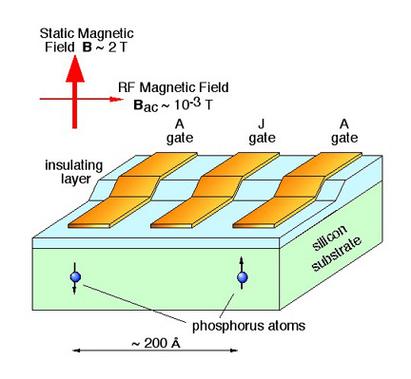
Encoded Universality
[DiVincenzo, Bacon, Kempe, Burkard, and Whaley, Nature 408, 339 (2001)]
[Bacon, Kempe, DiVincenzo, Lidar, and Whaley, Proc. Int. Conf. on Exp. Imp.
of Quant. Comp. Sydney, Australia (2001)]
[Kempe, Bacon, DiVincenzo, and Whaley, Quant. Inf. & Comp. 1, 33 (2001)]
Turn given interactions into a universal quantum computer
by using encoded information
Kane Model
[Kane, Nature 393, 133 (1998)]
~0.1 meV
exchange interaction
single qubit gates not needed

Slide 25
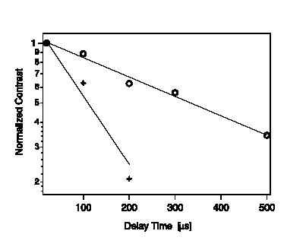
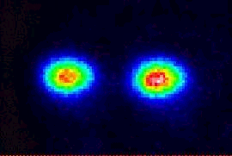
What’s Missing?
[Kielpinski et al Science 291, 1013 (2001)]
DFS
NIST ion trap
quantum computing
non-DFS
Physics Helped, but we need more help from physics…..

Slide 26








Energetics of Decoherence
system
environment
Perturbative regime:
Perturbative regime: decoherence conserves system and
environment energy.
cooling
heating
dephasing
by cooling environment we can eliminate heating

Slide 27
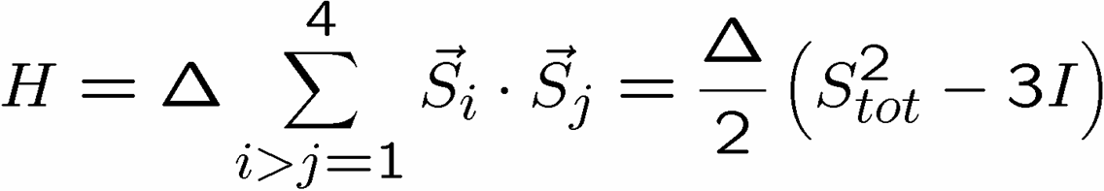


Exchange Everywhere
Can we engineer systems which turn
dephasing/cooling → heating?
1
2
4
3
S_{tot}=2
Energy
S_{tot}=1
S_{tot}=0
ground state is a decoherence-free subspace
Encode quantum information into ground state

Slide 28
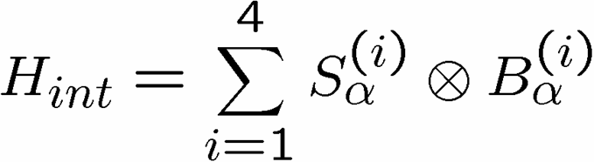


Supercoherence
[Bacon, Brown, and Whaley, Phys. Rev. Lett. 87, 247902 (2001)]
Independent coupling of system to environment
S_{tot}=2
all single qubit interactions on
this system are of heating
(ground state is quantum error
detecting code)
S_{tot}=1
S_{tot}=0
never cause transitions on encoded space
All first order decoherence processes suppressed

Slide 29
The Path to 2020
Hard Drive
Integrated Circuit
QC
Error Rate

Slide 30





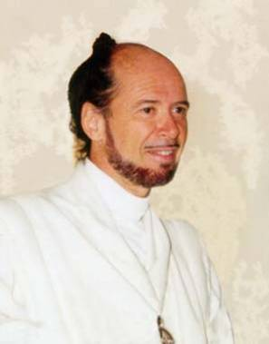



No Quantum Transistor
Quantum Cloning Machine
[Wootters and Zurek, Nature, 299, 802 (1982)]

Slide 31






The Physics Guarantee
Classical Ising model:
one dimension
two dimensions
Redundancy code:
Order parameter: total magnetization
Information “still there”
1D memory bad
2D memory good

Slide 32

















Self Fixing
Excitations point-like
disordering entropy >> energy
Excitations string-like
Energy grows like perimeter
disordering entropy << energy

Slide 33
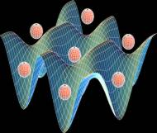
Self-Correcting Quantum
Computers
YY
XX
Quantum many-body systems which have
excitations which are string-like and are
self-correct, but into which we can encode
quantum information?
ZZ
XX
ZZ
YY
YY
ZZ
ZZ
XX
XX
YY
Q
coherence order parameter(s)
optical lattice
[Bacon, Ph.D. thesis, U.C. Berkeley 2001]
[Bacon, “Quantum Error Correcting Subsystems” in preparation]

Slide 34
Building a Quantum Computer
2020 Edition
traditional approach
self-correcting approach
control single quantum systems
engineer many body systems
control two qubit interactions
robustness guaranteed by
the physics of the device
scale up by adding more and
more qubits
scale down from large systems
to smaller
pay device complexity cost for
quantum error correcting
micro architecture
gain exponential number of
qubits with increasing
fabrication technology

Slide 35
Algorithms!
188198812920607963838697239461650439807
163563379417382700763356422988859715234
665485319060606504743045317388011303396
716199692321205734031879550656996221305
168759307650257059
Factoring is important because efficient
factoring algorithms break the most widely
used public key cryptosystem (RSA)
Peter Shor
What else can a quantum computer efficiently compute?

Slide 36

State of the Art
Quantum Algorithms
  Factoring, discrete log [Shor 94]
  Unstructured search [Grover 96]
  Various hidden subgroup problems [Long List]
  Pell’s equation [Hallgren 02]
  Hidden shift problems [van Dam, Hallgren, Ip 03]
  Graph traversal [CCDFGS 03]
  Spatial search [AA 03, CG 03/04, AKR 04]
  Element distinctness [Ambainis 03]
  Various graph problems [DHHM 04, MSS 03,…]
  Testing matrix multiplication [Buhrman,Špalek 04]
  …

Slide 37

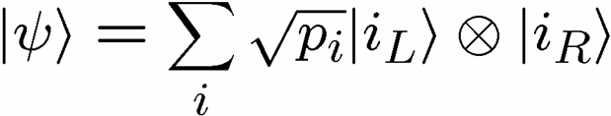
Algorithms and Entanglement
Recall: Two subsystem pure states can be separable:
or entangled, i.e.
Evidence now suggests that entanglement is an essential
component of the speedup offered by quantum computers
Entanglement has traditionally only been important for those
worrying about the foundations of quantum theory….no more!

Slide 38

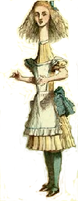
Bell’s Theorem
two quantum
subsystems
2. Separate
1. Interact and
entangle
BOB
ALICE
3. Measure
subsystem
3. Measure
subsystem
Bell’s Question: can we explain the measurement outcomes
by assuming there were variables (hidden) which were
carried by each subsystem?
Bell’s Answer: not for entangled quantum systems.
Note: correlations from entangled quantum systems cannot
be used to communicate between Alice and Bob.

Slide 39
Communication Complexity
How much (many bits) do Alice and Bob need to communicate
(worst case) in order to computer a joint function F(a,)B?
0
0
1
1
0
1
ALICE
? bits
BOB
a
b
0
1
0
1
0
0
1
1
1
0
F_{xor}(a,b)=a₁⊕a₂ ⊕ …⊕a_{n}⊕b₁⊕b₂ ⊕ …⊕b_{n}
No error: 1 bits

Slide 40
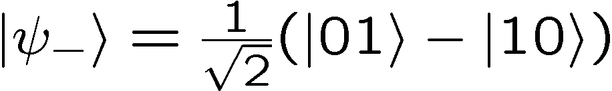
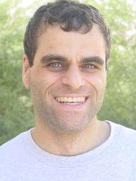
Quantum Communication
Complexity
? entangled bits (ebits)
plus
a
b
0
0
1
1
0
1
ALICE
? bits
BOB
There exist functions F(a,b) which require
Ω(m^{1/4} log⁻¹(m)) bits of communication to
compute but can be computed using only
O(log(m)) bits and ebits [m is the input lengths]
Ran Raz
(1999)
Exponential gain of quantum over classical

Slide 41
Making Bell Useful
classical
correlations
quantum
correlations
Bell’s Theorem
Bell’s Theorem divides classical from quantum, but does not quantify the power of quantum correlations.
Compare:
classical correlations
plus
b bits of communication
to
quantum correlations

Slide 42
Compare
two quantum
subsystems
2. Separate
3. Choose measurement
4. Get measurement outcome
3. Choose
measurement
4. Get measurement outcome
1. Interact and
entangle
BOB
ALICE
Share classical
correlations
2. Choose
measurement
2. Choose
measurement
data
data
0
0
1
1
0
1
4. Produce
measurement
outcome
03XSFW3331
03XSFGF111
4. Produce
measurement
outcome
3. Communicate b bits
BOB
ALICE

Slide 43




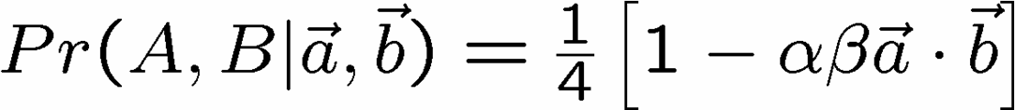
The Cost of One Ebit
measurement
direction
measurement
direction
BOB
ALICE
measurement
outcome
measurement
outcome
Quantum correlations:
How to produce these correlations without sending infinite
string describing measurement directions?

Slide 44

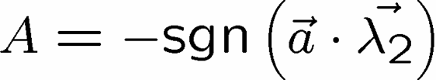
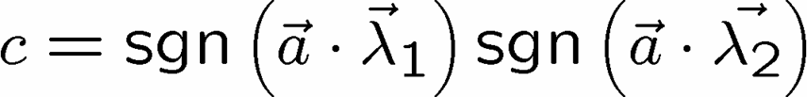
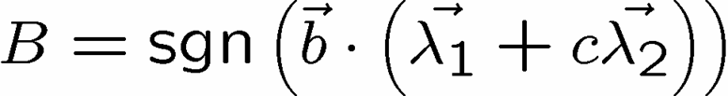
Surprise
[Bacon, and Toner, Phys. Rev. Lett. 90, 157904 (2003)]
[Toner and Bacon, Phys. Rev. Lett. 91, 187904 (2003)]
The Bell Experiment can be simulating using
classical correlations
plus
one bit of communication
1. Alice and Bob share two sets of perfectly classically
correlated unit vectors randomly distributed over all
directions:
2. Alice outputs
3. Alice sends a bit c to Bob
4. Bob outputs

Slide 45
Finiteness Conjecture
Conjecture: all multipartite entangled systems can be exactly
simulated by augmenting a classical correlations with
an amount of communication polynomial in the product
of the dimensions of the entangled subsystems.
projective measurements on two entangled qubits
[Toner and Bacon, Phys. Rev. Lett. 91, 187904 (2003)]
[Bacon and Toner, Phys. Rev. Lett. 90, 157904 (2003)]
all bipartite two outcome correlation observables
[Bacon and Toner, in preparation (2005)]
Pauli measurements on a n-party GHZ states
  [Tessier, Caves, Deutsch, Eastin, Bacon, quant-ph/ 0407133 (2005)]
average case with projective measurements on n ebits
    [Massar, Bacon, Cerf, Cleve, Phys. Rev. A 63, 052305 (2001)]
….

Slide 46
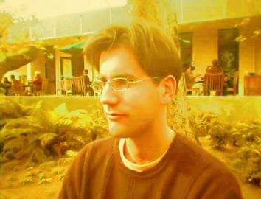
Back To Efficiency
Small entanglement implies there is an efficient
classical simulation.
[G. Vidal, Phys. Rev. Lett. 93, 040502 (2004)]
Guifre Vidal
Entanglement is necessary for a quantum speedup.
How does this influence how we use
quantum devices?

Slide 47



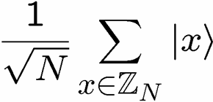



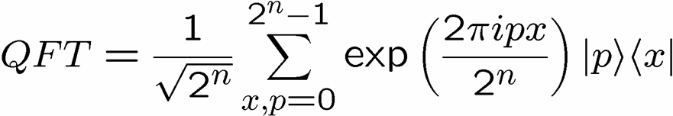
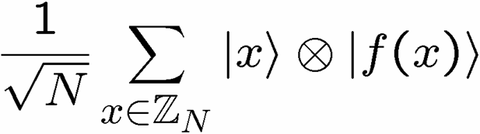
Factoring and Entanglement
Factoring can be reduced to period finding.
period=r
measure and use to find r
highly entangled basis

Slide 48

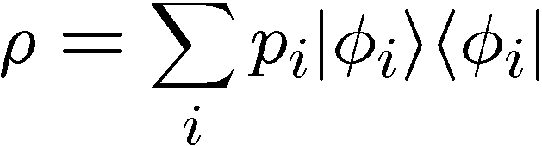

Spectrum Estimation
n copies of a d-dimensional unknown mixed state
we don’t know
Best method to estimate the p_{i}?
Try: Separate system measurements? (state tomography)
No: optimal measurement is to project onto entangled states
across all n subsystems

Slide 49




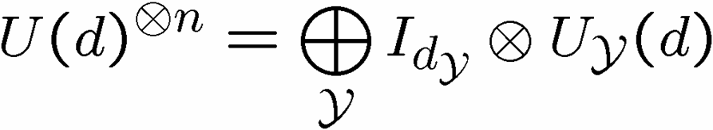
Schur Transform
entangled basis for best
estimating the spectrum
Measuring estimates spectrum
n=8
r₁=3
p₁≈3/8
r₂=2
p₂≈1/4
Young diagram of size n
r₃=2
p₃≈1/4
r₄=1
p₄≈1/8
How to efficiently implement as quantum circuit?

Slide 50
One Fell Swoop
Efficient quantum circuit constructions:
[Bacon, Harrow, Chuang, quant-ph/0407082, (2004)]
yields efficient quantum circuits for….
Spectrum Estimation
[Keyl and Werner, Phys. Rev. A 64, 052311 (2001)]
Quantum Hypothesis Testing
[M. Hayashi, J. Phys. A 35, 10759 (2002)]
Universal Quantum Source Coding
[M. Hayashi and K. Matsumoto, Quant. Inf. Comp. 2, 519 (2002)]
[M. Hayashi and K. Matsumoto, Phys. Rev. A 66 022311 (2003)]
Universal Entanglement Concentration
[M. Hayashi and K. Matsumoto, quant-ph/ 0209030 (2002)]
Communication Without a Shared Reference Frame
[S. Bartlett, et al, Phys. Rev. Lett. 91 027901 (2003)]

Slide 51
Future Algorithms
Problem: Fix a group G (known) and a subgroup
H⊆G (unknown). Given query access to a function
f : G → S that is constant and distinct on left cosets
of H in G. We say that f hides H. Identify H.
g_{m}H
f
g₃H
g₂H
g₁H
H
G
S

Slide 52
Hidden Subgroup Problems
Shor’s algorithm is an example of a HSP.
Efficient algorithms for the HSP over
an efficient algorithm
for graph isomorphism
the Symmetric group
the Dihedral group
an efficient algorithm for
poly(d)–unique shortest
vector in a lattice

Slide 53





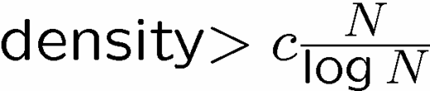
Phase Transition
Subset Sum Problem [NP-complete]
Given:
Problem:
Is there a subset of S which sums mod N to t?
classically efficiently solvable
1 to 1
Many to 1

Slide 54

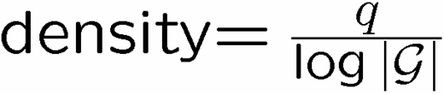
Dihedral HSP
[Bacon, Childs, van Dam, quant-ph/0501044 , (2005)]
Optimal measurement for
the Dihedral Hidden Subgroup Problem
q copies of hidden subgroup states
Optimal measurement is entangled measurement and…
p_{success}

Slide 55
2020
How to build a quantum computer? Use physics:
Attempt 1: Decoherence-free subspaces
passive
(discover encoded universality)
Attempt 2: Supercoherent Quantum Bits
use spectrum of few qubit systems
Attempt 3: Self-correcting Quantum Computers
jumpstart the quantum computer revolution?
Quantum algorithms? Entanglement matters:
Attempt 1: The Cost of Quantum Correlations
1 bit + classical = ebit experiment
Attempt 2: Schur Transform for Quantum Tasks
efficient quantum circuits
Attempt 3: Hidden Subgroup Problems
phase transitions and entangled measurements

Slide 56
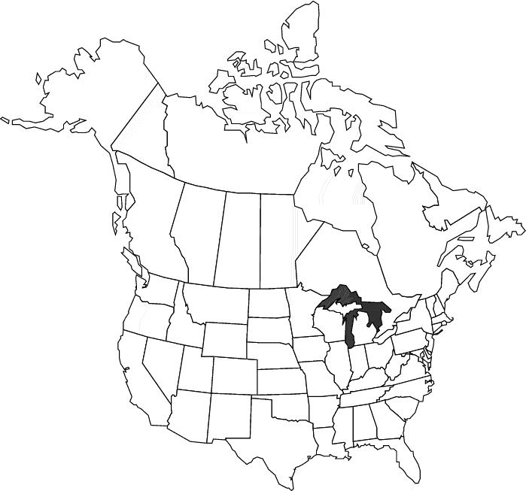


Collaborators
Univ. of Waterloo
Richard Cleve
MIT
Isaac Chaung
Kenneth Brown
Aram Harrow
U.C. Berkeley
K. Birgitta Whaley
Univ. of Toronto
Daniel Lidar
Stanford
Xinlan Zhou
IBM T.J. Watson
David Divencenzo
Guido Burkard
U.C. Santa Barbara
Wim van Dam
Univ. of New Mexico
Carl Caves
Ivan Deutsch
Brian Eastin
Tracey Tessier
Caltech
Andrew Childs
Debbie Leung
Benjamin Toner
Universit Libre de Bruxelles
Nicholas Cerf
Serge Masar
Univ. of Queensland
Michael Nielsen
Michael Bremner
Jennifer Dodd
Universite de Paris-Sud
Julia Kempe

