Slide 1

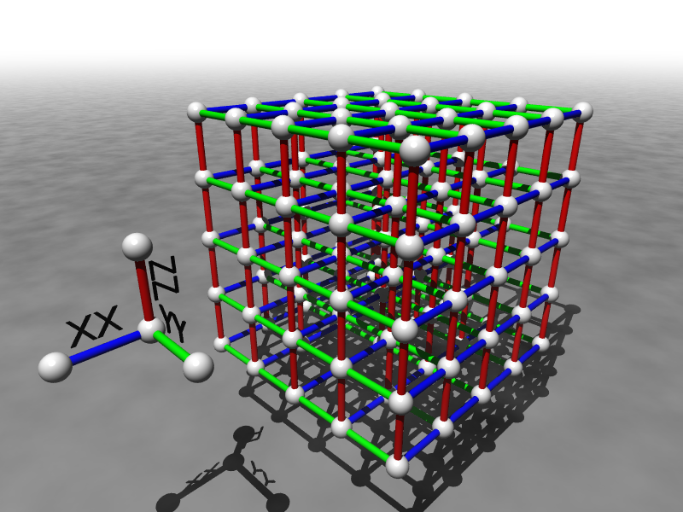
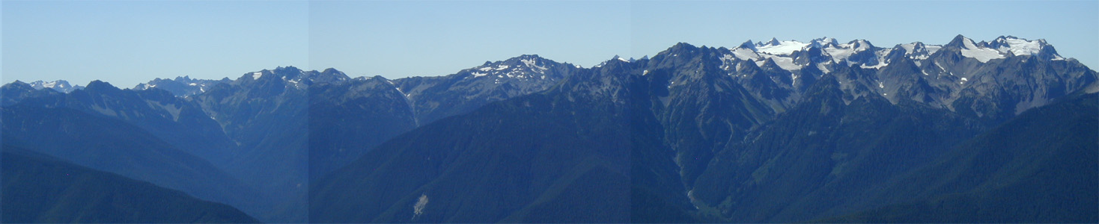
How to Build a
Quantum Computer
Dave Bacon
Department of Computer Science & Engineering
University of Washington, Seattle, WA

Slide 2
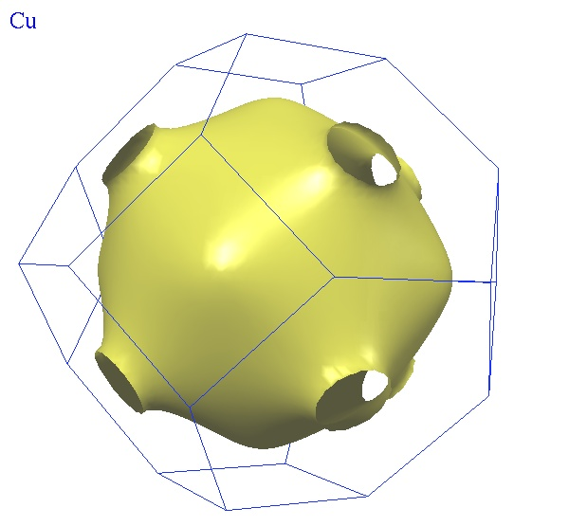
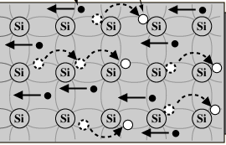
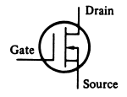
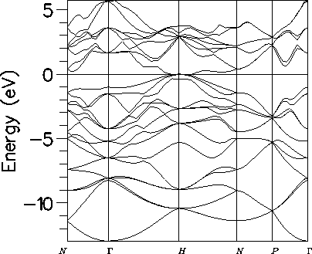
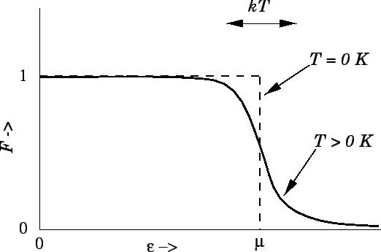
Behind the Bit
bits
noisy bits
quantum bits
deterministic
probabilistic
quantum

Slide 3
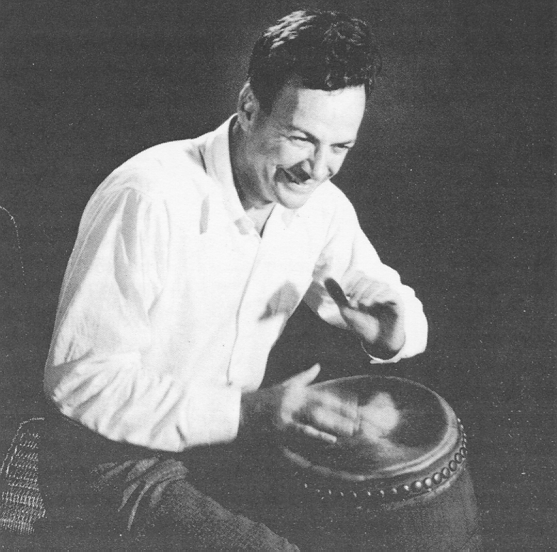
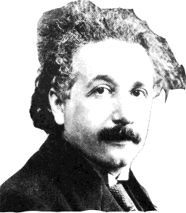
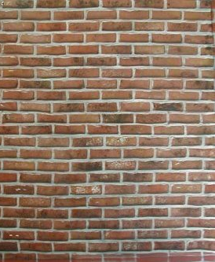
Quantum Computer?
“How can we simulate quantum mechanics? ...Can we do it with a new kind of computer… a quantum computer? It’s not a Turing machine but a machine of a different kind” - Richard Feynman (1981)
simulating
quantum
theory
Richard Feynman
0
1
0
?
?
?
?
?
?
1
1
0
?
?
?
?
?
?
0
1
1
?
?
?
?
?
?
deterministic
bit configuration
probability
of bit configuration
amplitude
of bit configuration
“real positive number”
“real number”
Probability =“square of real number”

Slide 4
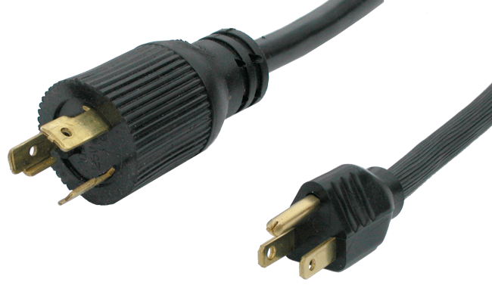
Subtracting Computers
Probabilistic
40%
5%
60%
0
0
0
0
60%
50%
95%
60%
40%
30%
1
1
1
1
50%
40%
70%
Quantum
1/√2
1/√3
-1/√2
0
0
0
0
1/√2
1/√2
√2/3
-1/√2
1/√2
1/√2
1
1
1
1
-1/√2
1/√2
1/√2
What Power These Negative Numbers?

Slide 5


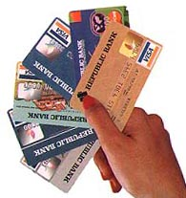
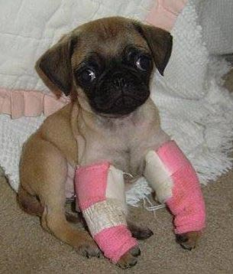
Quantum Computers!
18819881292060796383869723
94616504398071635633794173
82700763356422988859715234
66548531906060650474304531
73880113033967161996923212
05734031879550656996221305
168759307650257059
18819881292060796383869723
94616504398071635633794173
82700763356422988859715234
66548531906060650474304531
73880113033967161996923212
05734031879550656996221305
168759307650257059
3980750864240649373971
2550055038649119906436
2342526708406385189575
946388957261768583317
4727721461074353025362
2307197304822463291469
5302097116459852171130
520711256363590397527
Classical
Quantum
FACTORING
Public Key Cryptosystems
RSA
Diffie-Hellman
Elliptic Curves
BROKEN

Slide 6
Quantum Computers!
Quantum algorithms that offer speedups over classical algorithms
  Factoring, discrete log [Shor 94]
  Unstructured search [Grover 96]
  Pell’s equation [Hallgren 02]
  Hidden shift problems [van Dam, Hallgren, Ip 03]
  Graph traversal [CCDFGS 03]
  Spatial search [AA 03, CG 03/04, AKR 04]
  Element distinctness [Ambainis 03]
  Various graph problems [DHHM 04, MSS 03,…]
  Testing matrix multiplication [Buhrman,Špalek 04]
  Simulation of quantum systems
Applications to chemistry,
biology, material science….

Slide 7
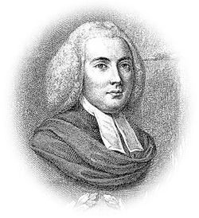

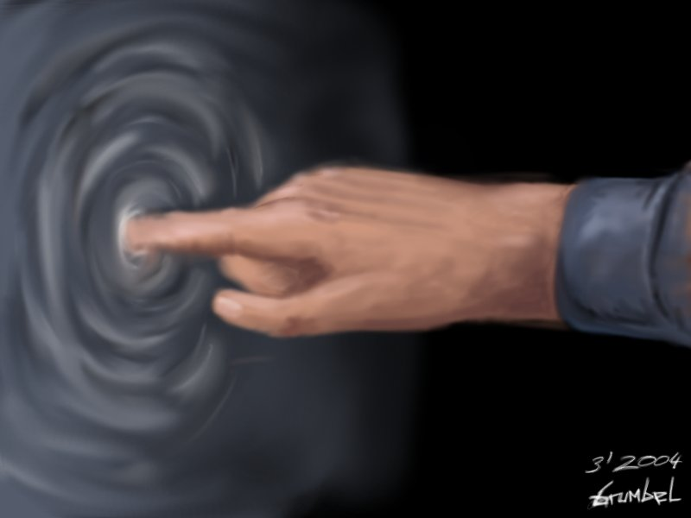
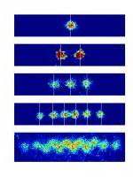
Why Aren’t All Computers Quantum?
No Information without Physical Representation!
Quantum information
environment
control
?
?
?
?
?
?
?
?
?
?
?
?
?
?
?
?
?
?
quantum
classical

Slide 8
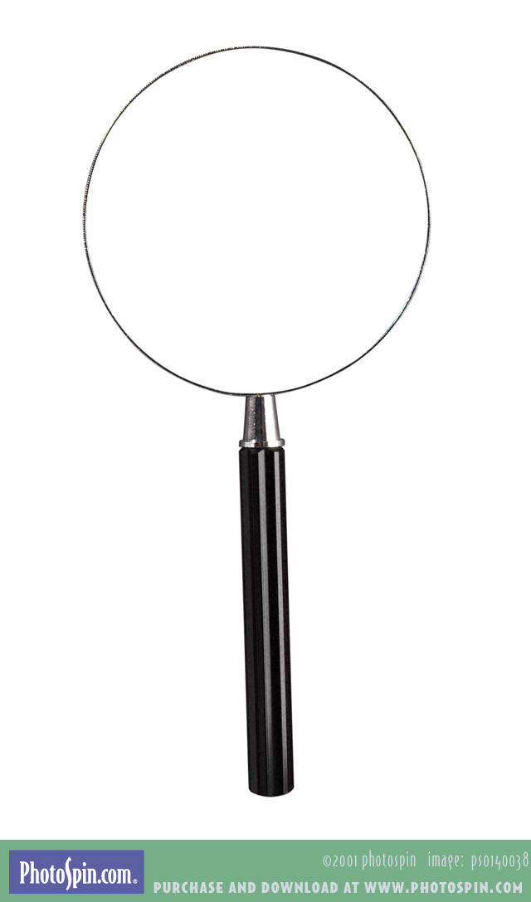

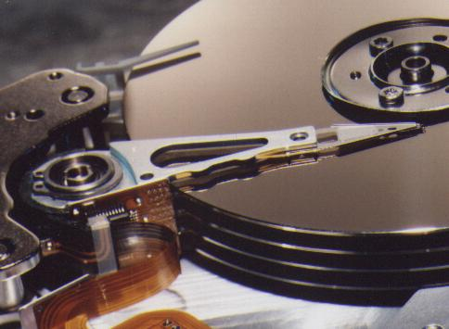
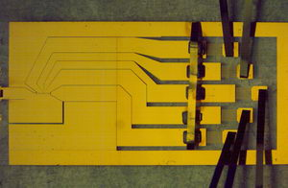
Why Aren’t All Computers Quantum?
No Information without Physical Representation!
Noisy classical
Robust classical
Noisy quantum
?
Robust quantum
NIST Boulder

Slide 9
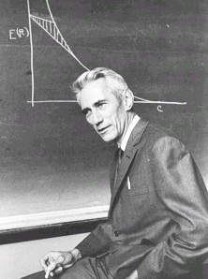
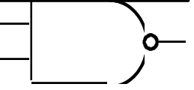
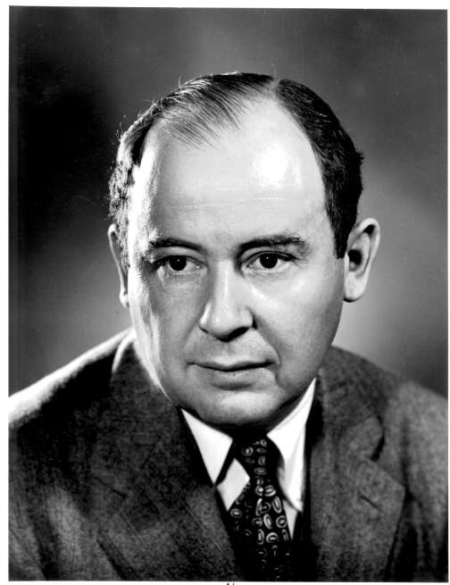
Classical Fault Tolerance….Theory
error correcting codes + fault tolerant construction
Redundancy to protect information against noise
Claude Shannon 1948
“A mathematical theory of communication”
M
John von Neumann, 1956
“Probabilistic logics and the synthesis of reliable organisms from unreliable components”
M
M
Preempt:

Slide 10

Quantum Threshold Theorem
QC
errosol
“decoherence”
“imprecision”
Threshold Theorem for Fault-Tolerant Quantum Computation
[Aharonov, Ben-Or, Knill, LaFlamme, Zurek,
Kitaev, Gottesman, Preskill, Shor, + others]
If noise is weak enough and control is precise enough, then a
quantum computation to a desired accuracy can be carried out
with an overhead polynomial in the log of the accuracy.

Slide 11
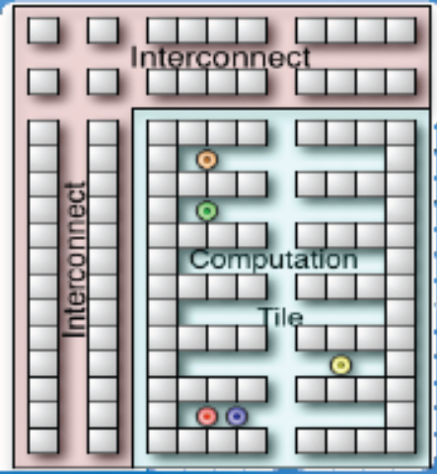
Turning Theorems Into Devices
Natural fault-tolerant
quantum computing
Quantum error
correcting architectures

Slide 12
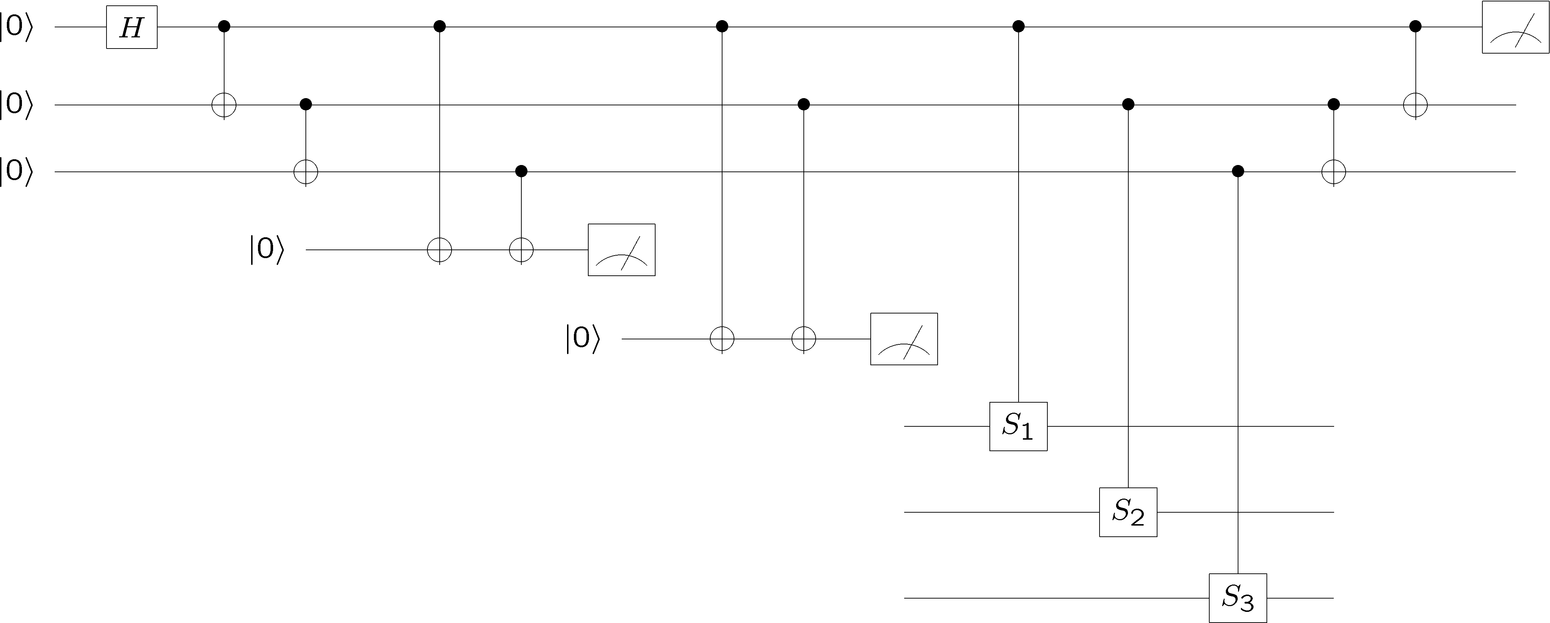
Quantum Architectures
Next few years = scaling to 10-100s of qubits
Abstract theory
How to build, optimize
Tool chain for
quantum architectures
Ion traps, Phosphorus donors in Silicon, Superconducting circuits,….

Slide 13
Naturally Fault-Tolerance
Physics of device responsible for robustness
Cooling = Error Correction
Duplicate for quantum devices?
ZZ
ZZ
XX
ZZ
ZZ
XX
XX
XX
XX
XX
XX
ZZ
ZZ
XX
ZZ
ZZ
XX
XX
XX
XX
ZZ
ZZ
ZZ
ZZ
ZZ
ZZ
ZZ
ZZ
XX
XX
XX
XX
ZZ
ZZ
XX
ZZ
ZZ
XX
XX
XX
XX
XX
XX
ZZ
ZZ
XX
ZZ
ZZ
Leapfrog to robust devices?

Slide 14
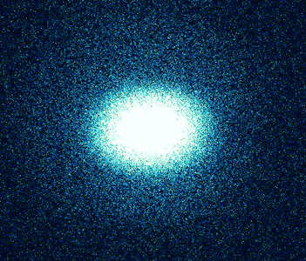
Quantum Computing at UW
| ⟩
QW
group
Dave Bacon (CSE)
Quantum Architectures
Ion Trap
Quantum Computers
Mark Oskin (CSE)
Boris Blinov (Physics)

Slide 15



How to Build a
Quantum Computer
Funded by:

