Slide 1
This Page Left Unintentionally Blank

Slide 2




Quantum Error Correcting Subsystem Codes
and Fault-Tolerant Quantum Computing
Dave Bacon
Department of Computer Science & Engineering
University of Washington, Seattle, WA
Andrea Casaccino
Department of Information Engineering
University of Siena, Italy
Funded by:

Slide 3
Talk Design Strategy
Ramping Up

Slide 4
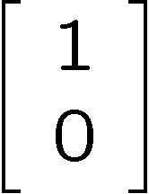
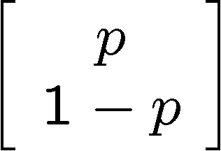
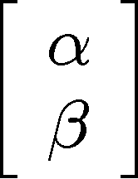


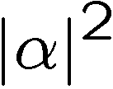
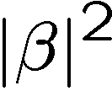
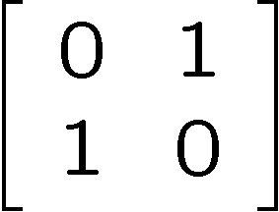
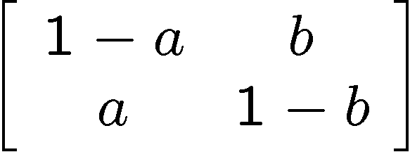
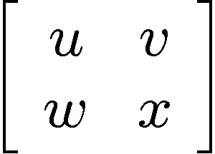
Bit, Pbit, and Qubit
bit
probabilistic bit
quantum bit
Configurations:
0
1
0
1
0
1
Description:
Observation:
0
certainty
0
p percent
0
percent
1
1-p percent
1
percent
Evolution:
deterministic
stochastic
unitary

Slide 5
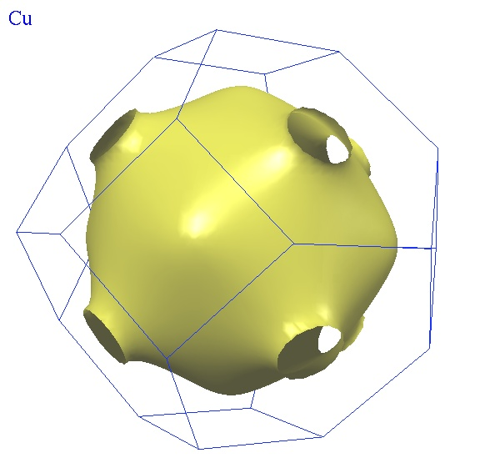
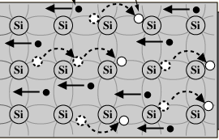
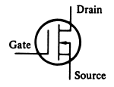
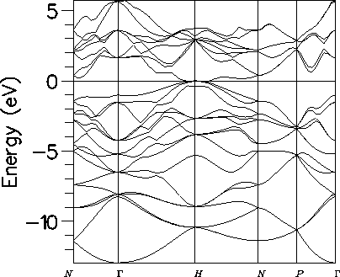
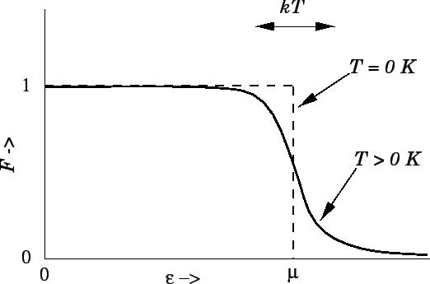
There Are No Bits
bits
pbits
qubits

Slide 6
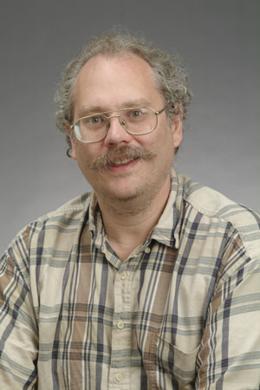
Quantum Computers
18819881292060796383869723946165043
98071635633794173827007633564229888
59715234665485319060606504743045317
38801130339671619969232120573403187
9550656996221305168759307650257059
3980750864240649373971
2550055038649119906436
2342526708406385189575
946388957261768583317
4727721461074353025362
2307197304822463291469
5302097116459852171130
520711256363590397527
1994
Quantum computers can efficiently factor whole numbers (and compute discrete log.)
No known classical efficient algorithm.
Breaks RSA, Diffie-Hellman cryptosystems.
Peter Shor

Slide 7

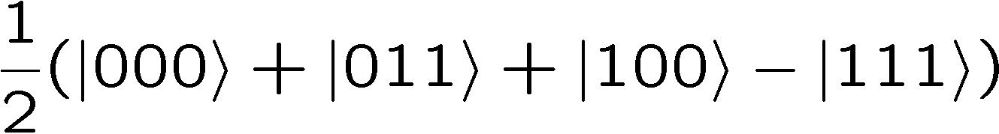


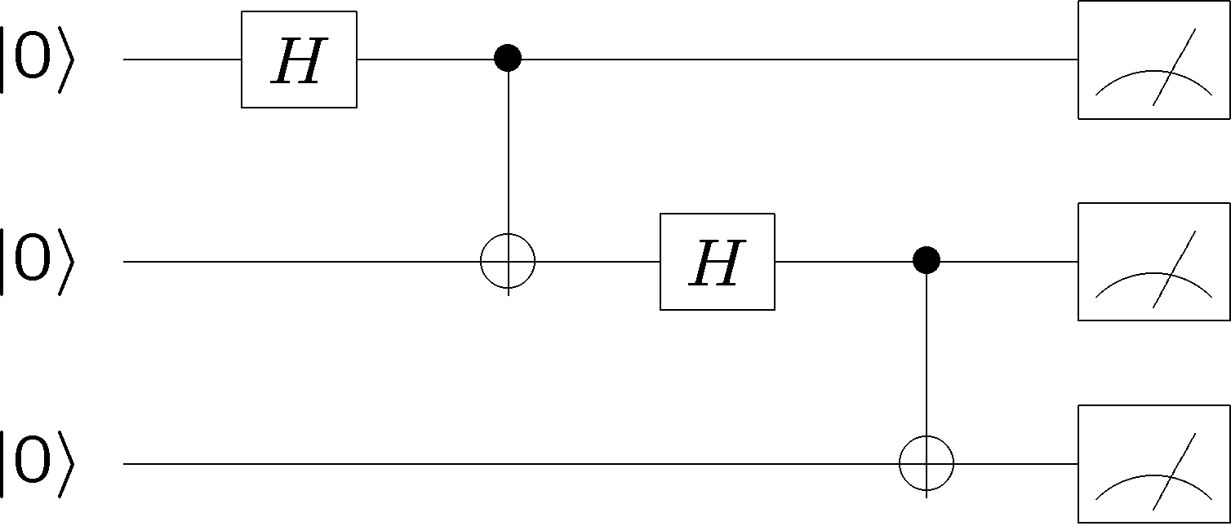
Dreamboat Quantum Computer
qubits
Quantum algorithm
1. Initialize
2. Series of unitary gates
3. Measurement

Slide 8
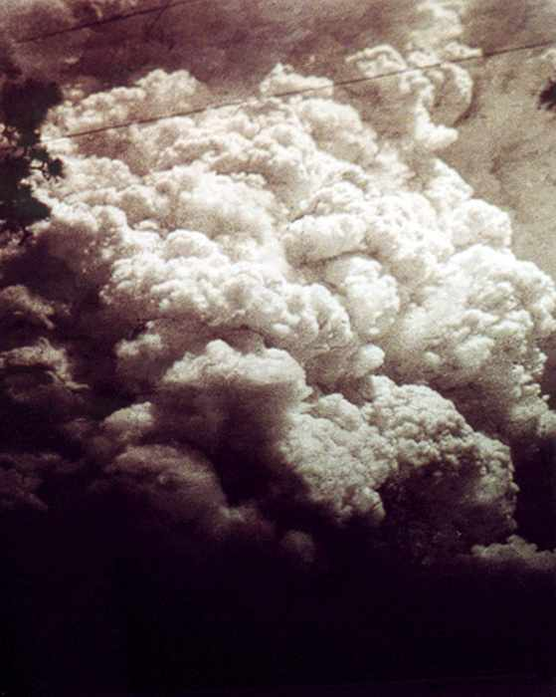
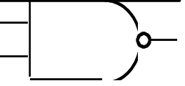
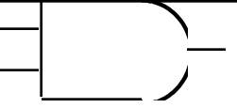
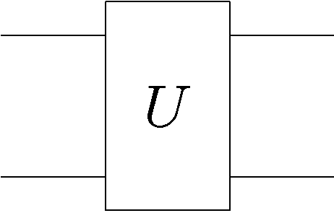
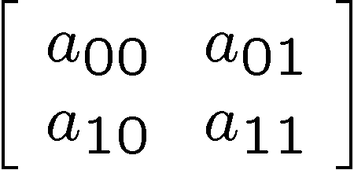
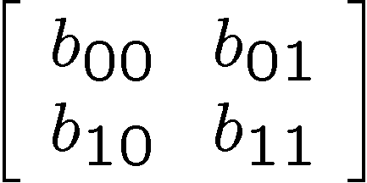
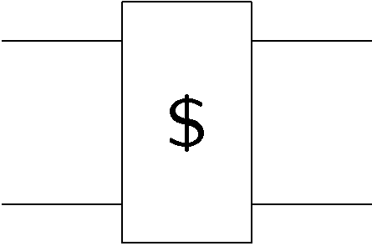
Fragile
Classical Noise
Classical Faults
0
Quantum Noise
Quantum Faults

Slide 9
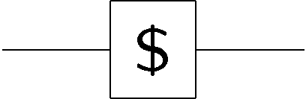
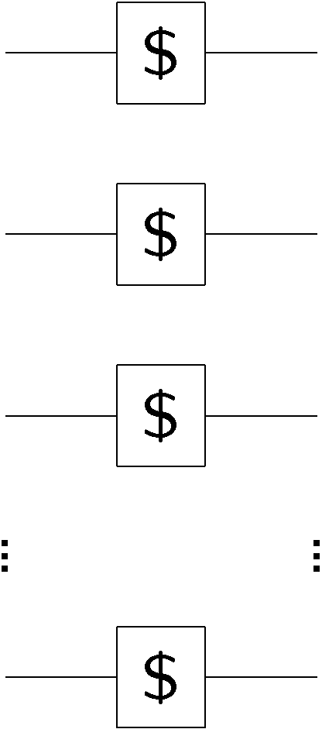
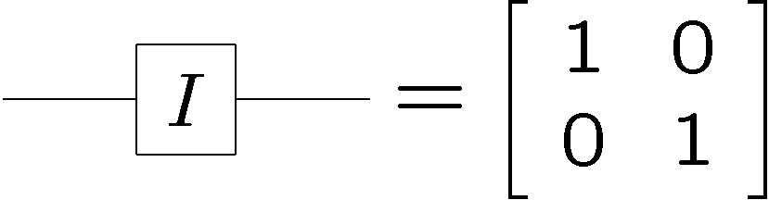
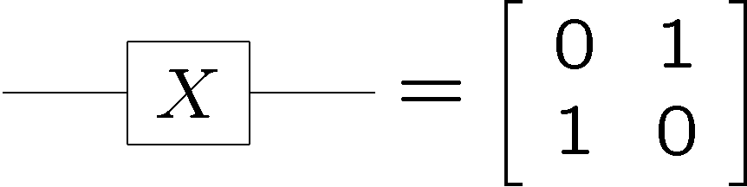
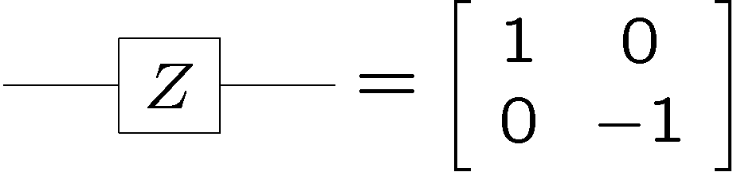
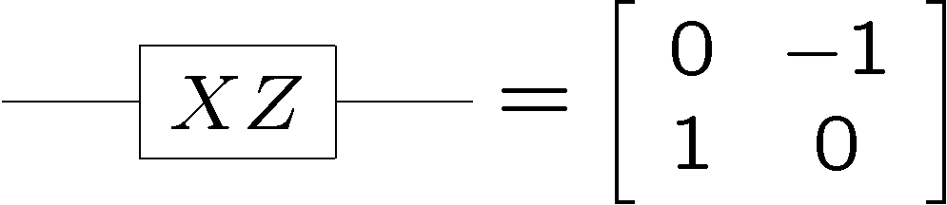
Reasonable Quantum Error Model
basis for errors
independent error
model
transition amplitude for each error

Slide 10
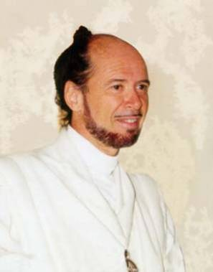




Reason’s To Be Pessimistic, 1994
No cloning:
Quantum Cloning Machine
No quantum repetition code:
Measurement destroys coherence:
How can one decode without destroying the information?

Slide 11
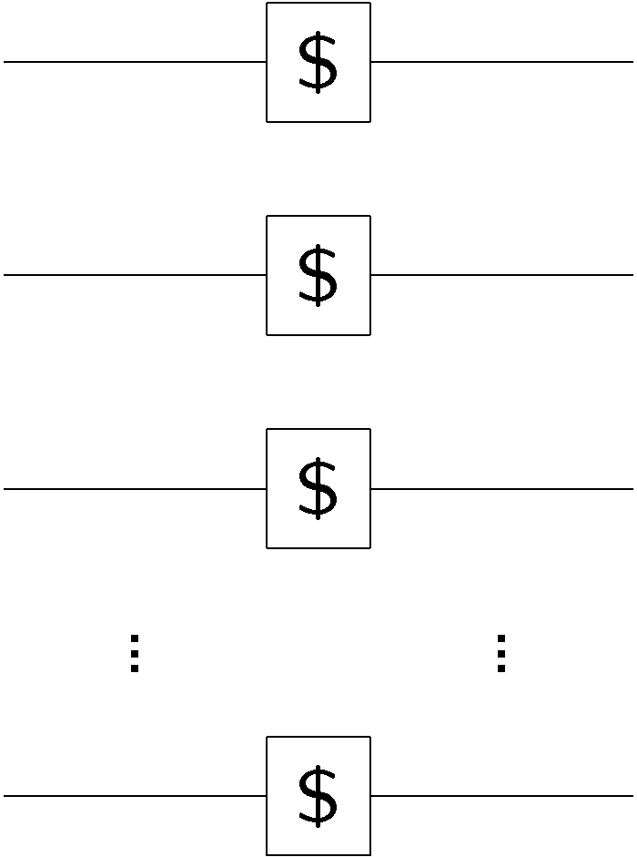

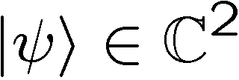
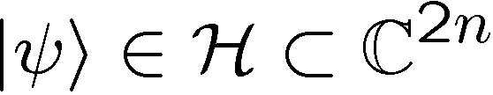
Reason’s To Be Optimistic, 1994
Encode
Decode
Encode into a subspace of n qubits
Possible to design encoding/decoding such that any single qubit
error can be corrected: quantum error correcting code

Slide 12
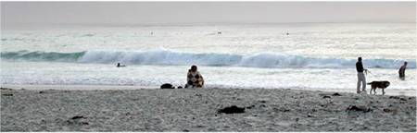


Shor’s Code
H
H
H
H
H
H

Slide 13
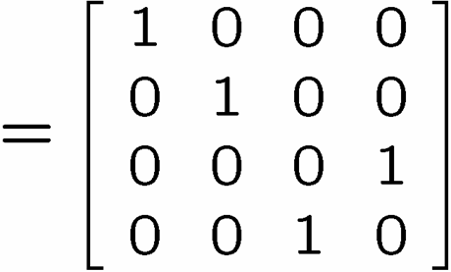



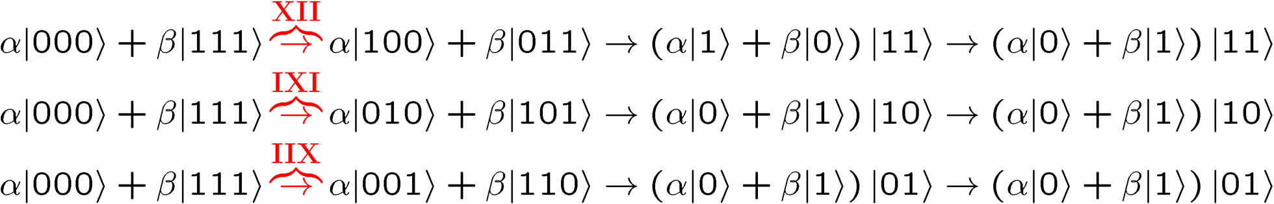
A Start
encode
error
decode fix
?
error
decode
fix
encoded into subspace:
2. errors take to orthogonal
subspaces + maintain orthogonality
3. syndrome
(no-cloning evaded!)

Slide 14


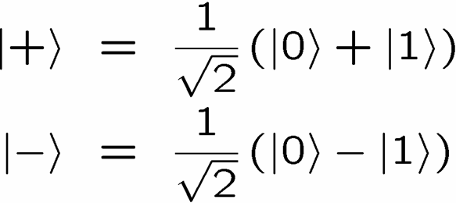
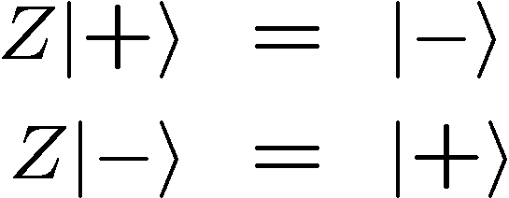


OK Wise Guy
Wise guy says “basis change please”:
looks like bit flit error in this new basis!
H
H
H
H
H
H
phase errors
bit flip errors

Slide 15
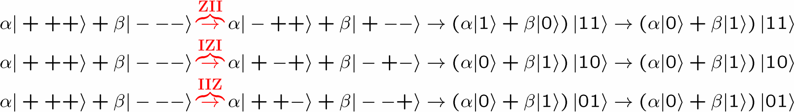
Molly: “I love you, I really love you”
Sam: “Ditto.”
encode
error
decode
fix
H
H
?
H
H
H
H
error
decode
fix
encoded into subspace:
2. errors take to orthogonal
subspaces + maintain orthogonality
3. syndrome
(no-cloning evaded!)

Slide 16
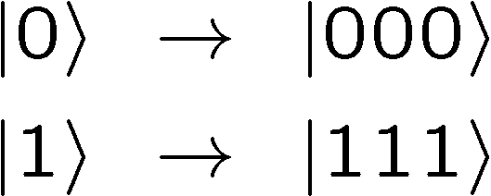
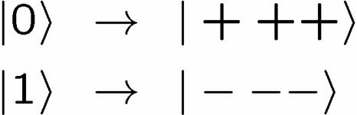


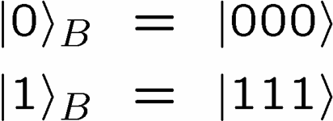
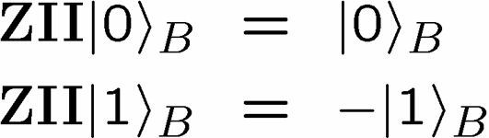
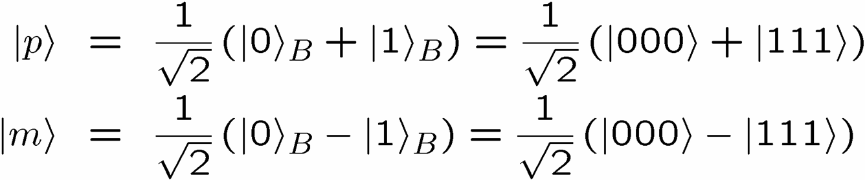
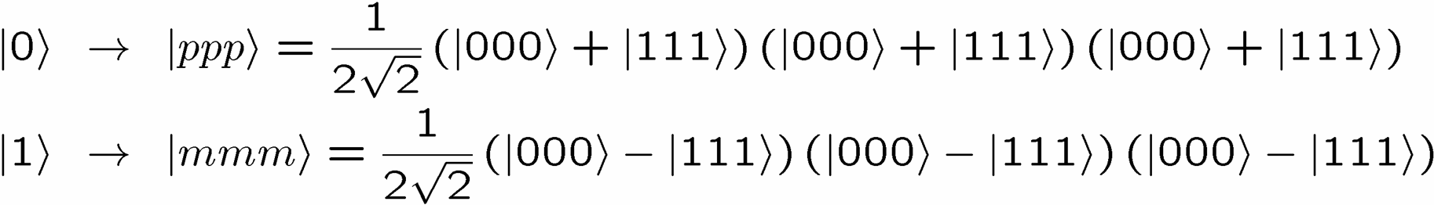
Encoding Away Your Ills
3 qubit bit flip code
3 qubit phase flip code
phase errors act as on bit flip code qubits:
define:
Shor Code: (Peter Shor, 1995)

Slide 17
Shor’s Code
H
H
H
H
H
H
bit flip code
phase flip code

Slide 18

Seminal Result
QC
errosol
“decoherence”
“imprecision”
Threshold Theorem for Fault-Tolerant Quantum Computation
[a partial list: Aharonov, Ben-Or, Kitaev, Knill, LaFlamme, Zurek, Shor, DiVincenzo, Gottesman, Preskill]
If decoherence (quantum noise) is weak enough and control
is precise enough,then a quantum computation to a desired accuracy
can be carried out with an overhead polynomial in the log of the
accuracy.

Slide 19
Threshold Theorems
TWO TYPES
provable and heuristic
ASSUMPTIONS
provably essential:
1. parallel operations
2. cold ancillas
3. error rates below 50% gate speed
4. ability to not leak or fix leaks
error model:
correlations (spatial and temporal)
quantum noise (single qubit, leakage, Markovian, etc.)
classical computation:
free fast robust classical computation?
architecture:
non-local gates, local gates
dimension of architecture
explicit architecture (scheduling, routing, etc.)
→Thresholds from 10⁻¹ to 10⁻⁸

Slide 20
Codes Better
For
Fault-Tolerance?

Slide 21






Subspaces Versus Subsystems
The most general way to encode quantum information is into
subsystem (not subspaces)
two qubits
encode a qubit in a subspace
encode a qubit in a subsystem
generic subsystem:

Slide 22





Subsystem Error Correction
Only need to protect subsystem,
not full subspaces.
encoding
subsystem
error
recovery
encoded quantum
information
recovery need not perfectly restore system, but only
preserve information encoded into subsystem.

Slide 23









Shor Stabilizer
Quantum version of parity check matrix
Stabilizer generators:
Define subspace:
Logical operators:

Slide 24
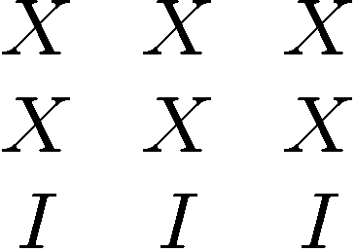
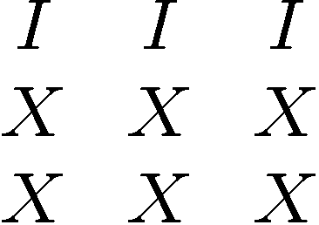
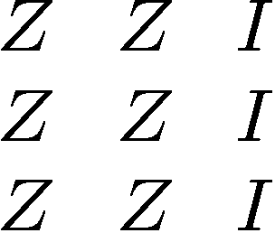
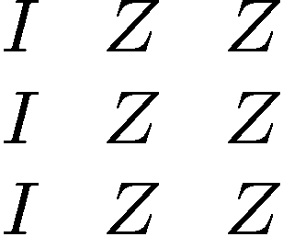
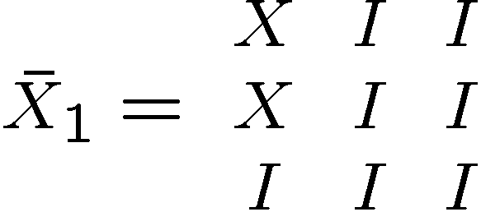









Shor Redux
Stabilizer generators:
Encodes 9-4=5 qubits of information
Logical operators:
[Bacon, Phys. Rev A, 73, 012340]

Slide 25



Seen This Before
Measuring +1,-1 eigenvalue of
determines whether the number of phase flips in each row is
even or odd
Measuring +1,-1 eigenvalue of
is just like a simple redundancy code for this even/odd info
[Bacon, Phys. Rev A, 73, 012340]

Slide 26
Subsystem Code
Stabilizer generators:
plus encoded Z operators
generate all even number of Z’s per row
Measuring +1,-1 eigenvalue of
Fix modulo this group
i.e. do nothing to 5th
encoded qubit!
[Bacon, Phys. Rev A, 73, 012340]

Slide 27


Quantum Compass Model
ZZ
ZZ
XX
XX
XX
ZZ
ZZ
XX
XX
XX
ZZ
ZZ
Was studying because I wanted to build a naturally fault-tolerant
quantum system (physics enforces robustness.)
But had implications for fault-tolerance!
Aliferis and Cross, in prep (2006, soon!), have shown that
these codes can move threshold a factor of 10 better.

Slide 28
Generalized Shor Subsystem Codes
Two classical codes: C₁=[n₁,k₁,d₁] and C₂=[n₂,k₂,d₂]
Quantum Shor subspace code [[n₁n₂,k₁k₂,min(d₁,d₂)]]
Number of stabilizers = (n₁-k₁)n₂+(n₂-k₂)
Quantum Shor subsystem code [[n₁n₂,k₁k₂,min(d₁,d₂)]]
Number of stabilizers= (n₁-k₁)k₂+(n₂-k₂)k₁
Same exciting ancilla savings as
Aliferis and Cross, in prep (2006)

Slide 29




Shor Subsystem Codes
Simpler error recovery routines
Better fault-tolerant properties
Useful for physicists in constructing physically robust qubits
theory
practice
Practical devices of information processing enact the ideas of
fault-tolerant classical computation in the physics of the devices.

Slide 30
Quantum Error Correcting Subsystem Codes
and Fault-Tolerant Quantum Computing
Dave Bacon
Department of Computer Science & Engineering
University of Washington, Seattle, WA
Andrea Casaccino
Department of Information Engineering
University of Siena, Italy
Funded by:

