Slide 1
This Page Left Unintentionally Blank

Slide 2
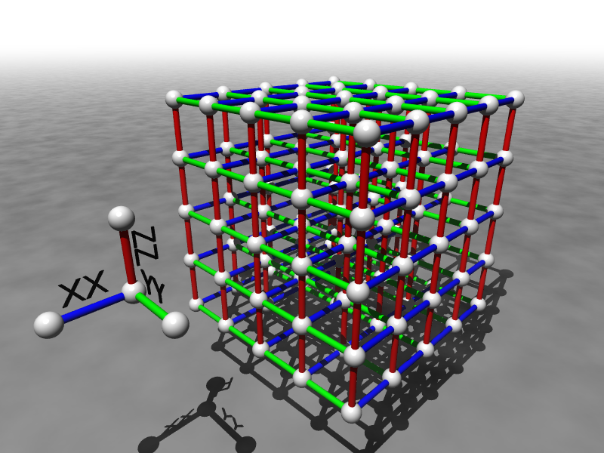


Self-Correcting Quantum Computers
Dave Bacon
funded by
Department of Computer Science & Engineering
University of Washington

Slide 3

My Mortal Enemy

Slide 4
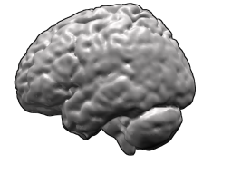
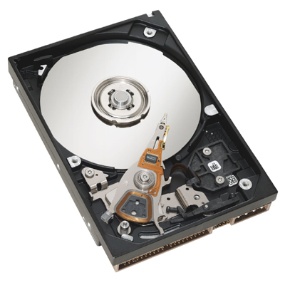
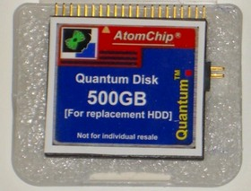

Success Stories
Life
Computers
How is it that nearly error free behavior can arise from
systems whose components are unreliable?
Robust Quantum Computers?

Slide 5

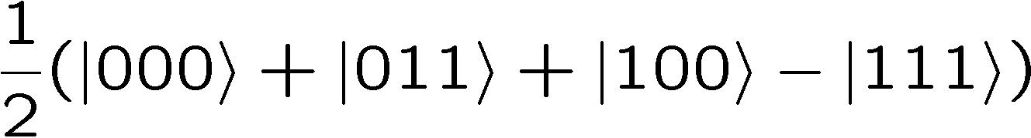


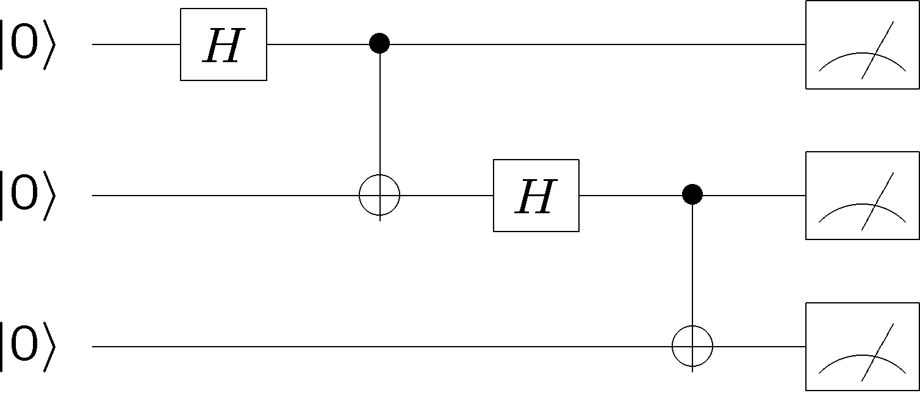
Dreamboat Quantum Computer
qubits
Quantum algorithm
1. Initialize
2. Series of unitary gates
3. Measurement

Slide 6
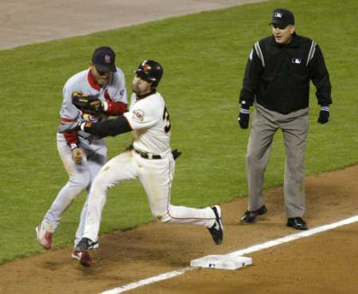


Obstructions
DECOHERENCE
Environment
Total Hamiltonian
System
system
environment
interaction
open quantum systems can become
entangled with their environment
coherent superposition
incoherent sum
FAILS

Slide 7

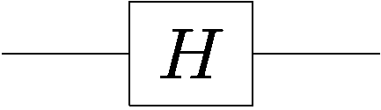

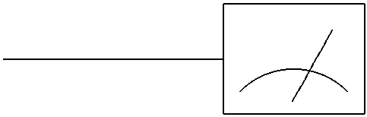

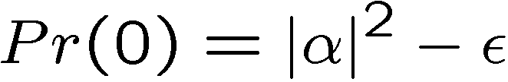

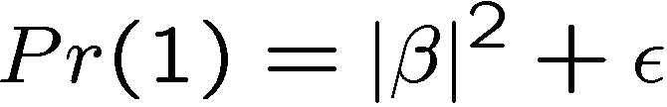
More Obstructions
FAULTY CONTROL
System
Controller
Imperfect state
preparation
FAILS
Imprecise or faulty unitary gates
FAILS
Imperfect
measurements
FAILS

Slide 8

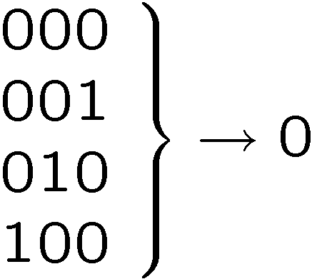






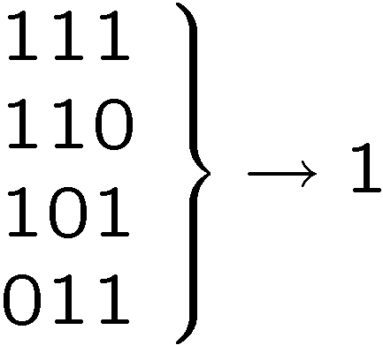
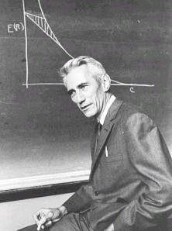
Classical Solutions
Probability of bit flip = p
Solution: redundancy
Probability of failure =3(1-p)p²+p³
=3p²-2p³
<p if p<1/2
Use redundancy to protect information against noise
Claude Shannon 1948
“A mathematical theory of communication”

Slide 9
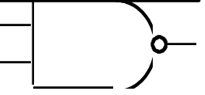
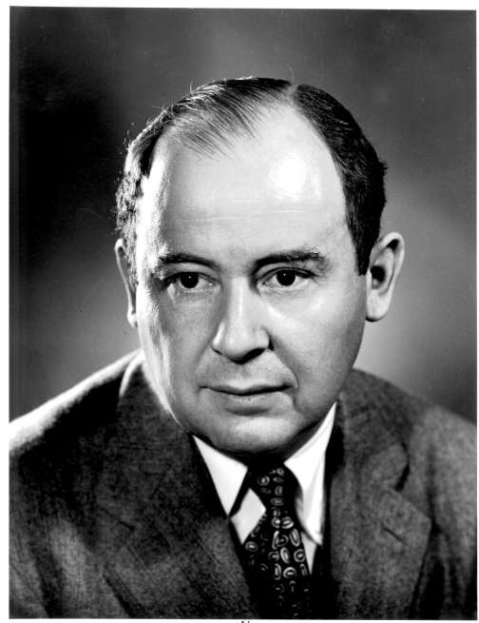
More Classical Solutions
Classical gates fail with probability p
Solution: error correcting codes + fault tolerant construction
M
John von Neumann, 1956
“Probabilistic logics and the synthesis of reliable organisms from unreliable components”
M
M

Slide 10

Wherefore Are Thou Quantum Computation?
QC
errosol
“decoherence”
“imprecision”
Threshold Theorem for Fault-Tolerant Quantum Computation
[Aharonov, Ben-Or, Knill, LaFlamme, Zurek,
Kitaev, Gottesman, Preskill, Shor, + others]
If noise is weak enough and control is precise enough, then a
quantum computation to a desired accuracy can be carried out
with an overhead polynomial in the log of the one over the error

Slide 11

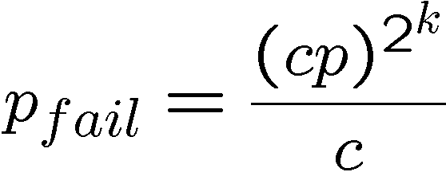
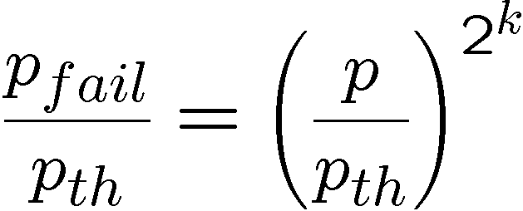
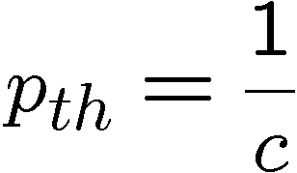
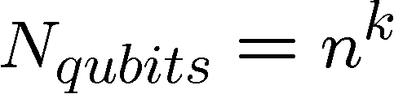
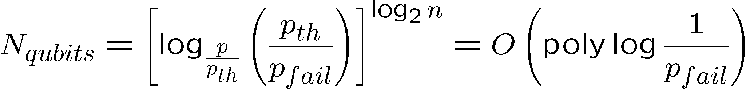
Perfection Through Concatenation
failure
probability
p
cp²
c(cp²)²
At k^{th} level of concatenation, probability of an error which
destroys the encoded quantum information is
and uses qubits

Slide 12
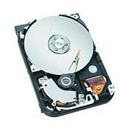
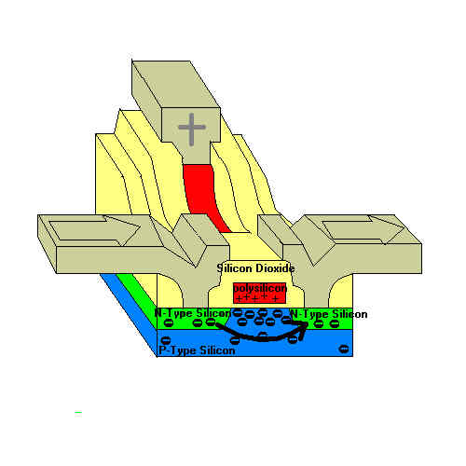
Back To Reality
theory
practice
Practical devices of information processing enact the ideas of
fault-tolerant classical computation in the physics of the devices.

Slide 13
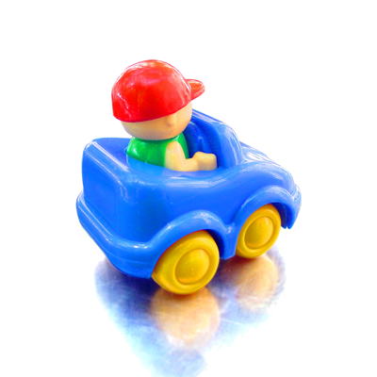

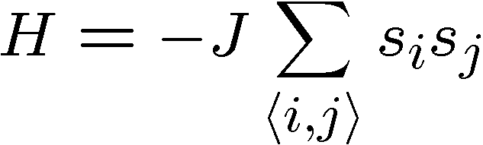


Toy Model
Ising model in two+ dimensions
Redundancy code:

Slide 14


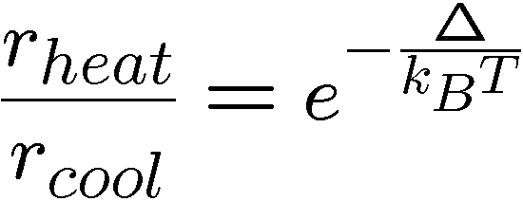



Dynamical Ising Model
Energy of excitation=
2J (Sum of perimeters of flipped domains)
Dynamics obeying principle of detailed balance:
Competition between growth and decimation of flipped domains

Slide 15
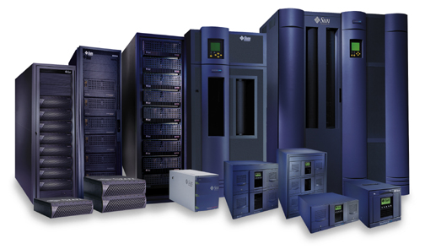
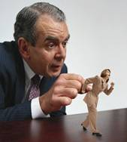





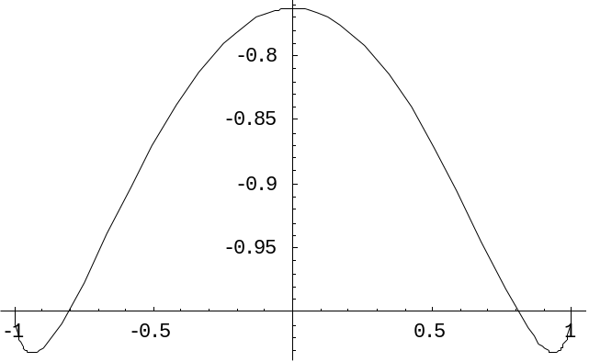
Robust
Relaxation to thermal
Imperfect preparation
Manipulation
The two encoded states have lifetimes which grow with the size
of the system:
free energy
magnetization

Slide 16


Quantum Hard Drive?
Do there exist (or can we engineer) quantum systems whose
physics guarantees fault-tolerant quantum computation?
Today in QC: we have theory (like von Neumann, Shannon) but not devices which implement these idea (without severe device complexity overhead.)

Slide 17









Energetics of Decoherence
system
environment
Perturbative regime:
Perturbative regime: decoherence conserves system and
environment energy.
cooling
heating
dephasing
by cooling environment we can eliminate heating

Slide 18








1st Attempt
1
2
Hamiltonian
ZZ
XX
XX
Quantum error detecting code
3
ZZ
4
quantum
Code is a symmetry of the Hamiltonian:
Code detects any single qubit error:
H does not depend on second qubit (use to store encoded qubit)

Slide 19























ground state is +1 eigenvalue of four qubit interactions

Slide 20

Supercoherence
ALL single qubit errors take degenerate ground state to higher energy levels.
Single qubit errors change value of (S₁,S₂) and hence take ground state to higher energy level.
To first order all single qubit
decoherence becomes heating
FORBIDDEN
Energy gap and low temperature suppress 1st order decoherence

Slide 21


Self-Correction
energy
eigenstates
Important for high T operation as well as for fault-tolerance
Energy gap is not enough to guarantee fault-tolerance
(though it is sufficient for memory)

Slide 22



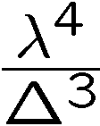


Concatenate?
ZZ
ZZ
ZZ
ZZ
ZZZZ
ZZ
XX
XX
XX
XX
XX
XX
XX
XX
ZZ
ZZ
ZZ
ZZ
ZZ
XX
XX
XX
XX
XXXX
XXXX
ZZ
ZZ
ZZ
ZZ
ZZZZ
ZZ
XX
XX
XX
XX
XX
XX
XX
XX
ZZ
ZZ
ZZ
ZZ
ZZ
strength
strength
strength

Slide 23
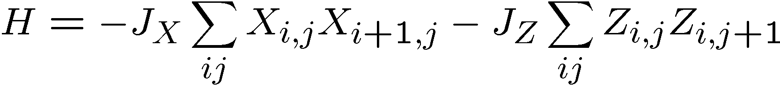



Quantum Compass Model
ZZ
ZZ
XX
XX
XX
ZZ
ZZ
XX
XX
XX
ZZ
ZZ
Abelian symmetries

Slide 24






Subspaces Versus Subsystems
The most general way to encode quantum information is into
subsystem (not subspaces)
two qubits
encode a qubit in a subspace
encode a qubit in a subsystem
generic subsystem:

Slide 25





Subsystem Error Correction
Only need to protect subsystem,
not full subspaces.
encoding
subsystem
error
recovery
encoded quantum
information
recovery need not perfectly restore system, but only
preserve information encoded into subsystem.

Slide 26





Quantum Subsystem Code
Measure these operators
Diagnose parity of bit and phase flips in column and rows
3. Apply recovery routine for parity of errors
Routine fixes error UPTO an operation generated by
bonds of Hamiltonian

Slide 27
Quantum Subsystem Code
extra symmetry which implies states are doubly degenerate:

Slide 28
Quantum Compass Model
ZZ
ZZ
XX
XX
XX
ZZ
ZZ
XX
XX
XX
ZZ
ZZ
Ground state is a new kind of quantum error correcting code
(This code is related to Shor’s original code as well as Kitaev’s
toric code and has remarkable fault-tolerant properties
[Aliferis unpublished])
quantum error correcting subsystem

Slide 29
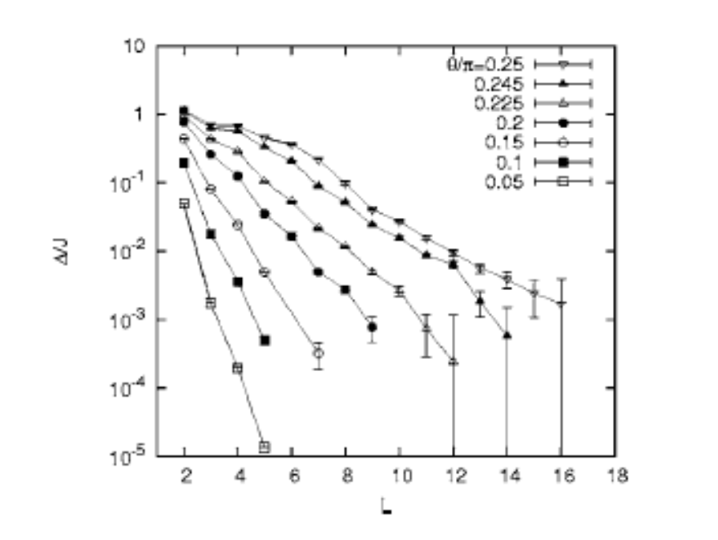
Self-Correcting?
ZZ
ZZ
XX
XX
XX
ZZ
ZZ
XX
XX
XX
ZZ
ZZ
Energy gap vanishes for large
lattice size ☹
[Dourier, Becca, Mila 2005]

Slide 30
The Proper Concatenation
ZZ
ZZ
XX
ZZ
ZZ
XX
XX
XX
XX
XX
XX
ZZ
ZZ
XX
ZZ
ZZ
XX
XX
XX
XX
ZZ
ZZ
ZZ
ZZ
ZZ
ZZ
ZZ
ZZ
XX
XX
XX
XX
ZZ
ZZ
XX
ZZ
ZZ
XX
XX
XX
XX
XX
XX
ZZ
ZZ
XX
ZZ
ZZ
Self-correcting!

Slide 31
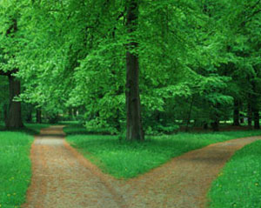

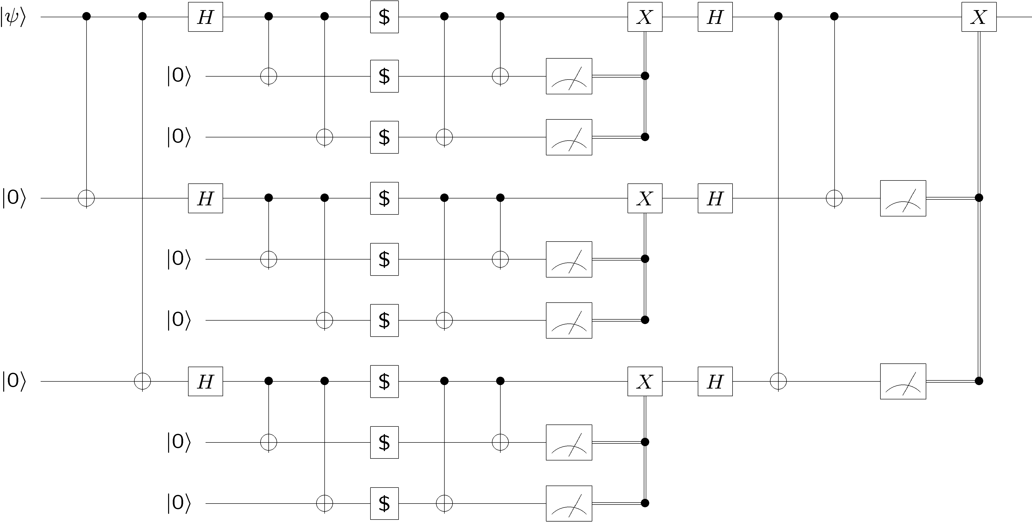
Towards Robust Qubits
Wire many faulty
qubits together into a fault-tolerant scheme
Engineer physical systems whose physics enacts error correction
free energy
Relative number
of errors

