Slide 1
THS SNTNC HS N VWLS

Slide 2
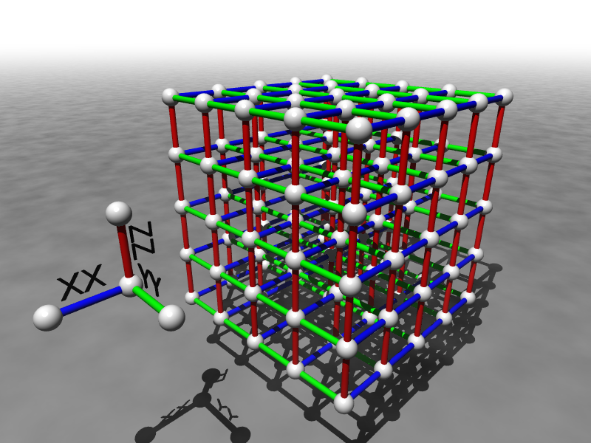

Spatial Locality and
Robust Quantum Computation
Dave Bacon
Department of Computer Science & Engineering
University of Washington

Slide 3
I am a Quantum Information Science
Theorist, but…..
Trapped Ions Saved My Life

Slide 4
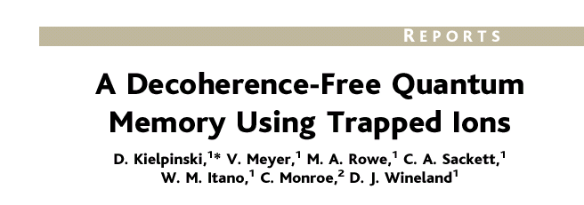
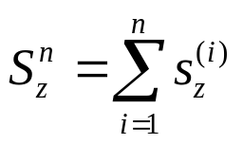

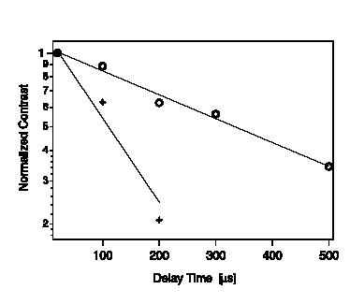
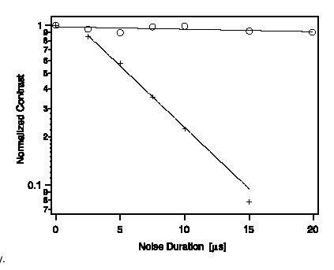


Experimental Demonstration
collective phase errors:
engineered noise (detuned laser)
ambient conditions!
(see also Kwiat et al., Science 2000)
non-DFS
DFS

Slide 5
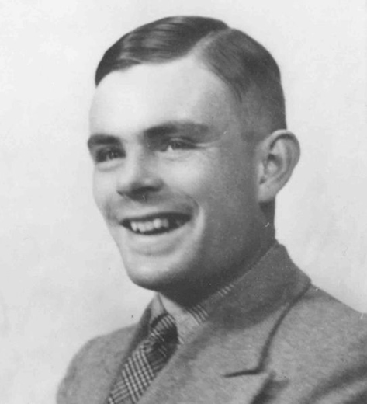
Building a Quantum Computer
Is Full of Problems
Is a Quantum Computer Even
A Valid Model of Computation?

Slide 6


The First Problem
THE DECOHERENCE PROBLEM
Environment
System
open quantum systems can become
entangled with their environment
EXAMPLE:
evolve
coherent superposition
evolve
incoherent sum
Decoherence turns quantum information into classical information
It does this on a time scale which only a few hundred to million times slower than the rate we can manipulate the quantum information

Slide 7




Second Problem
THE FAULTY CONTROL PROBLEM
System
Control
unitary gates cannot
be implemented with
arbitrary accuracy
THE FAULTY MEASUREMENT PROBLEM
measurements are imperfect
wrong result, wrong resulting state
related state preparation problem
LEAKAGE PROBLEM

Slide 8

Why We Are Here
QC
errosol
“decoherence”
“imprecision”
Threshold Theorem for Fault-Tolerant Quantum Computation
[a partial list: Aharonov, Ben-Or, Kitaev, Knill, LaFlamme, Zurek, Shor, DiVincenzo, Gottesman, Preskill]
If decoherence is weak enough and control is precise enough,
then a quantum computation to a desired accuracy can be
carried out with an overhead polynomial in the log of the accuracy.

Slide 9
Concatenated Threshold Sketch
probability
of failure
level
qubits
0
1 qubit
p
1
n qubits
cp²
2
n² qubits
c(cp²)²
k
2^{k}
n^{k} qubits
(cp) /c
exponential decrease
in # qubits if
p<1/c=p_{thresh}

Slide 10
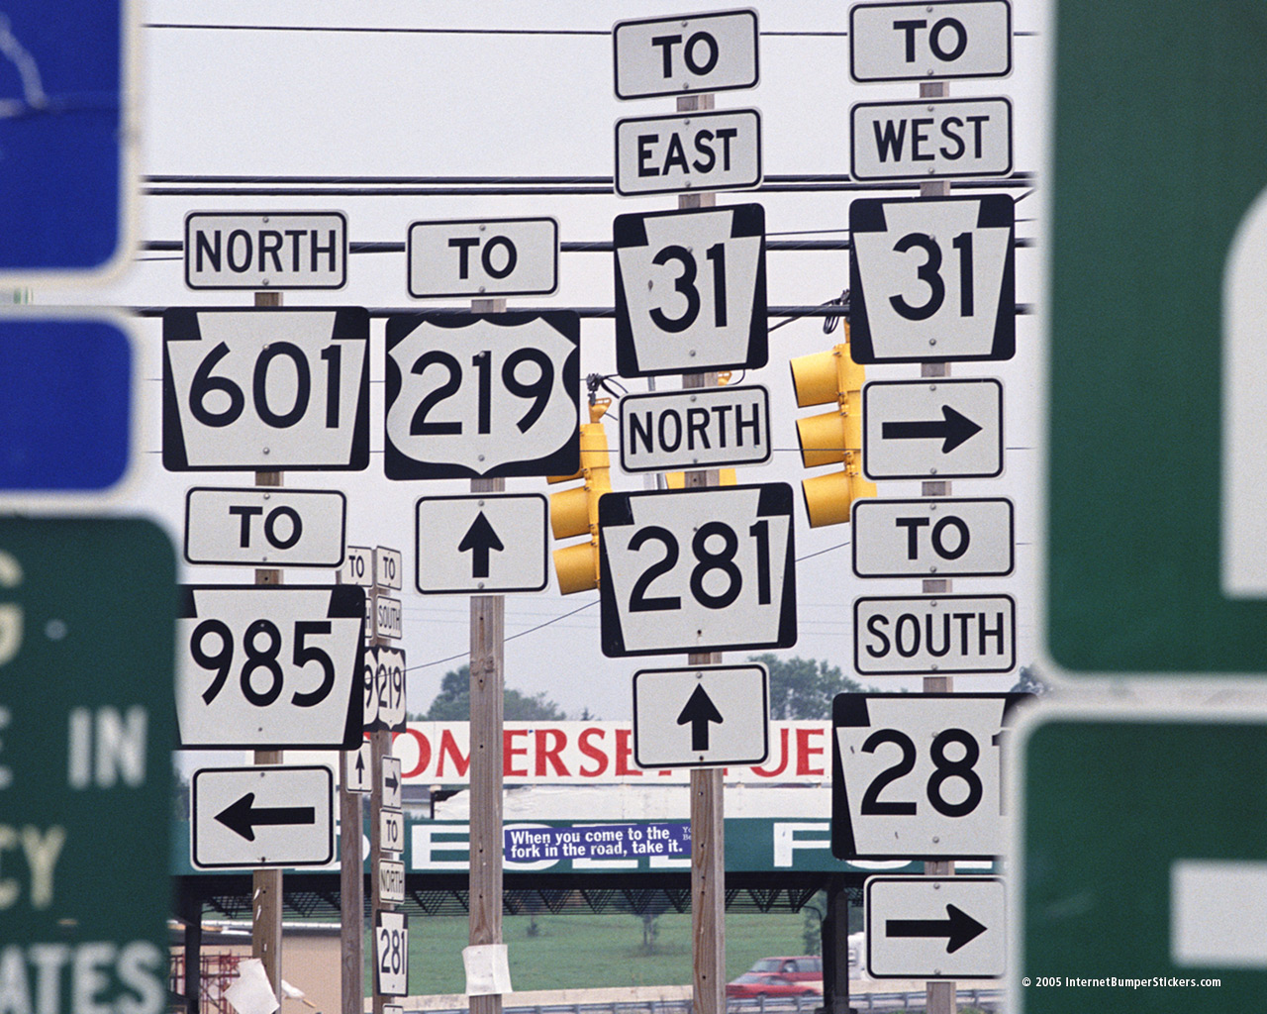
Paths to the Threshold
1. CONCATENATED FAULT-TOLERANCE
2. NON-CONCATENATED FAULT-TOLERANCE
3. NATURAL FAULT-TOLERANCE

Slide 11
There is No Threshold Theorem

Slide 12
Threshold Theorems
TWO TYPES
provable and heuristic
ASSUMPTIONS
provably essential:
1. parallel operations
2. cold ancillas
3. error rates below 50% gate speed
4. ability to not leak or fix leaks
error model:
correlations (spatial and temporal)
decoherence types (single qubit, leakage, Markovian, etc.)
classical computation:
free fast robust classical computation?
architecture:
non-local gates, local gates
dimension of architecture
explicit architecture (scheduling, routing, etc.)

Slide 13
Local Threshold Theorem
Ground breaking:
Gottesman 1999 and Aharonov, Ben-Or 1999
Local threshold still exists
Local gates, but global classical computation
Dennis, Kitaev, Landahl, and Preskill 2001
surface quantum codes 2D (memory)
and 3D (computation)
memory threshold: 0.01
fault tolerant threshold: ~0.0001
Local gates, concatenation
Svore, Terhal, DiVincenzo 2004
2D Steane code, loss of a factor of 10-50.
Szkopek et al. 2004
1D Steane code, loss of a factor of 200.

Slide 14
Spatial Locality
This talk:
A Story of My Attempt to come to Grips with Locality
And
Adventures in where these Ideas Led

Slide 15
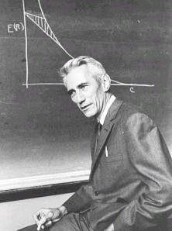
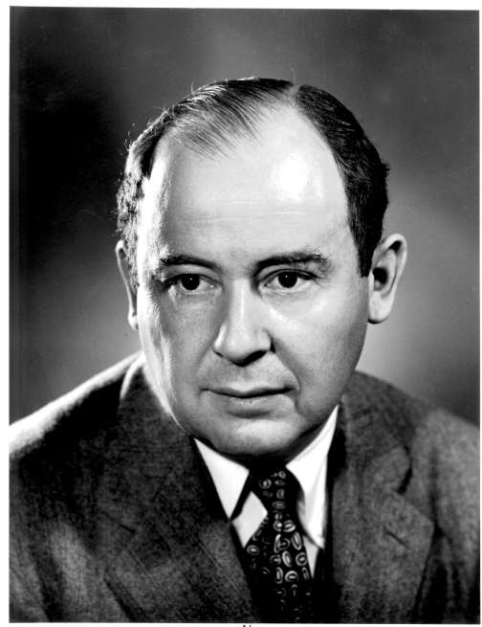
To Build a Quantum Computer
Classical
Problem (1938): How to build a reliable system from
unreliable components?
“A mathematical theory of communication” (1948)
How to communicate in the presence of noise
“Probabilistic logics and the synthesis
of reliable organisms from unreliable
components” (1956)
Claude
Shannon
How to compute when the subsystems
of your computer can fail?
John
von Neumann

Slide 16
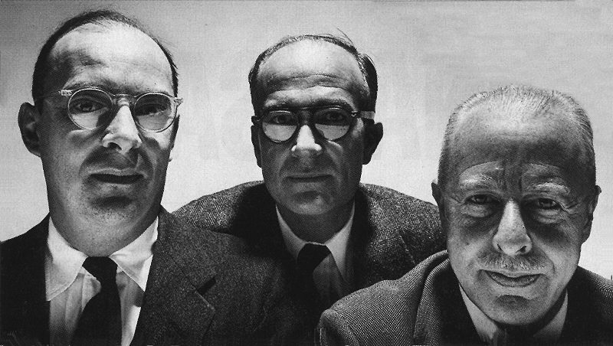
A Different Path

Slide 17


Two Storage Testbeds
Ferromagnetic Ising models:
A. one dimensional
B. two (and >) dimensional

Slide 18
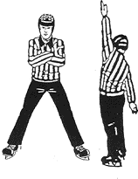

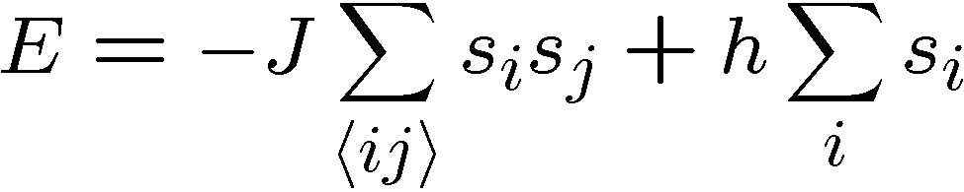


Ferromagnetic Ising Models
Ising model
spins on edges of a lattice:
energy of a configuration:
sum over neighbors
external magnetic field
for now

Slide 19

Dynamic Ising Models
Dynamic Ising model (Metropolis update)
Interaction with environment causes spin flips
Update rule:
If flipping spin would decrease energy, flip spin
If flipping spin would increase energy, flip spin with probability

Slide 20


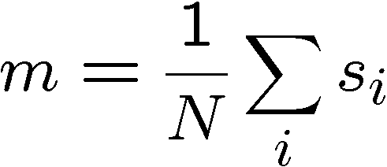
Compare and Contrast
Encode information into the system and watch what happens
Redundancy code.
Order parameter is magnetization:

Slide 21



Storage
Long time behavior (not infinite time, but effectively)
1D Ising
2D Ising
Criticism: (1) thermodynamic limit taken
(2) what if relaxation to equilibrium takes a long time?

Slide 22
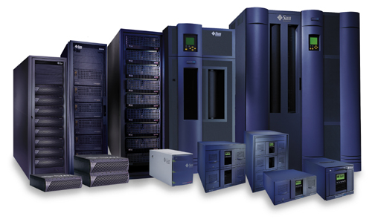


Storage
2nd attempt:
Relaxation to thermal
1D Ising
2D Ising
Imperfect preparation

Slide 23
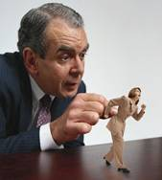




Manipulation
Flipping spins is imperfect
1D Ising
2D Ising
1D Ising
temperature less than gap
manipulation error must be small
(i.e. NOT fault-tolerant)
2D Ising
temperature less than critical temp

Slide 24















“Self Fixing”
Excitations point-like
Energy to err is constant
Disordering entropy >> Energy
Excitations string-like
Energy to error is prop to size
Energy >> Disordering entropy

Slide 25

Lessons
encode information into error correcting code
0
2. energy gaps can slow loss of information
important for memory
keep cold
3. excited state energetics can “self-correct”
important for fault-tolerant operations

Slide 26
Quantum Error Correction
Error
Fix
“cold” ancilla
“hot” ancilla
By encoding quantum information into a subspace of many
quantum systems we can protect this information from noise.

Slide 27
Lessons Learned?
What do we do in fault-tolerant quantum computing?
encode information into error correcting code
0
use information encoded into a quantum error correcting code
2. energy gaps can slow loss of information
important for memory
keep cold
NO
3. excited state energetics can “self-correct”
important for fault-tolerant operations
NO

Slide 28
[Joked Deleted Due To Time
Constraints]

Slide 29
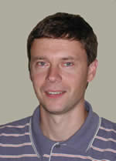

The Quantum Hard Drive?
Kitaev
Do there exist (or can we engineer) quantum systems whose
physics guarantees fault-tolerant quantum computation?

Slide 30
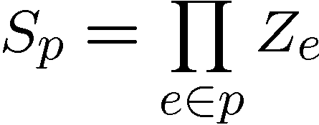
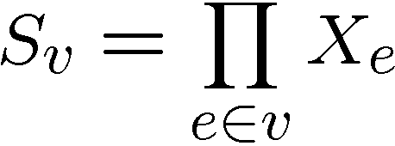




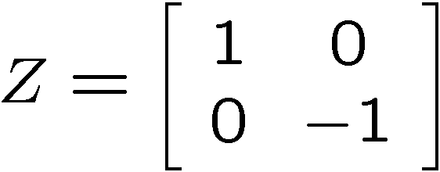
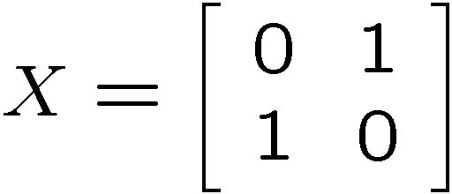
Kitaev’s Model
plaque operators:
qubits on links
vertex operators:
vertex and plaque operators
all commute with each other

Slide 31
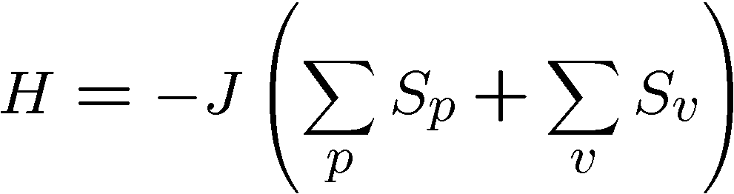






Kitaev’s Model, Continued
Hamiltonian
plaque operators:
vertex operators:
ground state has all

Slide 32


Kitaev’s Model
plaque operators:
vertex operators:
anti-commutes with
two plaque operators
−
−
excitation is above ground state

Slide 33
Excitations
excitations particles come in pairs (particle/antiparticle)
at end of “error” chains
two types of particles, X-type (live on vertices of dual lattice)
Z-type (live on vertices of the lattice)

Slide 34


Anyons Anyone?
Phase:

Slide 35



A Qubit
Moving an X or Z type particle on a homologically nontrivial
path and annihilating with it’s partner preserves the ground
states
Action on ground state must be representation of non-Abelian
group: Acts as encoded single qubit Pauli operator.

Slide 36



Two Qubits
Moving an X or Z type particle on a homologically nontrivial
path and annihilating with it’s partner preserves the ground
states
Action on ground state must be representation of non-Abelian
group: Acts as encoded single qubit Pauli operator.

Slide 37
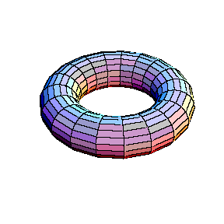


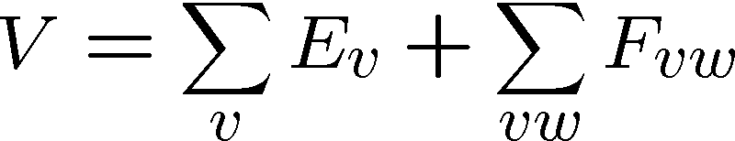
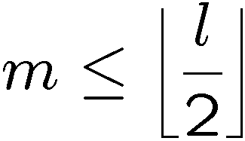
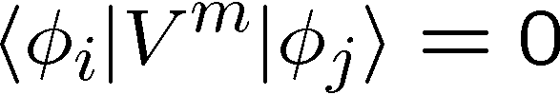
Topological Protection
Encode two qubits
into the ground state
gap
Perturbation theory:
But for

Slide 38

Topological Quantum Computing
Encode two qubits
into the ground state
gap
If we keep then quantum information encoded into ground state will be “topologically” robust to perturbation.
We can perform gates (in this example X and Z) by creating
anyon pairs and moving them around the torus.

Slide 39

Whence Kitaev’s Model?
Robust storage of quantum information.
But it does not provide a mechanism for
robust manipulation of quantum information.
Is it possible to construct a Hamiltonian, which allows for fault-tolerant manipulation as well?

Slide 40
Topological Error Correction
Different mode of using Kitaev’s Model, as a component in
a fault-tolerant quantum computer, encode into ground state
1. Errors occur
2. Measure vertex and plaque operators
3. Apply recovery operator
4. If created loop is homologically trivial,
then we have restored information
encoded into ground state.
Full analysis: measurements uncertain, recovery may fail, etc.
Threshold for fault-tolerant storage of quantum information:
[Dennis, Kitaev, Landahl, Preskill 2002]
[Wang, Harrington, Preskill 2003]

Slide 41
Lessons Learned?
What do we do in fault-tolerant quantum computing?
encode information into error correcting code
0
use information encoded into a quantum error correcting code
2. energy gaps can slow loss of information
important for memory
keep cold
3. excited state energetics can “self-correct”
important for fault-tolerant operations
NO

Slide 42

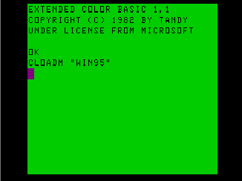
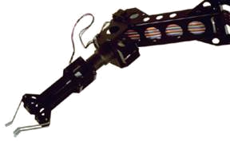
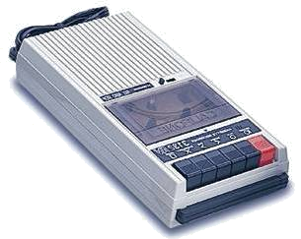

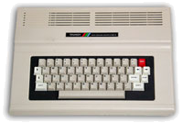
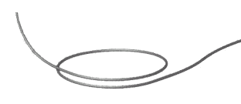
Self Correcting Quantum Computers
The toric code in four dimensions is probably self-correcting
Can we self-correct in realistic systems?
D. Bacon “Operator Quantum Error Correcting Subsystems for
Self-Correcting Quantum Memories”
Phys. Rev A, 73, 012340 (2006)

Slide 43






A Small Quantum Try
1
2
Hamiltonian
ZZ
ZZ
ZZ
ZZ
XX
XX
ZZ
3
ZZ
4
quantum error detecting code
classical
quantum
symmetry
simultaneously diagonalize with symmetries
H does not depend on second qubit

Slide 44
























Slide 45
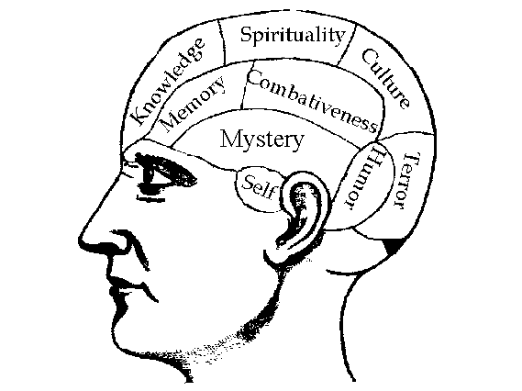


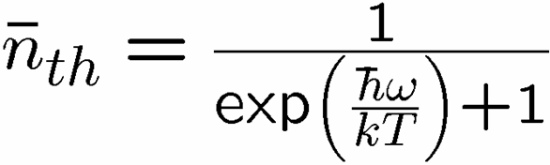

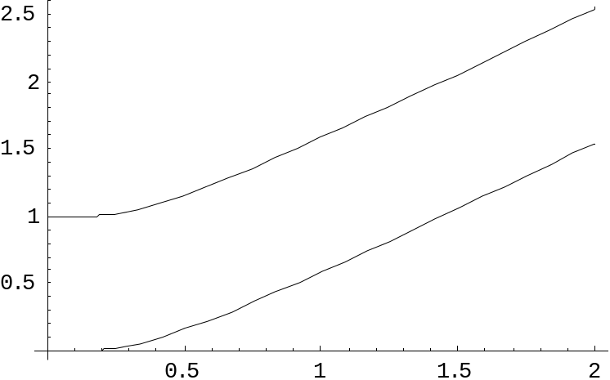
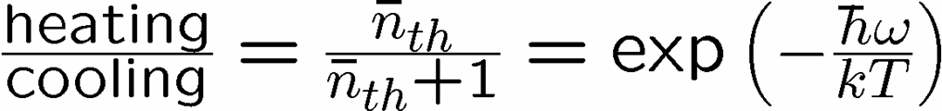


Reminder
two-level system perturbatively coupled to a thermal boson bath
“heating”
“cooling”
“non-dissipative”

Slide 46

Supercoherence
Bacon, Brown, and Whaley, Phys. Rev. Lett. 87, 247902 (2001)
ALL single qubit errors take degenerate ground state to higher energy levels.
Single qubit errors change value of (S₁,S₂) and hence take ground state to higher energy level.
To first order all single qubit
decoherence becomes heating
FORBIDDEN

Slide 47
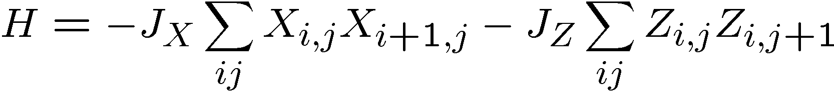
Quantum Compass Model
ZZ
ZZ
XX
XX
XX
ZZ
ZZ
XX
XX
XX
ZZ
ZZ
Ground state is a new kind of quantum error correcting code!
quantum error correcting subsystem

Slide 48
Quantum Compass Model
ZZ
ZZ
XX
XX
XX
ZZ
ZZ
XX
XX
XX
ZZ
ZZ
Abelian symmetries

Slide 49






Subspaces Versus Subsystems
The most general way to encode quantum information is into
subsystem (not subspaces)
two qubits
encode a qubit in a subspace
encode a qubit in a subsystem
generic subsystem:

Slide 50





Subsystem Error Correction
Only need to protect subsystem,
not full subspaces.
encoding
subsystem
error
recovery
encoded quantum
information
recovery need not perfectly restore system, but only
preserve information encoded into subsystem.

Slide 51





Quantum Subsystem Code
Measure these operators
Diagnose parity of bit and phase flips in column and rows
3. Apply recovery routine for parity of errors
Routine fixes error UPTO an operation generated by
bonds of Hamiltonian

Slide 52
Quantum Subsystem Code
extra symmetry which implies states are doubly degenerate:

Slide 53
Quantum Compass Model
ZZ
ZZ
XX
XX
XX
ZZ
ZZ
XX
XX
XX
ZZ
ZZ
Ground state is a new kind of quantum error correcting code!
quantum error correcting subsystem

Slide 54
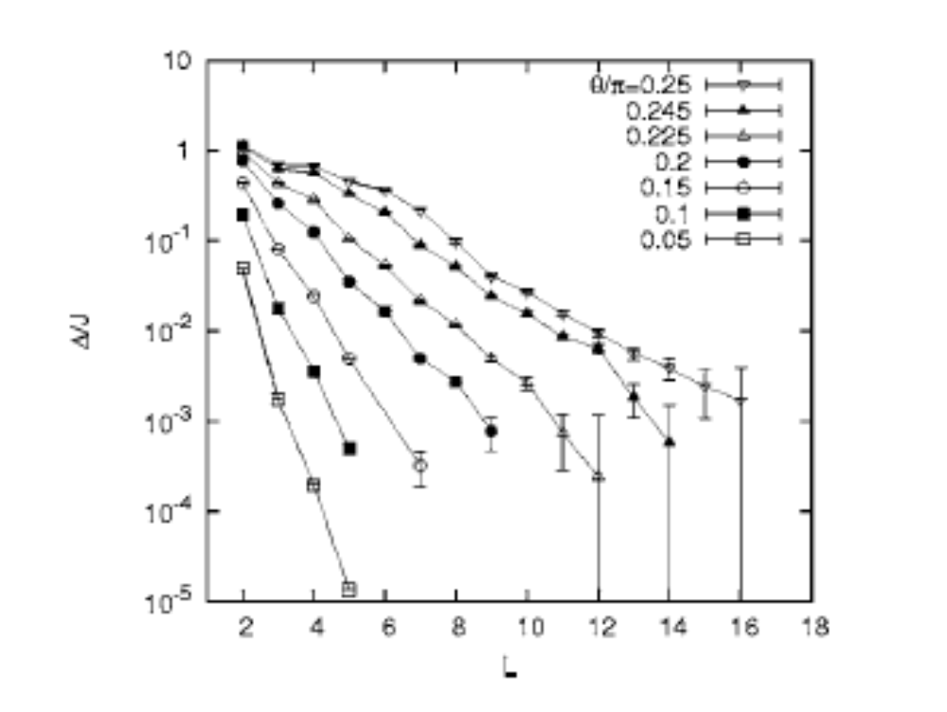
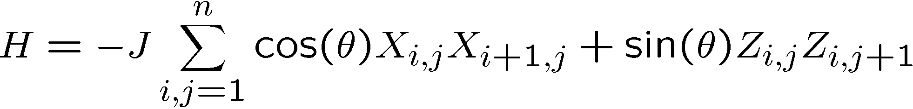
Problems:
[Dourier, Becca, Mila 05]
no gap in the thermodynamic limit

Slide 55

Problems, Continued
XX
XX
XX
ZZ
ZZ
ZZ
ZZ
XX
XX
XX
ZZ
ZZ
ZZ
ZZ
XX
XX
XX
Exact diagonalization 3x3, 4x4, 4x5
Even at finite size, not “self-correcting”

Slide 56
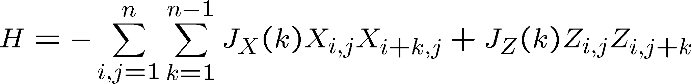
Toward Self-Correction
ZZ
ZZ
ZZ
XX
XX
XX
XX
n by n
square
lattice
ZZ
ZZ
ZZ
XX
XX
XX
XX
ZZ
ZZ
ZZ
XX
XX
XX
XX
ZZ
ZZ
ZZ
Exact diagonalization of 4x4 model, shows that with constant couplings, this model is self-correcting!

Slide 57





Toward Self-Correction

Slide 58
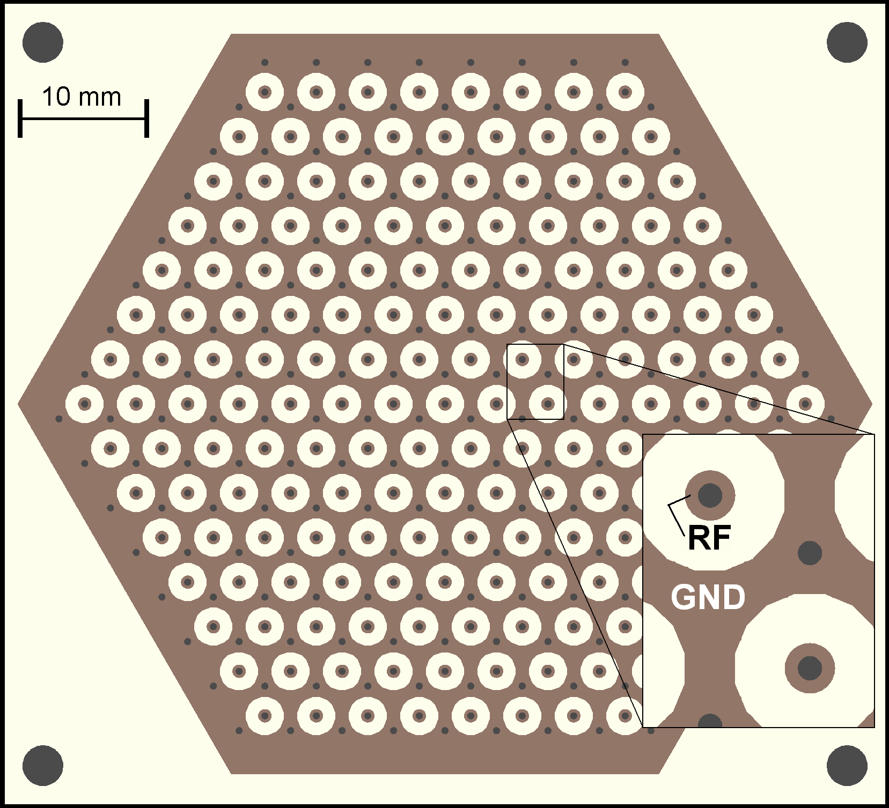
The Future
Can techniques used in creating two qubit interactions be
used to engineer such interactions
(Ideas from quantum simulation? Deng, Porras, and Cirac?)
Figure 2. Hexagonal planar ion trap. 2D mult-zone ion traps allow one to trap ions in any spatial arrangement including a disordered lattice.
Picture courtesy Ken Brown
(Isaac Chuang’s Lab, MIT)

Slide 59
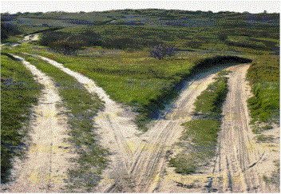
A Different Path
Quantum error correction can be performed by cooling an
interacting quantum system.
Potential for robust substrates for quantum information.

Slide 60
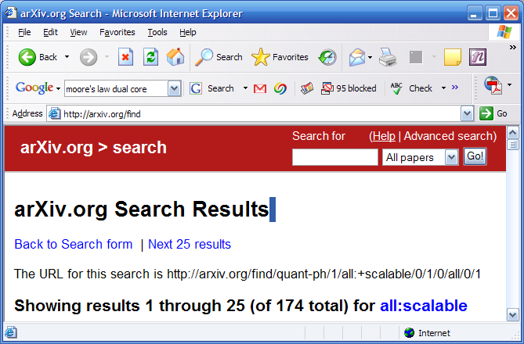
What Does “Scalable” Mean?
1. All of the necessary components.
2. Easy to fabricate.
3. Below “threshold”
1+3. All of the necessary components which operate below “threshold”
1+2+3. All of the necessary components, below “threshold”, and easy
to fabricate.

Slide 61
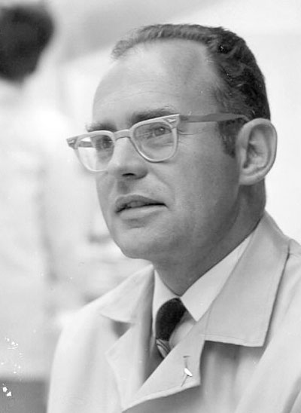
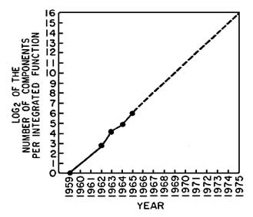
What Does “Scalable” Mean?
Gordon Moore
Scalable has a rate and a lifetime.
Scalable means that you can predict from current technology this
rate and a lower bound on the lifetime.
Scalable means that you can write Moore’s 1965 paper
….and be right!

Slide 62
The Future
Is it possible to engineer the systems described above?
(Ideas of Deng, Porras, and Cirac?)
Possible to engineer such systems in planar ion trap system?
Figure 2. Hexagonal planar ion trap. 2D mult-zone ion traps allow one to trap ions in any spatial arrangement including a disordered lattice.
Picture courtesy Ken Brown
(Isaac Chuang’s Lab, MIT)

Slide 63
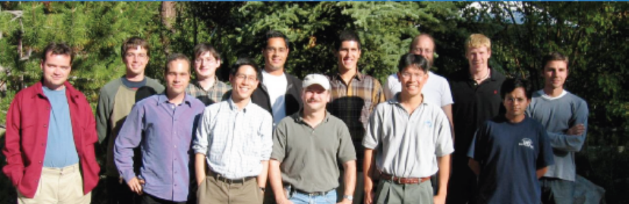
Quantum Architecture?
Chuang (MIT), Chong (UCSB), Kubiatowicz (UCB), Oskin (UW)
Some early work: Oskin, Chong, Chuang. IEEE Computer, Jan. 2002
“A Practical Architecture for Reliable Quantum Computers”

Slide 64
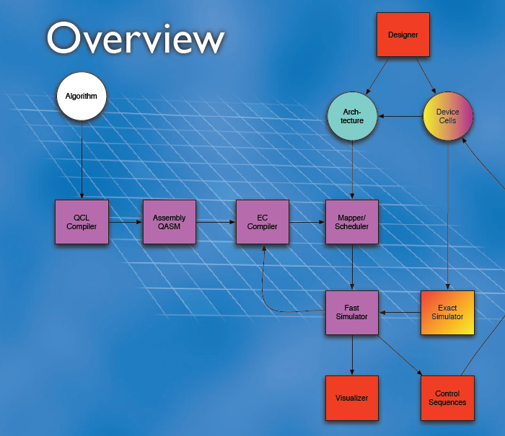
Quantum Architecture?

