Slide 1
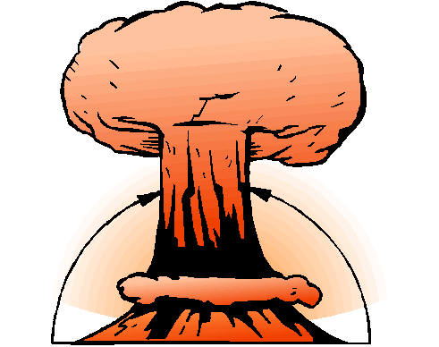
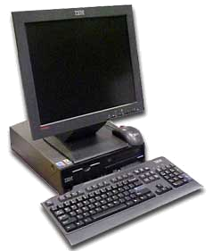
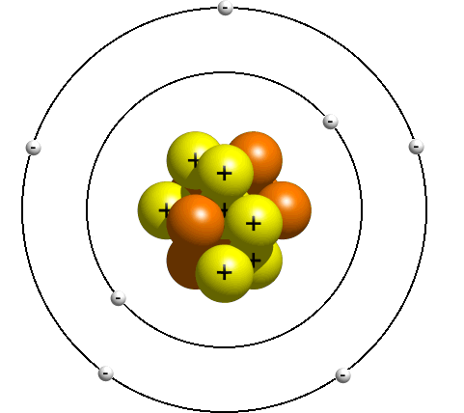
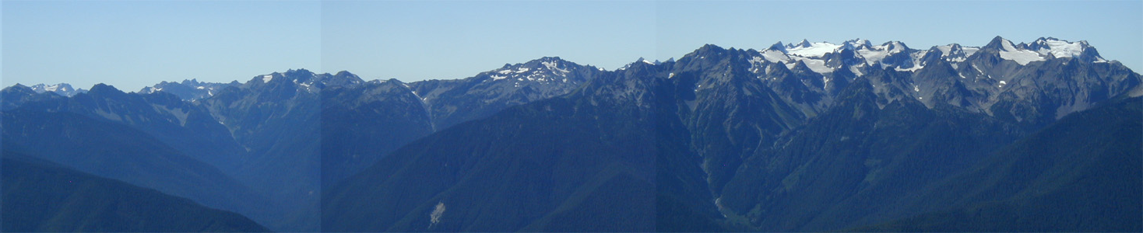
When Physics and Computer Science Collide
Dave Bacon
Department of Computer Science & Engineering
University of Washington, Seattle, WA

Slide 2
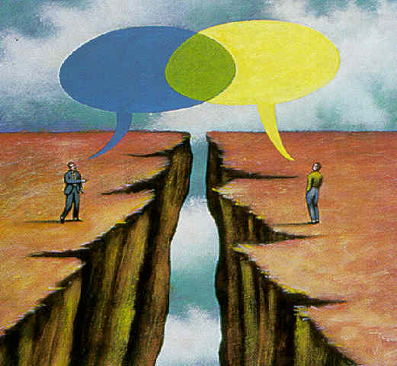
Err…can you
fix my computer?

Slide 3
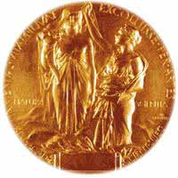
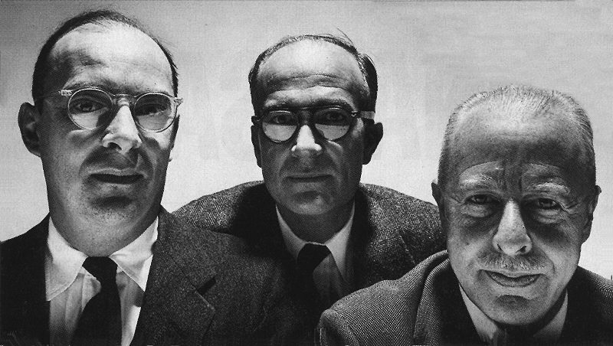
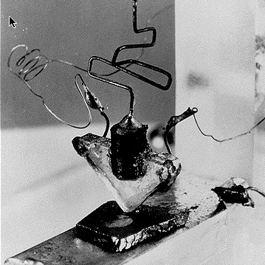
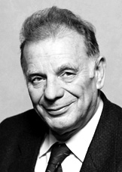
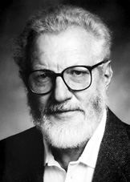
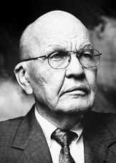
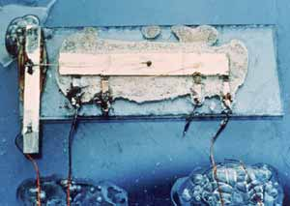
1956
Shockley, Bardeen, and Brattain
Transistor
2000
Alferov, Kroemer, Kilby
Integrated Circuit

Slide 4
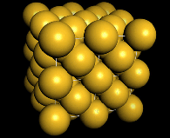
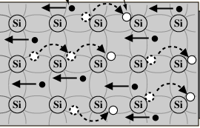
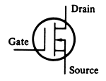
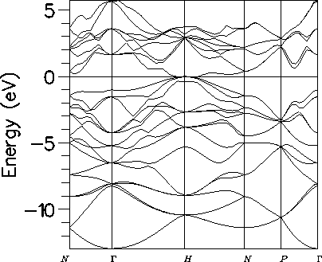
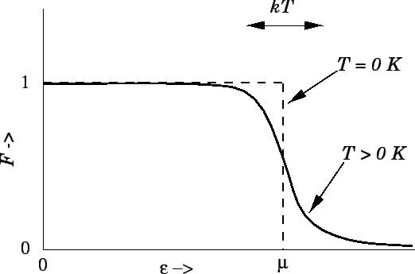
Behind the Bit
bits
noisy bits
quantum bit
Emergence of orders which can compute

Slide 5
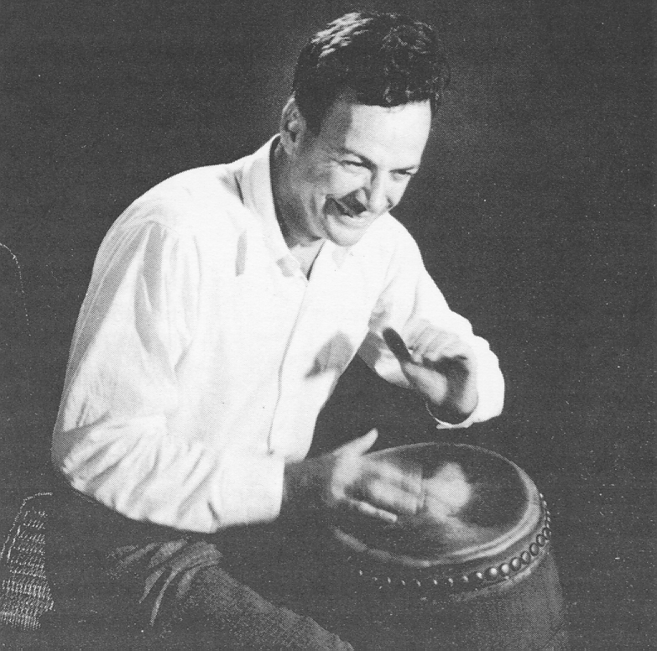
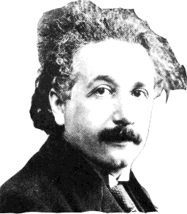
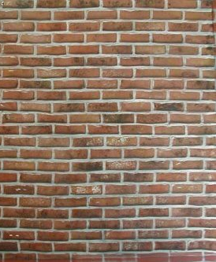


Quantum Computer?
“How can we simulate quantum mechanics? ...Can we do it with a new kind of computer… a quantum computer? It’s not a Turing machine but a machine of a different kind” - Richard Feynman (1981)
simulating
quantum
theory
Richard Feynman
18819881292060796383869723
94616504398071635633794173
82700763356422988859715234
66548531906060650474304531
73880113033967161996923212
05734031879550656996221305
168759307650257059
3980750864240649373971
2550055038649119906436
2342526708406385189575
946388957261768583317
4727721461074353025362
2307197304822463291469
5302097116459852171130
520711256363590397527
FACTORING
Classical: Quantum:
Peter Shor 94

Slide 6
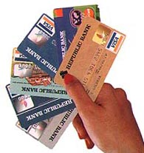
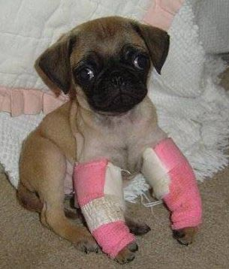
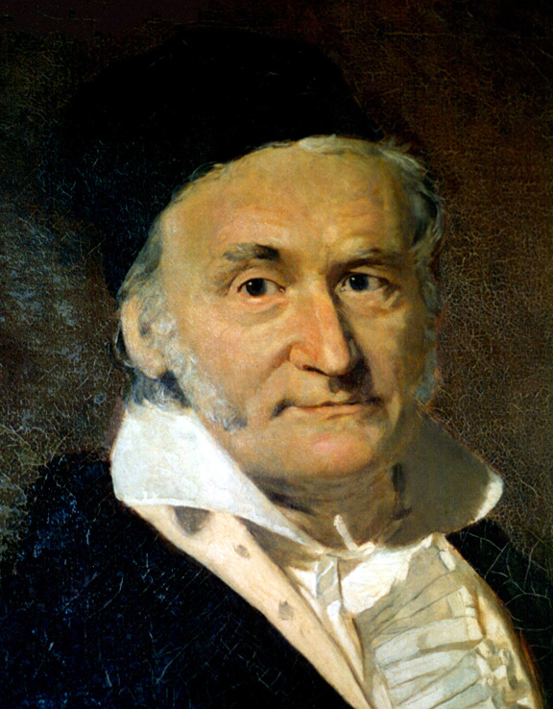
Quantum Computers!
Public Key Cryptosystems
18819881292060796383869723
94616504398071635633794173
82700763356422988859715234
66548531906060650474304531
73880113033967161996923212
05734031879550656996221305
168759307650257059
RSA
Diffie-Hellman
Elliptic Curves
BROKEN
“The problem of distinguishing prime numbers from composites, and of resolving composite numbers into their prime factors, is one of the most important and useful in all of arithmetic... The dignity of science seems to demand that every aid to the solution of such an elegant and celebrated problem be zealously cultivated”
— Carl Gauss
Gauss

Slide 7
Quantum Computers!
Quantum algorithms that offer speedups over classical algorithms
  Factoring, discrete log [Shor 94]
  Unstructured search [Grover 96]
  Pell’s equation [Hallgren 02]
  Hidden shift problems [van Dam, Hallgren, Ip 03]
  Graph traversal [CCDFGS 03]
  Spatial search [AA 03, CG 03/04, AKR 04]
  Element distinctness [Ambainis 03]
  Various graph problems [DHHM 04, MSS 03,…]
  Testing matrix multiplication [Buhrman,Špalek 04]
  Simulation of quantum systems
Applications to chemistry,
biology, material science….
But Can We Build Quantum Computers?

Slide 8
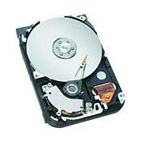

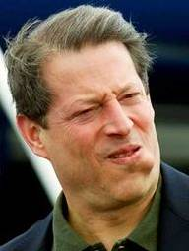
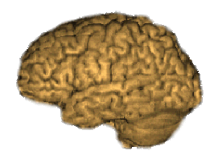
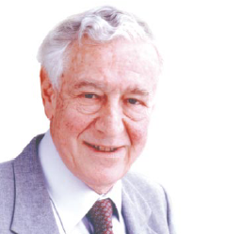
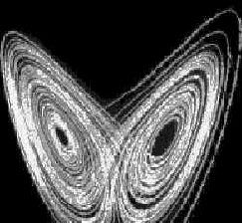
Two Views of Information
Information is “fungible” adj. being of such a nature that one part or quantity may be replaced by another equal part or quantity in the satisfaction of an obligation.
Al Gore
George Bush
Ralph Nader
Pat Buchanan
No Information without Physical Representation!
Not all physical systems are robust
information processing machines
Rolf Landauer

Slide 9

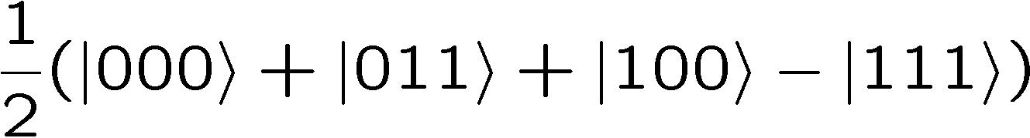


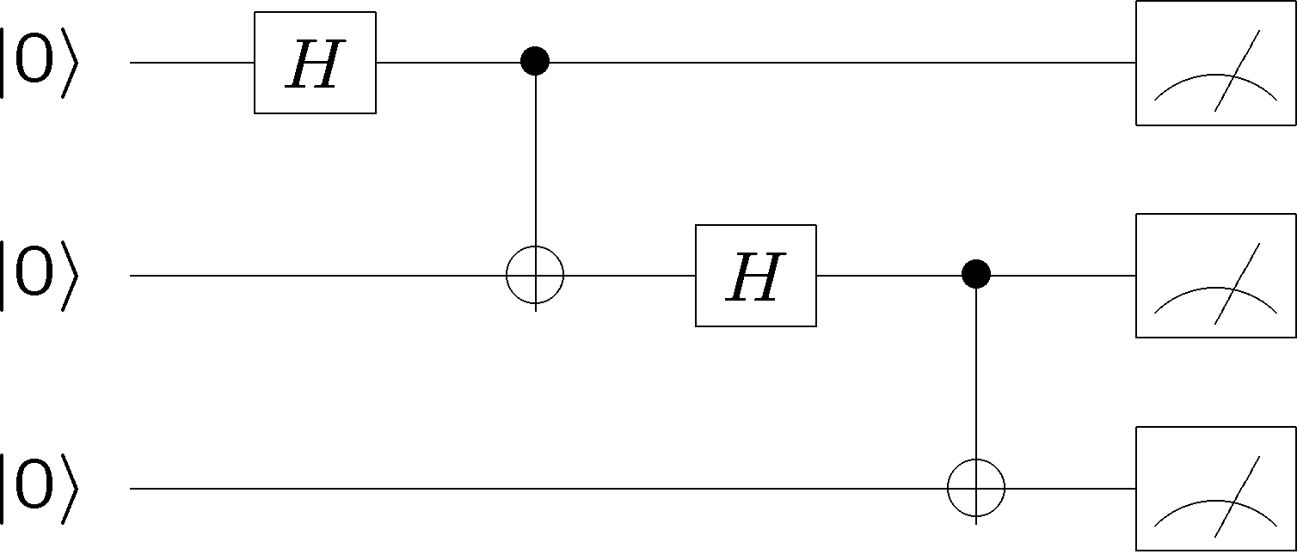
The Ideal Quantum Computer
qubits
Quantum algorithm
1. Initialize
2. Series of unitary gates
3. Measurement

Slide 10


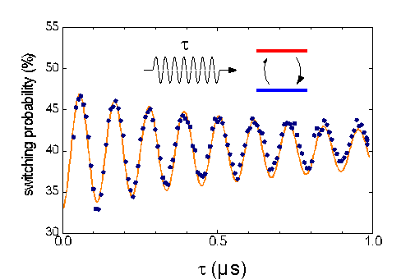
Obstructions
DECOHERENCE
Environment
Total Hamiltonian
System
system
environment
interaction
open quantum systems can become entangled with their environment
coherent superposition
incoherent sum
Quantronium (CEA, France)

Slide 11



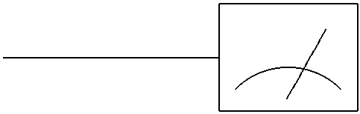

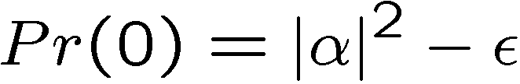

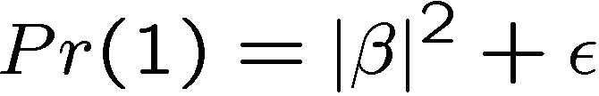
More Obstructions
FAULTY CONTROL
System
Controller
Imperfect state
preparation
Imprecise or faulty unitary gates
Imperfect
measurements

Slide 12
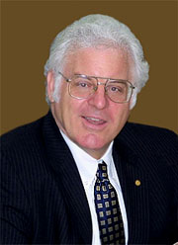
This is the End, My Only Friend, the End
Everything, (quantum) noisy, all the time.
Is a Quantum Computer Even a Computer?
A skeptics checklist:
1. quantum data is analog
2. quantum data likes to become classical data
3. quantum evolution is analog
Laughlin
4. quantum theory is wrong

Slide 13
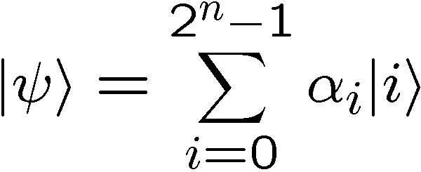
Quantum Data is Analog
n qubit quantum state:
Objection:
Superposition of an exponential number of states.
Each amplitude is a complex number…i.e. analog data
How do you control 2^{n} complex numbers?
In the real world, nothing can be done with infinite precision

Slide 14
Quantum data likes to become classical data
coherent superposition
incoherent sum
Decoherence is a complex process which is fundamentally
responsible for there being classical information
Quantronium (CEA, France)
Decoherence is irreverislbe

Slide 15

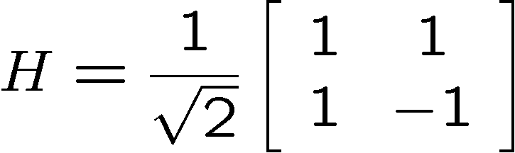
Quantum Evolution is Analog
Quantum evolution:
A unitary “gate” also has a bunch of complex numbers
Each amplitude is a complex number…i.e. analog data
In the real world, nothing can be done with infinite precision

Slide 16
Quantum Theory is Wrong
Quantum theory has only ever been observed for small
(micro to meso) systems.
It will break down for large systems
No Job For You Corollary: Do not think to hard about
quantum theory or you will get lost in a philosophical
hole from which no graduate student has ever emerged
(except in philosophy departments)

Slide 17
This is the End, My Only Friend, the End
Everything, (quantum) noisy, all the time.
Is a Quantum Computer Even a Computer?
A skeptics checklist:
1. quantum data is analog
2. quantum data likes to become classical data
3. quantum evolution is analog
Laughlin
4. quantum theory is wrong
Why Is Classical Computation Possible?

Slide 18

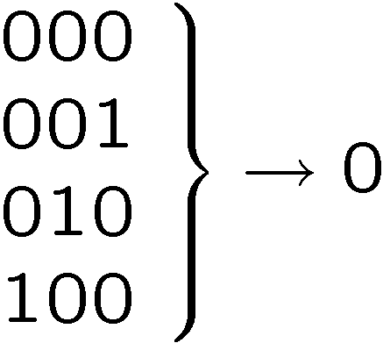






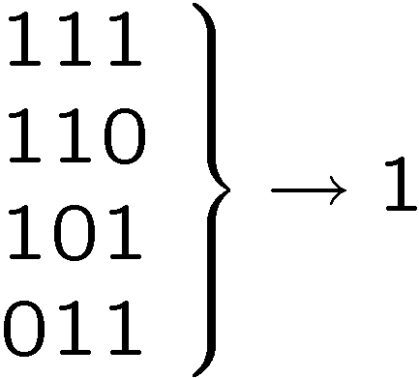
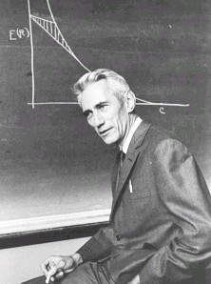
Classical Solutions
Probability of bit flip = p
Solution: redundancy
Probability of failure =3(1-p)p²+p³
=3p²-2p³
<p if p<1/2
Use redundancy to protect information against noise
Claude Shannon 1948
“A mathematical theory of communication”

Slide 19
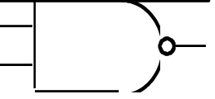
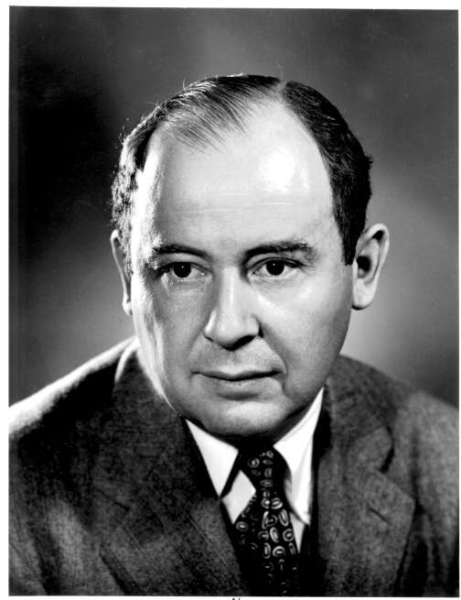
More Classical Solutions
Classical gates fail with probability p
Solution: error correcting codes + fault tolerant construction
M
John von Neumann, 1956
“Probabilistic logics and the synthesis of reliable organisms from unreliable components”
M
M

Slide 20
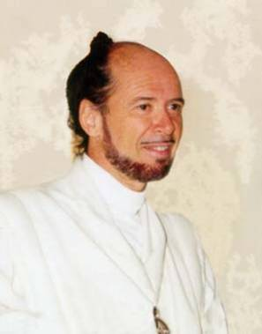



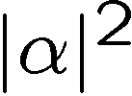

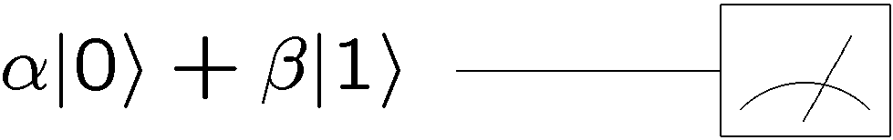
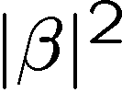

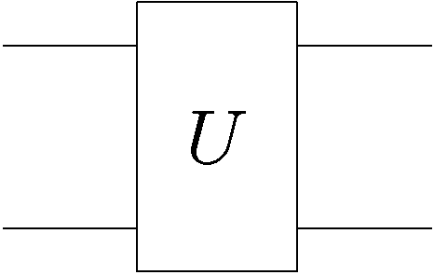
Quantum Problems?
No cloning of quantum information
How to perform error correction without measuring?
Quantum errors seem “analog”
system
decohered system
environment

Slide 21
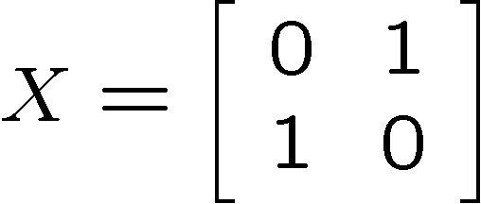
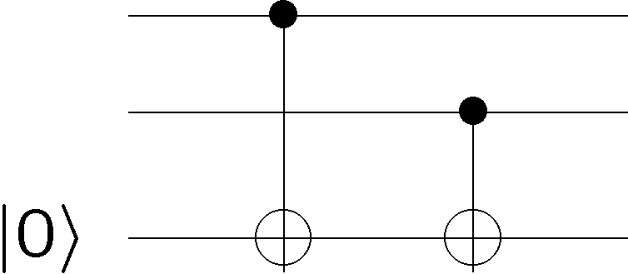


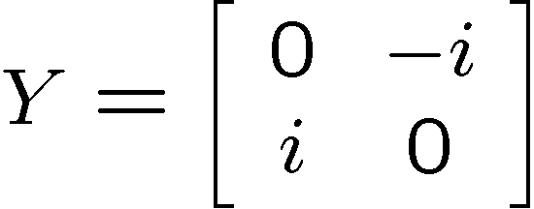






Quantum Observations
How to perform error correction without measuring?
Observation: not all measurements destroy quantum information
Information encoded into a subspace undisturbed
Can detect “leaving” of subspace

Slide 22















Quantum Observations
By encoding into subspaces we can correct single bit flips

Slide 23

Quantum Problems?
Environment
qubit
digitized effects of decoherence
Think: amplitude for no error, X error, Y error, Z error

Slide 24




Quantum Error Correcting Codes
Encode qubit into 2 dimensional
subspace with all +1 eigenvalues
Single qubit errors (i.e. )
all lead to a unique subspace labeled by s_{i} eigenvalues
“bare” error rate = p
error rate on encoded = O(p²)

Slide 25






Perfection Through Concatenation
failure
probability
p
cp²
c(cp²)²
At k^{th} level of concatenation, probability of an error which
destroys the encoded quantum information is
and uses qubits

Slide 26




Fault-Tolerance
Everything noisy:
Compute on qubits encoded in quantum error correcting code?
encoded Paulis
COMPARE
Exact:
Error:
Exact:
Error:
single qubit Z

Slide 27

Fault-Tolerant Quantum Computation
Must design quantum circuits which succeed even when
every element of the circuit (preparation, unitary gates,
measurements) can fail.
Quantum error correction + Fault-tolerant procedures

Slide 28





Accuracy?
oops
Error in probabilities is less than
Errors add
Each gate should be implemented with
polynomial accuracy in circuit size
Fault-tolerant universal gate sets:

Slide 29

Quantum Threshold Theorem
QC
errosol
“decoherence”
“imprecision”
Threshold Theorem for Fault-Tolerant Quantum Computation
[Aharonov, Ben-Or, Knill, LaFlamme, Zurek,
Kitaev, Gottesman, Preskill, Shor, + others]
If noise is weak enough and control is precise enough, then a
quantum computation to a desired accuracy can be carried out
with an overhead polynomial in the log of the accuracy.

Slide 30
Lessons
1. quantum data is analog
Degrees of freedom
Description of system
analog
digital
deterministic
probabilistic
quantum
2. quantum data likes to become classical data
quantum information can be encoded
encodings can reduce effective error rate
quantum noise can be “digitized”
3. quantum evolution is analog
encoded quantum information can be computed on
fault-tolerant constructions can be error corrected
4. quantum theory is wrong
maybe, but then…what a discovery!!!

Slide 31
Lessons
No Job For You Corollary: Do not think to hard about
quantum theory or you will get lost in a philosophical
hole from which no graduate student has ever emerged
(except in philosophy departments)
Quantum information science is not about questioning quantum theory but about accepting it!

Slide 32


Our Probable Paths
quantum error
correcting architectures
Physics motivated methods
for error correction
Engineering
Physics

Slide 33
Threshold(s) Theorem(s)
Threshold theorems come in many different forms….
provable bounds, Monte Carlo estimates, …
different shapes…
assumptions of error models
assumptions of physical devices
assumptions of architectures
yielding threshold values for relative error rates from
10⁻⁹ to 10⁻²
…but device complexities are universally very high. (hundreds to thousands to millions of “bare” qubits per encoded qubit with extremely complex manipulations)

Slide 34
History
1994-5
Shor, Steane invent quantum error correction
Shor invents FT protocols
Aharonov, Ben-Or
FT Proof
Knill, Laflamme, Zurek
FT Estimate
Kiteav
Topological QC
FT Proof
1996
Zalka
Threshold estimate
(10⁻⁴)
1997-2003
Everyone admires how cool the threshold theorem is
Aliferis, Gottesman, Preskill
FT Proof (2.7 x 10⁻⁵)
Knill / Reichardt (1 x10⁻²)
Threshold estimates
(High overhead ancilla
factories)
2004-NOW
Aliferis, Cross
FT Proof (1.9 x 10⁻⁴)
Renaissance

Slide 35

Developments
Spatial architecture
Gottesman / Aharonov, Ben-Or (1999)
Still a threshold with “local gates”
Denis, Gottesman, Kitaev, Preskill (2001)
Topological quantum memory
Memory threshold of 10⁻⁴
(Fast reliable classical control)
Svore, Terhal, DiVincenzo (2004)
~factor of 10 loss in 2D
Szkopek et al., (2004)
~factor of 100 loss in 1D
Raussendorf, Harrington (2006)
Local in 2D, threshold estimate 5x10⁻³

Slide 36
Developments, II
Is the model of noise correct?
Alicki, Horodecki, Horodecki, Horodecki (2001)
Alicki, Lidar, Zanardi (2005)
Independent bath model. Non-Markovian noise?
Terhal, Burkhard (2004)
Separate environments, non-Markovian noise
Aliferis, Gottesman, Preskill (2005)
Shared environments, non-Markovian noise
Aharonov, Kitaev, Preskill (2005)
Algebraically decaying correlated noise

Slide 37
Our Probable Paths
quantum error
correcting architectures
Physics motivated methods
for error correction
Engineering
Physics

Slide 38

Back To Reality
theory
practice
Practical devices of information processing enact the ideas of
fault-tolerant classical computation in the physics of the devices.

Slide 39




Toy Model
Ising model in two+ dimensions
Redundancy code:

Slide 40






Dynamical Ising Model
Energy of excitation=
2J (Sum of perimeters of flipped domains)
Dynamics obeying principle of detailed balance:
Competition between growth and decimation of flipped domains

Slide 41








Robust
Relaxation to thermal
Imperfect preparation
Manipulation
The two encoded states have lifetimes which grow with the size
of the system:
free energy
magnetization

Slide 42


Quantum Hard Drive?
Do there exist (or can we engineer) quantum systems whose
physics guarantees fault-tolerant quantum computation?
Today in QC: we have theory (like von Neumann, Shannon) but not devices which implement these idea (without severe device complexity overhead.)

Slide 43
Quantum Threshold
Threshold
Theorem
New type of order in quantum
many-body systems
4 spatial dimensional toric code is a quantum hard drive
[Dennis, Gottesman, Kitaev, Preskill 2001]
Problems:
4 spatial dimensions!
Hamiltonian involves 6 and great qubit interactions

Slide 44









Energetics of Decoherence
system
environment
Perturbative regime:
Perturbative regime: decoherence conserves system and
environment energy (rotating wave approx)
cooling
heating
dephasing
by cooling environment we can eliminate heating

Slide 45








1st Attempt
1
2
Hamiltonian
ZZ
XX
XX
Quantum error detecting code
3
ZZ
4
quantum
Code is a symmetry of the Hamiltonian:
Code detects any single qubit error:
H does not depend on second qubit (use to store encoded qubit)

Slide 46























ground state is +1 eigenvalue of four qubit interactions

Slide 47

Supercoherence
ALL single qubit errors take degenerate ground state to higher energy levels.
Single qubit errors change value of (S₁,S₂) and hence take ground state to higher energy level.
To first order all single qubit
decoherence becomes heating
FORBIDDEN
Energy gap and low temperature suppress 1st order decoherence
Bacon, Brown, Whaley (2001)

Slide 48
Quantum Error Correcting Is
Sophisticated Cooling
Quantum Computation
Output
measure
fix error
state
preparation
error
measure, diagnose error
entropy dump
(cool ancillas)
cold ancilla qubits

Slide 49


Self-Correction
[Dennis et al (2001), Bacon (2006)]
energy
eigenstates
Important for high T operation as well as for fault-tolerance
Energy gap is not enough to guarantee fault-tolerance
(though it is sufficient for memory)

Slide 50






Concatenate?
ZZ
ZZ
ZZ
ZZ
ZZZZ
ZZ
XX
XX
XX
XX
XX
XX
XX
XX
ZZ
ZZ
ZZ
ZZ
ZZ
XX
XX
XX
XX
XXXX
XXXX
ZZ
ZZ
ZZ
ZZ
ZZZZ
ZZ
XX
XX
XX
XX
XX
XX
XX
XX
ZZ
ZZ
ZZ
ZZ
ZZ
strength
strength
strength

Slide 51
The Proper Concatenation
ZZ
ZZ
XX
ZZ
ZZ
XX
XX
XX
XX
XX
XX
ZZ
ZZ
XX
ZZ
ZZ
XX
XX
XX
XX
ZZ
ZZ
ZZ
ZZ
ZZ
ZZ
ZZ
ZZ
XX
XX
XX
XX
ZZ
ZZ
XX
ZZ
ZZ
XX
XX
XX
XX
XX
XX
ZZ
ZZ
XX
ZZ
ZZ
Use gadgets to get strong concatenation: self-correcting!

Slide 52
Who Will Build
a Quantum Computer?
quantum error
correcting architectures
physics motivated methods
for error correction
Challenge: quantum statistical physics theory of fault-tolerant quantum computing

Slide 53
When Physics and Computer
Science Collide

Slide 54
What Worth, Quantum Computation?
Quantum algorithms research is about much more than just
coming up with new quantum algorithms.
Bold Reasons
Suppose that tomorrow someone proves that P≠NP,
would we be satisfied? BQP≠NP?
The language of the universe is quantum mechanical,
shouldn’t the language of our theory of computation match?
[Kerenidis, de Wolf 02] Length bounds on 2 query locally decodable codes via a quantum proof
[Aaronson 04] PP closed under intersection via post selected quantum computation
[Kerenidis 05] Classical circuit lower bounds from quantum communication complexity bounds
[Feige] Parallel repetition theorem bounds were done using quantum theory (without the author know about it!)

Slide 55
What Worth, Quantum Computation?
Quantum algorithms research is about much more than just
coming up with new quantum algorithms.
Bold Reasons
Understanding what “powers” quantum algorithms helps
us come up with new algorithms, but it also helps us
understand when a quantum system can be simulated
Entanglement is necessary for quantum speedups
[Jozsa and Linden 02]
New (classical) algorithms for efficient simulation of certain
many-body quantum systems
[Vidal 03, Verstraete, Cirac 05]

Slide 56
When Physics and Computer
Science Collide
Best comment that received the most laughter last week at FOCS: Leslie Valiant in his great talk on 'accidental algorithms': "We have all these complexity classes, and we don't know at all if they are different... It would be a nightmare if they turn out to be all the same, such that NC2=P=P^#P and so on." <comment from the audience about if this would really be so bad> "Yes it would be a nightmare, but the *worst* possible nightmare would be if NC=P=P^#P and if it was a *physicist* who proved it."

Slide 57



When Physics and Computer Science Collide
Dave Bacon
Department of Computer Science & Engineering
University of Washington, Seattle, WA
Funded by:

