Slide 1
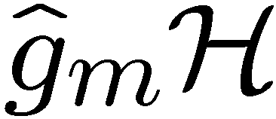
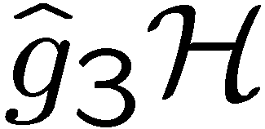
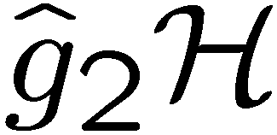
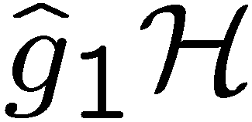





The Hidden Subgroup Conjugacy
Problem and Beyond
Dave Bacon
Computer Science & Engineering, University of Washington
f
| ⟩
QW
group

Slide 2

State of the Art
Quantum Algorithms
  Factoring, discrete log [Shor 94]
  Unstructured search [Grover 96]
  Various hidden subgroup problems [Long List]
  Pell’s equation [Hallgren 02]
  Hidden shift problems [van Dam, Hallgren, Ip 03
  Childs, van Dam 05]
  Graph traversal [CCDFGS 03]
  Spatial search [AA 03, CG 03/04, AKR 04]
  Element distinctness [Ambainis 03]
  Various graph problems [DHHM 04, MSS 03,…]
  Testing matrix multiplication [Buhrman,Špalek 04]
  …

Slide 3



The Hidden Subgroup Problem
Setup: Fix a group (known) and a subgroup (unknown). Given query access to a function f : → S that is constant and distinct on left (right) cosets of in . We say that f hides .
Problem: Find a generating set for (“identify ”).
Efficient: If runs in time polylog(| |)
f
S

Slide 4


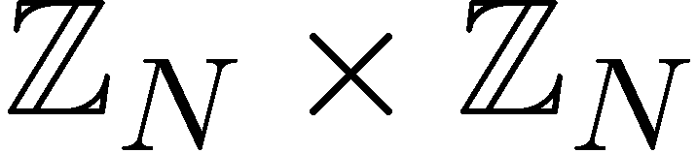

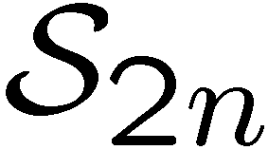

Why the Fuss?
Solved Problems (Shor 1994)
efficient algorithm for HSP
over
efficient algorithm for factoring whole numbers
efficient algorithm for HSP
over
efficient algorithm for the discrete logarithm problem
Open Problems
efficient algorithm for HSP
over (or )
efficient algorithm for the
graph isomorphism problem
efficient “standard” quantum
algorithm for HSP over
dihedral group
efficient algorithm for the poly(n) unique shortest vector in a lattice problem

Slide 5

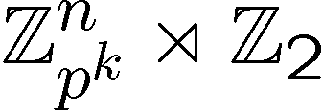
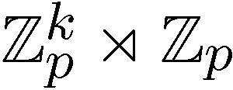
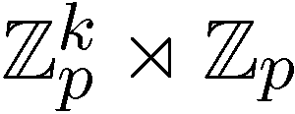
Hidden Subgroup Successes
Abelian groups [Shor 94; Kitaev 95]
[Püschel, Rötteler, Beth 98]
Normal subgroups [Hallgren, Russell, Ta-Shma 00]
“Amost Abelian” groups [GSVV 01]
[FIMMS 02]
“Near Hamiltonian” groups [Gavinsky 04]
Some q-hedral groups [MRRS 04]
[Inui, Le Gall 04]
Heisenberg type groups [Bacon, Childs,
and van Dam 05]
Some
Why THESE successes?

Slide 6





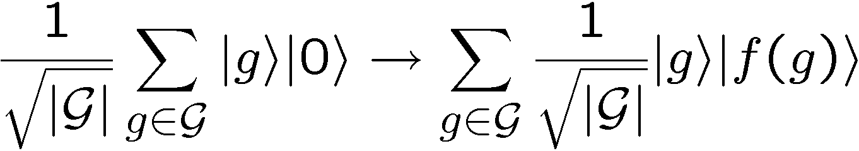
Standard Query Model
Oracle:
U_{f}
Query in equal superposition over group elements

Slide 7
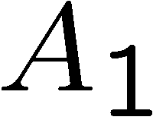
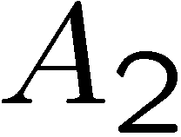
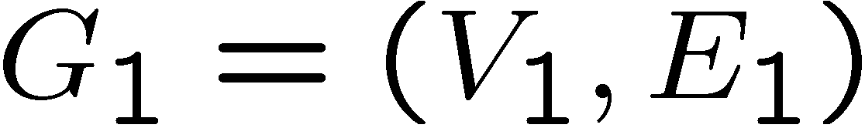
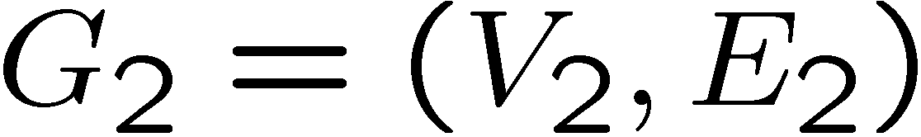

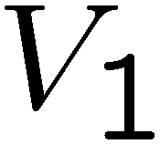
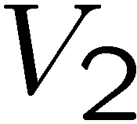
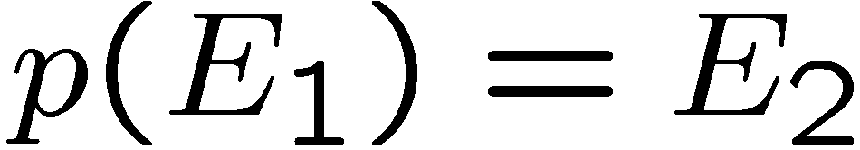
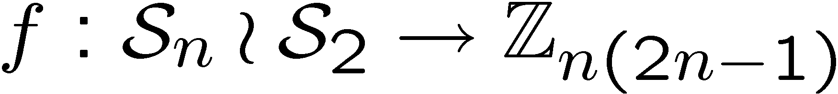

Graph Isomorphism
adjacency
matrix
adjacency
matrix
Problem: Is there a 1-to-1 mapping from the vertices to the
vertices such that the edges are respected, ?
Mapping to the HSP:
Notice now we are only worried if hidden subgroup has
a nontrivial

Slide 8
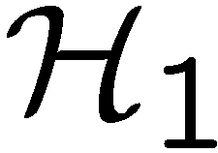
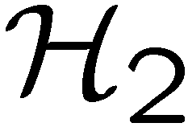
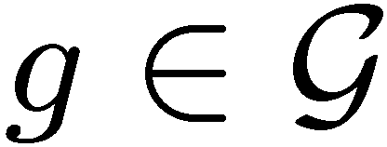
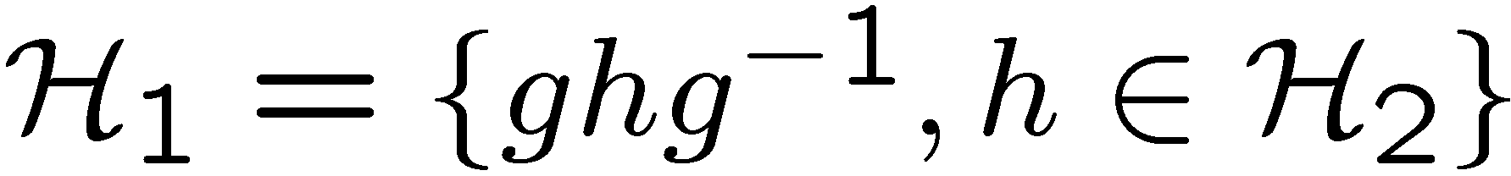

Conjugate Subgroups
Two subgroups, and , are conjugate if there exists an
element of the group such that
This is an equivalence relation among the subgroups of

Slide 9
Hidden Subgroup Conjugacy Problem
Setup: Fix a group (known) and a subgroup (unknown). Given query access to a function f : → S that is constant and distinct on left (right) cosets of in . We say that f hides .
Problem: identify the conjugate subgroup class of .
Efficient: If runs in time polylog(| |)
f
S

Slide 10
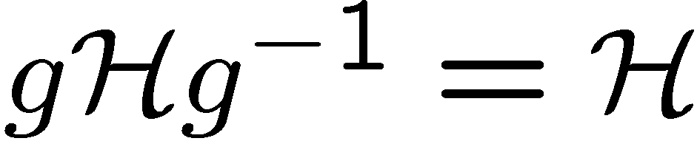
Relationships
How do the hidden subgroup problem (HSP) and the
hidden subgroup conjugacy problem (HSCP) differ?
1. If group is abelian, HSCP=HSP
All subgroups are only conjugate to themselves
2. If subgroups are normal, HSCP=HSP
All subgroups are only conjugate to themselves
These are two cases where we know quantum computers
can efficiently solve the HSP. Coincidence?

Slide 11
Graph Isomorphism
adjacency
matrix
adjacency
matrix
If we want to find the isomorphism, we can attach extra vertices
and edges to detect whether permutation of these vertices is in
isomoprhism group.
HSCP → solve graph isomorphism and identify the isomorphism

Slide 12


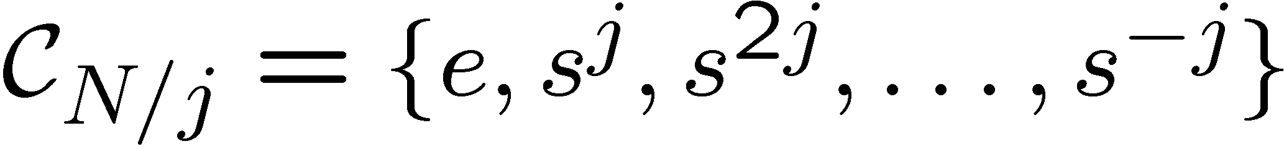
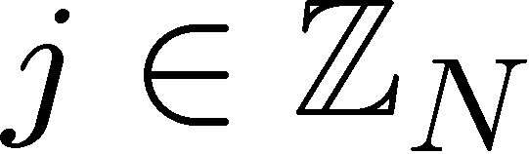
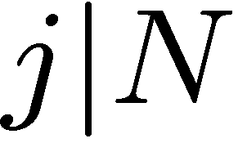
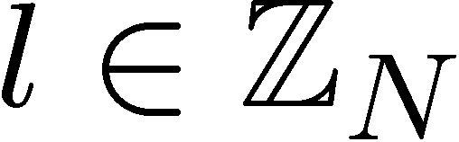
Dihedral Group
Dihedral group
group of symmetries of a N sided
regular polygon
= rotation
= reflection
Subgroups of
cyclic subgroups:
dihedral subgroups:

Slide 13
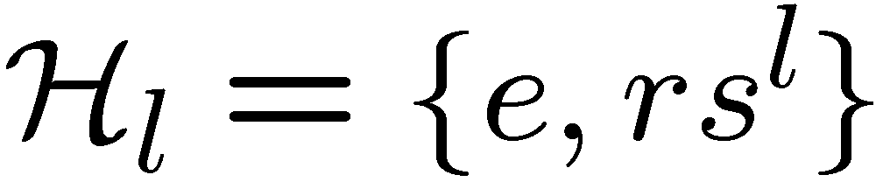
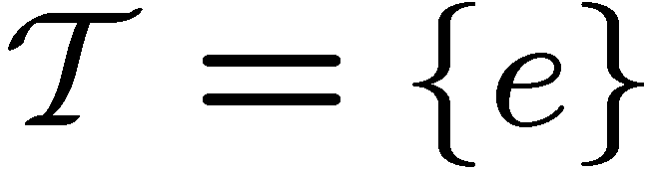

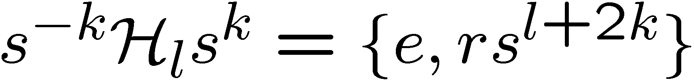
Dihedral HSP
Theorem [Ettinger, Hoyer 98]
Sufficient to solve Dihedral HSP when subgroups are
limited to
or
if is odd, then the subgroups are all conjugate to each other:
solving the Dihedral HSCP does not immediately solve
the Dihedral HSP…

Slide 14
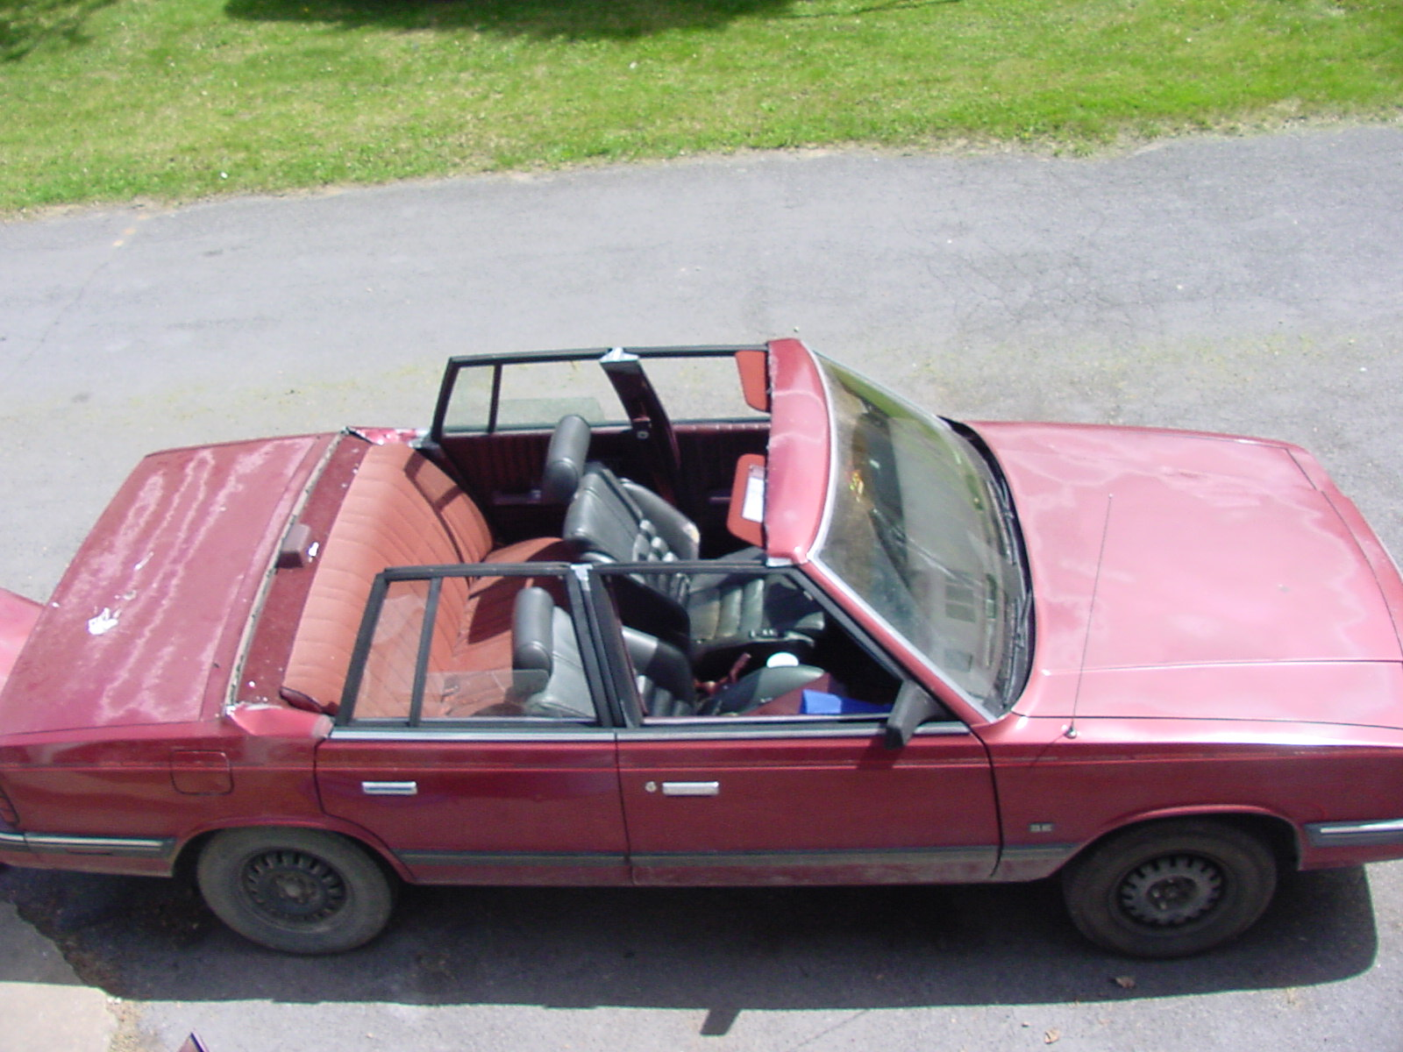
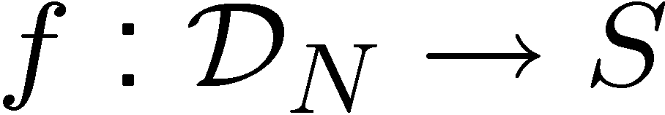
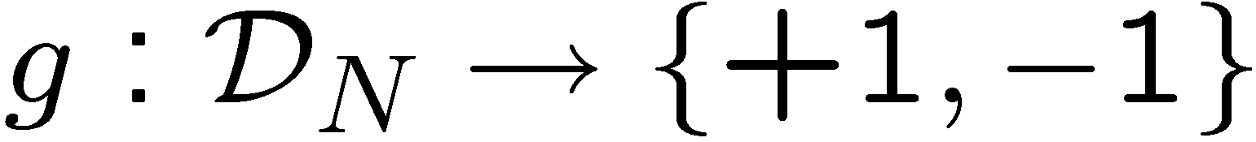
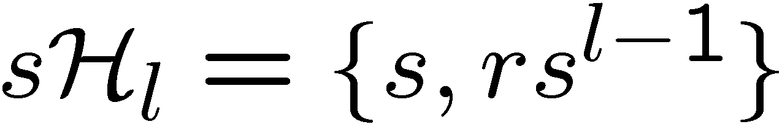
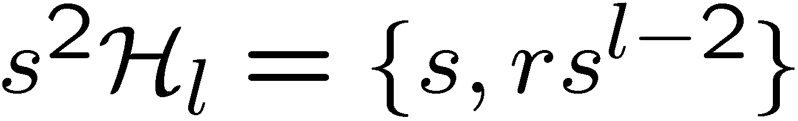
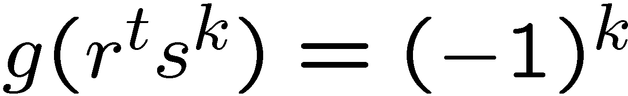

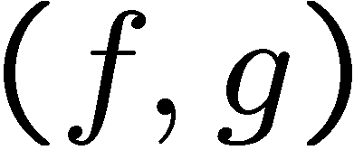

Modification
Modify the function hiding the subgroup:
left cosets:
If is even, then is constant and distinct on left cosets
of
If is odd, then is constant and distinct on left cosets
of
Solving HSCP for new problem thus allows us to distinguish
between odd and even subgroups
[Moore 05, personal communication]

Slide 15
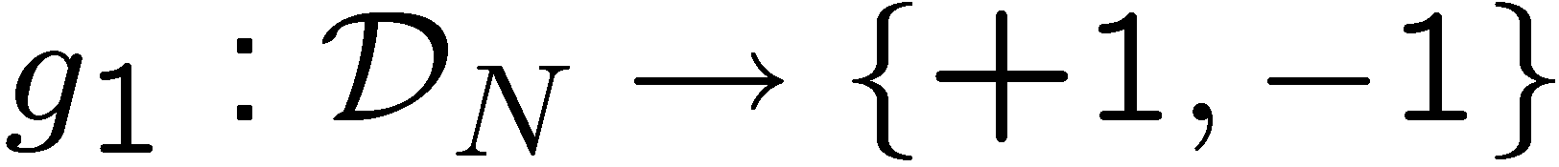
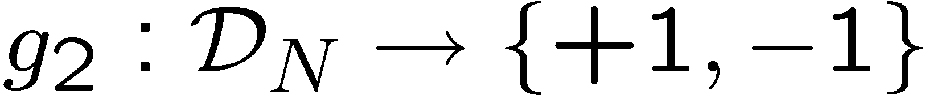
Modification
Modify the function hiding the subgroup:
left cosets:
Using more functions, we can determine 2nd least significant
bit of
Generalizing this allows us to use the Dihedral HSCP to solve
the Dihedral HSP (they are polynomial time equivalent.)
[Moore 05, personal communication]
see also [Kuperberg 03]
Open question: When are HSP and HSCP equivalent?

Slide 16

Why the HSCP?
The HSCP has more symmetry than the HSP

Slide 17




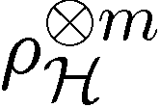
Multiple Queries
If we make a single measurement on the
HS state, can we distinguish different
In general, NO
We need multiple queries to
distinguish different subgroups
sufficient
[Ettinger, Høyer, Knill 99]

Slide 18


Multiple Queries
Can we make a measurement on
copies and
learn the subgroup?
In general (and for important case
of symmetric group) NO
[Moore, Russell, Hallgren,
Roetteler, Sen 05]

Slide 19


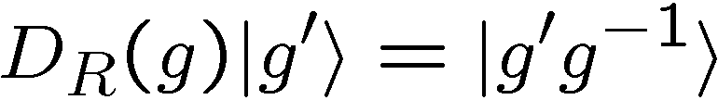

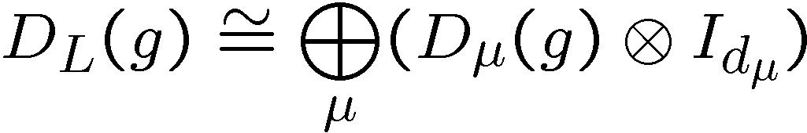
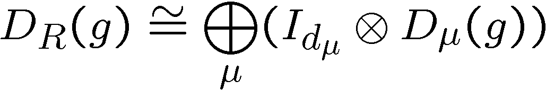



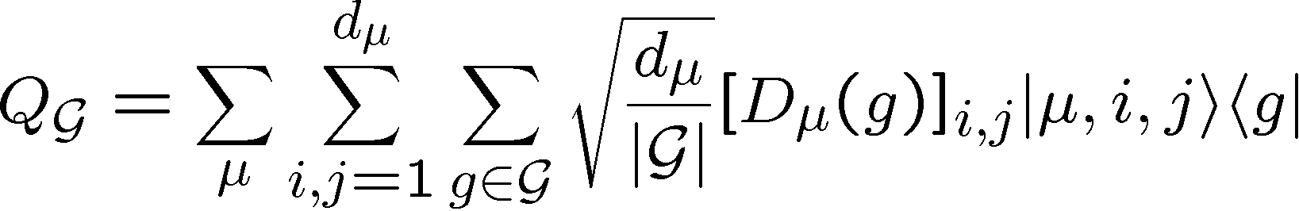
Symmetries
left regular representation
right regular representation
they commute
representation theory
sum over all irreps
The transform from the basis of group elements to this
block diagonal basis is the Fourier transform over

Slide 20
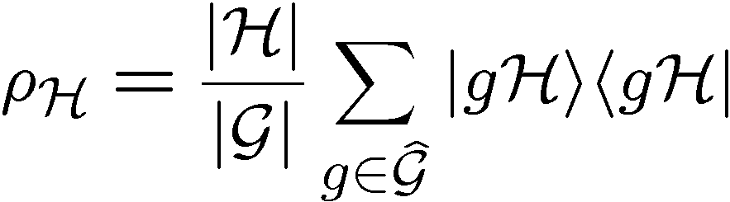


Symmetries of HS States
left regular representation
right regular representation

Slide 21
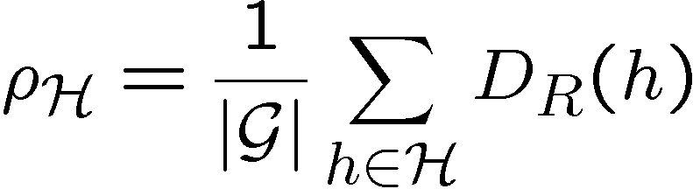

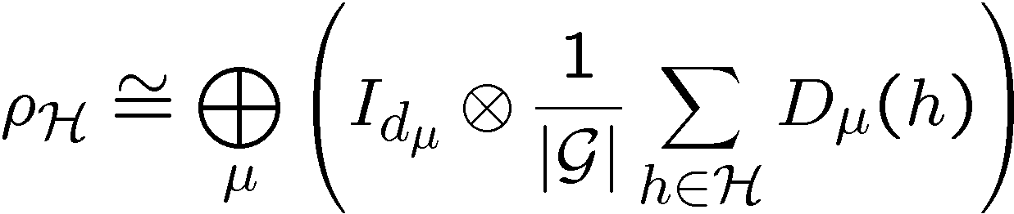



Symmetries of HS States
left regular representation
right regular representation
via Schur’s lemma this implies
after applying the Fourier transform

Slide 22

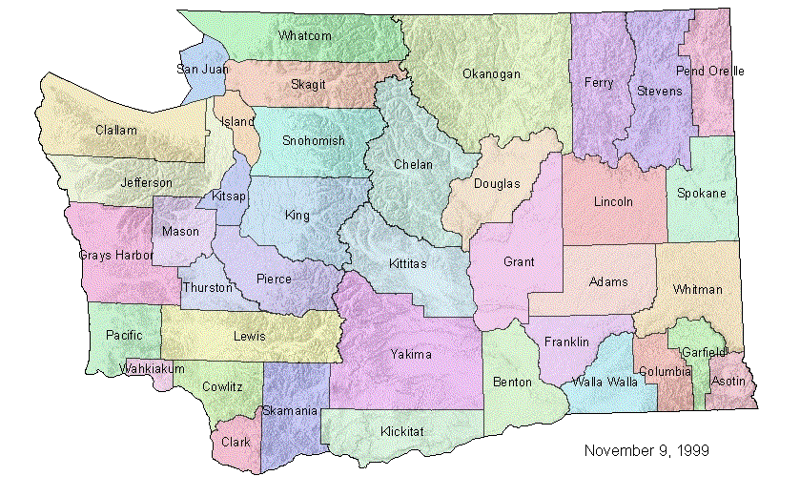
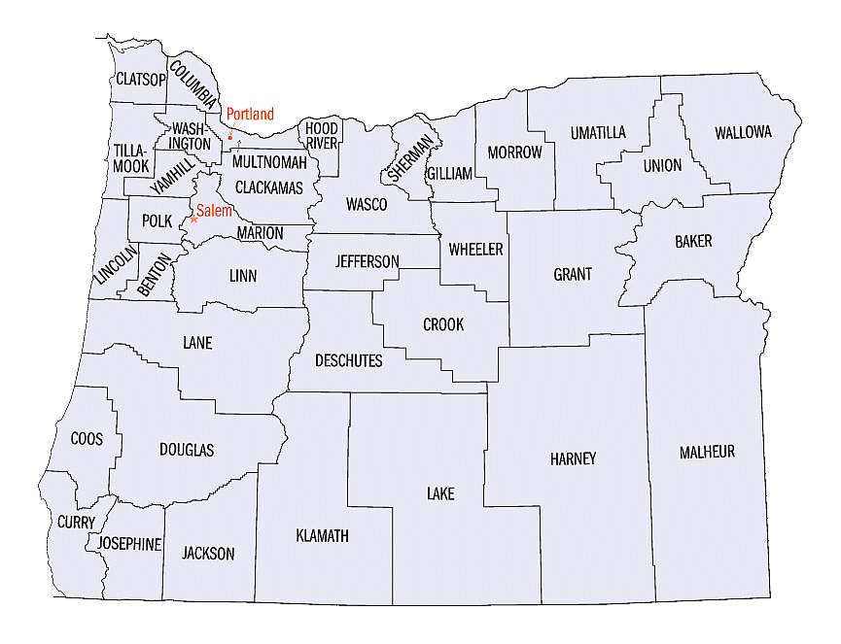
State Distinguishablity
Given with probability
Find measurement which maximizes probability of successfully
identifying
[Ip 03, Bacon, Childs, van Dam 05, Moore, Russell 05,
Bacon, Childs, van Dam 05, Childs, van Dam 05,
Childs, Wocjan 05, …]
Often the measurement which maximizing this probability is
the “pretty-good-measurement” (PGM)

Slide 23
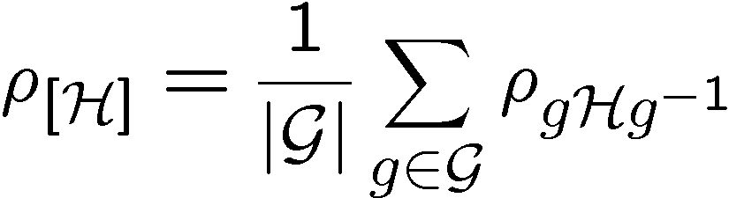


State Distinguishablity
HSCP: we don’t care about which subgroup, just it’s conjugacy. New problem
Probability:
HSC state
multiple queries:
Probability:
These states have been symmetricized!

Slide 24




Single HSC State
Single HSC state is completely diagonalized (like Abelian!)

Slide 25













Dihedral HSCP
Dihedral group
2 one dimensional irreps
two dimensional irreps

Slide 26





Optimal Measurement?
Pretty good measurement:
For Dihedral group HSCP, PGP is
But this is not the optimal measurement!

Slide 27


Multiple Query HSC States
Diagonal representation of the group

Slide 28


Clebsch-Gordan Decomposition
Averaging over this representation,
implies

Slide 29












General Circuit

Slide 30
Quantum Algorithms for HSCP
1. Prepare m copies of the HS state.
2. Perform the QFT over on each copy.
  efficient circuits for most groups of interest
  [Moore, Russell, Rockmore 03]
3. Perform CG transform on resulting states
  efficient circuits?
4. Measurement on multiplicity index
  efficient circuits?

Slide 31

The Second Role of Symmetry
Without efficient circuits for the quantum Fourier transform,
all is for naught!
Second role of symmetries:
Subgroup adapted basis provide a recursive structure
useful for constructing representation theoretic transforms
[Moore, Rockmore, Russel 03] Generic QFTs
[Bacon, Chuang, Harrow 04,06] Schur Transform

Slide 32


Clebsch-Gordan
[Bacon, Chuang, Harrow 04,06] Schur Transform
Clebsch-Gordan transform for U(d)
U(d) subgroup adapted basis (Gelfand-Zetlin basis)
Can these techniques be adapted for finite groups?
CG transform for U(d) is polynomial in d.
We want CG transform for regular representation of a finite group
efficient in log of group size.

Slide 33
The To Do List!
Are the hidden subgroup conjugacy problem and the hidden subgroup problem equivalent?
For which groups are they equivalent?
Explicit understanding of the Clebsch-Gordan symmetry involved in the dihedral and symmetric group hidden subgroup conjugacy problem.
Construction of efficient circuits for finite group Clebsch-Gordan transforms.
Identification of optimal measurement for single copy hidden subgroup problem

Slide 34



| ⟩
QW
group
Dave Bacon, Research Assistant Professor
Paul Pham, Graduate Student, CS
Gregory Crosswhite, Graduate Student, Physics
Funded by

