Slide 1

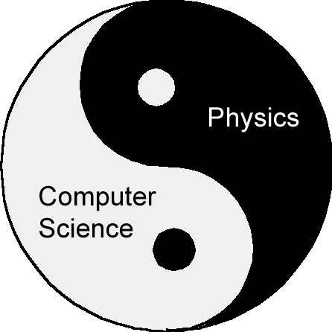
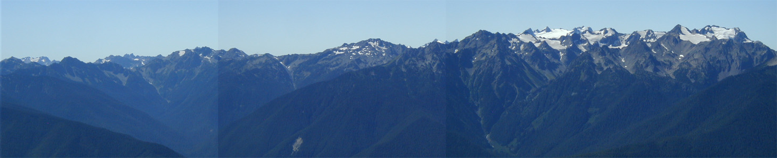
Physics and Computer Science Through the Lens of Quantum Computing
Dave Bacon
Department of Computer Science & Engineering
University of Washington, Seattle, WA

Slide 2

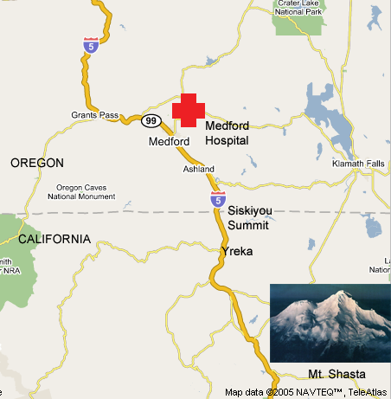
All Apologies

Slide 3
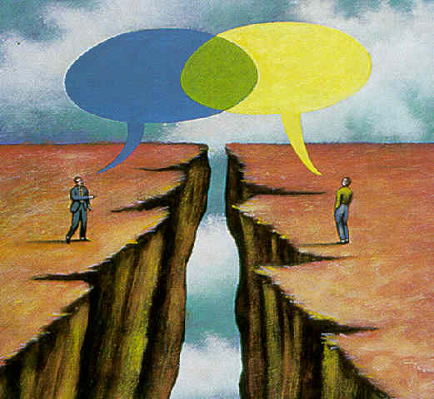
Physics and Computer Science
Err…can you
fix my computer?

Slide 4
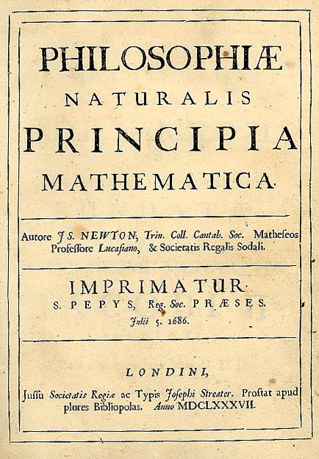
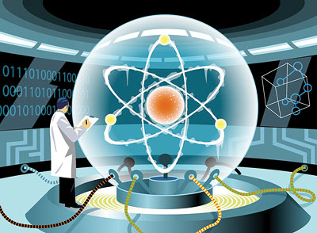
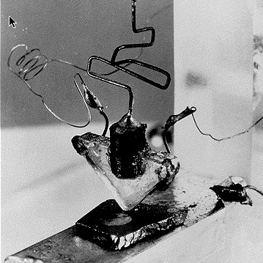
What Gets Me Out of Bed
Quantum Information Science
Intellectual Merit
Practical Consequences

Slide 5
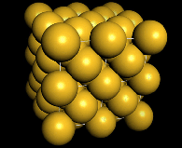
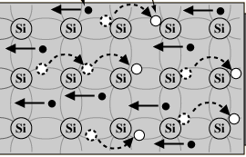
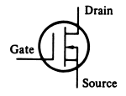
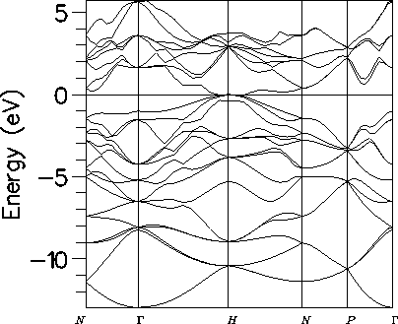
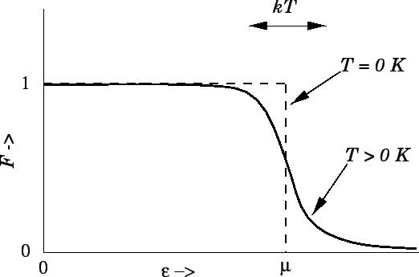
Behind the Bit
bits
noisy bits
quantum bit

Slide 6
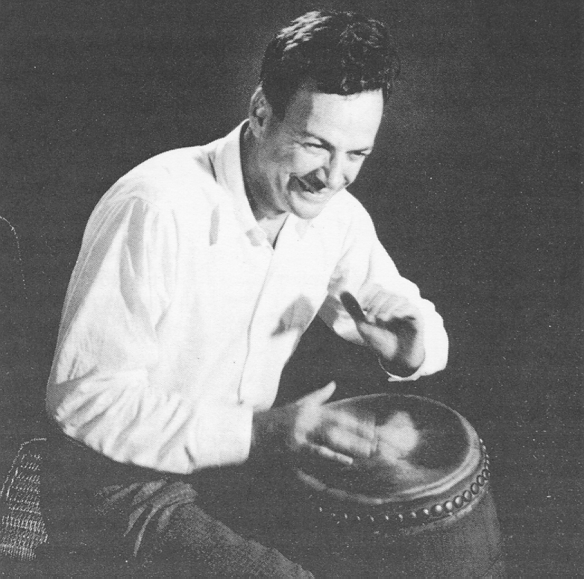
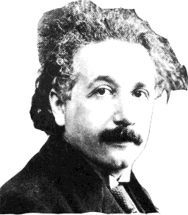
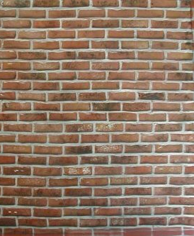
Quantum Computer?
“How can we simulate quantum mechanics?...Can we do it with a new kind of computer…a quantum computer? It’s not a Turing machine but a machine of a different kind”
- Richard Feynman (1981)
A Famous Bongo Player
simulating quantum
theory on a computer

Slide 7
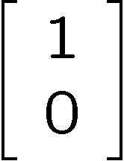
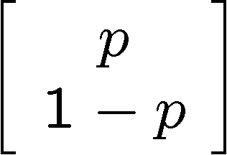
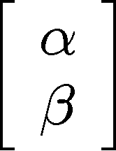


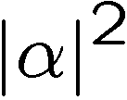
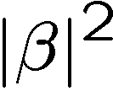
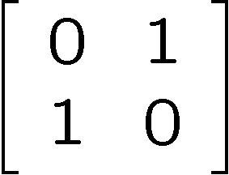
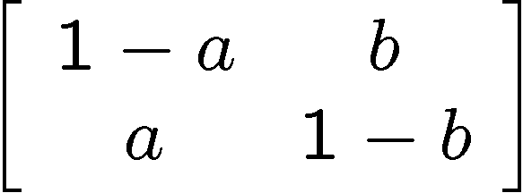
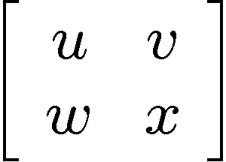
Bit, Noisy bit, and Qubit
bit
noisy bit
quantum bit
Configurations:
0
1
0
1
0
1
Description:
Observation:
0
certainty
0
p percent
0
percent
1
1-p percent
1
percent
Evolution:
deterministic
stochastic
unitary

Slide 8

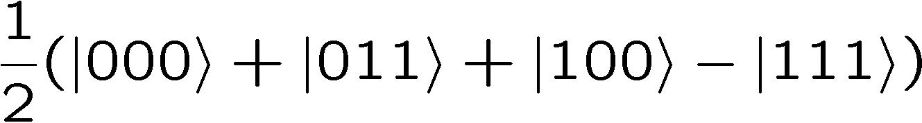


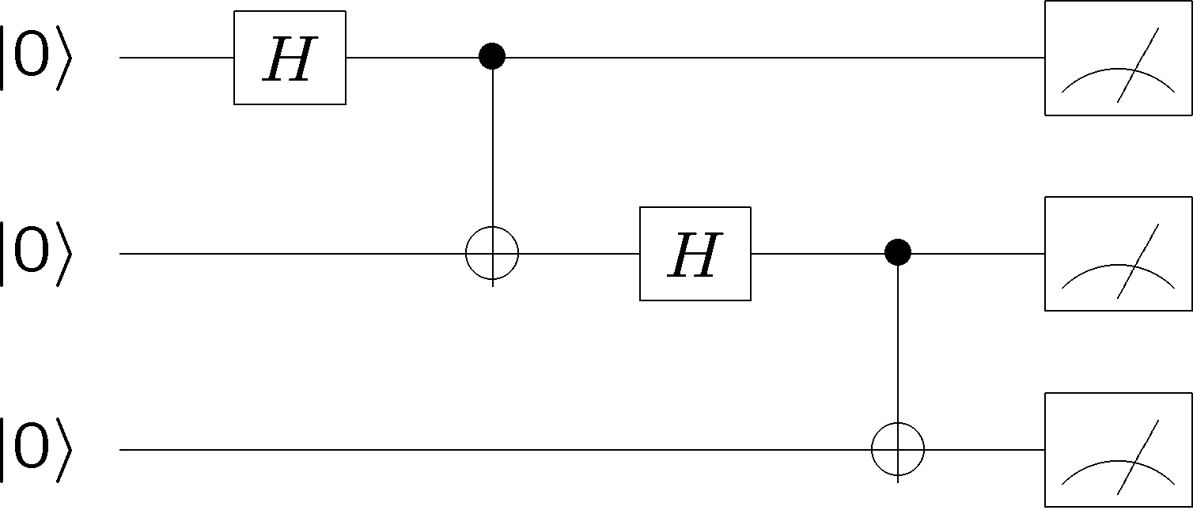
The Ideal Quantum Computer
qubits
Quantum algorithm
1. Initialize
2. Series of unitary gates
3. Measurement

Slide 9
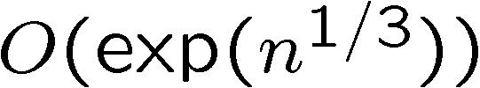

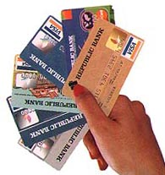
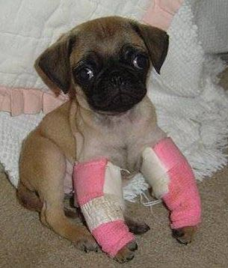
Quantum Computing
FACTORING: Given an n digit positive integer N, find its factors.
18819881292060796383869723
94616504398071635633794173
82700763356422988859715234
66548531906060650474304531
73880113033967161996923212
05734031879550656996221305
168759307650257059
18819881292060796383869723
94616504398071635633794173
82700763356422988859715234
66548531906060650474304531
73880113033967161996923212
05734031879550656996221305
168759307650257059
3980750864240649373971
2550055038649119906436
2342526708406385189575
946388957261768583317
4727721461074353025362
2307197304822463291469
5302097116459852171130
520711256363590397527
Conventional Computers:
Quantum Computer:
[Peter Shor 94]
Public Key Cryptosystems
RSA
Diffie-Hellman
Elliptic Curves
BROKEN

Slide 10
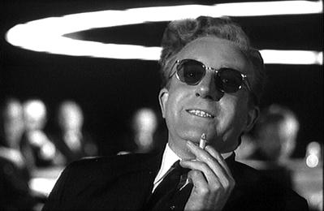
Over the Top
“Only time will tell if and when the problems of building a quantum computer can be overcome….As information becomes the world’s most valuable commodity, the economic, political and military fate of nations will depend on the strength of ciphers. Consequently, the development of a fully operational quantum computer would imperil our personal privacy, destroy electronic commerce and demolish the concept of national security. A quantum computer would jeopardize the stability of the world. Whichever country gets there first will have the ability to monitor the communications of its citizens, read the minds of its commercial rivals and eavesdrop on the plans of its enemies. Although it is still in its infancy, quantum computing presents a potential threat to the individual, to international business and to global security.” -Simon Singh

Slide 11
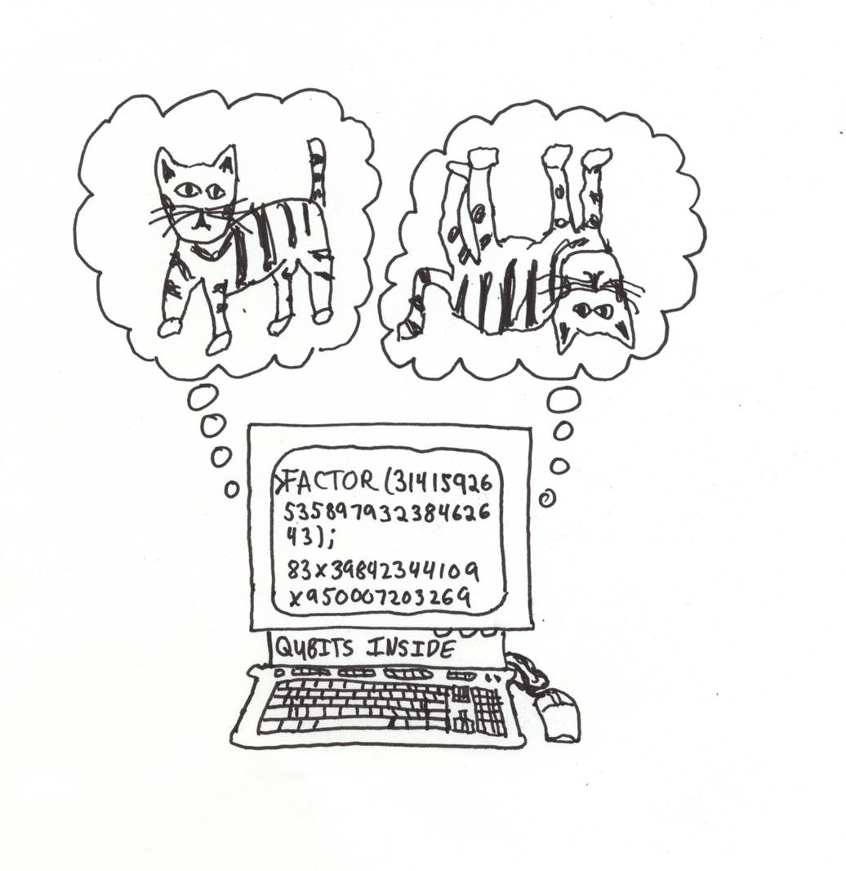
Quantum Algorithms
Quantum algorithms > Classical algorithms
  Factoring, discrete log [Shor 94]
  Unstructured search [Grover 96]
  Pell’s equation [Hallgren 02]
  Hidden shift problems [van Dam, Hallgren, Ip 03]
  Graph traversal [CCDFGS 03]
  Spatial search [AA 03, CG 03/04, AKR 04]
  Element distinctness [Ambainis 03]
  Various graph problems [DHHM 04, MSS 03,…]
  Testing matrix multiplication [Buhrman,Špalek 04]
  Simulation of quantum systems
Applications to chemistry,
biology, material science….

Slide 12
Quantum Computing?
What merit? (beyond new algorithms which scare the NSA)
What gives quantum computers their power
over classical computers
How building a quantum computer will result
in a new phase of matter

Slide 13
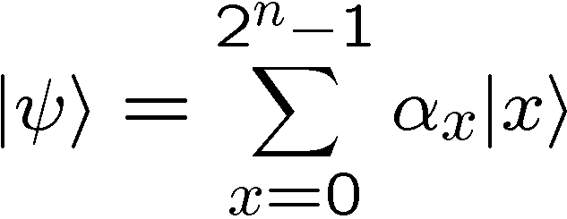
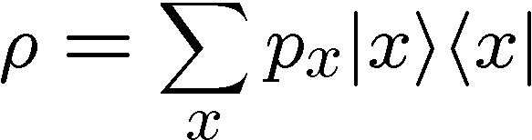
Quantum Computer = Parallel Computer?
n qubits = superposition over 2^{n} states
“massively parallel computer”?
NO!
Measurement results
in only one outcome
Compare:
n noisy bits = convex sum of 2^{n} states

Slide 14

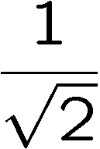
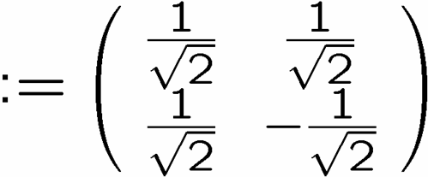

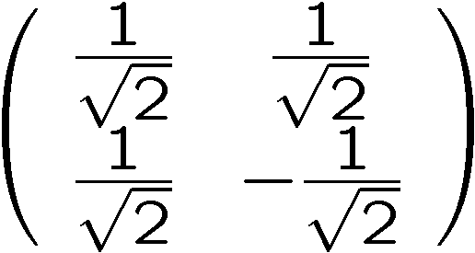
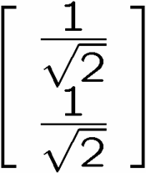
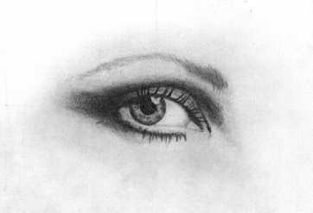
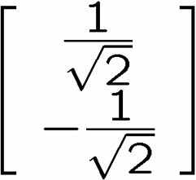
Interference?
0
0
1
1
qubit
input
0
50%
100%
1
50%
0%
measure
0
50%
0%
1
50%
100%
measure

Slide 15

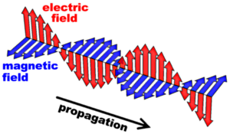
Not Interference
Interference is not only quantum mechanical

Slide 16
GHZ/Mermin Game
Alice
Input A
Output a
Bob
Input B
Output b
Input: X or Y, Output: +1 or -1
Winning Payoffs:
A B C abc
X X X +1
Y Y X -1
Y X Y -1
X Y Y -1
Charlie
Input C
Output c
deterministic local strategies, given by a_{X} a_{Y} b_{X} b_{Y} c_{X} c_{Y}
a_{Y} b_{Y} c_{X} = -1
even with
prior classical
communication
not possible
to always win
a_{Y} b_{X} c_{Y} = -1
×
a_{X} b_{Y} c_{Y} = -1
convex sum
of deterministic
local stratgies
a_{X} b_{X} c_{X} = -1

Slide 17

GHZ/Mermin Game
Alice
Input A
Output a
Bob
Input B
Output b
Input: X or Y, Output: +1 or -1
Winning Payoffs:
A B C abc
X X X +1
Y Y X -1
Y X Y -1
X Y Y -1
Charlie
Input C
Output c
Quantum communication before game is played:
Each party measure along
X or Y direction
⟨GHZ|XXX|GHZ⟩=+1
⟨GHZ|YYX|GHZ⟩=-1
⟨GHZ|YXY|GHZ⟩=-1
⟨GHZ|XYY|GHZ⟩=-1
possible to always win!

Slide 18
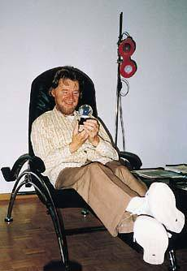


Bell’s Theorem
Alice
time
Bob
space
Separable:
Entangled:
John Bell
Measurements on space-like separated entangled quantum systems cannot be explained by local classical communication.

Slide 19
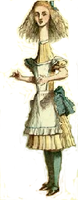

Minimizing the
Yakking
1 if a=b
0 if a≠b
F_{eq}(a,b)=
ALICE
BOB
a
b
0
1
0
1
0
0
1
1
1
0
n bits
n bits
How many bits do Alice and Bob need to exchange
(in the worst case) to compute F(a,b)?
With no error: n+1 bits
With one-sided error ε: O(log(n/ε)) bits

Slide 20
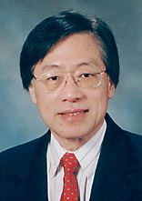
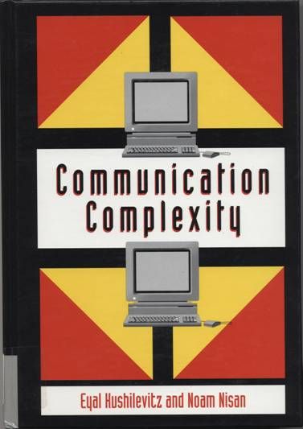
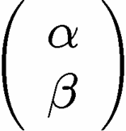
Communication Complexity
Classical communication
costs of distributed
classical computations
[Yao, STOC 79]
[Kushilevitz and Nisan 96]
Quantum communication
costs of distributed
classical computations
[Yao, FOCS 93]
exchange qubits

Slide 21

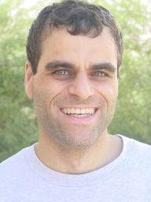
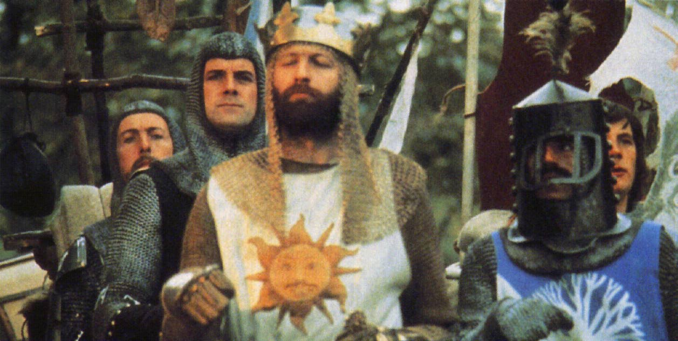
Quantum Communication
Complexity
Holevo’s Theoerem: sending n classical bits
over a quantum channel requires n qubits
There exist functions F(a,b) which require
Ω(m^{1/4}/log(m)) bits of communication to solve
(with error) but can be solved using only
O(log(m)) qubits of communication.
(m is the length of a and b)
[Raz, STOC 99]
Exponential benefit of
quantum over classical.

Slide 22

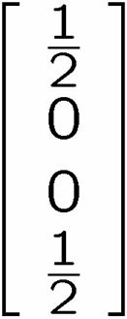

Teleportation (Demystified)
Alice wants to send to Bob
1 bit
A
1 bit
B
AB
If Alice’s bit is 1,
then flip A
If received bit is 1,
then flip B

Slide 23
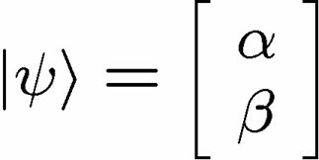

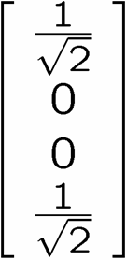
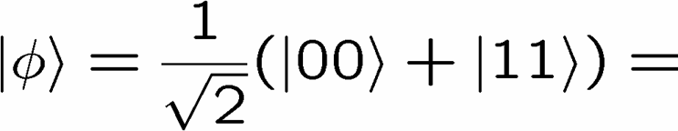
Quantum Teleportation
Alice wants to send to Bob
1 qubit
X
2 bits
Y
Alice performs operation on
her state and half of entangled
system and sends outcome
Conditional on received bits,
Bob performs manipulation of
his half of entangled system

Slide 24

Rehash
There exist functions F(a,b) which require
Ω(m^{1/4}/log(m)) bits of communication to solve
(with error) but can be solved using only
O(log(m)) bits and O(log(m)) ebits.
(m is the length of a and b)
[Raz, STOC 99]
1 ebit :=
Entanglement can be used to gain exponential reduction in
  communication resources
2. Entanglement is “like” classically correlated bits…but it’s
  different…
Preliminary thesis: entanglement is involved in quantum benefits

Slide 25




Quantifying Entanglement
Pure state bipartite entanglement
Entropy of one-half of mixed state is measure of entanglement
Schmidt decomposition: r is the Schmidt rank
Schmidt rank is upper bound on entropy:
Crucial insight: r numbers to describe entangled state

Slide 26

“Small” Entanglement
n qubits
A
B
Theorem [Vidal 03]: If χ is O(poly(n)) then there is an efficient
description of the state. If χ remains small throughout a quantum computation then there is a O(poly(n)) classical simulation of the quantum computation.
“Small” Entanglement = Efficiently Classical Simulation

Slide 27

Matrix Product States
“Small” Entanglement = Efficiently classical simulation
?
Better classical algorithms for simulating
real world quantum systems?
M₁
M₂
M₃
Matrix Product States: (Each M_{i} requires D²s numbers)
Schmidt rank bounded by D ⇒ D small, efficient simulation
Density Matrix Renormalization Group [White]

Slide 28
Perimeter “Law”
In many quantum systems, the low energy sector has an entropy of a region which grows like the perimeter of the region
“Small” entanglement

Slide 29
DMRGish Algorithm in 2D
Design states which
respect this scaling!
Efficient algorithms for simulating low energy sector of
high (spatial) dimensional systems.
[Verstraete, Cirac 04]

Slide 30
Quantum Computing?
What gives quantum computers their power
over classical computers
New classical algorithms for use by physicists!
Inverting promise of quantum computing!

Slide 31
Quantum Computing?
How building a quantum computer will result
in a new phase of matter

Slide 32






Two Views of Information
Information is “fungible” adj. being of such a nature that one part or quantity may be replaced by another equal part or quantity in the satisfaction of an obligation.
Al Gore
George Bush
Ralph Nader
Pat Buchanan
No Information without Physical Representation!
Not all physical systems are robust
information processing machines
Rolf Landauer

Slide 33
The Ideal Quantum Computer
qubits
Quantum algorithm
1. Initialize
2. Series of unitary gates
3. Measurement

Slide 34



Obstructions
DECOHERENCE
Environment
Total Hamiltonian
System
system
environment
interaction
open quantum systems can become entangled with their environment
coherent superposition
incoherent sum
Quantronium (CEA, France)

Slide 35








More Obstructions
FAULTY CONTROL
System
Controller
Imperfect state
preparation
Imprecise or faulty unitary gates
Imperfect
measurements

Slide 36

This is the End, My Only Friend, the End
Everything, (quantum) noisy, all the time.
Is a Quantum Computer Even a Computer?
A skeptics checklist:
1. quantum data is analog
2. quantum data likes to become classical data
3. quantum evolution is analog
Laughlin
4. quantum theory is wrong

Slide 37

Quantum Data is Analog
n qubit quantum state:
Objection:
Superposition of an exponential number of states.
Each amplitude is a complex number…i.e. analog data
How do you control 2^{n} complex numbers?
In the real world, nothing can be done with infinite precision

Slide 38
Quantum data likes to become classical data
coherent superposition
incoherent sum
Decoherence is a complex process which is fundamentally
responsible for there being classical information
Quantronium (CEA, France)
Decoherence is irreverislbe

Slide 39


Quantum Evolution is Analog
Quantum evolution:
A unitary “gate” also has a bunch of complex numbers
Each amplitude is a complex number…i.e. analog data
In the real world, nothing can be done with infinite precision

Slide 40
Quantum Theory is Wrong
Quantum theory has only ever been observed for small
(micro to meso) systems.
It will break down for large systems

Slide 41
This is the End, My Only Friend, the End
Everything, (quantum) noisy, all the time.
Is a Quantum Computer Even a Computer?
A skeptics checklist:
1. quantum data is analog
2. quantum data likes to become classical data
3. quantum evolution is analog
Laughlin
4. quantum theory is wrong
Why Is Classical Computation Possible?

Slide 42










Classical Solutions
Probability of bit flip = p
Solution: redundancy
Probability of failure =3(1-p)p²+p³
=3p²-2p³
<p if p<1/2
Use redundancy to protect information against noise
Claude Shannon 1948
“A mathematical theory of communication”

Slide 43


More Classical Solutions
Classical gates fail with probability p
Solution: error correcting codes + fault tolerant construction
M
John von Neumann, 1956
“Probabilistic logics and the synthesis of reliable organisms from unreliable components”
M
M

Slide 44










Quantum Problems?
No cloning of quantum information
How to perform error correction without measuring?
Quantum errors seem “analog”
system
decohered system
environment

Slide 45











Quantum Observations
How to perform error correction without measuring?
Observation: not all measurements destroy quantum information
Information encoded into a subspace undisturbed
Can detect “leaving” of subspace

Slide 46















Quantum Observations
By encoding into subspaces we can correct single bit flips

Slide 47

Quantum Problems?
Environment
qubit
digitized effects of decoherence
Think: amplitude for no error, X error, Y error, Z error

Slide 48




Quantum Error Correcting Codes
Encode qubit into 2 dimensional
subspace with all +1 eigenvalues
Single qubit errors (i.e. )
all lead to a unique subspace labeled by s_{i} eigenvalues
“bare” error rate = p
error rate on encoded = O(p²)

Slide 49






Perfection Through Concatenation
failure
probability
p
cp²
c(cp²)²
At k^{th} level of concatenation, probability of an error which
destroys the encoded quantum information is
and uses qubits

Slide 50

Fault-Tolerant Quantum Computation
Must design quantum circuits which succeed even when
every element of the circuit (preparation, unitary gates,
measurements) can fail.
Quantum error correction + Fault-tolerant procedures

Slide 51

Quantum Threshold Theorem
QC
errosol
“decoherence”
“imprecision”
Threshold Theorem for Fault-Tolerant Quantum Computation
[Aharonov, Ben-Or, Knill, LaFlamme, Zurek,
Kitaev, Gottesman, Preskill, Shor, + others]
If noise is weak enough and control is precise enough, then a
quantum computation to a desired accuracy can be carried out
with an overhead polynomial in the log of the accuracy.

Slide 52
Lessons
1. quantum data is analog
Degrees of freedom
Description of system
analog
digital
deterministic
probabilistic
quantum
2. quantum data likes to become classical data
quantum information can be encoded
encodings can reduce effective error rate
quantum noise can be “digitized”
3. quantum evolution is analog
encoded quantum information can be computed on
fault-tolerant constructions can be error corrected
4. quantum theory is wrong
maybe, but then…what a discovery!!!

Slide 53
Threshold(s) Theorem(s)
Threshold theorems come in many different forms….
provable bounds, Monte Carlo estimates, …
different shapes…
assumptions of error models
assumptions of physical devices
assumptions of architectures
yielding threshold values for relative error rates from
10⁻⁹ to 10⁻²

Slide 54
History
1994-5
Shor, Steane invent quantum error correction
Shor invents FT protocols
Aharonov, Ben-Or
FT Proof
Knill, Laflamme, Zurek
FT Estimate
Kiteav
Topological QC
FT Proof
1996
Zalka
Threshold estimate
(10⁻⁴)
1997-2003
Everyone admires how cool the threshold theorem is
Aliferis, Gottesman, Preskill
FT Proof (2.7 x 10⁻⁵)
Knill / Reichardt (1 x10⁻²)
Threshold estimates
(High overhead ancilla
factories)
2004-NOW
Aliferis, Cross
FT Proof (1.9 x 10⁻⁴)
Renaissance

Slide 55


Developments
Spatial architecture
Gottesman / Aharonov, Ben-Or (1999)
Still a threshold with “local gates”
Denis, Gottesman, Kitaev, Preskill (2001)
Topological quantum memory
Memory threshold of 10⁻⁴
(Fast reliable classical control)
Svore, Terhal, DiVincenzo (2004)
~factor of 10 loss in 2D
Szkopek et al., (2004)
~factor of 100 loss in 1D
Raussendorf, Harrington (2006)
Local in 2D, threshold estimate 5x10⁻³
Why Should Physicists Care?

Slide 56




Toy Classical Model
Ising model in two+ dimensions
Redundancy code:

Slide 57






Dynamical Ising Model
Energy of excitation=
2J (Sum of perimeters of flipped domains)
Dynamics obeying principle of detailed balance:
Competition between growth and decimation of flipped domains

Slide 58








Robust
Relaxation to thermal
Imperfect preparation
Manipulation
The two encoded states have lifetimes which grow with the size
of the system:
free energy
magnetization

Slide 59

Why Should Physicists Care?
Spatial architecture
Local quantum many-body system
with a new interesting order parameter:
The Quantum Error Correcting Order Parameter(s)
Can we engineer simple many-body quantum systems where quantum error correction is enacted by the physics of the device?
Today: Partial answers to this question. But a grand challenge!

Slide 60

Our Probable Paths
quantum error
correcting architectures
Physics motivated methods
for error correction
Engineering
Physics

Slide 61
Physics and Computer Science Through the Lens of Quantum Computing
Dave Bacon
Department of Computer Science & Engineering
University of Washington, Seattle, WA

Slide 62




Fault-Tolerance
Everything noisy:
Compute on qubits encoded in quantum error correcting code?
encoded Paulis
COMPARE
Exact:
Error:
Exact:
Error:
single qubit Z

Slide 63





Accuracy?
oops
Error in probabilities is less than
Errors add
Each gate should be implemented with
polynomial accuracy in circuit size
Fault-tolerant universal gate sets:

