Slide 1
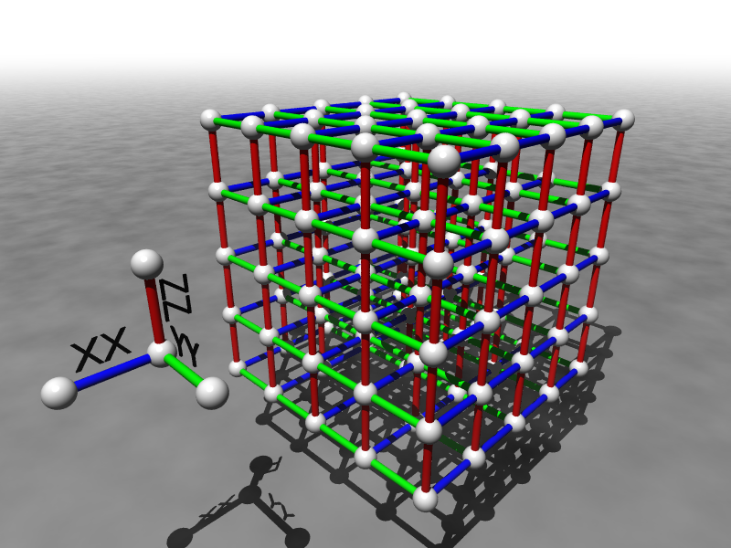

Novel Methods for Robust
Quantum Computation
Dave Bacon
Department of Computer Science & Engineering
University of Washington
funded by

Slide 2
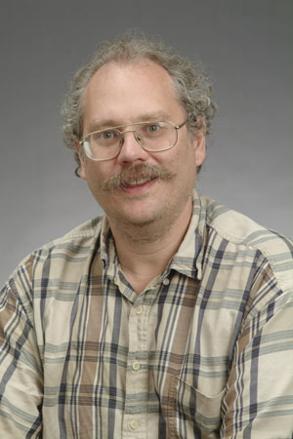
1994
18819881292060796383869723946165043
98071635633794173827007633564229888
59715234665485319060606504743045317
38801130339671619969232120573403187
9550656996221305168759307650257059
3980750864240649373971
2550055038649119906436
2342526708406385189575
946388957261768583317
4727721461074353025362
2307197304822463291469
5302097116459852171130
520711256363590397527
Peter Shor discovers that a computer which uses
quantum data and quantum gates, can be used to efficiently factor and hence break the most widely used public key cryptosystems

Slide 3
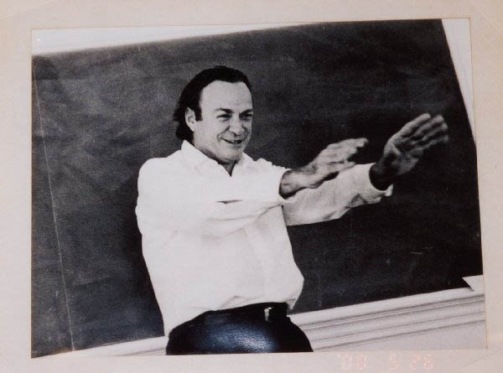
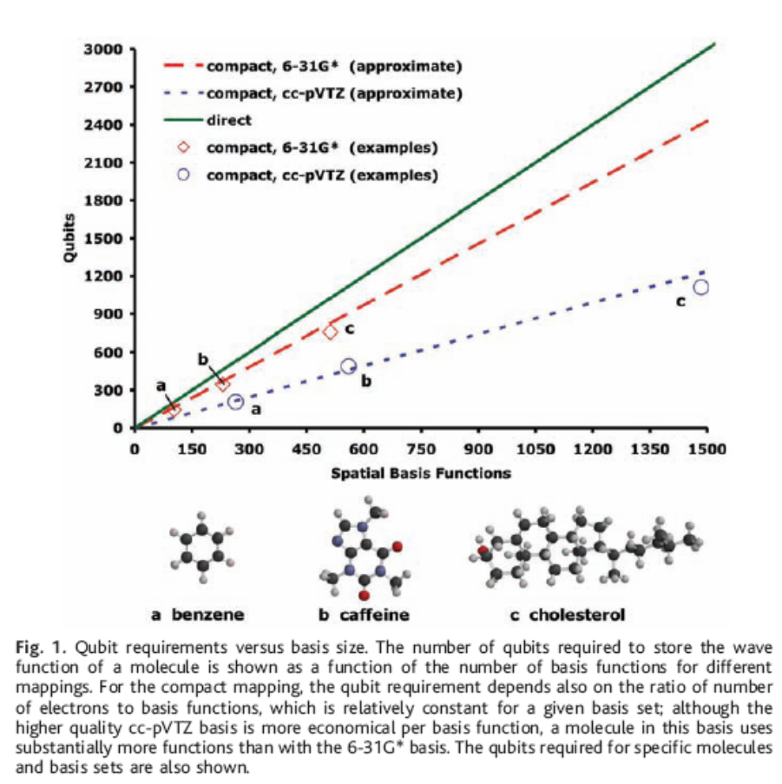
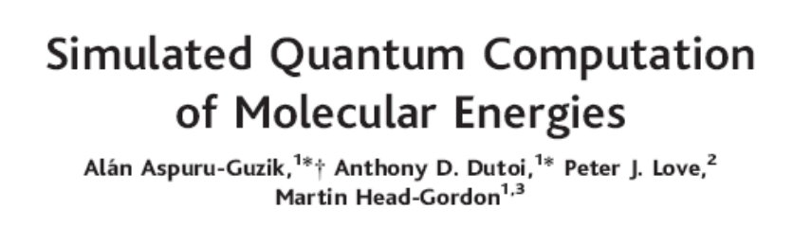
Quantum Simulation
Richard Feynman
Science 9 September 2005:
Vol. 309. no. 5741, pp. 1704 - 1707
“For most molecules and basis set combinations shown in Fig. 1, an FCI calculation is certainly classically intractable…This demonstrates an often-stated conjecture, that quantum simulation algorithms with 30 to 100 qubits will be among the smallest applications of quantum computing that can exceed the limitations of classical computing.”

Slide 4


The First Problems
THE DECOHERENCE PROBLEM
Environment
System
open quantum systems can become
entangled with their environment
EXAMPLE:
evolve
coherent superposition
evolve
incoherent sum
Decoherence turns quantum information into classical information
It does this on a time scale which only a few hundred to million times slower than the rate we can manipulate the quantum information

Slide 5




Second Problem
THE FAULTY CONTROL PROBLEM
System
Control
unitary gates cannot
be implemented with
arbitrary accuracy
THE FAULTY MEASUREMENT PROBLEM
measurements are imperfect
wrong result, wrong resulting state
related state preparation problem

Slide 6

Problem Solution
QC
errosol
“decoherence”
“imprecision”
Threshold Theorem for Fault-Tolerant Quantum Computation
[Aharonov, Ben-Or, Kitaev, Knill, LaFlamme, Zurek, Shor, Gottesman, Preskill]
If decoherence is weak enough and control is precise enough,
then a quantum computation to a desired accuracy can be
carried out with an overhead polynomial in the log of the accuracy.

Slide 7
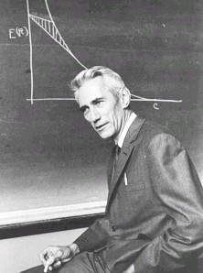
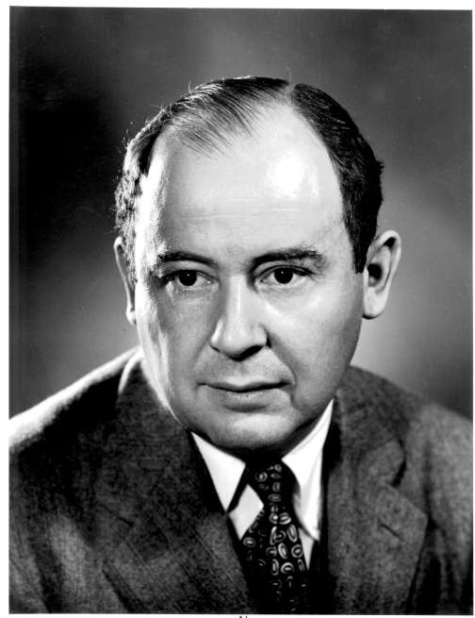
To Build a Quantum Computer
Classical
Problem (1938): How to build a reliable system from
unreliable components?
“A mathematical theory of communication” (1948)
How to communicate in the presence of noise
“Probabilistic logics and the synthesis
of reliable organisms from unreliable
components” (1956)
Claude
Shannon
How to compute when the subsystems
of your computer can fail?
John
von Neumann

Slide 8
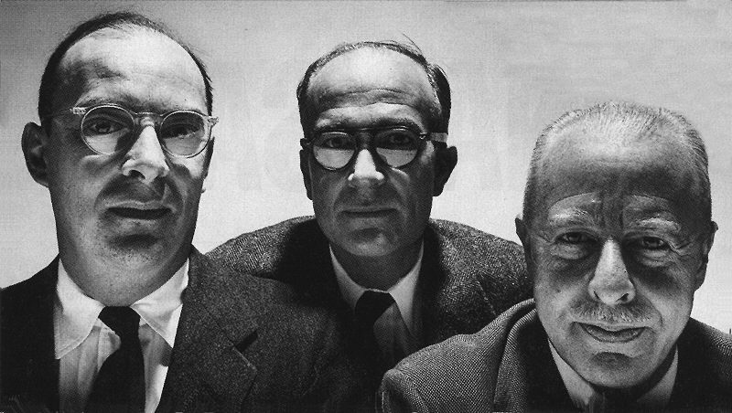
A Different Path

Slide 9


Three Storage Testbeds
Ferromagnetic Ising models:
A. one dimensional
B. two (and >) dimensional
Toom’s rule:
0
0
1
0
0
0
0
0
0
1
1
0
1
0
0
0
C. two dimensional noisy
cellular automata
0
1
0
0
0
0
0
0
0
0
1
1
1
1
1
0
0
0
0
0
1
0
1
0
1
1
1
0
0
0
0
0

Slide 10
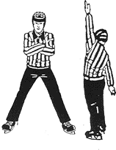

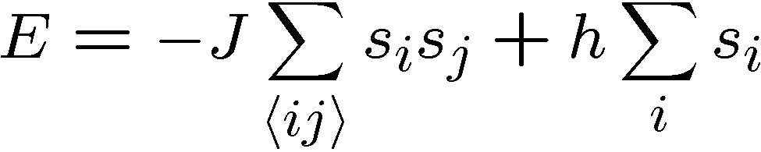


Ferromagnetic Ising Models
Ising model
spins on edges of a lattice:
energy of a configuration:
sum over neighbors
external magnetic field
for now

Slide 11

Dynamic Ising Models
Dynamic Ising model (Metropolis update)
Interaction with environment causes spin flips
Update rule:
If flipping spin would decrease energy, flip spin
If flipping spin would increase energy, flip spin with probability

Slide 12
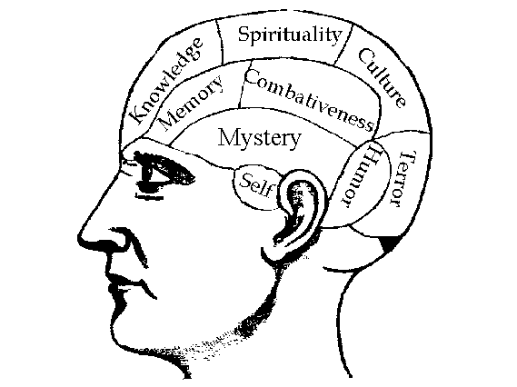


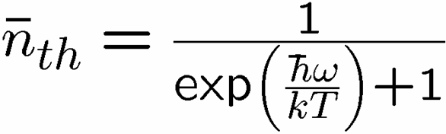

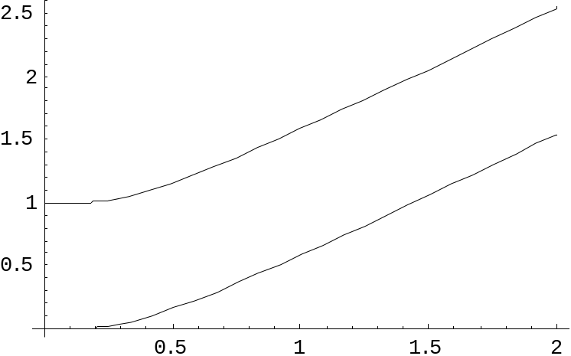
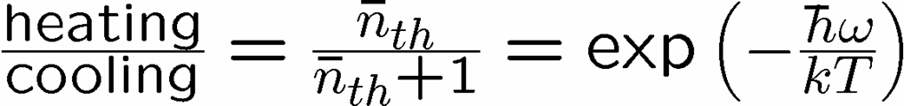


Reminder
two-level system perturbatively coupled to a thermal boson bath
“heating”
“cooling”
“non-dissipative”

Slide 13
Dynamic Ising Models
Dynamic Ising model (Metropolis update)
Interaction with environment causes spin flips
Update rule (alternate with noise):
If flipping spin would decrease energy, flip spin
If flipping spin would increase energy, flip spin with probability

Slide 14
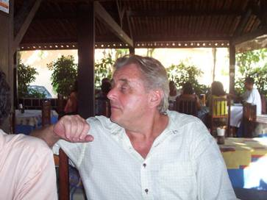
Toom’s Rule
0
0
1
0
0
0
0
0
0
1
1
0
1
0
0
0
two dimensional noisy cellular automata
0
1
0
0
0
0
0
0
0
0
1
1
1
1
1
0
0
0
0
0
1
0
1
0
1
1
1
0
0
0
0
0
Update rule:
n
n
b=majority(n,e,b)
a
e
b
e
0
0
0
0
0
0
0
0
0
0
0
0
0
0
0
0
0
1
1
0
0
1
0
0
0
0
0
0
0
0
0
0
0
1
0
0
0
1
0
0
0
1
0
0
0
0
0
0
0
0
0
0
0
0
0
0
0
0
0
0
0
0
0
0
Update rule with noise: with some probability the update fails
and a random state is assigned

Slide 15


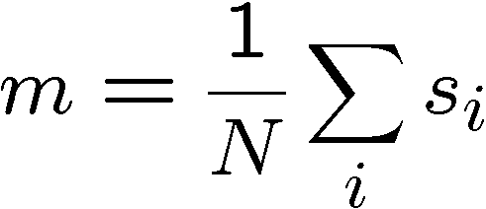
Compare and Contrast
Encode information into the system and watch what happens
0
0
0
0
0
0
0
0
0
0
0
0
0
0
0
0
0
0
0
0
0
0
0
0
0
0
0
0
0
0
0
0
0
0
0
0
0
0
0
0
0
0
0
0
0
0
0
0
Redundancy code.
Order parameter is magnetization:

Slide 16



Storage
Long time behavior (not infinite time, but effectively)
1D Ising
2D Ising
Toom’s Rule
Criticism: (1) thermodynamic limit taken
(2) what if relaxation to equilibrium takes a long time?

Slide 17
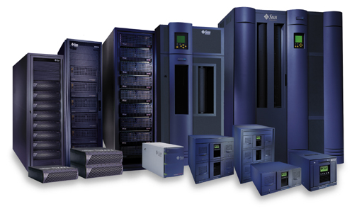


Storage
2nd attempt:
Relaxation to thermal
1D Ising
2D Ising, Toom’s Rule
Imperfect preparation

Slide 18
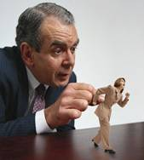




Manipulation
Flipping spins is imperfect
2D Ising
Toom’s Rule
1D Ising
1D Ising
temperature less than gap
manipulation error must be small
(i.e. NOT fault-tolerant)
2D Ising
temperature less than critical temp

Slide 19















“Self Fixing”
Excitations point-like
Energy to err is constant
Disordering entropy >> Energy
Excitations string-like
Energy to error is prop to size
Energy >> Disordering entropy

Slide 20

Toom’s Rule Versus 2D Ising
Applied magnetic field (corresponds to a bias in noise)
2D Ising
Toom’s Rule
Regions with two coexisting phases
External magnetic fields disorder magnetic media

Slide 21

Lessons
encode information into error correcting code
0
2. energy gaps can slow loss of information
important for memory
keep cold
3. excited state energetics can “self-correct”
important for fault-tolerant operations

Slide 22
Quantum Error Correction
Error
Fix
“cold” ancilla
“hot” ancilla
By encoding quantum information into a subspace of many
quantum systems we can protect this information from noise.

Slide 23
Lessons Learned?
What do we do in fault-tolerant quantum computing?
encode information into error correcting code
0
use information encoded into a quantum error correcting code
2. energy gaps can slow loss of information
important for memory
keep cold
NO
3. excited state energetics can “self-correct”
important for fault-tolerant operations
NO

Slide 24
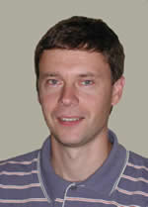

The Quantum Hard Drive?
Kitaev
Do there exist (or can we engineer) quantum systems whose
physics guarantees fault-tolerant quantum computation?

Slide 25





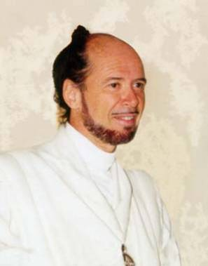



No Quantum Transistor?
Quantum Cloning Machine
“A single quantum cannot be cloned,” Wootters and Zurek, Nature, 1982

Slide 26
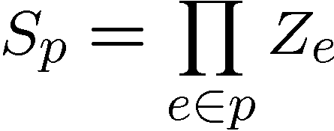
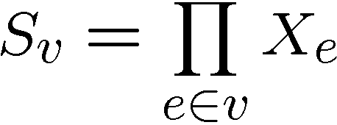




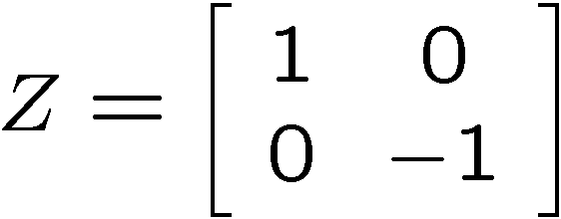
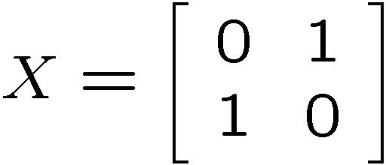
Kitaev’s Model
plaque operators:
qubits on links
vertex operators:
vertex and plaque operators
all commute with each other

Slide 27
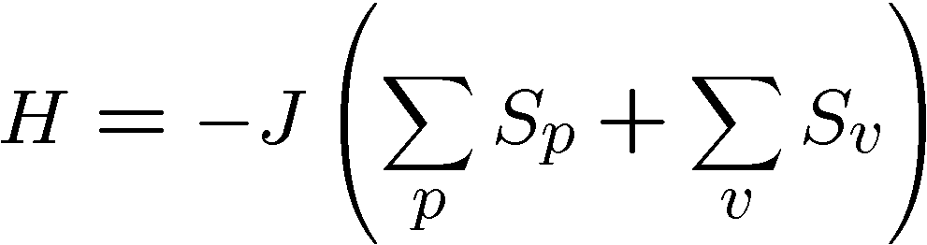






Kitaev’s Model, Continued
Hamiltonian
plaque operators:
vertex operators:
ground state has all

Slide 28


Kitaev’s Model
plaque operators:
vertex operators:
anti-commutes with
two plaque operators
−
−
excitation is above ground state

Slide 29
Excitations
excitations particles come in pairs (particle/antiparticle)
at end of “error” chains
two types of particles, X-type (live on vertices of dual lattice)
Z-type (live on vertices of the lattice)

Slide 30


Anyons Anyone?
Phase:

Slide 31



A Qubit
Moving an X or Z type particle on a homologically nontrivial
path and annihilating with it’s partner preserves the ground
states
Action on ground state must be representation of non-Abelian
group: Acts as encoded single qubit Pauli operator.

Slide 32



Two Qubits
Moving an X or Z type particle on a homologically nontrivial
path and annihilating with it’s partner preserves the ground
states
Action on ground state must be representation of non-Abelian
group: Acts as encoded single qubit Pauli operator.

Slide 33
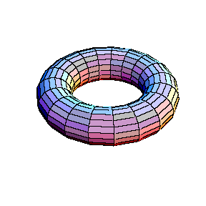


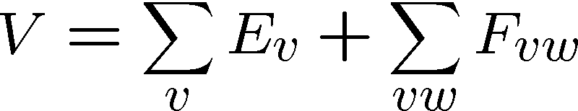
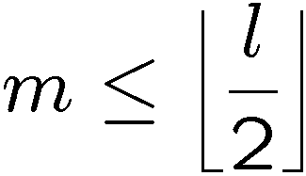
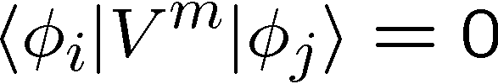
Topological Protection
Encode two qubits
into the ground state
gap
Perturbation theory:
But for

Slide 34

Topological Quantum Computing
Encode two qubits
into the ground state
gap
If we keep then quantum information encoded into ground state will be “topologically” robust to perturbation.
We can perform gates (in this example X and Z) by creating
anyon pairs and moving them around the torus.
Are these assumptions reasonable?

Slide 35

Whence Kitaev’s Model?
Robust storage of quantum information.
But it does not provide a mechanism for
robust manipulation of quantum information.
Is it possible to construct a Hamiltonian, which allows for fault-tolerant manipulation as well?

Slide 36
Lessons Learned?
What do we do in fault-tolerant quantum computing?
encode information into error correcting code
0
use information encoded into a quantum error correcting code
2. energy gaps can slow loss of information
important for memory
keep cold
3. excited state energetics can “self-correct”
important for fault-tolerant operations
NO

Slide 37
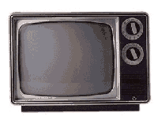
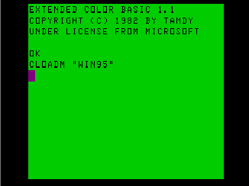
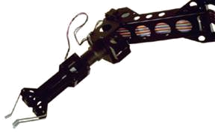
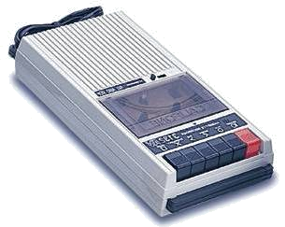

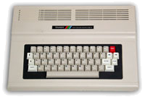
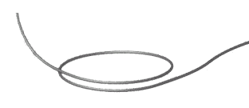
Self Correcting Quantum Computers
The toric code in four dimensions is probably self-correcting
Can we self-correct in realistic systems?
D. Bacon “Operator Quantum Error Correcting Subsystems for
Self-Correcting Quantum Memories”
Phys. Rev A, 73, 012340 (2006)

Slide 38






A Small Quantum Try
1
2
Hamiltonian
ZZ
ZZ
ZZ
ZZ
XX
XX
ZZ
3
ZZ
4
quantum error detecting code
classical
quantum
symmetry
simultaneously diagonalize with symmetries
H does not depend on second qubit

Slide 39
























Slide 40
Reminder
two-level system perturbatively coupled to a thermal boson bath
“heating”
“cooling”
“non-dissipative”

Slide 41

Supercoherence
Bacon, Brown, and Whaley, Phys. Rev. Lett. 87, 247902 (2001)
ALL single qubit errors take degenerate ground state to higher energy levels.
Single qubit errors change value of (S₁,S₂) and hence take ground state to higher energy level.
To first order all single qubit
decoherence becomes heating
FORBIDDEN

Slide 42
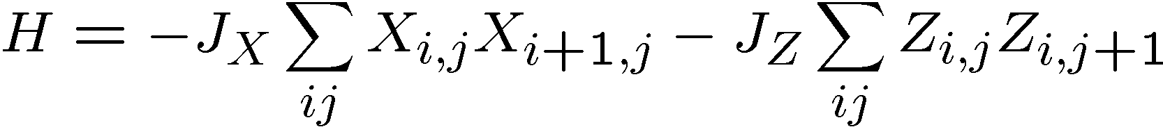
Quantum Compass Model
ZZ
ZZ
XX
XX
XX
ZZ
ZZ
XX
XX
XX
ZZ
ZZ
Ground state is a new kind of quantum error correcting code!
quantum error correcting subsystem

Slide 43
Quantum Compass Model
ZZ
ZZ
XX
XX
XX
ZZ
ZZ
XX
XX
XX
ZZ
ZZ
Abelian symmetries

Slide 44






Subspaces Versus Subsystems
The most general way to encode quantum information is into
subsystem (not subspaces)
two qubits
encode a qubit in a subspace
encode a qubit in a subsystem
generic subsystem:

Slide 45





Subsystem Error Correction
Only need to protect subsystem,
not full subspaces.
encoding
subsystem
error
recovery
encoded quantum
information
recovery need not perfectly restore system, but only
preserve information encoded into subsystem.

Slide 46





Quantum Subsystem Code
Measure these operators
Diagnose parity of bit and phase flips in column and rows
3. Apply recovery routine for parity of errors
Routine fixes error UPTO an operation generated by
bonds of Hamiltonian

Slide 47
Quantum Subsystem Code
extra symmetry which implies states are doubly degenerate:

Slide 48
Quantum Compass Model
ZZ
ZZ
XX
XX
XX
ZZ
ZZ
XX
XX
XX
ZZ
ZZ
Ground state is a new kind of quantum error correcting code!
quantum error correcting subsystem

Slide 49
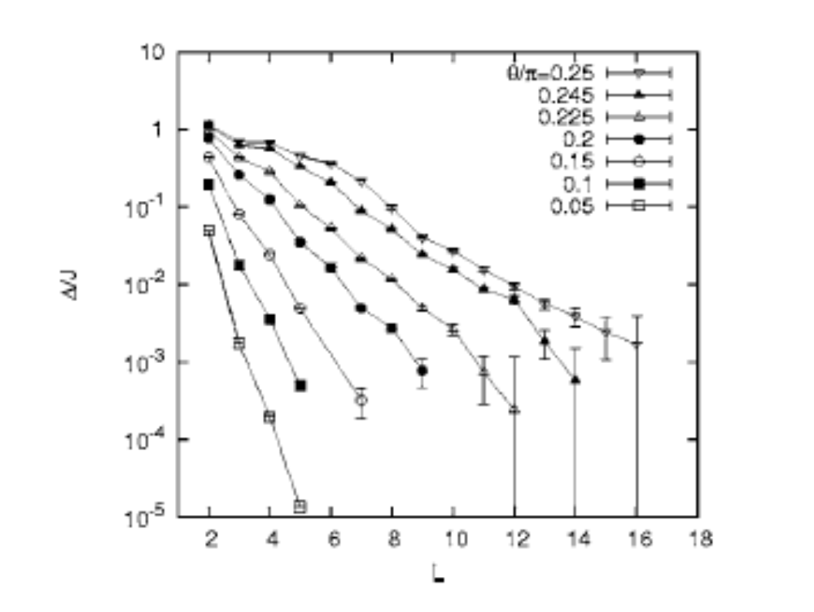
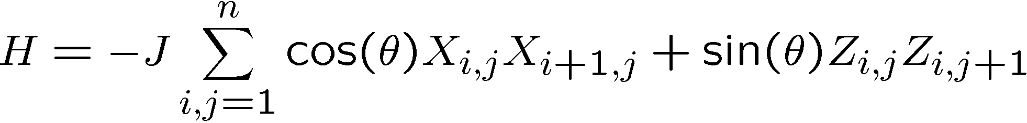
Problems:
[Dourier, Becca, Mila 05]
no gap in the thermodynamic limit

Slide 50

Problems, Continued
XX
XX
XX
ZZ
ZZ
ZZ
ZZ
XX
XX
XX
ZZ
ZZ
ZZ
ZZ
XX
XX
XX
Exact diagonalization 3x3, 4x4, 4x5
Even at finite size, not “self-correcting”

Slide 51
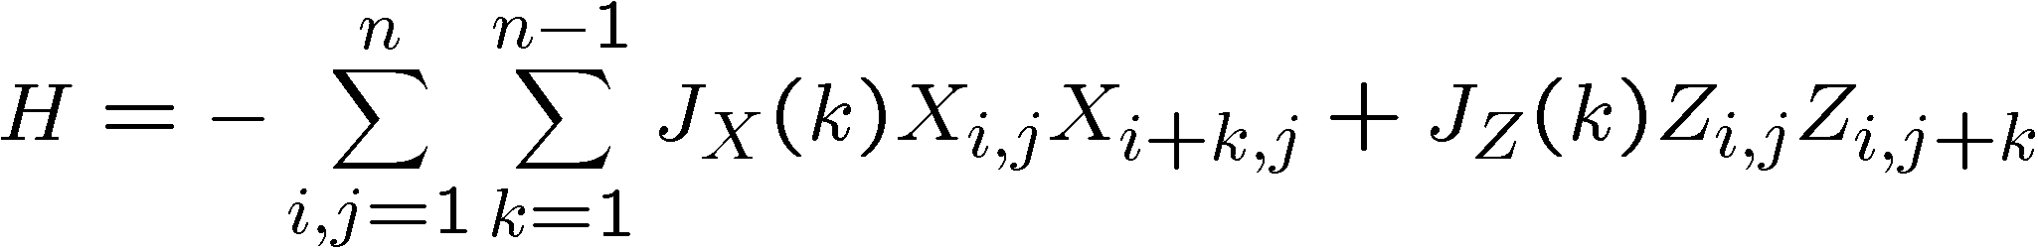
Toward Self-Correction
ZZ
ZZ
ZZ
XX
XX
XX
XX
n by n
square
lattice
ZZ
ZZ
ZZ
XX
XX
XX
XX
ZZ
ZZ
ZZ
XX
XX
XX
XX
ZZ
ZZ
ZZ
Exact diagonalization of 4x4 model, shows that with constant couplings, this model is self-correcting!

Slide 52





Toward Self-Correction

Slide 53
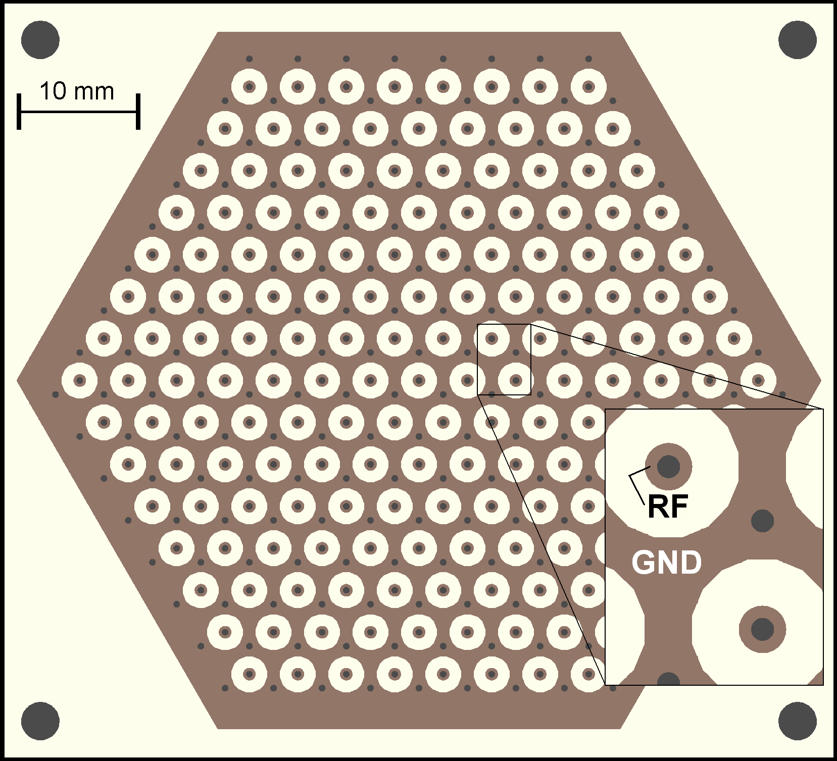
The Future
Can techniques used in creating two qubit interactions be
used to engineer such interactions
(Ideas of Deng, Porras, and Cirac?)
Possible to engineer such systems in planar ion trap system?
Figure 2. Hexagonal planar ion trap. 2D mult-zone ion traps allow one to trap ions in any spatial arrangement including a disordered lattice.
Picture courtesy Ken Brown
(Isaac Chuang’s Lab, MIT)

Slide 54
The Future
systems with “little” entanglement are efficiently simulatable
projected entangled pair states (Verstraete and Cirac)
simulation of self-correcting models

Slide 55
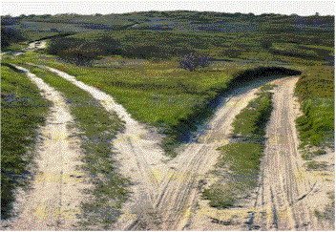
A Different Path
Quantum error correction can be performed by cooling an
interacting quantum system.
Potential for robust substrates for quantum information.

