Slide 1



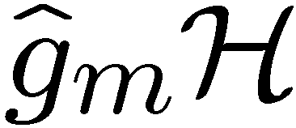
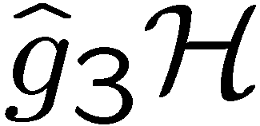
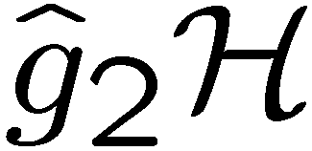
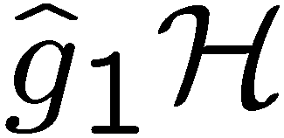

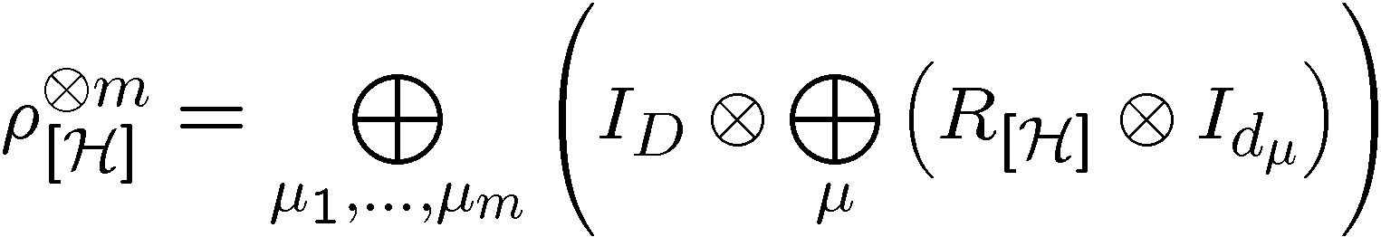
The Hidden Subgroup Conjugacy Problem and Beyond
Dave Bacon, University of Washington
dabacon@gmail.com / http://www.cs.washington.edu/homes/dabacon/qw/
Objective
f
New quantum algorithms for hidden subgroup problems
Understanding the relationship between the hidden subgroup conjugacy problem and the hidden subgroup problem
Efficient quantum circuits for Clebsch-Gordan transforms over finite groups
Understanding and exploiting the role of symmetry in quantum algorithms
Objective Approach
Status
Focus on the double role symmetry takes on in efficient quantum algorithms
1st role makes query complexity low
2nd role makes efficient circuits possible
Work with “more symmetric” hidden subgroup conjugacy problem instead of hidden subgroup problem
Use of techniques from previous approaches including subgroup adapted basis, generalized Kitaev circuits, and “pretty good measurements”
Exploiting the well understood structure of Clebsch-Gordan transforms for finite groups
New start
In the prior year + a little:
  Developed optimal measurement technique for nonabelian hidden subgroup problem *
  Efficient quantum algorithm for the Heisenberg group *
  Efficient quantum circuits for the Schur and Clebsch-Gordan transform **
* with Andrew Childs (Caltech), Wim van Dam (UCSB)
** with Ike Chuang (MIT) and Aram Harrow (Bristol)

Slide 2

The Hidden Subgroup Conjugacy Problem and Beyond
Dave Bacon, University of Washington
Progress on last years objectives
New start
Research plan for next 12 months
Are the hidden subgroup conjugacy problem and the hidden subgroup problem equivalent? For which groups are they equivalent?
Explicit understanding of the Clebsch-Gordan symmetry involved in the dihedral and symmetric group hidden subgroup conjugacy problem.
Begin study of the construction of efficient circuits for finite group Clebsch-Gordan transforms.
Identification of optimal measurement for single copy hidden subgroup problem
Long term objectives (demonstrations)
Algorithms for non-abelian hidden subgroup problems. (Take heed of lower bounds, but the goal is upper bounds.)
Efficient quantum algorithms for graph isomorphism and certain k-shortest vector in a lattice problems
Construction of efficient quantum algorithms for use in problem with symmetries (beyond the hidden subgroup problem: exploitation of symmetries of simulations of quantum systems)
Very long term goals: New quantum algorithms. Wash our brains of what we’ve learned and come up with totally new approaches for efficient quantum algorithms.

Slide 3
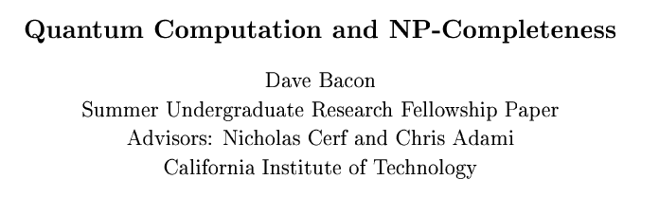


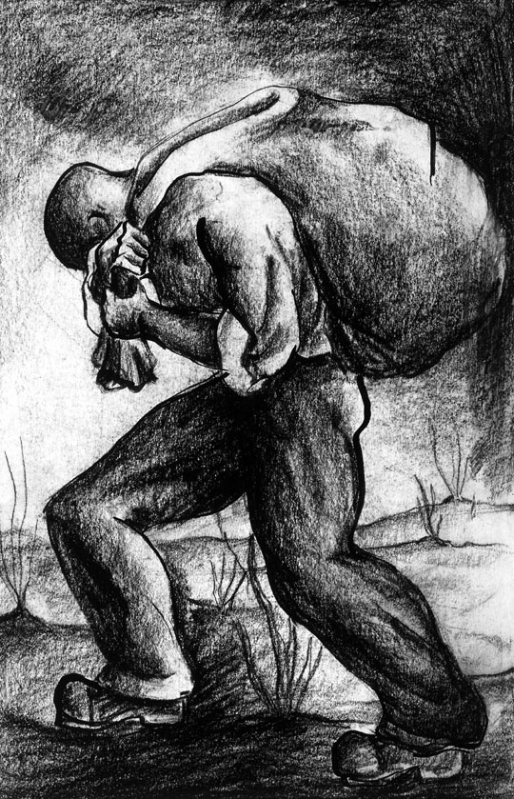

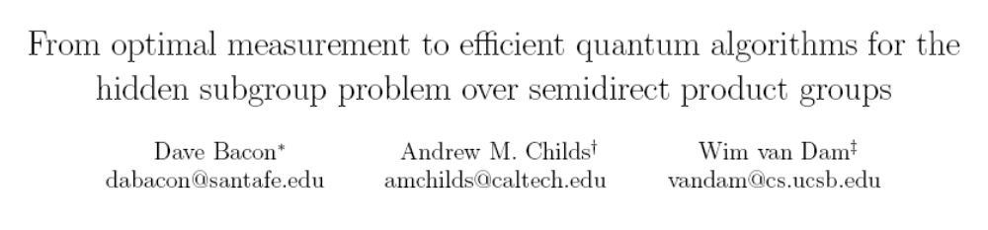
Newbie
1996:
,
,
,
and
Caltech
Berkeley
Caltech
Santa Fe Institute
2005:

Slide 4
Results from Past Year + A Little
[Bacon, Childs, and van Dam 05]
Optimal PGM for dihedral HSP
[Bacon, Childs, and van Dam 05]
Efficient algorithm for the Heisenberg HSP
[Bacon, Harrow, Chuang 04-06]
Efficient transform for Schur transform and
Clebsch-Gordan transform for U(d)
FORWARD LOOKING

Slide 5
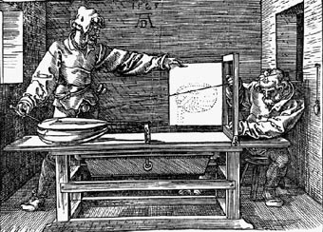
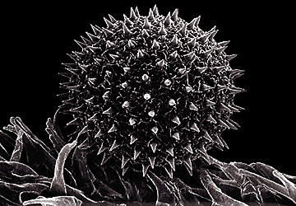
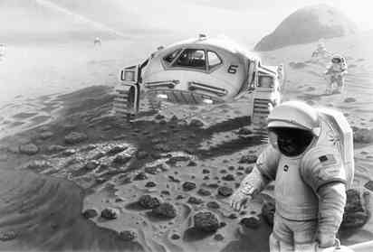
Outline
Perspective
Highlight role of symmetry in successes
Why can we solve the Heisenberg HSP?
The Hidden Subgroup Conjugacy Problem
Importance
Symmetry
Open problems
The Future
Transforms?
Algorithms?

Slide 6



The Hidden Subgroup Problem
Setup: Fix a group (known) and a subgroup (unknown). Given query access to a function f : → S that is constant and distinct on left (right) cosets of in . We say that f hides .
Problem: Find a generating set for (“identify ”).
Efficient: If runs in time polylog(| |)
f
S

Slide 7

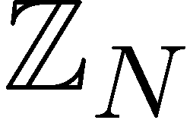
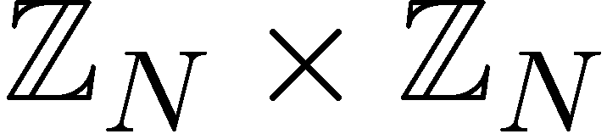

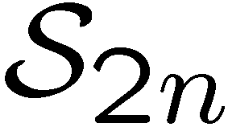

Why the Fuss?
Solved Problems (Shor 1994)
efficient algorithm for HSP
over
efficient algorithm for factoring whole numbers
efficient algorithm for HSP
over
efficient algorithm for the discrete logarithm problem
Open Problems
efficient algorithm for HSP
over (or )
efficient algorithm for the
graph isomorphism problem
efficient “standard” quantum
algorithm for HSP over
dihedral group
efficient algorithm for the poly(n) unique shortest vector in a lattice problem

Slide 8

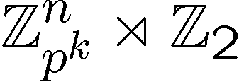
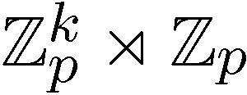
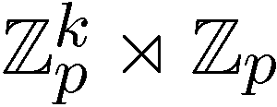
Hidden Subgroup Successes
Abelian groups [Shor 94; Kitaev 95]
[Püschel, Rötteler, Beth 98]
Normal subgroups [Hallgren, Russell, Ta-Shma 00]
“Amost Abelian” groups [GSVV 01]
[FIMMS 02]
“Near Hamiltonian” groups [Gavinsky 04]
Some q-hedral groups [MRRS 04]
[Inui, Le Gall 04]
Heisenberg type groups [Bacon, Childs,
and van Dam 05]
Some
Why THESE successes?

Slide 9





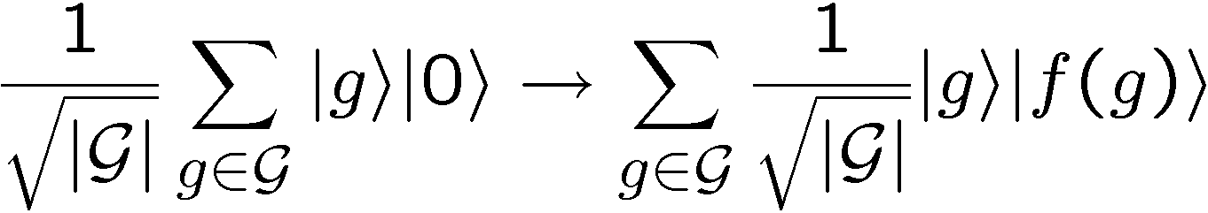
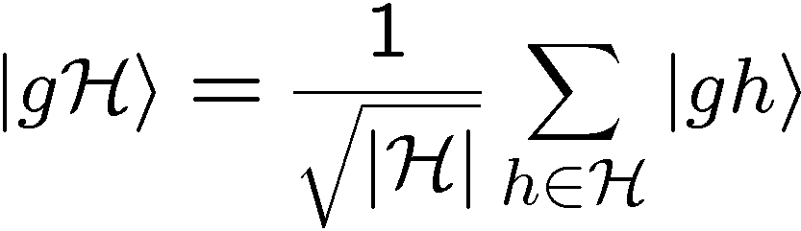
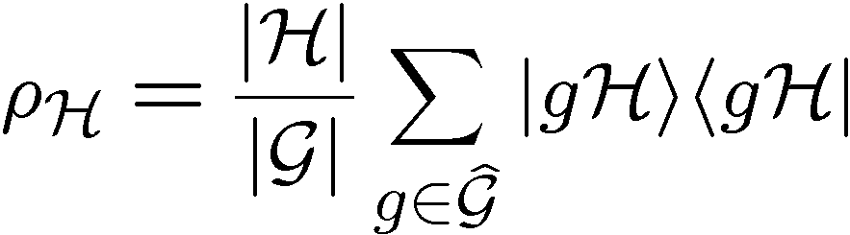

Standard Query Model
Oracle:
U_{f}
Query in equal superposition over group elements
constant and distinct on different left cosets of
random left coset state
hidden subgroup state
set of coset representatives

Slide 10


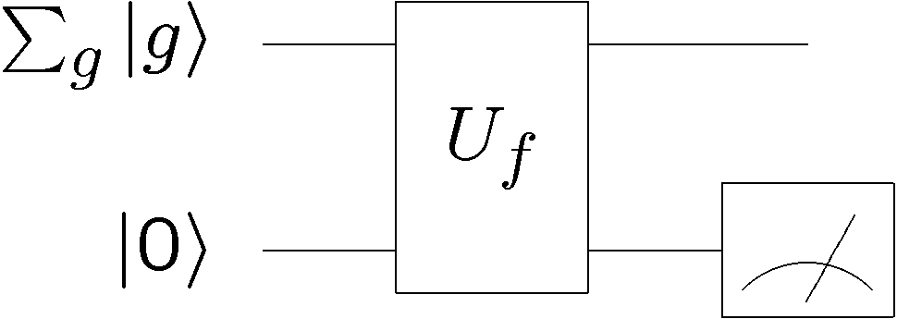








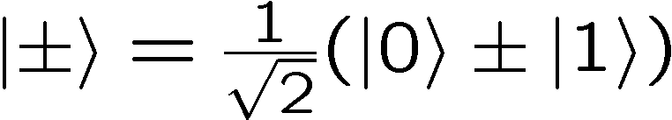
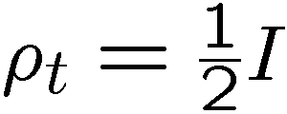

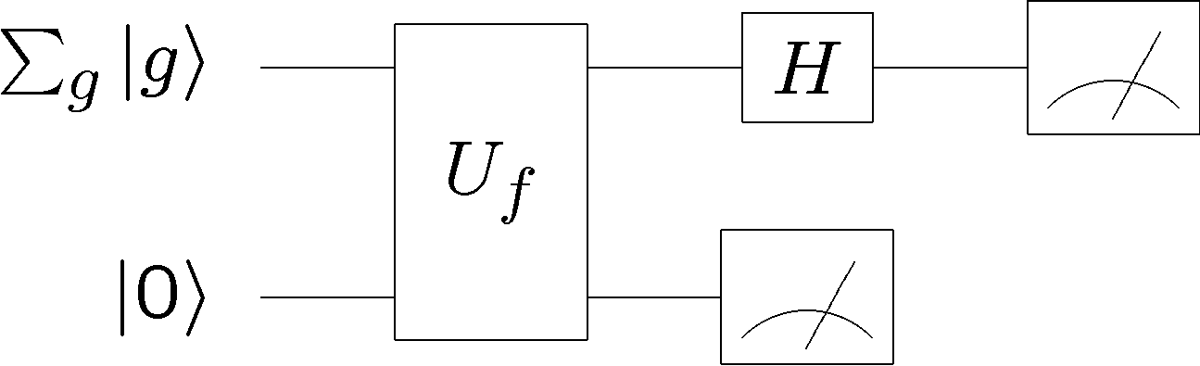
Start Simple
Two possible hidden subgroups
or
50%
50%

Slide 11
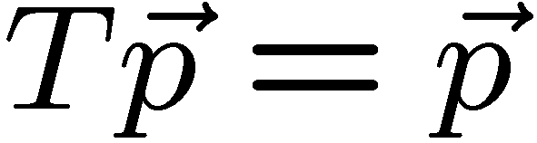
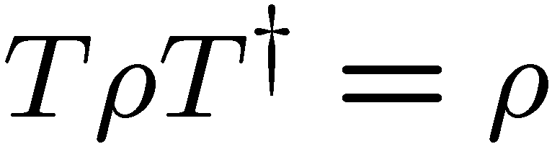
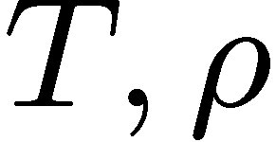
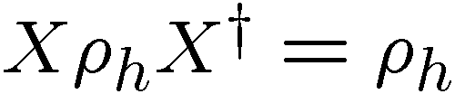

Symmetry, Role I
I give you a symmetric probability distribution
how does this help you?
I give you a symmetric quantum density matrix
how does this help you?
can be simultaneously diagonalized!
diagonalize in
basis

Slide 12

Symmetries As a Guide
The more symmetries we can identify, the more likely we are
able to distinguish between different quantum states.
Example: Heisenberg HSP [Bacon, Childs, and van Dam 05]
After two standard queries, algorithm queries over multiple
solutions to certain quadratic equations:
i.e. the symmetry which is essential to solving the problem
is the symmetry group for the roots of these equations

Slide 13
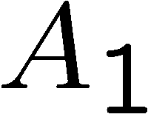
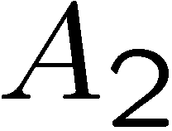
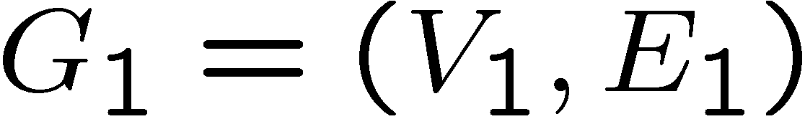
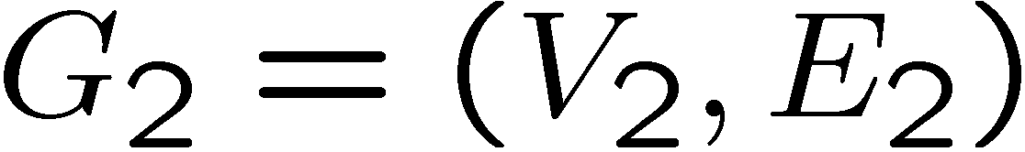

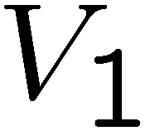
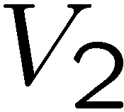
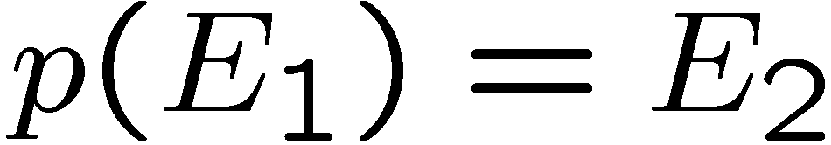
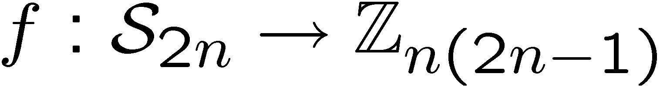
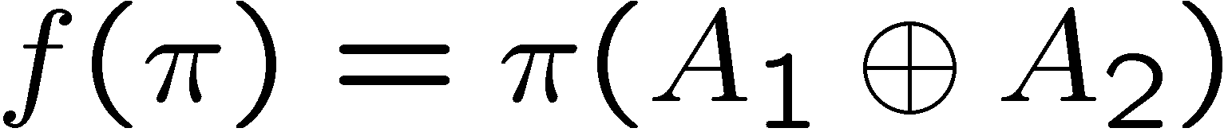
Graph Isomorphism
adjacency
matrix
adjacency
matrix
Problem: Is there a 1-to-1 mapping from the vertices to the
vertices such that the edges are respected, ?
Mapping to the HSP:
If graphs are not isomorphic, hidden subgroup will not mix
the graphs. If they are isomorphic, they will mix the graphs.

Slide 14
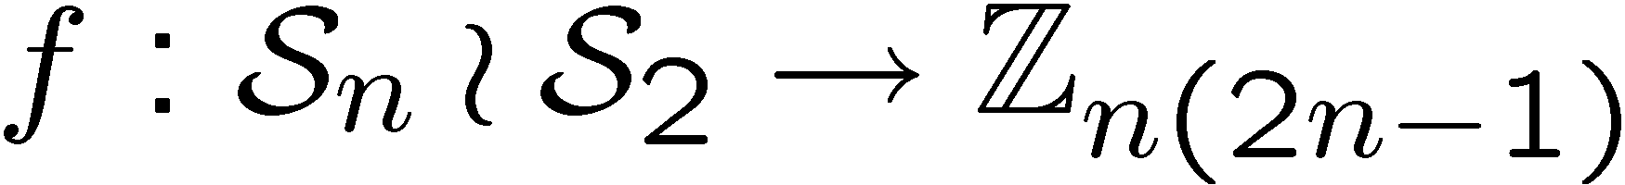

Graph Isomorphism
adjacency
matrix
adjacency
matrix
Problem: Is there a 1-to-1 mapping from the vertices to the
vertices such that the edges are respected, ?
Mapping to the HSP:
Notice now we are only worried if hidden subgroup has
a nontrivial

Slide 15
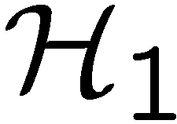
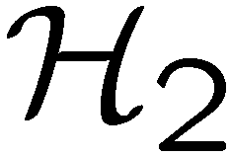

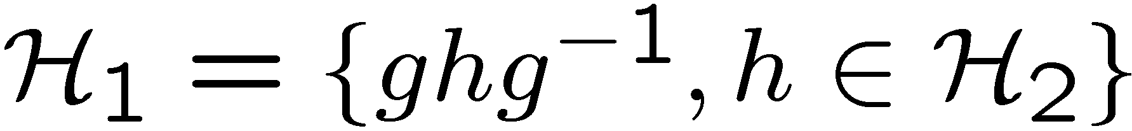
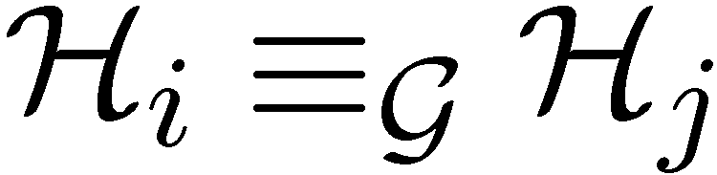
Conjugate Subgroups
Two subgroups, and , are conjugate if there exists an
element of the group such that
This is an equivalence relation among the subgroups of
ir: voy, vas, va, vamos, van

Slide 16
Hidden Subgroup Conjugacy Problem
Setup: Fix a group (known) and a subgroup (unknown). Given query access to a function f : → S that is constant and distinct on left (right) cosets of in . We say that f hides .
Problem: identify the conjugate subgroup class of .
Efficient: If runs in time polylog(| |)
f
S

Slide 17
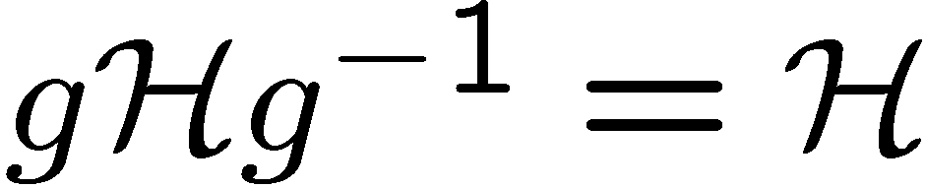
Relationships
How do the hidden subgroup problem (HSP) and the
hidden subgroup conjugacy problem (HSCP) differ?
1. If group is abelian, HSCP=HSP
All subgroups are only conjugate to themselves
2. If subgroups are normal, HSCP=HSP
All subgroups are only conjugate to themselves
These are two cases where we know quantum computers
can efficiently solve the HSP. Coincidence?

Slide 18
Graph Isomorphism
adjacency
matrix
adjacency
matrix
If we want to find the isomorphism, we can attach extra vertices
and edges to detect whether permutation of these vertices is in
isomoprhism group.
HSCP → solve graph isomorphism and identify the isomorphism

Slide 19


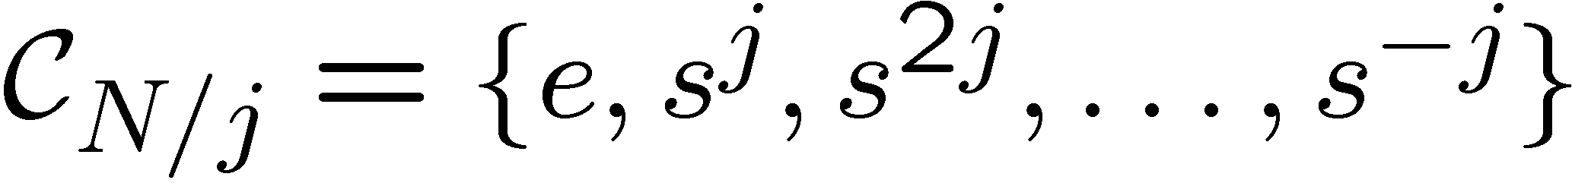
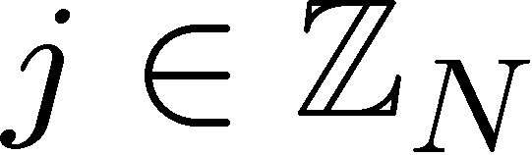
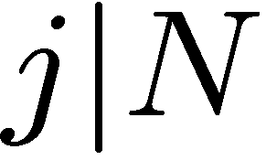
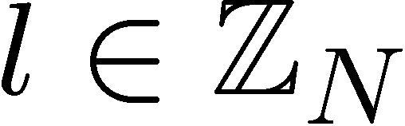
Dihedral Group
Dihedral group
group of symmetries of a N sided
regular polygon
= rotation
= reflection
Subgroups of
cyclic subgroups:
dihedral subgroups:

Slide 20
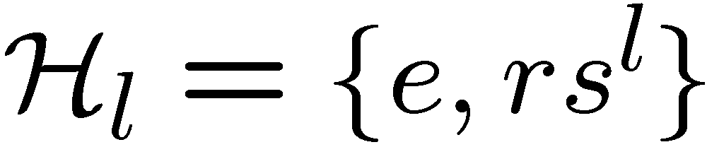
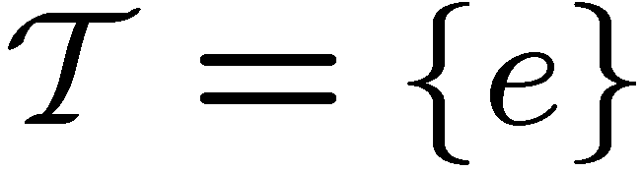

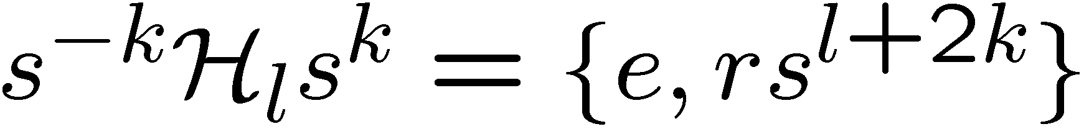
Dihedral HSP
Theorem [Ettinger, Hoyer 98]
Sufficient to solve Dihedral HSP when subgroups are
limited to
or
if is odd, then the subgroups are all conjugate to each other:
solving the Dihedral HSCP does not immediately solve
the Dihedral HSP…

Slide 21









Modification
Modify the function hiding the subgroup:
left cosets:
If is even, then is constant and distinct on left cosets
of
If is odd, then is constant and distinct on left cosets
of
Solving HSCP for new problem thus allows us to distinguish
between odd and even subgroups
[Bacon, Moore unpublished 05]

Slide 22


Modification
Modify the function hiding the subgroup:
left cosets:
Using more functions, we can determine 2nd least significant
bit of
Generalizing this allows us to use the Dihedral HSCP to solve
the Dihedral HSP (they are polynomial time equivalent.)
[Bacon, Moore unpublished 05]
see also [Kuperberg 03]

Slide 23
HSP and HSCP
More generally, we can ask if this method can be extended to work for any group/set of subgroups?
Open question 1: When are HSP and HSCP equivalent?

Slide 24

Why the HSCP?
The HSCP has more symmetry than the HSP

Slide 25





Multiple Queries
If we make a single measurement on the
HS state, can we distinguish different
In general, NO
We need multiple queries to
distinguish different subgroups
sufficient
[Ettinger, Høyer, Knill 99]

Slide 26



Multiple Queries
Can we make a measurement on
copies and
learn the subgroup?
In general (and for important case
of symmetric group) NO
[Moore, Russell, Hallgren,
Roetteler, Sen 05]

Slide 27


Symmetries of HSCP States
Hidden subgroup conjugate state
Hidden subgroup conjugate states
In context of optimal measurement method (PGM)
[e.g. Ip 03, Bacon, Childs, and van Dam 05]
this translates into extra symmetry of the optimal measurement

Slide 28


Symmetries of HSCP States
What is the extra symmetry of the multiple HSCP states?
Clebsch-Gordan transform for the regular representation of
finite groups:

Slide 29
















General Circuit

Slide 30

The Second Role of Symmetry
Without efficient circuits for the quantum Fourier transform,
all is for naught!
Second role of symmetries:
Subgroup adapted basis provide a recursive structure
useful for constructing representation theoretic transforms
[Moore, Rockmore, Russel 03] Generic QFTs
[Bacon, Chuang, Harrow 04,06] Schur Transform

Slide 31


Clebsch-Gordan
[Bacon, Chuang, Harrow 04,06] Schur Transform
Clebsch-Gordan transform for U(d)
U(d) subgroup adapted basis (Gelfand-Zetlin basis)
Can these techniques be adapted for finite groups?
CG transform for U(d) is polynomial in d.
We want CG transform for regular representation of a
finite group efficient in log of group size.

Slide 32
The To Do List!
Are the hidden subgroup conjugacy problem and the hidden subgroup problem equivalent?
For which groups are they equivalent?
Explicit understanding of the Clebsch-Gordan symmetry involved in the dihedral and symmetric group hidden subgroup conjugacy problem.
Construction of efficient circuits for finite group Clebsch-Gordan transforms.
BIG QUESTION: Why are some non-abelian HSPs efficiently solvable? Is there a unifying picture?

Slide 33


The Hidden Subgroup Conjugacy
Problem and Beyond
Dave Bacon
Computer Science & Engineering, University of Washington
f
| ⟩
Dave Bacon
Paul Pham (grad student, CS)
Gregory Crosswhite (grad student, Physics)
QW
group

Slide 34

Episode IV
: A New Hope

