Slide 1

New Algorithms for the Nonabelian Hidden Subgroup Problem
g_{m}H
g₃H
G
f
S
g₂H
g₁H
H
Dave Bacon
Department of Computer Science & Engineering
University of Washington
in collaboration with Andrew Childs (Caltech)
and Wim van Dam (UCSB)

Slide 2
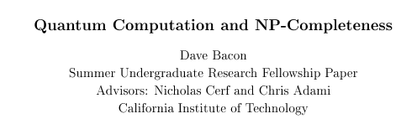
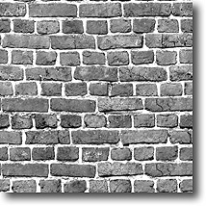
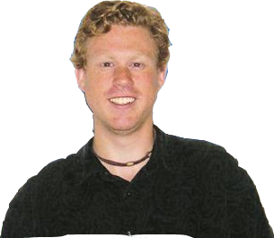

Looking For New Algorithms
1996:

Slide 3
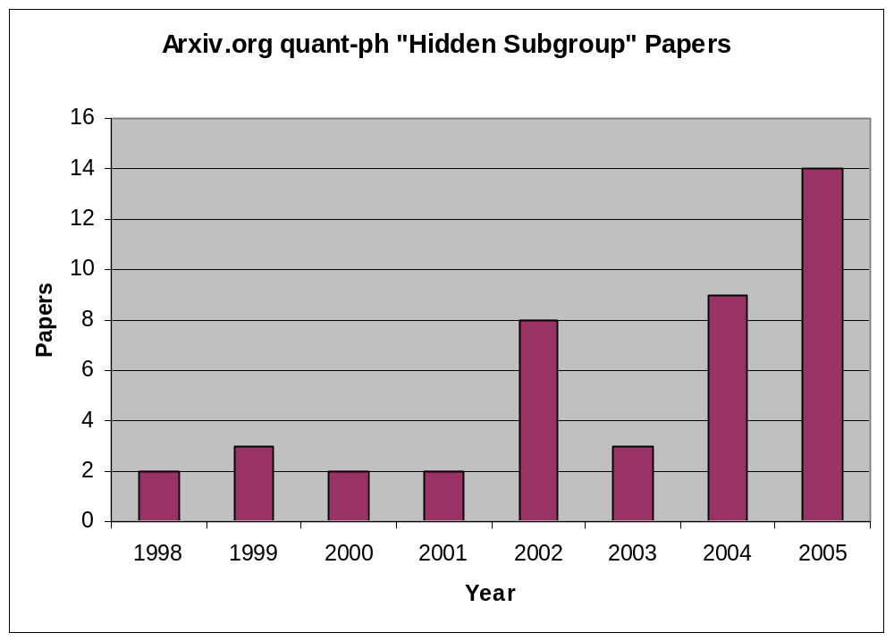
Hidden Subgroup Problem

Slide 4
quant-ph/0501044 “Optimal measurements for the dihedral hidden subgroup problem,” Bacon, Childs, van Dam
quant-ph/0501056 “The Symmetric Group Defies Strong Fourier Sampling: Part I”, Moore, Russell, Schulman
quant-ph/0501177 “The Symmetric Group Defies Strong Fourier Sampling: Part II,” Moore, Russell
quant-ph/0501177 “For Distinguishing Conjugate Hidden Subgroups, the Pretty Good Measurement is as Good as it
Gets”, Moore, Russell
quant-ph/0503095 “The Power of Strong Fourier Sampling: Quantum Algorithms for Affine Groups and Hidden Shifts,”
Moore, Rockmore, Russell, Schulman
quant-ph/0503114 “On the Power of Random Bases in Fourier Sampling: Hidden Subgroup Problem in the
Heisenberg Group” Radhakrishnan, Roetteler, Sen
quant-ph/0504067 “Explicit Multiregister Measurements for Hidden Subgroup Problems; or, Fourier Sampling Strikes
Back,” Moore, Russell
quant-ph/0504083 “From optimal measurement to efficient quantum algorithms for the hidden subgroup problem over
semidirect product groups,” Bacon, Childs, van Dam
quant-ph/0507190 “Quantum algorithm for a generalized hidden shift problem,” Childs, van Dam
quant-ph/0510185 “On the quantum hardness of solving isomorphism problems as nonabelian hidden shift problems,”
Childs, Wocjan
quant-ph/0511054 “Strong Fourier Sampling Fails over G^{n},” Alagic, Moore, Russell
quant-ph/0511148 “Limitations of Quantum Coset States for Graph Isomorphism,” Hallgren, Roetteler, Sen
quant-ph/0511149 “Tight Results on Multiregister Fourier Sampling: Quantum Measurements for Graph Isomorphism
Require Entanglement,” Moore, Russell

Slide 5
quant-ph/0501044 “Optimal measurements for the dihedral hidden subgroup problem,” Bacon, Childs, van Dam
quant-ph/0501056 “The Symmetric Group Defies Strong Fourier Sampling: Part I”, Moore, Russell, Schulman
quant-ph/0501177 “The Symmetric Group Defies Strong Fourier Sampling: Part II,” Moore, Russell
quant-ph/0501177 “For Distinguishing Conjugate Hidden Subgroups, the Pretty Good Measurement is as Good as it
Gets”, Moore, Russell
quant-ph/0503095 “The Power of Strong Fourier Sampling: Quantum Algorithms for Affine Groups and Hidden Shifts,”
Moore, Rockmore, Russell, Schulman
quant-ph/0503114 “On the Power of Random Bases in Fourier Sampling: Hidden Subgroup Problem in the
Heisenberg Group” Radhakrishnan, Roetteler, Sen
quant-ph/0504067 “Explicit Multiregister Measurements for Hidden Subgroup Problems; or, Fourier Sampling Strikes
Back,” Moore, Russell
quant-ph/0504083 “From optimal measurement to efficient quantum algorithms for the hidden subgroup problem over
semidirect product groups,” Bacon, Childs, van Dam
quant-ph/0507190 “Quantum algorithm for a generalized hidden shift problem,” Childs, van Dam
quant-ph/0510185 “On the quantum hardness of solving isomorphism problems as nonabelian hidden shift problems,”
Childs, Wocjan
quant-ph/0511054 “Strong Fourier Sampling Fails over G^{n},” Alagic, Moore, Russell
quant-ph/0511148 “Limitations of Quantum Coset States for Graph Isomorphism,” Hallgren, Roetteler, Sen
quant-ph/0511149 “Tight Results on Multiregister Fourier Sampling: Quantum Measurements for Graph Isomorphism
Require Entanglement,” Moore, Russell

Slide 6
The Problem
The Hidden Subgroup Problem (HSP)
Problem: Fix a group G (known) and a subgroup
H⊆G (unknown). Given query access to a function
f : G → S that is constant and distinct on left cosets
of H in G. We say that f hides H.
Goal: Find (a generating set for) H.
Efficient algorithm: run time poly(log |G|).

Slide 7
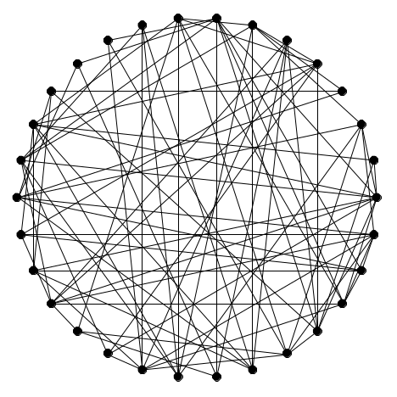
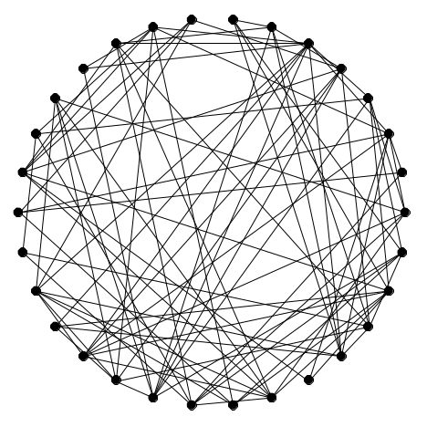
Why We Care
Graph Isomorphism
HSP for Symmetric Group
Unique k-Shortest Vector
In a Lattice
HSP for Dihedral Group

Slide 8





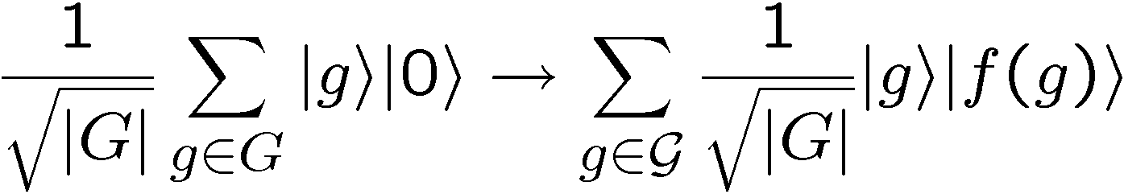
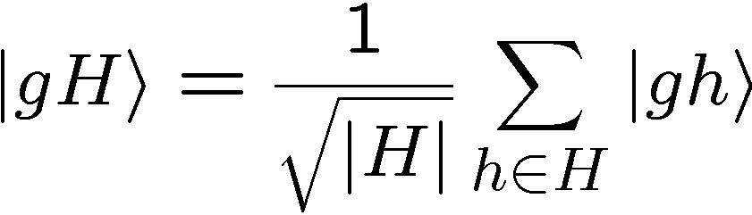
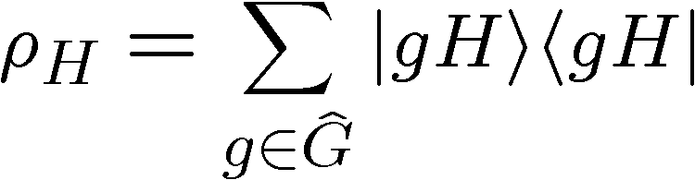
Standard Query Model
U_{f}
constant and distinct on different left cosets of H:
Hidden Subgroup State

Slide 9

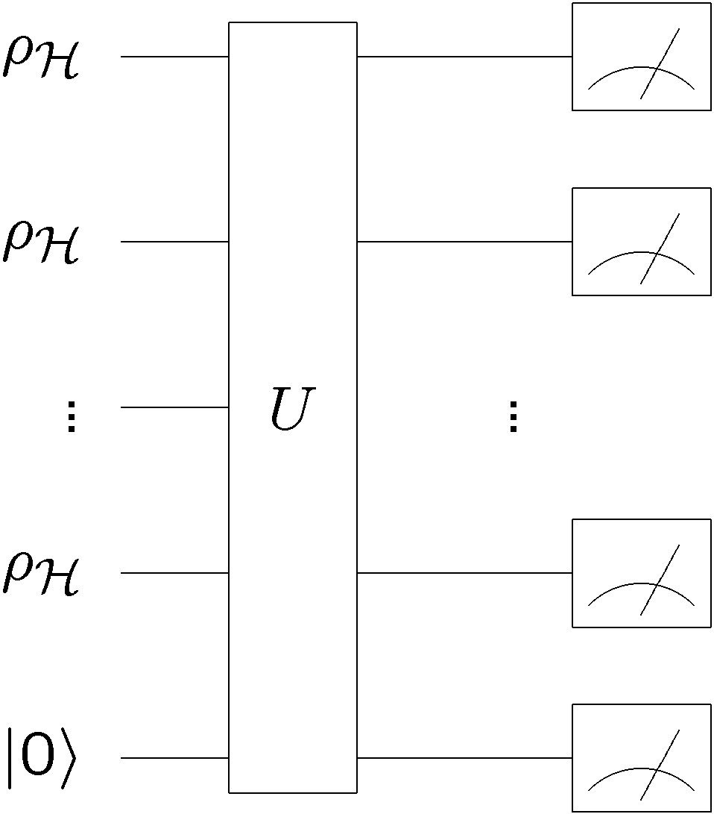

Copies
Single Copy
Multiple Copy
Given:
Given:
Classic early result:
[Ettinger, Hoyer 98]
copies are sufficient
(but no efficient circuit known)

Slide 10

What Will It Look Like?
quant-ph/0501056 “The Symmetric Group Defies Strong Fourier Sampling: Part I”, Moore, Russell, Schulman
quant-ph/0501177 “The Symmetric Group Defies Strong Fourier Sampling: Part II,” Moore, Russell
quant-ph/0510185 “On the quantum hardness of solving isomorphism problems as nonabelian hidden shift problems,”
Childs, Wocjan
quant-ph/0511148 “Limitations of Quantum Coset States for Graph Isomorphism,” Hallgren, Roetteler, Sen
quant-ph/0511149 “Tight Results on Multiregister Fourier Sampling: Quantum Measurements for Graph Isomorphism
Require Entanglement,” Moore, Russell
Symmetric Group
Measurement on copies
are information theoretically
necessary (and also sufficient.)

Slide 11
Nattering Nabobs
of Negativism
“Our result can be viewed as a negative result because highly entangled measurements seem hard to implement in general.”
- Hallgren, Roetteler, Sen
“Limitations of Quantum Coset States
for Graph Isomorphism”
Is There Hope?
Bacon (UW), Childs (Caltech), and van Dam (UCSB)
quant-ph/0504083, FOCS 2005

Slide 12
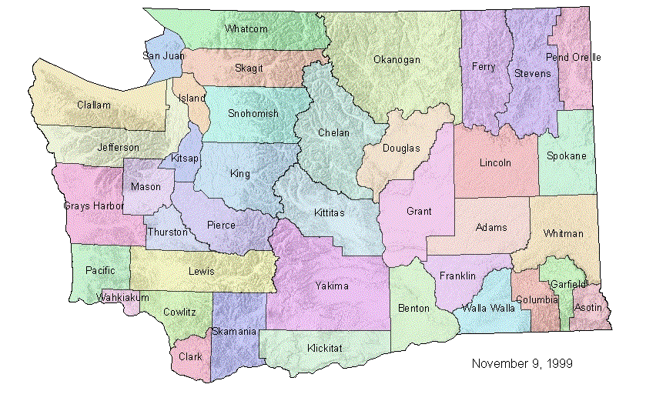
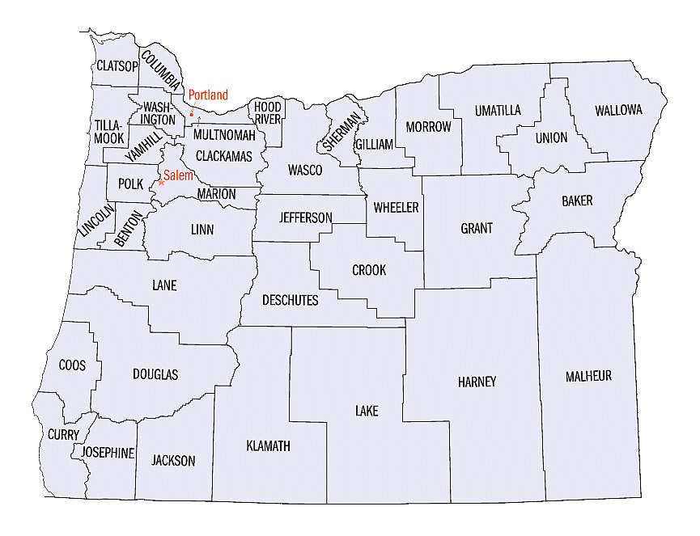
HSP as State Distinction
Single Copy
Given:
with probability p_{H}
Determine:
H by a generalized measurement
Maximize: probability of successfully identifying H

Slide 13
HSP as State Distinction
Multiple Copy
Given:
with probability p_{H}
Determine:
H by a generalized measurement
Maximize: probability of successfully identifying H

Slide 14

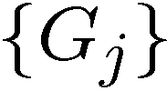

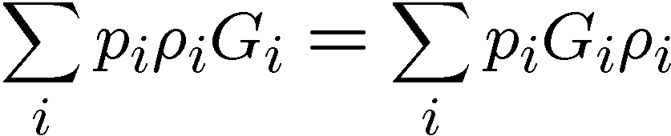
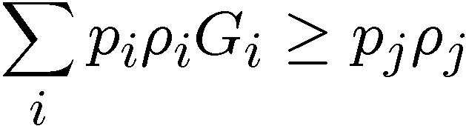
Holevo’s Condition
Given:
with probability p_{i}
Measure:
POVM with elements
Outcome:
j corresponds to guessing state
Maximize:
probability of successfully identifying
Necessary and Sufficient Condition:
[Holevo 73]
Hard to find explicit forms for G_{j}

Slide 15
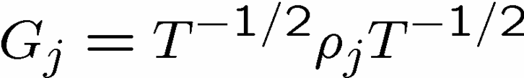
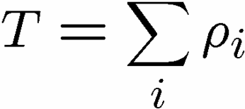
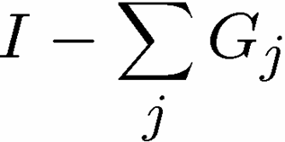
Pretty Good
Given:
with equal probabilities
Observation:
the “Pretty Good Measurement” is
often pretty good.
Pretty Good Measurement (PGM):
(plus if needed.)
PGM is often optimal HSP Measurement
[Bacon, Childs, van Dam 05, Moore, Russell 05]

Slide 16
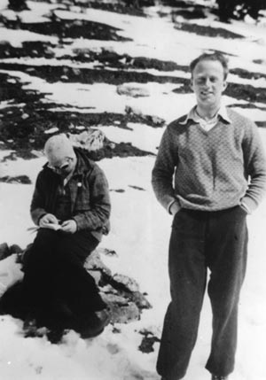

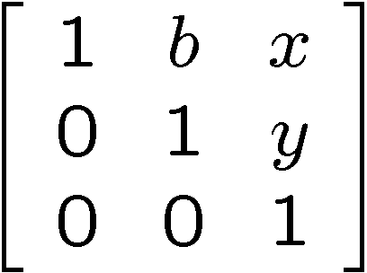

Heisenberg Group
Multiplication of upper triangular
matrices over
Heisenberg and Bohr
Margrethe Bohr to Heisenberg (from the play “Copenhagen”)
  “Your talent is for ski-ing too fast for anyone to see where
  you are. For always being in more than one position at a time,
  like one of your particles.”

Slide 17
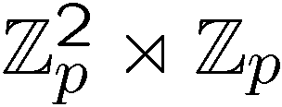
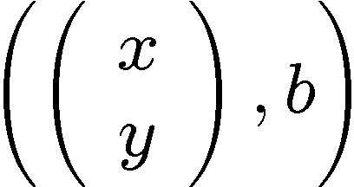
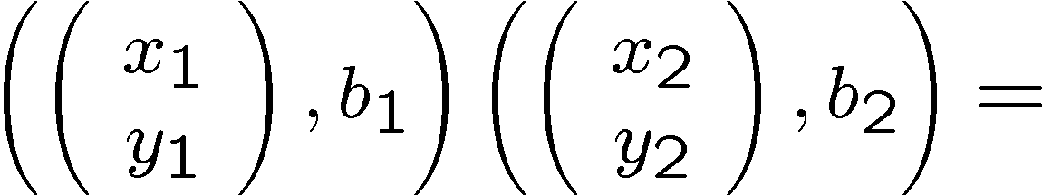
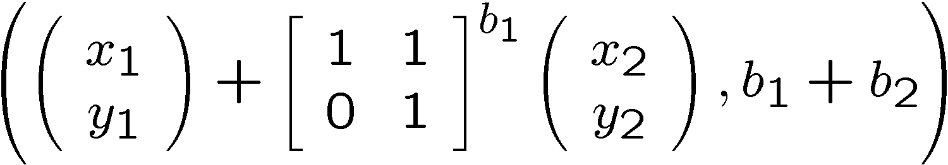
Heisenberg Group
Semidirect product group
Elements of the group:
Multiplication rule:

Slide 18
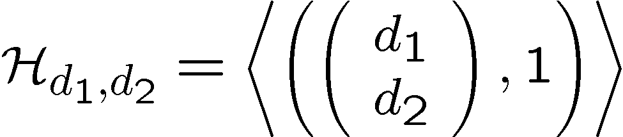
Heisenberg HSP
We can restrict to subgroups of the form
General version of theorem from [Ettinger, Hoyer 98]

Slide 19
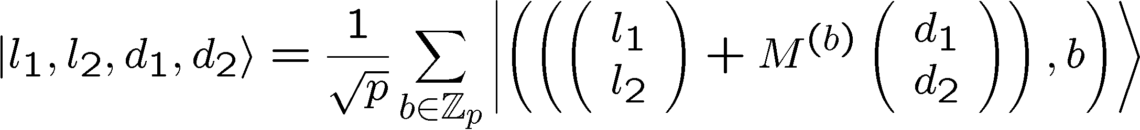
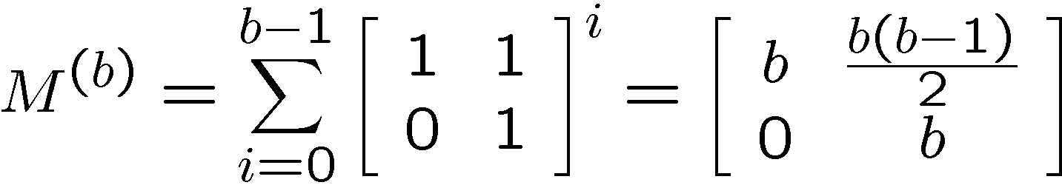

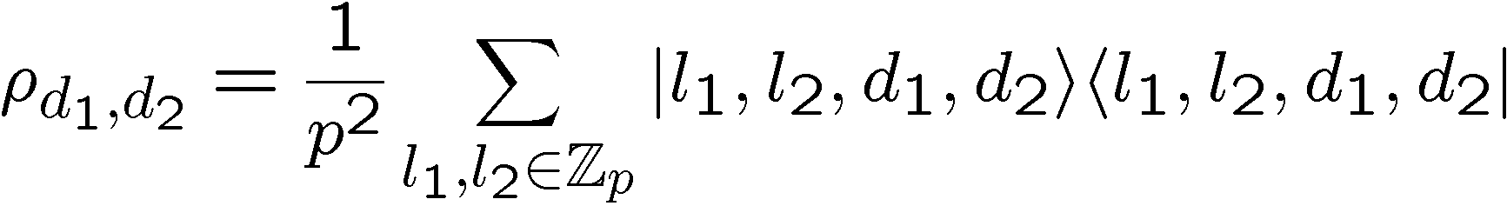
Heisenberg HS State
Restricted subgroups:
Random coset states:
Coset labels:
Hidden Subgroup states:

Slide 20
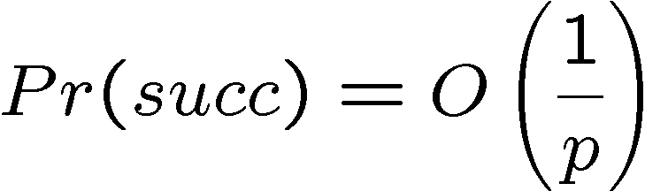

Optimal Measumrent
The optimal measurement for k copies is again the
pretty good measurement.
For one copy, the probability of successfully
identifying the hidden subgroup is
But for two copies, the probability of succesfully
identifying the hidden subgroup is
Can we efficiently implement this measurement?

Slide 21
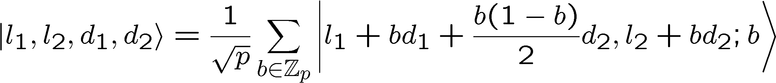
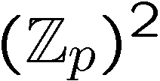

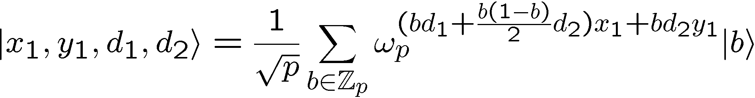
HS States
Perform the QFT over to the first two registers:
Measure these two registers:

Slide 22

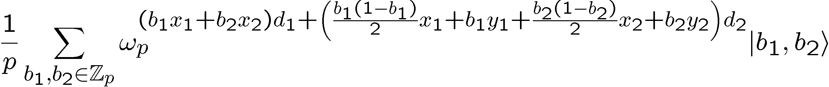

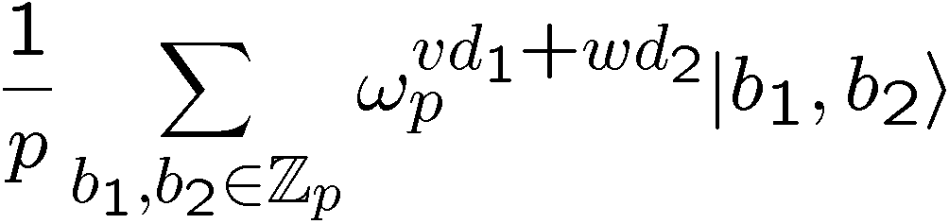
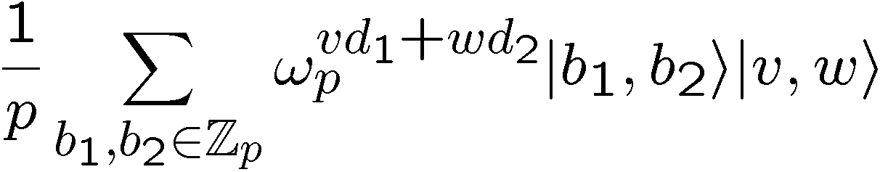
HS States
Two copies:
Compute v and w:

Slide 23
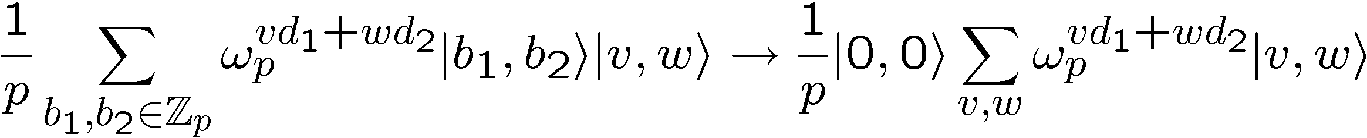
Uncompute
If we could erase the b₁,b₂ values:
Then a QFT over would find d₁ and d₂.
Remember v and w are a function of b₁ and b₂.

Slide 24

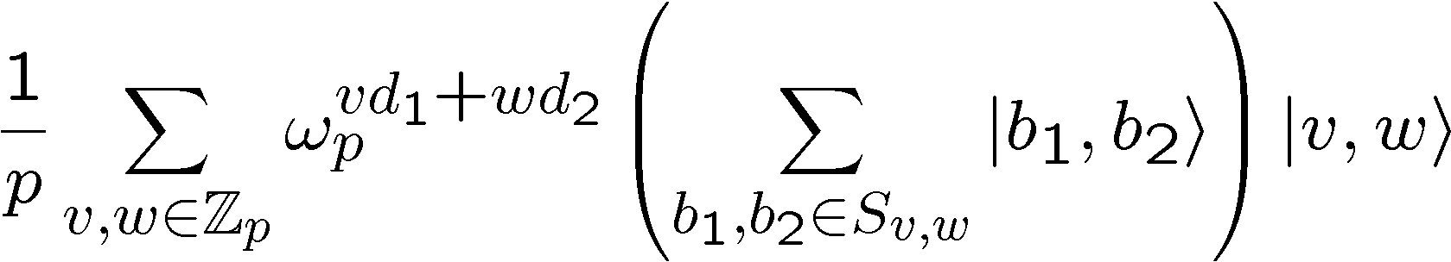
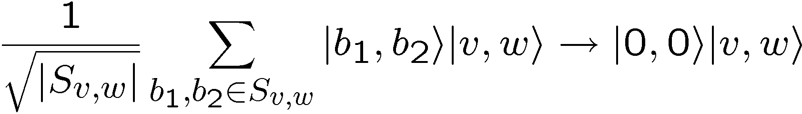
Solving Equations
Compute v and w:
For fixed x₁,x₂,y₁,y₂ let be the set of b₁,b₂
solutions to these equations.
We want to implement

Slide 25
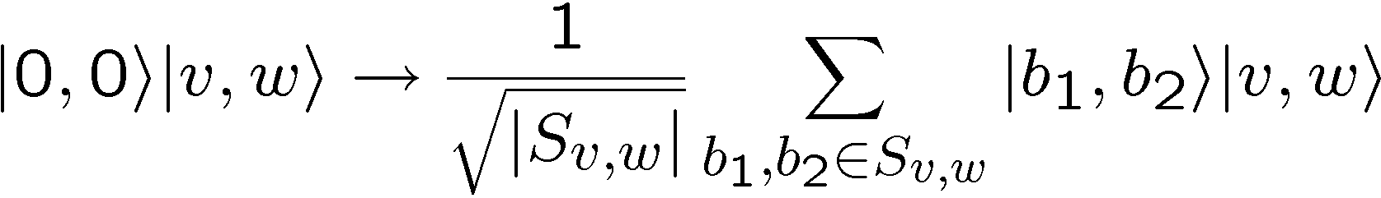
Solving Equations
Easier to think about the inverse (do it unitarily):
i.e. given v and w, transform to superposition over
solutions to the equations

Slide 26
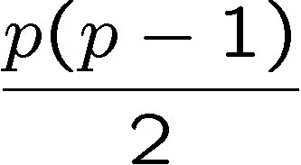




Solving Equations
Assuming y₁,y₂,y₁+y₂ do not equal 0 (prob O(1/p)),
then
solutions have
solutions have
solutions have

Slide 27
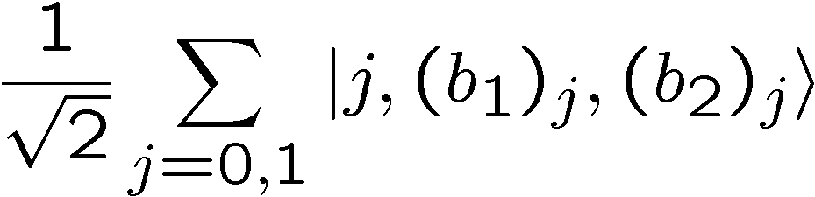
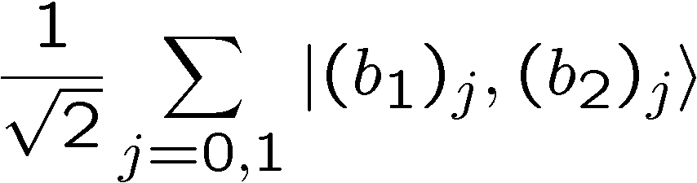
Solving Equations
Focus on when there are two solutions.
We can use standard finite arithmetic to find these
solutions. Use to create labeled superposition of
solutions:
Hadamard first qubit, measure. If 0, you have

Slide 28
Heisenberg HSP Solved
This allows us to perform:
Which has a O(1/2) fidelity squared with the
state we desire.
QFTing the second register will let us find d₁ and d₂
Efficient algorithm for the Heisenberg HSP!

Slide 29
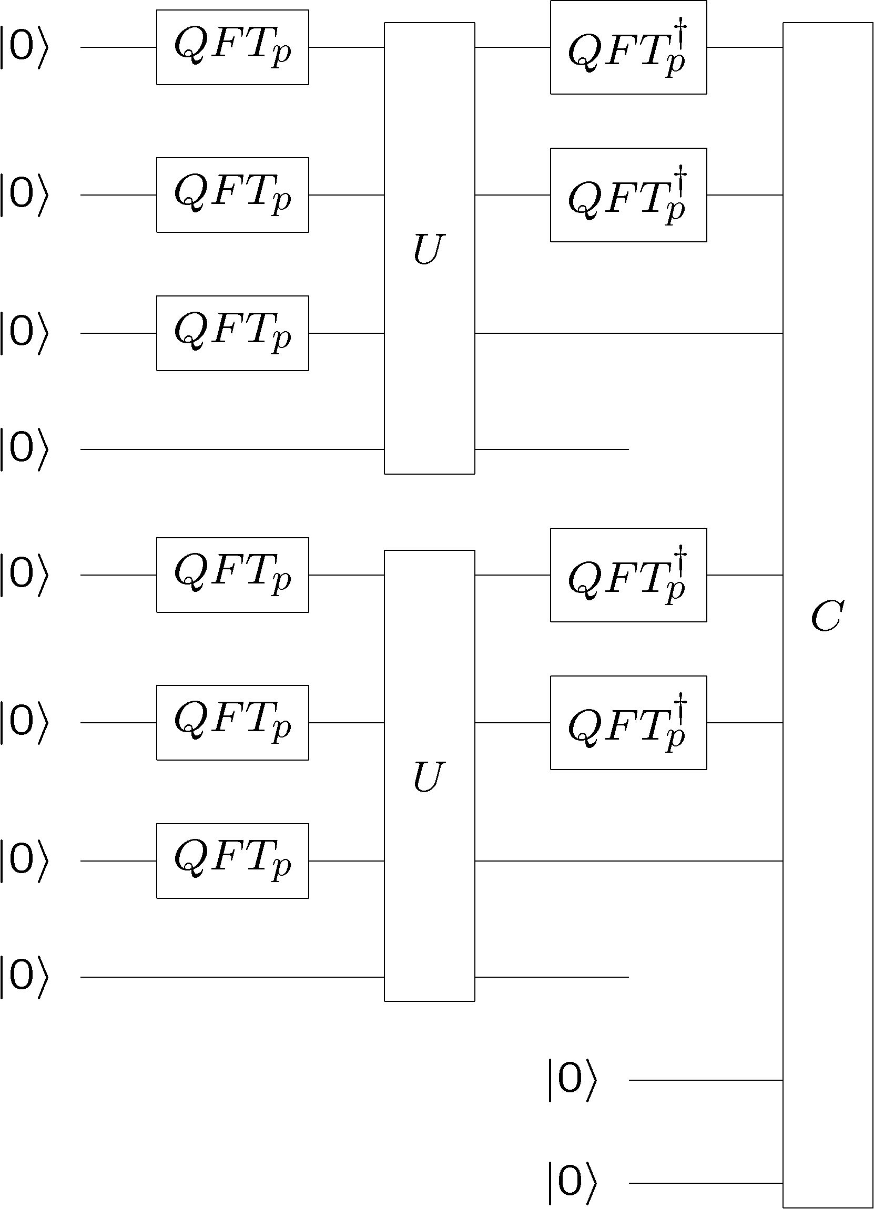
Efficient Quantum Circuit

Slide 30
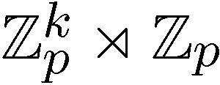

(Non-Homework) Extensions
This algorithm can be extended to an efficient
quantum algorithm for all
Also, certain metacyclic groups

Slide 31

Conclusion
PGM is often optimal for distinguishing HS states
and can lead to new efficient algorithms.
Efficient algorithm for Heisenberg, generalizations.

