Slide 1
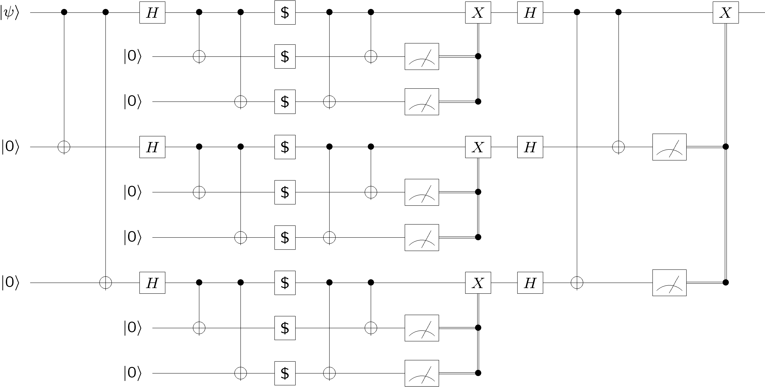
Designing Quantum Computers
Dave Bacon

Slide 2
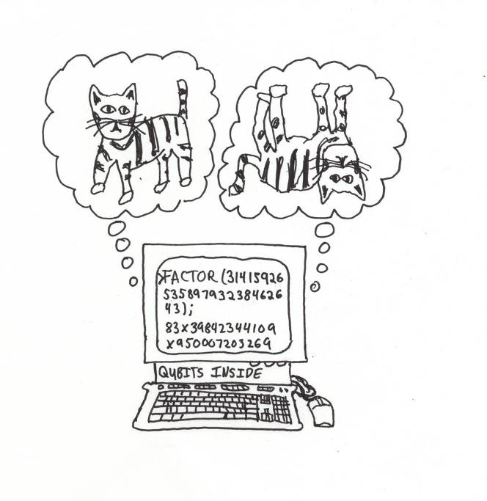
The Quantum Dream
Quantum computer:
a computer whose physical operation exploits the quantum laws of physics
Quantum machines will change our lives.
Break public key cryptosystems
Simulate quantum systems
revolutionize chemistry, biology, material science
??? [This is what I spend about half my time working on]

Slide 3
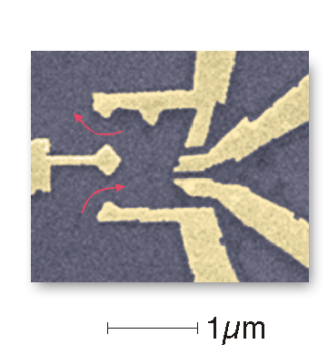
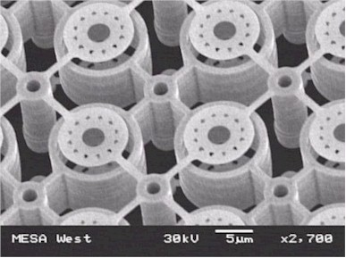
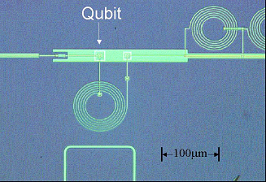
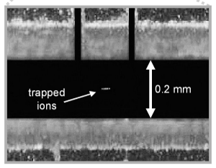

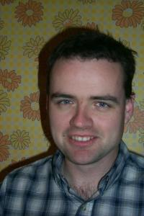
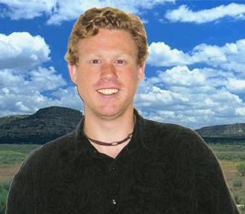
The Quest
Building a quantum computer:
  100s of physicists (worldwide) working on hardware for quantum computers.
Cusp of large efforts to build scalable quantum computers.
Sandia National lab
ion traps
Harvard (Marcus)
quantum dots
UCSB (Martinis)
Josphenson junctions
NIST (Wineland)
Ion traps
One of only a very few groups
who are poised to meaningfully
contribute to designing this scaleup:
Quantum Computer Architectures
Oskin
Bacon

Slide 4

A Quantum Theorem
QC
errosol
“decoherence”
“imprecision”
Threshold Theorems for Fault-Tolerant Quantum Computation
[a partial list from the mid 90s: Aharonov, Ben-Or, Kitaev, Knill, LaFlamme, Zurek, Shor, DiVincenzo, Gottesman, Preskill]
If decoherence is weak enough and control is precise enough,
then a quantum computation to a desired accuracy can be
carried out with an overhead polynomial in the log of the accuracy.

Slide 5
A Theorem Does Not a Computer Make
What I do: a portfolio of two
1. Architecture friendly quantum error correcting codes
quantum error
correcting codes
hardware constraints
hardware specifications
spatial locality
THEORY
ARCHITECTURE
X
X
X
X
X
X
X
X
X
X
X
X
X
X
X
X
X
X
X
X
X
X
XXX
XXX
I I I
measurement
X
X
X
X
X
X
X
X
X
X
X
X
X

Slide 6
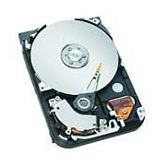
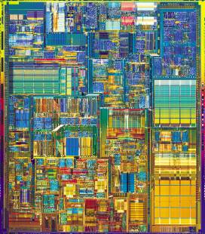
A Theorem Does Not a Computer Make
What I do: a portfolio of two
2. Self-correcting quantum micro-architectures
Classical computers are fault-tolerant due to the physics
of the device. The physics enacts error correction.
Hard Drive
Integrated Circuit
Can we engineer physical systems whose physics
naturally enacts quantum error correction?

Slide 7
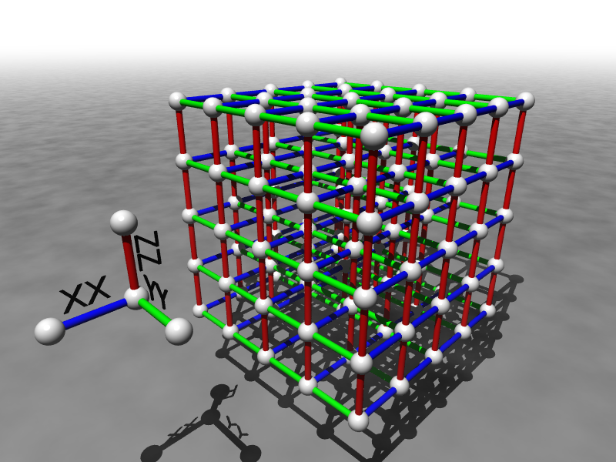
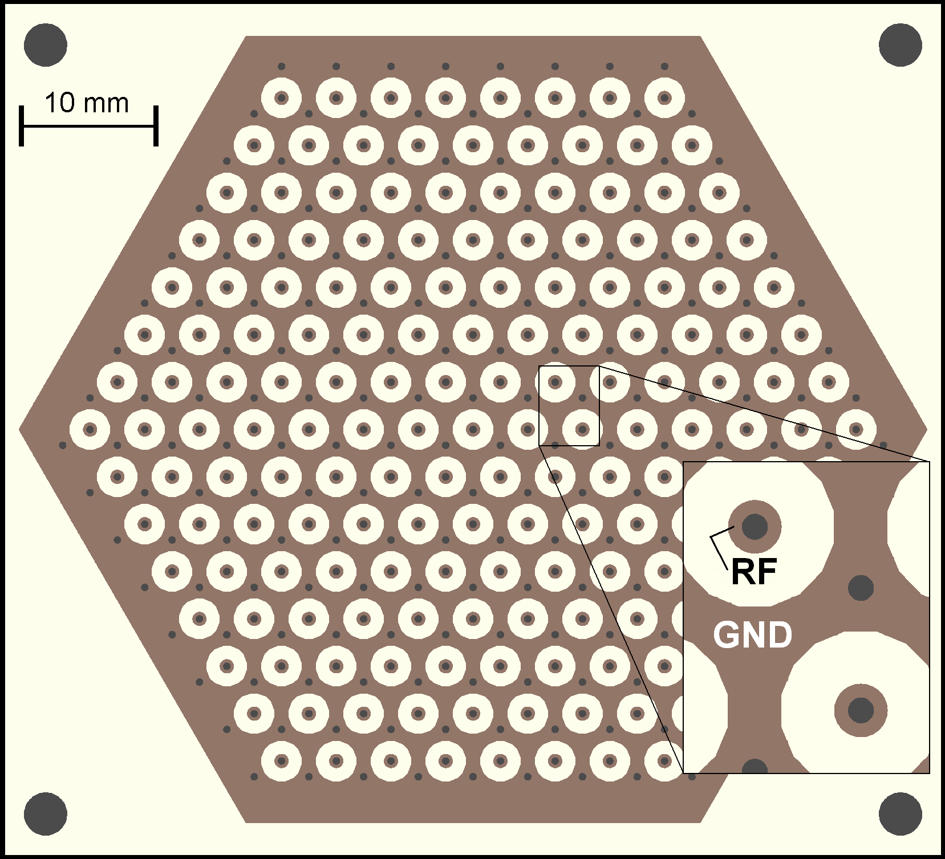
Toward Quantum Hard Drives
Self Correcting Quantum Memories
Figure 2. Hexagonal planar ion trap. 2D mult-zone ion traps allow one to trap ions in any spatial arrangement including a disordered lattice.
(ion trap picture courtesy
Ken Brown, MIT)

Slide 8
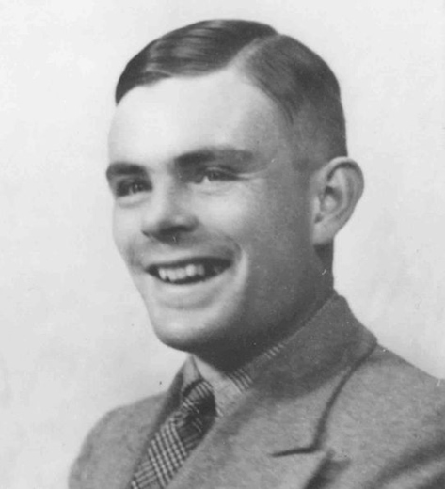
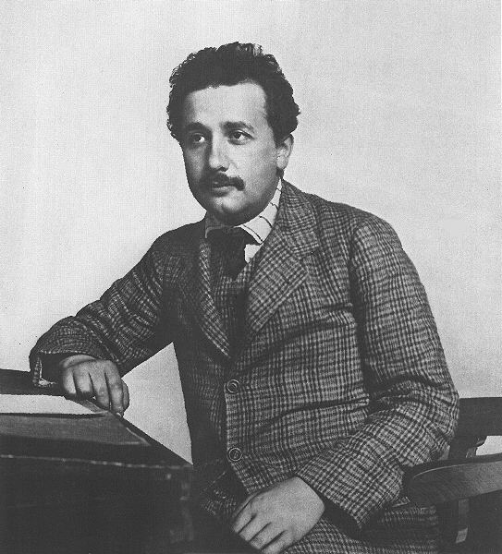
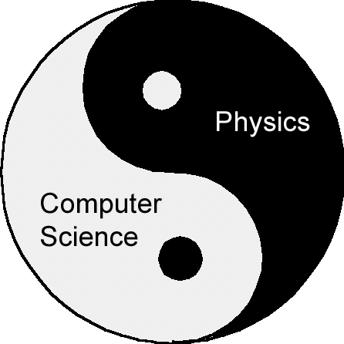
Quantum Computers
…an invitation to help found a new field

Slide 9
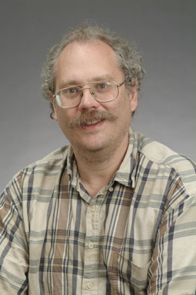
One Reason To Build
18819881292060796383869723946165043
98071635633794173827007633564229888
59715234665485319060606504743045317
38801130339671619969232120573403187
9550656996221305168759307650257059
18819881292060796383869723946165043
98071635633794173827007633564229888
59715234665485319060606504743045317
38801130339671619969232120573403187
9550656996221305168759307650257059
3980750864240649373971
2550055038649119906436
2342526708406385189575
946388957261768583317
4727721461074353025362
2307197304822463291469
5302097116459852171130
520711256363590397527
Shor’s algorithm (1994) breaks the most widely used
public key cryptosystems (RSA, Diffie-Hellman)
Peter Shor

