Slide 1
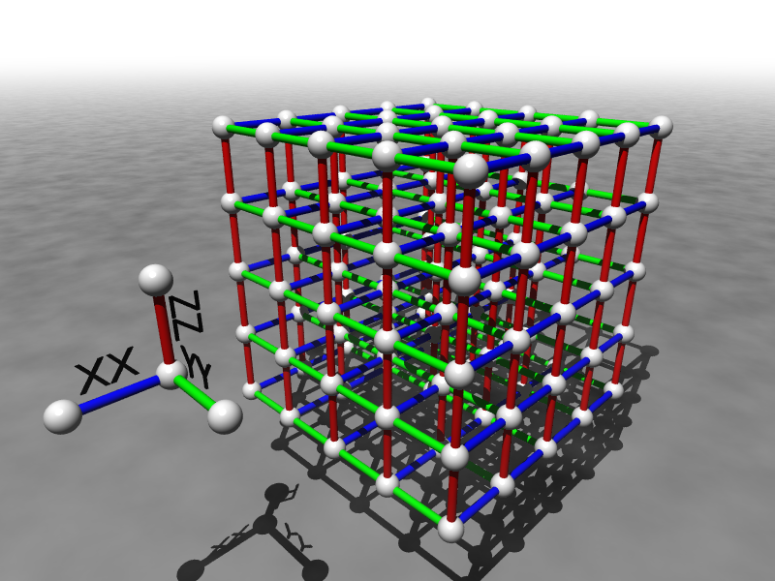
Quantum Computing Theory
Dave Bacon

Slide 2
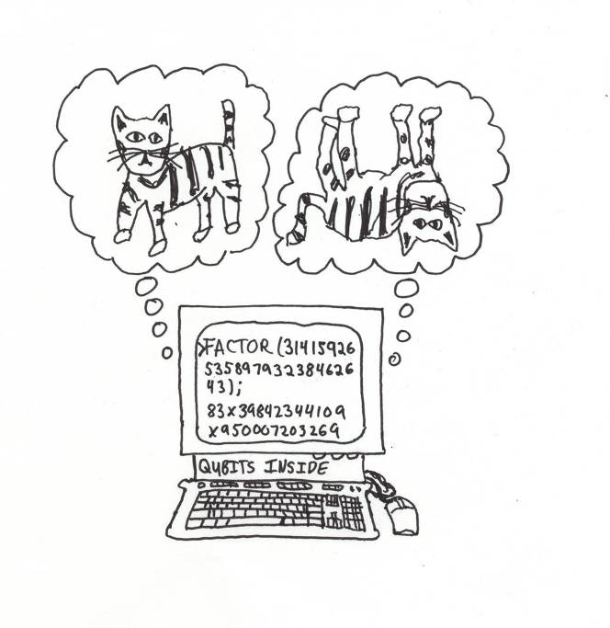
The Quantum Dream
Quantum computer:
a computer whose physical operation exploits the quantum laws of physics
Quantum computing theory is still an infant.

Slide 3
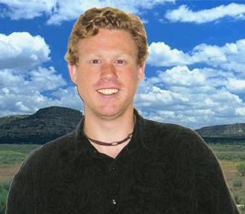
My Quantum Dreams
fault-tolerant
quantum
computation
new
quantum
algorithms
quantum simulations
novel
quantum
circuits
subsystem quantum error correcting codes
self-correcting
quantum memories
entanglement simulation

Slide 4
Quantum Problems
New quantum algorithms
General: What is the power of quantum computers?
g_{m}H
g₃H
G
f
S
g₂H
g₁H
H
Can they solve the nonabelian hidden subgroup problem?

Slide 5
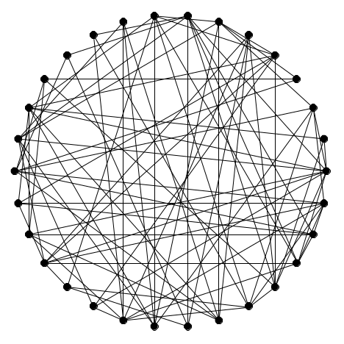
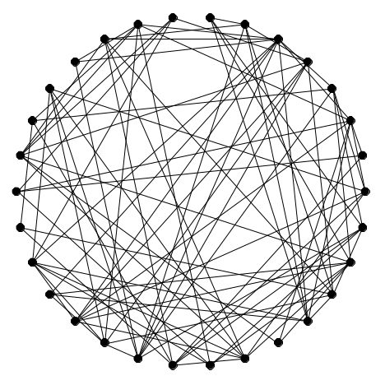
Why We Care
Graph Isomorphism
HSP for Symmetric Group
Unique k-Shortest Vector
In a Lattice
HSP for Dihedral Group

Slide 6
Why It Is Fun
quantum theory
+ group theory
+ semidefinite programming
+ representation theory of finite groups
+ harmonic analysis on nonabelian groups
+ study of quantum entanglement
+ quantum circuit design
But most importantly + CREATIVITY
Benefits: fame of new fundamental quantum algorithms

Slide 7

Quantum Problem 2
QC
errosol
“decoherence”
“imprecision”
Threshold Theorems for Fault-Tolerant Quantum Computation
[a partial list from the mid 90s: Aharonov, Ben-Or, Kitaev, Knill, LaFlamme, Zurek, Shor, DiVincenzo, Gottesman, Preskill]
If decoherence is weak enough and control is precise enough,
then a quantum computation to a desired accuracy can be
carried out with an overhead polynomial in the log of the accuracy.

Slide 8
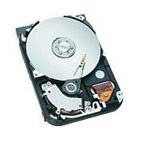
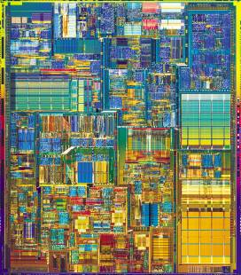
A Theorem Does Not a Computer Make
Classical computers are fault-tolerant due to the physics
of the device. The physics enacts error correction.
Hard Drive
Integrated Circuit
Can we engineer physical systems whose physics
naturally enacts quantum error correction?
“Self-correcting quantum memories”

Slide 9
Toward Quantum Hard Drives

Slide 10
Why It Is Fun
error correcting codes
+ universal quantum computation
+ quantum simulation via efficient quantum data structures
+ thermodynamics of computation
+ subsystem quantum error correcting codes
+ quantum error correcting phases of matter
+ cutting edge quantum experiments
+ theory of fault-tolerant computation
And again, most importantly + CREATIVITY
Benefits: jumpstart the building of a quantum computer

Slide 11
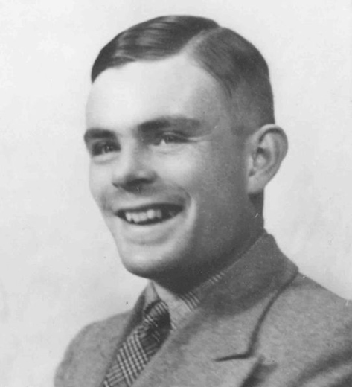
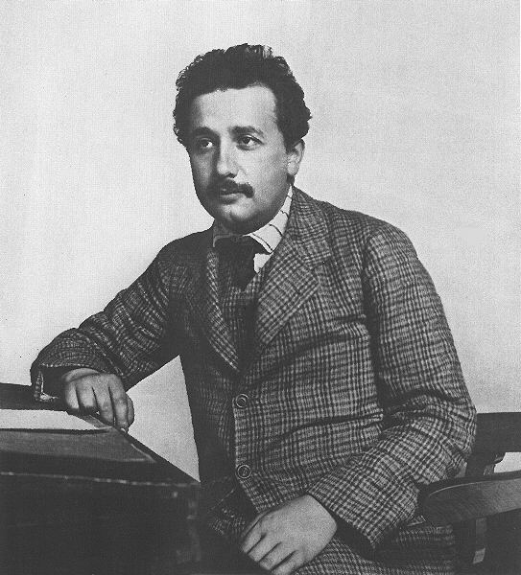
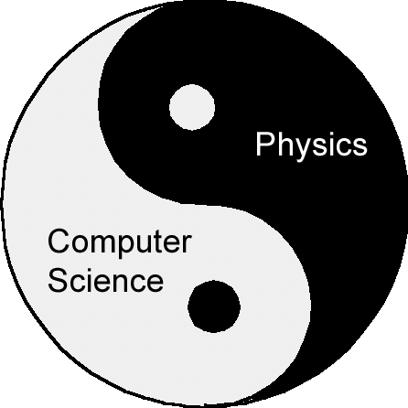
Quantum Computers
…an invitation to a young field

