Slide 1
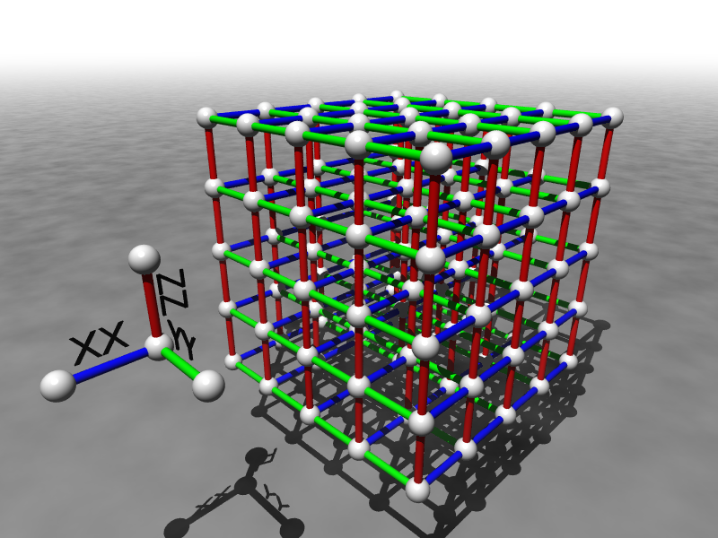
Building Robust Qubits Using Many-Body Strongly Interacting Quantum Systems
Dave Bacon, Principal Research Scientist
Department of Computer Science & Engineering
University of Washington

Slide 2
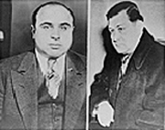
Happy Valentine’s Day

Slide 3
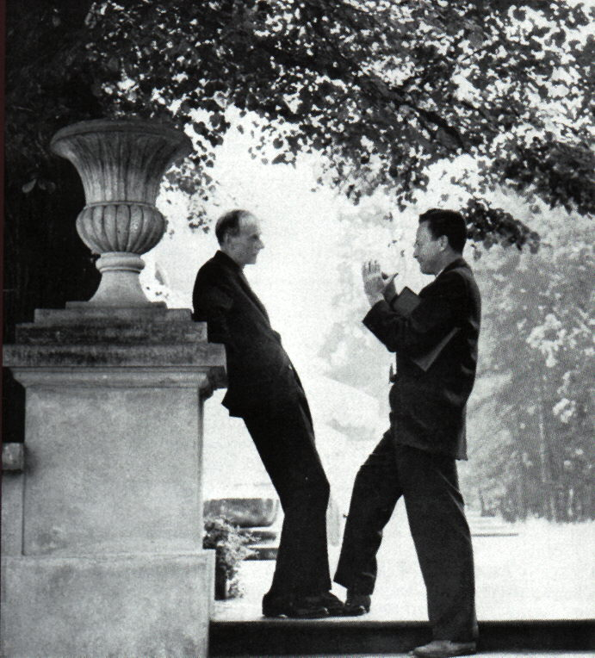
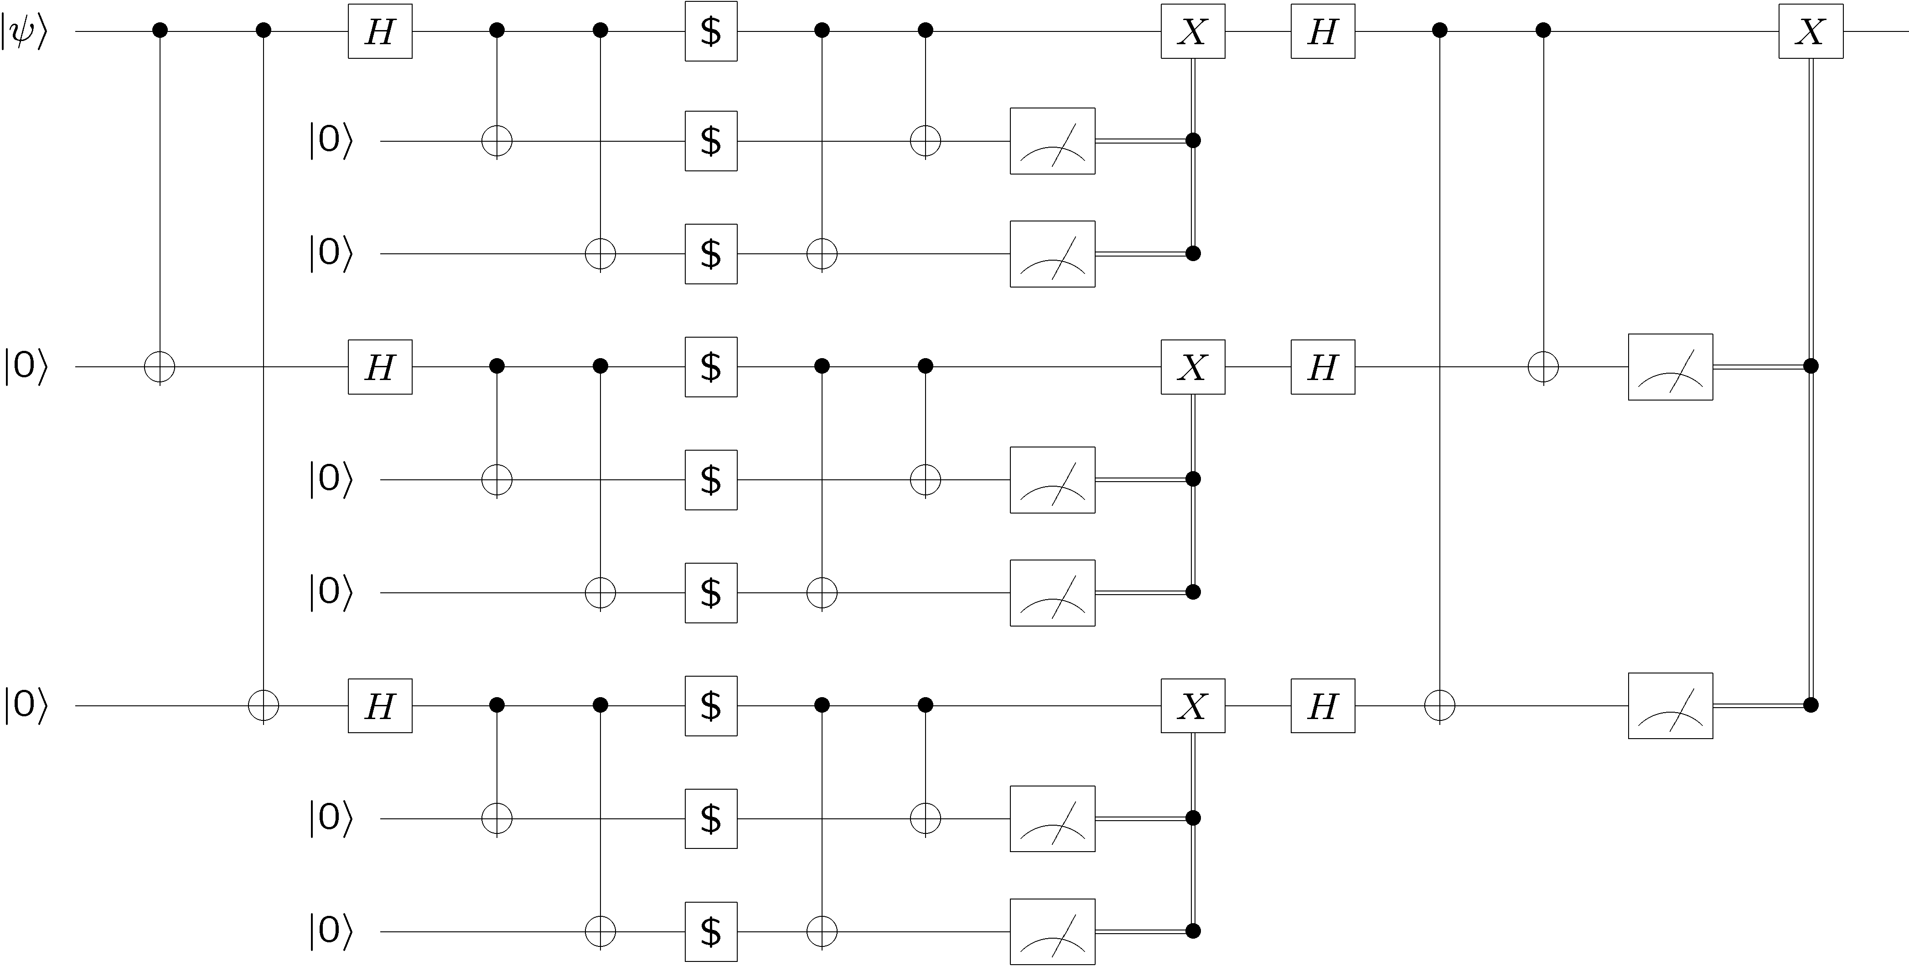
Quantum World, Quantum Computers
“Nature isn't classical, dammit, and if you want to make a simulation of Nature, you'd better make it quantum mechanical, and by golly it's a wonderful problem, because it doesn't look so easy.”
– Richard Feynman 1981
Dirac and Feynman

Slide 4
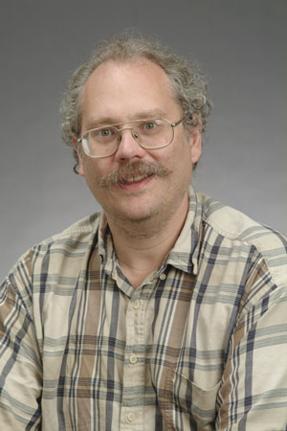


Shor’s Algorithm (1994)
18819881292060796383869723946165043
98071635633794173827007633564229888
59715234665485319060606504743045317
38801130339671619969232120573403187
9550656996221305168759307650257059
Peter Shor
3980750864240649373971
2550055038649119906436
2342526708406385189575
946388957261768583317
4727721461074353025362
2307197304822463291469
5302097116459852171130
520711256363590397527
FACTORING
Best classical algorithm
takes time
Shor’s quantum algorithm
takes time
Shor’s algorithm breaks the most widely used
public key cryptosystem (RSA, Diffie-Hellman)

Slide 5
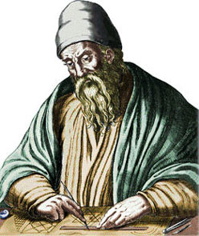
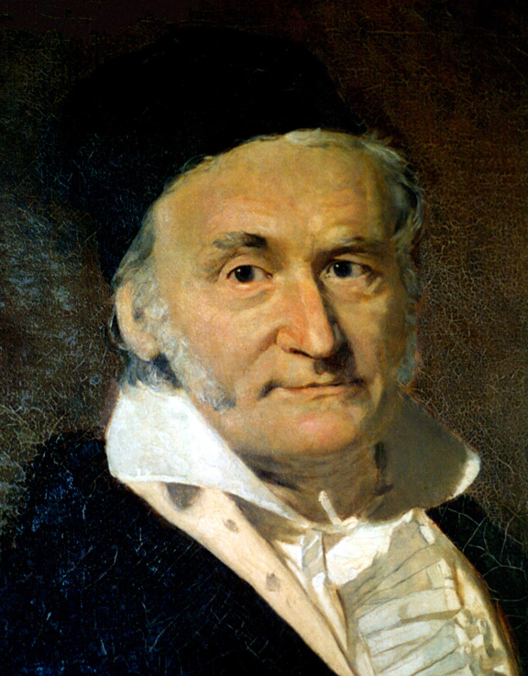
Perspective
GREATEST COMMON DIVISOR
Euclid’s Algorithm
gcd(1020,153)
1020 = 6×153+102
gcd(1020,153)=gcd(153,102)
153 = 1×102+51
gcd(153,102)=gcd(102,51)
102 = 2×51
gcd(102,51)=51
“The problem of distinguishing prime numbers from composites, and of resolving composite numbers into their prime factors, is one of the most important and useful in all of arithmetic... The dignity of science seems to demand that every aid to the solution of such an elegant and celebrated problem be zealously cultivated” — Carl Gauss

Slide 6
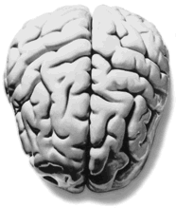
Two Quests
What can quantum
information processing
devices do?
How can we build
quantum information
processing devices?
Some Notable Recent Results
Two Divisions
Efficiently solve Pell’s equation
[Hallgren 2002]
Theory of fault-tolerant quantum computing
New efficient methods for density
matrix renormalization group in
high dimensions
[Vidal, Verstraete et al. 2003-now]
“engineering”
Experimental implementations of quantum computers
Quantum Shannon theory
[various authors]
“physics”

Slide 7
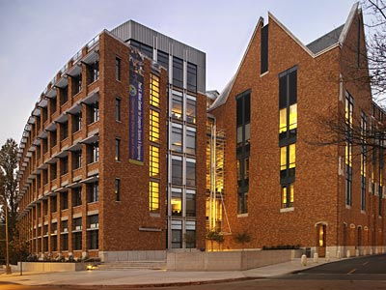
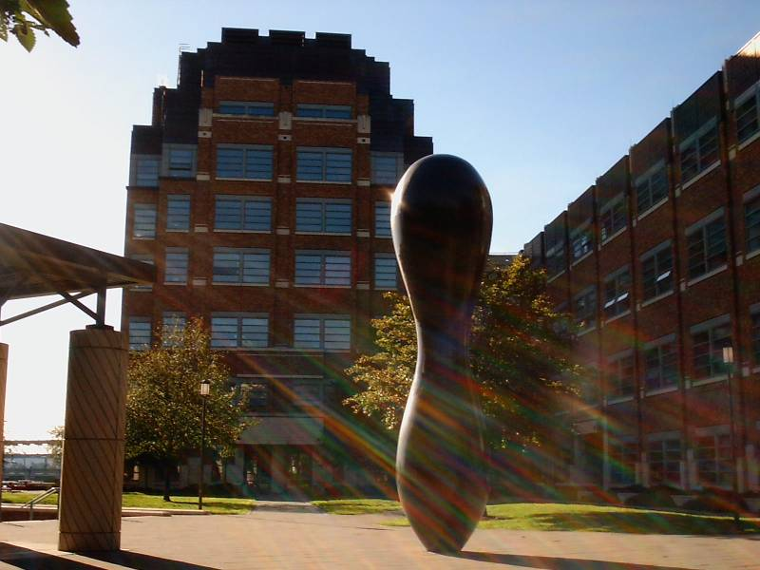
Building Battle Royale
Computer Science & Engineering
Physics
Who will dominate construction of a large scale quantum computer?

Slide 8
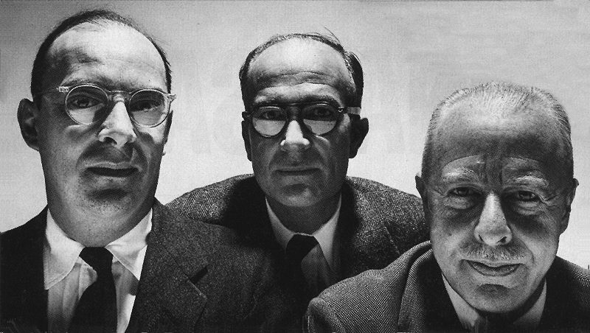
A Different Path
I will argue that the path to constructing a robust large scale
quantum computer will look nothing like what is currently
envisioned, but instead will be achieved via a careful application
of physics to the problems of building robust quantum computers.

Slide 9




Problem Child
decoherence:
Environment
System
open quantum systems can become
entangled with their environment
coherent superposition
incoherent sum
imprecise and faulty control:
unitary gates, preparation, measurements
System
Control

Slide 10

Problem Solution
QC
errosol
“decoherence”
“imprecision”
Threshold Theorem for Fault-Tolerant Quantum Computation
[Aharonov, Ben-Or, Knill, LaFlamme, Zurek, Shor, Gottesman, Preskill]
If decoherence is weak enough and control is precise enough,
then a quantum computation to a desired accuracy can be
carried out with an overhead polynomial in the log of the accuracy.

Slide 11
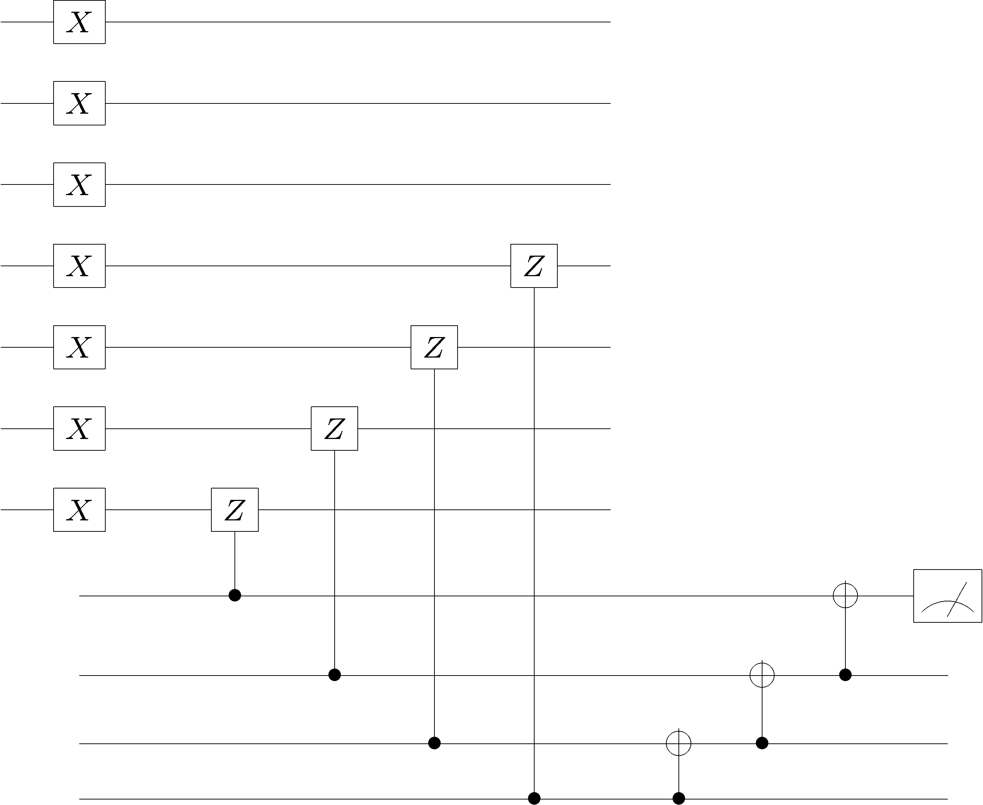
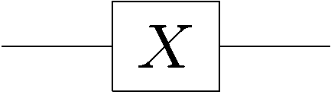
Sketch: How It Works
To make robust elements, information is encoded into a quantum
error correcting codes of significant size and fault-tolerant methods
are used for gates, preparation, measurement, and correction

Slide 12
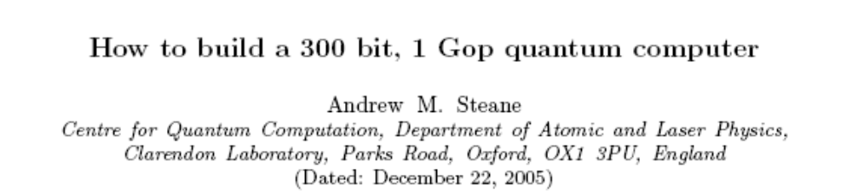
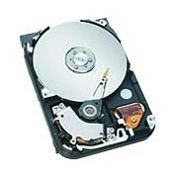
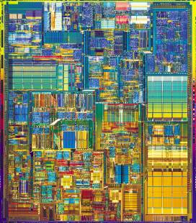
In Practice?
13000 ions, 1000 laser beams, 160000 electrodes in ion trap
The device complexity simply to engineer robust qubits is severe
“A quantum computer will spend most of its time doing error correction.”
CONTRAST:
Is there a better way? Can we mimic classical computers?

Slide 13
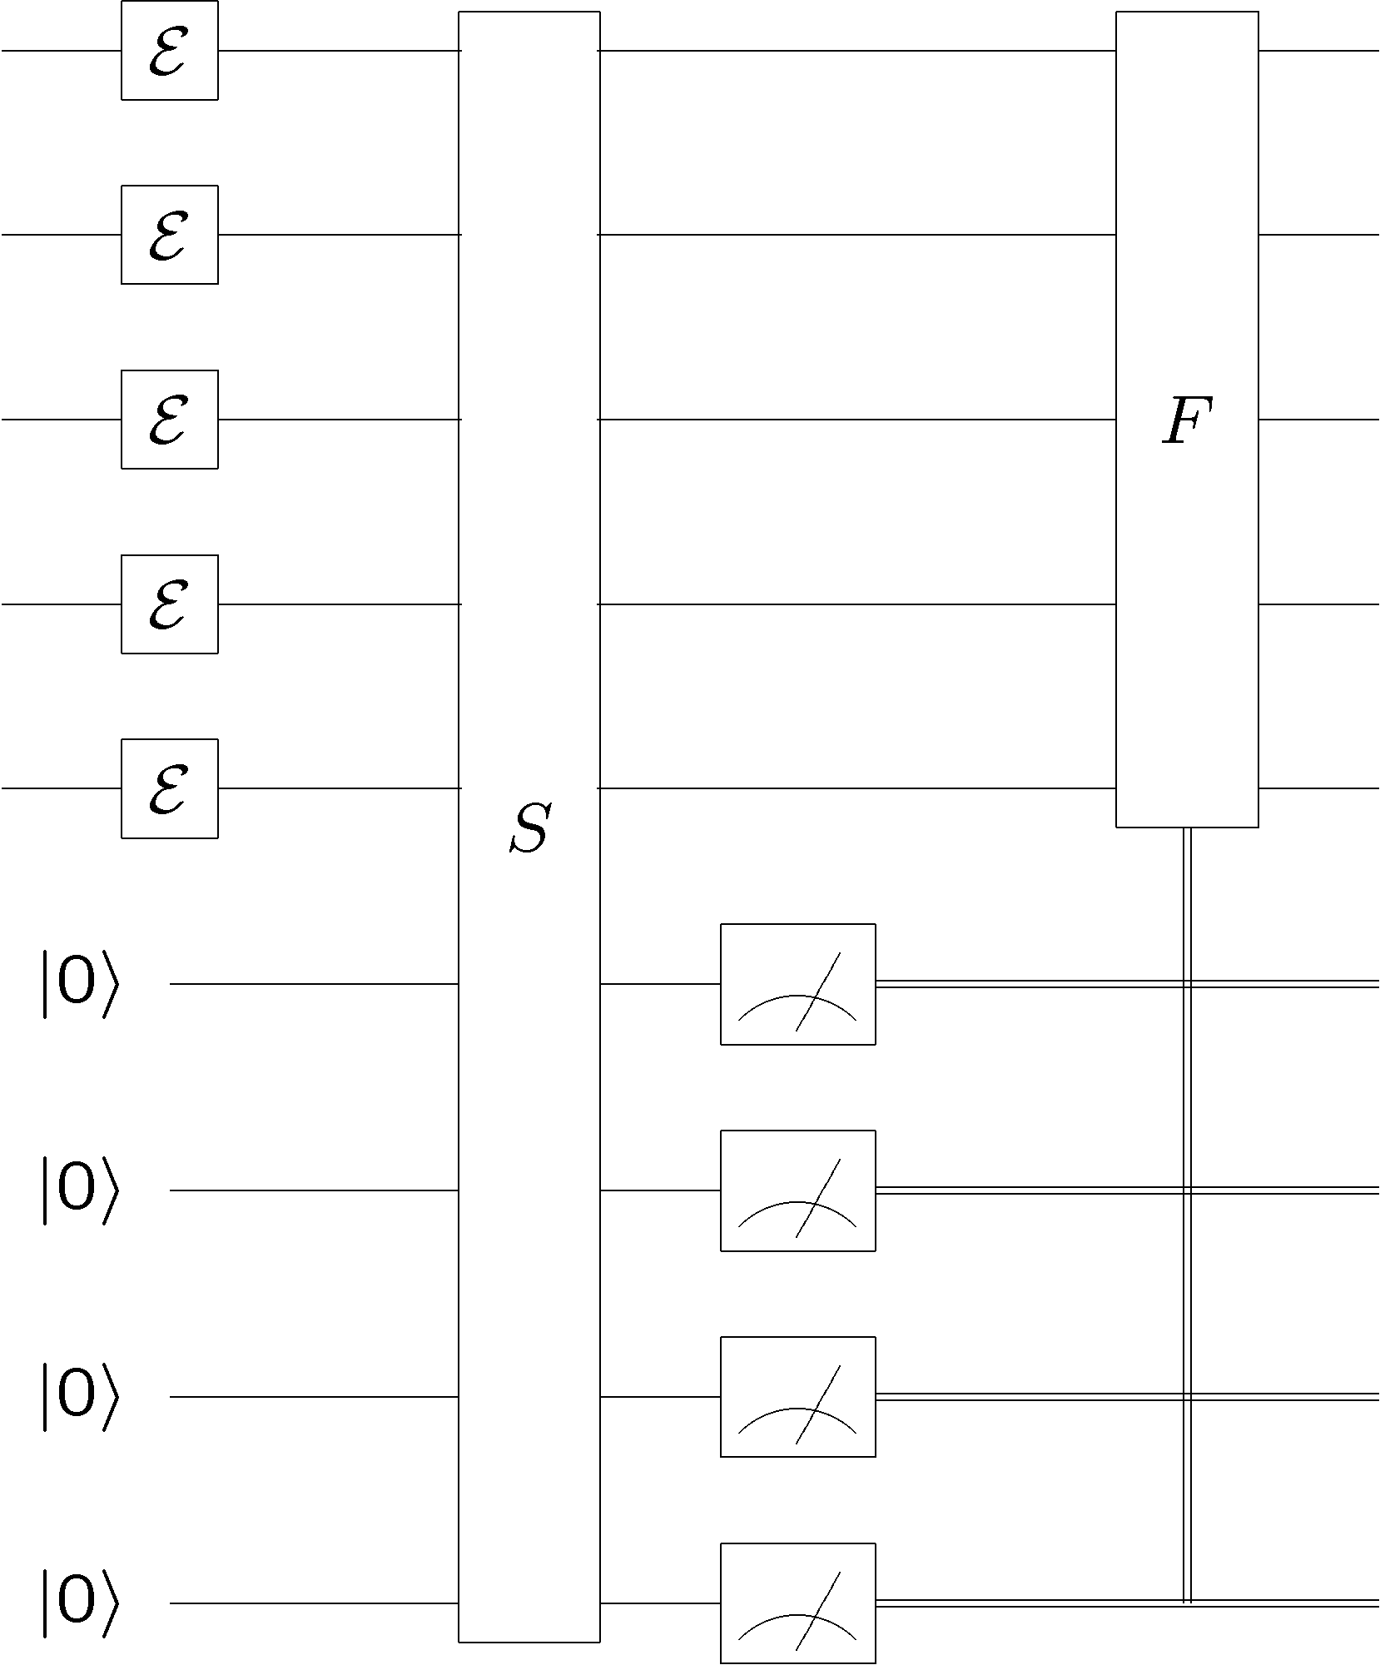
Quantum Error Correction
error
diagnose
fix
encoded
quantum
information
encoded
quantum
information
“cold”
ancilla
qubits
“hot”
ancilla
qubits
Quantum error correction is essentially (sophisticated) cooling

Slide 14
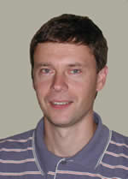


The Quantum Hard Drive?
Kitaev
Do there exist (or can we engineer) quantum systems whose
physics guarantees fault-tolerant quantum computation?

Slide 15
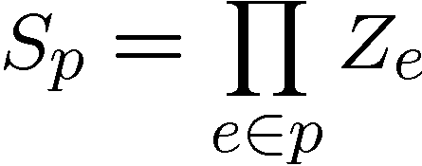
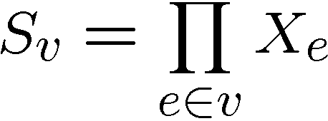




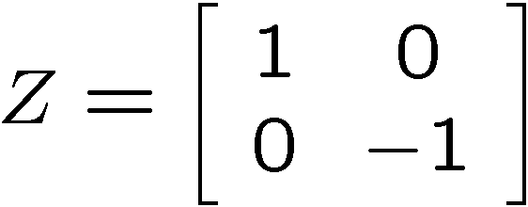
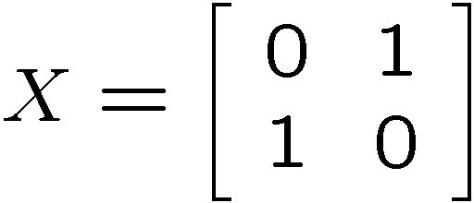
Kitaev’s Model
plaque operators:
qubits on links
vertex operators:
vertex and plaque operators
all commute with each other

Slide 16
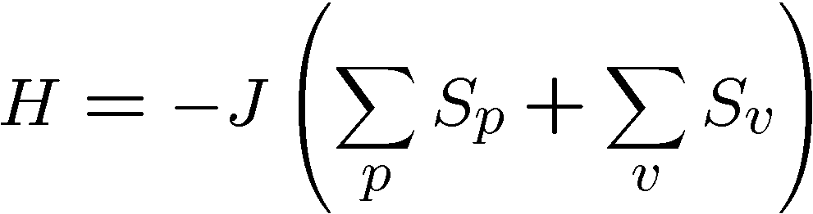






Kitaev’s Model, Continued
Hamiltonian
plaque operators:
vertex operators:
ground state has all

Slide 17
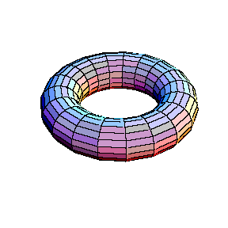
Topology of Operators
plaque operators:
products of vertex operators
are closed loops of Z’s which
are homologically trivial
on dual lattice, vertex operators play same rule

Slide 18

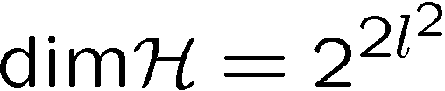

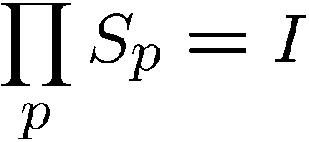
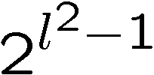

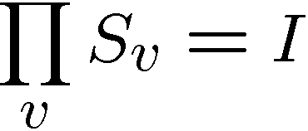

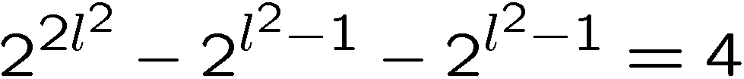
Degeneracy
Hamiltonian
plaque operators:
vertex operators:
qubits
plaque operators
values
vertex operators
values
every energy level is degenerate

Slide 19


Kitaev’s Model
plaque operators:
vertex operators:
anti-commutes with
two plaque operators
−
−
excitation is above ground state

Slide 20
Excitations
excitations particles come in pairs (particle/antiparticle)
at end of “error” chains
two types of particles, X-type (live on vertices of dual lattice)
Z-type (live on vertices of the lattice)

Slide 21



A Qubit
Moving an X or Z type particle on a homologically nontrivial
path and annihilating with it’s partner preserves the ground
states
Action on ground state must be representation of non-Abelian
group: Acts as encoded single qubit Pauli operator.

Slide 22



Two Qubits
Moving an X or Z type particle on a homologically nontrivial
path and annihilating with it’s partner preserves the ground
states
Action on ground state must be representation of non-Abelian
group: Acts as encoded single qubit Pauli operator.

Slide 23


Anyons Anyone?
Phase:

Slide 24


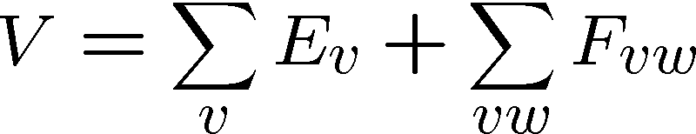
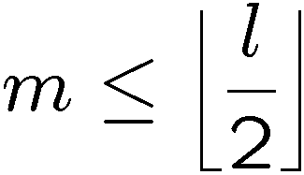
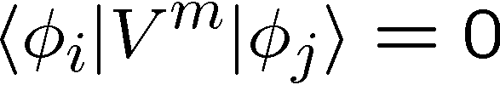
Topological Protection
Encode two qubits
into the ground state
gap
Perturbation theory:
But for

Slide 25

Topological Quantum Computing
Encode two qubits
into the ground state
gap
If we keep then quantum information encoded into ground state will be “topologically” robust to perturbation.
We can perform gates (in this example X and Z) by creating
anyon pairs and moving them around the torus.
Are these assumptions reasonable?

Slide 26
Topological Error Correction
Different mode of using Kitaev’s Model, as a component in
a fault-tolerant quantum computer, encode into ground state
1. Errors occur
2. Measure vertex and plaque operators
3. Apply recovery operator
4. If created loop is homologically trivial,
then we have restored information
encoded into ground state.
Full analysis: measurements uncertain, recovery may fail, etc.
Threshold for fault-tolerant storage of quantum information:
[Dennis, Kitaev, Landahl, Preskill 2002]
[Wang, Harrington, Preskill 2003]

Slide 27
Fault-Tolerant?
Encode two qubits
into the ground state
gap
If we keep then quantum information encoded into ground state will be “topologically” robust to perturbation.
We can perform gates (in this example X and Z) by creating
anyon pairs and moving them around the torus.
Are these assumptions reasonable?

Slide 28
What is a Computer?
Practical question (as opposed to philosophical)
What is the phase of matter corresponding to the computer?
There are distinct physical reasons why robust classical
computation is possible.
Hard Drive
Integrated Circuit

Slide 29





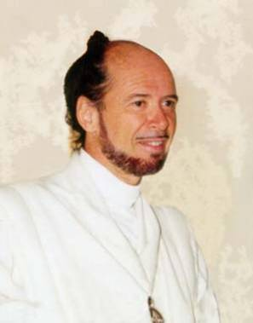



No Quantum Transistor?
Quantum Cloning Machine
“A single quantum cannot be cloned,” Wootters and Zurek, Nature, 1982

Slide 30
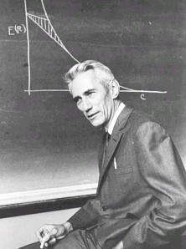
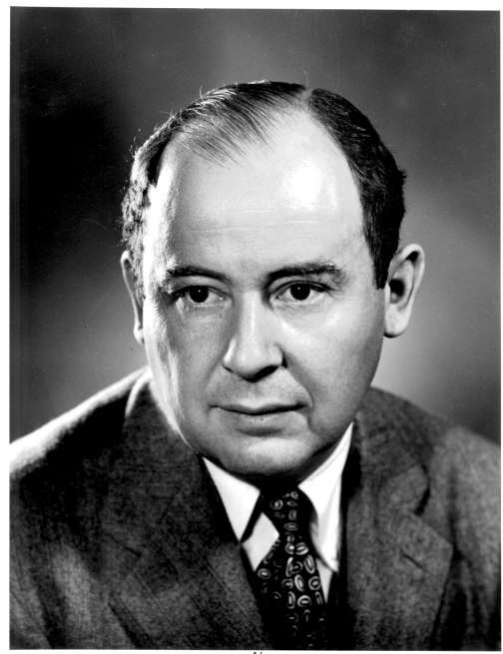
To Build a Quantum Computer
Classical
Problem (1938): How to build a reliable system from
unreliable components?
“A mathematical theory of communication” (1948)
How to communicate in the presence of noise
“Probabilistic logics and the synthesis
of reliable organisms from unreliable
components” (1956)
Claude
Shannon
How to compute when the subsystems
of your computer can fail?
John
von Neumann

Slide 31


Three Storage Testbeds
Ferromagnetic Ising models:
one dimensional
two (and >) dimensional
Toom’s rule:
0
0
1
0
0
0
0
0
0
1
1
0
1
0
0
0
two dimensional noisy
cellular automata
0
1
0
0
0
0
0
0
0
0
1
1
1
1
1
0
0
0
0
0
1
0
1
0
1
1
1
0
0
0
0
0

Slide 32
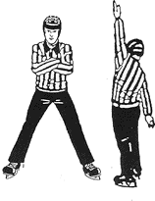

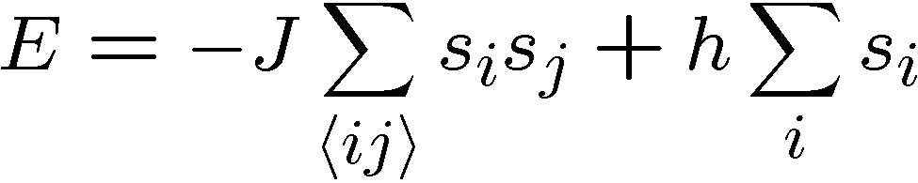


Ferromagnetic Ising Models
Ising model
spins on edges of a lattice:
energy of a configuration:
sum over neighbors
external magnetic field
for now

Slide 33

Dynamic Ising Models
Dynamic Ising model (Metropolis update)
Interaction with environment causes spin flips
Update rule:
If flipping spin would decrease energy, flip spin
If flipping spin would increase energy, flip spin with probability

Slide 34
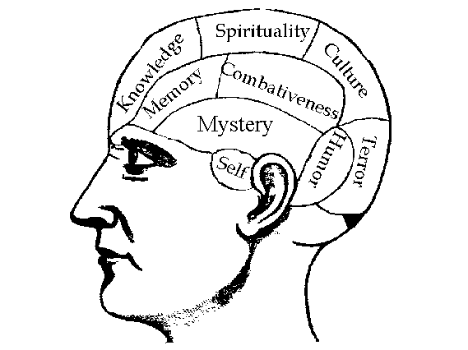


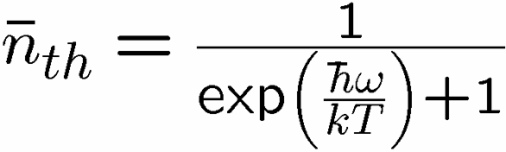

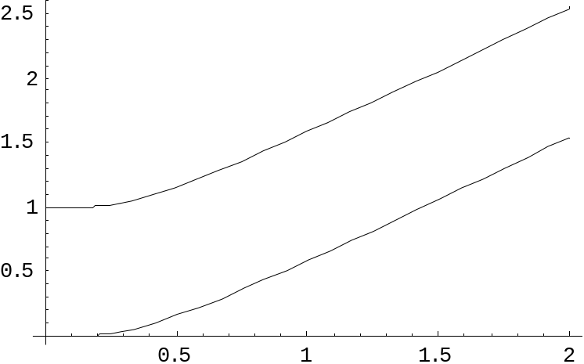
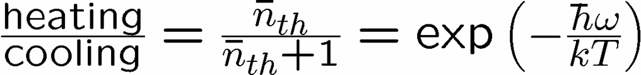


Reminder
two-level system perturbatively coupled to a thermal boson bath
“heating”
“cooling”
“non-dissipative”

Slide 35
Dynamic Ising Models
Dynamic Ising model (Metropolis update)
Interaction with environment causes spin flips
Update rule (alternate with noise):
If flipping spin would decrease energy, flip spin
If flipping spin would increase energy, flip spin with probability

Slide 36
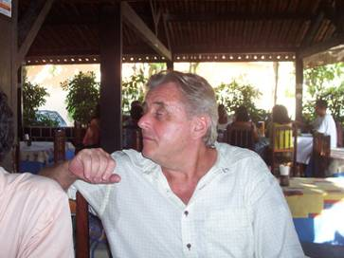
Toom’s Rule
0
0
1
0
0
0
0
0
0
1
1
0
1
0
0
0
two dimensional noisy cellular automata
0
1
0
0
0
0
0
0
0
0
1
1
1
1
1
0
0
0
0
0
1
0
1
0
1
1
1
0
0
0
0
0
Update rule:
n
n
b=majority(n,e,b)
a
e
b
e
0
0
0
0
0
0
0
0
0
0
0
0
0
0
0
0
0
1
1
0
0
1
0
0
0
0
0
0
0
0
0
0
0
1
0
0
0
1
0
0
0
1
0
0
0
0
0
0
0
0
0
0
0
0
0
0
0
0
0
0
0
0
0
0
Update rule with noise: with some probability the update fails
and a random state is assigned

Slide 37


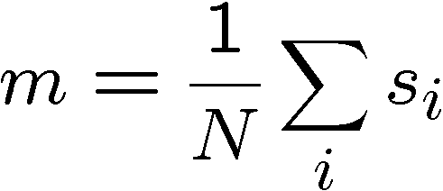
Compare and Contrast
Encode information into the system and watch what happens
0
0
0
0
0
0
0
0
0
0
0
0
0
0
0
0
0
0
0
0
0
0
0
0
0
0
0
0
0
0
0
0
0
0
0
0
0
0
0
0
0
0
0
0
0
0
0
0
Redundancy code.
Order parameter is magnetization:

Slide 38


Storage
Long time behavior (not infinite time, but effectively)
1D Ising
2D Ising
Toom’s Rule
Criticism: (1) thermodynamic limit taken
(2) what if relaxation to equilibrium takes a long time?

Slide 39
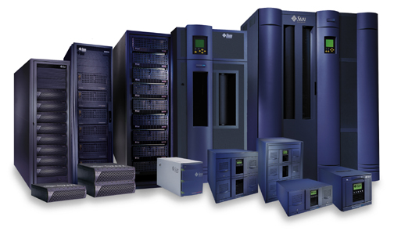


Storage
2nd attempt:
Relaxation to thermal
1D Ising
2D Ising, Toom’s Rule
Imperfect preparation

Slide 40
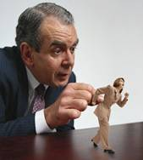




Manipulation
Flipping spins is imperfect
2D Ising
Toom’s Rule
1D Ising
1D Ising
temperature less than gap
manipulation error must be small
(i.e. NOT fault-tolerant)
2D Ising
temperature less than critical temp

Slide 41















“Self Fixing”
Excitations point-like
Energy to err is constant
Disordering entropy >> Energy
Excitations string-like
Energy to error is prop to size
Energy >> Disordering entropy

Slide 42

Toom’s Rule Versus 2D Ising
Applied magnetic field (corresponds to a bias in noise)
2D Ising
Toom’s Rule
Regions with two coexisting phases
External magnetic fields disorder magnetic media

Slide 43

Whence Kitaev’s Model?
Robust storage of quantum information.
But it does not provide a mechanism for
robust manipulation of quantum information.
Is it possible to construct a Hamiltonian, which allows for fault-tolerant manipulation as well?

Slide 44
Goal
1. Many-body quantum system with degeneracy due to
existence of quantum error correcting code
2. “Self-correcting”
3. Interaction which we could reasonably engineer
4. Ability to manipulate and measure erred quantum
information.

Slide 45
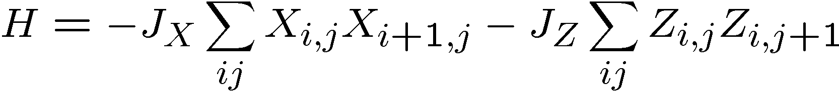
Quantum Compass Model
ZZ
ZZ
XX
XX
XX
ZZ
ZZ
XX
XX
XX
ZZ
ZZ
Ground state is a new kind of quantum error correcting code:
quantum error correcting subsystem

Slide 46






Subsystem Error Correction
Only need to protect subsystem,
not full subspaces.
encoding
subsystem
error
recovery
encoded quantum
information
recovery need not perfectly restore system, but only
preserve information encoded into subsystem.

Slide 47
Quantum Compass Model
ZZ
ZZ
XX
XX
XX
ZZ
ZZ
XX
XX
XX
ZZ
ZZ

Slide 48
Subsystem Error Correction
Measure:
Diagnose error and apply fix. Fix may apply operator of form
D. Bacon, Phys. Rev. A 73, 012340 (2006)
“Operator quantum error-correcting subsystems
for self-correcting quantum memories”
But this commutes with
ogical operators:

Slide 49
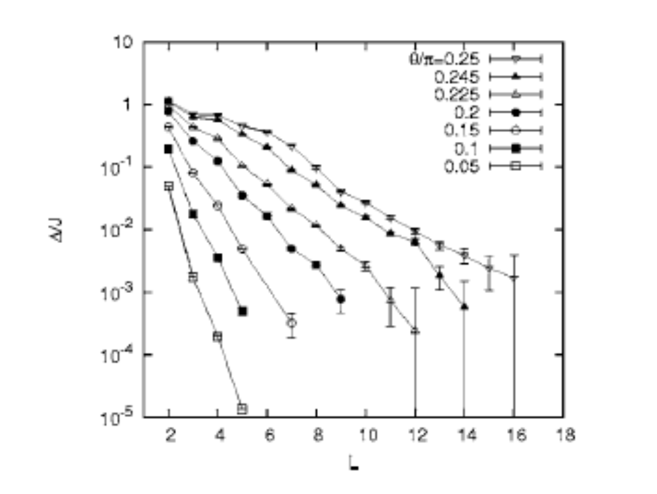
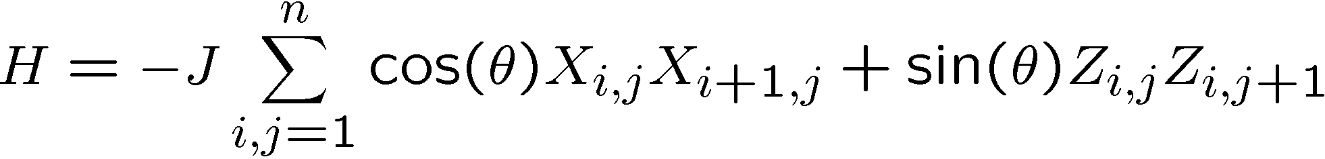
Problems:
[Dourier, Becca, Mila 05]
no gap in the thermodynamic limit

Slide 50

Problems, Continued
XX
XX
XX
ZZ
ZZ
ZZ
ZZ
XX
XX
XX
ZZ
ZZ
ZZ
ZZ
XX
XX
XX
Exact diagonalization 3x3, 4x4, 4x5
Even at finite size, not “self-correcting”

Slide 51
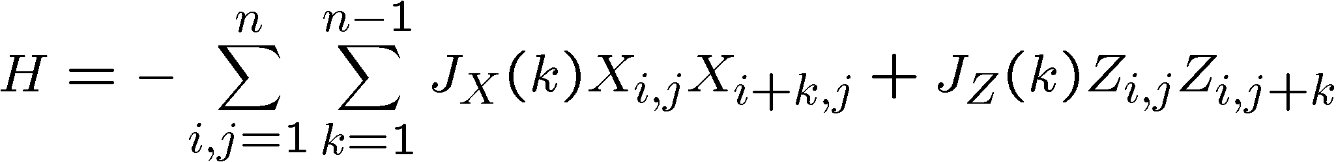
Toward Self-Correction
ZZ
ZZ
ZZ
XX
XX
XX
XX
n by n
square
lattice
ZZ
ZZ
ZZ
XX
XX
XX
XX
ZZ
ZZ
ZZ
XX
XX
XX
XX
ZZ
ZZ
ZZ
Exact diagonalization of 4x4 model, shows that with constant couplings, this model is self-correcting!

Slide 52


Self-Correction
energy
eigenstates

Slide 53
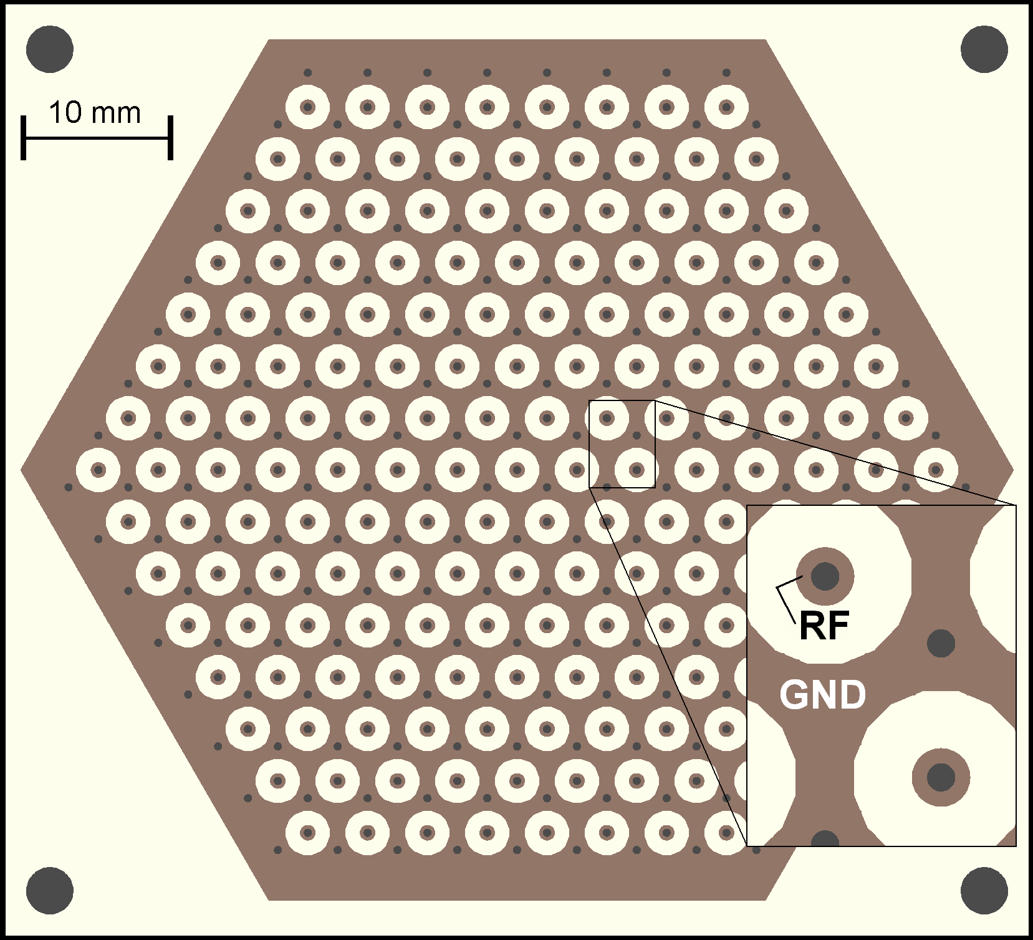

Toward Self-Correction
Can techniques used in creating two qubit interactions be
used to engineer such interactions
(Sorenson-Molmer gates? Ideas of Deng, Porras, and Cirac?)
Possible to engineer such systems in planar ion trap system?
Figure 2. Hexagonal planar ion trap. 2D mult-zone ion traps allow one to trap ions in any spatial arrangement including a disordered lattice.
Picture courtesy Ken Brown
(Isaac Chuang’s Lab, MIT)

Slide 54
Into The Third Dimension

Slide 55

Into The Third Dimension
subsystem code
implementation in optical lattices?
Duan, Demler, and Lukin,
Phys. Rev. Lett. 91, 090402 (2003)
Current research: numerical work looking for self-correction
[using new methods for density matrix renormalization group in
greater than one dimension developed by Vidal, Verstraete et al.]

Slide 56

A Different Path
Quantum error correction can be performed by cooling an
interacting quantum system.
Potential for robust substrates for quantum information.

Slide 57


Funding and Support

