Slide 1
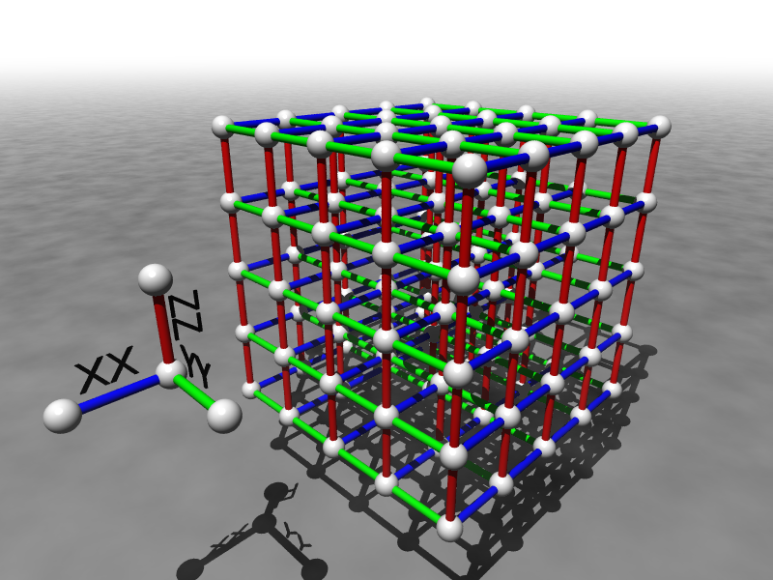
Towards Robust and Powerful Quantum Computers
Dave Bacon
University of Washington

Slide 2
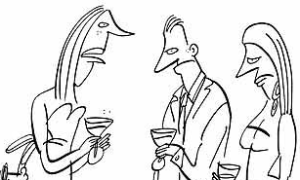
The Question
What do you do for a living, Dave?
I’m a scientist working in the field of quantum computation.
Oh!
When are we going to build a quantum computer?
And will it be able to do more than efficiently factor whole numbers and compute the discrete logarithm?

Slide 3
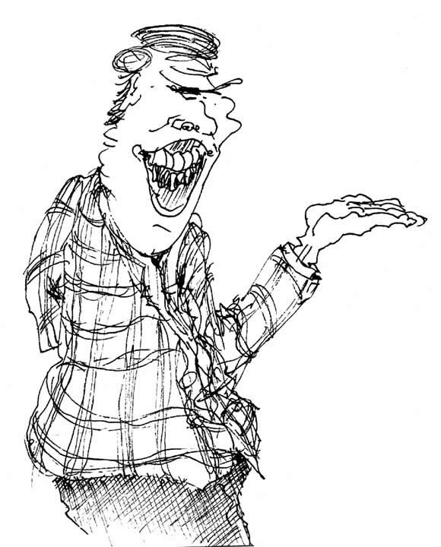
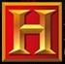
Why the Confidence?
Why are we confident that large scale quantum computers can be built?
Why are we confident that quantum computers are worth studying and building?
A historical account: including the future!

Slide 4
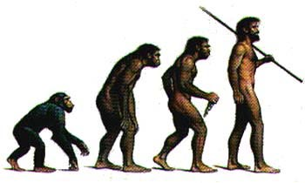
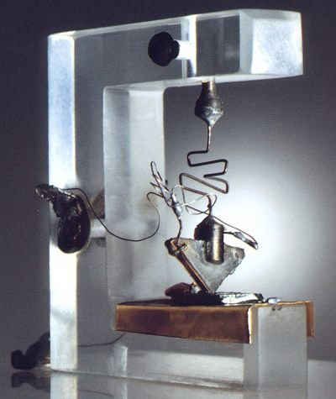
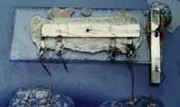
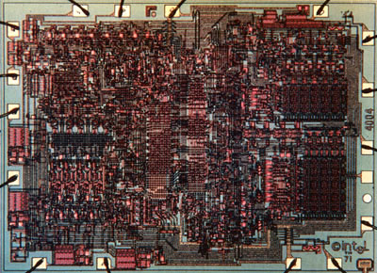
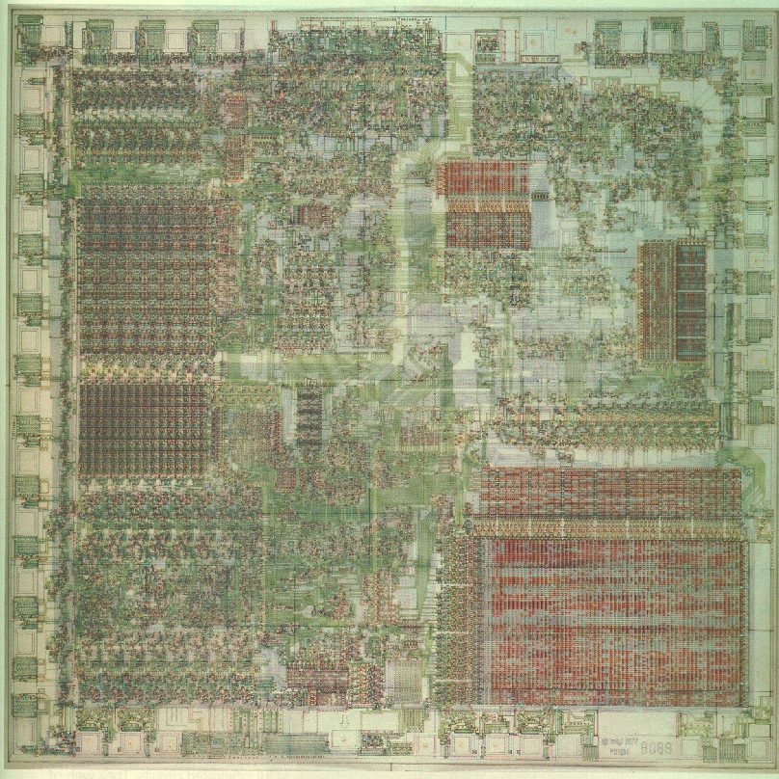
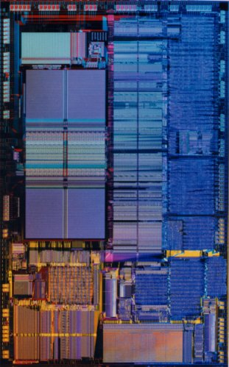
Where Are We Going?
?

Slide 5
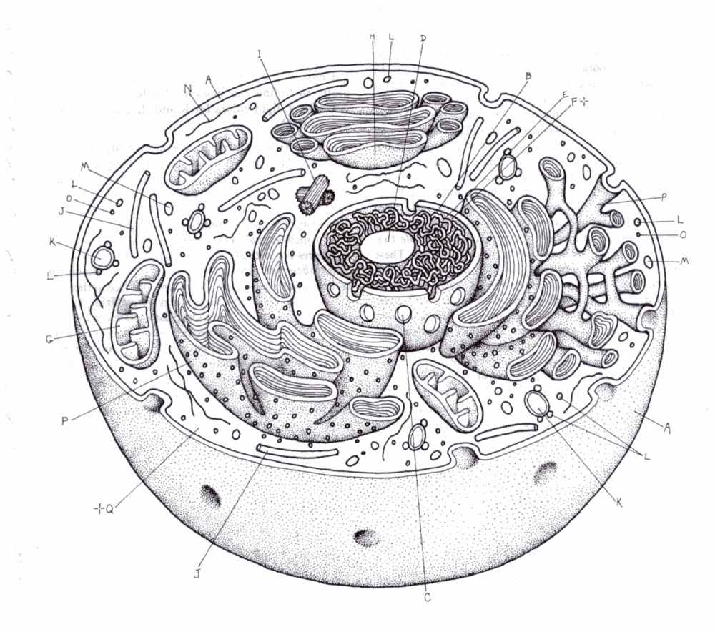
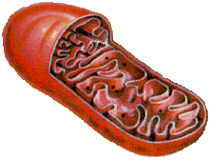
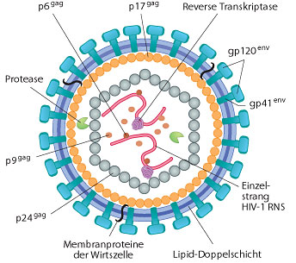
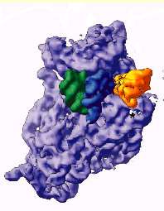

New Sizes, New Rules
NOISY (FAULTY)
QUANTUM
10,000nm
1,000nm
100nm
10nm
1nm
0.1nm
1. Can we build digital devices?
2. Quantum computers?

Slide 6
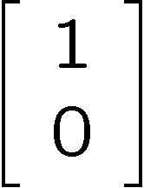
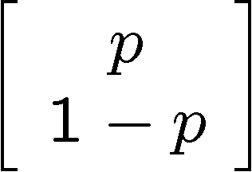
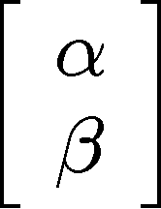


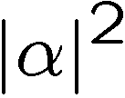
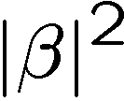
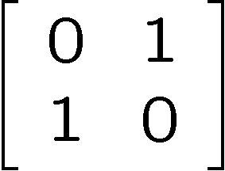
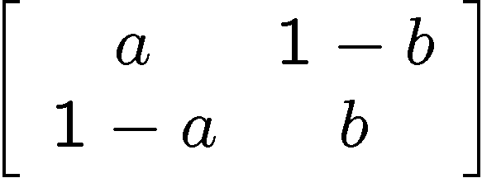
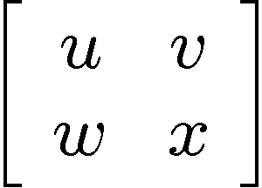
Bit, Pbit, and Qubit
bit
probabilistic bit
quantum bit
Configurations:
0
1
0
1
0
1
Description:
Observation:
0
certainty
0
p percent
0
percent
1
p percent
1
percent
Evolution:
deterministic
stochastic
unitary

Slide 7
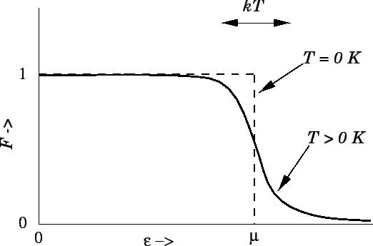
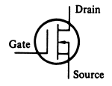
There Are No Bits
bits

