Slide 1
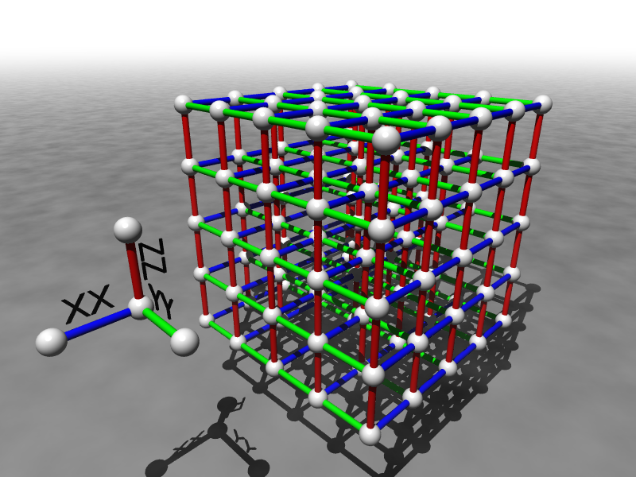
Towards Robust and Powerful Quantum Computers
Dave Bacon
University of Washington
Department of Computer Science & Engineering

Slide 2
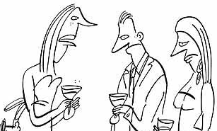
The Question
What do you do for a living, Dave?
I’m a scientist working in the field of quantum computation.
Oh!
When are we going to build a quantum computer?
And will it be able to do more than just efficiently factor whole numbers and compute the discrete logarithm?

Slide 3
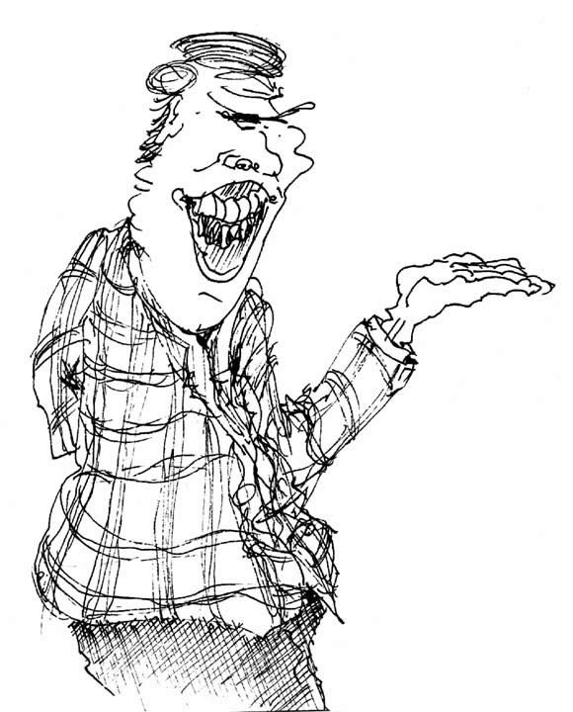
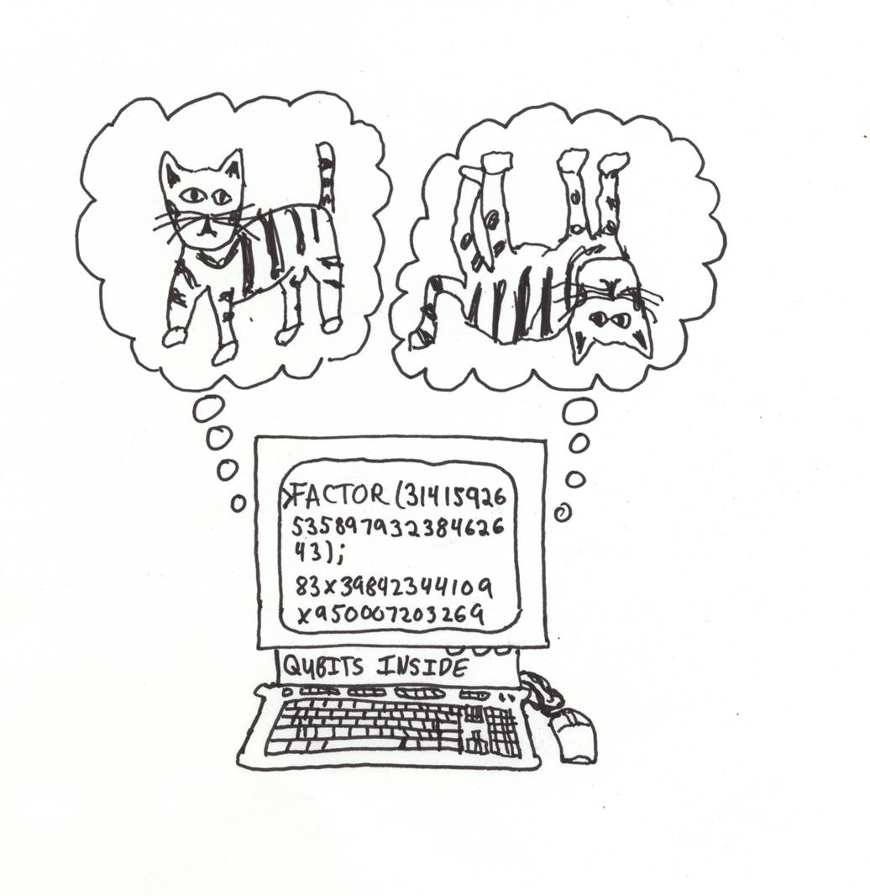

Why the Confidence?
Why are we confident that large scale
quantum computers can be built?
Why are we confident that quantum computers
are worth studying and building?
A historical account: including the future!

Slide 4
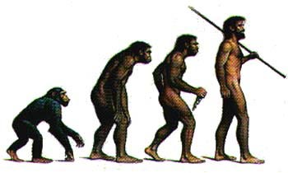
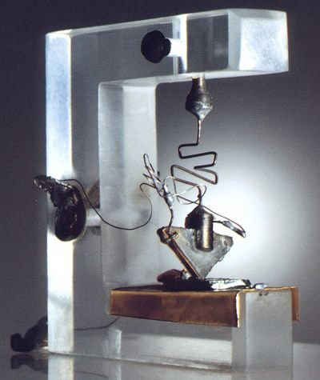
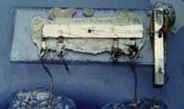
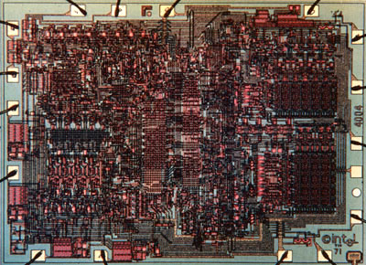
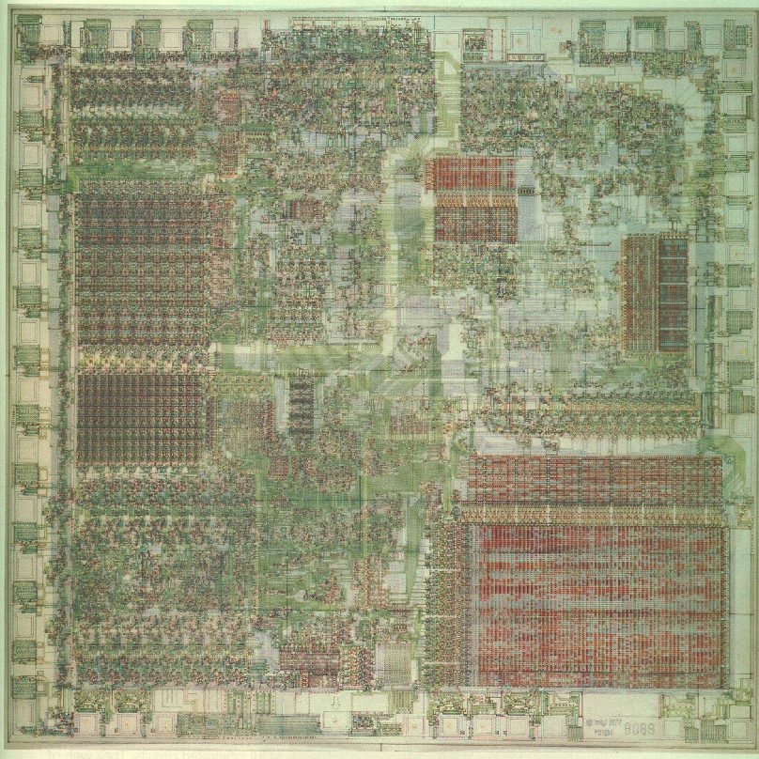
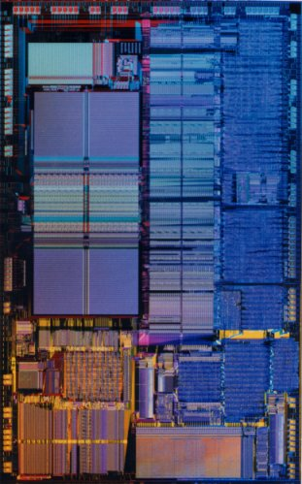
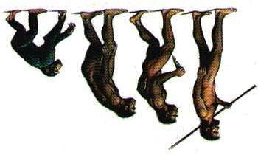
Where Are We Going?
?

Slide 5
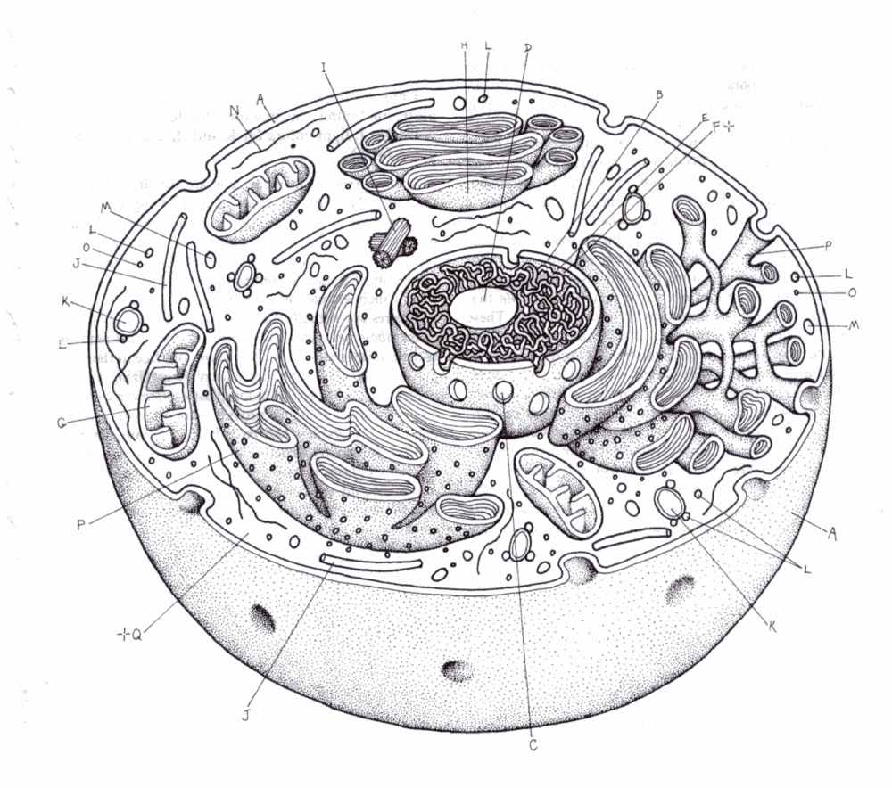
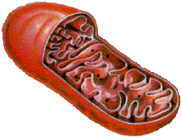
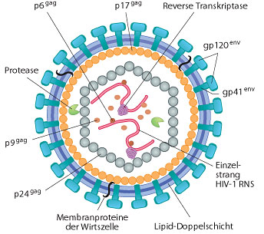
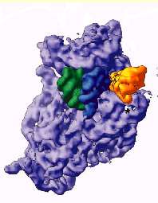
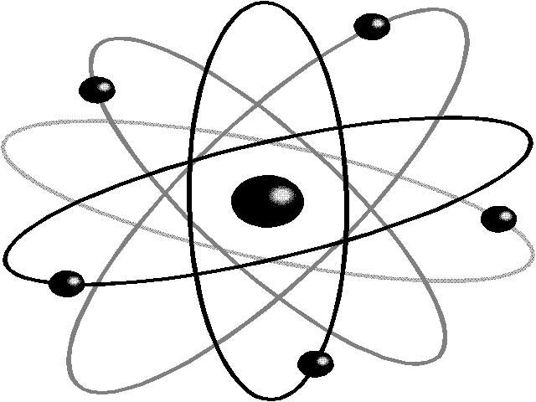
New Sizes, New Rules
NOISY (FAULTY)
QUANTUM
10,000nm
1,000nm
100nm
10nm
1nm
0.1nm
1. Can we build digital devices?
2. Quantum computers?

Slide 6
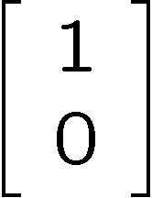
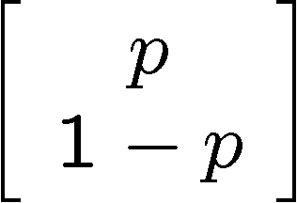
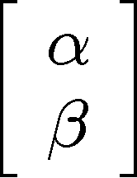


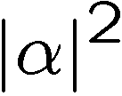
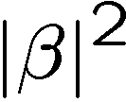
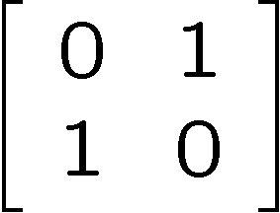
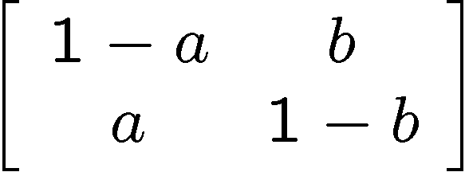
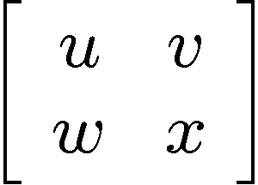
Bit, Pbit, and Qubit
bit
probabilistic bit
quantum bit
Configurations:
0
1
0
1
0
1
Description:
Observation:
0
certainty
0
p percent
0
percent
1
1-p percent
1
percent
Evolution:
deterministic
stochastic
unitary

Slide 7
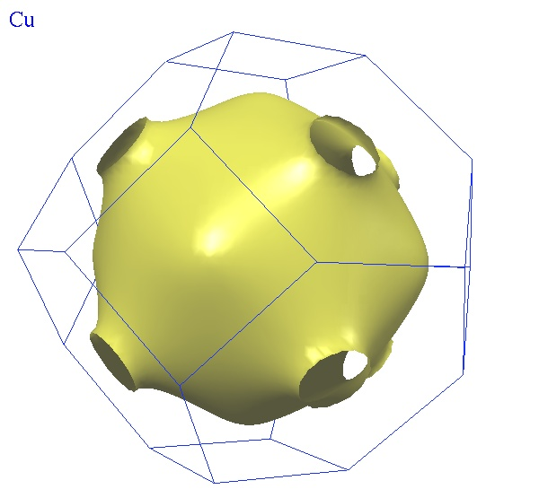
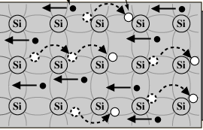
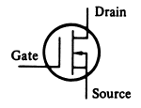
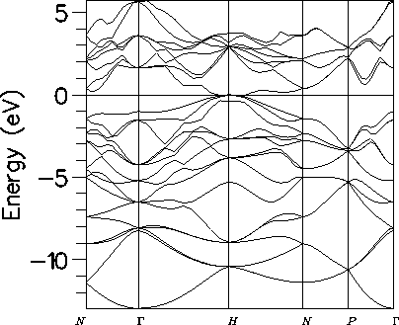
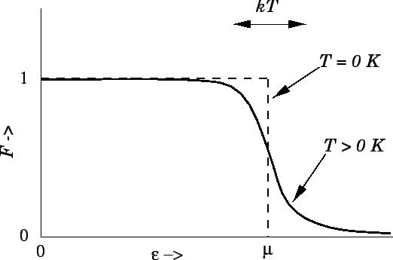
There Are No Bits
bits
pbits
qubits
Probabilistic Algorithms
Quantum Algorithms

Slide 8
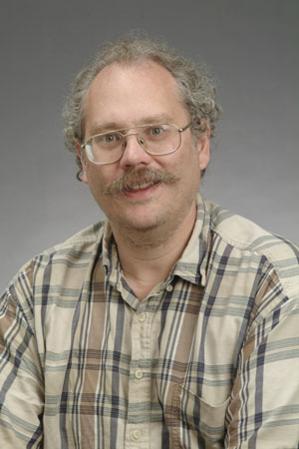
Quantum Computers
18819881292060796383869723946165043
98071635633794173827007633564229888
59715234665485319060606504743045317
38801130339671619969232120573403187
9550656996221305168759307650257059
3980750864240649373971
2550055038649119906436
2342526708406385189575
946388957261768583317
4727721461074353025362
2307197304822463291469
5302097116459852171130
520711256363590397527
1994
Quantum computers can efficiently factor whole numbers (and compute discrete log.)
No known classical efficient algorithm.
Breaks RSA, Diffie-Hellman cryptosystems.
Peter Shor

Slide 9
Qubits?
bits
pbits
qubits
Quantum Algorithms
Can we exploit qubits in digital algorithms?

Slide 10
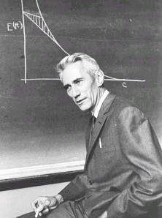
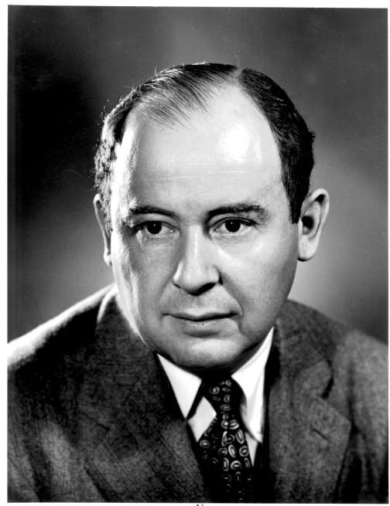
Noisy Pbits to Bits (Theory)
How to communicate in the presence of noise?
“A mathematical theory of communication” (1948)
Error correcting codes
Claude
Shannon
How to compute when the subsystems
of your computer can fail?
“Probabilistic logics and the synthesis of reliable organisms from unreliable components” (1956)
John
von Neumann
Fault-tolerant architectures

Slide 11
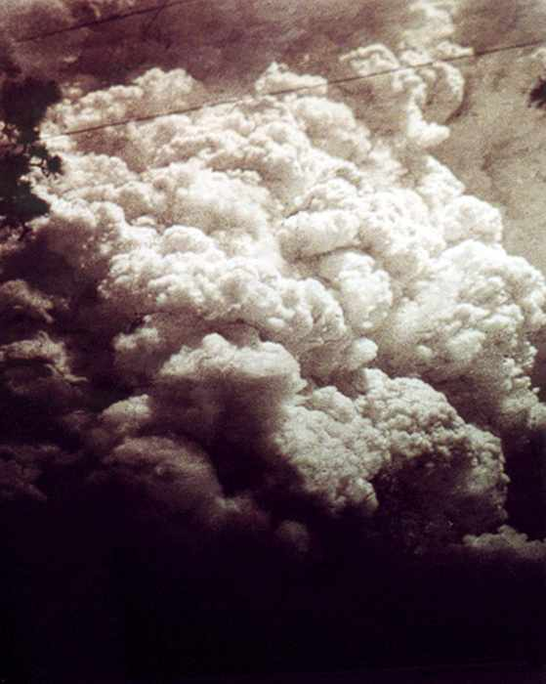
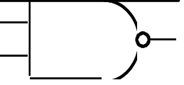
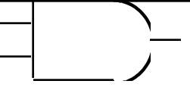
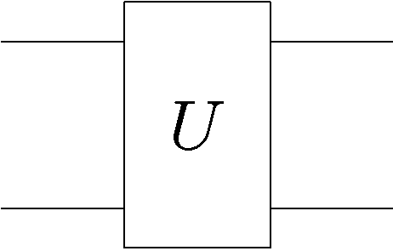
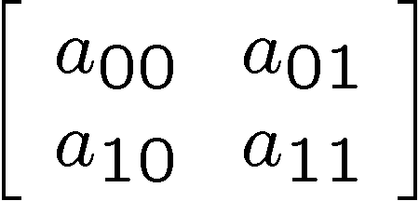
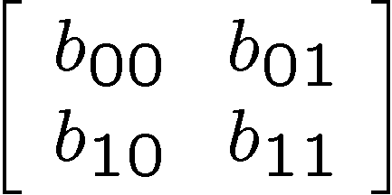
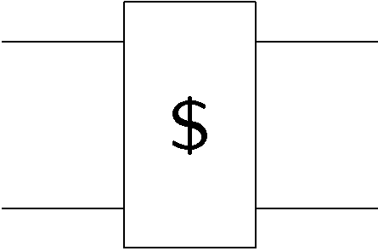
Fragile
Classical Noise
Classical Faults
0
Quantum Noise
Quantum Faults

Slide 12
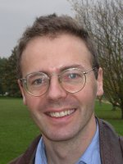
Error Correction
0
0
0
1
0
0
0
1
1
1
1
classical error
correcting code:
(bits and pbits)
0
0
1
0
0
0
1
0
1
1
0
0
0
1
1
0
0
1
1
0
0
1
1995: quantum error correcting codes
encode quantum information across
multiple quantum subsystems
Peter Shor
Andrew Steane

Slide 13

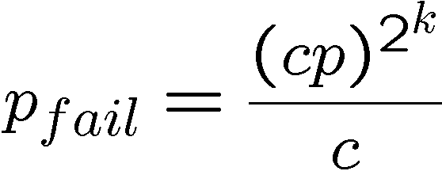
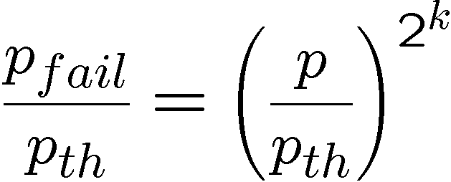
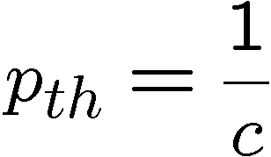
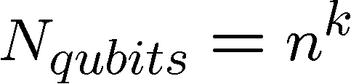
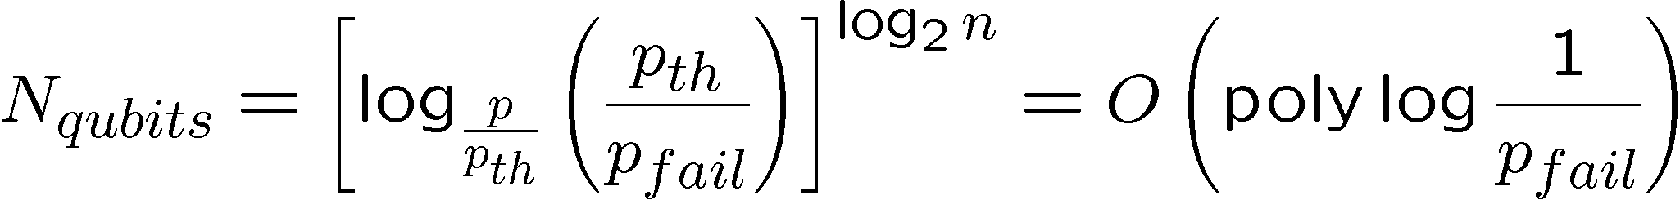
Perfection Through Concatenation
failure
probability
p
cp²
c(cp²)²
At k^{th} level of concatenation, probability of an error which
destroys the encoded quantum information is
and uses qubits

Slide 14
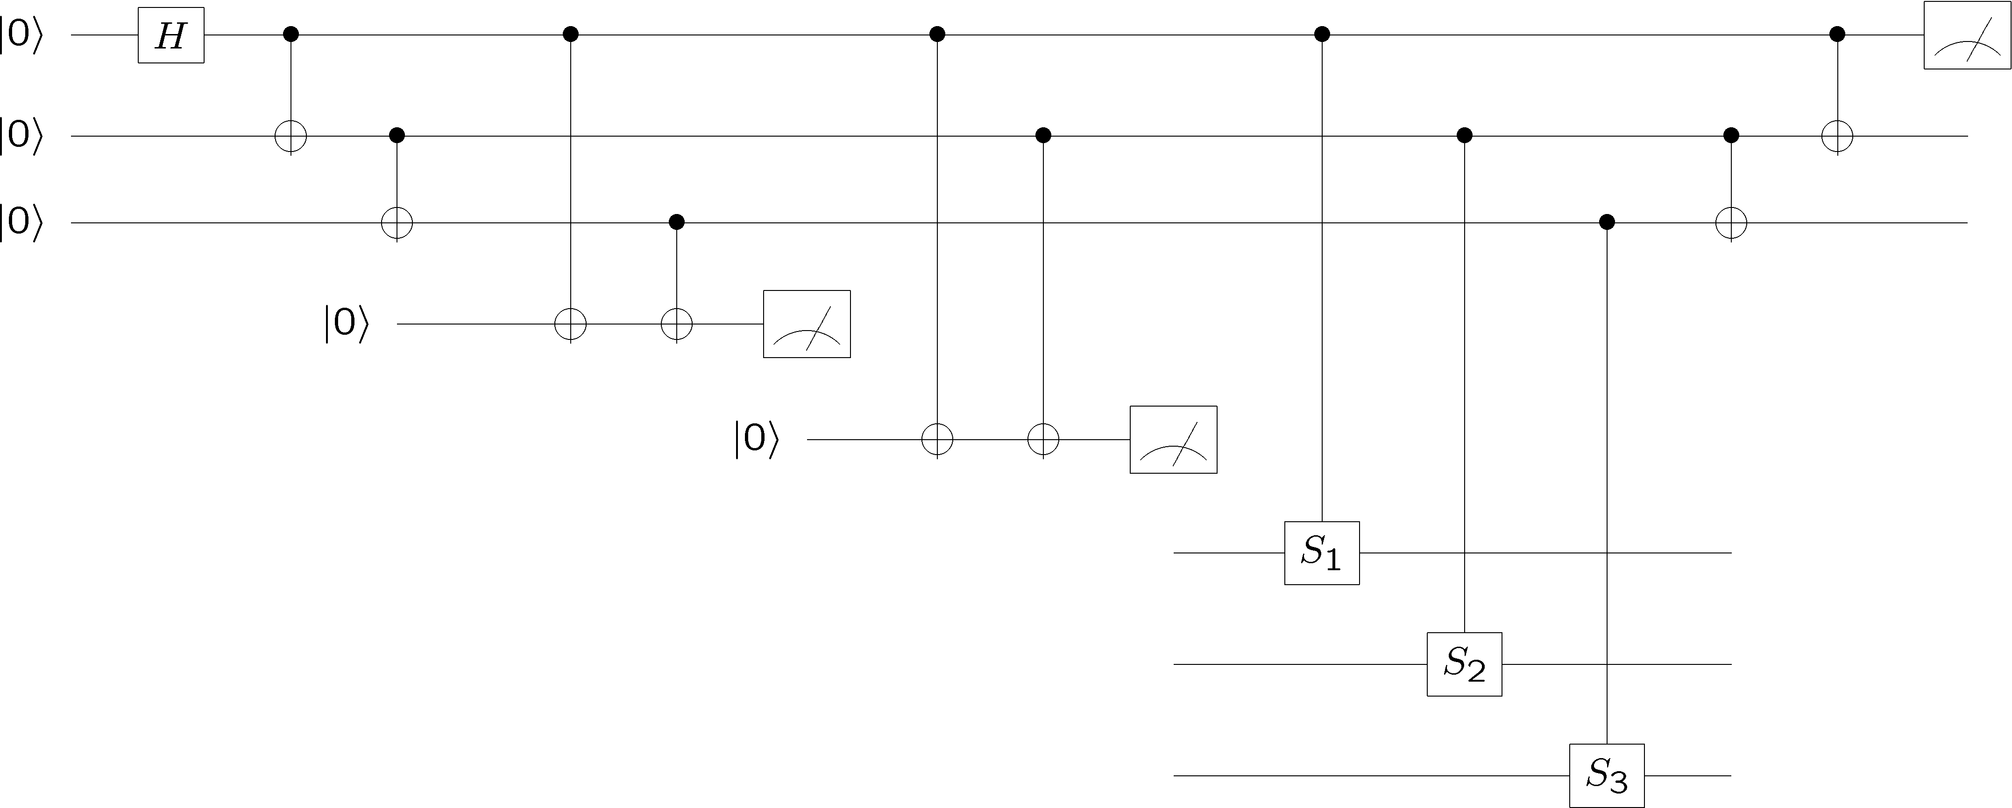
Fault-Tolerant Quantum Computation
Must design quantum circuits which succeed even when
every element of the circuit (preparation, unitary gates,
Measurements) can fail.
Quantum error correction + Fault-tolerant procedures

Slide 15

Threshold Theorem, 1996
QC
errosol
“decoherence”
“imprecision”
Threshold Theorem for Fault-Tolerant Quantum Computation
[Aharonov, Ben-Or, Knill, LaFlamme, Zurek, Shor, Gottesman, Preskill]
If noise is weak enough and control is precise enough, then a
quantum computation to a desired accuracy can be carried out
with an overhead polynomial in the log of the accuracy.

Slide 16
Reflection
No theory of fault-tolerant quantum computation
⇒
No such thing as a quantum computer
Common misconception
Digital
Analog
0
1
versus
Deterministic
Nondeterministic
Probabilistic
Quantum

Slide 17




Reflection
Even with the theory of fault-tolerant quantum computation
⇒
Is quantum computation a viable technology?

Slide 18
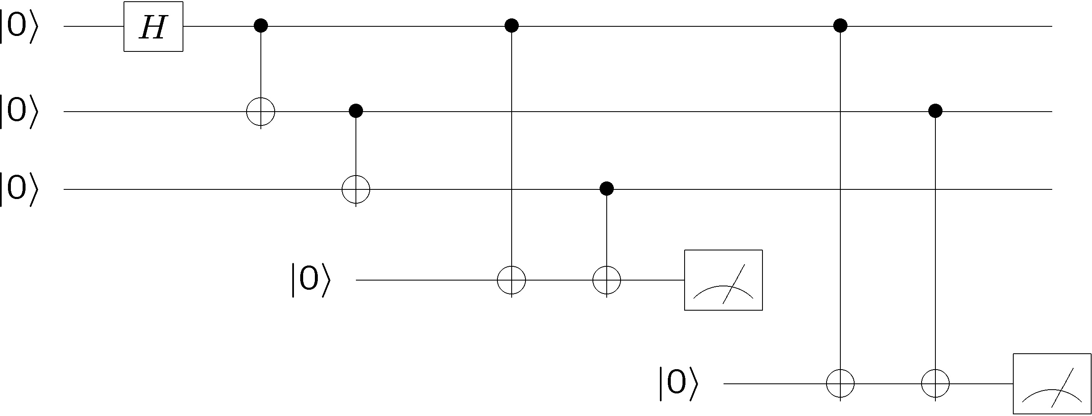
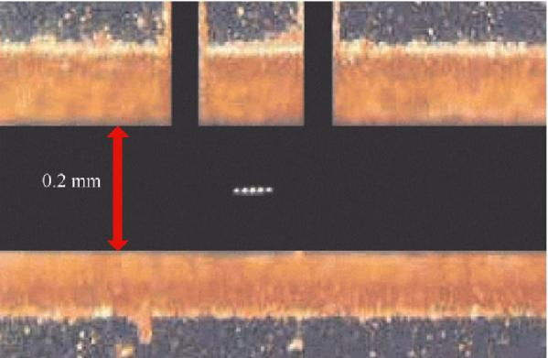
Peculiarities
quantum error correction
fault-tolerant methods
physical architecture
Photo from NIST Boulder

Slide 19
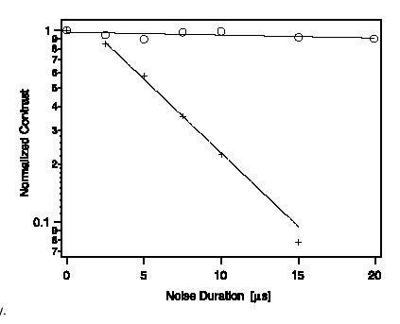
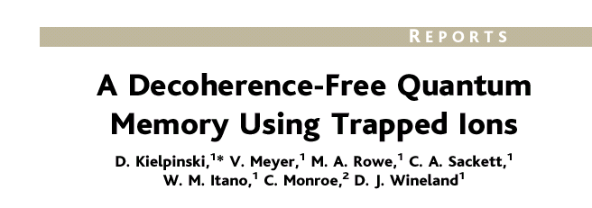

Decoherence-Free
individual environments
collective environment
Use SYMMETRY of coupling to COMPLETELY eliminate effect of noise
by encoding into a special quantum error correcting code (DFS)

Slide 20
Decoherence-Free QC
Symmetry breaking interactions enter at third order (robustness)
[Bacon, Lidar, and Whaley, Phys. Rev. A 60, 1944 (1999)]
Alternative symmetric decoherence mechanisms
[Lidar, Bacon, Kempe, and Whaley, Phys. Rev. A 63, 022306 (2001)]
[Lidar, Bacon, Kempe, and Whaley, Phys. Rev. A 63, 022307 (2001)]
Combining with quantum error correcting codes
[Lidar, Bacon, and Whaley, Phys. Rev. Lett. 82, 4556 (1999)]
How to perform quantum computation on the information
encoded in a decoherence-free subspaces?

Slide 21

Exchange Is Universal
[Bacon, Lidar, and Whaley, Phys. Rev. Lett. 85, 1758 (2000)]
[DiVincenzo, Bacon, Kempe, Burkard, and Whaley, Nature 408, 339 (2001)]
[Kempe, Bacon, Lidar, and Whaley, Phys. Rev. A 63, 042307 (2001)]
Universal Classical Gate Set
Universal Quantum Gate Set
exp(-i t₀ SWAP)
NAND
SWAP
exchange interaction
alone is universal!
(fan-out, fan-in)
Just as NAND, NOR, use less
resources, exchange interaction
is least costly interaction in many
solid state quantum comptuers
[Bacon, Kempe, DiVincenzo, Lidar, and Whaley, Proc. Int. Conf. on Exp. Imp.
of Quant. Comp. Sydney, Australia (2001)]
[Kempe, Bacon, DiVincenzo, and Whaley, Quant. Inf. & Comp. 1, 33 (2001)]

Slide 22

But Still, a Technology?
Observation:
Quantum error correction is not that different from
classical error correction.
Observation:
Our most basic classical computational components
are naturally robust (and often need only minor amounts
of classical error correction.)
Observation:
Device complexity of quantum error correcting schemes
are very high. “A quantum computer will spend most of it’s
time performing error correction.”
Question: What are the mechanism which allow robust classical
computational components and can we port them to the
quantum world?
?

Slide 23


Three Storage Testbeds
Ferromagnetic Ising models:
one dimensional
two (and >) dimensional
Toom’s rule:
0
0
1
0
0
0
0
0
0
1
1
0
1
0
0
0
two dimensional noisy
cellular automata
0
1
0
0
0
0
0
0
0
0
1
1
1
1
1
0
0
0
0
0
1
0
1
0
1
1
1
0
0
0
0
0

Slide 24





Ferromagnetic Ising Models
Ising model
spins on edges of a lattice:
energy of a configuration:
sum over neighbors
external magnetic field
for now

Slide 25

Dynamic Ising Models
Dynamic Ising model (Metropolis update)
Interaction with environment causes spin flips
Update rule:
If flipping spin would decrease energy, flip spin
If flipping spin would increase energy, flip spin with probability

Slide 26









Energetics of Decoherence
system
environment
Perturbative regime:
Perturbative regime: decoherence conserves system and
environment energy.
cooling
heating
dephasing
by cooling environment we can eliminate heating

Slide 27
Dynamic Ising Models
Dynamic Ising model (Metropolis update)
Interaction with environment causes spin flips
Update rule (alternate with noise):
If flipping spin would decrease energy, flip spin
If flipping spin would increase energy, flip spin with probability

Slide 28

Toom’s Rule
0
0
1
0
0
0
0
0
0
1
1
0
1
0
0
0
two dimensional noisy cellular automata
0
1
0
0
0
0
0
0
0
0
1
1
1
1
1
0
0
0
0
0
1
0
1
0
1
1
1
0
0
0
0
0
Update rule:
n
n
b=majority(n,e,b)
a
e
b
e
0
0
0
0
0
0
0
0
0
0
0
0
0
0
0
0
0
1
1
0
0
1
0
0
0
0
0
0
0
0
0
0
0
1
0
0
0
1
0
0
0
1
0
0
0
0
0
0
0
0
0
0
0
0
0
0
0
0
0
0
0
0
0
0
Update rule with noise: with some probability the update fails
and a random state is assigned

Slide 29



Compare and Contrast
Encode information into the system and watch what happens
0
0
0
0
0
0
0
0
0
0
0
0
0
0
0
0
0
0
0
0
0
0
0
0
0
0
0
0
0
0
0
0
0
0
0
0
0
0
0
0
0
0
0
0
0
0
0
0
Redundancy code.
“Order parameter” is magnetization:

Slide 30



Storage
Long time behavior (not infinite time, but effectively)
1D Ising
2D Ising
Toom’s Rule
Criticism: (1) thermodynamic limit taken
(2) what if relaxation to equilibrium takes a long time?

Slide 31



Storage
2nd attempt:
Relaxation to thermal
1D Ising
2D Ising, Toom’s Rule
Imperfect preparation

Slide 32





Manipulation
Flipping spins is imperfect
2D Ising
Toom’s Rule
1D Ising
1D Ising
temperature less than gap
manipulation error must be small
(i.e. NOT fault-tolerant)
2D Ising
temperature less than critical temp

Slide 33















“Self Fixing”
Excitations point-like
Energy to err is constant
Disordering entropy >> Energy
Excitations string-like
Energy to error is prop to size
Energy >> Disordering entropy

Slide 34

Toom’s Rule Versus 2D Ising
Applied magnetic field (corresponds to a bias in noise)
2D Ising
Toom’s Rule
Regions with two coexisting phases
External magnetic fields disorder magnetic media

Slide 35
But Still, a Technology?
Observation:
Quantum error correction is not that different from
classical error correction.
Observation:
Our most basic classical computational components
are naturally robust (and often need only minor amounts
of classical error correction.)
Observation:
Device complexity of quantum error correcting schemes
are very high. “A quantum computer will spend most of it’s
time performing error correction.
Question: What are the mechanism which allow robust classical
computational components and can we port them to the
quantum world?
?

Slide 36
Energetics of Decoherence
system
environment
Perturbative regime:
Perturbative regime: decoherence conserves system and
environment energy.
cooling
heating
dephasing
by keeping a cool environment we can eliminate heating

Slide 37



Exchange Everywhere
Can we engineer systems which turn
dephasing/cooling → heating?
1
2
4
3
S_{tot}=2
Energy
S_{tot}=1
S_{tot}=0
ground state is a quantum error correcting code
Encode quantum information into ground state

Slide 38



Supercoherence
[Bacon, Brown, and Whaley, Phys. Rev. Lett. 87, 247902 (2001)]
Independent coupling of system to environment
S_{tot}=2
all single qubit interactions on
this system are of heating
(ground state is quantum error
detecting code)
S_{tot}=1
S_{tot}=0
never cause transitions on encoded space
All first order decoherence processes suppressed

Slide 39

The Quantum Hard Drive?
RANT
MODE
ON
Do there exist (or can we engineer) quantum systems whose
physics guarantees fault-tolerant quantum computation?
Today in QC: we have theory (like von Neumann, Shannon) but not devices which implement these idea (without severe a device complexity overhead.)

Slide 40

Self-Correcting Quantum Computers
[Bacon, Phys. Rev. A, 73, 012340 (2006)]
ZZ
ZZ
XX
XX
XX
ZZ
ZZ
quantum compass model
XX
XX
XX
ZZ
ZZ
Symmetries of this system kind of quantum error correcting:
quantum error correcting subsystem

Slide 41
Quantum Error Correcting
Order Parameter
Quantum Computation
Output
measure
fix error
state
preparation
error
measure, diagnose error
entropy dump
(cool ancillas)
cold ancilla qubits
Erred quantum information in a quantum error correcting code
is “still there.” How to see it? Perform correction, measure.
Quantum error correcting order parameter
(Actually central to Superconductivity, Quantum Hall effect,….)

Slide 42
Self-Correcting Quantum Computers
[Bacon, Phys. Rev. A, 73, 012340 (2006)]
ZZ
ZZ
XX
XX
XX
ZZ
ZZ
quantum compass model
XX
XX
XX
ZZ
ZZ
Quantum error correcting procedure for quantum error correcting
order parameter: surprise, subsystem code!
Spin-off: The code discovered here greatly reduces overhead for
“traditional” fault-tolerant quantum computing (improves threshold)
[Aliferas, Preskill, Cross 2006]

Slide 43


Self-Correction
energy
eigenstates

Slide 44

Self-Correcting Quantum Computers
[Bacon, Phys. Rev. A, 73, 012340 (2006)]
ZZ
ZZ
XX
XX
XX
ZZ
ZZ
quantum compass model
XX
XX
XX
ZZ
ZZ
Self-correcting?
Energy gap vanishes for large
lattice size ☹
Even worse, excitations are
“particle like” ☹
[Dourier, Becca, Mila 05]

Slide 45


Ideas, Ideas, Ideas
[Bacon, Phys. Rev. A, 73, 012340 (2006)]
[Bacon, unpublished, 2006]
long range quantum compass model
doubled toric code combined + quantum compass model
three dimensional quantum compass model

Slide 46


Self-Correcting Quantum Computers
[Bacon, unpublished, 2006]
long range quantum compass model
First self correcting quantum memory!
Can we implement in ion traps?
Figure 2. Hexagonal planar ion trap. 2D mult-zone ion traps allow one to trap ions in any spatial arrangement including a disordered lattice.
Pictures courtesy Ken Brown (Isaac Chuang’s Lab, MIT)
Ken Brown ⇒ (Georgia Tech, joint Chemistry/CS)

Slide 47

Self-Correcting Quantum Computers
Strange meshing of:
quantum error correction
thermodynamics
fault-tolerant quantum computation
many-body quantum physics
NSF EMT Grant (with Mark Oskin)
“Self-Correcting Fault-Tolerant Quantum Computers”
Ph.D. students:
Paul Pham (CSE), Gregory Crosswhite (Physics)
Masters students:
Yoshiro Toda (Evening Masters, Physics)
Undergrad projects:
Loren Merritt, Thomas Patecky

Slide 48

Where To?
Self-correcting quantum computers
First proof of principle. Need more. How ubiquitous?
Physical implementation (ion traps, optical lattices, superconducting circuits)
Universal fault-tolerant constructions
End result: equivalent of the transistor/integrated circuit
Theory of quantum error correction
New subsystem codes: subsystem codes bring quantum error correction even closer to classical error correction.
General theory of fault-tolerance (current methods are ad hoc with few unifying principles.)
End results: aid in constructing self-correcting quantum computers and more traditional quantum error correcting microarchitectures

Slide 49
Why the Confidence?
Why are we confident that large scale quantum computers can be built?
Why are we confident that quantum computers are worth studying and building?
A historical account: including the future!

Slide 50
Stop the Myth
Quantum Algorithms
  Factoring, discrete log [Shor 94]
  Unstructured search [Grover 96]
  Amplitude Amplification [Long List]
  Various hidden subgroup problems [Long List]
  Pell’s equation [Hallgren 02]
  Hidden shift problems [van Dam, Hallgren, Ip 03, Childs, van Dam 05]
  Graph traversal [CCDFGS 03]
  Spatial search [AA 03, CG 03/04, AKR 04]
  Element distinctness [Ambainis 03]
  Various graph problems [DHHM 04, MSS 03,…]
  Testing matrix multiplication [Buhrman,Špalek 04]
  …

Slide 51
What Worth, Quantum Computation?
Quantum algorithms research is about much more than just
coming up with new quantum algorithms.
Bold Reasons
Suppose that tomorrow someone proves that P≠NP,
would we be satisfied? BQP≠NP?
The language of the universe is quantum mechanical,
shouldn’t the language of our theory of computation match?
[Kerenidis, de Wolf 02] Length bounds on 2 query locally decodable codes via a quantum proof
[Aaronson 04] PP closed under intersection via post selected quantum computation
[Kerenidis 05] Classical circuit lower bounds from quantum communication complexity bounds

Slide 52
What Worth, Quantum Computation?
Quantum algorithms research is about much more than just
coming up with new quantum algorithms.
Bold Reasons
Understanding what “powers” quantum algorithms helps
us come up with new algorithms, but it also helps us
understand when a quantum system can be simulated
Entanglement is necessary for quantum speedups
[Jozsa and Linden 02]
New (classical) algorithms for efficient simulation of certain
many-body quantum systems
[Vidal 03, Verstraete, Cirac 05]

Slide 53







Example: Hidden Subgroup Problem
Low dimensional
systems
Not much entanglement
AND
No way to make
an entangling measurement
k copies of the hidden subgroup states:
entangled
measurement
to determine the
hidden subgroup

Slide 54


Example: Hidden Subgroup Problem
Bacon, Childs, van Dam FOCS 2005
  “From Optimal Measurement to Efficient Quantum Algorithms for the Hidden Subgroup Problem over Semidirect Product Groups”
Basic new powerful primitive? Ability to produce superposition
of solutions to quadratic equations (inverse of this transform.)

Slide 55

What Worth, Quantum Computation?
Quantum algorithms research is about much more than just
coming up with new quantum algorithms.
Bold Reasons
Simulating quantum systems
(biomolecular, quantum solids)
Quantum materials
Simulation, verification, design, understanding….
Real time feedback in quantum materials: currency of
quantum information in design of quantum materials with
novel physical behavior

Slide 56
The Coming Quantum Age
Every day experiments bring us closer and closer to viable large scale quantum computers
Optimism is based on a beautiful robust theory of quantum error correction
Optimism is based on comparisons of quantum theory with stochastic classical theory
Ideas like self-correcting quantum computers will lead to quantum computers sooner rather than latter
Quantum algorithms are the tip of a huge iceberg of ideas with tremendous potential for theory
Quantum algorithms are vital to the future engineering of “quantum” materials
Entanglement can guide in the construction of quantum algorithms

Slide 57
Towards Robust and Powerful Quantum Computers
Dave Bacon
University of Washington
Department of Computer Science & Engineering

