Slide 1





Recent Progress
In Quantum
Algorithms
Dave Bacon
University of Washington
Dave Bacon
University of Washington
AQIS07 [Kyoto, Japan, September 2007]

Slide 2


The Goal of This Talk
80s-early 90s: foundational work
1994: Shor’s algorithm
1996: Grover’s algorithm
Last decade: lots of very very smart people
worked on coming up with new quantum
algorithms which offered exponential
speed-ups, with no extraordinary
breakthroughs
Today I hope to show you that all hope
is not lost, that progress (not a breakthrough!)
can be made, even by slow witted physicists
like myself.

Slide 3

Jet Lag = Quantum Algorithms Nightmares
Tlon, Uqbar, Orbis Tetris Times, April 1, 20
HELP WANTED Quantum programmer. Only skill necessary is ability to type in large RSA keys. Salary commiserates with experience.
HELP WANTED Real estate agent. Best market since bubble popped in 07. Join a dedicated
HE
ne
ar
kr
st.
ed
r
ay
ed
m
HE
Sh
we
the
us
Grover speedups? To easy?
But what to work on?
Just right algorithms in BQP?
NP-complete? To hard

Slide 4
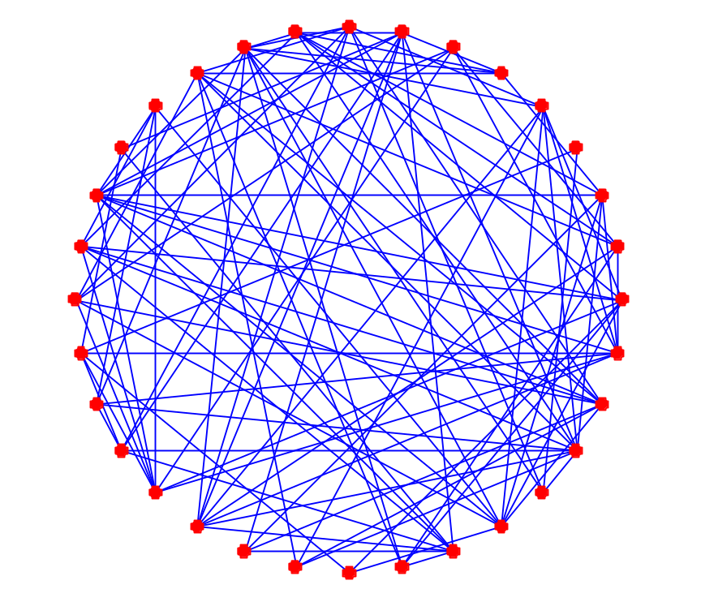
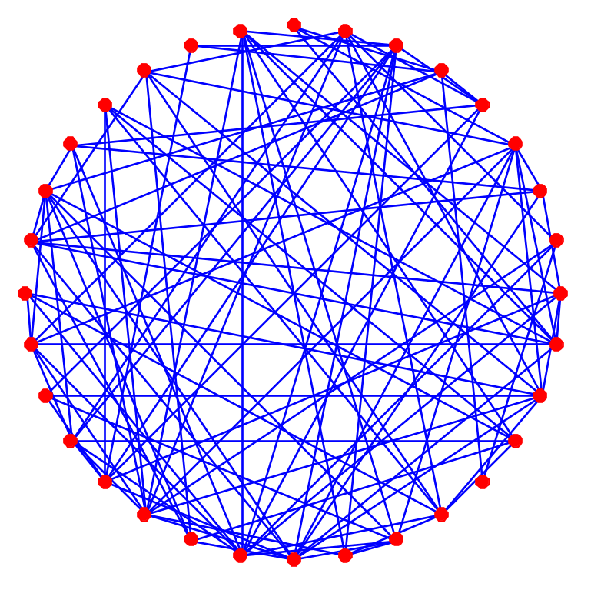
Graph Isomorphism
Are these two graphs isomorphic?
Graph isomorphism is in NP∩coAM
No known polynomial time algorithm
Probably not NP-complete (⇒collapse polynomial hierarchy)
Factoring in related class NP∩coNP

Slide 5

Graph Isomorphism
Adjacency matrix of G₁∪G₂ with edges permuted by π
[For simplicity, assume graphs rigid]
If isomorphic, exists a subgroup {e,π} which leaves function constant
on all left cosets cosets of this subgroup {g,gπ}.
This is an instance of the hidden subgroup problem.

Slide 6



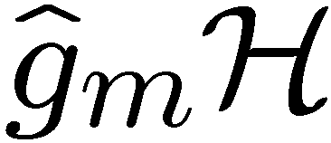
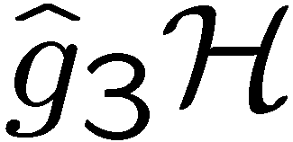
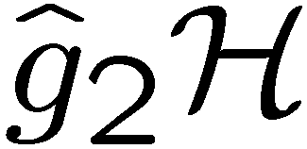
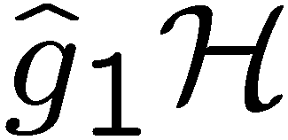

The Hidden Subgroup Problem
Setup: Fix a group (known) and a subgroup (unknown). Given query access to a function f : → S that is constant and distinct on left (right) cosets of in . We say that f hides .
Problem: Find a generating set for (“identify ”).
Efficient: If runs in time polylog(| |)
f
S

Slide 7

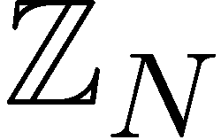
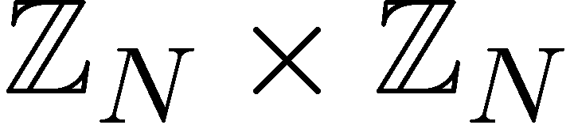

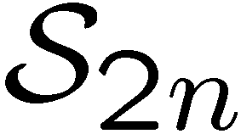

Why the Fuss?
Solved Problems (Shor 1994)
efficient algorithm for HSP
over
efficient algorithm for factoring whole numbers
efficient algorithm for HSP
over
efficient algorithm for the discrete logarithm problem
Open Problems
efficient algorithm for HSP
over (or )
efficient algorithm for the
graph isomorphism problem
efficient “standard” quantum
algorithm for HSP over
dihedral group
efficient algorithm for the poly(n) unique shortest vector in a lattice problem

Slide 8

A Strawman
BQP, PP, NP, PostBQP, MIT….
What makes you think the hidden subgroup
approach to solving graph isomorphism is the
correct approach to fining a quantum
algorithm for this problem?
Scott
Aaronson
of MIT

Slide 9
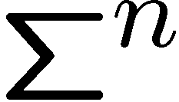


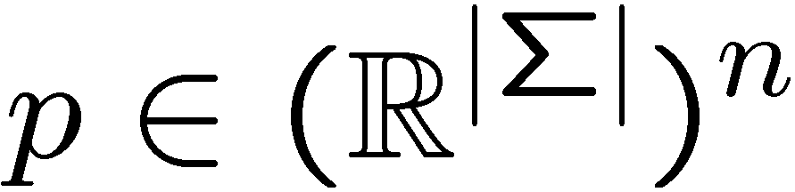
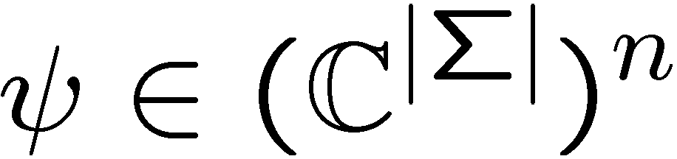

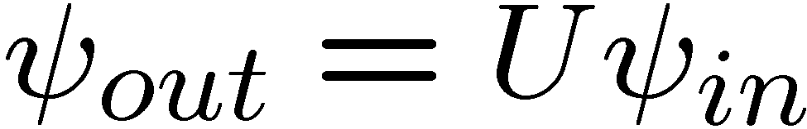


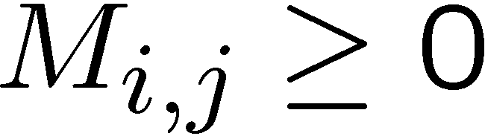
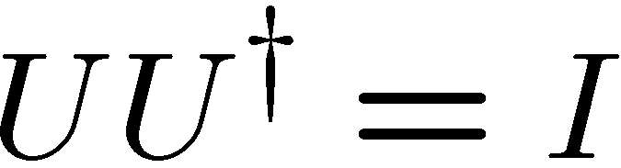
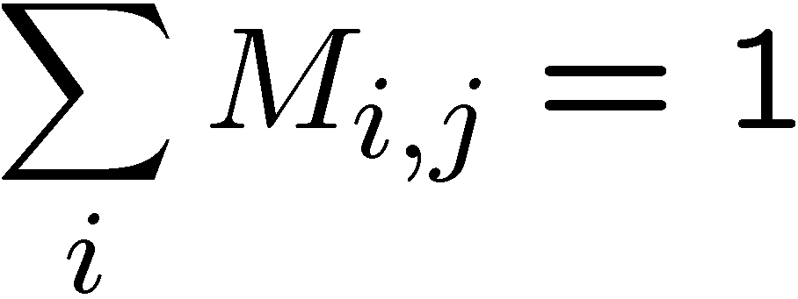
Philosonomicon
What is the difference between classical and quantum computing?
[The fair comparison is with probabilistic classical computing]
Configurations:
State
Descriptions:
Gates:
stochastic matrices
unitary matrices

Slide 10
Some Outrageous Statements
Classical Reversible Deterministic Computation:
Is nothing more than the study of the properties
of certain generating sets of a very large
permutation group
Classical Reversible Probabilistic Computation:
Leads to doubly stochastic matrices…and what?
Quantum Computation:
Leads to unitary matrices
We can now apply all the tools and trades of
representation theory of groups to the study
of computation
Group representation theory is the natural language of the most
natural model of computation

Slide 11
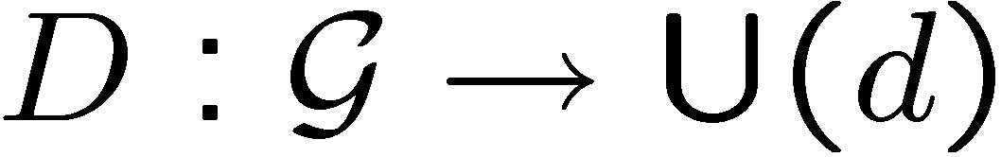
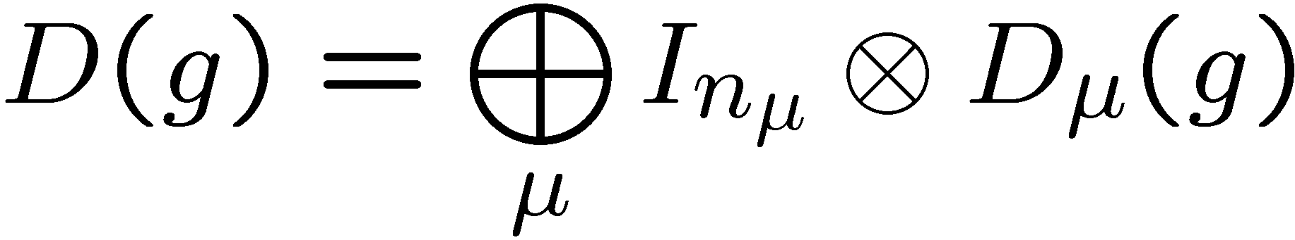
Group Representation Theory
Group: set of elements with binary multiplication operation
(satisfying closure, associativity, identity and inverse)
(Unitary) representation of a group
which is a homomorphism
For finite and compact groups we can decompose representation
into irreducible representations (irreps)
Irreps have no invariant subspaces except for the empty and
full subspace. They are the “primitives” of group representation
theory.

Slide 12
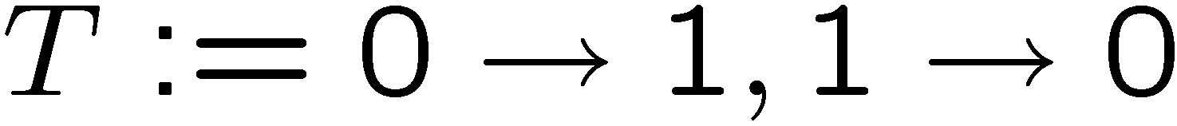
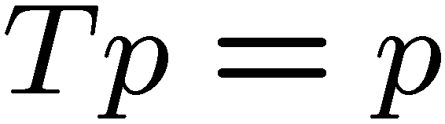
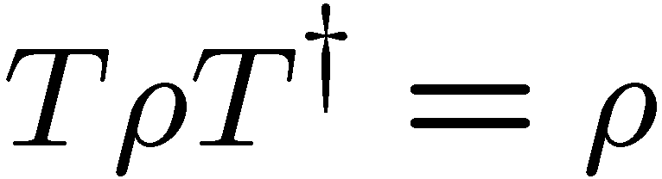
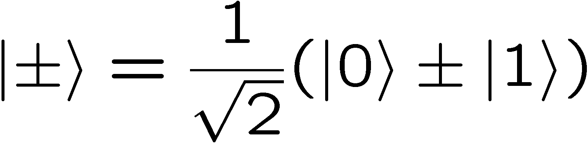
Comparison of Symmetry
Classically, suppose we have a probability distribution with
What can you do?
Quantum mechanically, suppose we have a density matrix with
Then there is “more” information about the state in a new basis

Slide 13
The Hidden Subgroup Problem
Setup: Fix a group (known) and a subgroup (unknown). Given query access to a function f : → S that is constant and distinct on left (right) cosets of in . We say that f hides .
Problem: Find a generating set for (“identify ”).
Efficient: If runs in time polylog(| |)
f
S

Slide 14


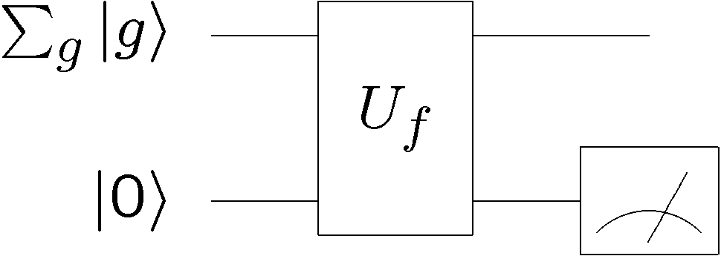








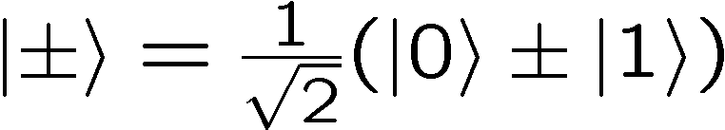
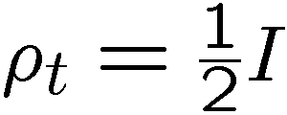

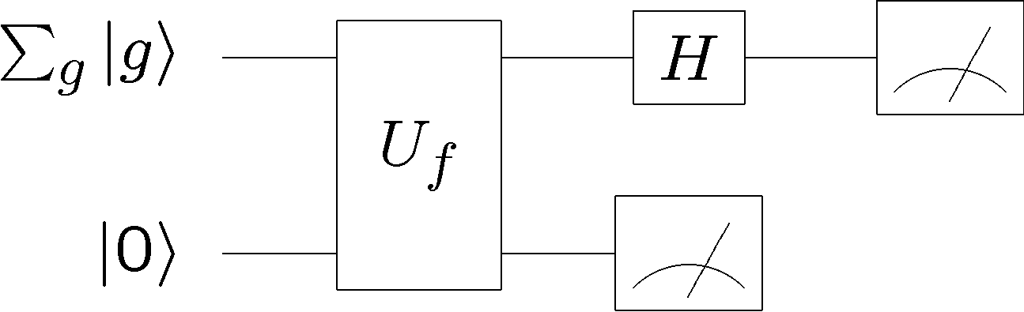
Start Simple
Two possible hidden subgroups
or
50%
50%

Slide 15
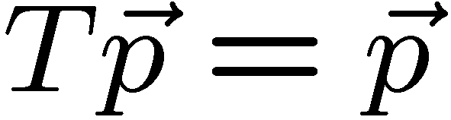
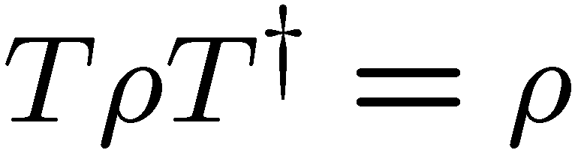
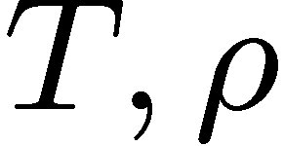
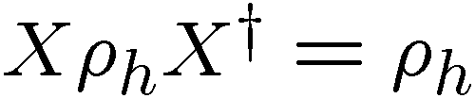

Symmetry
I give you a symmetric probability distribution
how does this help you?
I give you a symmetric quantum density matrix
how does this help you?
can be simultaneously diagonalized!
diagonalize in
basis

Slide 16
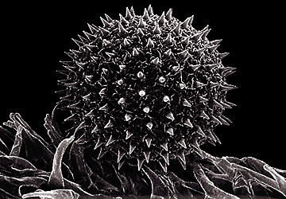
One More Outrageous Statements
The Symmetry Speedup Hypothesis of Quantum Computing
Every exponential quantum speedup in quantum algorithms
is fundamentally the result of exploiting symmetries.

Slide 17


Hidden Subgroup Divide
Successes
abelian groups
almost abelian groups
near Hamiltonian groups
normal subgroups
small commutator subgroup
solvable groups of bounded exponent and of bounded derived series
extraspecial groups
groups of nilpotency class at most 2
Specific groups
Failures
symmetric group (graph ismorphism!)
dihedral group (shortest vector!)
G^{n}, fixed G. Even for G=S₃!
Pessimism
in standard approach, multiregister measurements required
optimal measurement for dihedral HSP leads naturally to subset sum problem
Clebsch-Gordan sieves cannot solve symmetric group HSP
some including
the Heisenberg group
Subexponential algorithms
Dihedral
G^{n}, fixed G

Slide 18





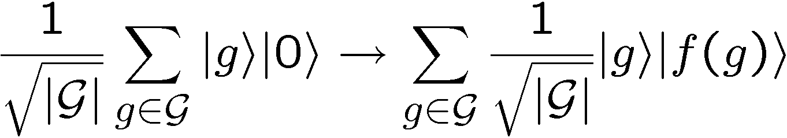
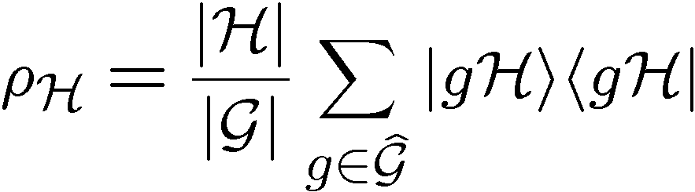
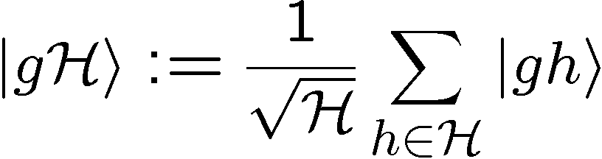
Standard Query Model
Oracle:
U_{f}
Query in equal superposition over group elements
Hidden subgroup state:

Slide 19



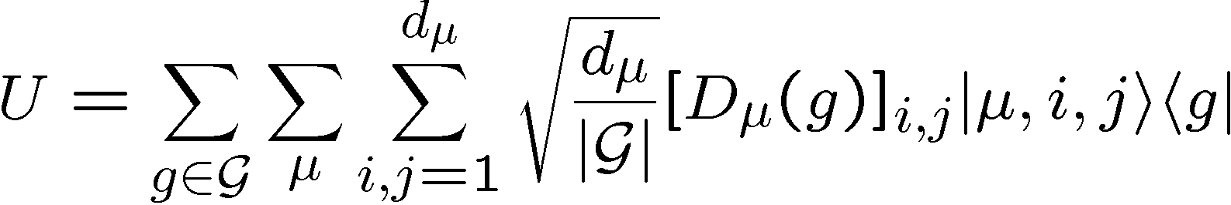
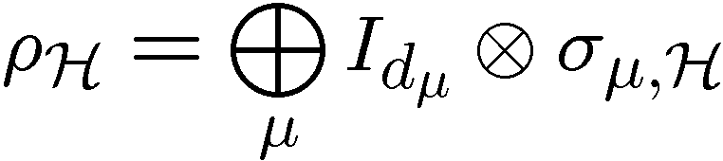
HSP Symmetries
Symmetry
left regular representation:
Transform/Consequence
QFT over
block diagonal in QFT basis:
This symmetry is “enough” to solve the abelian HSP and case where
subgroups are normal.

Slide 20
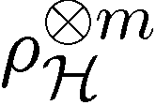
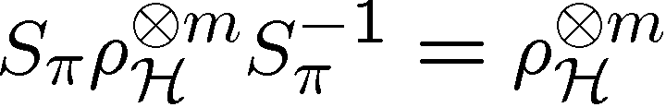
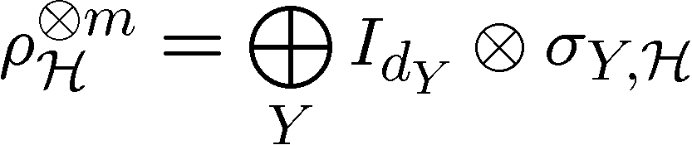
HSP Multiple Registers
Given m copies of HSP can we perform some measurement on
these states to identify H?
Hallgren, Moore, Roetteler, Russell Sen (2005 ): m > O(log |H|)
Multi-copy (multi-register) measurements required.
Symmetry
symmetric group
Transform/Consequence
Schur Transform
Measuring Y not enough to solve HSP [Childs, Wocjan 2006]

Slide 21
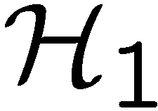
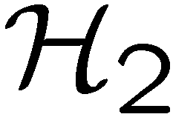
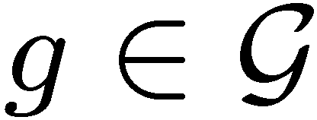

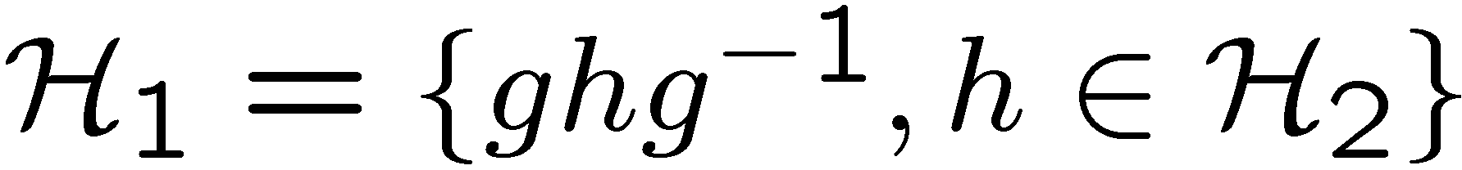

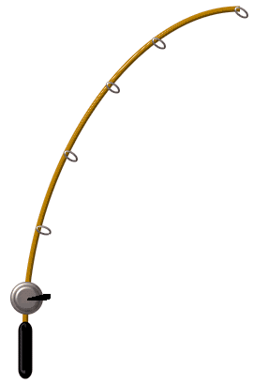
Our Approach, Recast!
Two subgroups, and , are conjugate if there exists an
element of the group such that
Equivalence relation among the subgroups of
Hidden Subgroup Conjugacy Problem
Setup: Fix a group (known) and a subgroup (unknown). Given query access to a function f : → S that is constant and distinct on left (right) cosets of in . We say that f hides .
Problem: identify the conjugate subgroup class of .
Efficient: If runs in time polylog(| |)

Slide 22

Why This Approach?
HSCP = HSP for many “solved” cases
  Abelian, Normal subgroups, more (this talk)
HSCP possesses more symmetry than HSP
  Symmetry in multi-register case (as REQUIRED)
  Symmetry related to Clebsch-Gordan transform
HSCP is the relevant problem for Graph Isomorphism

Slide 23

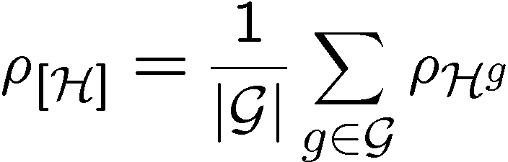
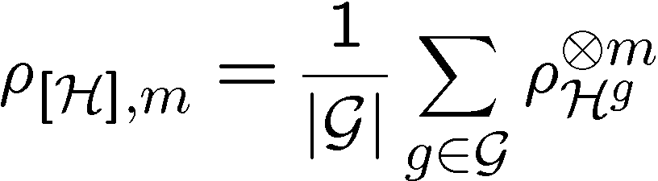
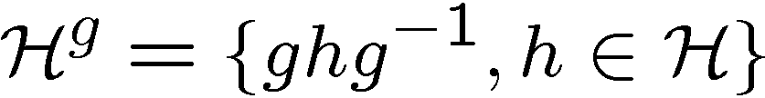
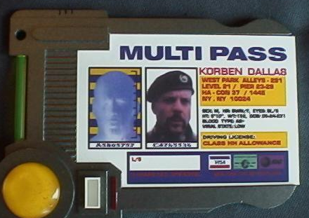
Multicopy HSP and HSCP
Algorithms should be able to distinguish:
Single query
Multiple queries
HSP
HSCP

Slide 24

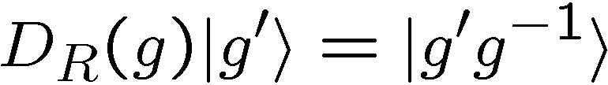
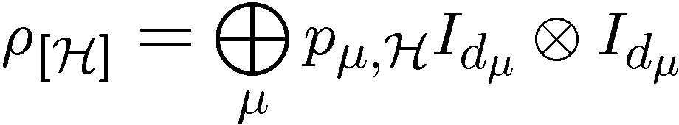



HSCP Symmetries
State
Symmetry
Transform/Consequence
right regular representation
QFT over
diagonal action of right
regular representation
Clebsch-Gordan
transform over

Slide 25
Clebsch-Gordan Transform
Clebsch-Gordan series
mulitplicity
If all then we say “multiplicity-free”
Clebsch-Gordan transform [m=2]
multiplicity space
irrep space
[general m]

Slide 26

















General HSCP Circuit
multiplicity
space

Slide 27

…Is the CG transform really
useful for HSP algorithms?

Slide 28




Simon’s Problem
Simon: Given a function f:{0,1}^n →{0,1}^n such that f(x)=f(x⊕y), y≠0
Problem: Find y∈{0,1}^n by querying f
Simon’s algorithm:
1. Query f in superposition:
2 .Discard second register:
3. Hadamard qubits:
Measuring we obtain s such that
(With high probability) repeating this n-1 times produces n-1 linearly
independent s’s. Using Gaussian elimination we can then obtain y

Slide 29











Simon’s Problem Redux
Simon: Hidden subgroup problem over with subgroups order two
QFT on is nothing more than the Hadamard transform
Regular representations of
Hadamard block-diagonalizes these to trivial and alternating irreps:
But what is Gaussian Elimination?
010010001
101001011
111011010
QFT transformed bit vectors
+
Gaussian elimination is nothing more than CG transforms over

Slide 30
…Is the CG transform really
useful for non-abelian
HSP algorithms?

Slide 31




Heisenberg Group
Semidirect product group:
Group of upper triangular matrices:
(Related to theory of discrete radar)
Bohr and Heisenberg
Efficient quantum algorithm for HSP over Heisenberg group
[Bacon, Childs, van Dam quant-ph/0504083]

Slide 32


















HSP and HSCP
Heisenberg group
Solving HSCP ⇒ Identifying α of ⇒ normal HS algorithm
Result: Heisenberg HSP = Heisenberg HSCP
[Bacon, quant-ph/0612107, submitted]

Slide 33
Heisenberg CG Series
Representation
Theory
p² 1D irreps
p (p-1)D irreps
Clebsch-Gordan series:
Nontrivial multiplicity space for (p-1)D irreps!

Slide 34





Heisenberg HSCP, CG Way
[Bacon, arXiv:quant-ph/0612107]
i labels set of conjugate subgroups

Slide 35


Heisenberg HSCP, CG Way
i can be found by performing
and performing a QFT
Clebsch-Gordan transform over Heisenberg group is related
to “symmetry” which allows for efficient quantum algorithm
for the Heisenberg HSP.

Slide 36




Heisenberg HSP Comparison
PGM/optimal measurement approach [Bacon,Childs, van Dam 05]
Two copy state:
CG symmetry reduces this to

Slide 37


Nonabelian Simon’s Problem
Generalize Simon’s problem to where is a fixed size
nonabelian group with an order two subgroup.
Alagic, Moore, Russell (2006) found a subexponential, but still
superpolynomial time algorithm for this problem.
Their algorithm relies on weak-Clebsch-Gordan sampling
What about information in the multiplicity register?

Slide 38
A New Quantum HSP Algorithm
Simon’s problem over the n-fold product of the
dihedral group of order eight

Slide 39

Dihedral Group of Order Eight
Group of symmetries of the square:
Rotation ≡ s, s⁴=e
Reflection ≡ r, r²=e and rsr=s⁻¹
Element of D₄: r^{t}s^{k}, where t∈Z₂,s∈Z₄
Consider the four two dimensional representations (reducible):
Clebsch-Gordan series

Slide 40








A Warm-up
HSCP on D₄, distinguish parity of k, {e,rs^{k}}
Partial QFT + measurement yields random
Note that if a Hadamard will reveal parity of l
if no information about l exists
Two copies,
CNOT+SWAP:
Measure first register, sometimes get
This is just a Clebsch-Gordan sieve, nothing really new here

Slide 41




A Warm-up, Part II
Three copies,
CNOT+SWAP, cascaded
Compute Clebsch-Gordan total and subtract off
Now there is a multiplicity. Example:
Irrep space has no information, but half the time, multiplicity space
has info about l

Slide 42

A New Quantum HSP Algorithm
Simon’s problem over the n-fold product of the
dihedral group of order eight
Multiplicity space algorithm for to find subgroups:
Outline of algorithm:
Determine t
Determine parity of l
Determine l
(Given parity of l, determining l is normal HSP)

Slide 43










Sketch of Algorithm
Random along with state
Run this m=n+2 times
parity strings of
Solve
Over copies where we can obtain a
Repeating this multiple times we can similarly distill
Then using Simon’s algorithm we can determine locals where t=1.
After determining where t_{i}=1, we can query over these bits and use
to determine parity of l.

Slide 44

Fin
The quantum algorithm for the Heisenberg HSP can be
partially understood as a Clebsch-Gordan multiplicity space
algorithm
A new quantum algorithm or hidden
symmetries of multiple squares

