Slide 1
I EEE A O OOA

Slide 2
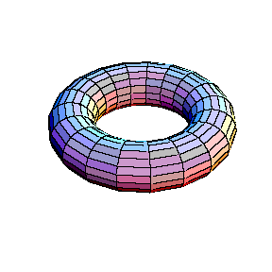
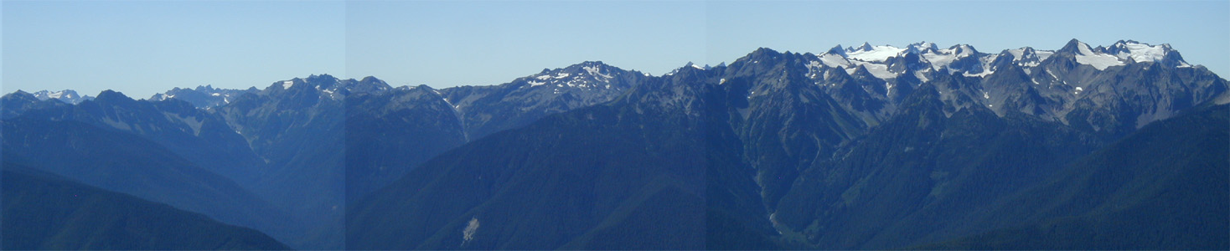
Topological Codes and Subsystem Codes and Why We Should Care About Them…
Dave Bacon
Department of Computer Science & Engineering
University of Washington, Seattle, WA
ZZ
ZZ
XX
XX
XX
ZZ
ZZ
XX
XX
XX
ZZ
ZZ

Slide 3
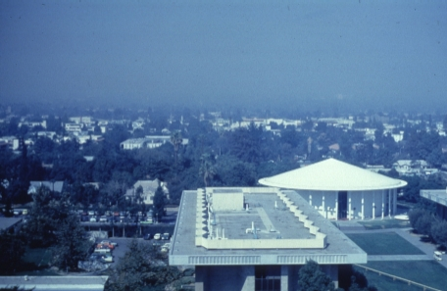
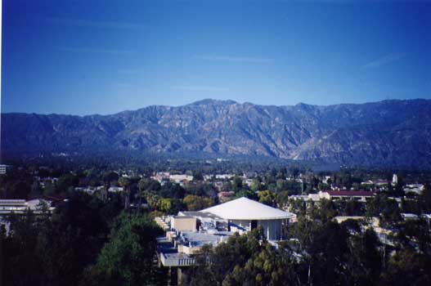


Slide 4
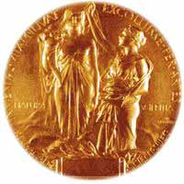
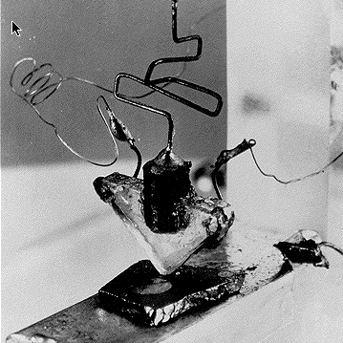
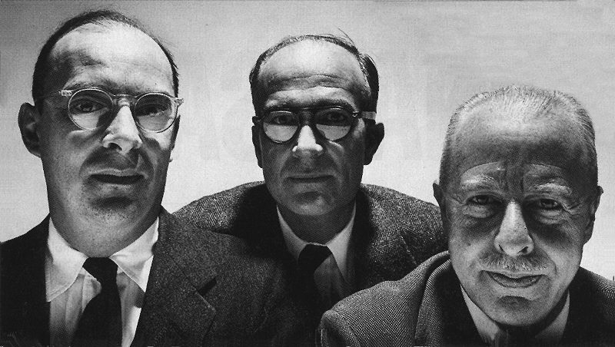
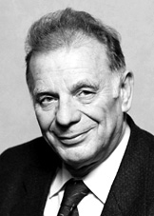
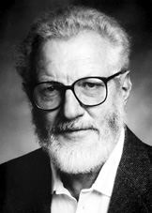
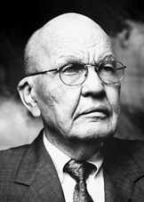
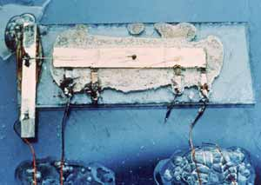
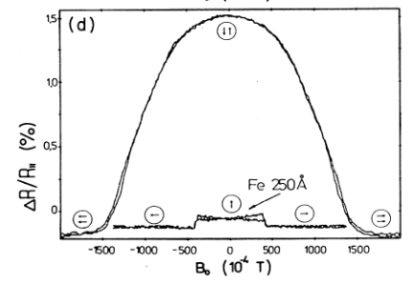

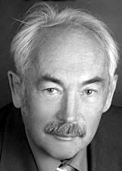
Lessons
1956
Shockley, Bardeen, Brattain
Transistor
2000
Alferov, Kroemer, Kilby
Integrated Circuit
2007
Fert, Grünberg
Giant Magnetoresistance

Slide 5
Can We Make Physical Devices
Which Robustly Quantum
Compute?

Slide 6

Our Panacea: Threshold Theorem
QC
errosol
“decoherence”
“imprecision”
Threshold Theorem for Fault-Tolerant Quantum Computation
[Aharonov, Ben-Or, Knill, LaFlamme, Zurek, Kitaev]
If noise is weak enough and control is precise enough and of
the “correct” form, then a quantum computation to with a desired
error can be carried out with an overhead polynomial in the
log of one over the error.

Slide 7
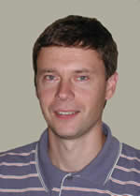
Can We Make Physical Devices
Which Robustly Quantum
Compute?
Physics, Physics, Physics, Physics!
Physics, Physics!
Kitaev
Kitaev, quant-ph/9707021, Annals Phys. 303, 2-30 (2003)

Slide 8
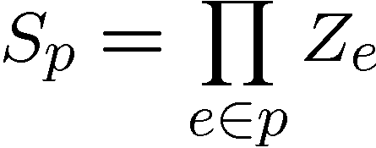
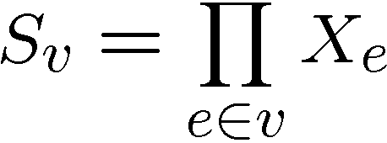




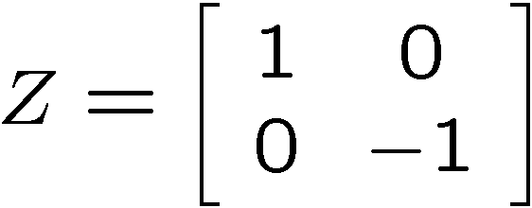
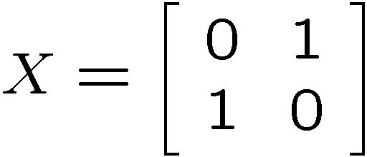
Kitaev’s Model
plaque operators:
qubits on links
vertex operators:
vertex and plaque operators
all commute with each other
Kitaev, quant-ph/9707021

Slide 9
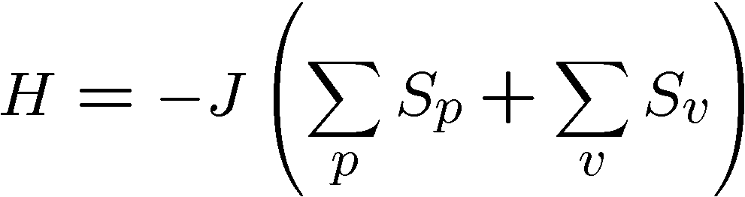






Kitaev’s Model Hamiltonian
Hamiltonian
plaque operators:
vertex operators:
ground state has all
Kitaev, quant-ph/9707021

Slide 10


Kitaev’s Model
plaque operators:
vertex operators:
anti-commutes with
two plaque operators
−
−
excitation is above ground state
Kitaev, quant-ph/9707021

Slide 11
Excitations
excitations particles come in pairs (particle/antiparticle)
at end of “error” chains
two types of particles, X-type (live on vertices of dual lattice)
Z-type (live on vertices of the lattice)
Kitaev, quant-ph/9707021

Slide 12


Anyons Anyone?
Phase:
“relative semions”
Kitaev, quant-ph/9707021

Slide 13



A Qubit
Moving an X or Z type particle on a homologically nontrivial
path and annihilating with it’s partner preserves the ground
states
Action on ground state must be representation of non-Abelian
group: Acts as encoded single qubit Pauli operator.
Kitaev, quant-ph/9707021

Slide 14



Two Qubits
Moving an X or Z type particle on a homologically nontrivial
path and annihilating with it’s partner preserves the ground
states
Action on ground state must be representation of non-Abelian
group: Acts as encoded single qubit Pauli operator.
Kitaev, quant-ph/9707021

Slide 15


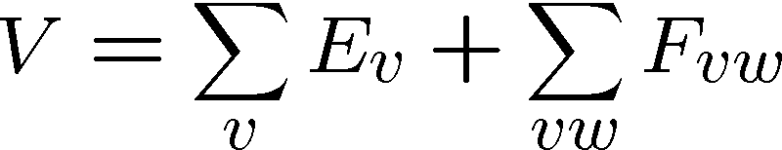
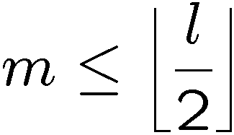
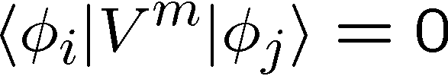
Topological Protection
Encode two qubits
into the ground state
gap
Perturbation theory:
But for
Kitaev, quant-ph/9707021

Slide 16

Topological Quantum Computing
Encode two qubits
into the ground state
gap
If we keep then quantum information encoded into ground state will be “topologically” robust to perturbation.
We can perform gates (in this example X and Z) by creating
anyon pairs and moving them around the torus.
Question: can we do this manipulation fault-tolerantly?
Kitaev, quant-ph/9707021

Slide 17
Topological Error Correction
Different mode of using Kitaev’s Model, as a component in
a fault-tolerant quantum computer, encode into ground state
1. Errors occur
2. Measure vertex and plaque operators
3. Apply recovery operator
4. If created loop is homologically trivial,
then we have restored information
encoded into ground state.
Full analysis: measurements uncertain, recovery may fail, etc.
Threshold for fault-tolerant storage of quantum information:
Dennis, Kitaev, Landahl, Preskill, quant-ph/0110143, J. Math. Phys. 43, 4452 (2002)
Wang, Harrington, Preskill, quant-ph/0207088, Annals Phys. 303, 31 (2003)

Slide 18


Three Storage Testbeds
Ferromagnetic Ising models:
one dimensional
two (and >) dimensional
Toom, Prob. of Inf. Trans., 10, 239 (1974)
Toom’s rule:
0
0
1
0
0
0
0
0
0
1
1
0
1
0
0
0
two dimensional noisy
cellular automata
0
1
0
0
0
0
0
0
0
0
1
1
1
1
1
0
0
0
0
0
1
0
1
0
1
1
1
0
0
0
0
0

Slide 19
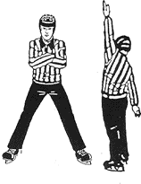

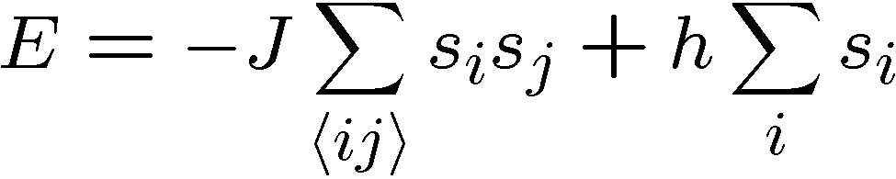


Ferromagnetic Ising Models
Ising model
spins on edges of a lattice:
energy of a configuration:
sum over neighbors
external magnetic field
for now

Slide 20

Dynamic Ising Models
Dynamic Ising model (Metropolis update)
Interaction with environment causes spin flips
Update rule:
If flipping spin would decrease energy, flip spin
If flipping spin would increase energy, flip spin with probability

Slide 21
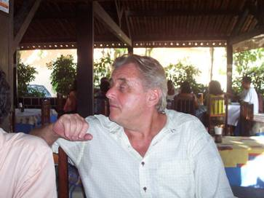
Toom’s Rule
0
0
1
0
0
0
0
0
0
1
1
0
1
0
0
0
two dimensional noisy cellular automata
0
1
0
0
0
0
0
0
0
0
1
1
1
1
1
0
0
0
0
0
1
0
1
0
1
1
1
0
0
0
0
0
Update rule:
n
n
b=majority(n,e,b)
a
e
b
e
0
0
0
0
0
0
0
0
0
0
0
0
0
0
0
0
0
1
1
0
0
1
0
0
0
0
0
0
0
0
0
0
0
1
0
0
0
1
0
0
0
1
0
0
0
0
0
0
0
0
0
0
0
0
0
0
0
0
0
0
0
0
0
0
Update rule with noise: with some probability the update fails
and a random state is assigned

Slide 22


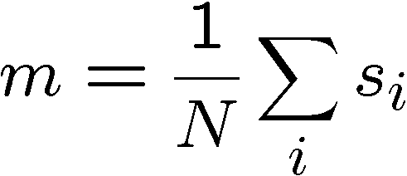
Compare and Contrast
Encode information into the system and watch what happens
0
0
0
0
0
0
0
0
0
0
0
0
0
0
0
0
0
0
0
0
0
0
0
0
0
0
0
0
0
0
0
0
0
0
0
0
0
0
0
0
0
0
0
0
0
0
0
0
Redundancy code.
Order parameter is magnetization:

Slide 23



Storage
Long time behavior (not infinite time, but effectively)
1D Ising
2D Ising
Toom’s Rule
Criticism: (1) thermodynamic limit taken
(2) what if relaxation to equilibrium takes a long time?

Slide 24
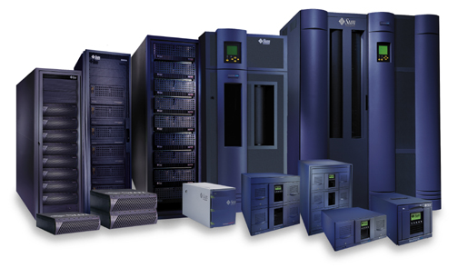


Storage
2nd attempt:
Relaxation to thermal
1D Ising
2D Ising, Toom’s Rule
Imperfect preparation

Slide 25
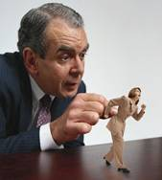




Manipulation
Flipping spins is imperfect
2D Ising
Toom’s Rule
1D Ising
1D Ising
temperature less than gap
manipulation error must be small
(i.e. NOT fault-tolerant)
2D Ising
temperature less than critical temp

Slide 26















“Self Fixing”
Excitations point-like
Energy to err is constant
Disordering entropy >> Energy
Excitations string-like
Energy to error is prop to size
Energy >> Disordering entropy

Slide 27

Toom’s Rule Versus 2D Ising
Applied magnetic field (corresponds to a bias in noise)
2D Ising
Toom’s Rule
Regions with two coexisting phases
External magnetic fields disorder magnetic media

Slide 28

Whence Kitaev’s Model?
Robust storage of quantum information.
But does it provide a mechanism for
robust manipulation of quantum information?
Is it possible to construct a Hamiltonian, which allows for fault-tolerant manipulation as well?

Slide 29
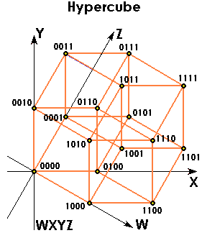
Into the Fourth Dimension
Toric code in four dimension
6-local operators
Excitations require energy proportional
to perimeter of erred region.
Major open question: are there three dimensional systems which possess a similar stability to quantum errors?
Dennis, Kitaev, Landahl, Preskill, quant-ph/0110143, J. Math. Phys. 43, 4452 (2002)

Slide 30


Quantum Correcting Order Parameter
order parameter is not
simply measuring macroscopic
magnetism
error
measure, diagnose error

Slide 31
Topological Quantum Computation
“Large” class of physical theories have non-abelian anyons.
3. Fusing of anyons ⇔ Measurement
2. Braiding of anyons ⇔ Unitary gates
1. Creation of anyons ⇔ Preparation

Slide 32
Topological Developments
Possible phases of fractional quantum Hall effect
  ν=5/2 may have non-abelian anyons
    not universal by just braiding
    (See however Bravyi PRA 73, 042313 (2003))
  ν=12/5 may have non-abelian anyons, universal
Plethora of other systems, some exactly solvable, proposed to have topological phases and be universal [Search word: Freedman, Nayak, Kitaev ]
Color codes [see talk by Héctor Bombin]
Implementation ideas in optical lattices and superconducting
circuits [see talk by Jiannis Pachos and Gavin Brennen]

Slide 33
Joke Deleted By
Hollywood Censors

Slide 34
Small Scale Memories
Are there small simple realistically implementable versions of Kitaev’s idea of using an energy gap to protect quantum information?

Slide 35
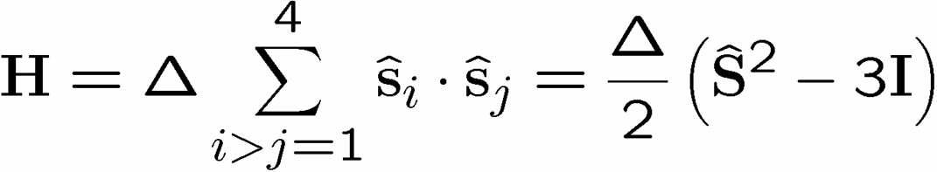
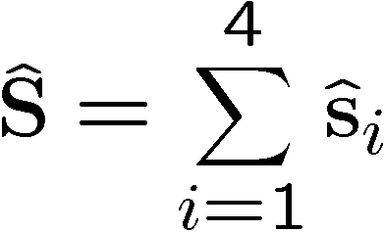








Supercoherent Qubits
D. Bacon, K.R. Brown, and K.B. Whaley, Phys. Rev. Lett. 87, 247902 (2001)
Y.S. Weinstein and C. S. Hellberg, Phys. Rev. Lett. 98, 110501 (2007)
1
2
total spin
4
3
= exchange
interaction
1
S=2
1
total
spin
1
3
1
2
S=1
1
2
n
S=0
1
2
3
4
number of qubits
Supercoherent Qubit

Slide 36



Run Uphill
“heating”
S=2
1
2
S=1
4
3
S=0
“nondissipative”
Supercoherent Qubit
All single qubit operators take S=0 states to S>0 states
Supercoherence:
made all single qubit processes “heating”!
At kT< single qubit decoherence mechanisms suppressed
Notes:
Show errors going up
Fix fonts
Talk about local errors

Slide 37






Another Small Quantum Try
1
2
Hamiltonian
ZZ
ZZ
ZZ
ZZ
XX
XX
ZZ
3
ZZ
4
quantum error detecting code
classical
quantum
symmetry
simultaneously diagonalize with symmetries
H does not depend on second qubit

Slide 38
























Slide 39

Supercoherence
ALL single qubit errors take degenerate ground state to higher energy levels.
Single qubit errors change value of (S₁,S₂) and hence take ground state to higher energy level.
FORBIDDEN

Slide 40






Subsystem Error Correction
Only need to protect subsystem,
not full subspaces.
encoding
subsystem
error
recovery
encoded quantum
information
recovery need not perfectly restore system, but only
preserve information encoded into subsystem.
Kribbs, Laflamme, Poulin, PRL 94, 180501 (2005)
D. Poulin, PRL 95, 230504, (2005)

Slide 41
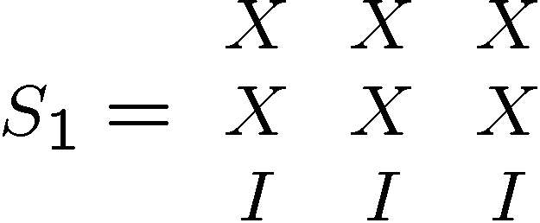
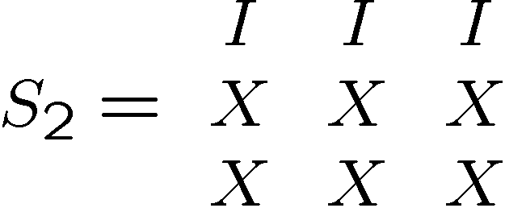
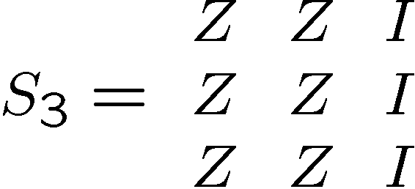
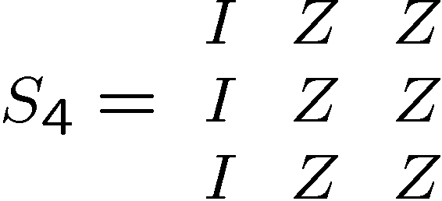
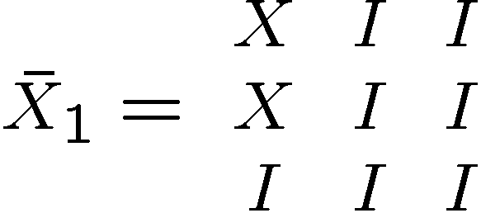
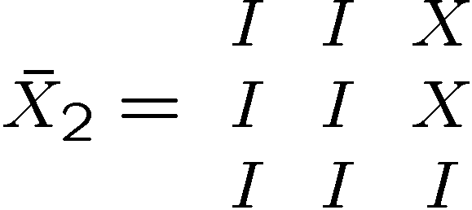
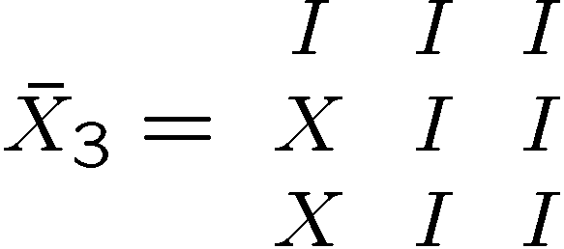
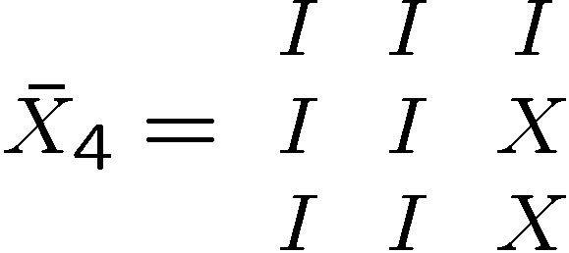
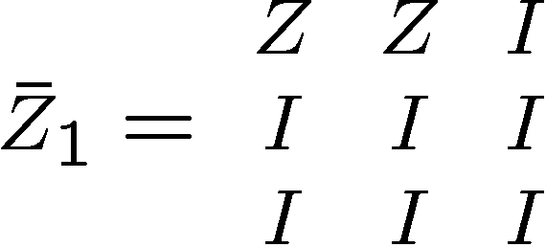
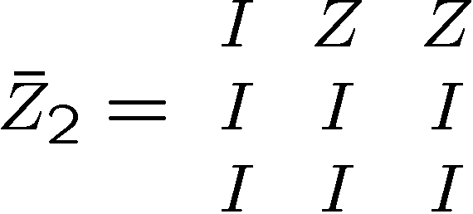
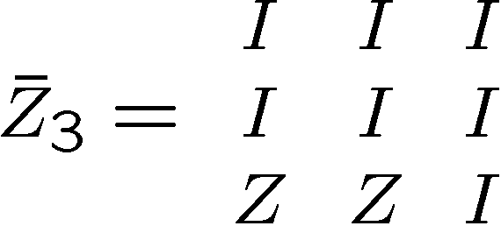
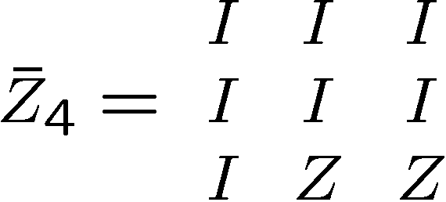
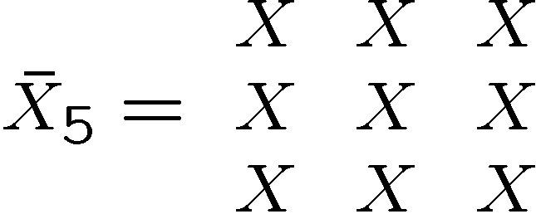
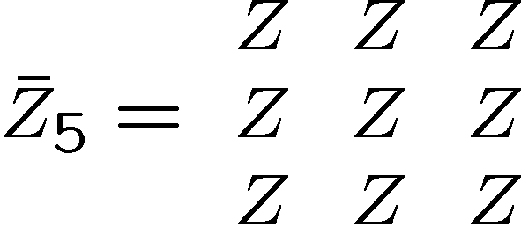
A Silly Stabilizer Code
Stabilizer generators:
Logical operators:
Bacon, Phys. Rev A, 73, 012340 (2006)

Slide 42
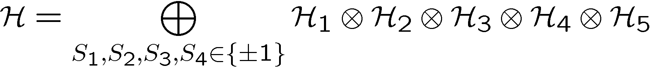
Subsystem Encoding

Slide 43
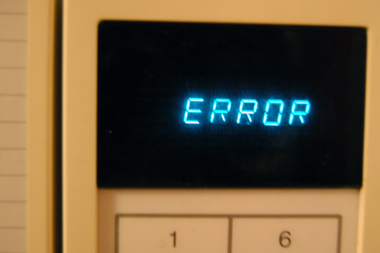
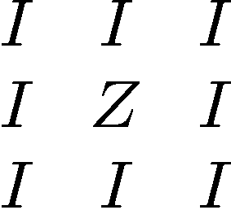
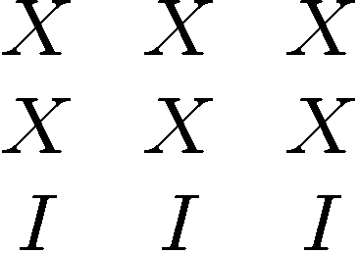
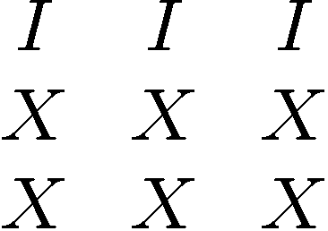


Sample Error

Slide 44








Syndrome
Fix
Resulting
Operation

Slide 45
Subsystem Code
Stabilizer generators:
plus encoded Z operators
generate all even number of Z’s per row
Measuring +1,-1 eigenvalue of
Fix modulo this group
i.e. do nothing to 5th
encoded qubit!
[Bacon, Phys. Rev A, 73, 012340, 2006]

Slide 46






Relation to Other Codes
Aliferis and Cross, Phys. Rev. Lett. 98 220502 (2007)
Measure red qubits in computational basis
leaves blue qubits in subsystem code.
Code is closely related to Shor’s original 9 qubit code:

Slide 47
Generalized Shor Subsystem Codes
Two classical codes: C₁=[n₁,k₁,d₁] and C₂=[n₂,k₂,d₂]
Quantum Shor subspace code [[n₁n₂,k₁k₂,min(d₁,d₂)]]
Number of stabilizers = (n₁-k₁)n₂+(n₂-k₂)
Quantum Shor subsystem code [[n₁n₂,k₁k₂,min(d₁,d₂)]]
Number of stabilizers= (n₁-k₁)k₂+(n₂-k₂)k₁
Bacon and Casaccnio, quant-ph/0610088 (2006)
More Subsystem Codes
Aly, Klappenecker, Sarvepalli, quant-ph/0610153 (2006)
Klappenecker, Sarvepalli, quant-ph/0703213 (2007)
[see talk by Salah Aly]

Slide 48
Extra Fault-Tolerant Properties

Slide 49

Quantum Compass Model
ZZ
ZZ
XX
XX
XX
ZZ
ZZ
XX
XX
XX
ZZ
ZZ
Ground state is subsystem code: does it have an energy gap?

Slide 50


Problems:
[Dourier, Becca, Mila 05]
no gap in the thermodynamic limit

Slide 51






Long Range Quantum
Compass Model?
Proposed implementation in ion traps (See however Brown 0705.2370)
Milman, Maineult, et al Phys. Rev. Lett. 99, 020503 (2007).
3D Codes Quantum Compass?

Slide 52
In Retrospect
Toric code / Topological protection
Toy models of physical devices which error correct
Subsystem codes
ZZ
ZZ
XX
XX
XX
ZZ
ZZ
XX
XX
XX
ZZ
ZZ

Slide 53

What Does “Scalable” Mean?
1. All of the necessary components.
2. Easy to fabricate.
3. Below “threshold”
1+3. All of the necessary components which operate below “threshold”
1+2+3. All of the necessary components, below “threshold”, and easy
to fabricate.

Slide 54


What Does “Scalable” Mean?
Gordon Moore
Scalable has a rate and a lifetime.
Scalable means that you can predict from current technology this
rate and a lower bound on the lifetime.
Scalable means that you can write Moore’s 1965 paper
….and be right!

Slide 55
Topological Codes and Subsystem Codes and Why We Should Care About Them…
Dave Bacon
Department of Computer Science & Engineering
University of Washington, Seattle, WA
ZZ
ZZ
XX
XX
XX
ZZ
ZZ
XX
XX
XX
ZZ
ZZ

