Slide 1
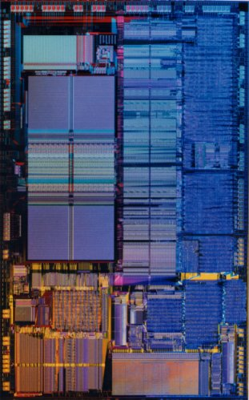
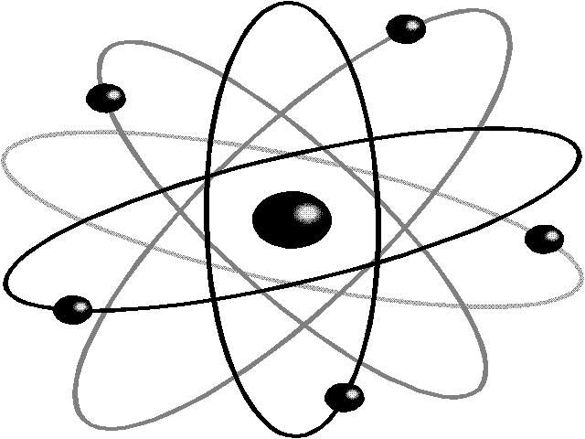
Quantum Computing Architectures
CSE 471 Lecture
May 31, 2007
Dave Bacon

Slide 2
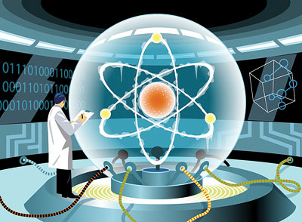

Slide 3
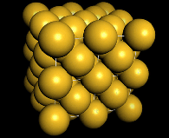
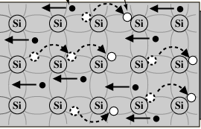
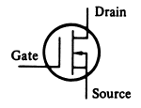
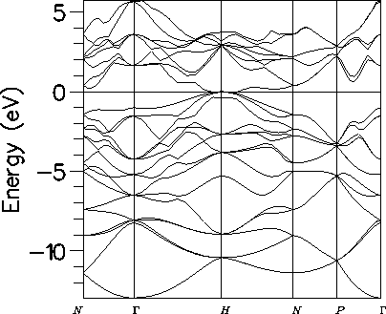
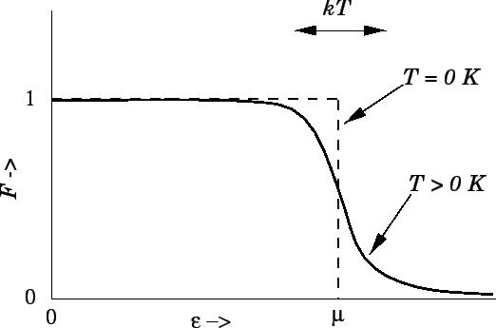
Behind the Bit
bits
noisy bits
quantum bit

Slide 4
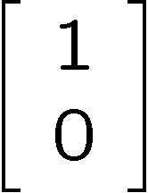
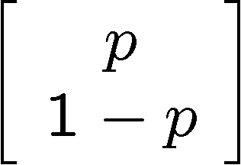
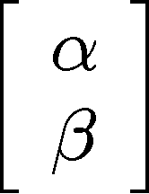


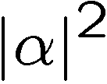
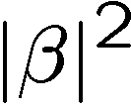
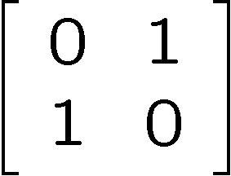
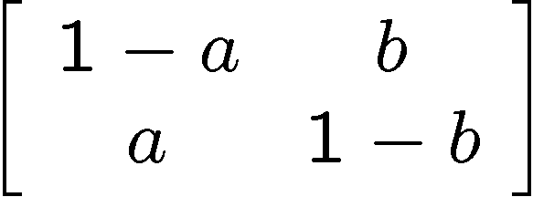
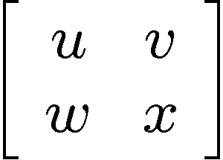
Bit, Pbit, and Qubit
bit
probabilistic bit
quantum bit
Configurations:
0
1
0
1
0
1
Description:
Observation:
0
certainty
0
p percent
0
percent
1
1-p percent
1
percent
Evolution:
deterministic
stochastic
unitary

Slide 5
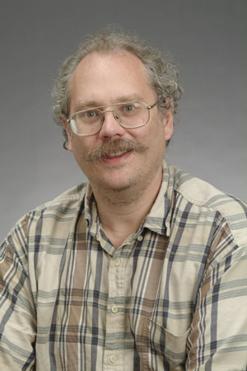
Quantum Computers
18819881292060796383869723946165043
98071635633794173827007633564229888
59715234665485319060606504743045317
38801130339671619969232120573403187
9550656996221305168759307650257059
3980750864240649373971
2550055038649119906436
2342526708406385189575
946388957261768583317
4727721461074353025362
2307197304822463291469
5302097116459852171130
520711256363590397527
1994
Quantum computers can efficiently factor whole numbers (and compute discrete log.)
No known classical efficient algorithm.
Breaks RSA, Diffie-Hellman cryptosystems.
Peter Shor

Slide 6
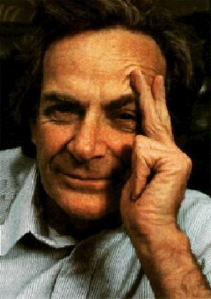
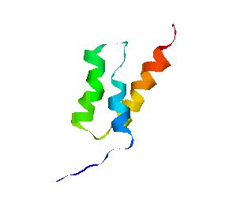
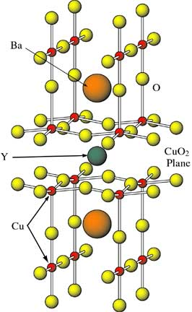
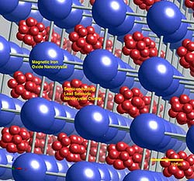
Quantum Simulations
Simulating quantum systems on classical computers is hard
Simulating quantum systems on quantum computers is easy
Richard Feynman
Quantum algorithms for simulating quantum processes
high temperature
superconductors
biochemistry
novel materials

Slide 7
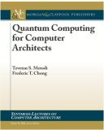
Architectures For Quantum Computers
Small scale (6-8 qubit) quantum computers have been built.
Systems-level challenges to achieving scalable, fault-tolerant
quantum computation
1st quantum computing architecture “book”
“Quantum Computing for Computer Architects”,
Tzvetan Metodi and Frederic Chong (2006)
Available (free from UW!) at
http://www.morganclaypool.com/doi/abs/10.2200/S00066ED1V01Y200610CAC001

Slide 8

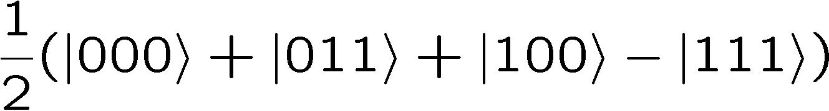


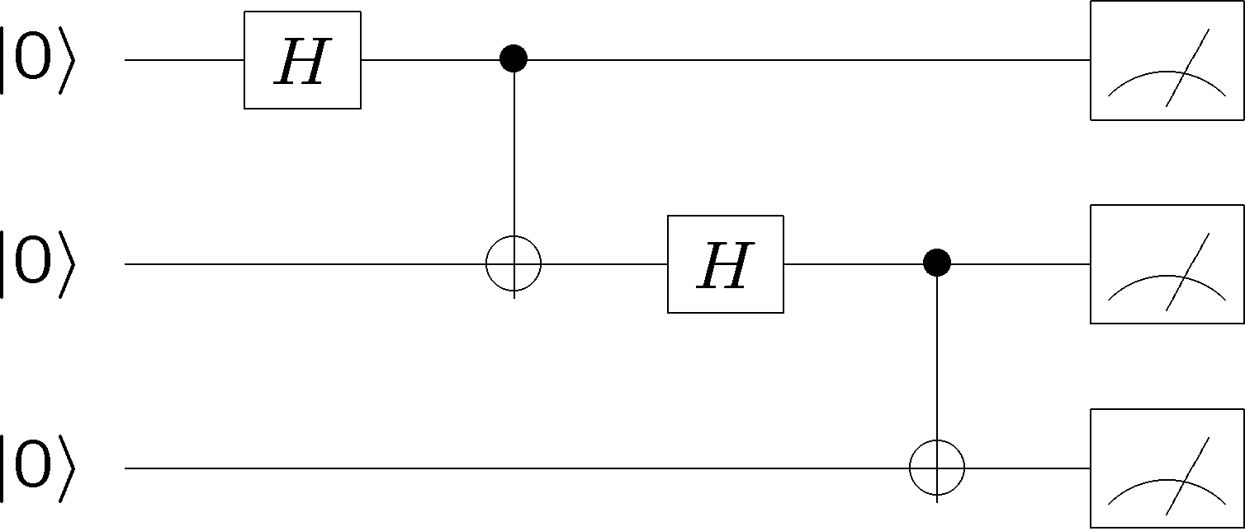
The Ideal Quantum Computer
qubits
Quantum algorithm
1. Initialize
2. Series of unitary gates
3. Measurement

Slide 9



“Unique” Quantum Challenges
Quantum info
cannot be copied:
“no fan-out”
Quantum info
likes to become
Classical:
010001110101..
010011110001..
“noisy channel”

Slide 10
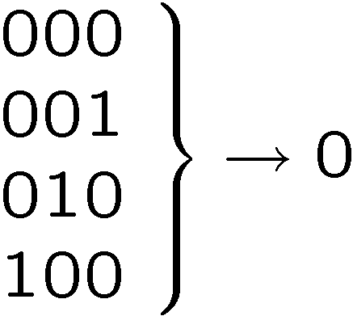






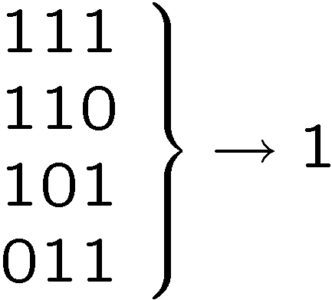
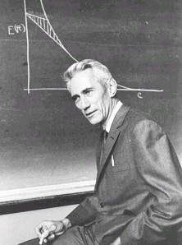
Classical Solutions
Probability of bit flip = p
Solution: redundancy
Probability of failure =3(1-p)p²+p³
=3p²-2p³
<p if p<1/2
Use redundancy to protect information against noise
Claude Shannon 1948
“A mathematical theory of communication”

Slide 11
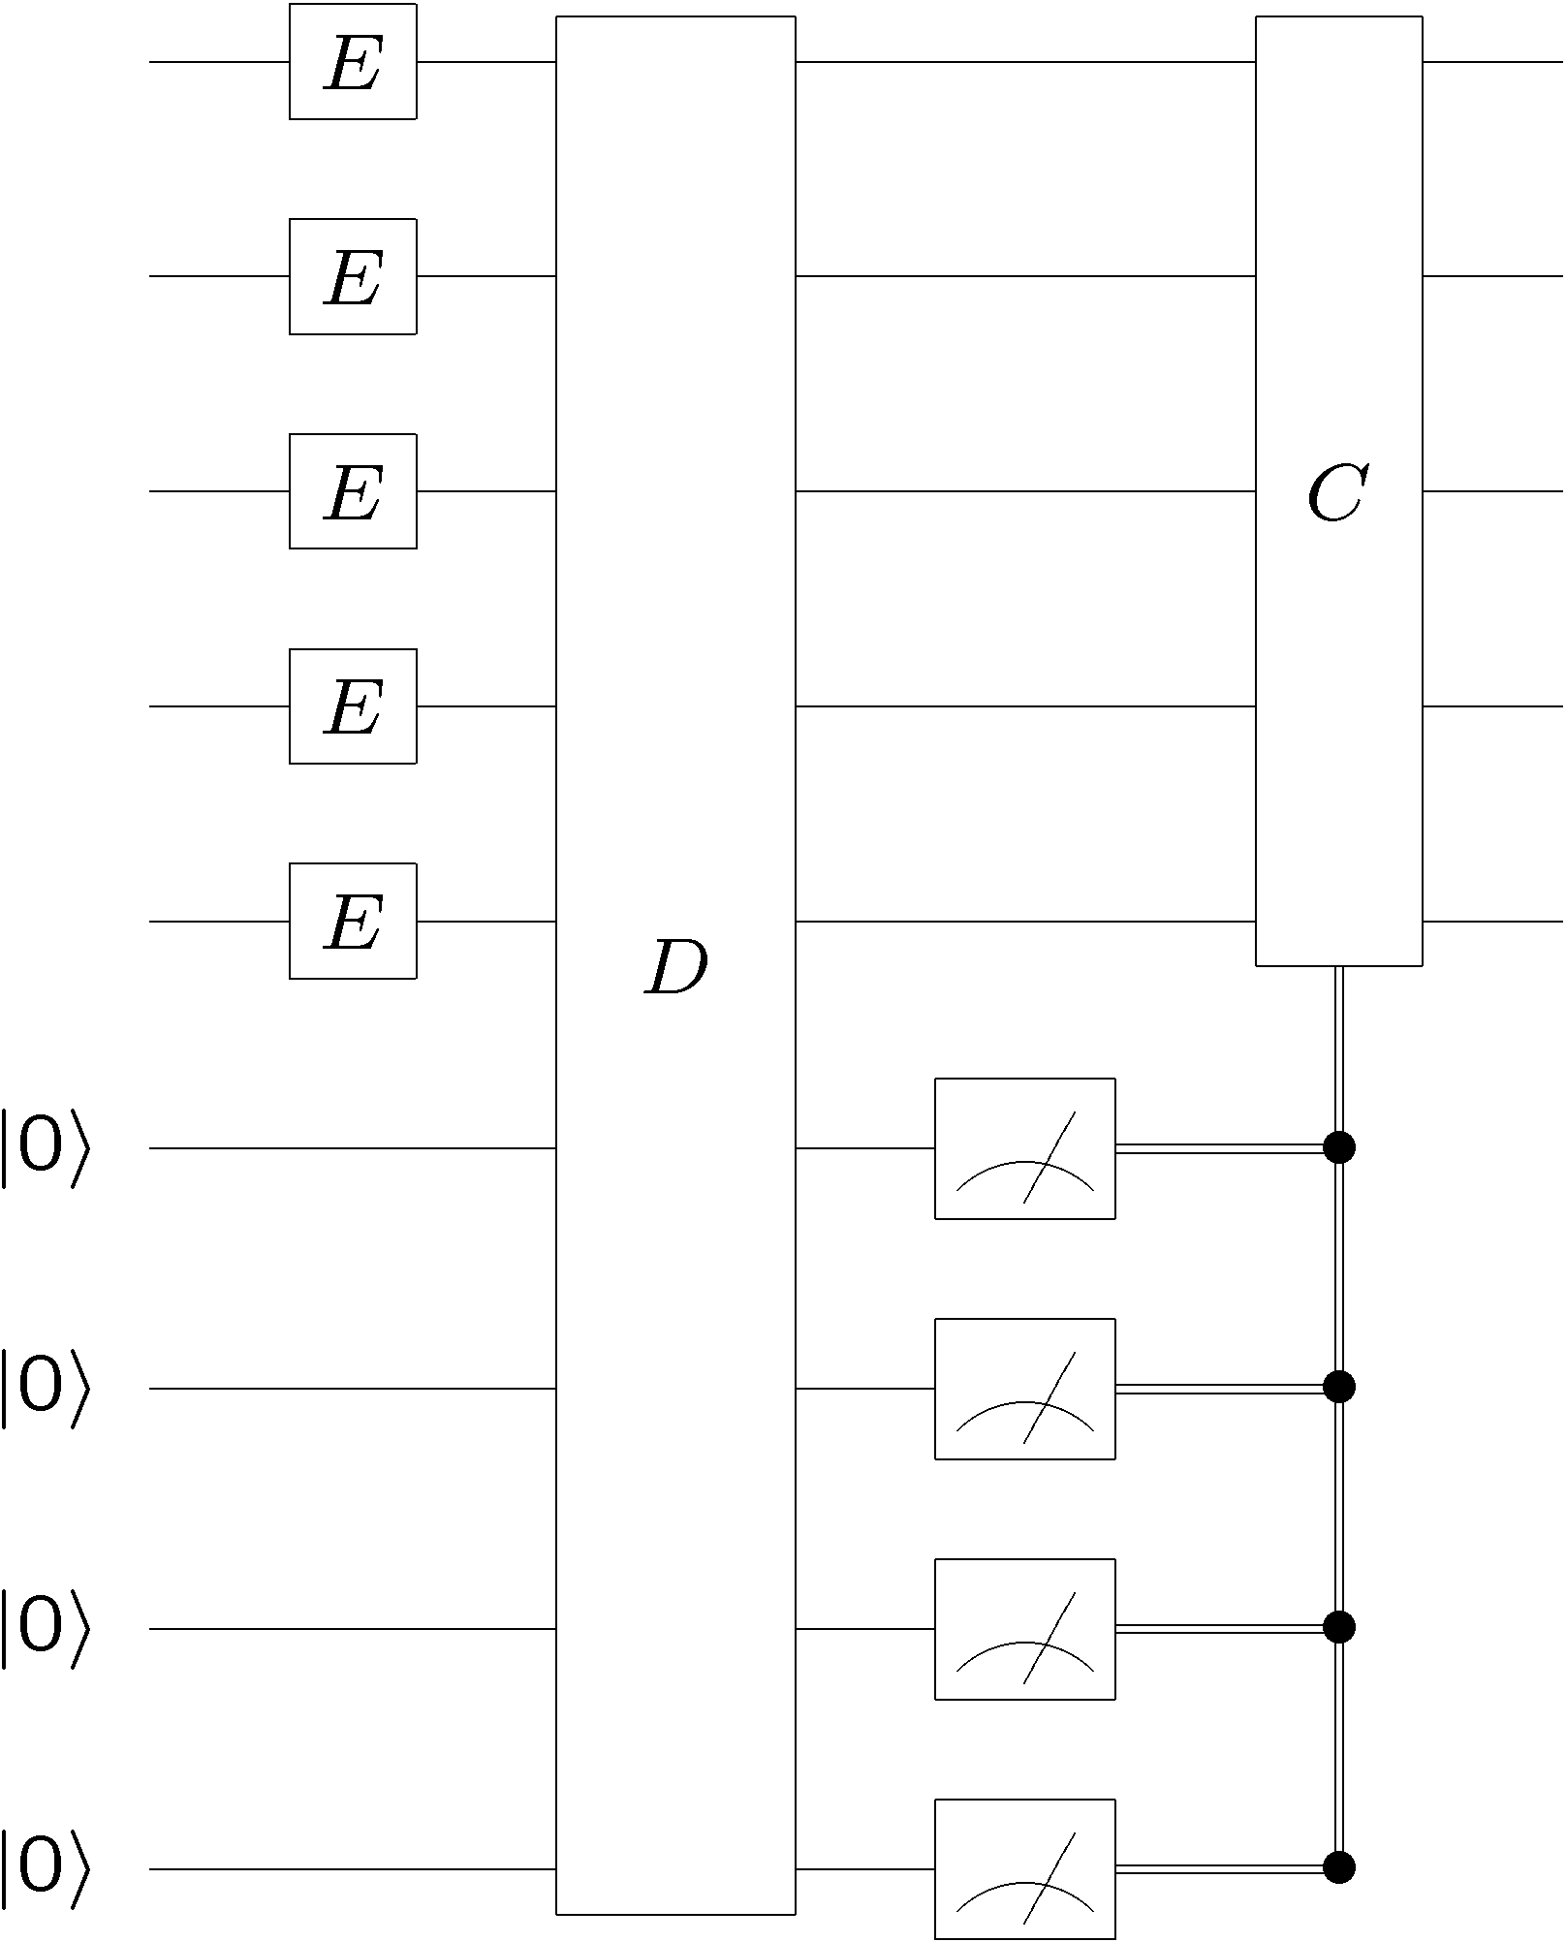


Quantum Error Correcting Codes
By encoding quantum information we can protect it from the
effects of noise:
“bare” error rate = p
error rate on encoded = O(p²)

Slide 12
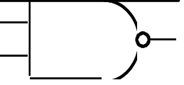
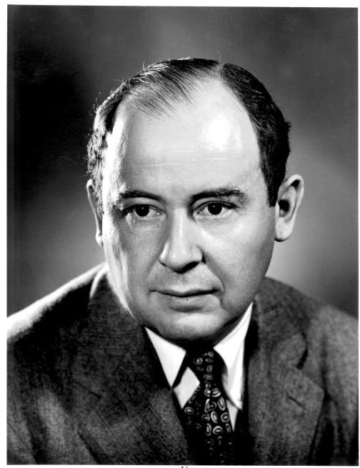
More Classical Problems
Classical gates fail with probability p
Solution: error correcting codes + fault tolerant construction
M
John von Neumann, 1956
“Probabilistic logics and the synthesis of reliable organisms from unreliable components”
M
M

Slide 13
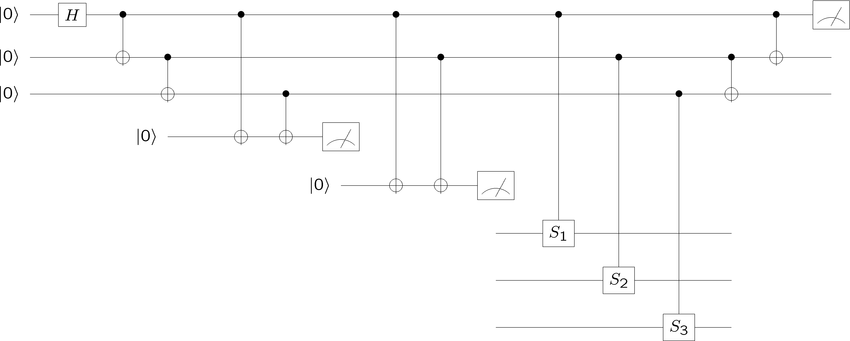
Fault-Tolerant Quantum Computation
Must design quantum circuits which succeed even when
every element of the circuit (preparation, unitary gates,
measurements) can fail.
Quantum error correction + Fault-tolerant procedures

Slide 14

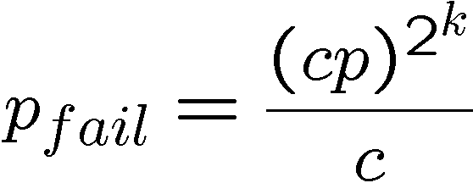
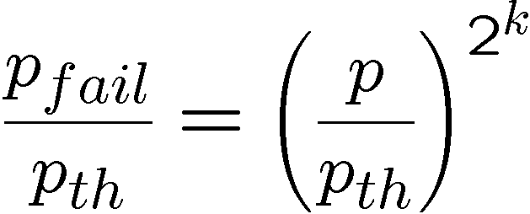
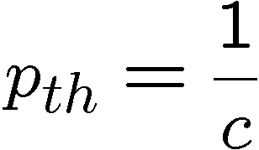
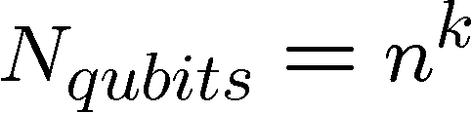
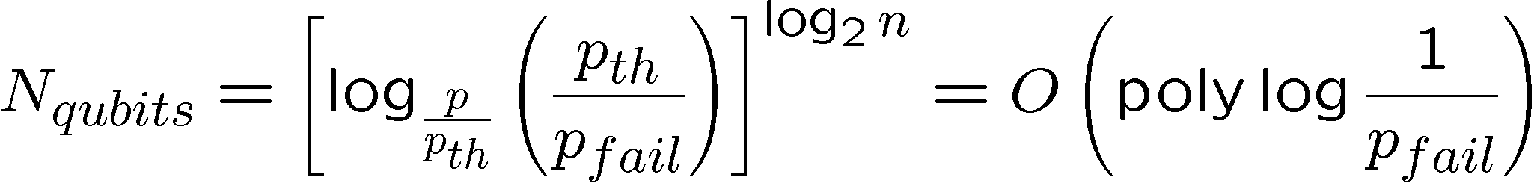
Perfection Through Concatenation
failure
probability
p
cp²
c(cp²)²
At k^{th} level of concatenation, probability of an error which
destroys the encoded quantum information is
and uses qubits

Slide 15
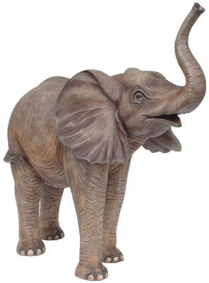
Architectures For Quantum Computers
Systems-level challenges to achieving scalable, fault-tolerant
quantum computation
Designing computer architectures
when components fail
The error correcting architectures
must be massively (but fairly
embarrassingly) parallel
Error Correction

Slide 16
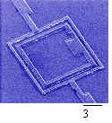
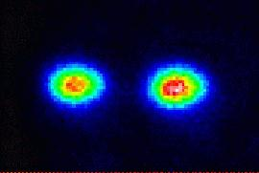
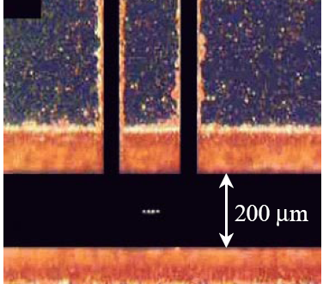
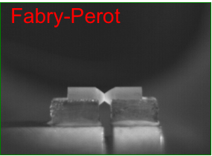
Building Blocks
Example:
superconducting qubits
stationary
fixed location
qubits
walking
Example:
ion trap qubits
“slow”
flying
Example:
photons
“fast”

Slide 17
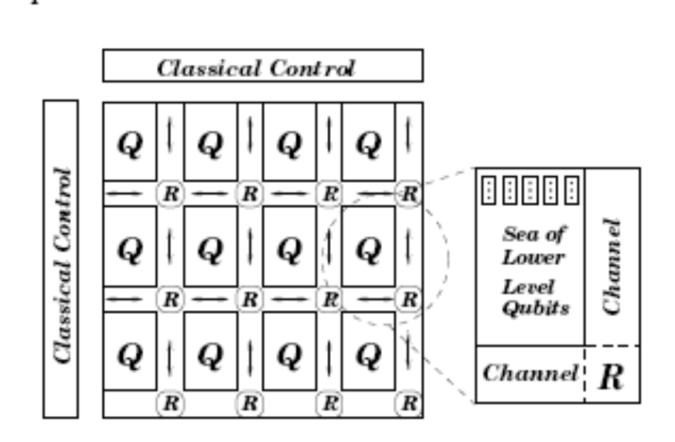
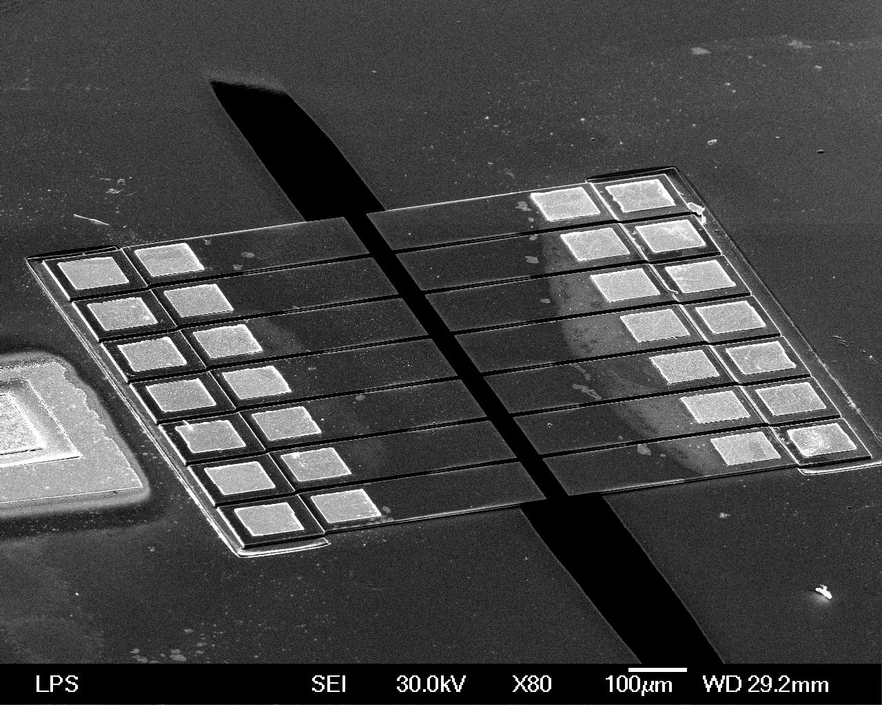
Sketch Ion Trap QC
http://iontrap.physics.lsa.umich.edu/
research/trap
(from Metodi et al, MICRO-38 )
Interaction “trapping” regions
X
X
X
X
X
X
X
X
X
X
X
X
X
X
X
X
X
X
X
X
X
X
X
X
“electrodes”
ions
X
X
X
X
X
X
X
X
X
X
X

Slide 18
Time Scales
walking
Example:
ion trap qubits
“slow”
Operation | Time (μs) | Failure rate (today) | Failure rate (future)
single qubit gate | 1 | 10⁻⁴ | 10⁻⁸
two qubit gate | 10 | 10⁻² | 10⁻⁷
measurement | 200 | 10⁻² | 10⁻⁸
movement | 20 | 10⁻³/ μm | 10⁻⁷/ μm
cooling | 200 | ? | ?
wait | 10⁷ / error

Slide 19
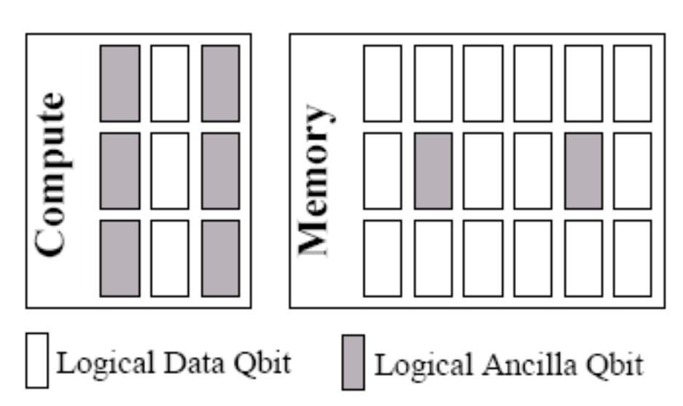
Quantum Memory Hierarchy
Memory error rates << Errors during computation
Error correction more frequent during computation
More ancillas (used for error correction) in compute region
Tradeoffs versus Size (Area)

Slide 20
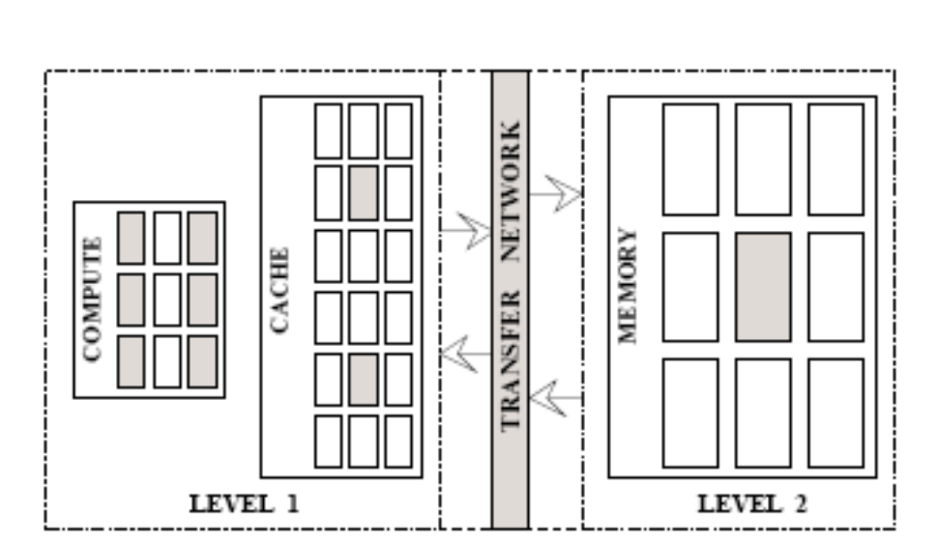
Quantum Memory Hierarchy
Slow memory / Fast compute leads to standard cache ideas…
except…

Slide 21
Communication
X
X
X
X
X
X
X
X
X
X
X
X
X
X
P_{f}=(p₀)^{k}
X
X
X
X
X
X
X
X
X
X
X
X
X
Exponential
decrease
in distance
Distance k
Could perform error correction every k₀ steps….slow!

Slide 22
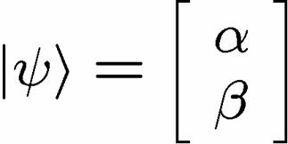
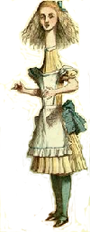


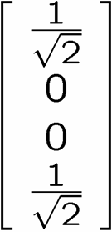
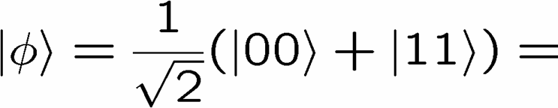
Quantum Teleportation
Alice wants to send to Bob
1 qubit
X
2 bits
Y
Alice performs operation on
her state and half of entangled
system and sends outcome
Conditional on received bits,
Bob performs manipulation of
his half of entangled system

Slide 23
Moving Qubits
Teleportation channel
classical control
entangled qubits
Entanglement distillation
classical control

Slide 24
Teleportation Units
Entanglement
Generator
classical control
Parallel distribution of
entanglement
+
Purification
=
On demand communication,
i.e. fast!
Purification
Teleportation

Slide 25
Quantum Architectures
New generation of tools in order to aid in the design of quantum computing architectures….

Slide 26
Tools!
Error Correction
Compiler
Stabilizer
Designer
Device
Cells
High level
description of
fault-tolerant
error correction
Assembly
compiler
QASM
Mapper/
Scheduler
Physical
Control
Sequence
QCL
Fast
Error
Simulation
Exact
Simulation
Visualizer/
Analyzer
error rates

Slide 27
High Level Languages
Example in QCL (http://tph.tuwien.ac.at/~oemer/qcl.html)
operator dft(qureg q) { // main operator
const n=#q; // set n to length of input
int i; int j; // declare loop counters
for i=0 to n-1 {
for j=0 to i-1 { // apply conditional phase gates
CPhase(2*pi/2^(i-j+1),q[n-i-1] & q[n-j-1]);
}
Mix(q[n-i-1]); // qubit rotation
}
flip(q); // swap bit order of the output
}

Slide 28
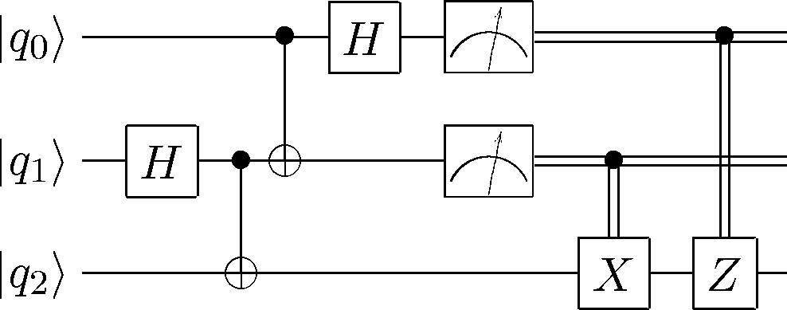
Quantum Assembly Language
qubit q0
qubit q1
qubit q2
h q1 # create EPR pair
cnot q1,q2
cnot q0,q1 # Bell basis measurement
h q0
nop q1
measure q0
measure q1
c-x q1,q2 # correction step
c-z q0,q2
QASM

Slide 29

Scheduler
Example from Chuang group at http://www.media.mit.edu/quanta

Slide 30
Further Resources
Quantum Computing For Computer Scientists (David Mermin):
http://people.ccmr.cornell.edu/~mermin/qcomp/CS483.html
“Standard” Textbook:
Quantum Computation and Quantum Information
by Michael Nielsen and Isaac Chuang
ISCA 2002 Tutorial Page (Oskin and Chong):
http://www.cs.washington.edu/homes/oskin/quantum-tutorial/

Slide 31

Quantum Architectures
Today: a taste
On the verge of becoming extremely important
5-8 qubit ion trap machines
microfabricated ion traps
large effort to scale up to traps with
30-100 in next few year
Picture from http://iontrap.physics.lsa.umich.edu/research/trap

