Slide 1
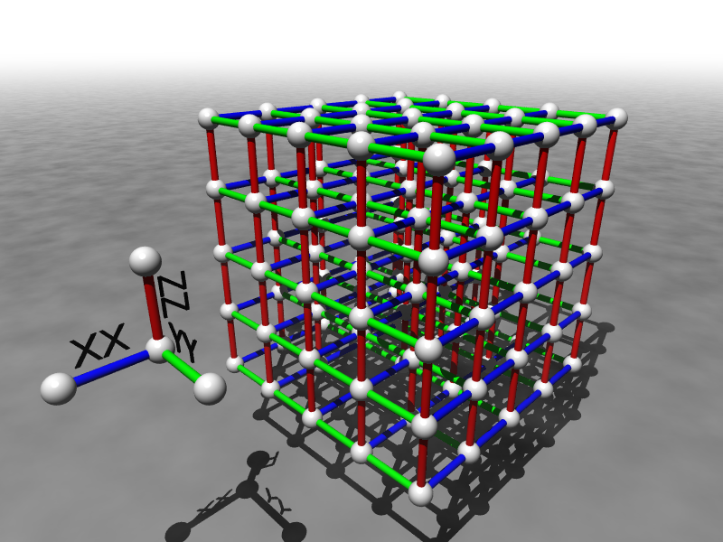
Building Robust Qubits
Dave Bacon
Department of Computer Science & Engineering
University of Washington

Slide 2

My Mortal Enemy

Slide 3
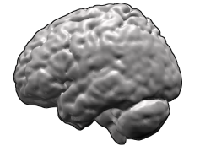
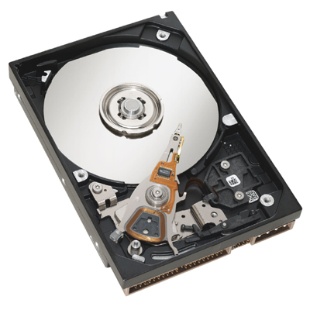
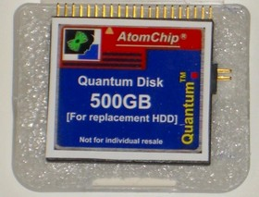

Success Stories
Life
Computers
How is it that nearly error free behavior can arise from
systems whose components are unreliable?
Quantum Computers

Slide 4

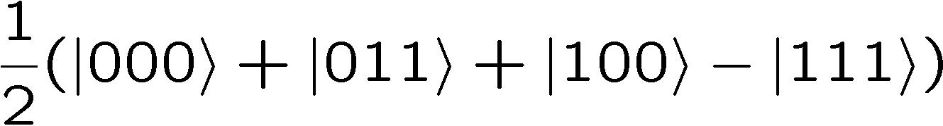


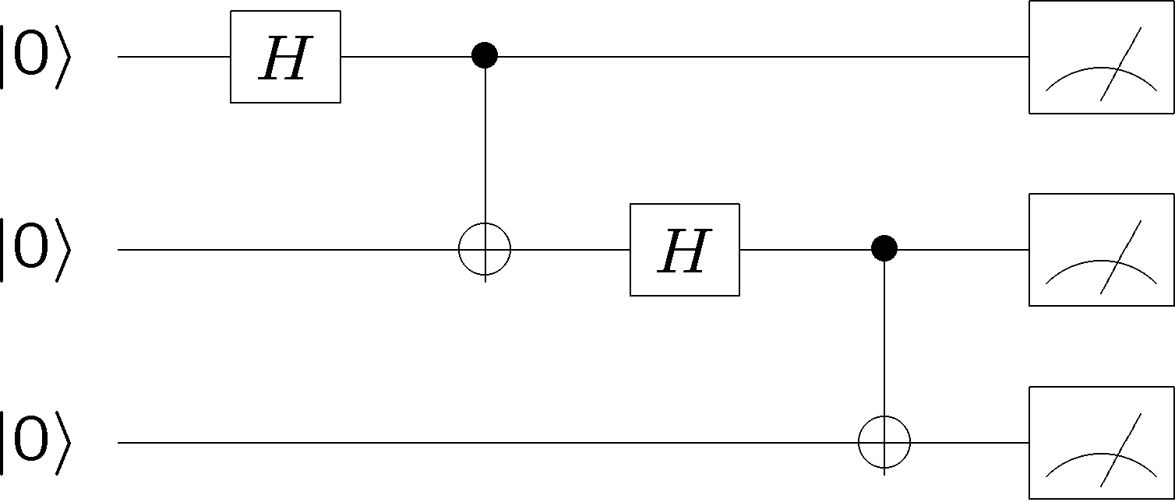
What is a Quantum Computer?
qubits
Quantum algorithm
1. Initialize
2. Series of unitary gates
3. Measurement

Slide 5


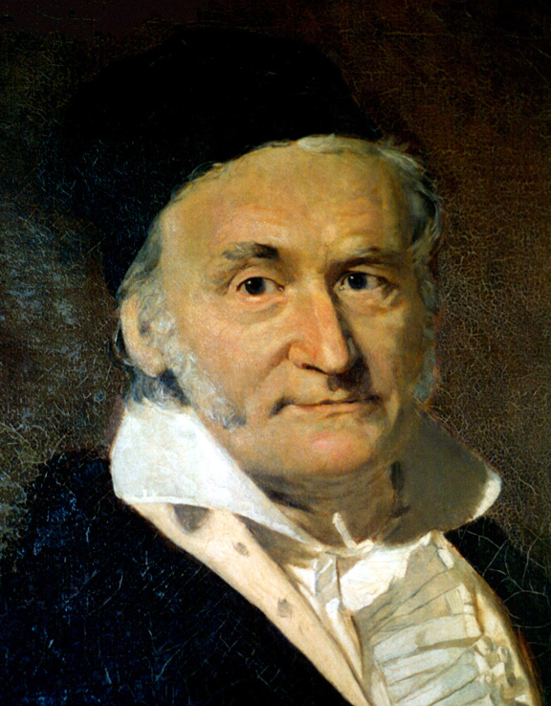
Why Build a Quantum Computer?
Original answer: [Peter Shor 1994]
18819881292060796383869723
94616504398071635633794173
82700763356422988859715234
66548531906060650474304531
73880113033967161996923212
05734031879550656996221305
168759307650257059
3980750864240649373971
2550055038649119906436
2342526708406385189575
946388957261768583317
4727721461074353025362
2307197304822463291469
5302097116459852171130
520711256363590397527
Best classical algorithm
takes time
Quantum algorithm
takes time
Breaks cryptosystems: RSA, Diffie-Hellman
(i.e. when you paid for this conference!)
“The problem of distinguishing prime numbers from composites, and of resolving composite numbers into their prime factors, is one of the most important and useful in all of arithmetic... The dignity of science seems to demand that every aid to the solution of such an elegant and celebrated problem be zealously cultivated” — Carl Gauss

Slide 6
Why Build a Quantum Computer?
Today’s answer:
  Factoring, discrete log [Shor 94]
  Unstructured search [Grover 96]
  Various hidden subgroup problems [Long List]
  Pell’s equation [Hallgren 02]
  Hidden shift problems [van Dam, Hallgren, Ip 03 Childs, van Dam 05]
  Graph traversal [CCDFGS 03]
  Spatial search [AA 03, CG 03/04, AKR 04]
  Element distinctness [Ambainis 03]
  Various graph problems [DHHM 04, MSS 03,…]
  Testing matrix multiplication [Buhrman,Špalek 04]
  Simulation of quantum systems ??!!??

Slide 7


Obstructions
DECOHERENCE
Environment
Total Hamiltonian
System
system
environment
interaction
open quantum systems can become
entangled with their environment
coherent superposition
incoherent sum

Slide 8

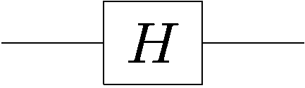

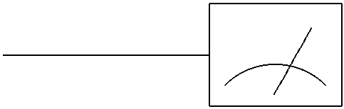

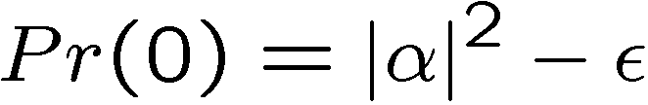

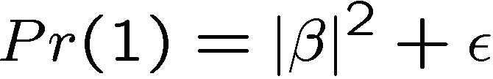
More Obstructions
FAULTY CONTROL
System
Controller
Imperfect state
preparation
Imprecise or faulty unitary gates
Imperfect
measurements

Slide 9

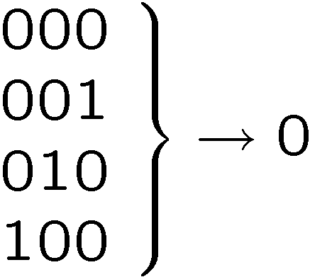






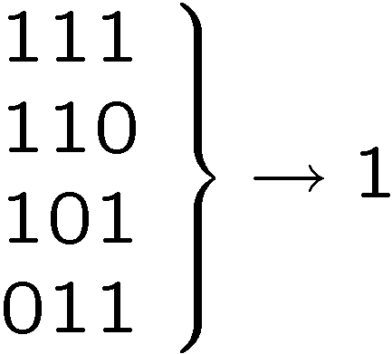
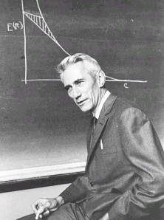
Classical Solutions
Probability of bit flip = p
Solution: redundancy
Probability of failure =3(1-p)p²+p³
=3p²-2p³
<p if p<1/2
Use redundancy to protect information against noise
Claude Shannon 1948
“A mathematical theory of communication”

Slide 10
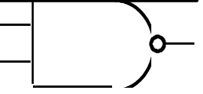
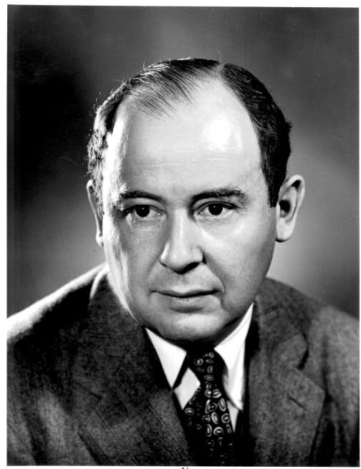
More Classical Solutions
Classical gates fail with probability p
Solution: error correcting codes + fault tolerant construction
M
John von Neumann, 1956
“Probabilistic logics and the synthesis of reliable organisms from unreliable components”
M
M

Slide 11
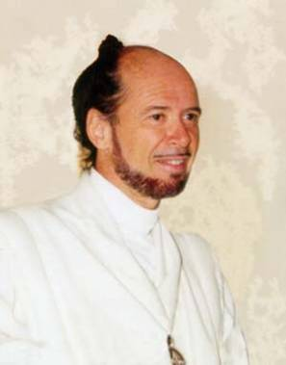



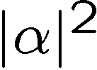

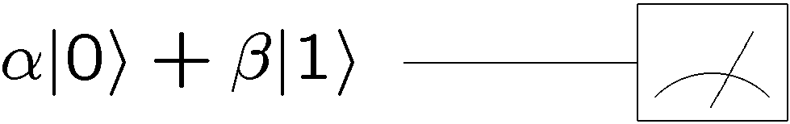
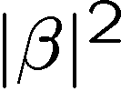

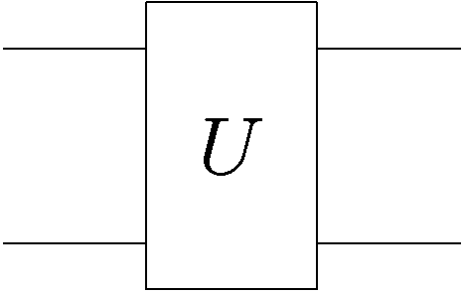
Quantum Problems?
No cloning of quantum information
How to perform error correction without measuring?
Quantum errors seem “analog”
system
decohered system
environment

Slide 12
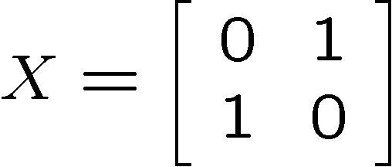
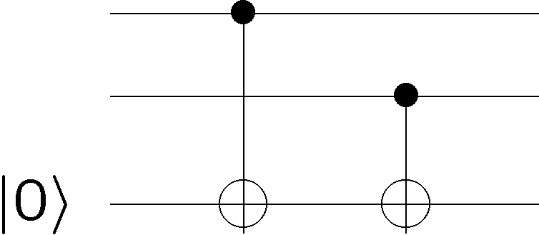

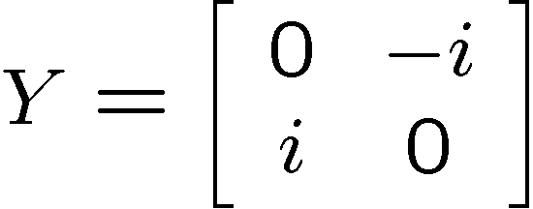
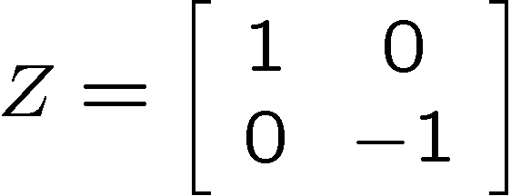

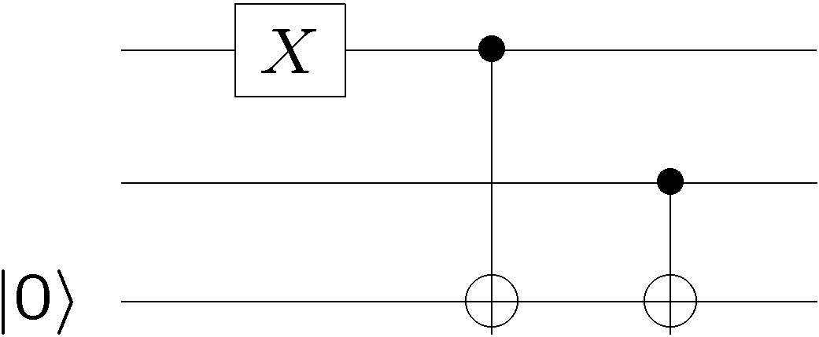


Quantum Observations
How to perform error correction without measuring?
Observation: not all measurements destroy quantum information
Information encoded into a subspace undisturbed
Can detect “leaving” of subspace

Slide 13
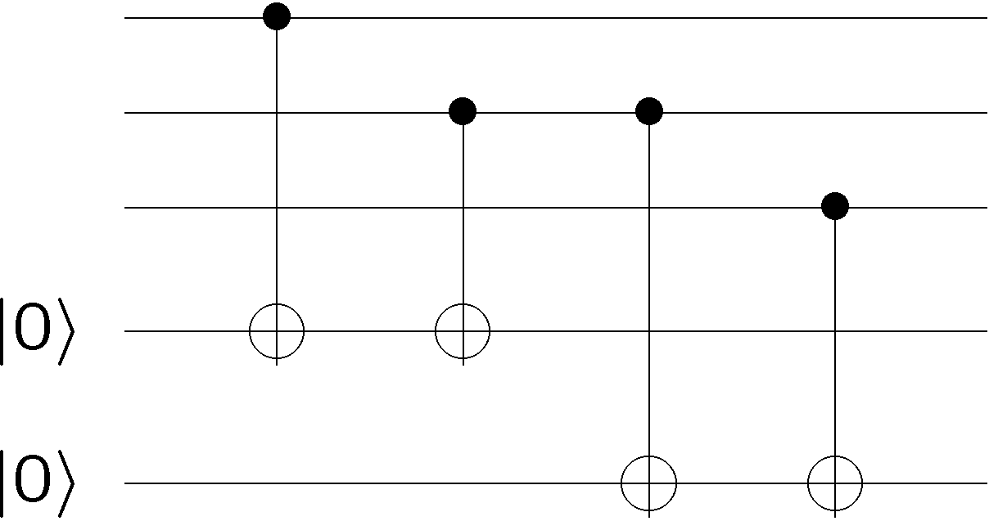














Quantum Observations
By encoding into subspaces we can correct single bit flips

Slide 14
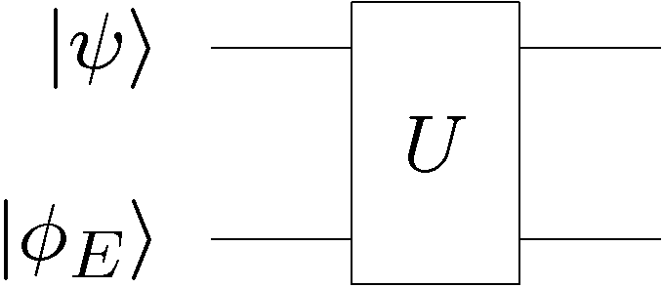
Quantum Problems?
Environment
qubit
digitized effects of decoherence
Think: amplitude for no error, X error, Y error, Z error

Slide 15
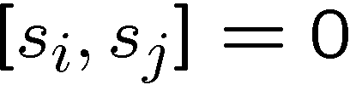
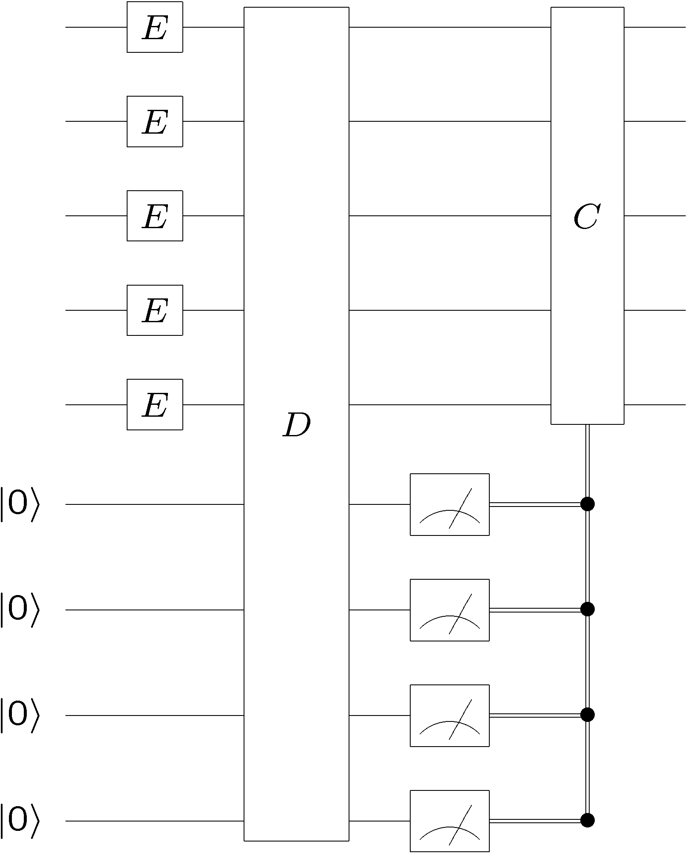


Quantum Error Correcting Codes
Encode qubit into 2 dimensional
subspace with all +1 eigenvalues
Single qubit errors (i.e. )
all lead to a unique subspace labeled by s_{i} eigenvalues
“bare” error rate = p
error rate on encoded = O(p²)

Slide 16
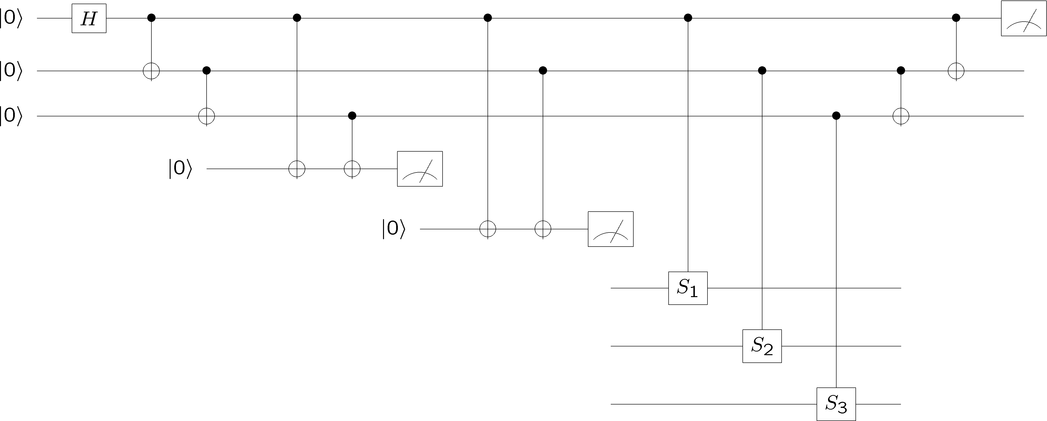
Fault-Tolerant Quantum Computation
Must design quantum circuits which succeed even when
every element of the circuit (preparation, unitary gates,
measurements) can fail.
Quantum error correction + Fault-tolerant procedures

Slide 17

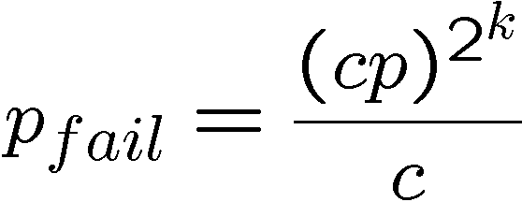
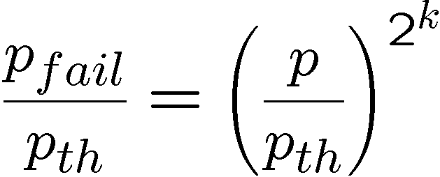
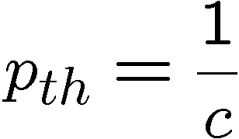
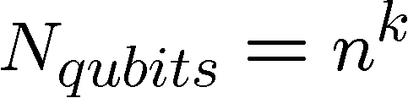
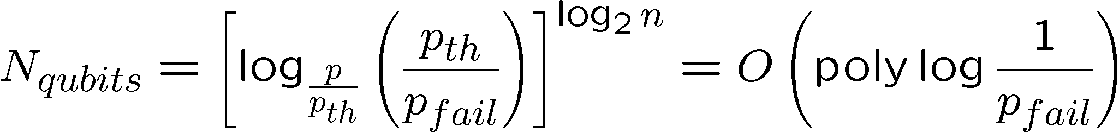
Perfection Through Concatenation
failure
probability
p
cp²
c(cp²)²
At k^{th} level of concatenation, probability of an error which
destroys the encoded quantum information is
and uses qubits

Slide 18

Threshold Theorem, ~1996
QC
errosol
“decoherence”
“imprecision”
Threshold Theorem for Fault-Tolerant Quantum Computation
[Aharonov, Ben-Or, Knill, LaFlamme, Zurek,
Kitaev, Gottesman, Preskill, Shor, + others]
If noise is weak enough and control is precise enough, then a
quantum computation to a desired accuracy can be carried out
with an overhead polynomial in the log of the accuracy.

Slide 19
Threshold(s) Theorem(s)
Threshold theorems come in many different forms….
provable bounds, Monte Carlo estimates, …
different shapes…
assumptions of error models
assumptions of physical devices
assumptions of architectures
yielding threshold values for error rates from between
10⁻⁹ to 10⁻²
…but device complexities are universally very high. (hundreds to thousands to millions of “bare” qubits per encoded qubit with extremely complex manipulations)

Slide 20
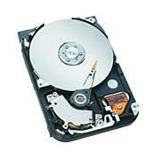
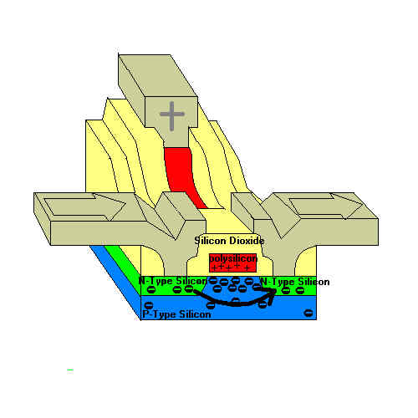
Back To Reality
theory
practice
Practical devices of information processing enact the ideas of
theory in the physics of the devices.

Slide 21

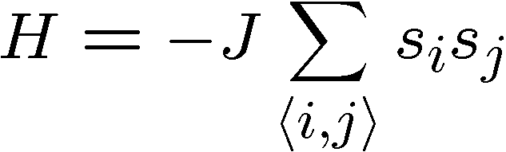


Toy Model
Ising model in two+ dimensions
Redundancy code:

Slide 22
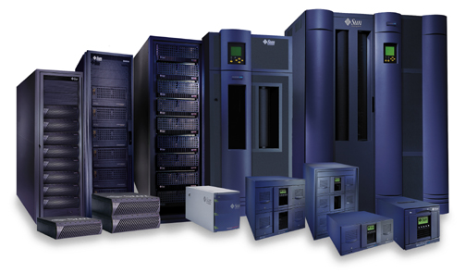
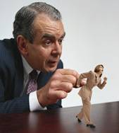





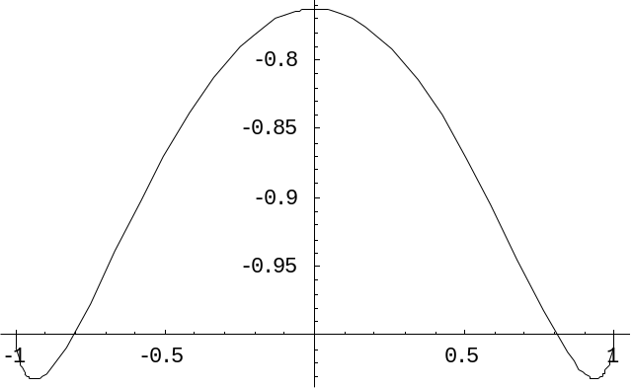
Robust
Relaxation to thermal
Imperfect preparation
Manipulation
The two encoded states have lifetimes which grow with the size
of the system:
free energy
magnetization

Slide 23


Quantum Hard Drive?
Do there exist (or can we engineer) quantum systems whose
physics guarantees fault-tolerant quantum computation?
Today in QC: we have theory (like von Neumann, Shannon) but not devices which implement these idea (without severe device complexity overhead.)

Slide 24
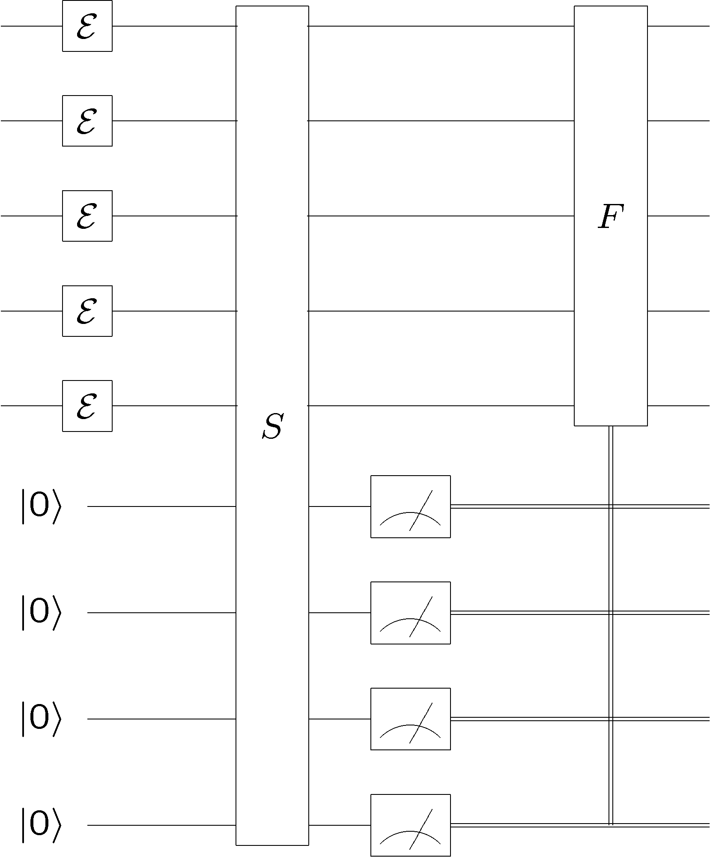
Quantum Error Correction
error
diagnose
fix
encoded
quantum
information
encoded
quantum
information
“cold”
ancilla
qubits
“hot”
ancilla
qubits
Quantum error correction is essentially (sophisticated) cooling

Slide 25
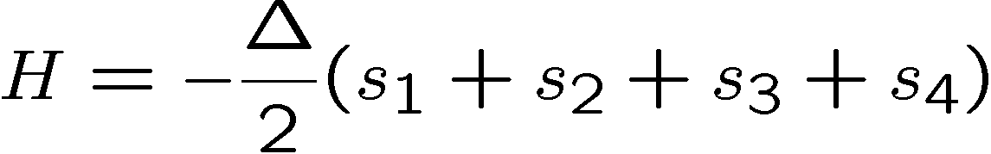


A Start
5 qubit quantum error correcting code
Hamiltonian such that ground state is this error correcting code
(ground state is twofold degenerate):
energy
2
1
0
-1
-2

Slide 26






Two Body?
Problem: four qubit interactions? Bleh.
1
2
Hamiltonian
ZZ
XX
XX
ZZ
quantum error detecting code
3
4
quantum
symmetry
H does not depend on second qubit (use to store encoded qubit)

Slide 27























ground state is +1 eigenvalue of four qubit interactions

Slide 28
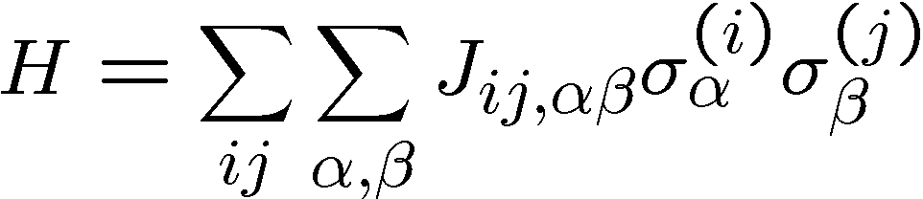
Problem?
free energy
Relative number
of errors
Suppose we want ground state to be a quantum error correcting code which corrects more than two errors using Hamiltonian with two qubit interactions.
These two qubit interactions should be correctible errors:
i.e. they take the codespace to outside of the codespace!

Slide 29
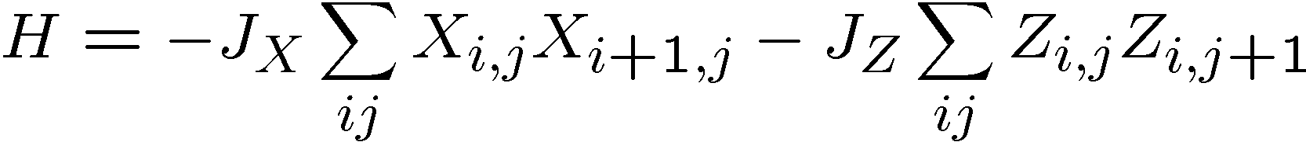
Degenerate Codes to the Rescue
Some errors, have no effect on the codespace, for example s_{i}
This leads to the concept of degenerate quantum codes
ZZ
ZZ
XX
XX
XX
ZZ
ZZ
quantum compass model
XX
XX
XX
ZZ
ZZ
Ground state is a quantum error correcting
code which tolerates ~L/2 errors
[Bacon, Phys. Rev. A, 73, 012340 (2006)]

Slide 30
Mountains, Molehills
energy
2
1
0
-1
same for quantum
compass model ☹
-2
versus
free energy
Relative number
of errors

Slide 31
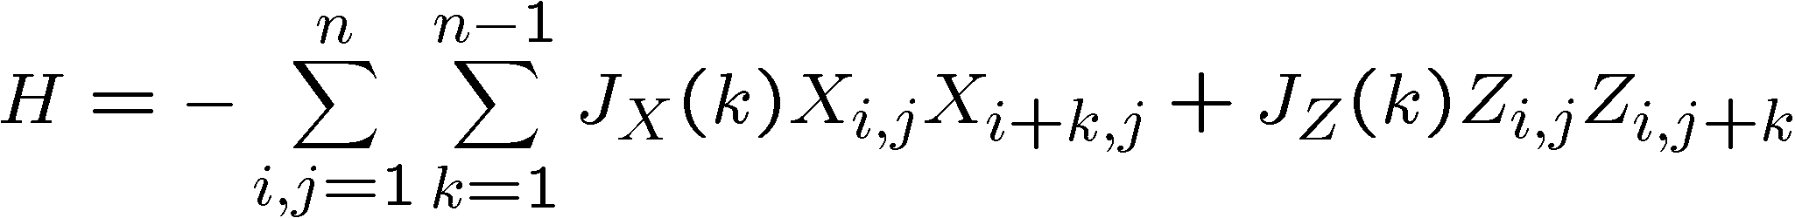
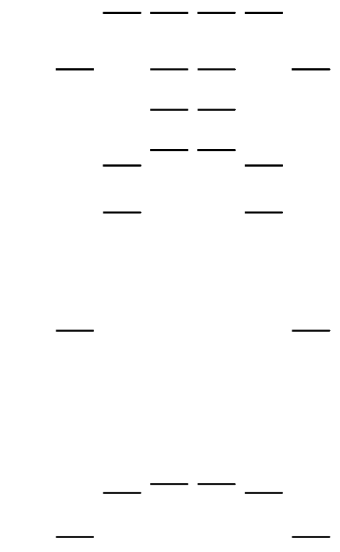
Mountains into Molehills
Long range quantum compass model
energy
Low energy spectrum for L=4,
uniform coupling strength
“Self-correcting”
Bacon 06, in preparation

Slide 32
Into The Third Dimension

Slide 33
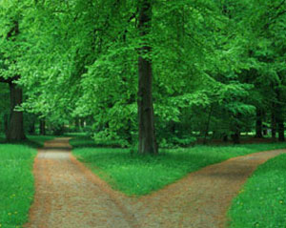

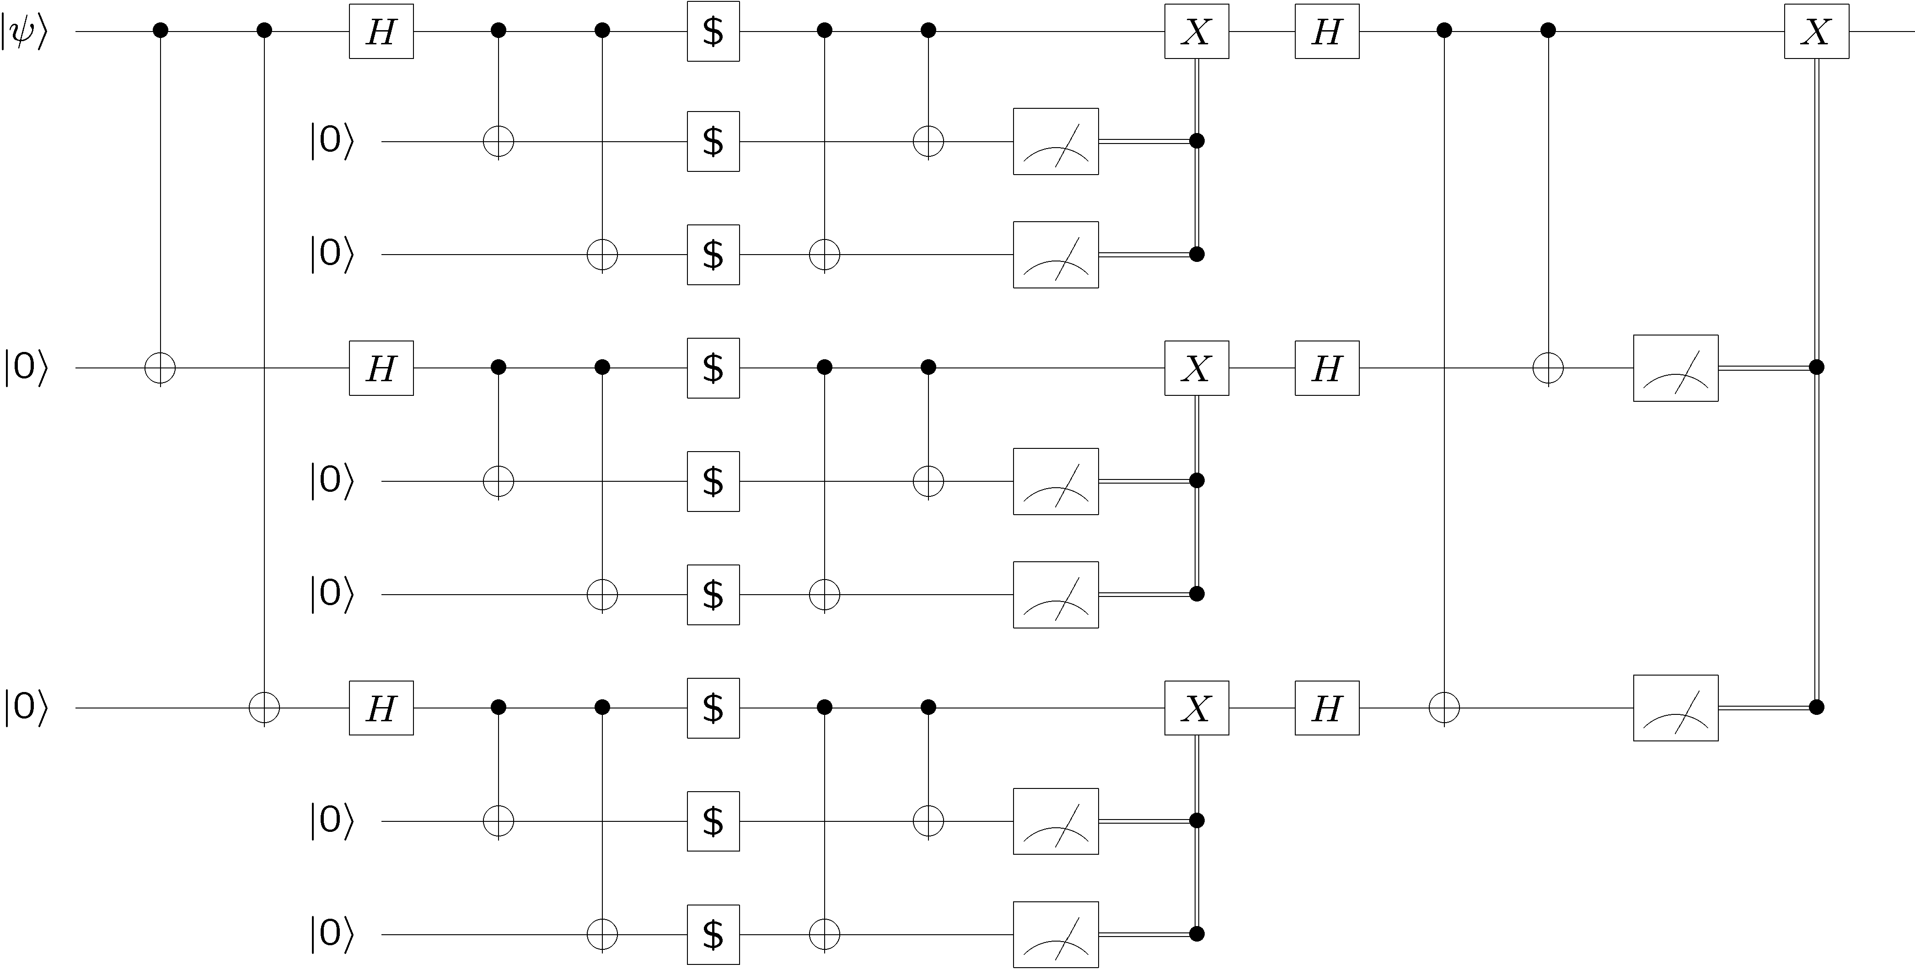
Towards Robust Qubits
Wire many faulty
qubits together into a fault-tolerant scheme
Engineer physical systems whose physics enacts error correction
free energy
Relative number
of errors

