Slide 1
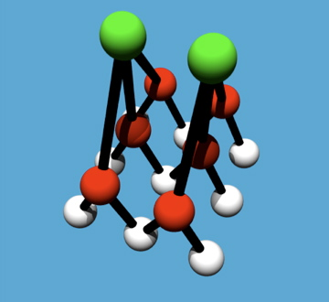
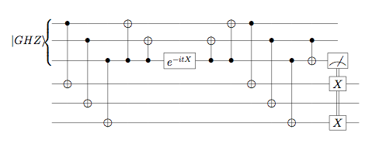
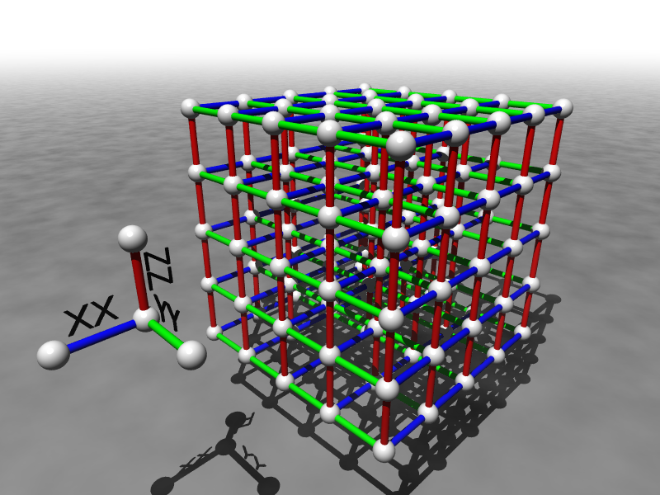
Robust Quantum Gadgets
Dave Bacon
Department of Computer Science & Engineering
Department of Physics
University of Washington
“Jump starting a new path to robust quantum devices”
slide 1, D. Bacon, “Robust Quantum Gadgets”

Slide 2
Self-Correcting Quantum Computers
traditional roadmap to quantum computers
self-correcting quantum computers
many-body engineered quantum system
quantum error correction is performed by keeping the system below a threshold temperature
low device complexity
complex quantum error correcting protocols
low threshold rates
high device complexity
not fundamentally tied to thermodynamics of error correction
BUT : are these methods achievable
with realistic assumptions and with todays technology? (This Project)
slide 2, D. Bacon, “Robust Quantum Gadgets”

Slide 3

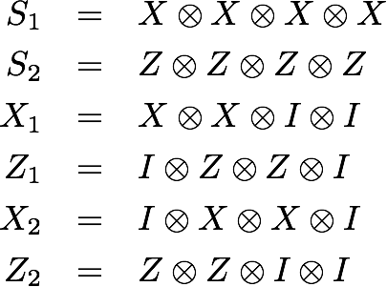
Subsystem Stabilizer Hamiltonians
few examples of energy stabilized quantum systems with realistic two qubit interactions are all subsystem code constructions
TASK: systematic analytic and numeric study of subsystem code Hamiltonians generated by 2-local interactions
ZZ
XX
XX
ZZ
POSITIVE RESULT: few qubit systems suitable for implementing basic self-correction in ten to twenty qubit systems.
subsystem code
stabilizer
gauge
SYNERGY: PI identified first nontrivial subsystem codes and developed original notion of “supercoherent” qubits
logical
slide 3, D. Bacon, “Robust Quantum Gadgets”

Slide 4



Robust Perturbation Theory Gadgets
TASK: development of new perturbation theory gadgets for implementing stabilizer Hamiltonians with greater than two qubit interactions and making them fault-tolerant
POSITIVE RESULT: methods for engineering strongly interacting quantum systems with quantum error correcting order parameters
SYNERGY: PI and physics graduate student have implemented matrix product state-like methods for simulation of hundred qubit quantum systems.
slide 4, D. Bacon, “Robust Quantum Gadgets”

Slide 5
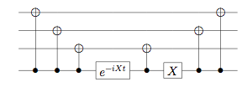
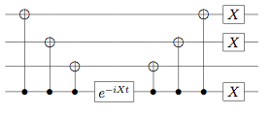
Bang-Bang Simulation of Stabilizer Hamiltonians
not fault-tolerant:
TASK: develop fault-tolerant bang-bang simulation techniques for trotter simulation of stabilizer Hamiltonians
POSITIVE RESULT: render simulation techniques suitable for self-correcting quantum computation
fault-tolerant:
SYNERGY: PI has background in fault-tolerant quantum computation as well as in quantum simulation techniques
slide 5, D. Bacon, “Robust Quantum Gadgets”

