Slide 1

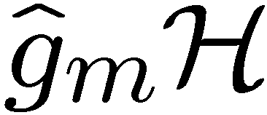
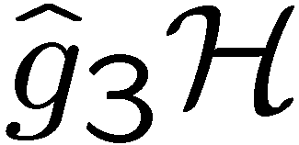
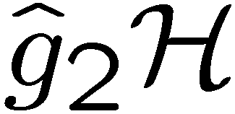
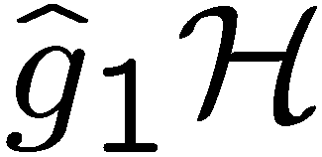



The Hidden Subgroup Conjugacy Problem and Beyond
Dave Bacon
University of Washington
Program Review, Atlanta, GA
August 2008
funded by
Grant W911NSF-06-1-0379:

Slide 2
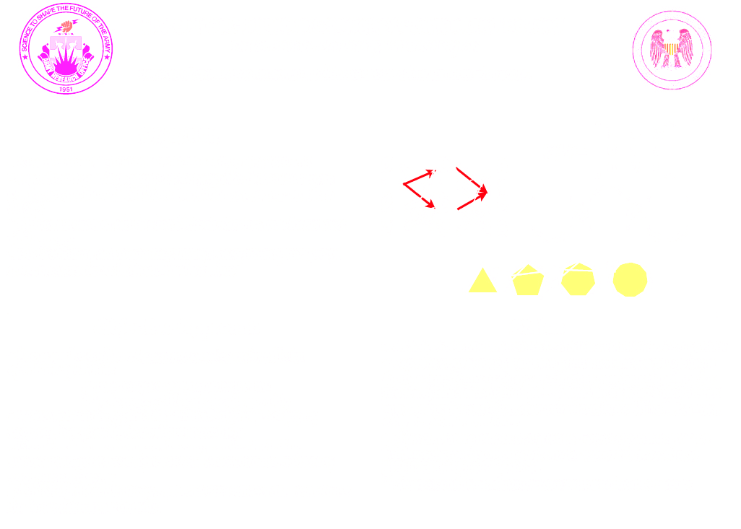
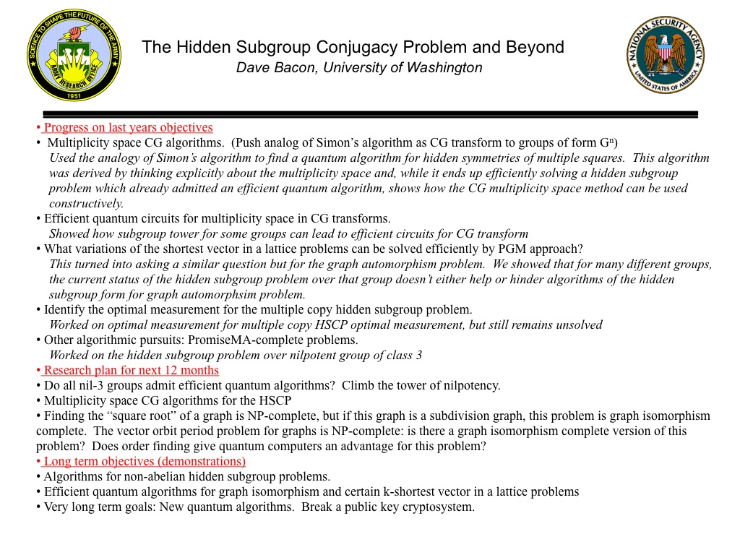
This Year’s Main Points of Progress
Clebsch-Gordan derivations of efficient quantum algorithms
Can any of the efficient quantum algorithms for the non-Abelian hidden subgroup problem be used for Graph Isomorphism?

Slide 3

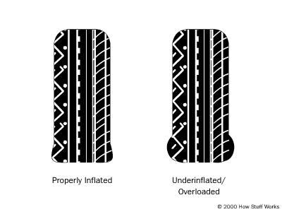
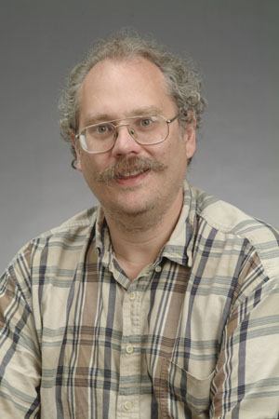
The Power Question
Where does the power of quantum algorithms come from?
offshore
oil drilling?
properly inflated
tires?
Peter Shor’s
brain!
(vote the Quantum Party ticket
or at least allow off-Shor drilling?)

Slide 4
The Real Question:
Where does the power of quantum algorithms come from?
Where does the power of classical algorithms come from?
Why are quantum algorithms sometimes exponentially more efficient than classical algorithms?

Slide 5
The Symmetry Conjecture
Quantum computers exponentially outperform classical computers because groups admit unitary representations

Slide 6
An Example
Two probability distributions p and q over {1,2,..2N}
Both are evenly distributed over subset size N
  p equals q
  p is complement of q
Problem: distinguish two cases
Classically: Ω(N^{1/2}) copies of this distribution needed

Slide 7
An Example
Two amplitude distributions p and q over {1,2,..2N}
Both are evenly distributed over subset size N
  p equals q
  p is complement of q
Problem: distinguish two cases
Quantum: O(1) copies of distribution needed

Slide 8








Swap Test
H
SWAP
if
if
What’s this got to do with symmetry?

Slide 9



Symmetry
SWAP
Under unitary basis change this becomes
Classical probabilistic transforms are stochastic and
cannot perform this basis change.

Slide 10
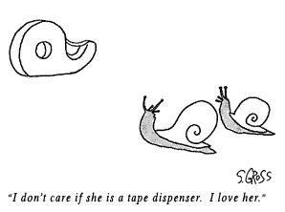
Cognitive Dissonance
Parts of exponentially faster quantum algorithms which don’t seem to be exploiting symmetry.

Slide 11







Simon’s Algorithm
Given:
such that
iff
or
Problem: Find
Quantum algorithm:
1. Query function and produce
2. Perform Hadamard transform on qubits
3. Measure state and produce random s.t.
4. Repeat 1-3 times and use Gaussian elimination to identify

Slide 12








Simon’s Algorithm Symmetry
Hidden subgroup state:
Symmetry:
Schur’s lemma: diagonal in basis of irreps of
Symmetry ⇒ apply Hadamard transform
trivial irrep
⇒
alternating irrep

Slide 13
Cognitive Dissonance
But what about the Gaussian elimination part of Simon’s algorithm? Symmetry?

Slide 14

The Hidden Subgroup Problem
Given: a function , from a group , to a set , which is constant and distinct on left cosets of a hidden subgroup .
Problem: identify by querying
Problem size:

Slide 15

Reminder
Shor’s algorithm uses an efficient algorithm for the Abelian HSP
Efficient algorithm for HSP over Sn would yield an efficient algorithm for graph isomorphism
Efficient algorithm for HSP over dihedral group would yield an efficient algorithm for certain unique shortest vector in a lattice problems (Regev)

Slide 16


The Hidden Subgroup Conjugacy Problem
Given: a function , from a group , to a set , which is constant and distinct on left cosets of a hidden subgroup .
Problem: identify by querying
Problem size:

Slide 17




Symmetries
Hidden subgroup state
Symmetry
Transform
QFT over
Hidden subgroup
conjugacy states
Symmetry
Transform
Clebsch-
Gordan
transform over

Slide 18








Clebsch-Gordan Transform
new irrep label
CG
multiplicity
irrep space

Slide 19
Clebsch-Gordan Symmetry
QFT
QFT
CG
CG
QFT
CG
QFT
coherent information about HSCP
output:
classical information
no HSCP info
[Bacon, Quantum Inf. and Comp., 8, 438-467 (2008)]

Slide 20


Previously
The efficient quantum algorithm for the HSP over the Heisenberg group can be partly understood using Clebsch-Gordan transforms over the Heisenberg group
[Bacon, Quantum Inf. and Comp., 8, 438-467 (2008)]

Slide 21


Simon’s Algorithm Symmetry
Symmetry ⇒ apply Hadamard transform
trivial irrep
⇒
alternating irrep
Abelian group CG:
CG :
Gaussian elimination stage
is nothing more than
a Clebsch-Gordan seive

Slide 22


Generalized Simon’s Problem
arXiv:quant-ph/0603251:
“Quantum Algorithms for Simon's Problem Over General Groups” by Alagic, Moore, and Russell
Subexponential time algorithms for finding hidden
involution ( ) over .
Uses Clebsch-Gordan sieving on irreps.
But we know groups for which admits efficient
quantum algortihms. Do CG sieves work for them?

Slide 23

Hidden Symmetries of Multiple Squares
Hidden Subgroup Problem for with subgroups of order 2 which contain a reflection
is smoothly solvable (derived series is of constant
length and bounded exponent) and so efficient algo in:
arXiv:quant-ph/0211091
“Hidden Translation and Orbit Coset in Quantum Computing” Friedl, Ivanyos, Magniez, Santha, and Sen

Slide 24




Symmetries of a Square
representations:
reducible:
Clebsch-Gordan series:

Slide 25



Symmetries of a Square
Hidden subgroup state (hides l):
Irrep 2 can be used to find parity information about l
0
1
2
3
0
1
2
3
0
1
2
3
We can use Clebsch-Gordan transform
to distill out 0 or 2 irreps from non 0/2 irreps
Parity information solve HSCP. To solve HSP compute
extra function when querying HSP.

Slide 26



Symmetries of a Squares
Must run same algorithm in parallel
hidden involution:
Three steps
Determine
Determine parity of
Determine
All three steps use Clebsch-Gordan transforms
D. Bacon, arXiv:0808.0174

Slide 27
Moral
We already knew this group admitted an efficient
quantum algorithm. Now we understand it in terms of
Clebsch-Gordan transforms

Slide 28
Graph Automorphism
Given: a graph
Problem: Does there exist a nontrivial subgroup of the symmetric group acting on the vertices of
which preserves the graph’s edge structure?
(at least as hard as graph isomorphism)

Slide 29


Sn HSP and Graph Automorphism
Hidden subgroup problem on symmetric group
function:
adjacency matrix of graph
Problem: decide if hidden subgroup is non-trivial

Slide 30
HSP and Graph Automorphism
There are now numerous efficient quantum algorithms for
non-Abelian HSPs.
HSPs which admit efficient quantum algorithms:
almost abelian groups near Hamiltonian groups normal subgroups small commutator subgroup solvable groups of bounded exponent and of bounded derived series groups of nilpotency class at most 2 (including extraspecial groups)
groups with an Elementary Abelian Normal 2-Subgroup of Small Index
Are any of these useful for Graph Automorphism?
work with Will Johnson (UW)

Slide 31
HSP and Graph Automorphism
Some groups have hidden subgroup problem which have
widely resisted efficient quantum algorithms.
Dihedral group
Certain Metacyclic groups
Are any of these useful for Graph Automorphism?

Slide 32




Dihedral Group into Sn
Efficient permutation representation of some dihedral groups
Represented as permutation representation in
but size of group is

Slide 33

Dihedral HSP and GA
Suppose we had efficient algorithm for HSP over dihedral
group, could this be used to solve (restricted) graph automorphism problems?
Given: Graph and action of dihedral group on
specified by two generators.
Problem: Find

Slide 34




Dihedral HSP and GA
Partition into orbits
For each (including )
Find subgroup of local group which acts as automorphism
Lift to original dihedral group and add to running list of subgroups
Take intersection of list of subgroups
When efficient embedding into permutation group exists the above classical algorithm solves this restricted GA

Slide 35

Normal Subgroups?
There exist efficient quantum algorithms for solving HSP when subgroups are normal. Useful?
If then there is an efficient classical
algorithm which finds
We can show: Normal subgroup HS algorithm not useful for GA (we can determine normal core)

Slide 36


Plethora Not Useful
Given: Graph and permutation group
Use efficient quantum algorithm over to
find ?
HSPs which admit efficient quantum algorithms:
almost abelian groups near Hamiltonian groups normal subgroups small commutator subgroup solvable groups of bounded exponent and of bounded derived series groups of nilpotency class at most 2 (including extraspecial groups)
groups with an Elementary Abelian Normal 2-Subgroup of Small Index

Slide 37


Failures
Optimal measurement for the multicopy HSP: plan to work on optimal measurement for HSCP
No grip on the multiplicity of the symmetric group irreps: plan to work on HSP over

Slide 38

Future
Finding the “square root” of a graph is NP-complete, but if this graph is a subdivision graph, this problem is graph isomorphism complete. The vector orbit period problem for graphs is NP-complete: is there a graph isomorphism complete version of this problem? Does order finding give quantum computers an advantage for this problem?
Climb the tower of nilpotency: can we solve HSP over 3-nil groups (note that Bacon, Childs, van Dam already solved one such group and recent 2-nil algorithm is similar in spirit to Heisenberg HSP)
Algorithms for HSP for multiplicity > 1 Clebsch-Gordan series groups

Slide 39

Hidden symmetries of multiple squares
Current efficient non-Abelian hidden subgroup problem algorithms are not useful for Graph Automorphism?
funded by
Grant W911NSF-06-1-0379:

Slide 40
Flow Chart
Optimal single copy HSP measurement
Clebsch-Gordan transform used in efficient algorithm for HSP
Clebsch-Gordan circuits, multiplicity free-case
Optimal multi-copy
HSCP measurement
Clebsch-Gordan symmetry for dihedral group
Clebsch-Gordan circuits multiplicity>1 case
Optimal multi-copy
HSP measurement
Clebsch-Gordan symmetry for symmetric group
Clebsch-Gordan algorithms for A5^{n}
Optimal measurements in shortest vector in lattice problems
Clesbsch-Gordan seives for a solved non-Abelian Simon’s problem
Efficient quantum algorithm for HPFGP
Novel approaches to Graph Isomorphism: Square root of graph
Reverse engineering HSPs with efficient quantum algorithms
HSP for the chandelier group
Efficient quantum algorithms for Graph isomorphism
Uselessness of current efficient quantum HSP algorithms for graph automorphism
Completed, submitted, or Published
In progress
Future Program

Slide 41


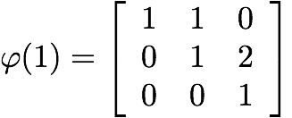
The Hidden Subgroup Conjugacy Problem and Beyond
Dave Bacon, University of Washington
dabacon@cs.washington.edu / http://abstract.cs.washington.edu/~dabacon/
Objective
New quantum algorithms for hidden subgroup problems
Understanding the relationship between the hidden subgroup conjugacy problem (HSCP) and the hidden subgroup problem (HSP)
Efficient quantum circuits for Clebsch-Gordan transforms over finite groups
Understanding and exploiting the role of symmetry and pretty good measurements in quantum algorithms
0
1
2
3
0
1
2
3
0
1
2
3
Objective Approach
Status
Focus on the double role symmetry takes on in efficient quantum algorithms
1st role makes query complexity low
2nd role makes efficient circuits possible
Work with “more symmetric” hidden subgroup conjugacy problem instead of hidden subgroup problem
Use of techniques from previous approaches including subgroup adapted basis, generalized Kitaev circuits, and pretty good measurements
Exploiting the multiplicity space of Clebsch-Gordan transforms for new quantum algorithms
A Clebsch-Gordan transform is hidden within Simon’s algorithm
Used the above insight, and the multiplicity space of Clebsch-Gordan transforms to derive an efficient quantum algorithm for hidden symmetries of multiple squares, thus giving a new insight into the previous efficient quantum algorithm of Friedl, Ivanyos, Magniez, Santha, and Sen
Showed that a plethora of current efficient algorithms for the hidden subgroup problem don’t make a dent in the restricted graph automorphism problem
Progress on the hidden subgroup problem for nil-3 groups

Slide 42
The Hidden Subgroup Conjugacy Problem and Beyond
Dave Bacon, University of Washington
Progress on last years objectives
Multiplicity space CG algorithms. (Push analog of Simon’s algorithm as CG transform to groups of form G^{n})
Used the analogy of Simon’s algorithm to find a quantum algorithm for hidden symmetries of multiple squares. This algorithm was derived by thinking explicitly about the multiplicity space and, while it ends up efficiently solving a hidden subgroup problem which already admitted an efficient quantum algorithm, shows how the CG multiplicity space method can be used constructively.
Efficient quantum circuits for multiplicity space in CG transforms.
Showed how subgroup tower for some groups can lead to efficient circuits for CG transform
What variations of the shortest vector in a lattice problems can be solved efficiently by PGM approach?
This turned into asking a similar question but for the graph automorphism problem. We showed that for many different groups, the current status of the hidden subgroup problem over that group doesn’t either help or hinder algorithms of the hidden subgroup form for graph automorphsim problem.
Identify the optimal measurement for the multiple copy hidden subgroup problem.
Worked on optimal measurement for multiple copy HSCP optimal measurement, but still remains unsolved
Other algorithmic pursuits: PromiseMA-complete problems.
Worked on the hidden subgroup problem over nilpotent group of class 3
Research plan for next 12 months
Do all nil-3 groups admit efficient quantum algorithms? Climb the tower of nilpotency.
Multiplicity space CG algorithms for the HSCP
Finding the “square root” of a graph is NP-complete, but if this graph is a subdivision graph, this problem is graph isomorphism complete. The vector orbit period problem for graphs is NP-complete: is there a graph isomorphism complete version of this problem? Does order finding give quantum computers an advantage for this problem?
Long term objectives (demonstrations)
Algorithms for non-abelian hidden subgroup problems.
Efficient quantum algorithms for graph isomorphism and certain k-shortest vector in a lattice problems
Very long term goals: New quantum algorithms. Break a public key cryptosystem.

