Slide 1
Test Slide
SAT
MCAT
GRE
LSAT

Slide 2
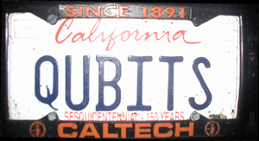
Quantum Computing
Dave Bacon
University of Washington

Slide 3
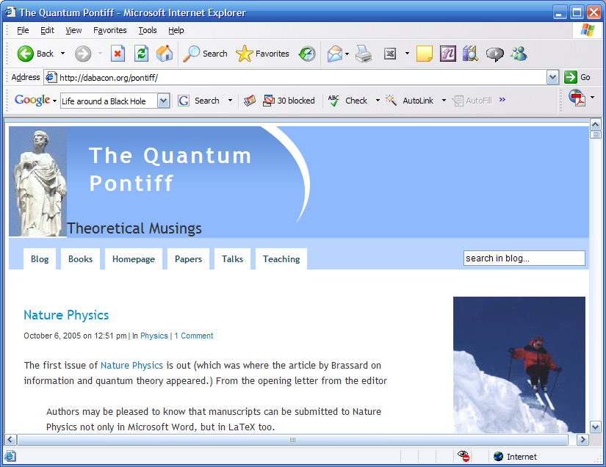
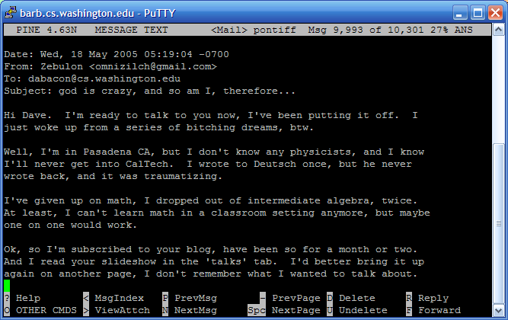
Quantum Pontiff Email

Slide 4
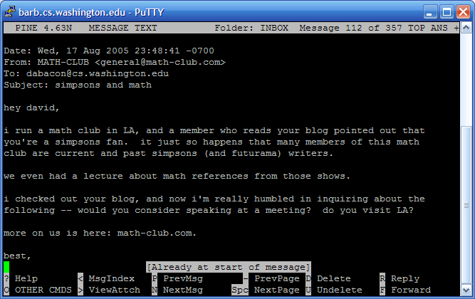
Whah?

Slide 5
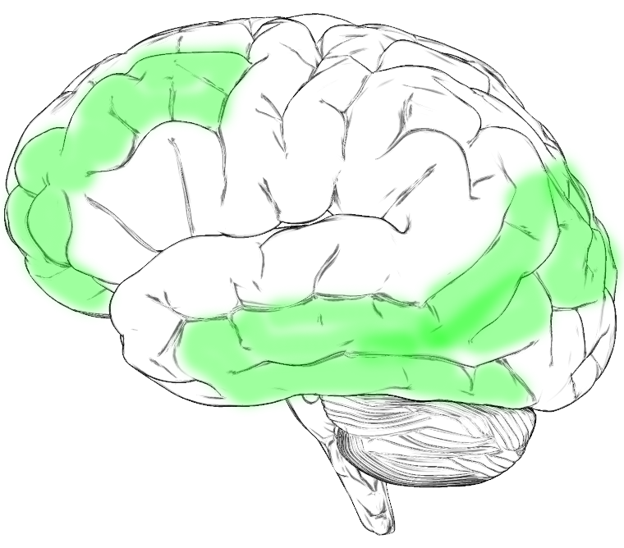
“Whah?” Continued
Simpsons
Dave’s Brain

Slide 6
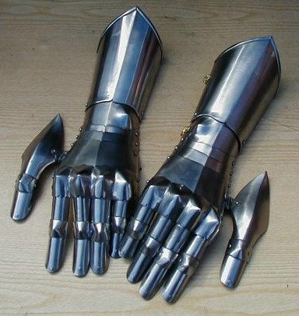
A Challenge
18819881292060796383869723
94616504398071635633794173
82700763356422988859715234
66548531906060650474304531
73880113033967161996923212
05734031879550656996221305
168759307650257059

Slide 7
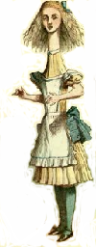

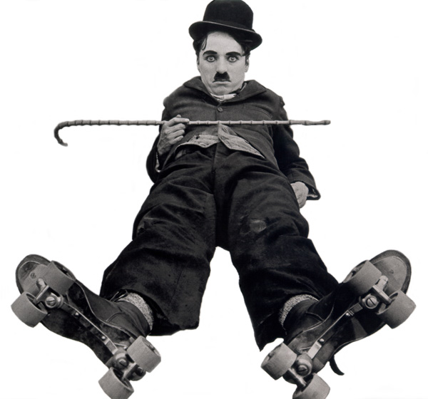
A Game
Alice
Bob
Charlie

Slide 8

An Evil Game
Alice
Bob
Charlie
X
Y
1. Each given slip or
2. At midnight each party shouts
“+1” or “-1”

Slide 9
Winning the Game
Winning
Product
Alice
Bob
Charlie
X
X
X
+1
X
Y
Y
-1
Y
Y
X
-1
Y
X
Y
-1

Slide 10
A Game
Alice
Bob
Charlie
A_{X}
B_{X}
C_{X}
A_{Y}
B_{Y}
C_{Y}
All either +1 or -1

Slide 11
A Game
Alice
Charlie
Product
Bob
X
X
X
A_{X}B_{X}C_{X}
X
Y
Y
A_{X}B_{Y}C_{Y}
Y
Y
X
A_{Y}B_{Y}C_{X}
Y
A_{Y}B_{X}C_{Y}
Y
X

Slide 12
Winners?
Assuming winning strategy:
A_{X}B_{X}C_{X} = +1
A_{X}B_{Y}C_{Y} = -1
A_{Y}B_{Y}C_{X} = -1
A_{Y}B_{X}C_{Y} = -1
Multiply equations….contradiction!
LHS: A_{X}²A_{Y}²B_{x}²B_{Y}²C_{x}²C_{Y}²=+1
RHS: -1

Slide 13
Losers
Alice
Bob
Charlie
There is no strategy to win the game

Slide 14
In the Real World
Alice
Bob
Charlie
This is wrong, there is a way to win
Quantum Theory

Slide 15
Welcome to the
Wonderfully Wacky World
Of Quantum Theory
Please Check Your Notion of Reality at the Door

Slide 16
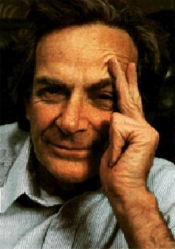
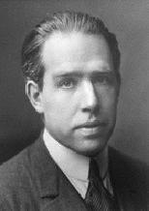
Quantum Propaganda
I think I can safely say that
nobody understands
quantum mechanics.
Richard Feynman
Nobel Prize (1965)
Anyone who is not shocked
by quantum theory has not
understood it.
Niels Bohr
Nobel Prize (1922)

Slide 17
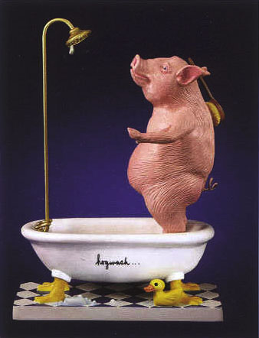

Slide 18
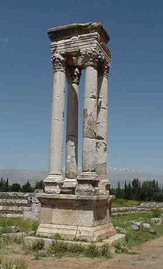
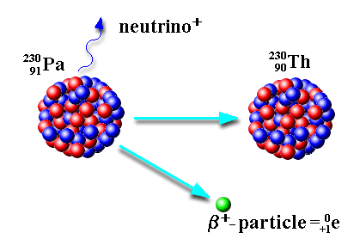
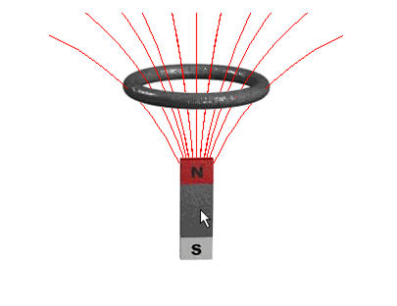
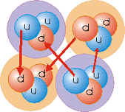
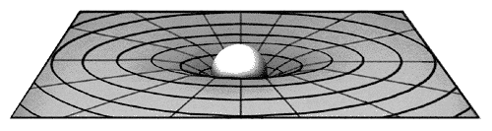
What is Quantum Theory?
Electromagnetic
Force
Weak
Force
Strong
Force
Gravitational
Force (?!?!)
Quantum Theory
Physic’s “computer language”

Slide 19
Where is Quantum Theolry?
Quantum
Classical
large
small
roughly size

Slide 20
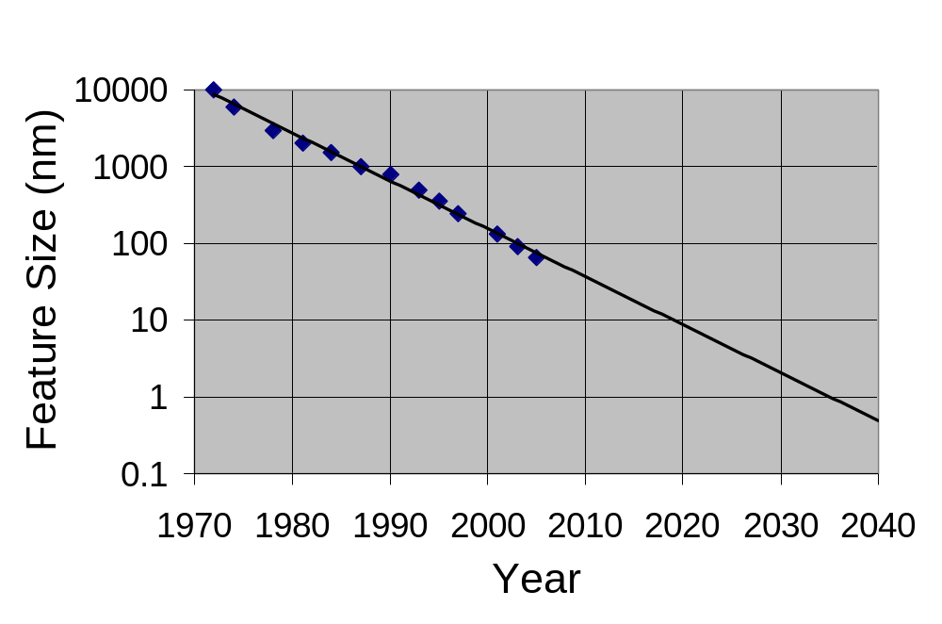
Moore’s Law
Computer Chip Feature Size versus Time
Eukaryotic cells
Mitochondria
AIDS virus
Amino acids
Quantum
Theory
“Prediction is very difficult,
especially if it's about the future.”
Niels Bohr

Slide 21
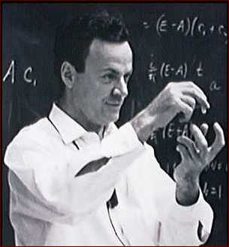
A Worrying Physicist
2040 is a long time in the future….so why worry?
Observations
Richard Feynman
No efficient computer simulations of
quantum theory
2. Systems evolving according to quantum
theory efficiently compute properties of the
quantum system (that’s what experiments are!)
“How can we simulate quantum mechanics?...
Can we do it with a new kind of computer…a
quantum computer? It’s not a Turing machine
but a machine of a different kind” (1981)

Slide 22
Quantum Theory Made Easy
Classical
Quantum
probabilities
amplitudes
p₀
a₀
0
0
p₁
a₁
1
1
p_{i} is a real number
a_{i} is a complex number
p₀+p₁=1
|a₀|²+|a₁|² =1
Prob(i)=p_{i}
Prob(i)=|a_{i}|²
bit
qubit

Slide 23
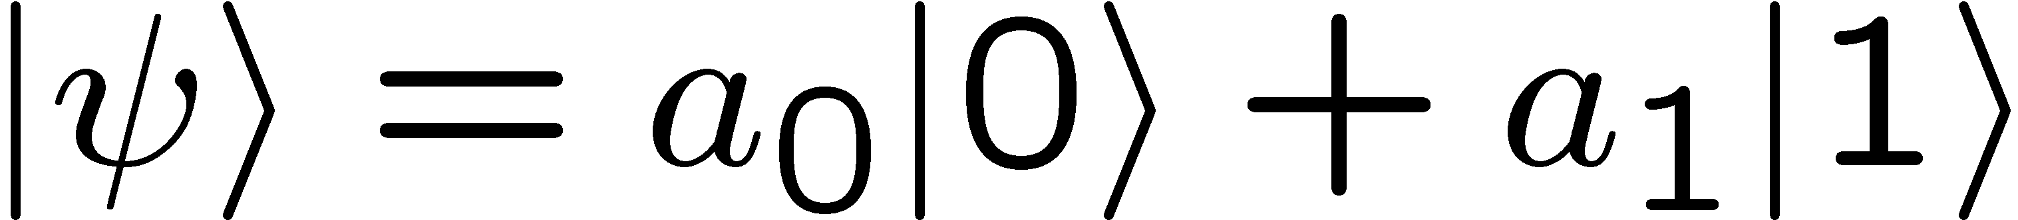


Superposition
Qubits
amplitudes
a₀
0
1
a₁
a_{i} is a complex number
Schrödinger’s Cat
(| ⟩ + | ⟩)
1
√2

Slide 24
Commercial Philosophy Break
Dead or Alive?
(| ⟩ + | ⟩)
1
√2
Dr. Thurman: Do you feel alone right now?
Donnie Darko: I don’t know. I mean I’d like to believe I’m not, but I just… I’ve just never seen any proof so I… just don’t debate it any more it’s like I could spend my whole life debating it over and over again, weighing the pros and cons, and in the end I still wouldn’t have any proof. So I just, I just don’t debate it any more. <laughs> It’s absurd. The search for God is absurd.

Slide 25







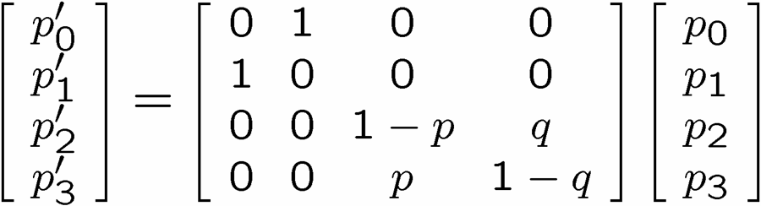
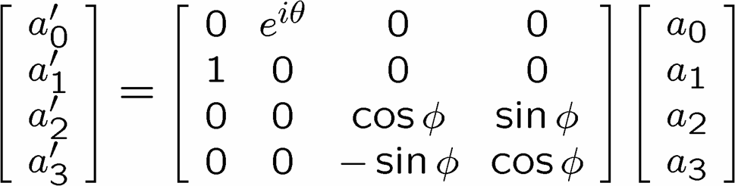
Quantum Theory Made Easy
Classical Evolution
Quantum Evolution
0
0
0
0
0
0
0
0
0
1
0
1
0
1
0
1
1
0
1
0
1
0
1
0
1
1
1
1
1
1
1
1
transition probabilities
transition amplitudes
stochastic matrix
unitary matrix

Slide 26

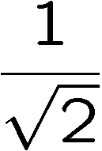
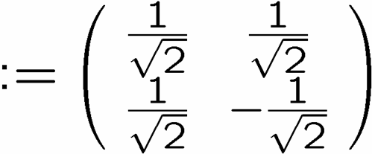

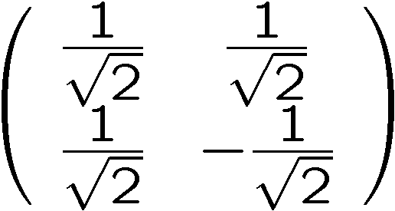
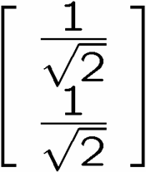
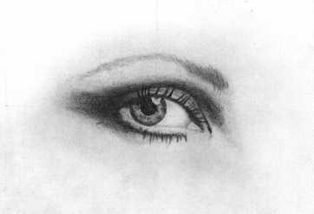
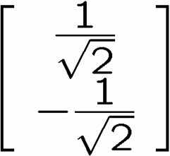
Interference
0
0
1
1
qubit
input
0
50%
100%
1
50%
0%
measure
0
50%
0%
1
50%
100%
measure

Slide 27
Interfering Pathways
100% H
1.0 H
50%
50%
0.707
0.707
50% H
50% C
0.707 H
0.707
0.707 C
90%
10%
0.707
0.707
80%
20%
-0.707
85% C
0.0 H
1.0 C
15% H
Always addition!
Subtraction!
Classical
Quantum

Slide 28
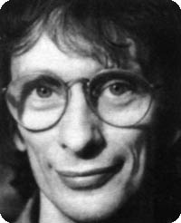
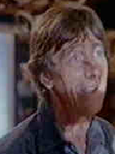








Deutsch’s Problem
output
David Deutsch
Dr. Falcon
controlled-NOT
+ NOT 2nd bit
“identity”
NOT 2nd bit
controlled-NOT
constant
balanced
Deutsch’s Problem:
How many times do we have to use this black box to determine whether we are given the first two or the second two?

Slide 29
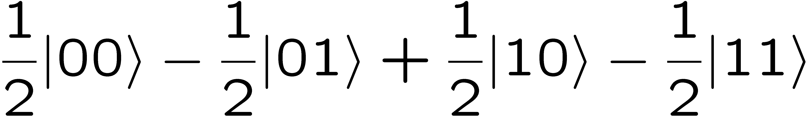
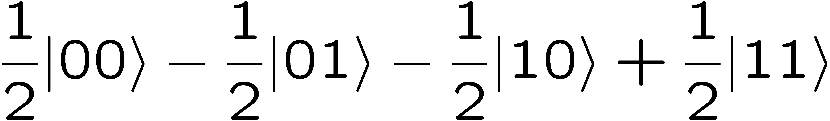
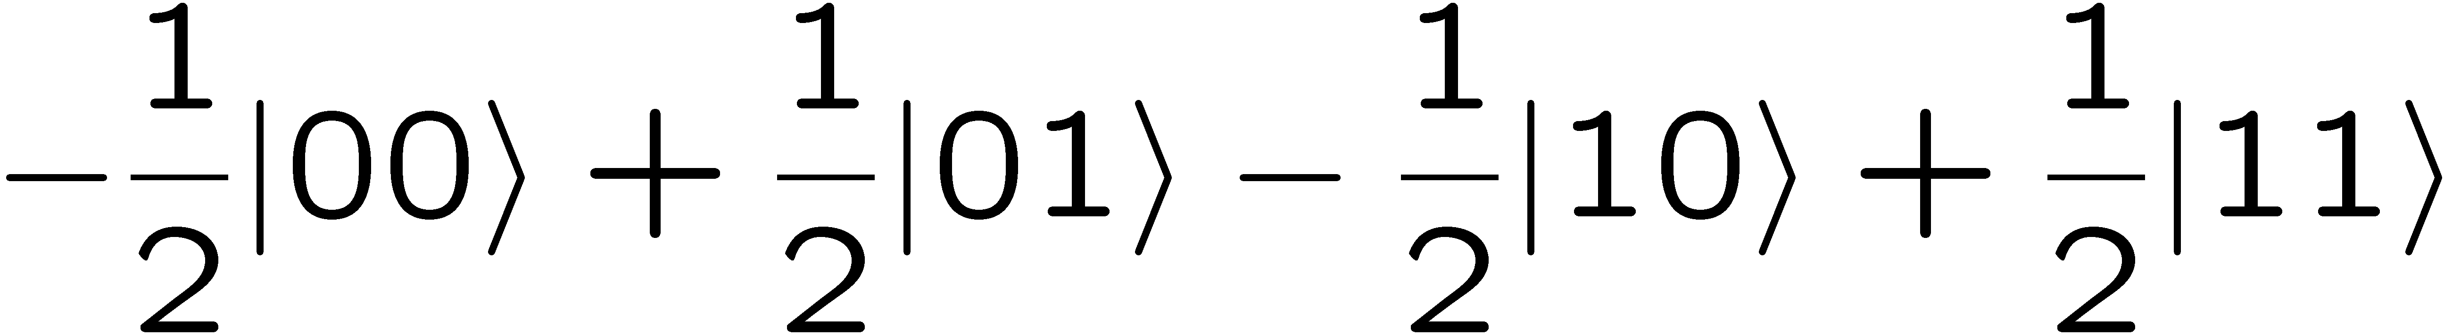
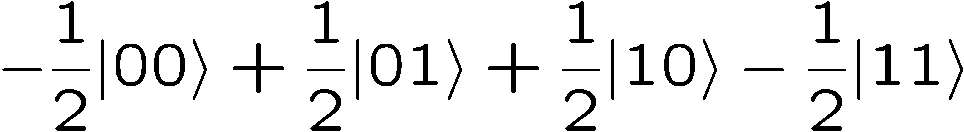
Deutsch’s Problem
controlled-NOT
+ NOT 2nd bit
“identity”
NOT 2nd bit
controlled-NOT
constant
balanced

Slide 30
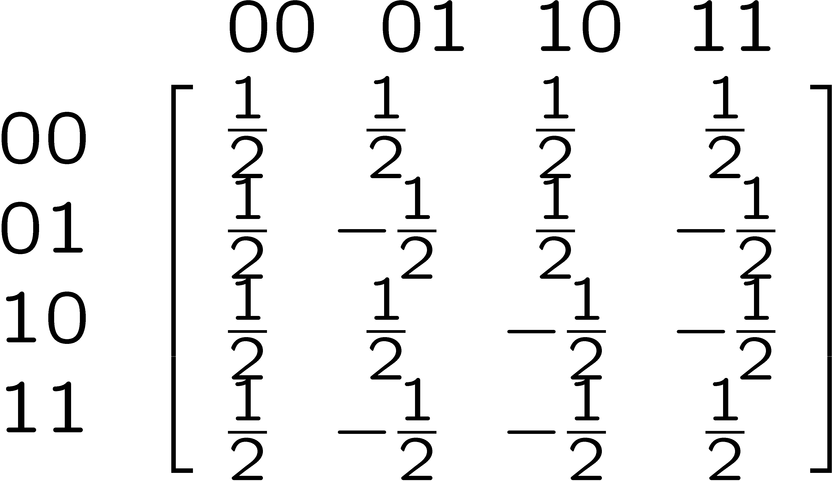
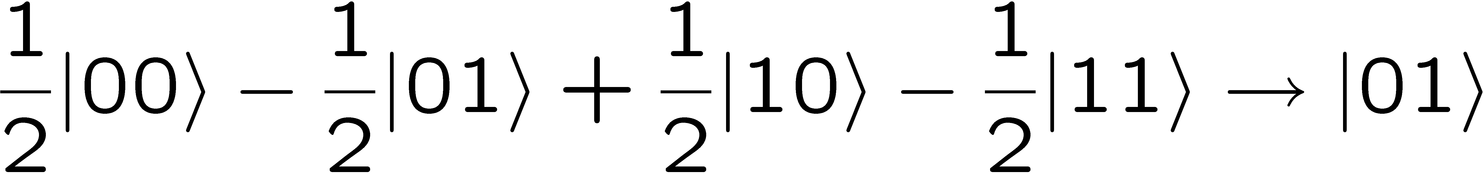
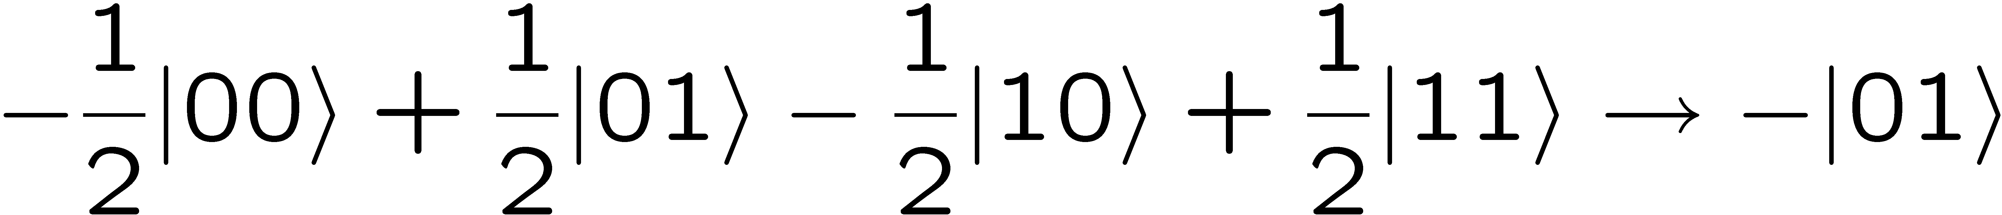
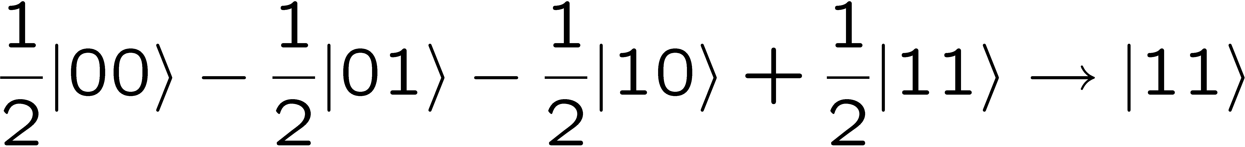
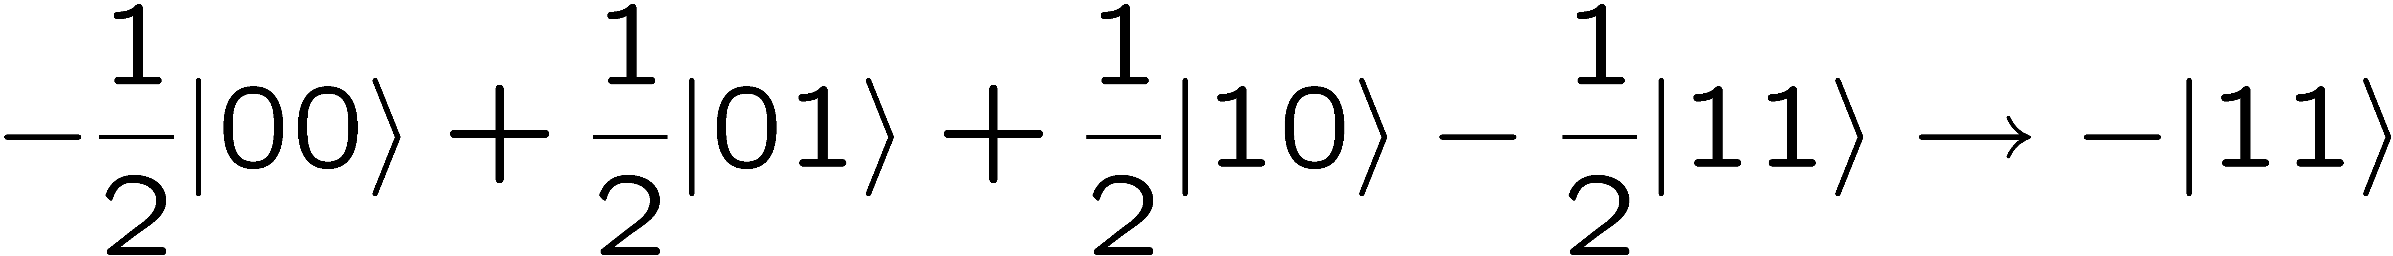
Deutsch’s Problem
constant
balanced

Slide 31
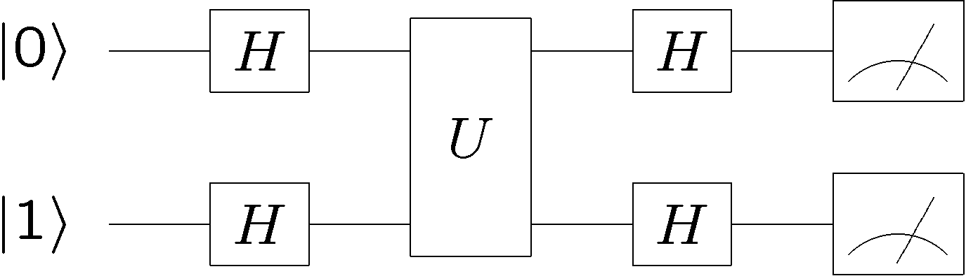
Quantum Deutsch
Classical
2 Uses
Quantum
1 Use
David Deutsch
1st Quantum Speedup
1985

Slide 32
Computational Complexity
How many basic computational
steps does a computation take?
Multiplication
152
Input: 2 n digit numbers
×
421
152
Number of operations: about n²
304
+
1008
Scales as polynomial in input size
103992

Slide 33
A Challenge
18819881292060796383869723
94616504398071635633794173
82700763356422988859715234
66548531906060650474304531
73880113033967161996923212
05734031879550656996221305
168759307650257059

Slide 34
pq
398075086424064937397125500550386491199064362342526708406385189575946388957261768583317
×
472772146107435302536223071973048224632914695302097116459852171130520711256363590397527

Slide 35
Computational Complexity
How many basic computational
steps does a computation take?
Factoring
Factoring
Input: n digit numbers
2537
Number of operations: about 10^{n/2}
divisible by 2?
divisible by 3?
Scales as exponential in input size
divisible by 5?
2537=43 × 59

Slide 36
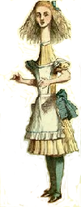

One Time Pads
Random n bit string
0010101111010001
0010101111010001
Alice
Bob
Alice’s message
0110110011100101
secret
key
secret
key
0100011100110100
Eve
0110110011100101
cannot learn message

Slide 37
Public Key Cryptography
Interesting history:
1st schemes “known in public” where put forth by
Diffie and Hellman in 1976 (key exchange) and
Rivest, Shamir and Adleman in 1978 (encryption algorithm)
(based on work by Merkle in 1974, published 1978)
However, it now appears that the British researchers working for
British intelligence (GCHQ) were actually the first to discover
these protocols, but their work was classified at the time!
Cooks in 1973 (encryption algorithm)
Williamson in ~1973 (key exchange)
(based on work by James Ellis in the late 1960s.)

Slide 38


Public Key Cryptography Roughly
Instructions for how
to make her lock.
Bob’s secret
documents
Alice
Bob
Assume: very hard to design key from instructions to make lock
This is (very roughly) what happens in public key cryptography

Slide 39








Public Key Encryption RSA
Alice
Bob
Alice generates two random large primes, and
2. Alice chooses a number which is coprime with .
3. Alice computes such that
Public Key:
Private Key:

Slide 40


Public Key Encryption: RSA
Public Key:
Alice
Bob
Public Key:
Bob’s message:
Private Key:
(FLT)
(CRT)

Slide 41
Public Key Encryption: RSA
Alice
Bob
Public Key:
Bob’s message:
Private Key:
Bob, using public key can encrypt
message.
Alice, using private key, can
decrypt the message
But decrypting without the private
key is (thought) to be
computationally hard

Slide 42



Public Key Encryption: RSA
Public Key:
Private Key:
Alice
Bob
Bob’s message:
Factoring can be used to break RSA
If we could factor, then we could compute
from which you could use to find
Then we just use the standard decryption:

Slide 43


Shocking Discoveries
Quantum computers offer superpolynomial speedups (for certain oracle promise problems) over classical computers
[Bernstein, Vazirani 1993]
Umesh Vazirani
(U.C. Berkeley)
Quantum computers offer exponential speedups (for certain oracle promise
problems) over classical computers
[Simon 1994]
Dan Simon
(Microsoft)

Slide 44
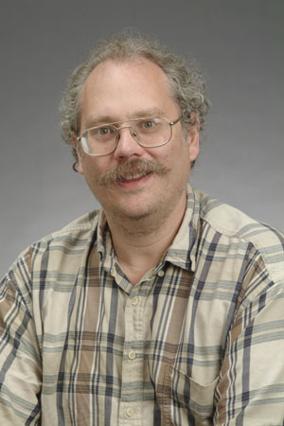


Shor’s Algorithm
18819881292060796383869723946165043
98071635633794173827007633564229888
59715234665485319060606504743045317
38801130339671619969232120573403187
9550656996221305168759307650257059
Peter
Shor
1994
3980750864240649373971
2550055038649119906436
2342526708406385189575
946388957261768583317
4727721461074353025362
2307197304822463291469
5302097116459852171130
520711256363590397527
Best classical algorithm
takes time
Shor’s quantum algorithm
takes time

Slide 45
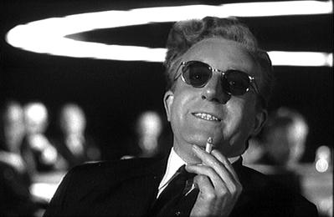
Shor’s Algorithm
Breaks RSA Cryptography!
“Only time will tell if and when the problems of building a
quantum computer can be overcome….As information
becomes the world’s most valuable commodity, the
economic, political and military fate of nations will depend
on the strength of ciphers. Consequently, the development
of a fully operational quantum computer would imperil
our personal privacy, destroy electronic commerce and demolish the concept of
national security. A quantum computer would jeopardize the stability of the world.
Whichever country gets there first will have the ability to monitor the communications
of its citizens, read the minds of its commercial rivals and eavesdrop on the plans
of its enemies. Although it is still in its infancy, quantum computing presents a
potential threat to the individual, to international business and to global security. “
-Simon Singh

Slide 46




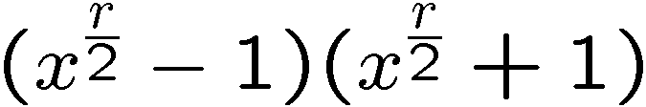
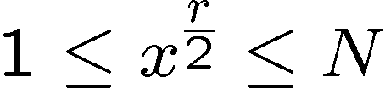

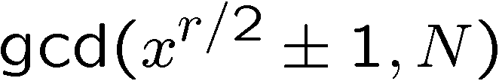
Order-Finding and Factoring
Factor N
choose x coprime to N (Euclid’s algorithm for gcd)
Order finding: find smallest r such that
Use order finding to factor: suppose is even,
divides
divides
But
must share a common factor
not equal to with
If r is even then compute as factor!
More tricky: is even happens with high probability

Slide 47
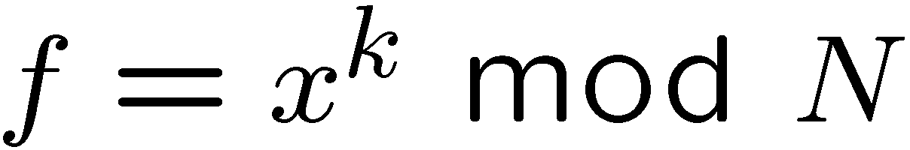



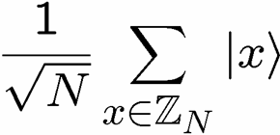



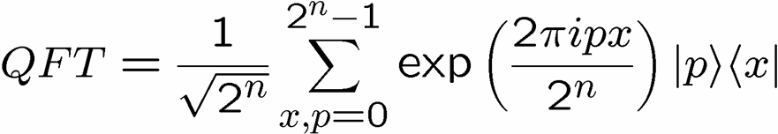
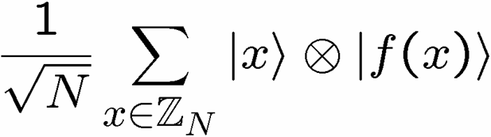
Shor’s Algorithm
Factoring can be reduced to period finding.
period=r
Anatomy of Shor’s algorithm:
Measure
and use to
determine r

Slide 48
Quantum Computers
Nature is Quantum!
The most fundamental theory of
computation must be Quantum!

Slide 49
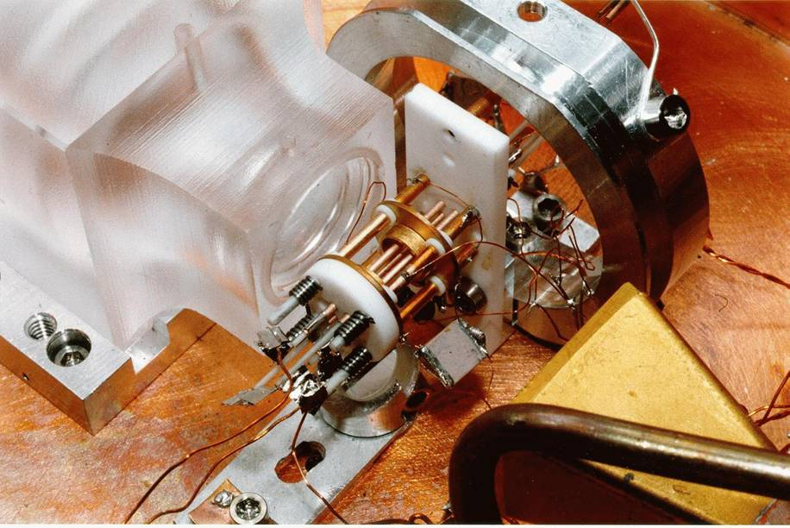


Ion Trap Quantum Computers
Oscillating electric
fields trap ions
like charges repel
2 ⁹Be⁺ Ions in an Ion Trap

Slide 50
In the Real World
Alice
Bob
Charlie
This is wrong, there is a way to win
Quantum Theory

Slide 51

GHZ State
Alice
Bob
Charlie

Slide 52


GHZ Protocol
Alice
Bob
Charlie
Each party applies:

Slide 53


GHZ Magic
Alice
Bob
Charlie
XXX
YXX
XYX
XXY

Slide 54
In the Real World
Alice
Bob
Charlie
By sharing “entangled” quantum
particles, Alice, Bob, and Charlie win!

Slide 55
Quantum Information Science
Coming age of quantum devices
Foundations should be based on
quantum theory
Ultimate physical limits to computation?

Slide 56

Fin

Slide 57


