Slide 1

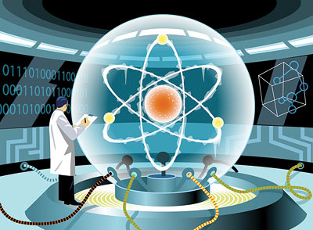
Quantum Computing
Dave Bacon
University of Washington

Slide 2
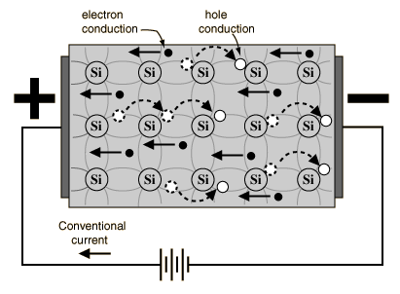
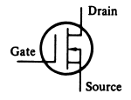
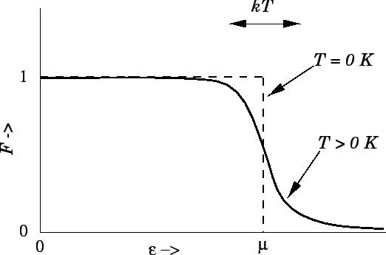

A Mystery
bits
behind the bit
How is possible?

Slide 3

Category Errors
Analog / Digital
x
vs
0
1
0.998213123....
0
Probabilistic / Deterministic
1
0.9
vs
0.4
0.1
0.6
1

Slide 4
Analog Probabilistic
Digital Deterministic
D
Analog
Voltages
Digital
Signal
bits
Probabilistic
Electrons
Deterministic
Gates
behind the bit

Slide 5
Alternative Models
Analog Computers
  Infinite precision analog computers can efficiently solve NP-complete problem
Probabilistic Computers
  Does randomness help build more efficient computers?
  Practice: of course!
  Theory: open question

Slide 6
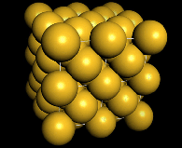
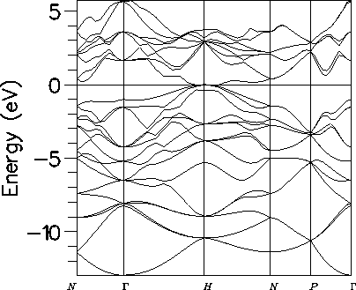
Deeper
bits
noisy bits
quantum bit
Deterministic / Probabilistic / Quantum

Slide 7
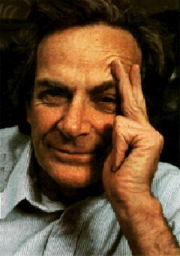
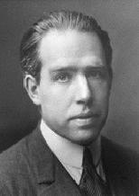
Quantum Propaganda
I think I can safely say that nobody
understands quantum mechanics.
Richard Feynman
Nobel Prize 1965
Anyone who is not shocked by quantum
theory has not understood it.
Niels Bohr
Nobel Prize 1922

Slide 8
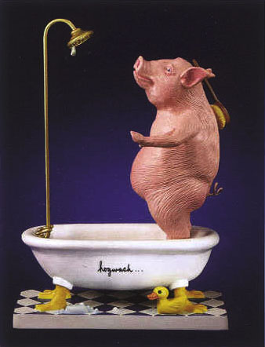
Hogwash
They understand it
They use it
But do they believe it?

Slide 9
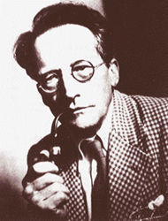
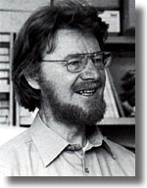
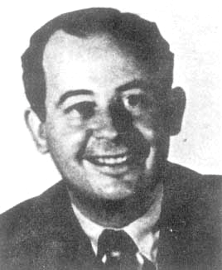
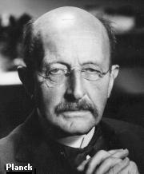
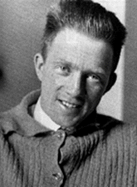
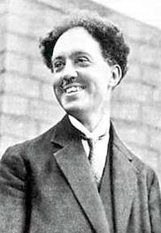
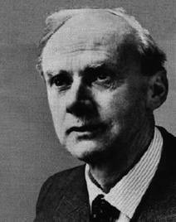
Quantum History
Inventing
Worrying
Accepting?
1900
1910
1920
1930
1940
1950
1960
1970
1980
1990
2000
Erwin Schrodinger
Niels Bohr
John Bell
John Von Neumann
Max Planck
Werner Heisenberg
Louis de Broglie
Richard Feynman
P.A.M. Dirac

Slide 10




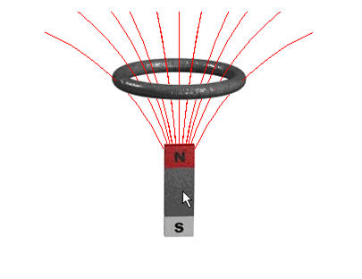
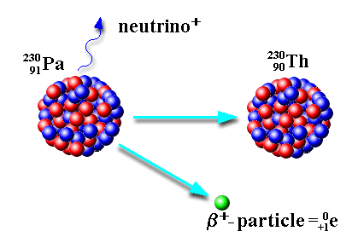
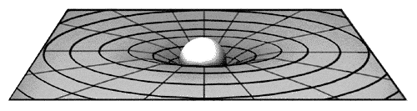
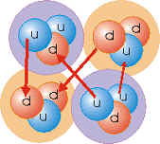
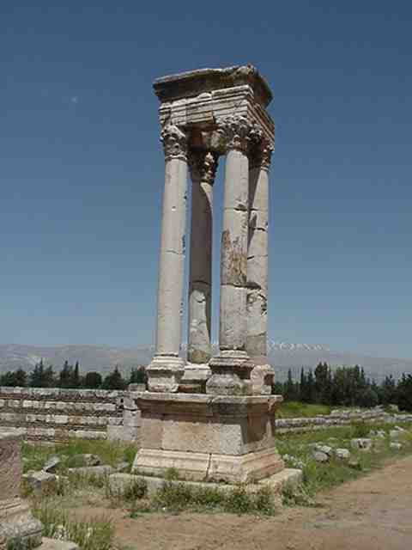
Worrying?
Electromagnetism
Strong force
Weak force
Gravity ?!?!
Quantum Theory

Slide 11
Stop Worrying and Love Quantum Theory

Slide 12
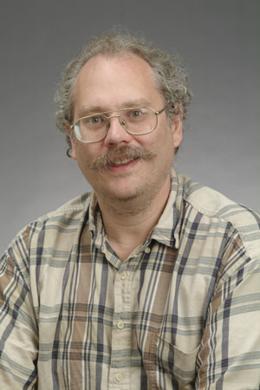
Quantum Computers
18819881292060796383869723946165043
98071635633794173827007633564229888
59715234665485319060606504743045317
38801130339671619969232120573403187
9550656996221305168759307650257059
=
3980750864240649373971
2550055038649119906436
2342526708406385189575
946388957261768583317
4727721461074353025362
2307197304822463291469
5302097116459852171130
520711256363590397527
x
Peter Shor, 1994:
Quantum computers can efficiently factor
No known classical efficient algorithm.
Breaks RSA, Diffie-Hellman cryptosystems.

Slide 13










Bits, Pbits, Qubits
bit
probabilistic bit
quantum bit
Configurations:
0
1
0
1
0
1
Description:
Observation:
0
certainty
0
p percent
0
percent
1
1-p percent
1
percent
Evolution:
deterministic
stochastic
unitary

Slide 14

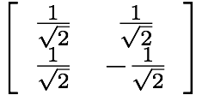



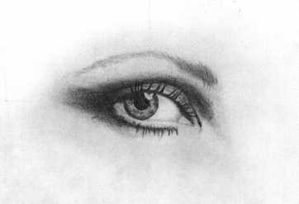

Interference
+
0
1
0
+
0
0
1
+
1
1
-
0
50%
0
100%
1
50%
1
0%
0
50%
0
0%
1
50%
1
100%
measure
evolve

Slide 15
Garden of Re-forking Paths
0.5
0.6
0.5
(0.6)(0.5)+(0.4)(0.7)=0.58
0.4
0.7
0.3
0.787
0.787
0.787
2
|(0.787)(0.787)+(-0.787) (0.787)| =0
0.787
-0.787
0.787

Slide 16
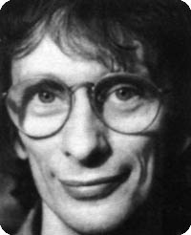
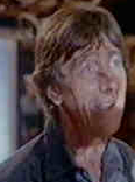




Deutsch’s Problem
David Deutsch
Dr. Falcon
constant
balanced

Slide 17









Deutsch’s Problem
constant
balanced

Slide 18







Deutsch’s Problem
=
constant
balanced

Slide 19
Deutsch’s Problem
1985
Classically: 2 queries
Quatumly: 1 query
Might the computational complexity depend on physics?

Slide 20


Beyond a Curiosity
Quantum computers offer superpolynomial query complexity speedups over classical computers [Bernstein, Vazirani 1993]
Umesh Vazirani
(Berkeley)
Quantum computers offer exponential query complexity speedups over classical computers [Simon 1994]
Dan Simon
(Microsoft)

Slide 21


Shor’s Breakthrough
18819881292060796383869723946165043
98071635633794173827007633564229888
59715234665485319060606504743045317
38801130339671619969232120573403187
9550656996221305168759307650257059
Peter Shor
=
3980750864240649373971
2550055038649119906436
2342526708406385189575
946388957261768583317
4727721461074353025362
2307197304822463291469
5302097116459852171130
520711256363590397527
x
Best classical algorithm
Shor’s quantum
algorithm

Slide 22
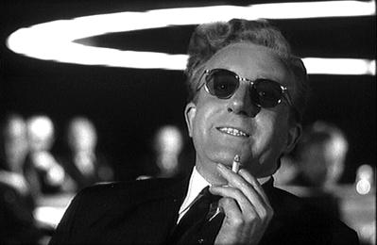
Hyperbole
Only time will tell if and when the problems of building a quantum computer can be overcome….As information becomes the world’s most valuable commodity, the economic, political and military fate of nations will depend on the strength of ciphers. Consequently, the development of a fully operational quantum computer would imperil our personal privacy, destroy electronic commerce and demolish the concept of national security. A quantum computer would jeopardize the stability of the world. Whichever country gets there first will have the ability to monitor the communications of its citizens, read the minds of its commercial rivals and eavesdrop on the plans of its enemies. Although it is still in its infancy, quantum computing presents a potential threat to the individual, to international business and to global security
- Simon Singh

Slide 23

Landscape
Quantum Entanglement
Quantum Error Correction
Experimental Quantum Computing
Quantum Information Theory
Quantum Computer Science
ion traps
quantum dots
superconducting circuits
linear optics
Quantum Cryptography
Quantum Algorithms

Slide 24


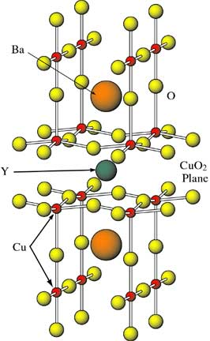
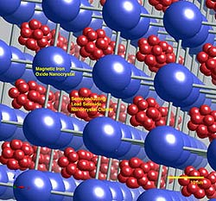
Quantum Algorithms
Exponential speedup
Polynomial speedup
Shor’s algorithm
Breaks RSA, Diffie-Helman
Only a few alternatives which are note broken by quantum computers
Grover’s algorithm
quadratic speedup in needle-in-haystack search
NAND tree algorithm
quadratic speedup in game algorithms
Amplitude amplifiction
Ubiquitous quadratic speedups
Simulation of quantum physics

Slide 25
Grover’s Algorithm
x | f(x)
0 | 0
1 | 0
2 | 0
3 | 0
4 | 1
5 | 0
6 | 0
7 | 0
By querying f, find single marked item
Classical: O(N)
Quantum: O(N^{1/2})
Sometimes erroneously called
quantum database search

Slide 26
Games
W
player 1
L
W
player 2
L
W
W
W
player 1
L
L
W
L
L
W
W
W

Slide 27
Games
or
player 1
and
and
player 2
or
or
or
or
player 1
a1
a2
a3
a4
a5
a6
a7
a8

Slide 28
AND-OR Tree Evaluation
L
L
W
L
L
W
W
W
How many leaves do you need to query to compute value of root?

Slide 29



AND-OR Tree Evaluation
Classically (alpha-beta pruning)
L
L
W
L
L
W
W
W
Quantum [Farhi, Goldstone, Gutman 2007]
L
L
W
L
L
W
W
W

Slide 30
Landscape
Quantum Entanglement
Quantum Error Correction
Experimental Quantum Computing
Quantum Information Theory
Quantum Computer Science
ion traps
quantum dots
superconducting circuits
linear optics
Quantum Cryptography
Quantum Algorithms

Slide 31
Quantum Cryptography
What quantum computing taketh away it also giveth
(sort of)
Key distribution system
can detect if eavesdropped upon
not secure to man-in-the-middle (i.e. you need some sort of authentication.)
best thought of as key amplification
  small initial key multiplied to nearly unlimited key

Slide 32








Quantum Cryptography
Alice
Bob

Slide 33



Quantum Cryptography
1. Choses random state
2. Randomly apply {I,H}
Alice
Bob
If no H, and A’s state from
bits correlated
If H, and A’s state from
bits correlated
If A reveals then random secret key

Slide 34

Quantum Cryptography
Alice
Bob
1. Alice sends states
2. Bob makes measurements
3. Alice reveals for states
4. Alice reveals a few of her secret bits
5. Bob can detect if eavesdropping has occurred

Slide 35

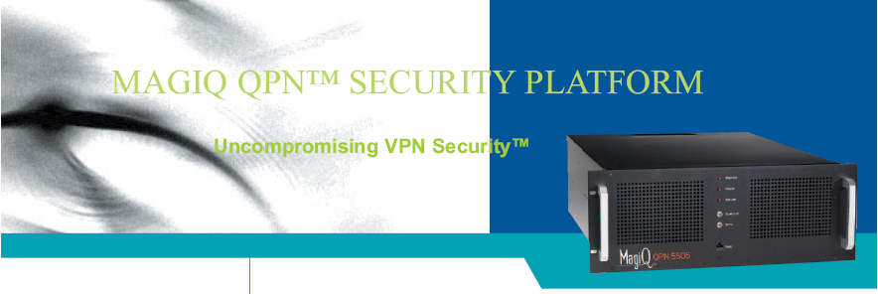
Quantum Cryptography
Alice
Bob
from the low, $100,000s

Slide 36
Landscape
Quantum Entanglement
Quantum Error Correction
Experimental Quantum Computing
Quantum Information Theory
Quantum Computer Science
ion traps
quantum dots
superconducting circuits
linear optics
Quantum Cryptography
Quantum Algorithms

Slide 37
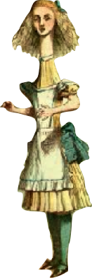
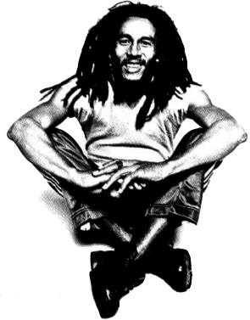
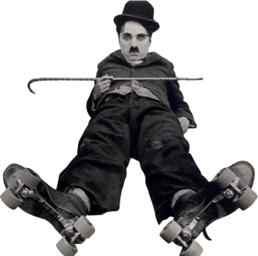
A Game
Alice
Bob
Charlie

Slide 38
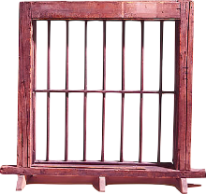


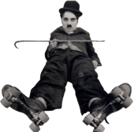
An Evil Game
Alice
Bob
Charlie
X
Y
1. Each given slip or
2. At midnight each party shouts
“+1” or “-1”

Slide 39



Winning the Game
Winning
Product
Alice
Bob
Charlie
X
X
X
+1
X
Y
Y
-1
Y
Y
X
-1
Y
X
Y
-1

Slide 40
A Game
Alice
Bob
Charlie
A_{X}
B_{X}
C_{X}
A_{Y}
B_{Y}
C_{Y}
All either +1 or -1

Slide 41
A Game
Alice
Bob
Charlie
Product
X
X
X
A_{X}B_{X}C_{X}
X
Y
Y
A_{X}B_{Y}C_{Y}
Y
Y
X
A_{Y}B_{Y}C_{X}
Y
X
Y
A_{Y}B_{X}C_{Y}

Slide 42
Winners?
Assuming winning strategy:
A_{X}B_{X}C_{X} = +1
A_{X}B_{Y}C_{Y} = -1
A_{Y}B_{Y}C_{X} = -1
A_{Y}B_{X}C_{Y} = -1
Multiply equations….contradiction!
LHS: A_{X}²A_{Y}²B_{x}²B_{Y}²C_{x}²C_{Y}²=+1
RHS: -1

Slide 43
Losers
Alice
Bob
Charlie
There is no strategy to win the game

Slide 44

In the Real World
Alice
Bob
Charlie
This is wrong, there is a way to win
Quantum Theory

Slide 45



In the Real World
Alice
Bob
Charlie
Share
Apply
Measure

Slide 46
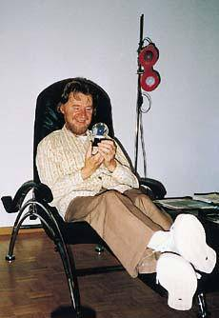
Bell’s Theorem
Alice
time
Bob
space
John Bell
Measurements on space-like separated entangled quantum systems cannot be explained by local classical communication.

Slide 47
Minimizing the
Yakking
1 if a=b
0 if a≠b
F_{eq}(a,b)=
BOB
ALICE
a
b
0
1
0
1
0
0
1
1
1
0
n bits
n bits
How many bits do Alice and Bob need to exchange
(in the worst case) to compute F(a,b)?
With no error: n+1 bits
With one-sided error ε: O(log(n/ε)) bits

Slide 48
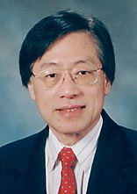
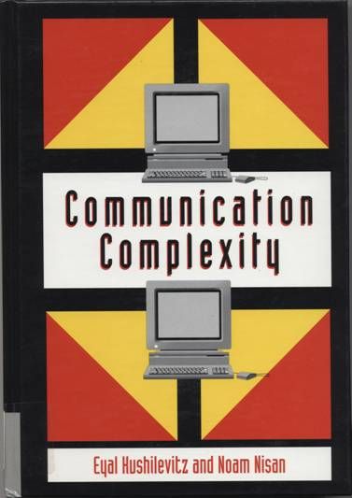
Communication Complexity
Classical communication
costs of distributed
classical computations
[Yao, STOC 79]
[Kushilevitz and Nisan 96]
Quantum communication
costs of distributed
classical computations
[Yao, FOCS 93]
exchange qubits

Slide 49

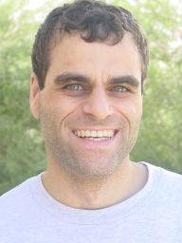
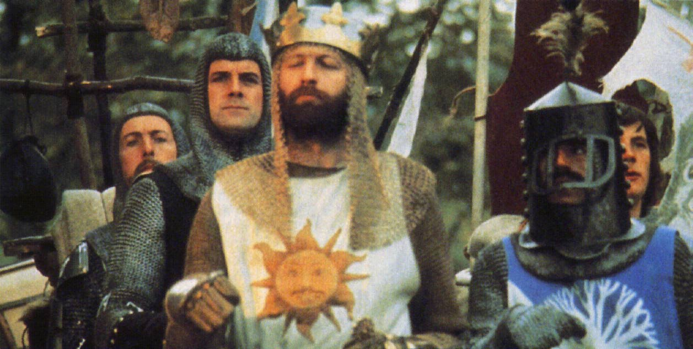
Quantum Communication
Complexity
Holevo’s Theoerem: sending n classical bits
over a quantum channel requires n qubits
There exist functions F(a,b) which require
Ω(m^{1/4}/log(m)) bits of communication to solve
(with error) but can be solved using only
O(log(m)) qubits of communication.
(m is the length of a and b)
[Raz, STOC 99]
Exponential benefit of
quantum over classical.

Slide 50
Landscape
Quantum Entanglement
Quantum Error Correction
Experimental Quantum Computing
Quantum Information Theory
Quantum Computer Science
ion traps
quantum dots
superconducting circuits
linear optics
Quantum Cryptography
Quantum Algorithms

Slide 51
Towards a Real Quantum Computer
Experimental Quantum Computing
ion traps
quantum dots
superconducting circuits
linear optics

Slide 52
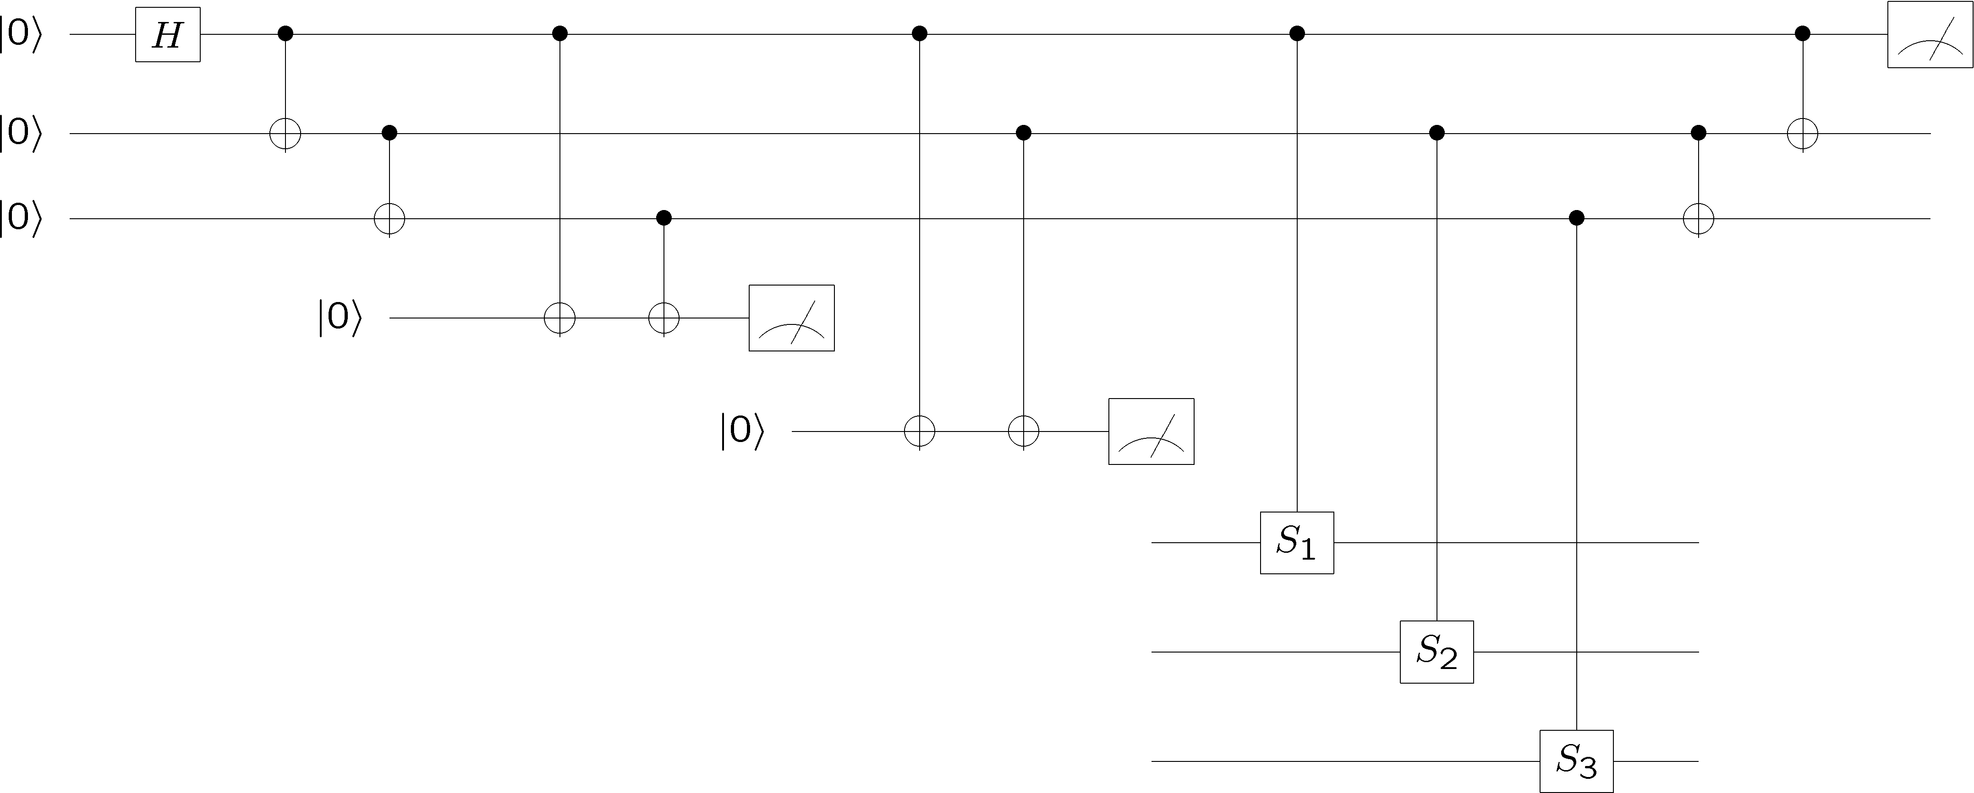
Quantum Circuit
Preparation
Gates
Measurement
Time

Slide 53
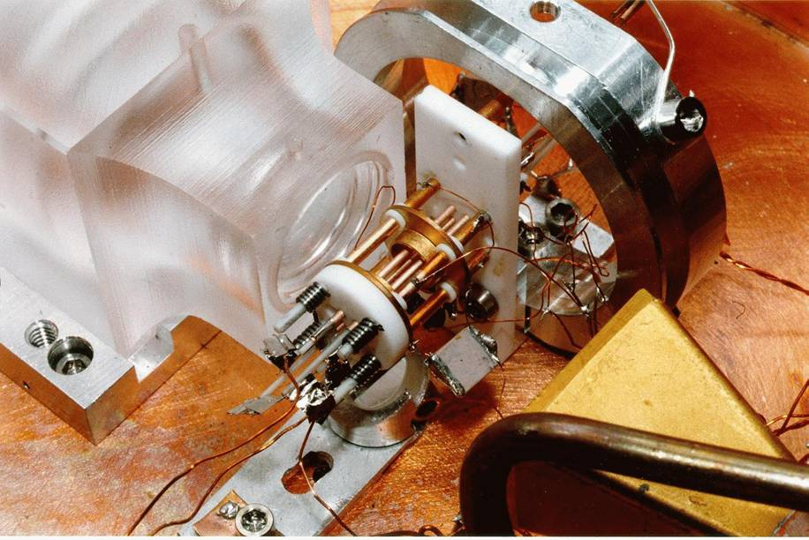
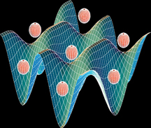
But What Will It Look Like?
Solid State
Atomic
superconducting circuits
electron spin in Phosphorus doped Silicon
quantum dots
defects in diamonds
cavity QED
neutral atoms in optical lattices
ion traps
Photon Based
Molecular
linear optics + single photon devices
Liquid NMR (no longer?)
Pics: Martinis (UCSB), Wineland (NIST), Orlando (MIT)

Slide 54

DiVincenzo’s Criteria
David
DiVincenzo
1. Well defined qubits in a scalable architecture
2. The ability to initialize the system to a fixed wave function.
3. Have faster control over the system than error processes in the system.
4. Have the ability to perform a universal set of quantum gates.
5. Have the ability to perform high quality measurements

Slide 55
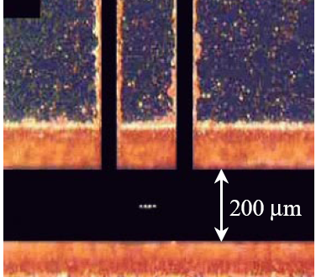
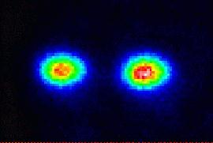
Ion Trap
Oscillating electric
fields trap ions
like charges repel
2 ⁹Be⁺ Ions in an Ion Trap

Slide 56

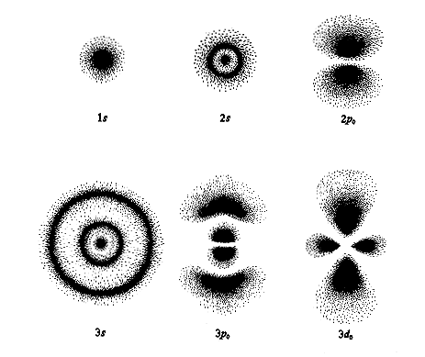
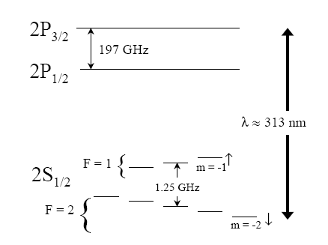
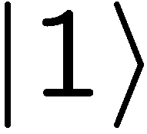

Where’s the Qubit?
Energy
Each ion = 1 qubit
1. Well defined qubits
orbitals

Slide 57
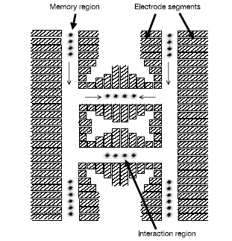
Scalable?
Well defined qubits in a scalable architecture?
Solid state qubits seem to have a huge advantage for scalability.

Slide 58

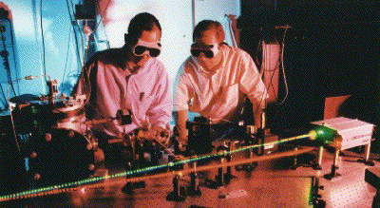
Measurement
laser
Energy
decay
Detecting florescence implies
in state 0
99.99% efficiency
5. Have the ability to perform high quality measurements

Slide 59

Single Qubit Operations
Laser 1
Laser 2
Energy
Allows any one qubit unitary operations

Slide 60
Initialization
Laser 1
laser
Laser 2
decay
If not in zero state, flip
measure
2. The ability to initial the system to a deterministic state.

Slide 61


Universal Computers
Turing machine reads state of tape at current position.
Based on this reading and state of machine, Turing machine writes new symbol at current position and possibly moves left or right, and updates state.
Certain Turing machines can perform certain tasks.
A Universal Turing Machine can act like any other possible
Turing machine (i.e. it is programmable)

Slide 62

Universal Quantum Computer
Universal Quantum Computer
a quantum computer which can be programmed to perform any algorithmic manipulation on quantum information.
U(2)
Set of Universal Quantum Gates
a set of operations/gates which, acting on the quantum information, can be used to implement (to any desired accuracy) any unitary evolution of the quantum info.
The Royal King and Queen of Universal Quantum Gates
CNOT and 1-qubit rotations

Slide 63

Coupling Two Qubits
stationary
sloshing mode
These modes can be used as a bus between the qubits.
=
4. Have the ability to perform a universal set of quantum gates

Slide 64

What is the Problem?
3. Have faster control over the system than error processes in the system.
Real quantum systems are open quantum systems!
system
environment
Quantum systems readily couple to an environment…
0
System decoheres:
qubits
pbits
50% 0 50% 1
Quantum
Classical
The Decoherence Problem (1996)
Notes:
Quantum systems readily couple to an environment.

Slide 65







More Obstructions
FAULTY CONTROL
System
Controller
Imperfect state
preparation
Imprecise or faulty unitary gates
Imperfect
measurements

Slide 66


Noisy Pbits to Bits (Theory)
How to communicate in the presence of noise?
“A mathematical theory of communication” (1948)
Error correcting codes
Claude
Shannon
How to compute when the subsystems
of your computer can fail?
“Probabilistic logics and the synthesis of reliable organisms from unreliable components” (1956)
John
von Neumann
Fault-tolerant architectures

Slide 67








Fragile
Classical Noise
Classical Faults
Quantum Noise
Quantum Faults

Slide 68

Error Correction
0
0
0
1
0
0
0
1
1
1
1
classical error
correcting code:
(bits and pbits)
0
0
1
0
0
0
1
0
1
1
0
0
0
1
1
0
0
1
1
0
0
1
1995: quantum error correcting codes
encode quantum information across
multiple quantum subsystems
Peter Shor
Andrew Steane

Slide 69






Perfection Through Concatenation
failure
probability
p
cp²
c(cp²)²
At k^{th} level of concatenation, probability of an error which
destroys the encoded quantum information is
and uses qubits

Slide 70
Fault-Tolerant Quantum Computation
Must design quantum circuits which succeed even when
every element of the circuit (preparation, unitary gates,
Measurements) can fail.
Quantum error correction + Fault-tolerant procedures

Slide 71

Threshold Theorem, 1996
errosol
QC
“decoherence”
“imprecision”
Threshold Theorem for Fault-Tolerant Quantum Computation
[Aharonov, Ben-Or, Knill, LaFlamme, Zurek, Shor, Gottesman, Preskill]
If noise is weak enough and control is precise enough, then a
quantum computation to a desired accuracy can be carried out
with an overhead polynomial in the log of the accuracy.

Slide 72





Reflection
Even with the theory of fault-tolerant quantum computation
⇒
Is quantum computation a viable technology?
?
Can we write down Moore’s law for a quantum computer
....and be correct?
What was it that led us to be able to build classical computers in the first place...

Slide 73



Three Storage Testbeds
Ferromagnetic Ising models:
one dimensional
two (and >) dimensional
Toom’s rule:
0
0
1
0
0
0
0
0
0
1
1
0
1
0
0
0
two dimensional noisy
cellular automata
0
1
0
0
0
0
0
0
0
0
1
1
1
1
1
0
0
0
0
0
1
0
1
0
1
1
1
0
0
0
0
0

Slide 74





Ferromagnetic Ising Models
Ising model
spins on edges of a lattice:
energy of a configuration:
sum over neighbors
external magnetic field
for now

Slide 75

Dynamic Ising Models
Dynamic Ising model (Metropolis update)
Interaction with environment causes spin flips
Update rule:
If flipping spin would decrease energy, flip spin
If flipping spin would increase energy, flip spin with probability

Slide 76









Energetics of Decoherence
system
environment
Perturbative regime:
Perturbative regime: decoherence conserves system and
environment energy.
cooling
heating
dephasing
by cooling environment we can eliminate heating

Slide 77
Dynamic Ising Models
Dynamic Ising model (Metropolis update)
Interaction with environment causes spin flips
Update rule:
If flipping spin would decrease energy, flip spin
If flipping spin would increase energy, flip spin with probability

Slide 78

Toom’s Rule
0
0
1
0
0
0
0
0
0
1
1
0
1
0
0
0
0
1
0
0
0
0
0
0
two dimensional noisy cellular automata
0
0
1
1
1
1
1
0
0
0
0
0
1
0
1
0
1
1
1
0
0
0
0
0
Update rule:
n
n
a
e
b
e
b=majority(n,e,b)
0
0
0
0
0
0
0
0
0
0
0
0
0
0
0
0
0
1
1
0
0
1
0
0
0
0
0
0
0
0
0
0
0
1
0
0
0
1
0
0
0
1
0
0
0
0
0
0
0
0
0
0
0
0
0
0
0
0
0
0
0
0
0
0
Update rule with noise: with some probability the update fails
and a random state is assigned

Slide 79


Compare and Contrast
Encode information into the system and watch what happens
0
0
0
0
0
0
0
0
0
0
0
0
0
0
0
0
0
0
0
0
0
0
0
0
0
0
0
0
0
0
0
0
0
0
0
0
0
0
0
0
0
0
0
0
0
0
0
0
Redundancy code.
“Order parameter” is magnetization:

Slide 80
Storage
Long time behavior (not infinite time, but effectively)
1D Ising
2D Ising
Toom’s Rule
m
m
m
Temp
Temp
Temp
Criticism: (1) thermodynamic limit taken
(2) what if relaxation to equilibrium takes a long time?

Slide 81



Storage
2nd attempt:
Relaxation to thermal
1D Ising
2D Ising, Toom’s Rule
m
m
Temp
Temp
Imperfect preparation
m
m
Temp
Temp

Slide 82






Manipulation
Flipping spins is imperfect
2D Ising
Toom’s Rule
1D Ising
1D Ising
temperature less than gap
manipulation error must be small
(i.e. NOT fault-tolerant)
2D Ising
temperature less than critical temp

Slide 83


Quantum Hard Drive?
Do there exist (or can we engineer) quantum systems whose
physics guarantees fault-tolerant quantum computation?
Today in QC: we have theory (like von Neumann, Shannon) but not devices which implement these idea (without severe device complexity overhead.)

Slide 84

Toom’s Rule Versus 2D Ising
Applied magnetic field (corresponds to a bias in noise)
2D Ising
Toom’s Rule
Regions with two coexisting phases
External magnetic fields disorder magnetic media

Slide 85


Into the Fourth Dimension
Toric code in four dimension
Excitations require energy proportional
to perimeter of erred region.
Major open question: are there three dimensional systems which possess a similar stability to quantum errors?
Dennis, Kitaev, Landahl, Preskill, quant-ph/0110143, J. Math. Phys. 43, 4452 (2002)

Slide 86
Without Four Dimensions
ZZ
ZZ
XX
ZZ
ZZ
XX
XX
XX
XX
XX
XX
ZZ
ZZ
XX
ZZ
ZZ
XX
XX
XX
XX
ZZ
ZZ
ZZ
ZZ
ZZ
ZZ
ZZ
ZZ
XX
XX
XX
XX
ZZ
ZZ
XX
ZZ
ZZ
XX
XX
XX
XX
XX
XX
ZZ
ZZ
XX
ZZ
ZZ
Implementable using superconducting qubits

Slide 87

To Build a Quantum Computer....
physics motivated methods
for error correction

Slide 88
Landscape
Quantum Entanglement
Quantum Error Correction
Experimental Quantum Computing
Quantum Information Theory
Quantum Computer Science
ion traps
quantum dots
superconducting circuits
linear optics
Quantum Cryptography
Quantum Algorithms

