Slide 1


Climbing Mount Fault-Tolerance
Fault
tolerance
A Trailhead:
Supercoherent Qubits
Fault
tolerance
Error Correction
Error Correction
Dave Bacon
Institute for Quantum Information
California Institute of Technology
Error Detection
Error Detection

Slide 2
Computer Revolution = Physics
The Computer Science Assumption: robust digital storage and digital
manipulation of information is possible.
In this NOISY (ANALOG) world HOW can anything be DIGITAL?
Theory: Von Neumann showed methods for fault-tolerant computation
Practice: no need for these methods because
THERE EXIST SYSTEMS WHOSE PHYSICS GUARANTEES ROBUST CLASSICAL COMPUTATION
THE BILLION DOLLAR QUANTUM QUESTION
Do there exist (or can we engineer) quantum systems whose
physics guarantees fault tolerant quantum computation?

Slide 3




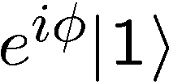
Making Decoherence Work Hard
system
bath
~
H_{I} = perturbative system-bath coupling
H_{I} energy small compared to E_{sys} and E_{bath} implies decoherence dominated by pathways that conserve unperturbed energies (essentially rotating wave approximation)
“cooling”
“heating”
“non-dissipative”

Slide 4


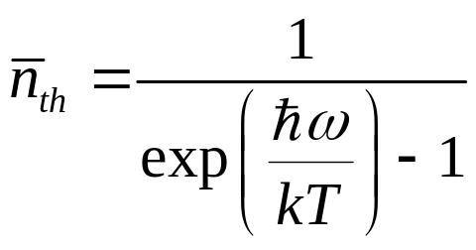

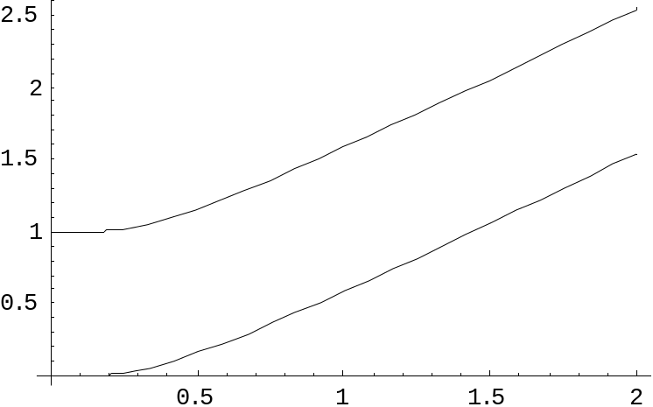

two-level atom radiatively coupled to a thermal reservoir:
“heating”
“cooling”
“non-dissipative”
At low bath temperatures, heating disappears……..
Can we make quantum errors “heating”?

Slide 5







Got Exchange?
Four spin systems with equal strength exchange interactions
between all spins:
1
2
4
3
Encode a qubit of quantum information in the degenerate ground state
Stabilized by collective operators:
Degenerate ground states are single qubit error detecting code

Slide 6
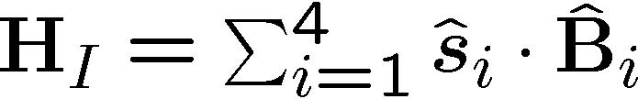

Supercoherence
Qubits coupling to baths:
1
2
4
3
All single qubit processes on
this system take the ground states
to states of higher energy.
forbidden
As temperature of the bath is decreased first-order decoherence processes will be eliminated…supercoherence
Limit to supercoherence is second order processes which act on two qubits
Bacon, Brown, and Whaley, PRL 87, 247902 (2001)
Notes:
higher energy.

Slide 7
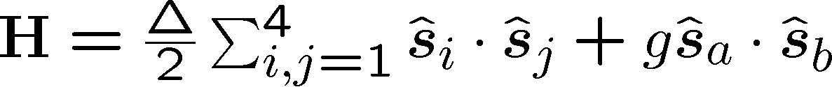


Computing on Supercoherence
Manipulation of the encoded qubit can be enacted by additional
exchange energy:
supercoherence
property not lost.
1
2
Extra exchange on
gives all SU(2) on encoded qubit
4
3
To compute on between two encoded qubits
exchange must be turned on between eight
physical qubits
Notes:
higher energy.

Slide 8



Beyond Supercoherence
Supercoherence is small step towards the ultimate goal of natural
fault tolerant quantum computation.
XX
XX
This systems ground state is a quantum error
correcting code.
ZZ
ZZ
ZZ
XX
XX
Kitaev and Freedman’s topological codes are examples of systems whose energy eigenstates are quantum error correcting code states.
ZZ
ZZ
ZZ
XX
XX
Problem: find a system with a persistent coherence order parameter
All known
systems
The goal
Notes:
higher energy.

