Slide 1
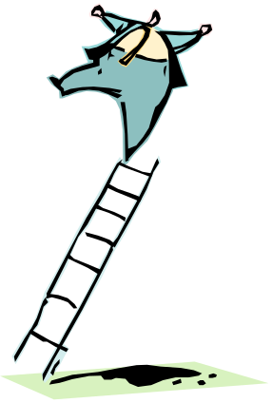


Ladder Qubits
Analysis of a Spin Ladder with Quantum Error Correcting and Detecting Properties
Dave Bacon
Institute for Quantum Information
California Institute of Technology

Slide 2
Nature’s Computers
The Computer Science Assumption: Discrete storage and discrete manipulation of information can be robustly enacted.
The theory of classical fault tolerance guarantees this assumption for classical information, but in practice, there are DISTINCT PHYSICAL REASONS FOR THE STABILITY OF CLASSICAL INFORMATION. i.e. there are physical systems which are naturally fault tolerant classical computers.
similarly
The theory of quantum fault tolerance guarantees that the computer science assumption works for quantum information.
Are there physical systems which are naturally fault tolerant quantum computers?

Slide 3
Oh Brave New Qubits!◻
Goal: proof of principle of natural fault tolerant quantum computation
What this really means: Are there physically realistic Hamiltonians for a many-body system which exhibit
A. Eigenstates of the Hamiltonian are quantum error correcting code states. (error correction)
B. Persistent coherence. Existence of an order parameter for coherence which is nonvanishing at nonzero temperature. (natural error correction)
C. Discrete set of manipulations of this order parameter which is form a universal set of gates and whose faulty implementation are errors (natural fault tolerance)
◻which is not to suggest we should show a Caliban-like (John the Savage-like?) despair towards the present theory of fault tolerant quantum computation!

Slide 4
Prior Inspirations
Kitaev’s toric codes: First example of a quantum error correction code for a many-body Hamiltonian (A).
Unfortunately toric codes use greater than two body interactions and to make universal these codes require many level systems coupled in an unnatural manner. Also coherence order parameter vanishes exponentially for nonzero temperature (supplement by error correction to make fault tolerant)
Barnes and Warren’s NMR code: Uses only two body interactions in a realistic NMR setting, BUT is only a classical error correcting code. (not different from 1D Ising model) Notion of a “funnel” of energy levels to make error correction natural is identically the concept of persistent coherence order parameter.
Freedman’s quantum loop gas: Evidence, but no concrete realization, for naturally fault tolerant quantum computer.
see also work of Preskill

Slide 5
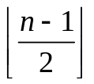
Summary of Results
Spin ladder with 2n qubits and a Hamiltonian with two qubit interactions along rungs and legs.
Ground state is two-fold degenerate: can be used to store qubit.
Ground state is quantum error correcting code for phase errors and quantum error detecting code for single bit flip errors
Exact calculation of the spectrum of the spin ladder shows gap for phase and bit flip excitations
Generalization of spin ladder to two dimensional spin lattice yields the a ground state which is fully error correcting
Baby step towards naturally fault tolerant quantum computation

Slide 6
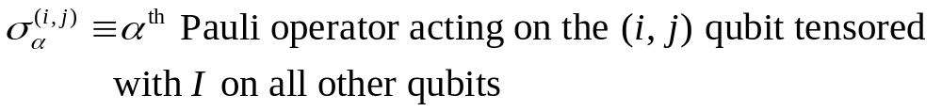
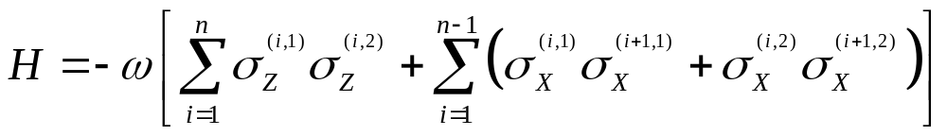
Description of the Spin Ladder
1
2
1
2
i-1
i
i+1
n-3
n-2
n-1
n
qubit (i,1)
qubit (i,2)
The Hamiltonian
X X
X X
X X
Z Z
Z Z
X X
X X
X X

Slide 7
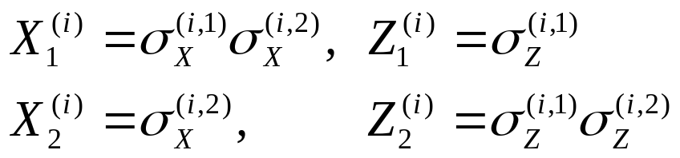
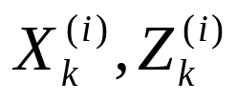
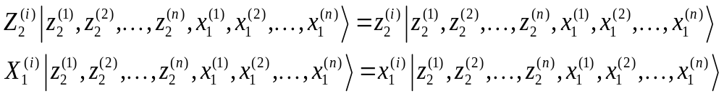
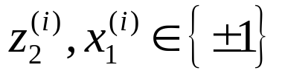
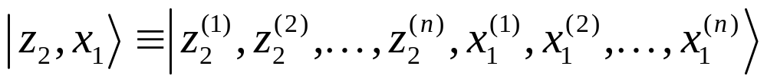
Twisted Ladder Basis
For rung i of the ladder define
(i,1)
(i,2)
Notice are simply two qubit Pauli operators in a different basis (related to old by controlled-not gate). We will use the basis specified by these operators via
where
To fit on the poster(!), use the shorthand
which we will call, the “twisted ladder basis”

Slide 8
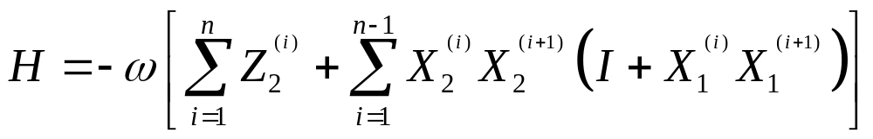
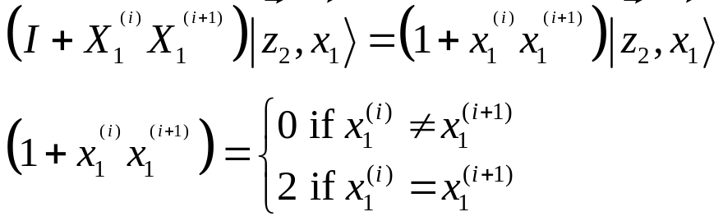
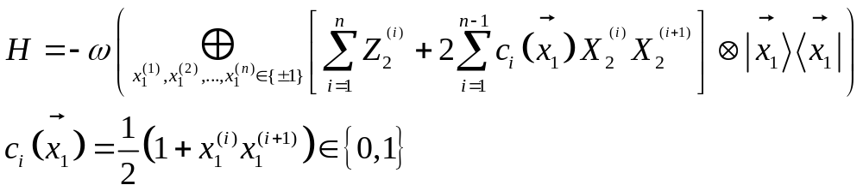


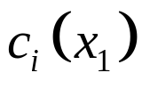
Ising Coefficients
The ladder Hamiltonian is, in terms of the twisted ladder basis operators
Since
We can write the ladder Hamiltonian as
This is block diagonal where each block corresponds to a given
Given the form of this block follows from the Ising coefficients

Slide 9
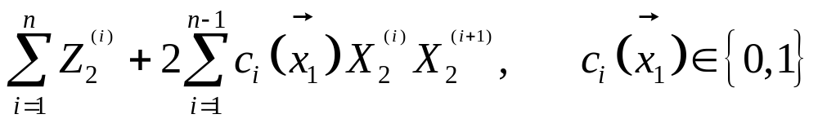











Clusters, Clusters, Everywhere
For a given the block Hamiltonian is
Which is the Hamiltonian for clusters of “Ising chains in a transverse field” and “transverse field only”
Ising + transverse field
Ising + transverse field
transverse field only
transverse field only
Note that a cluster of “Ising+transverse” need not be separated from another cluster of “Ising+transverse” by “transverse only”

Slide 10
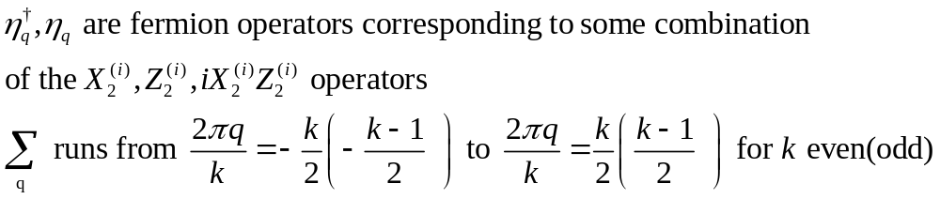
Jordan, Wigner, Bogoliubov
Length k spin chain of an Ising field with a transverse field can be exactly solved using a Jordan-Wigner transformation and a generalized Bogoliubov transformation:
Jordan-Wigner transformation: maps spins in a linear array to spinless fermions.
Bogoliubov transformation: diagonalizes quadratic fermion Hamiltonain.

Slide 11
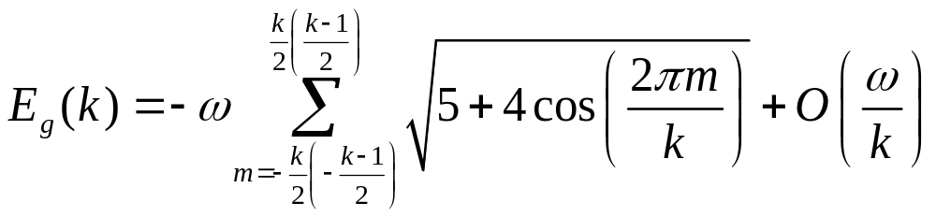
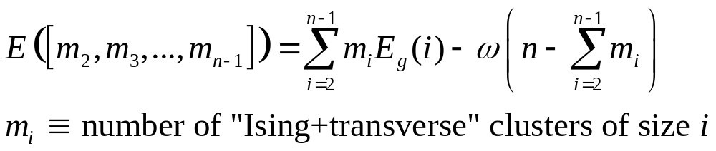
Cluster Structure Energy
Energy of the ground state (vacuum) for a cluster of length k is
Energy for the ground state of a given block Hamiltonian specified by depends only on the number and size of clusters
Ground state corresponds to the vacuum state for the full cluster configuration
Excitations within clusters (fermion creation) cost 2 and those which move between full cluster and other clusters cost 

Slide 12
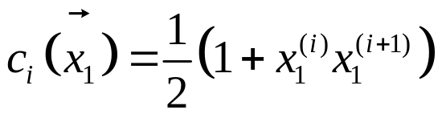

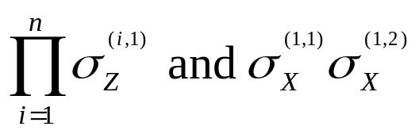
All a Bunch of Degenerates
Recall so there is a two-fold degeneracy in the assignment of a given c_{i} via a specification of the (flipping sign of every does not change any of the c_{i}) This degeneracy corresponds to a two-fold degeneracy of every energy level.
The algebra generated by the rungs and legs of the spin ladder, i.e. the algebra generated by the set
has a nontrivial commutant (operators which commute with everything in the algebra) generated by operators
These operators act on the above degeneracy as the encoded Pauli operators.

Slide 13
When is a Ladder a Quantum
Error Correcting Code?
Errors on the lattice which are products of single bit flip errors (_{X}) and n-1 phase errors (_{Z}) modulo the algebra of the spin ladder are not logical operators on the code. Hence
The ground state of the spin ladder is
an error detecting code for single bit flip errors
an error correcting code for up to phase flip errors
For our “Brave New Qubits”, we have partially satisfied the condition
A. Eigenstates of the Hamiltonian are quantum error correcting code states. (error correction)

Slide 14
The Gap is Repressive
Fight the Gap
Furthermore, there is a gap for excitations when the first of either such error occur. This leads to a repressive (but NOT to naturally error correction) of these errors at low temperatures.
All single qubit errors are energetically unfavorable = supercoherence.
|0
|1
Because the ground state is also quantum error correcting for phase errors, one can also perform error correction for these phase errors to supplement the supercoherent effect. (Helping the Gap can make it more repressive)
The correction corresponds to measuring and correcting the eigenvalues corresponding to the c_{i}

Slide 15
The Lattice Generalization
Obvious generalization to lattice system has nicer properties:
Quantum error correcting for independent single qubit errors (bit
flip and phase flip and combo)
First example of such a two qubit interaction with a useful error correcting code as its ground state.
XX
XX
XX
ZZ
ZZ
ZZ
ZZ
XX
XX
XX
ZZ
ZZ
ZZ
ZZ
XX
XX
XX
ZZ
ZZ
ZZ
ZZ
XX
XX
XX
Problems(?) for this lattice: (1) unknown whether there are gapless
excitations, (2) still no natural error correction (like 1D Ising model, does not naturally correct errors and unlike 2D Ising model with does naturally correct errors), (3) Universal set of gates on code seems difficult.

Slide 16
Collaborators and Funding
This work was done in collaboration with
Professor K. Brigitta Whaley
Department of Chemistry, University of California, Berkeley
Part of this work was completed while D.B was a graduate student in the Department of Physics, Berkeley and affiliated with the Department of Chemistry, Berkeley and part was completed while D.B was a postdoc at the Institute for Quantum Information, California Institute of Technology.
We are grateful for support from the NSA and ARDA under ARO contract No. DAAG55-09-1-0371 (Berkeley) and NSF under grant No. EIA-0086038 (IQI, Caltech)

