Slide 1




Towards Naturally Fault-Tolerance
Rhapsody on a Theme by Kitaev
Dave Bacon
Postdoctoral Scholar
Institute for Quantum Information
Department of Physics
California Institute of Technology

Slide 2
1941 – First programmable electronic calculator.
mechanical relays.
1943 – ENIAC.
18000 vacuum tubes: “nature abhors the vacuum tube.”
1947 – Bell labs develops the transistor.
1952 – G. W. Dummer proposes manufacturing electronic equipment in one
block with no connecting wires.
1959 – Texas Instruments and Fairchild Semiconductor invent the integrated
circuit.
1964 – first IBM 360 series (the concept of an “architecture”)
1964 – Integrated circuit which cost $1000 in 1959 now costs $10. Moore
describes his law.
1972 – Intel 8008 and 8 bit microprocessor.
1975 – First personal computer the Altair.
1982 – IBM PC introduced. Personal computer revolution begins.
Have We Learned Anything?

Slide 3
The Physics Guarantee
What is the phase of matter corresponding to the computer?
PRACTICAL QUESTION (as opposed to philosophical)
There are distinct PHYSICAL reasons why robust classical
computation is possible.
not all physical systems are equally good for computation:
there exists systems whose PHYSICS guarantees
their ability to enact robust classical computation.
Are there (or can we engineer) physical systems whose
PHYSICS guarantees robust quantum computation?
This poster: (1) this point of view for classical computers
(2) an attempt to port these ideas to a quantum computer

Slide 4



A Dynamic Ising Model
Ising model
Dynamic Ising model (Metropolis update)

Slide 5



Storage and Manipulation
Compare 1D and 2D Ising models at different temperatures for
a) storage of information
b) manipulation of information
1st attempt:
Storage in thermal state (infinite time - ensemble is thermal)
1D Ising
2D Ising
Criticism: (1) thermodynamic limit taken (N infinite)
(2) what if relaxation to equilibrium takes a long time?

Slide 6
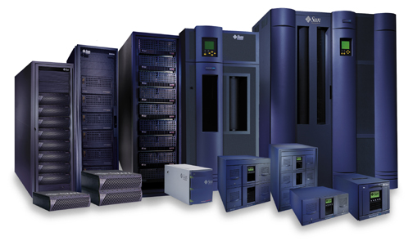



Storage
2nd attempt:
Relaxation to thermal
1D Ising
2D Ising
Imperfect preparation

Slide 7




Manipulation
Flipping spins is imperfect
1D Ising
2D Ising
1D Ising
temperature less than gap
manipulation error must be small
2D Ising
temperature less than critical temp
self correcting

Slide 8















Self Fixing

Slide 9



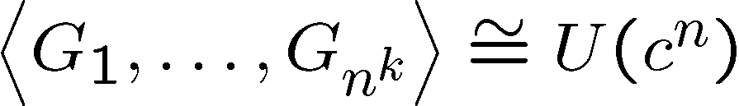
The Quantum Hard Drive?
(Kitaev)
Do there exist (or can we engineer) quantum systems whose
physics guarantees fault-tolerant quantum computation?
1. Coherence preserving.
2. Accessible Fault-Tolerant
Operations
“self-correcting”
3. Universality

Slide 10





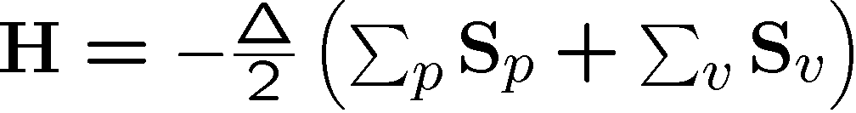


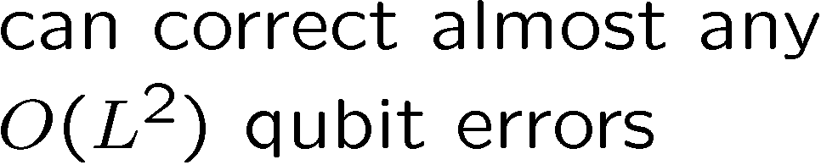



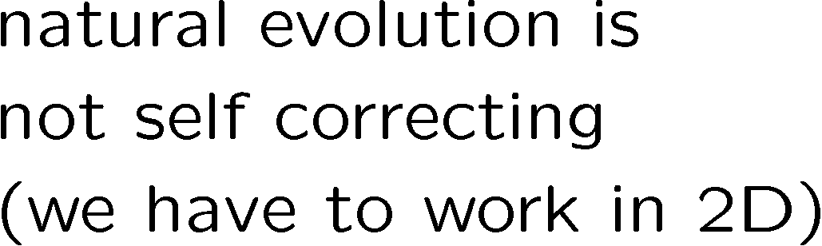




Wherefore Art Toric Codes?

Slide 11
Old School
prepare
Fix
compute
out
Error
“cold” ancilla
“hot” ancilla
encoded quantum information
information is still here (but erred)
if weight of errors is small enough
How do we reveal erred quantum information?

Slide 12





Quantum Error Correcting
Order Parameter
The quantum information is
still here. How do we see it?
diagnose
fix
measure encoded info
j
Encoded quantum information

Slide 13

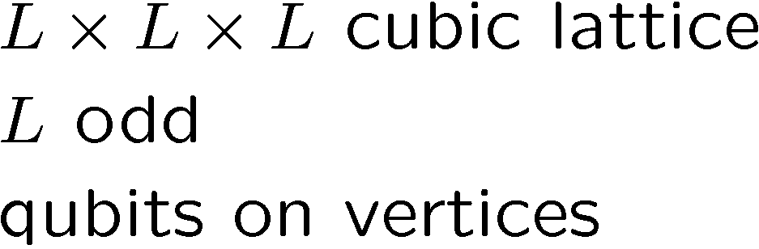







Into the Third Dimension
An interesting Hamiltonian:
Fudgy arguments about why persistent coherence…
How to proceed: simulate! But this systems has a “sign” problem.

Slide 14
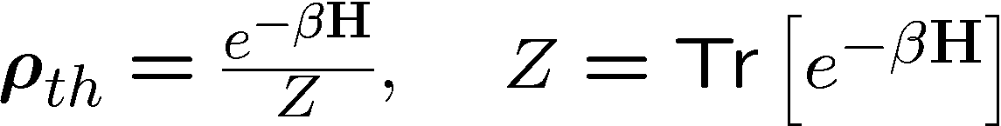


Quantum Monte Carlo

Slide 15
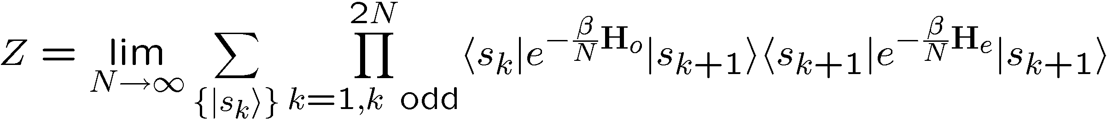

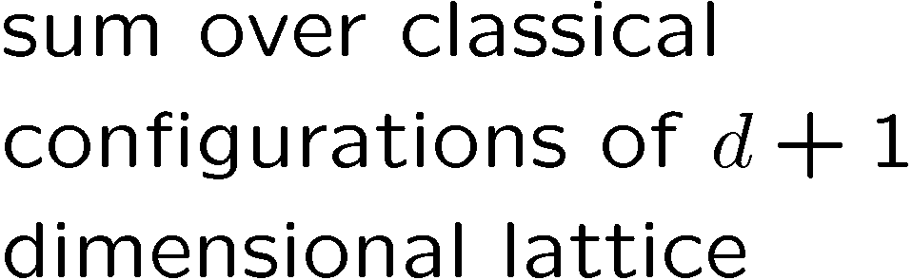
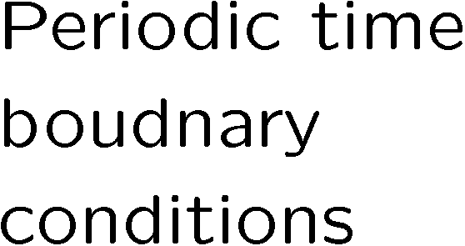


Quantum Monte Carlo II

Slide 16
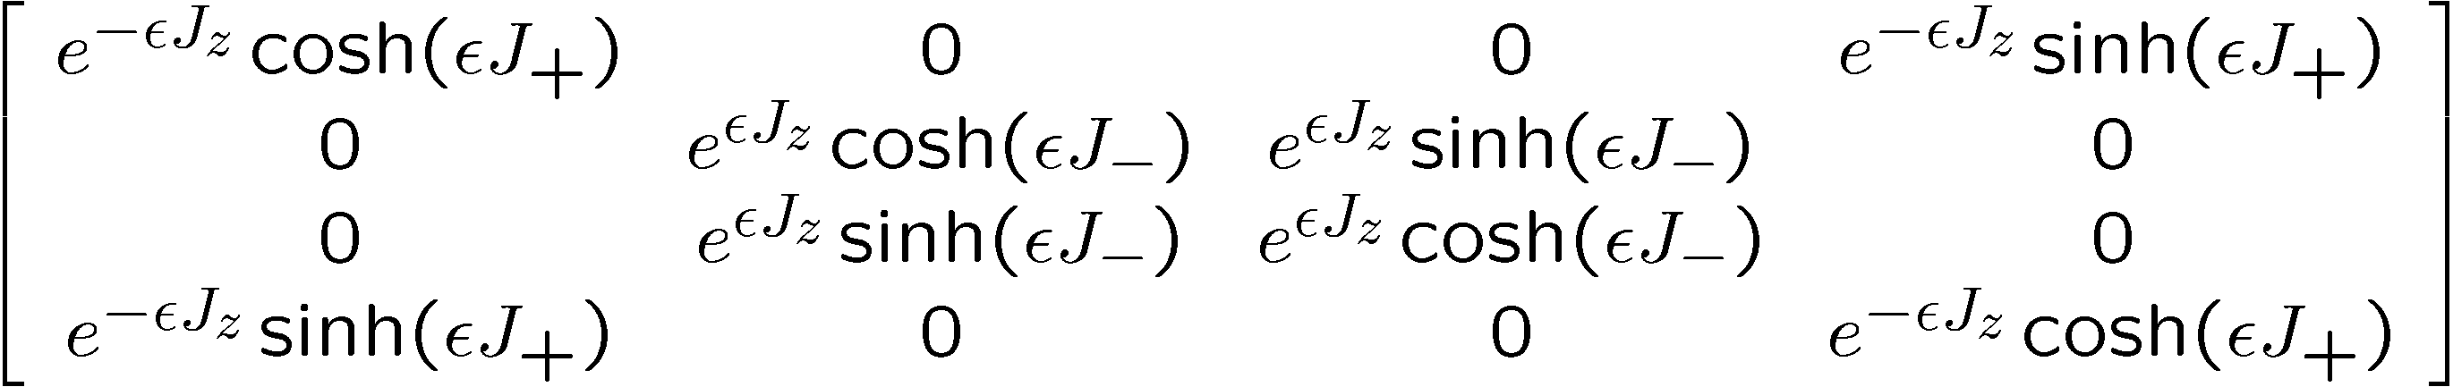
Partition-Like = Sign Problem
SIGN PROBLEM

Slide 17



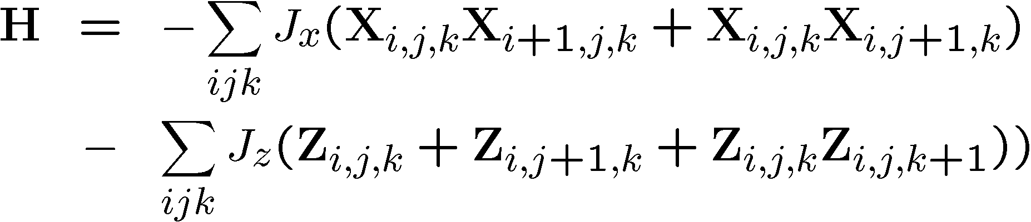

The Third Dimension Take II

Slide 18
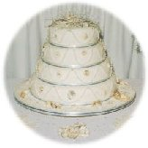
Stacks of Ising

Slide 19
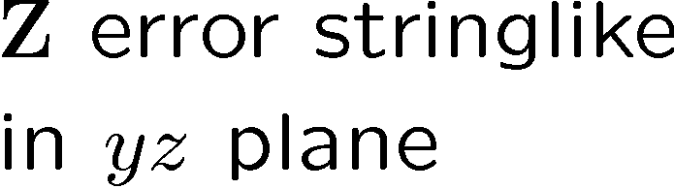

The Fudge for Stacks of Ising

Slide 20

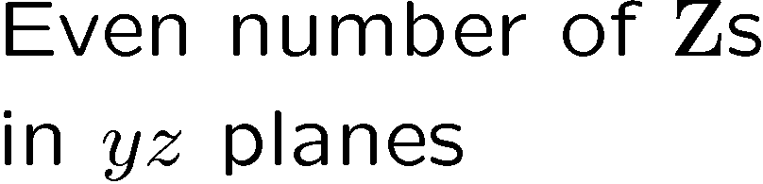
Group of Bonds (Barry and Bobby)

Slide 21




Abelian Invariant Subgroup

Slide 22
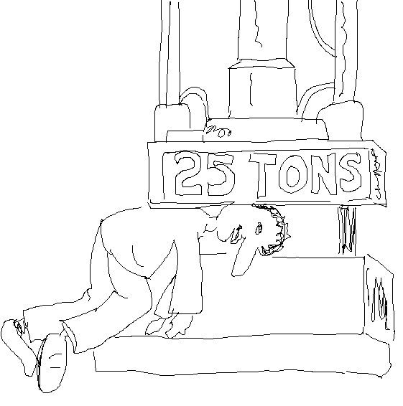
A Painful Construction

Slide 23




The Subsystem Code

Slide 24
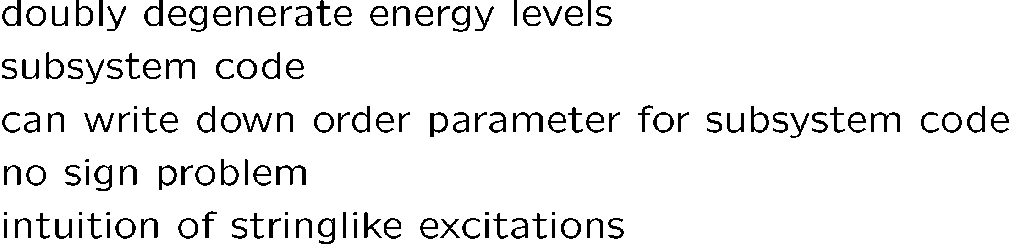
Fin

